Slide 1
AI-Based Crop Flood Damage Assessment
Agriculture + Disaster Management · Problem Statement 6
Five hybrid deep learning architectures benchmarked on one protocol,
fused with Indian district crop statistics
VIT Tech-a-thon · Fall Semester 2026–27
github.com/tejgokani/flood-crop-damage-ai

Slide 2
The problem
Why field surveys fail exactly when they are needed
• Floods destroy crops across large geographical regions.
• Traditional field surveys are impossible immediately after a disaster — roads and agricultural land are inaccessible.
• Relief and insurance decisions still have to be made, within days.
•
• Required output: Healthy → Mild → Moderate → Severe crop damage
• Required approach: satellite / drone imagery + deep learning, five hybrid techniques

Slide 3
Objective — derived from six papers' own future work
Every quote below is verbatim from the source paper's Future Work / Limitations section
Paper (2026) | Its stated future work — verbatim | What we built
FLNet arXiv:2601.03884 | "…experimenting with state-of-the-art backbones like Transformers"; "handle cloud cover" | Swin + 5-model benchmark; SAR instead of optical
Swin flood scene Sci Rep 2026 | "combining temporal modeling…"; "future research will concentrate on incorporating multi-spectral or hydrological inputs" | CNN+LSTM; Sentinel-1 SAR not RGB
Physics-guided U-Net+FNO RadarConf 2026 | "relaxing flow assumptions, optimizing memory usage, and enhancing regularization" | Automatic over/under-fit correction; capped compute
Explainable SAR CNN/Transformer arXiv:2606.16302 | "incorporating multi-temporal SAR data, in which pre-flood and post-flood images are jointly analyzed" | Real pre/post pairs; permanent water subtracted
TDAVM-UNet Frontiers Plant Sci 2026 | "Future work: dataset expansion, domain adaptation, edge deployment…" | GAN augmentation; progressive data tiering
Climate-informed cropland Sci Rep | "…can be used to study climate change impacts on the data-scarce, critical flood zones" | Indian district crop fusion (a data-scarce flood zone)

Slide 4
The objective statement
To design and evaluate a cloud-penetrating, multi-temporal, multi-architecture deep learning system that identifies agricultural fields from Sentinel-1 SAR imagery, classifies flood-induced crop damage as Healthy → Mild → Moderate → Severe, and fuses that severity with district-level Indian agricultural statistics to produce a region-scale crop loss assessment usable when field surveys are impossible.
• SO-1 Benchmark five hybrids under one identical protocol → gap G3
• SO-2 Overcome data scarcity without touching evaluation integrity → gap G1
• SO-3 Model flood evolution over time, not a single snapshot → gap G2
• SO-4 Fuse imagery with real regional agricultural context → gap G4
• SO-5 Make regularisation automatic and keep compute feasible → gap G6

Slide 5
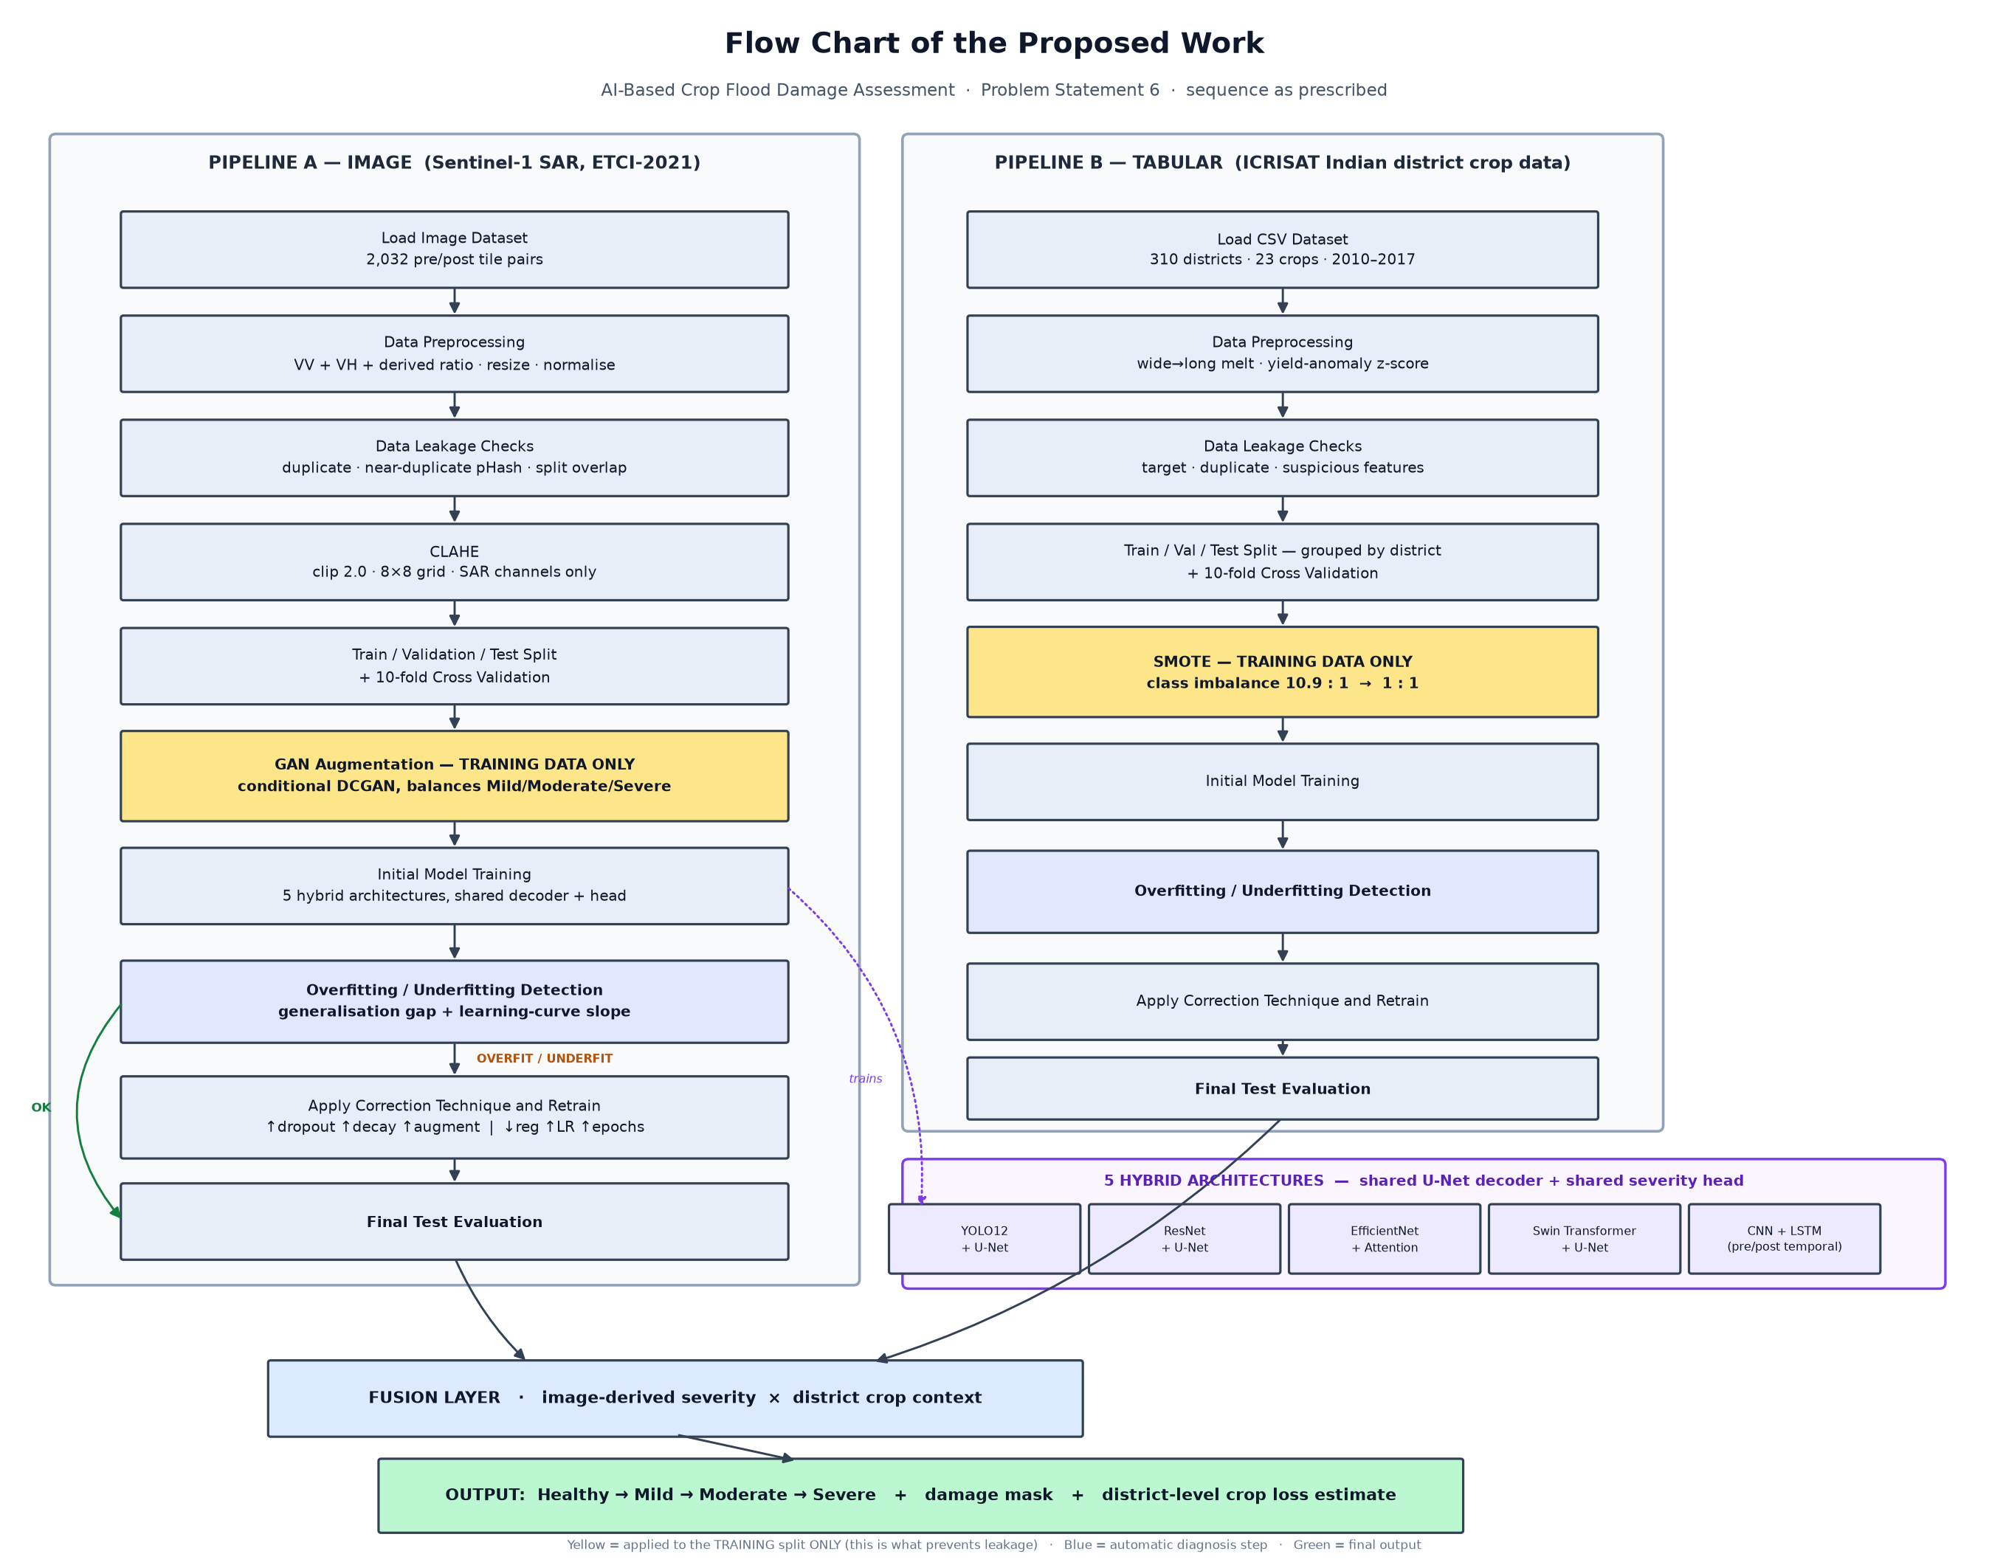
Flow chart of the proposed work
Both prescribed sequences, implemented in the given order

Slide 6
Compliance with the prescribed sequence
Every step maps to a function that actually runs
# | Step | Implemented in
1 | Load dataset | data/etci.py · data/india_agri.py
2 | Data preprocessing | preprocess/transforms.py
3 | Data leakage checks — target · duplicate · suspicious | preprocess/leakage.py
4 | CLAHE | preprocess/clahe.py
5 | Split / 10-fold cross validation | splits.py
6 | GAN augmentation / SMOTE — TRAINING DATA ONLY | augment/gan.py · augment/smote.py
7 | Initial model training | train/loop.py
8 | Overfitting / underfitting detection | train/diagnostics.py
9 | Apply correction technique and retrain | train/correction.py
10 | Final test evaluation | eval/metrics.py
Why augmentation comes after the split: SMOTE interpolates between neighbours, so fitting it before the split lets a test row be interpolated into a training row — the score then measures memorisation. tests/test_no_leakage.py asserts val/test are never resampled.

Slide 7
Two hybrid architectures, developed in depth
All five were implemented and benchmarked; two were carried forward. Shared decoder and head.
Hybrid | Params | Encoder | Input | Why this one
YOLO12 + U-Net | 5.5M | R-ELAN + area attention (implemented natively) | 6-channel change stack [post VV,VH,ratio, ΔVV,ΔVH,Δratio] | Was the weakest, for a diagnosable reason: from scratch, peaked at epoch 1
CNN + LSTM | 9.0M | Shared CNN + ConvLSTM at every scale | Ordered pre/post pair [T=2, 3 channels] | The only model of the five that did not overfit (gap +0.093)
• They are architecturally complementary: one reaches the pre→post change through an explicit difference channel, the other through recurrence. Comparing those says something; comparing two ImageNet CNNs would not.
• The other three (ResNet+U-Net, EfficientNet+Attention, Swin+U-Net) remain in the repo with their benchmarked results archived — this is depth over breadth, stated up front.

Slide 8
The problem was memorisation, not architecture
Train-val macro-F1 gap in the five-model benchmark
Model | Gap | Verdict
Swin + U-Net | +0.350 | memorising
EfficientNet + Attention | +0.319 | memorising
ResNet + U-Net | +0.292 | memorising
YOLO12 + U-Net | +0.185 | memorising — peaked at epoch 1
CNN + LSTM | +0.093 | the only healthy model
• 5-fold cross validation — every tile scored out-of-fold
• Change-detection input (the static scene cancels)
• YOLO12 narrowed 9.8M → 5.5M
• Flood-fraction regression loss
• Dihedral augmentation (8×) + crop + coarse dropout
• Regularisation raised at the start, not reactively
• Frequency-aware sampling (α = 0.5)
• Temperature-scaled confidence
Note what is NOT on that list: training longer. A model that peaks at epoch 1 does not improve at epoch 40. The freed compute bought better estimates and stronger regularisation instead.

Slide 9
Data
Both sources public, no credentials, nothing bulk-downloaded
• Imagery — ETCI-2021 Sentinel-1 SAR over Bangladesh (Ganges–Brahmaputra delta)
  – 2,032 tiles with a genuine pre/post pair: 2017-03-14 pre-monsoon and 2017-06-06 monsoon flood
  – Each carries VV, VH, a flood mask and a permanent-water mask at both dates
• Agriculture — ICRISAT district statistics: 310 Indian districts · 23 crops · 2010–2017
  – Label from per-district yield anomaly → a real 10.9 : 1 class imbalance, which is what justifies SMOTE
•
• Severity = net flood fraction (flood − permanent water), binned at 2% / 10% / 33%
  – The 33% boundary is the Indian NDRF/SDRF crop-loss relief threshold — not a round number
  – Permanent water is subtracted because a tile containing a river is not a damaged tile

Slide 10
Progressive data scaling
Start small; step up only as far as the machine demonstrably sustains
Tier | Tiles | Size | Purpose
T0_smoke | 40 | 128 px | Pipeline proof — offline, runs in CI
T1_tiny | 150 | 128 px | First real data
T2_small | 400 | 192 px | First meaningful signal
T3_medium | 900 | 256 px | Target tier
T4_large | 1800 | 256 px | Only if T3 finished comfortably
• After each tier we measure peak RSS, free disk and seconds/epoch
• Advance only if the next tier stays under a 6 GB disk floor, 70% of RAM and the time budget
• Otherwise stop at the last good tier and record why — in reports/scaling_log.json
• A complete five-model table exists after the first tier, so there is always something to show

Slide 11
Results — 5-fold cross validation
Every one of 900 tiles scored exactly once by a model that never saw it
Hybrid | Params | OOF macro-F1 | fold σ | Accuracy | Cohen's κ | Flood IoU | Train-val gap
YOLO12 + U-Net | 5.5M | 0.462 | ±0.048 | 0.713 | 0.388 | 0.205 | -0.076 ✅
CNN + LSTM | 9.0M | 0.459 | ±0.041 | 0.688 | 0.391 | 0.190 | -0.096 ✅
Train-val gap is the anti-overfitting check: ≤ 0.10 is healthy, and negative means validation scored above training. The five-model baseline ran at +0.19 to +0.35.
Hybrid | Within-1-class accuracy | Ordinal MAE | Binary damage accuracy | Binary damage F1
YOLO12 + U-Net | 0.951 | 0.338 | 0.798 | 0.664
CNN + LSTM | 0.934 | 0.383 | 0.790 | 0.692
Supplementary, not a replacement. Macro-F1 treats the four classes as unrelated, so calling a Severe tile Moderate scores as badly as calling it Healthy — and every Severe miss in our confusion matrices lands on Moderate, the adjacent class.

Slide 12
Confidence calibration
Temperature scaling, fitted on inner folds only
Hybrid | Temperature | ECE before | ECE after | Mean confidence before → after | Folds accepted
YOLO12 + U-Net | 0.476 | 0.163 | 0.078 | 61.0% → 76.9% | 5/5
CNN + LSTM | 0.521 | 0.157 | 0.067 | 59.4% → 72.7% | 5/5
• An uncalibrated softmax is a score that sums to one, not a probability.
• Temperature scaling divides the logits by one learned scalar — it is argmax-invariant, so it cannot change accuracy, only how honest the confidence is.
• Fitted on an inner validation slice of each training fold, never on the held-out fold.
• A fold's fit is accepted only if it cuts calibration error by at least 20%; otherwise the temperature resets to 1.0 and nothing is applied.
• Paper 4 of our review names temperature scaling as its first future-work item.

Slide 13
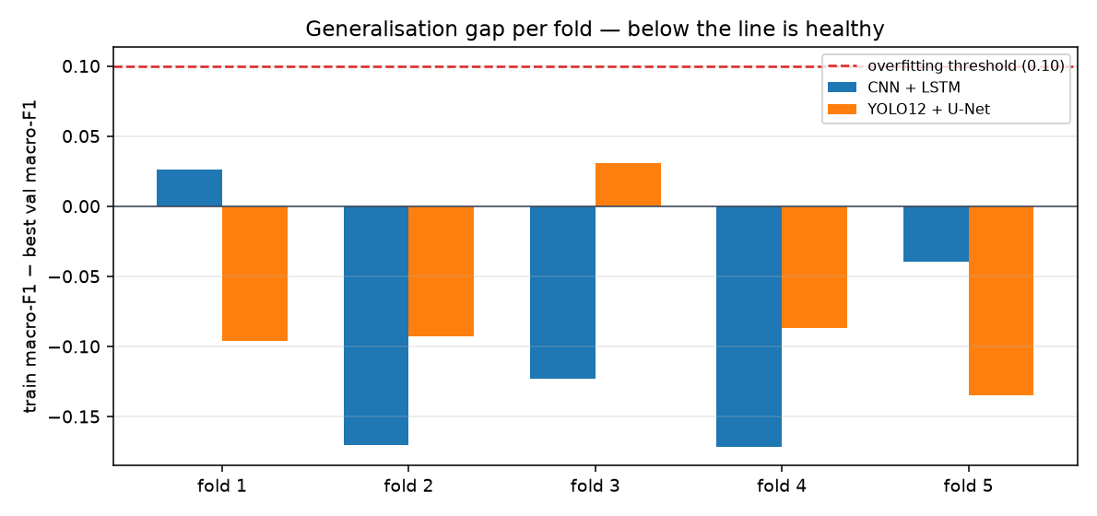
Generalisation gap per fold — below the line is healthy

Slide 14
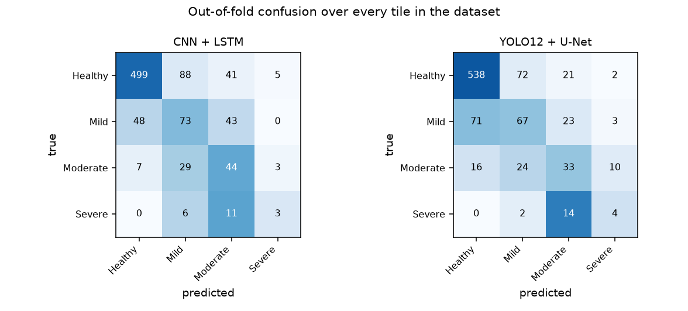
Out-of-fold confusion over every tile in the dataset

Slide 15
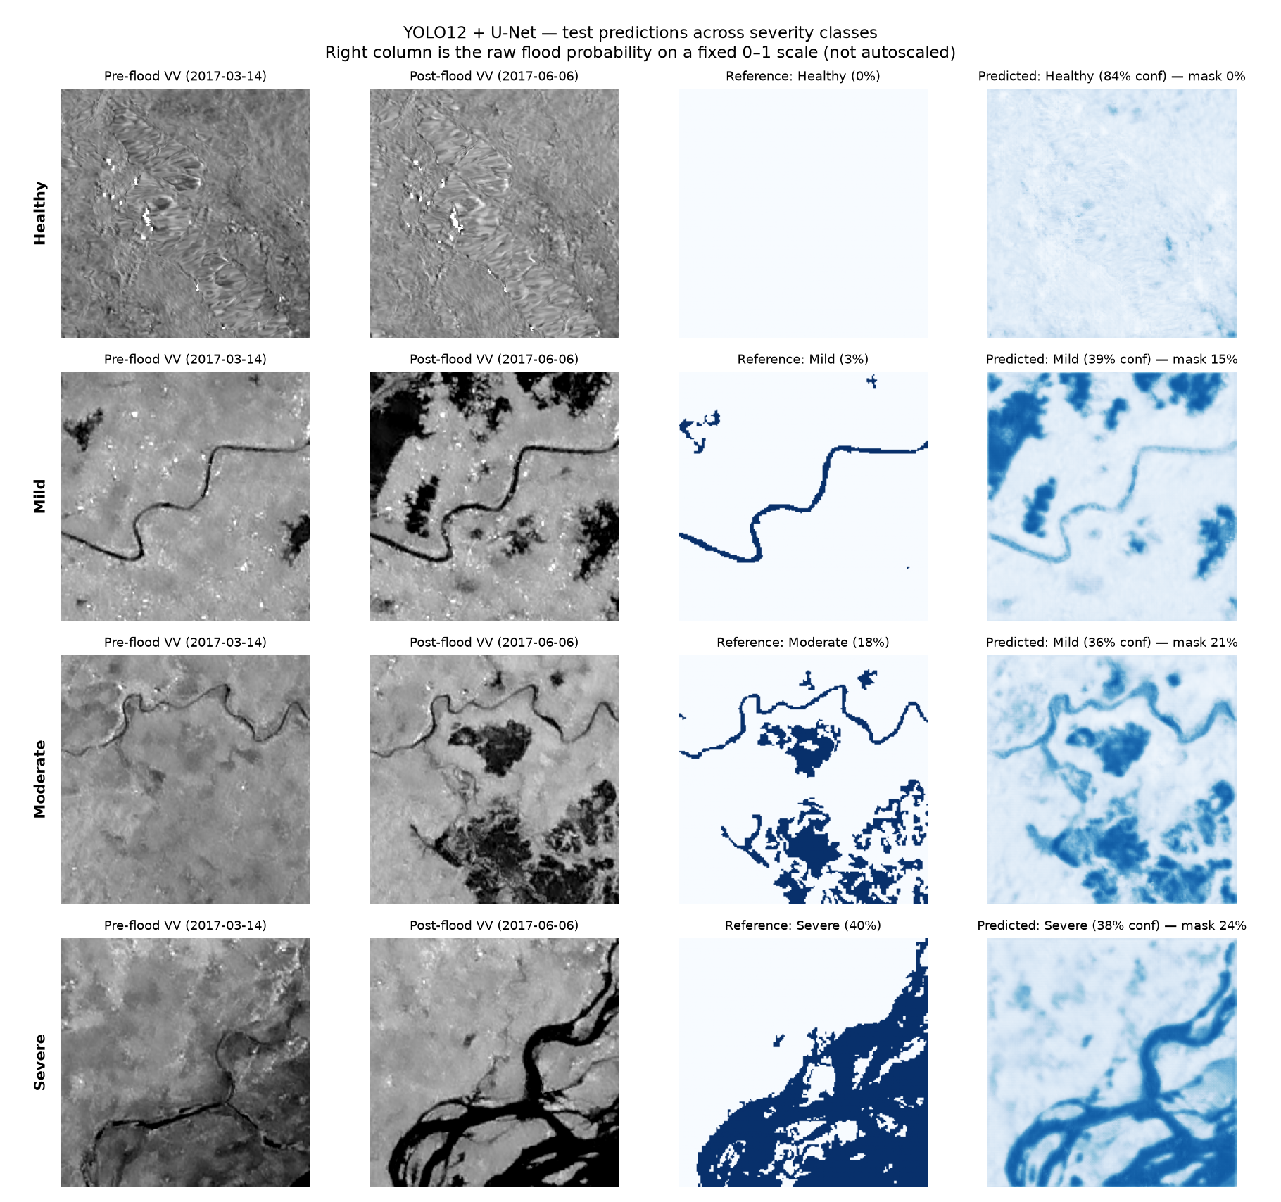
Predictions across severity classes

Slide 16
Working demo
streamlit run app/streamlit_app.py
• Select or upload a SAR tile → predicted damage mask overlaid on the backscatter image
• Severity with confidence, net inundated fraction, permanent water shown separately
• District loss estimate: affected hectares, production loss in tonnes, indicative value in ₹ crore
• Fusion panel showing whether imagery and district history agree, and whether severity was escalated
•
• Runs with or without a trained checkpoint — the rule-based path still demonstrates preprocessing, the severity rule and the fusion arithmetic

Slide 17
Honest limitations
Stated because they are the questions worth asking
• Agricultural field delineation is NOT implemented. The brief asks to identify agricultural fields; this system segments water. ETCI-2021 has no parcel labels, so YOLO12's detection head is present but unsupervised, and the crop context comes from district statistics. This is the largest gap against the brief.
• Severity is derived from flood extent, not measured agronomic damage — ETCI-2021 has flood masks, not crop-damage ground truth. Validation against field-surveyed loss is NOT claimed.
• Only 20 Severe tiles exist in the whole pool (0.98%). Cross validation scores all 20 rather than the ~3 a single holdout would, but it remains the corpus ceiling.
• Tiers cap Healthy at 45% to make the benchmark usable; the natural 86.9% prior is reported alongside every result, not hidden.
• Training geography is the Ganges–Brahmaputra delta — a reasonable analogue for eastern India, but cross-region transfer is untested. FLNet states the same limitation about itself.
• Rupee figures use assumed per-severity loss coefficients, surfaced as parameters rather than fitted values.

Slide 18
What remains — the other 40%
• Supervised agricultural field delineation — needs a cropland mask or parcel labels
• Validation against field-surveyed crop loss (BFCD-22, or state revenue records)
• Cross-region transfer to Indian districts, and domain adaptation
• Sentinel-1 + Sentinel-2 fusion, as FLNet's future work proposes
• Calibration and uncertainty estimates, as the Explainable SAR paper proposes
• 10-fold cross validation extended to the image pipeline once compute allows
• Higher tiers (T4) and longer schedules on stronger hardware

Slide 19
Summary
• Objective derived from six papers' own stated future work — quoted verbatim, not paraphrased
• Both prescribed sequences implemented in full, every step mapped to a function
• Five hybrid architectures on one shared protocol — the comparison isolates the encoder
• Leakage checks that produce real findings; augmentation confined to the training split by construction
• Automatic over/under-fit detection and correction, with before/after recorded
• Fusion turns predicted pixels into hectares, tonnes and rupees for a real Indian district
•
• github.com/tejgokani/flood-crop-damage-ai

