Slide 1
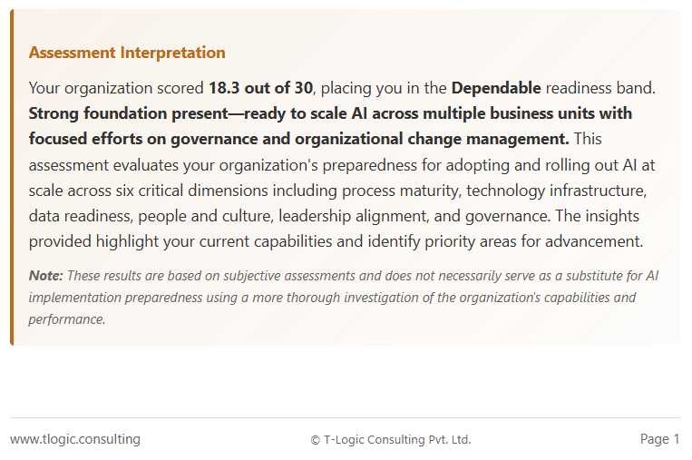
Should say “do not”
This should say: Pg. 1/3, next page 2/3 and next page 3/3

Slide 2
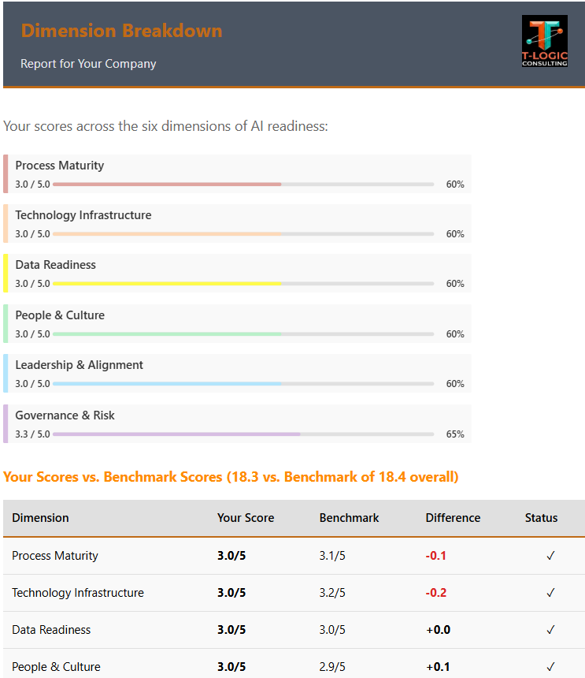
I want these header titles on each page to be brighter orange
I want these 2 headings to be the style and color of the “Executive Summary” title.
I wanted the horizontal color bars here to be double in width and the whole object slightly vertically greater in size.
These status icons do not match the “Difference” columns

