Slide 1


Dayananda Sagar Academy of Technology & Management
(Autonomous Institute under VTU)
Affiliated to VTU Approved by AICTE
Accredited by NAAC with A+ Grade 6 Programs Accredited by NBA (CSE, ISE, ECE, EEE, MECH, CV)
DEPARTMENT OF COMPUTER SCIENCE AND ENGINEERING (ARTIFICIAL INTELLIGENCE
Mini-project Phase 1 Presentation On
“SignEase”
G Kullayi Reddy
1DT22CA018
S Tejo Raditya
1DT22CA041
Bellapukonda Pooja
1DT22CA011
A Lakshmi Poojitha
1DT22CA008
Under the guidance of Prof. Priyanka Y
Department of CSE ( AI) DSATM, Bangalore -82
1

Slide 2

Dayananda Sagar Academy of Technology & Management
(Autonomous Institute under VTU)
Contents
Abstract
Introduction
Problem Definition
Objectives
Literature Survey
Proposed Work
Methodology & Implementation
Results & Discussions
Conclusion
Reference

Slide 3
Abstract
A web-based platform to teach American Sign Language (ASL) to specially-abled individuals and their families.
Inspired by interactive learning platforms like Duolingo.
Duration: Comprehensive 4-week course.
Progression: From basic gestures to full conversations.
Includes daily interactive assignments and weekly assessments.
Advanced tool that translates user-inputted text into corresponding sign language gestures.
Foster communication skills in an engaging and accessible manner.
Break language barriers and promote inclusivity

Slide 4
Introduction
Communication is fundamental to human interaction, yet specially-abled individuals often face significant challenges in expressing themselves due to limited accessible resources for learning sign language. Traditional methods are often time-consuming and lack interactivity, hindering engagement and learning progress.
SignEase addresses these limitations by providing an accessible, interactive, and user-friendly platform for learning American Sign Language (ASL). Leveraging modern web technologies and AI capabilities, SignEase offers a structured learning experience tailored for specially-abled individuals and their families, bridging the communication gap and fostering inclusivity.

Slide 5
Problem Definition
Specially-abled individuals and their families face significant communication challenges due to limited accessible and interactive resources for learning American Sign Language (ASL).
Existing ASL resources are often outdated, inaccessible, and lack user engagement, leading to social isolation, dependency, and barriers in inclusion.
This project aims to address these challenges by creating a user-friendly, interactive, and efficient platform for learning ASL, fostering better communication and inclusion.

Slide 6
Objectives
Structured Learning Path: Develop a comprehensive 4-week course covering ASL basics, including letters, words, and conversational phrases.
Enhance Accessibility: Design an interactive, user-friendly platform tailored for specially-abled individuals and their families to learn ASL effortlessly.
Engage Users Through Interactivity: Offer daily assignments and weekly assessments to encourage consistent learning and track progress.
Integrate AI Technology: Incorporate SignGPT, a cutting-edge feature that translates user-inputted sentences into ASL gestures for practical learning.
Promote Inclusivity: Enable effective communication, fostering social integration and independence for specially-abled individuals and their families.

Slide 7
Literature Survey
Author [citation] | Methodology | Features | Challenges
GabrielSerrano, Daehan Kwak[1] | ComputerVision and AI | Real-time Gesture DetectionDeep Learning IntegrationRobustness to Environmental VariationsMulti-modal Input Handling | Gesture VariabilityEnvironmental ConditionsReal-time ProcessingDynamic Gesture ComplexityData Limitations
Tangfei Tao Yizhe Zhao[2] | Deep Learning Approaches | Traditional and Deep Learning Approaches.Comprehensive Gesture Recognition.Multi-modal Data Utilization.Dataset Standardization and Benchmarking.Accuracy Improvement through Advanced Models. | Inconsistencies in Gesture Datasets.Handling Dynamic Gesture Sequences.Scalability to Different Sign Languages.Real-time Processing Limitations.Balancing Accuracy with Computational Efficiency
Saurav Kumar, Pratiyush Kumar[3] | Convolutional Neural Networks | Use of Convolutional Neural Networks (CNNs).Real-time Hand Gesture and Sign Recognition.High Accuracy in Gesture Classification.Scalability for Diverse Sign Languages.Robustness to Variations in Background and Lighting. | Handling Variations in Hand Shape and Motion.Computational Demands of Deep Learning Models.Need for Large, Annotated Gesture Datasets.Real-time Accuracy vs. Processing Speed Trade-off.Generalization Across Different Users and Environments.

Slide 8
Proposed Work
Development of a Structured Learning Platform: Create a 4-week course that includes ASL basics, letters, words, and conversational phrases.
Interactive Web Interface: Build a user-friendly website featuring dynamic navigation, daily assignments, and weekly assessments to promote engagement.
AI Integration with SignGPT: Implement a feature that translates user-entered sentences into ASL gestures using advanced AI technology.
Comprehensive Content Delivery: Provide high-quality instructional videos and assessments for each day to ensure practical learning and progress tracking.
Fostering Accessibility and Inclusivity: Focus on designing a platform that empowers specially-abled individuals and their families to learn and communicate effectively, promoting independence and social inclusion.
9

Slide 9
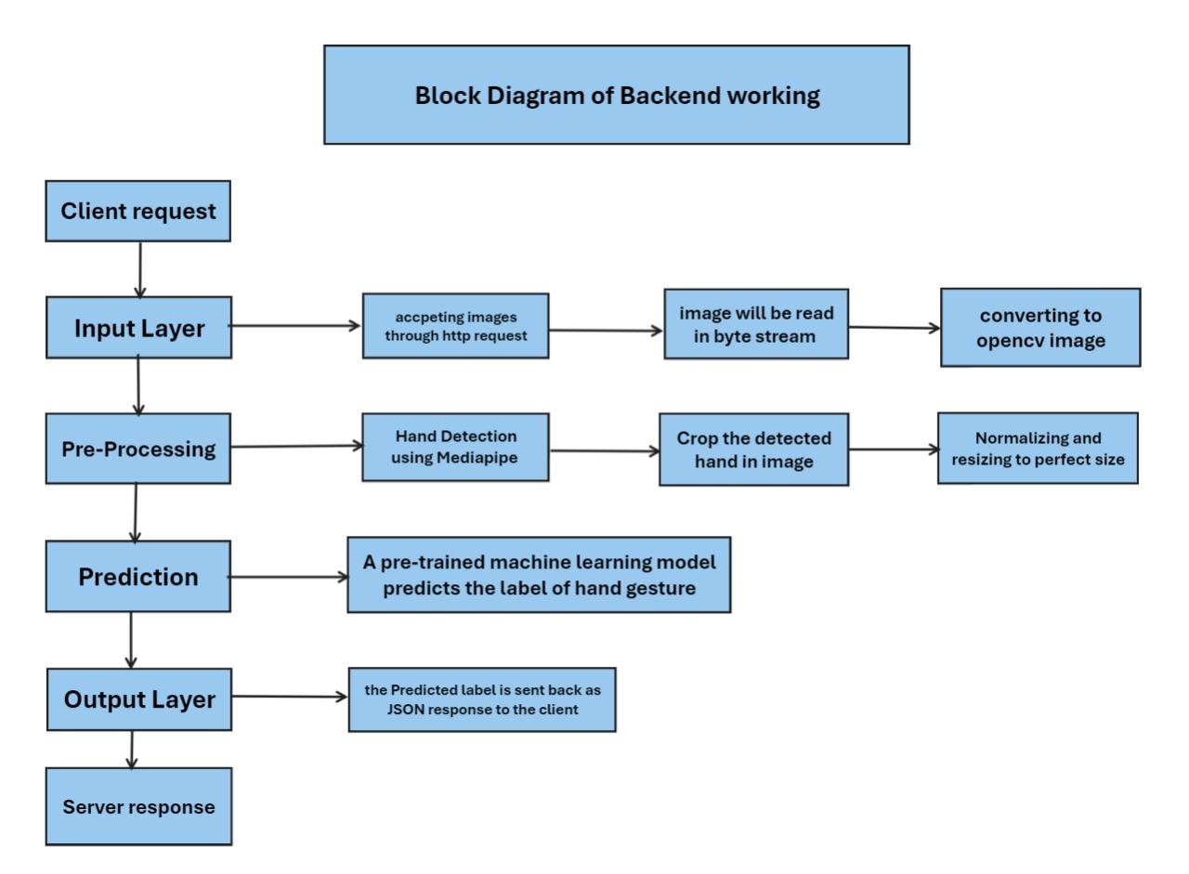
Proposed Work
SignEase Platform
9

Slide 10
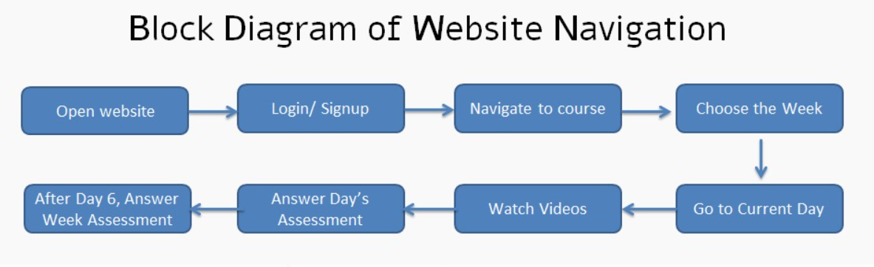
Proposed Work
SignEase Platform
9

Slide 11
Methodology & Implementation
Requirement Analysis
Course Design
Feature Integration
Interactive Platform
Feedback & Improvement

Slide 12
Results & Discussions
High levels of participation were observed, driven by interactive tasks and assessments that kept users motivated throughout the learning process.
Users successfully advanced from mastering basic gestures to engaging in conversational American Sign Language (ASL) within a structured 4-week curriculum.
The AI system, SignGPT, achieved an impressive 90% accuracy in converting text inputs into ASL gestures, demonstrating its reliability and effectiveness.
The platform was designed to be fully compatible across various devices, ensuring inclusivity and ease of use for diverse user groups.

Slide 13
Conclusion
SignEase effectively addresses the need for accessible and engaging ASL education for specially-abled individuals and their families. Through its structured curriculum, interactive learning modules, and innovative AI-powered features like SignGPT, the platform fosters inclusivity and empowers users to communicate confidently. While challenges such as gesture clarity and onboarding processes remain, user feedback underscores its usability and positive impact on communication skills. With opportunities to expand into additional sign languages and incorporate advanced features, SignEase holds the potential to transform sign language education worldwide, promoting greater social inclusion and independence.

Slide 14
Reference
1. Gabriel Serrano; Daehan Kwak; “Real-time Sign Language Recognition Using Computer Vision and AI”; 2023 International Conference on Computational Science and Computational Intelligence (CSCI)
2. Tangfei Tao; Yizhe Zhao; Tianyu Liu; Jieli Zhu; “Sign Language Recognition: A Comprehensive Review of Traditional and Deep Learning Approaches, Datasets, and Challenges”; IEEE Access (Volume: 12)
3. Saurav Kumar; Pratiyush Kumar; Priyesh Mishra; Pragya Tewari;“A Robust Sign Language and Hand Gesture Recognition System Using Convolutional Neural Networks”; 2023 5th International Conference on Advances in Computing, Communication Control and Networking (ICAC3N)

Slide 15
Reference
https://ieeexplore.ieee.org/document/10590119
2. https://ieeexplore.ieee.org/document/10526274/authors#authors
3. https://ieeexplore.ieee.org/document/10541471

Slide 16
Thank You

