Slide 1

WEB SCRAPING AND EXPLORATORY DATA ANALYSIS ON AMBITIONBOX LISTINGS
Team
Tejo kalimatha.M
Sangu Jahnavi

Slide 2
Problem Statement & Objectives
What is the average ratings across the companies
Are most companies are rated (4+) or average(3-4)
This project uses web scraping from Ambition box to collect real data.
EDA helps find trends and insights for better understanding
To collect real-time used companies review data from the Ambition Box using web scraping.
To clean and organize the collected data for analysis.
To analyze key factors like Name, branches, Ratings, and Reviews using EDA.

Slide 3
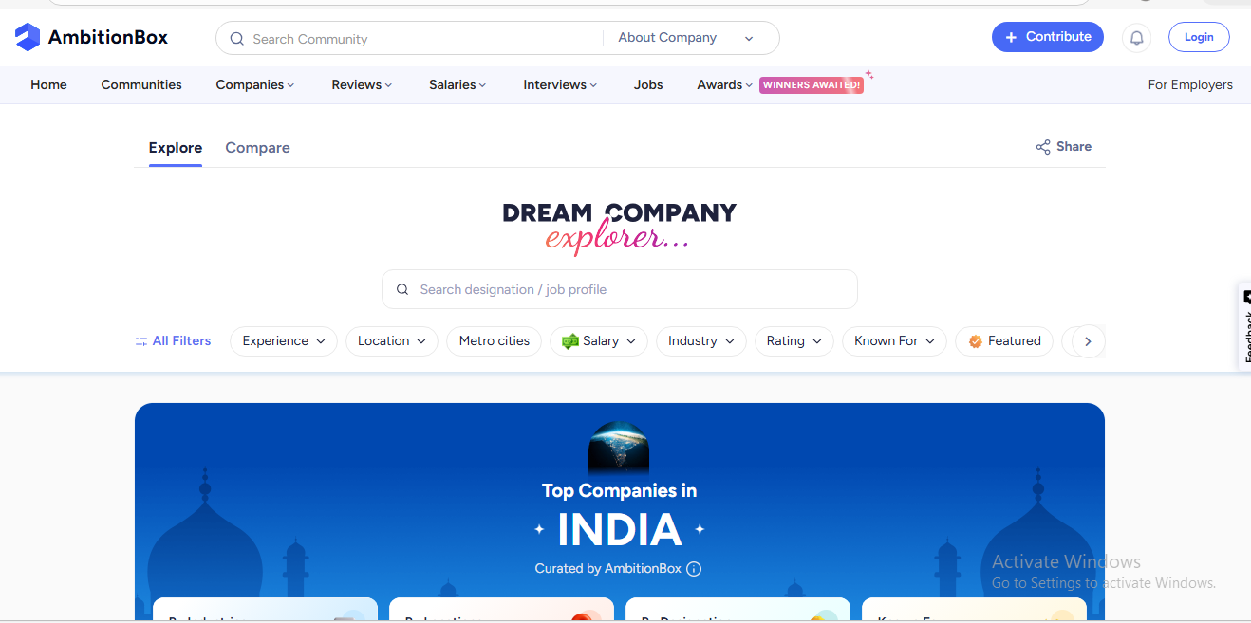
The website used for Web Scraping and obtained the data from –AmbitionBox

Slide 4
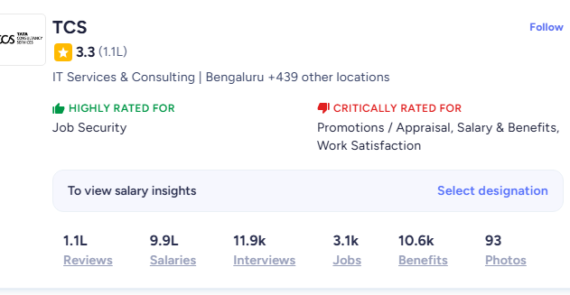
Features Extraction
Columns
Name
Industry
Branches
Location
Ratings
Reviews
Salaries
Jobs
Interviews
Benefits
Awards

Slide 5
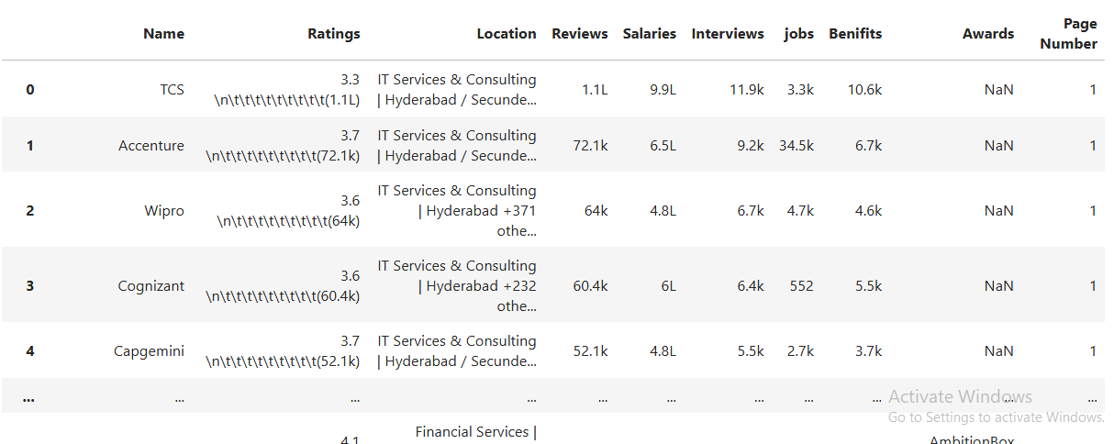
After scraping our final dataset

Slide 6
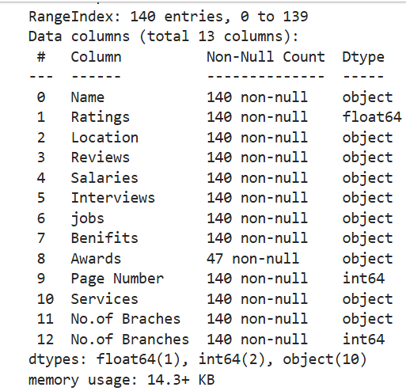
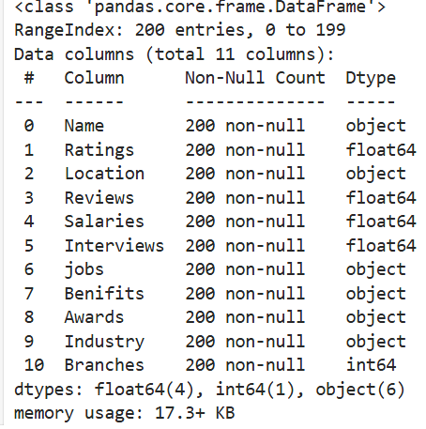
Info

Slide 7
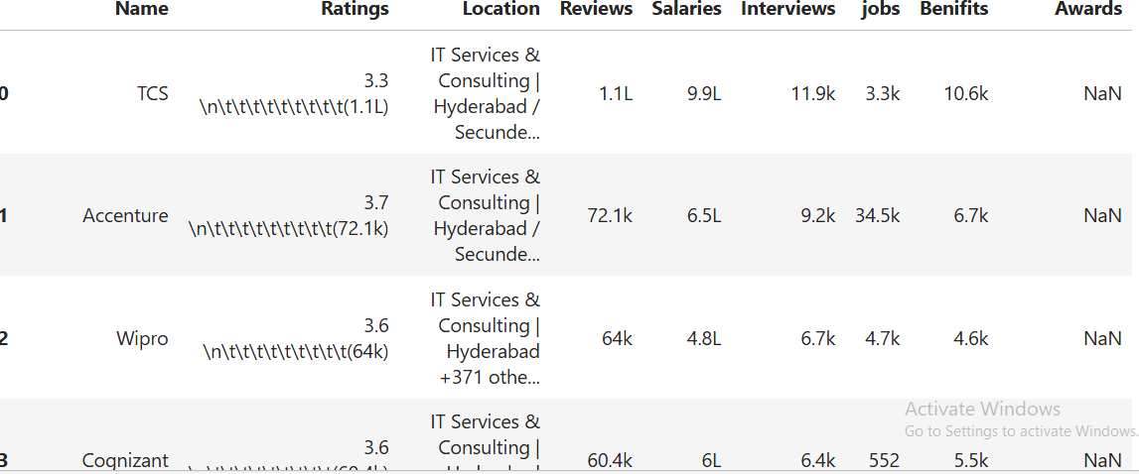
Data Cleaning
The cleaning process remove the unwanted columns and data

Slide 8
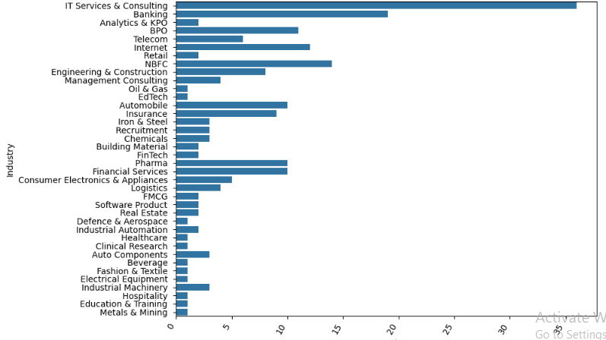
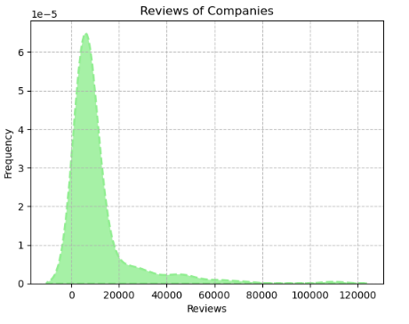
Univariate Analysis
Here the distribution regrading the total number of industries per sector
Here most of the companies are in IT Services and consulting
Here we can see the review distribution over the companies
Most of the reviews between 0 to 24000
This distribution is positive skewed

Slide 9
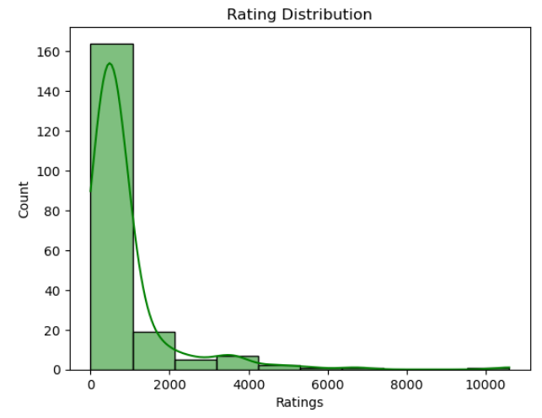
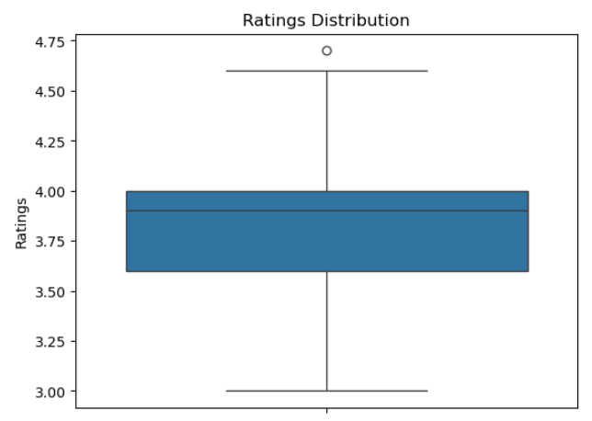
The distribution is positively skewed (right-skewed), meaning a few ratings extend toward much higher values.
Only a small number of observations appear at the higher end, which creates a long tail on the right side of the graph.
The median rating is around 3.9, indicating that most ratings are close to 4.
The interquartile range (IQR) lies approximately between 3.6 and 4.0, showing that the majority of ratings fall within this range.
The minimum rating is about 3.0, while the maximum rating reaches around 4.6.

Slide 10
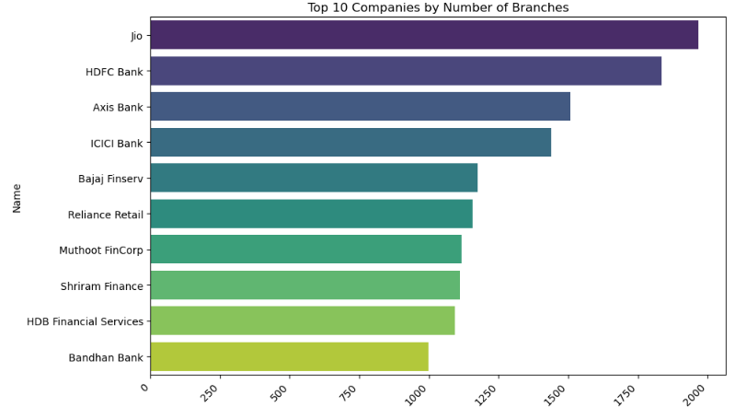
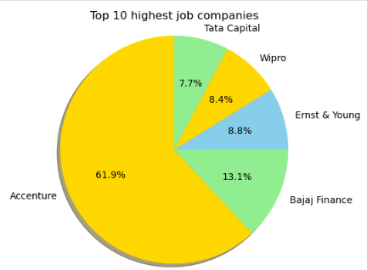
Bivariate Analysis
Jio has the highest number of branches with around 2000 branches, making it the top company in the list.
HDFC Bank and Axis Bank follow with approximately 1850 and 1500 branches respectively.
ICICI Bank also has a large network with about 1450 branches.
Accenture has the largest jobs reviews with 61.9%, making it the leading company in the chart.
Bajaj Finance is the second highest with 13.1% of the total job reviews

Slide 11
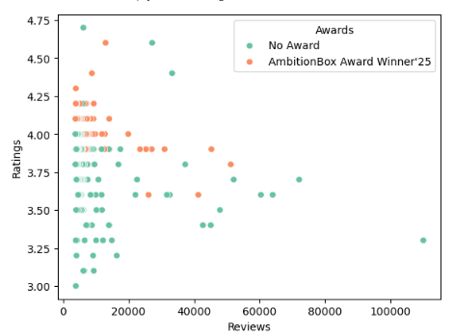
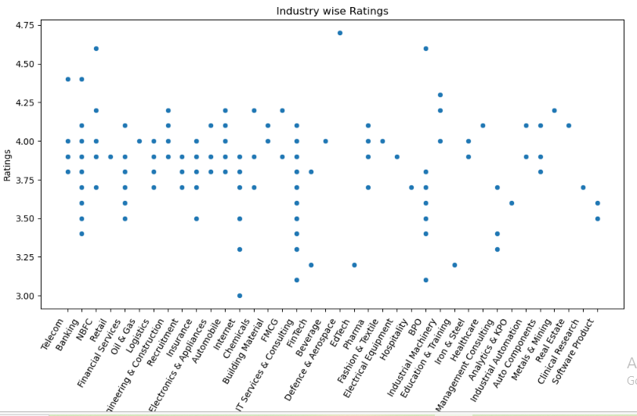
The company ratings distribution with a hue of awards
Here ,The graph shows which companys having highest ratings on receving awards
Graph indicated distribution ratings over the industries
Most of the industries got ratings between 3.5 to 4.0
Few of industries are low rated

Slide 12
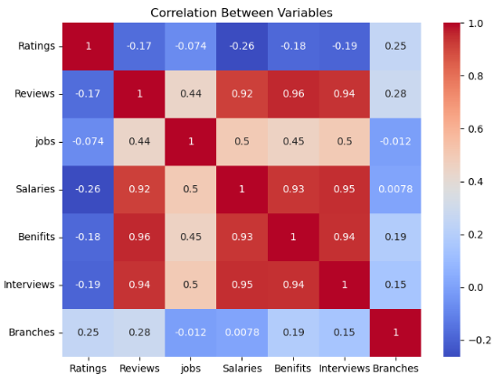
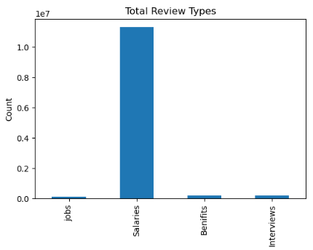
Strong Positive Correlation:Variables like Reviews, Salaries, Benefits, and Interviews show very strong positive correlations (around 0.92–0.96).
Moderate Relationship with Jobs
Ratings Have Weak/Negative Correlation
Branches Show Weak Relationship
The Salaries category has the highest number of reviews, far exceeding all other review types.
Jobs, Benefits, and Interviews have significantly fewer reviews compared to Salaries.
The high number of salary reviews indicates that users are highly interested in salary transparency and compensation details.

Slide 13
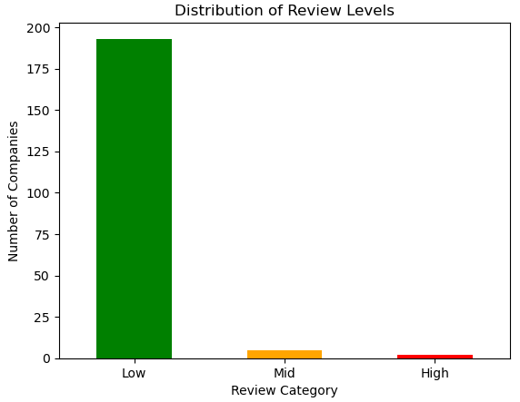
Low Review: Most companies fall in this category, showing lower review ratings.
Mid Review: A small number of companies have average or moderate reviews.
High Review: Very few companies have high ratings, indicating excellent performance.
Overall Insight: The distribution shows that high-rated companies are very limited compared to low-rated ones.

Slide 14

THANK YOU

