Slide 1


Celebal Project Domain – Power BI Team – PB-2
Made By – Devendra Singh Shekhawat
Tejpal singh
Ishan
Pranav

Slide 2
Objective
Create a Report using Financial Year Dataset making measures by Dax formulas in Power BI.
Applying DAX in following points are:-
Total Quantity Sold
Quantity Sold Last Month
Quantity Sold Last Year
Average Quantity Sold per Day
Quantity Sold in “Germany” and “Dell” & “Hp”
Quantity Sold Two Month Ago
Quantity Sold Two Quarters Ago
Last Month Profit
Profit 2 Month Ago
Last Month Cumulative Profit
Cumulative Profit 2 Month Ago
Total Profit Running Total in Date
How To Apply Fiscal Year
Apply Currency Conversion.

Slide 3
Create a Report using Cement Company Dataset making measures by Dax formulas in Power BI.
Applying DAX in following points are:-
1.Calculate the variation in manufacturing of cement plant wise
and on the basis of the fiscal year.
2.Quantity should be in tons.
3.Show the visuals which give the target and target achieved in a
particular year the manufacturing of cement.
4. The number of delivery and number of orders received Plantwise and month-wise.
5. Total Quantity Sold to date, total delivery of cement last month,
total delivery last year, average delivery per day.
. Total budget and production region wise.
6.Calculation against delivery of the cement on a yearly basis and plant wise.

Slide 4
What’s New
We have applied the fiscal year in the given data set in which we can divide the year in a two different parts. Like example (FY 14, FY15).
There is also a cumulative profit to find the cumulative profit last month and last two month in which we have used the conditional format so that we can get actual cumulative profit.
There is an Data Visualization part where we can drag and drop of the values we can make graphical representation.
Slicer is the main part in which we can drag and drop the values in there data field and after that with the help of slicer we can select the particular value to get visuals of that particular values which we selected in the slicer.
Filter options are also a interesting part in the Power BI in which we can drop the values in which when we select that dropped values in tha filter options so that we can that values or we can top values in that field.

Slide 5
Target Audience
1: for Finacial year project-
All type of Retails business
Any type of Inventory of supply chain management business
Any Type of business that are looking for calculated the financial year calculation can be are target audience
2: for Cement company model-
Trade Customer i.e. Dealer/Sub dealer /Wholesaler
Retail customer which is Individual house builders and non trade customer which includes industrial and government infrastructure.

Slide 6
Technology Used-
Power BI
Power BI is a business analytics service by Microsoft. It aims to provide interactive visualizations and business intelligence capabilities with an interface simple enough for end users to create their own reports and dashboards. It is part of the Microsoft Power Platform.
DAX (Data Analysis Expression)
DAX is a collection of functions, operators, and constants that can be used in a formula, or expression, to calculate and return one or more values. Stated more simply, DAX helps you create new information from data already in your model.

Slide 7
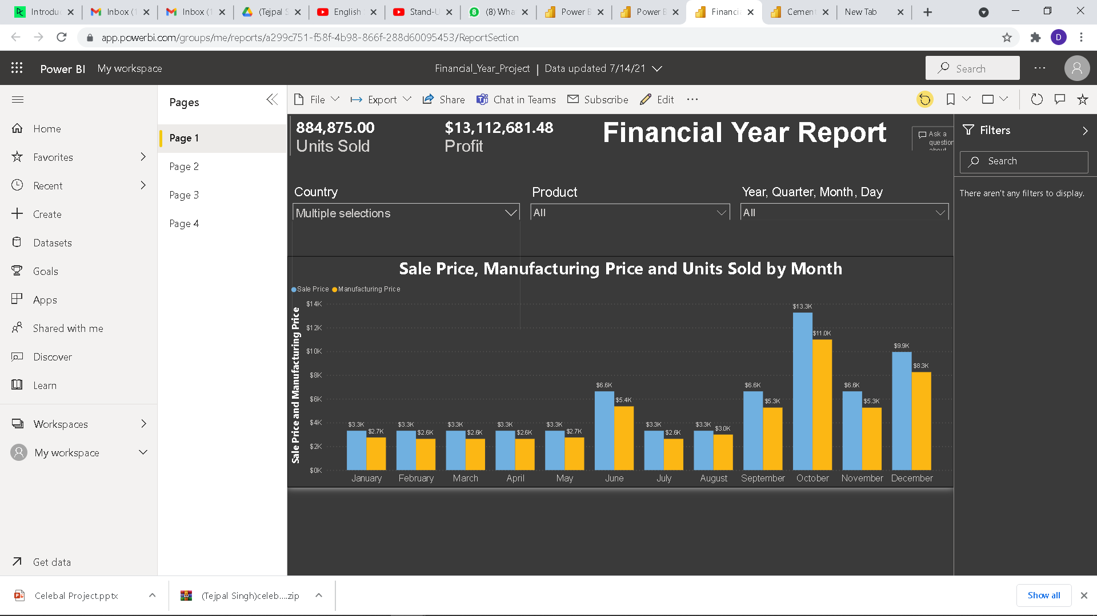
Project Demonstration

Slide 8
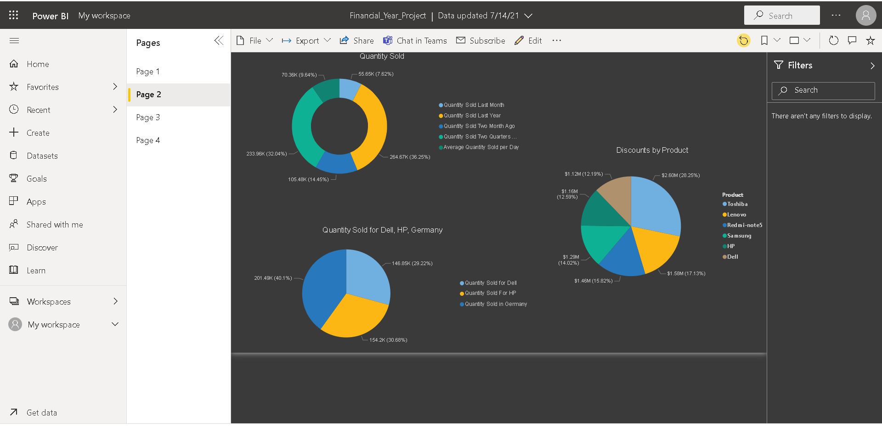
Page 2
Notes:
lineChart
No alt text provided.
map
No alt text provided.
clusteredColumnChart
No alt text provided.
pieChart
No alt text provided.

Slide 9
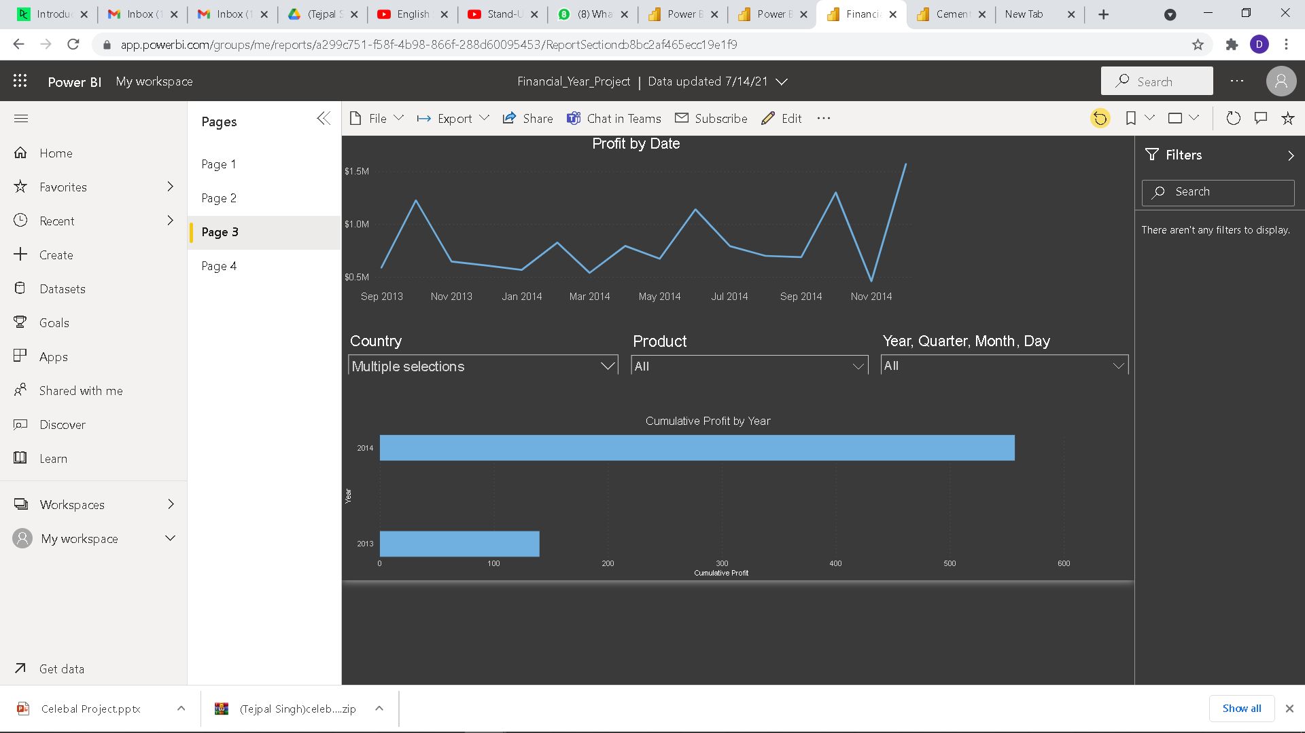
Page 3
Notes:
barChart
No alt text provided.
donutChart
No alt text provided.
ribbonChart
No alt text provided.
lineChart
No alt text provided.

Slide 10
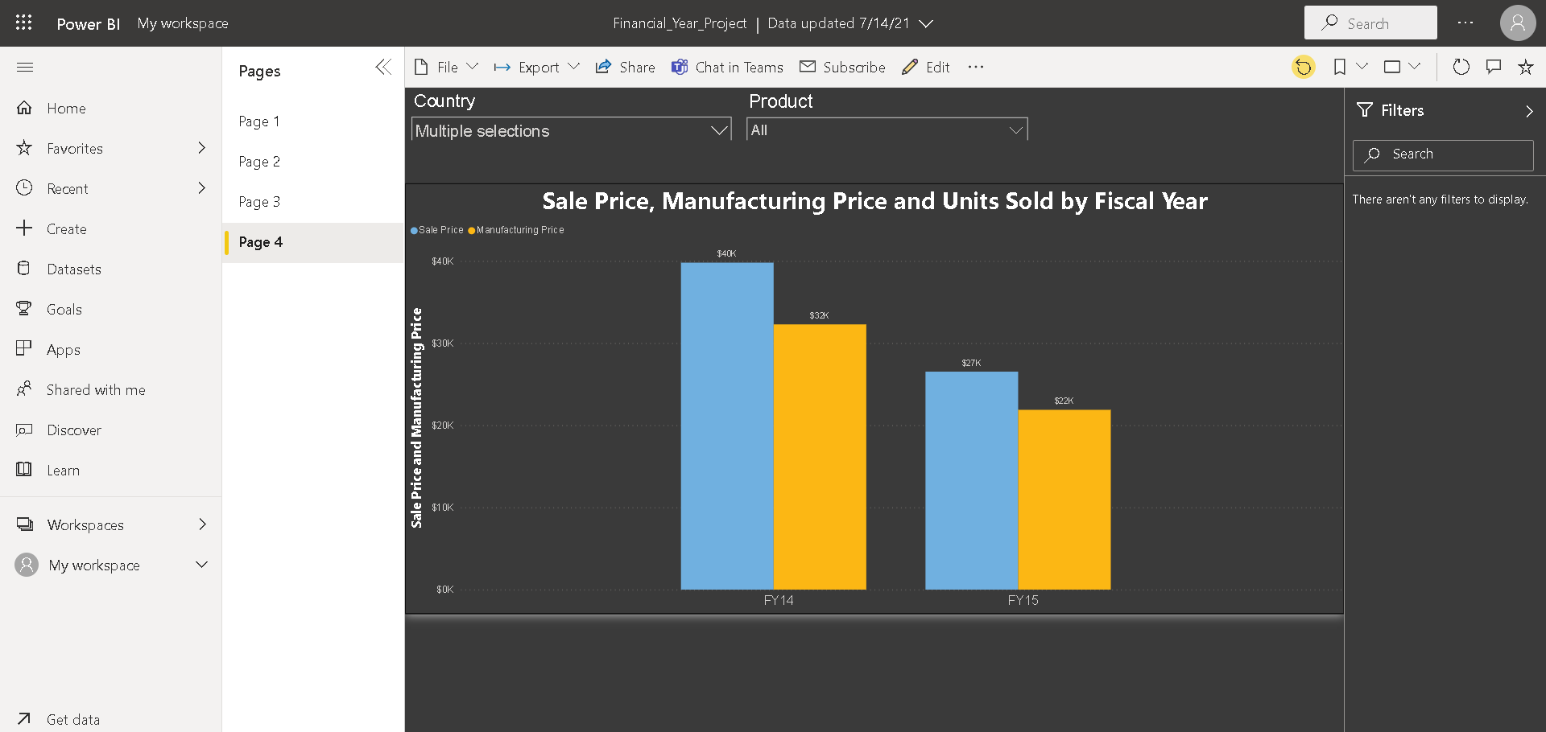
Page 3
Notes:
barChart
No alt text provided.
donutChart
No alt text provided.
ribbonChart
No alt text provided.
lineChart
No alt text provided.

Slide 11
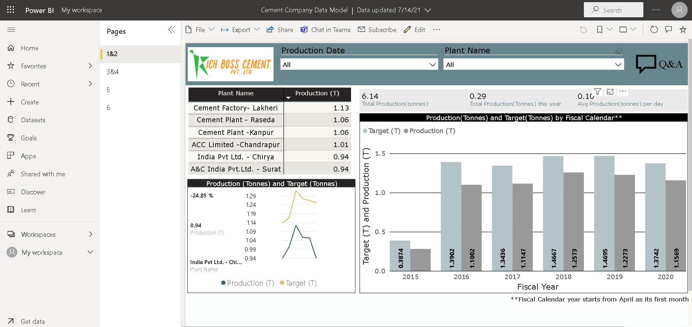
Page 3
Notes:
barChart
No alt text provided.
donutChart
No alt text provided.
ribbonChart
No alt text provided.
lineChart
No alt text provided.

Slide 12
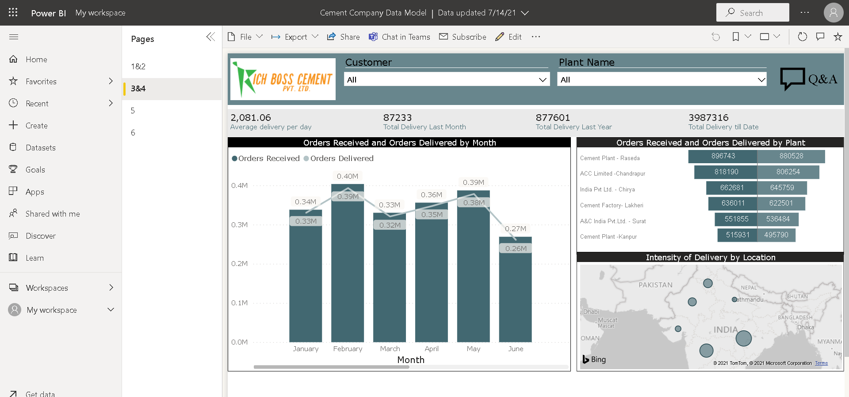
Page 3
Notes:
barChart
No alt text provided.
donutChart
No alt text provided.
ribbonChart
No alt text provided.
lineChart
No alt text provided.

Slide 13
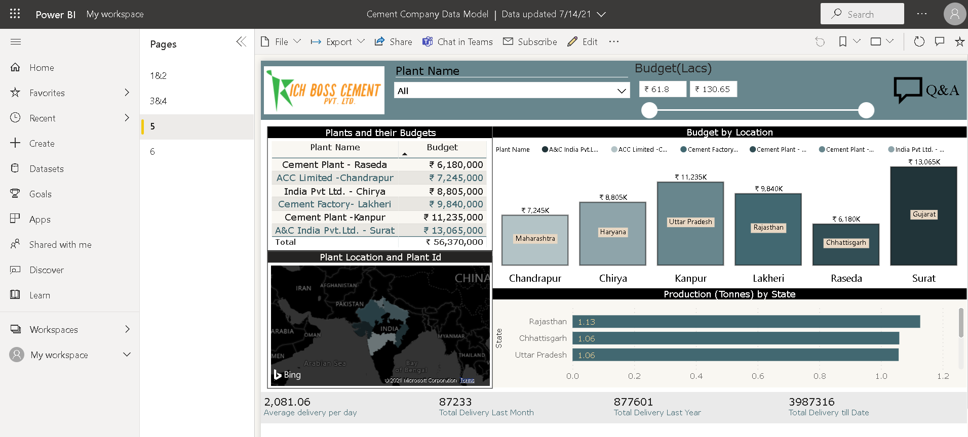
Page 3
Notes:
barChart
No alt text provided.
donutChart
No alt text provided.
ribbonChart
No alt text provided.
lineChart
No alt text provided.

Slide 14
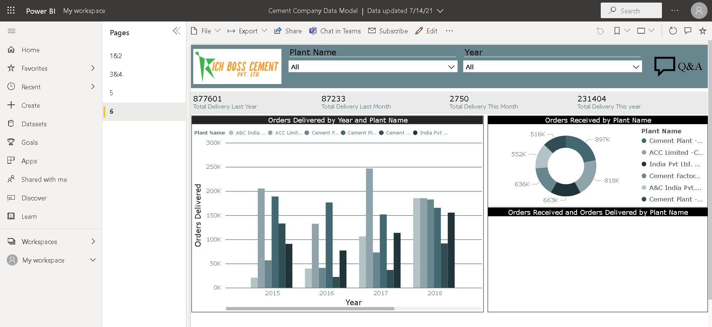
Page 3
Notes:
barChart
No alt text provided.
donutChart
No alt text provided.
ribbonChart
No alt text provided.
lineChart
No alt text provided.

Slide 15
Future Score
The future scope of this is very vast we can use these dashboard in any sales inventory or in any business Financial Analysis
For future Scope we also use with power bi feature by extracting data form web or dumping SQL
As we have taken the Fiscal Year of 2013 and 2014 for that we can connect are Model with the Web server or any Sql Server and apply refreshing query and Keep adding the data in model for yearly Calculation
Most important scope is that we can understand all type of Insights of Product , Price of Product , manufacturing of cement ,its delivery ,production , givrn Target and Target achieved
The demand for BI (Business Intelligence) and Decision Making will not dip in the near future. Definitely, no other BI tool is going to overcome Power BI’s dominance in the next ten years. Also, Power BI is easy to use and excellent for data visualization.
Moreover, the product is a Microsoft product. What makes it potent is that a range of products from Microsoft are already global leaders. Integration with Power BI is not only essential but also it augurs well for its users as the brand ensures it is here to stay with adding features every week at a random pace.

Slide 16
Conclusion
Notice that the Extreme and Productivity segments are growing faster than others. However, we don't compete in those segments; if we want to move into these segments, we can use our data to see which segments are popular in which regions. We can further investigate such questions as which regions are growing faster and who would be our biggest competitor in that segment.
We can improve our business through these analysis like for financial year ,we can see that how much quantity solds in last month ,year etc through which we analyze and increase our sales in any region and country of any product.
Also we can analyze Cement company data its production , delivery through which we can increase our target and achive more.

Slide 17

Thank You

