Slide 1
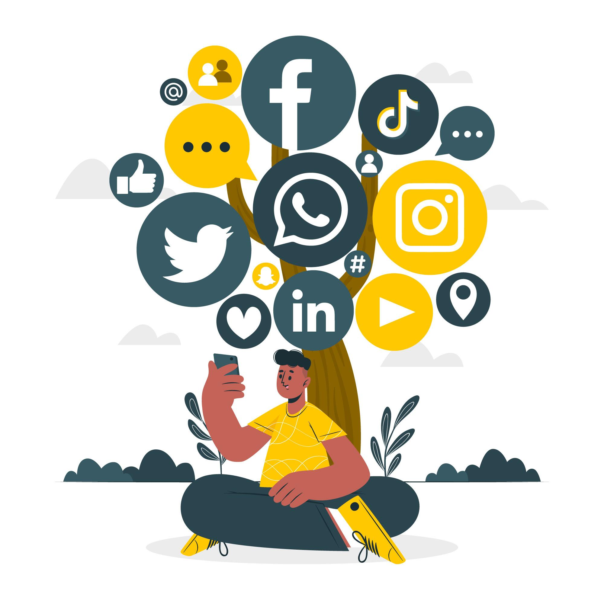
Social Media Analysis
Submitted By:
TEJPAL SINGH PACHAR

Slide 2
AGENDA
01
02
03
04
05
Problem Statement
Data Description
Key Metrics and Visualizations
Targeted marketing strategies
Conclusion

Slide 3
Problem Statement
You are hired as a data analyst at Meta and asked to collaborate with Marketing team. Marketing teams wants to leverage Instagram's user data to develop targeted marketing strategies that will increase user engagement, retention, and acquisition. Provide insights and recommendations to address the following objectives.

Slide 4
DATA DESCRIPTION
The dataset contains information 7 tables. Below is an overview of the dataset:
Users Table : information about users registered on the platform
Photos Table: information about the photos uploaded by users.
Comments Table: Stores all comments made by users on photos.
Likes Table: Tracks which users liked which photos.
Follows Table: Tracks user relationships (followers and followees).
Tags Table: Stores unique tags that are associated with photos.
Photo_Tags Table: connects photos with tags.
comments_id : unique identifier for each comment
comment_text : text content of a given comment
user_id : unique identifier for each user
photo_id : unique identifier for each photo
created_at : date of interaction in the form like, photos, tags
follower_id : user_id of the follower for a certain user
followee_id : user_id of followee for a certain user
tag_id : unique identifier for each tag
image_url : link to the image posted on the platform
username : username chosen by the user

Slide 5
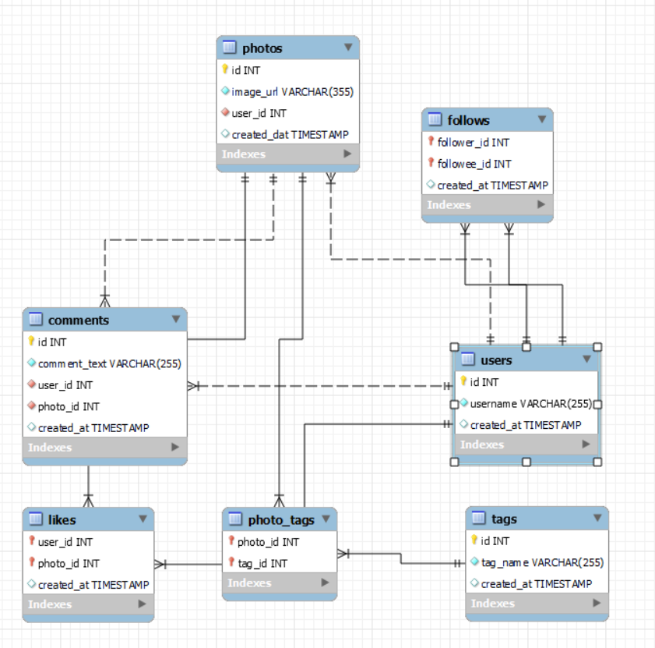
Database schema

Slide 6
KEY METRICS AND VISUALIZATION
TAGS
28% of users are using only one tag in their post.
We can work towards guiding them to use more tags for better reach.

Slide 7
KEY METRICS AND VISUALIZATION
Avg. Likes and Comments
57% users like the video and 43% comments on it
We can make work towards making comments more interesting for users by making fun and intrective comments.
We can also make good visuals while liking the post so that people are inclined to like the post because it’s fun.

Slide 8
CONTENT-CENTRIC ANALYSIS
TOP 3 LIKED CATEGORY:
Party & Fun
Landscape
Joy-Emotions
This shows, Mostly users are drawn to energetic, visually appealing, and emotionally uplifting content
LEAST 3 LIKED CATEGORY
Photography
Aesthetics
Fashion
While these categories have low overall engagement, they may still resonate with a niche audience.

Slide 9
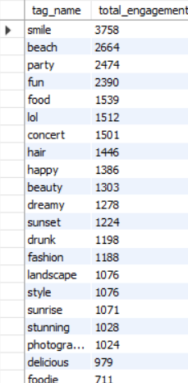
User Engagement by Tags
Smile, beach, party are the top most used tags.
Users are engaging in fun and entertaining contents.
We can work on the tags in the middle to increase engagement.
Like happy, beauty, dreamy, sunset.
Foodie, delicious, photography are least engagement.
Only people with particular interests engage in these types of tags

Slide 10
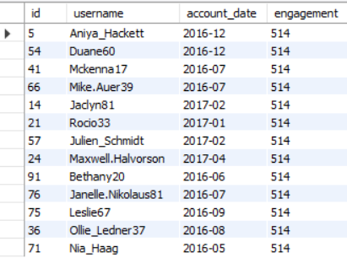
Top Users
Users with higher engagement can be rewarded in a certain manner.
It can lead to users being more active and motivated.
Even users with lower engagement will try to reach a higher level.

Slide 11
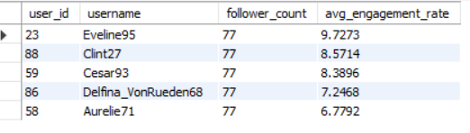
Top Users
Customized Outreach: Create personalized messages for each influencer by emphasizing their individual engagement levels and follower count.
Campaigns Tailored to Niche: Design marketing campaigns that align with each influencer’s specific niche and audience.
Enticing Incentives: Provide compelling incentives for collaboration, such as competitive compensation, free products, or exclusive event access.
Ongoing Partnerships: Consider building long-term relationships with the top-performing influencers.

Slide 12
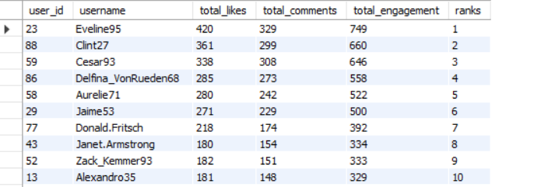
Top Users Behaviour
Based on users behaviour we can segment users for marketing campaigns or recommendations:
Demographics: Segment users based on their age, gender, location, income level, education level, etc
Psychographics: Segment users based on their interests, values, attitudes, and lifestyle choices.
Engagement level: Segment users based on their level of engagement with your platform, such as active users, dormant users, new users, etc.

Slide 13

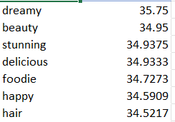
Hashtags with most number of Avg. Likes
Dreamy tag has the highest number of average likes.
We can encourage people for liking the posts.
We can use attractive animations and 3d visuals for more engagement.

Slide 14
Engagemet by Year
It allows you to compare engagement patterns of older users with newer and helps understand whether users with higher follower counts generally receive higher engagement and if post frequency correlates with engagement levels.
Newer users(2017) are more actively contributing content
Users from the 2017 cohort with 76 followers have the highest average engagement (82.96)
2017 cohort with 77 followers shows higher average posting activity (4 posts)

Slide 15
MARKETING STRATEGIES FOR USER RETENTION
MAIN CONCERN: Users With Either
No Activity
No Engagement
No Activity and No Engagement
Personalized Re-Engagement Campaigns
Exclusive Incentives
Suggest specific posts, hashtags, or users to follow based on their past engagement history, encouraging them to re-explore the platform.
Offer limited-time promotions or discounts on premium features or services to entice users back onto the platform

Slide 16
MARKETING STRATEGIES FOR USER ACQUISITION
Targeted Onboarding Campaigns
Educational Content on Tag usage
Referral Programs
Create a tailored onboarding experience for new users that highlights platform features, popular tags, and successful user stories
Launch campaigns to educate users on the benefits of using tags. This can include blog posts, video tutorials
Reward current users for bringing new users onto the platform. This could involve discounts, exclusive content access, or feature upgrades,

Slide 17
MARKETING STRATEGIES FOR USER ENGAGEMENT
Highlight Active Users
Photo Contest
Referral Programs
Recognize highly active users with award like ‘User of the Month’, which can motivate others to engage more actively to earn similar recognition.
Create challenges that encourage users to post photos and reward them with ‘Photo Of The Month’ recognition
Host tutorials or webinars to educate users on how to maximize their engagement on the platform.

Slide 18
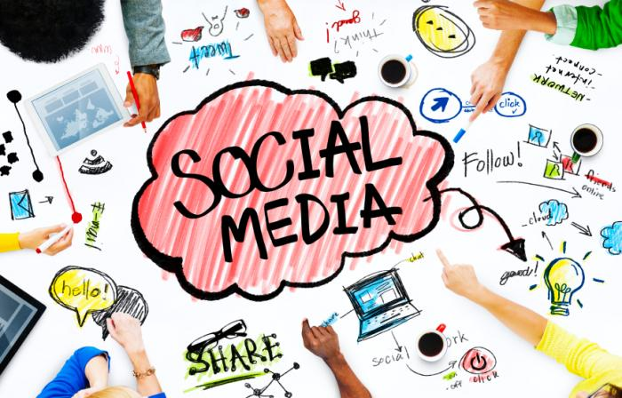
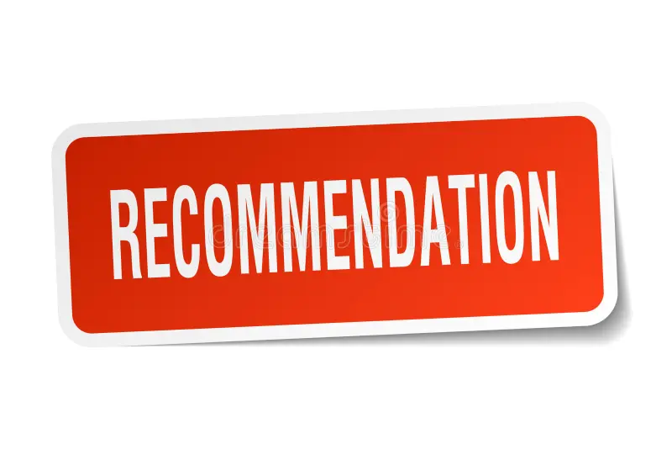
CONCLUSION
User Acquisition Efforts:
Utilize influencer partnerships and ambassador programs to leverage existing engaged users to attract new users, while also implementing educational initiatives to ensure new users understand how to effectively engage with the platform.
User Retention Strategies:
Implement personalized content recommendations, exclusive offers, and feedback mechanisms to retain users and address the reasons behind their inactivity
User Engagement Initiatives:
Reignite engagement by running targeted campaigns, promoting tag-based activities, and fostering community-building initiatives to encourage inactive and semi-active users to participate more actively. This will help elevate their overall platform experience.

Slide 19
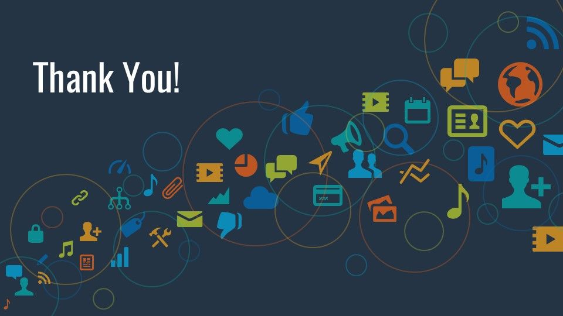
Submitted By:
TEJPAL SINGH PACHAR

