Slide 1
Modularity in shopping assistance system

Slide 2
Literature Survey
Shopping is an essential part of human life. That’s why many people tried to make the process better. Some tried to enhance the process of information retrieval like barcodes on each product, and others tried to make payment better like using credit card payment, but some people found flaws in those like thermal camera attack [4]. So, it is not possible to stick to a system for long.
For ex. There was a bug found in google wallet payment system called google wallet relay attack [9]. Then user has to switch to another service which can be change the way they used to shop.
To make a system that can bear these changes [1] , we introduce a modular system. In this system the whole shopping procedure is divided into important tasks like information retrieval and payment.

Slide 3
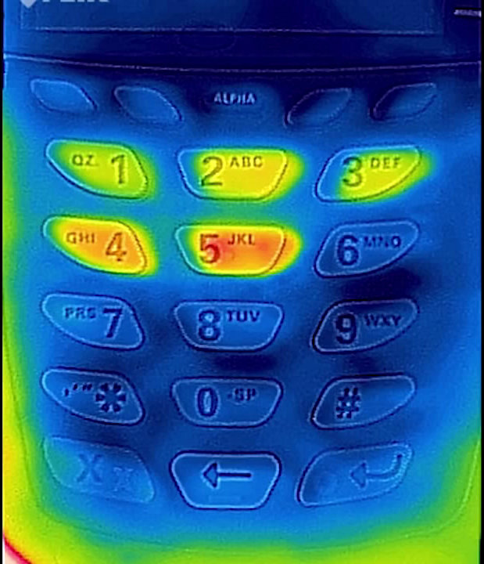
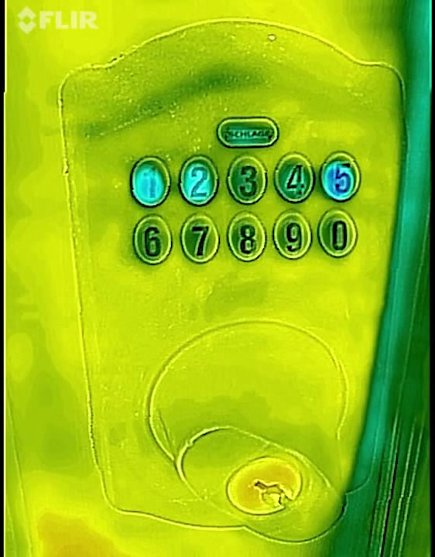
Security issues found in current system’s

Slide 4
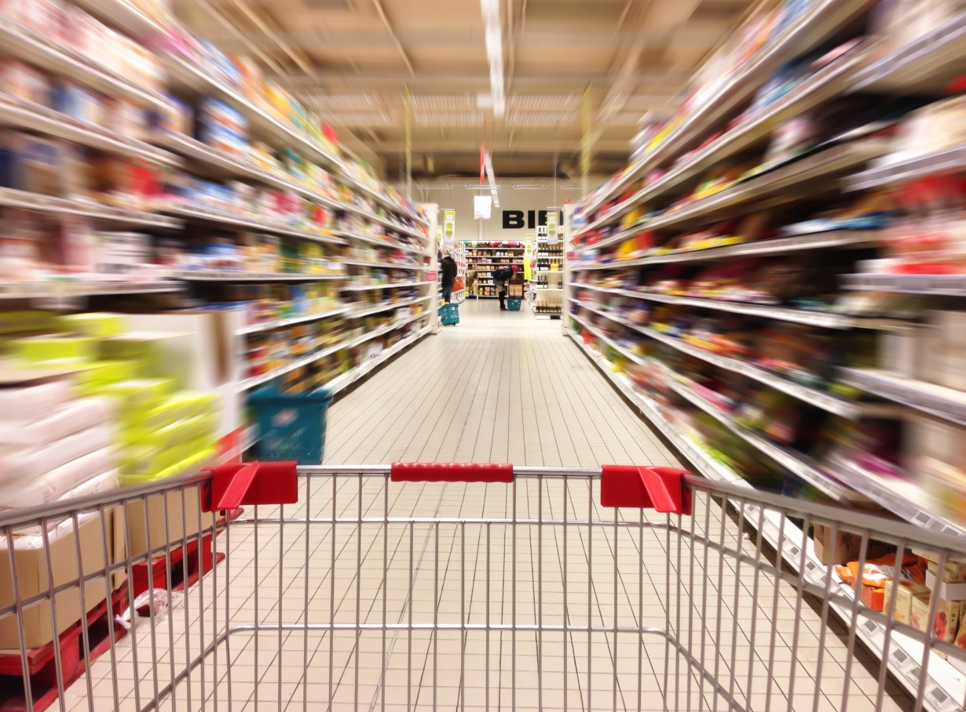
Time spent in finding product

Slide 5
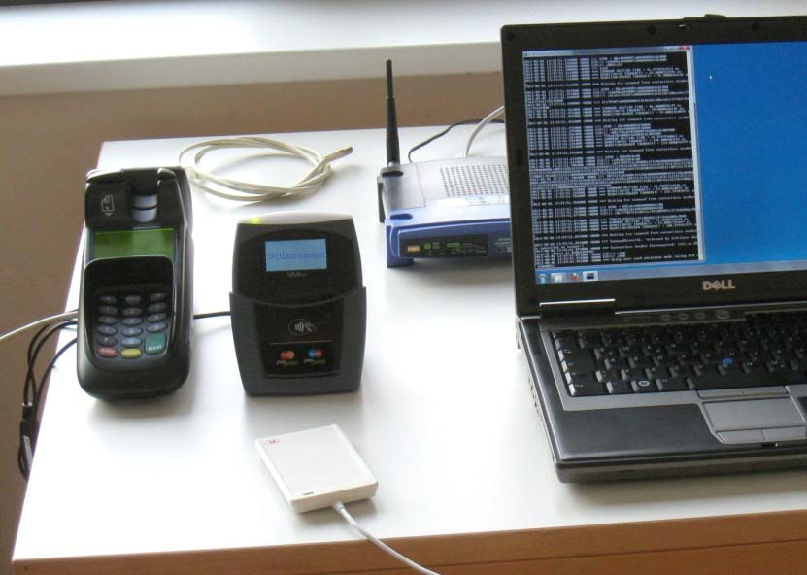
Google wallet relay attack

Slide 6
Introduction : Why?
People love shopping and their mobile phones.
They carry phones everywhere they go.
So, why not use mobile instead of other stuff like shopping card, credit card and shopping list.
There are some application that can perform some individual tasks like shopping list management and payment.
But they cannot fulfill the requirements of retailers infrastructure.
Our system can be changed/upgraded easily.
More secure ways for payment system.

Slide 7
Introduction : Modular approach
Now, The whole shopping process is mapped into modules.
Each module can use a set of technologies to work.
Technology used in modules can differ according to trends in technology.
Technologies can be changed accordingly to match retailers infrastructure.

Slide 8
Shopping Modules
Modules
Shopping list management
Orientation
Product information
Shopping basket management
Coupon redemption
Customer loyalty reward
payment

Slide 9
Technologies available in market
Shopping list management
Orientation
Product information
NFC
Barceode
QR-code
Nework
Wireless Nework
NFC
Barceode
QR-code
Nework
Image recorgination

Slide 10
Technologies available in market
Shopping basket management
NFC
Barceode
QR-code
Coupon redemption
NFC
Barcode
QR-code
Nework
Customer loyalty reward
NFC
Barcode
QR-code
Nework
Payment
NFC
Barcode
QR-code
Nework

Slide 11
Each module has a set on input’s and output’s
input
module1
Output
module2
output

Slide 12
So, for some case, model can be
Technologies
QR code
Network
QR Code
NFC
NFC
Network
Network

Slide 13
and for some other case, model can be
Technologies
NFC
QR Code
QR Code
Barcode
Barcode
Network
NFC

Slide 14
Problem Statement
Modularization of Mobile Shopping Assistance Systems

Slide 15
Platform / Technology
Platform:
For End User:
Android
Windows Phone
For Shopkeeper:
Android
Windows Phone
Web Browser
Technology:
Java
php
Wireless Network
NFC
QRCode

Slide 16
Block diagram
Shopping list management
Browse Items
Add To list
Orientation
Add products to shopping cart
Scan NFC tag/QRcode of product to add new product
Get orientation of product

Slide 17
Block diagram
At Bill Counter
Scan shopping list
Bill Is Generated
At Check Counter
Items are kept in bags from Shopping cart
Items are checked by worker simultaneously
Pay for bill Via NFC
Loyalty reward and coupon code is applied

Slide 18
UML diagrams

Slide 19
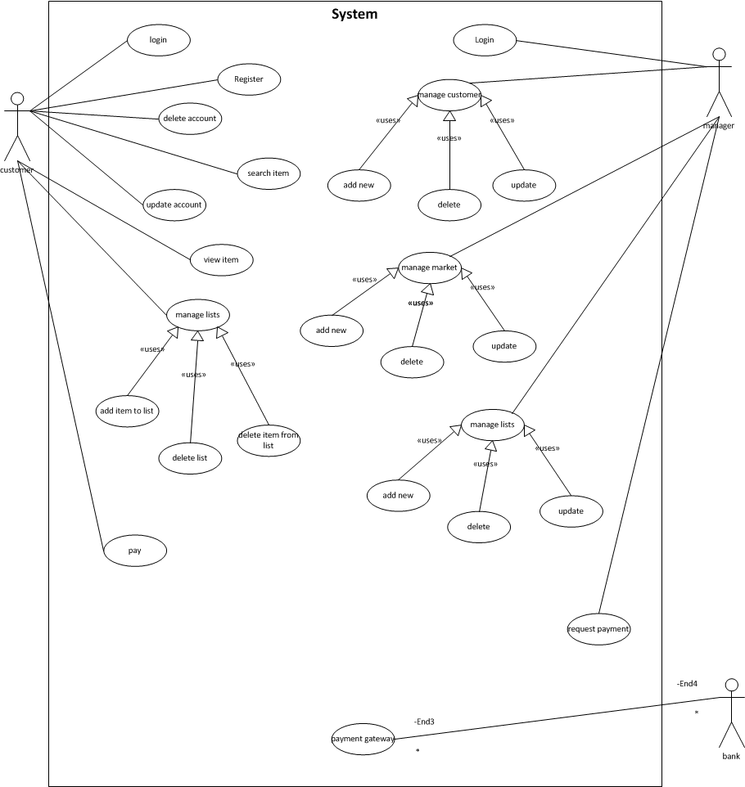

Slide 20
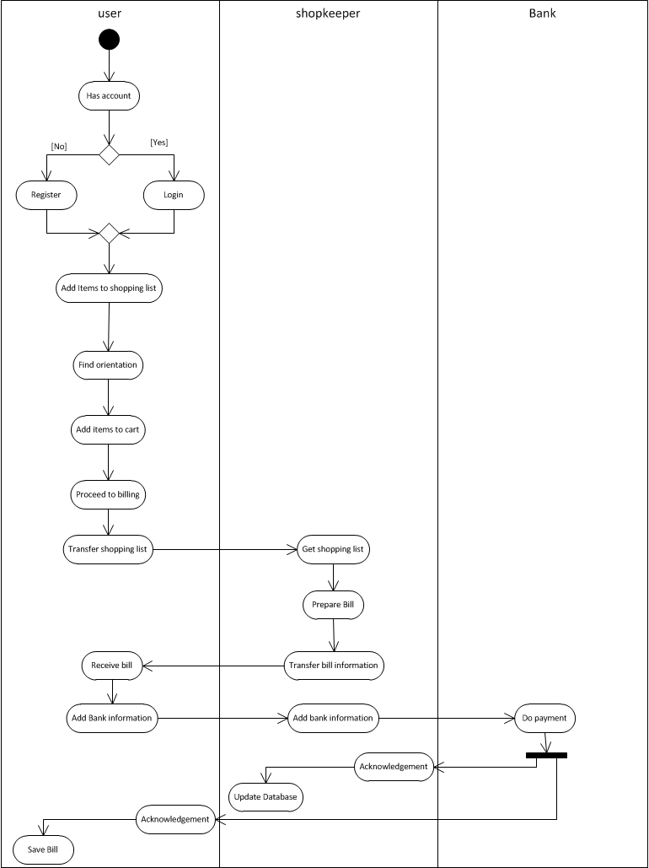

Slide 21
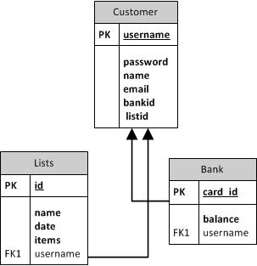
For mobile phone
Database Design

Slide 22
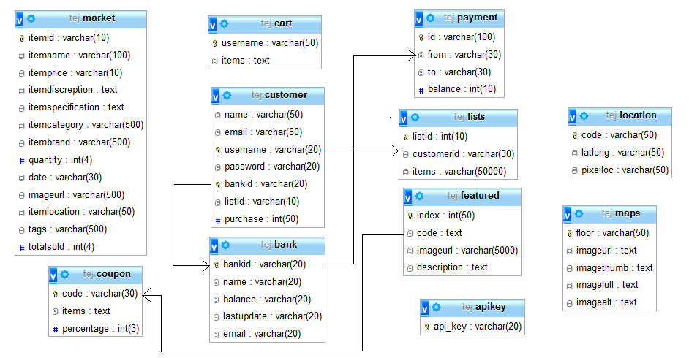
For web server

Slide 23
Limitations
Internet should be accessible to both user and shopkeeper.
NFC tags support data storage up to 1MB.
Phone battery.

Slide 24
Future scope
Automated item picking as per user shopping list.
A universal system for all shopping markets.
Theft protection.
Support for self scanning shopping cart.

Slide 25
Feasibility Assessment

Slide 26
TSP Algorithm
Takes coordinates in latitude and longitude manner.
Calculate permutation ($all Locations);
For all Routes calculate distance
Find The Shortest one

Slide 27
Feasibility Assessment
Algorithm I : Brute Force for TSP (Finding path for user)
Compute :
Longitude[] = set of all longitudes
Latitude[] = set of all Latitude
Find : array of allocations
Permutation(all Locations)
For all permutation :
Calculate total distance for that route
If(current Distance < lowest distance)
Update lowest

Slide 28
XOR encryption
This works on the basic mathematical principle that if
a XOR b equals c then
c XOR a equals b.

Slide 29
Feasibility Assessment
Algorithm 2 : Pretty Good Privacy : radix64
Encryption Algorithm:
1. k = key for encryption.
2. t = text to encrypt.
3. res = {empty}
4. Loop (length of t)
4.1 cc = character code of current char of t.
4.2 res = res + to character from code ( k XOR cc).
5. End
Decryption Algorithm:
1. k = key for encryption.
2. t = text to decrypt.
3. res = {empty}
4. Loop (length of t)
4.1 cc = character code of current char of t.
4.2 res = res + to character from code ( k XOR cc).
5. End
Time complexity = O(n).
Where n is the length of input string.

Slide 30
Mathematical model
The following are the variables used in A* algorithm to describe mathematical model.
f(n)[m] = estimated cost of the cheapest solution through n.
g(n)[m] = cost of path from start node to current node.
h(n)[m] = estimated cost of shortest path from current node to goal state.
f(n) = g(n) + h(n);
This equation should be satisfied at every node for the lowest value of f(n).
If C* is the optimal solution for that graph, then A* solution should be
f(n) = g(n) + h(n) <= C*
Cost of searching: = |h(n) – h*(n)| <= O(log h*(n))
Where h*(n) = true cost of getting from n to the goal.

Slide 31
Mathematical model
The following variables are used in XOR algorithm do describe mathematical model.
For Encryption:
t := Plane text to Encrypt.
i := current character of ‘t’ while encryption.
k := Key for Encryption.
res := Cipher text (Encrypted data).
res = res + k XOR t(i)
This equation is iterated for all characters in ‘t’. (1)
Now ‘res’ is in the form of bits, we have to convert it to simple text by converting it to text from ASCII values for each stage in encryption.

Slide 32
Mathematical model
For Decryption:
t := Cipher text to Decrypt (res from above equation).
i := current character of ‘t’ while decryption.
k := Key for Decryption (same as used for encryption).
res :=Plain text (Decrypted data).
res = res + k XOR t(i) (2)
This equation is iterated for all characters in ‘t’.
Now ‘res’ is in the form of bits, we have to convert it to simple text by converting it to text from ASCII values for each stage in encryption.

Slide 33
Function Point Analysis
EI -> External Input
For Registration:
FTR's | DET's | Complexity | Points
2 | 6 | Average | 4
For Login:
FTR's | DET's | Complexity | Points
2 | 2 | Low | 3
For Add to List:
FTR's | DET's | Complexity | Points
1 | 3 | Low | 3
For Save List:
FTR's | DET's | Complexity | Points
2 | 3 | Low | 3
For Payment:
FTR's | DET's | Complexity | Points
4 | 7 | High | 6

Slide 34
Function Point Analysis
EQ-> External Inquiries
For Registration:
FTR's | DET's | Complexity | Points
2 | 6 | Average | 4
For Login:
FTR's | DET's | Complexity | Points
2 | 2 | Low | 3
For Add to List:
FTR's | DET's | Complexity | Points
1 | 3 | Low | 3
For Save List:
FTR's | DET's | Complexity | Points
2 | 3 | Low | 3
For Payment:
FTR's | DET's | Complexity | Points
4 | 7 | High | 6

Slide 35
Function Point Analysis
EO-> External Output
For Payment transaction:
FTR's | DET's | Complexity | Points
1 | 6 | Average | 4
For payment Receive:
FTR's | DET's | Complexity | Points
2 | 1 | Low | 4
For Payment Send:
FTR's | DET's | Complexity | Points
1 | 1 | Low | 4
For pathfinding:
FTR's | DET's | Complexity | Points
2 | 1 | Low | 4
For list sold:
FTR's | DET's | Complexity | Points
2 | 6 | Average | 5

Slide 36
Function Point Analysis
EO-> External Output
For List Check:
FTR's | DET's | Complexity | Points
1 | 6 | Average | 4
For Encryption:
FTR's | DET's | Complexity | Points
0 | 1 | Low | 4
For Decryption:
FTR's | DET's | Complexity | Points
0 | 1 | Low | 4

Slide 37
Project Plan, Individual contribution
Points
Database management
Webui
REST apiSecurity
Testing
Shopping list management implementation
Orientation implementation
Information fetching technology implementation
Shopping basket management implementation
Loyalty reward implementation
Coupon redemption implementation
Payment implementation
Testing

Slide 38
References
[1] Modularization of mobile shopping assistance systems by Paradowski, Denise; German Research Center for Artificial Intelligence Campus D3_2, 66123 Saarbrücken, Germany, Kruger, Antonio.
[2] An NFC-Based Solution for Discount and Loyalty Mobile Coupons by Sanchez-Silos, J.J.; Dept. of Computer. & Numerical Anal., Univ. of Cordoba, Cordoba, Spain.
[3] Mobile Near Field Communications (NFC) “Tap ‘n Go” Keep it Secure & Private By Ann Cavoukian, Ph.D. Information and Privacy Commissioner, Ontario, Canada.
[4] Heat of the Moment: Characterizing the Efficacy of Thermal Camera-Based Attacks by Keaton Mowery, Sarah Meiklejohn, Stefan Savage.
[5] Mobile Sales Assistant: An NFC­based product information system for retailers by Stephan Karpischek, Florian Michahelles.
[6] Based on RFID and NFC Technology Retail Chain Supermarket Mobile Checkout by Fugui Ruan, Daijiang Chen.
[7] http://en.wikipedia.org/wiki/A*_search_algorithm
[8] http://en.wikipedia.org/wiki/XOR_cipher
[9] Applying Relay Attacks to Google Wallet by Michael Roland NFC Research Lab Hagenberg University of Applied Sciences Upper Austria

Slide 39
Conclusion :
Customer shopping tasks were mapped to modules
Each module can be implemented using a set of diﬀerent technologies and Requires certain customer behavior
Module overview helps retailers to identify possible beneﬁts or drawbacks
Modules are independent from each other
Allows composition of modules (technologies and use cases) that ﬁts to the market’s needs
Easy exchange of modules and technologies and easy integration of new Upcoming technologies / use cases

