Slide 1
Michigan PEVC
Gene Therapy Vertical
Winter 2026
Ranai Shah & Tej Prattipati

Slide 2
Gene Therapy Overview
Platform & Technology
Development of gene editing technologies
Research/Developers
Utilize editing platforms to develop new treatments
Commercialization
Distribution of therapies to hospitals and clinics
Range of Players
350
Main companies that dominate this market space
Key Industry Metrics
[1] Mid to Small firms make up ~50% of market
[2] High M&A Volume, many small players
11B
Market size for gene therapy¹
[3] Projected CAGR of ~19.0% until 2030²
[1] www.precedenceresearch.com/gene-therapy-market | [2] www.grandviewresearch.com/industry-analysis/gene-therapy-market
2

Slide 3

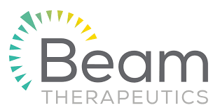
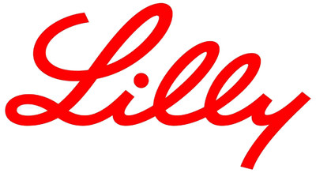
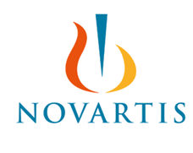
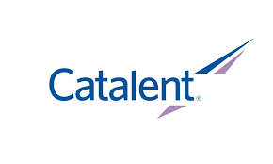
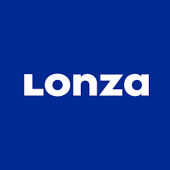
Business Models
Platform/Licensing
Big Pharma
CDMO (Tools/Infra)
Overview/Financial Profile:,
R&D-heavy, prone to burning cash. Develop the basis of the specialized gene therapy technology (in addition to University Labs), then pawn off to CDMOs for manufacturing.
Price Component:
Per-Unit royalties or long-term technology licensing deals with upfront payment structures.
Quantity Component:
Number of procedures/drugs sold, or number of licensing partnerships
Overview/Financial Profile:,
Also heavy R&D investment. Lots of M&A. Serve as the end of the supply chain, developing treatments using acquired or licensed research/technology (from companies like CRISPR). Steady revenue from large-scale commercialized medicine as well.
Price Component:
Price of Each Treatment/Drug. Negotiated with governments and insurers
Quantity Component:
Number of procedures/drugs sold, volume of patients/prescriptions
Overview/Financial Profile:,
Contract Development and Manufacturing Organizations (CDMOs) earn recurring revenue by developing methods to manufacture drugs and gene therapies and providing infra and tools for their biotech and pharma clients. High Fixed Costs.
Price Component:
Per-contract fees for development, per-unit for manufacturing.
Quantity Component:
Quantity of units produced, or the number of development contracts signed.
3

Slide 4
Business Models Continued
Platform/Licensing
Big Pharma
CDMO
Primary Buyers: Large pharma companies and established biotech firms that either license their technology or co-develop programs.
Primary Buyers: Insurers, Governments, and Hospitals. Not often directly to consumers.
Primary Buyers: Large pharma/biotech companies that outsource the manufacturing of products.
Power Balance: When drugs/treatments are initially developed, all power lies with the CRISPR, Beam, etc. But as tech becomes increasingly commoditized, this shifts towards big pharma buyers
Power Balance: Usually skewed towards the payer (because they are large institutions like Hospitals/Insurers with high negotiation power)it, unless a new/groundbreaking technology with few alternatives.
Power Balance: Balanced. Large pharmaceuticals companies have pull due to scale dependency, but CDMOs often have exclusive access to proprietary manufacturing techniques and necessary PP&E
Value Drivers: IP strength/differentiation and quality/number of partnerships.
Value Drivers: Commercial reach, quality of partnerships with CDMOs and Licensers, and internal R&D success
Value Drivers: Capacity utilization, long-term production contracts, technical know-how
4

Slide 5
Unit Economics
Headlined by High Upfront Costs for all business models: Labs/Licensing, Big Pharma, and CDMOs
COGS
Manufacturing costs - viral vectors, lab materials, quality testing, packaging, cold-storage, shipping etc. CDMO manufacturing fees if outsourced.
Operating Expenses/Overhead/R&D
Very high CapEx (especially for CDMOs and non-outsourcing big pharma). High R&D costs (heavily outweigh COGS). Low sales and marketing costs
Operating Margins
Negative during development periods without huge individual successes. Strongly positive if successful therapies are on the market
Common Valuation Metrics
Pre-revenue/clinical stage: risk-adjusted NPV
Commercial-stage: EV/Revenue in growth stage, EV/EBITDA if profitable.

Slide 6
Macro Drivers
Vertical Success contingent on both regulation and technology improvements
Technological Breakthroughs & Funding
New In-Vivo technology enabling more efficient editing
AI integration in research is minimizing R&D time spent
Regulatory Flexibility
FDA limiting constraints tied to small-batch gene therapy
Utilizing surrogate endpoints, minimizing clinical wait times
Common Disease Fit
Strong investment in oncology, currently growing success
Current expansion to CVD, neurology, & metabolic disease
6

Slide 7
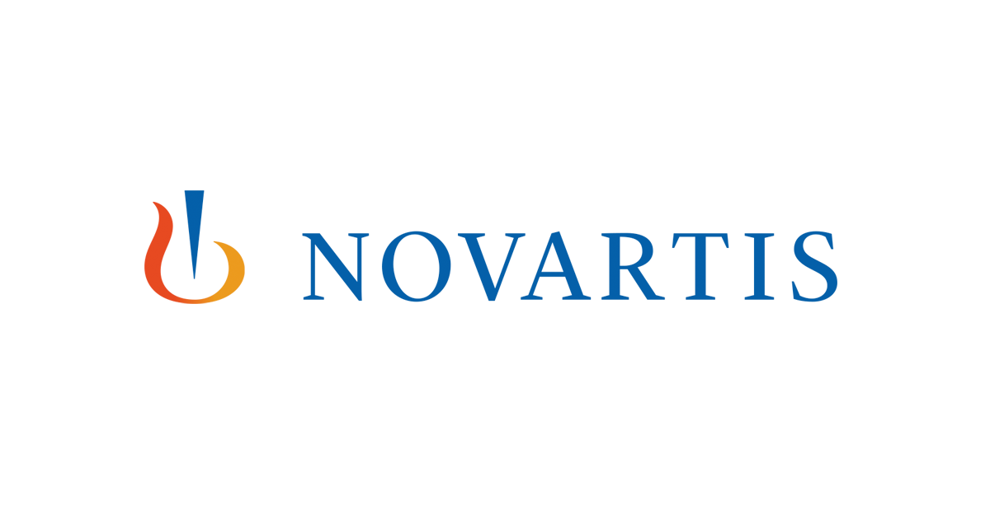
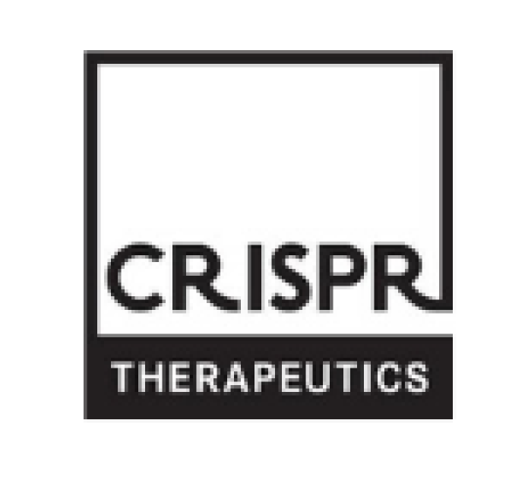
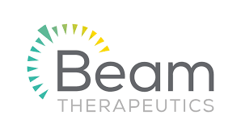

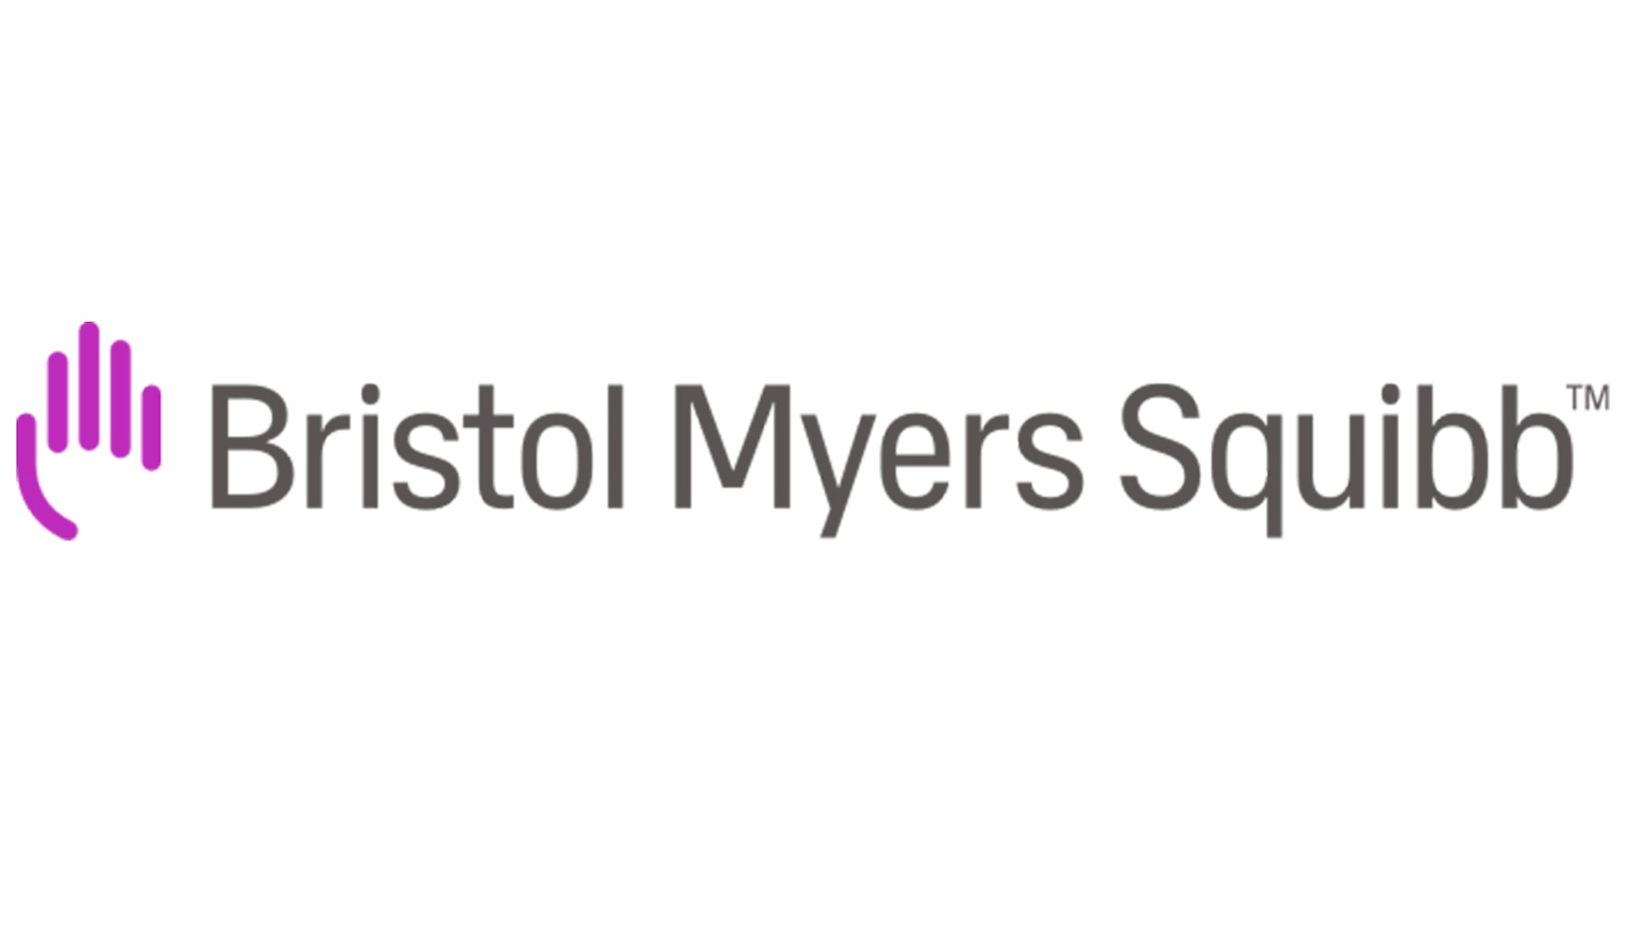
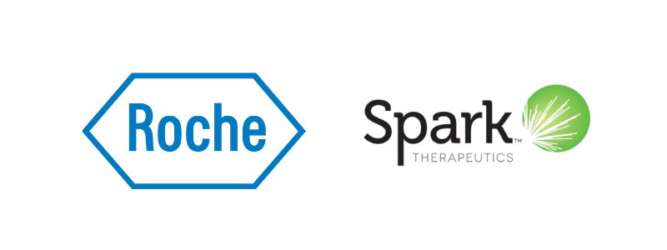



Key Players
Big Pharma
Innovation Drivers
CDMOs
Integrate modification into their supply chains, globalizing gene therapies
CRISPR alongside specialty therapeutics dominate innovation
Development and manufacturing for startups outsourced to these
Strong consolidation from large biopharma, buying Phase 2/3 companies & utilizing patents
Growth lays in gene therapy applications, as gene editing can extend to new diseases/therapies
7

Slide 8
Orna Therapeutics Acquisition
Deal Breakdown
Feb 2026: Eli Lilly announces $2.4B acquisition of Orna
Upfront cash investment, followed by milestone payments
Bought out previous funding done by Merck and Vertex Pharma
Pros & Cons of Deal
Downside protection for LLY, sustained cash for R&D for Orna
Invasive aspects to in-vivo therapy, unproven oRNA technology
Buyer and Seller Rationale
Eli Lilly
Current influx of cash from GLP-1 drugs
Reinvestment into immunology and research to sustain future
Orna Therapeutics
Faced ongoing layoffs throughout 2024-2025
Can sustain R&D investment & target “mass market” diseases
Together, this is signaling a strong shift toward in-vivo treatment, even for therapies like cancer treatment
8

Slide 9
Thank You!
9

