Slide 1
Deepfake detection by using convolutional neural network(CNN) model
Presented by: Tej Rup Sai Munagala
x19196628

Slide 2
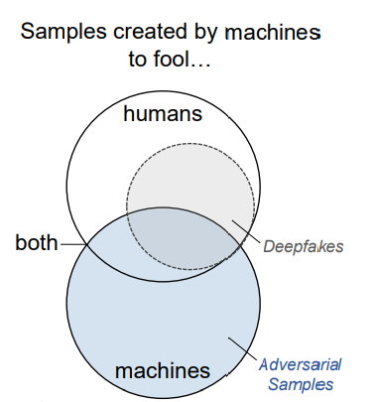
Deepfake definition
Deepfake is defined as believable media generated by a deep neural network.
The deepfake content is not only generated to fool the human but also synthesized to deceive machines, these are called adversarial samples

Slide 3
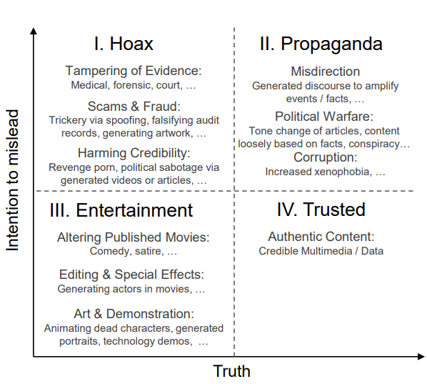
Deepfake trust chart
Deepfake information can be used and mislead in four different areas that are in Hoax, Propaganda, Entertainment, and trusted

Slide 4
Domain/Area investigated:
Deepfakes are mainly used in forensics, finance and health industry.
In health industry, deepfake are injected for remove medical evidence in CT and MRI scan for insurance fraud, disruption, and physical harm.
In finance, deepfake used as cloning, Sept. 2019 a CEO was scammed out of $250K via a voice clone deepfake
In forensics, deepfake are used to generate human fingerprints in oder to access multiple users' financial records.

Slide 5
Research Question:
Detection of deepfake videos by using convolutional neural network(CNN) model.
Objectives:
Following research objectives are needed to be answered to solve the research question :
Dataset exploration
Video exploration
Generation of frames from videos
Resizing the images
Model construction
Evaluation of model

Slide 6
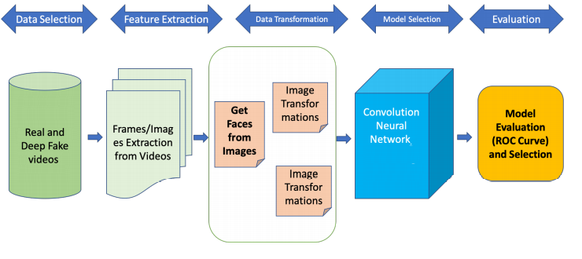
KDD methodology
As this project has lots of knowledge-driven business applications

Slide 7
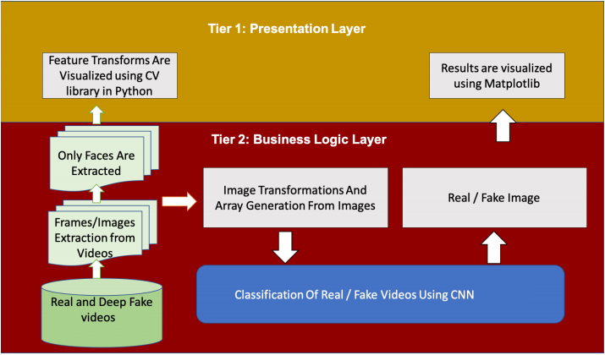
Design Specification
The design specification that is required for implementing this model is divided into two levels. The first level consist of the presentation layer and the second level is the business logic layer.

Slide 8
Brief presentation of steps followed in research
Initially, the dataset has been explored which has a total of 400 videos in training dataset and 400 videos in testing dataset.
Generation of images and frames per seconds from all the videos.
Exploration of images by identifying the region of interest (ROI) in a given face by using cascading tools like haarcascade and blazeface.
Resizing the images to 256*256 frame size, resizing helps in converting the lower dimensional images to higher dimensional images and it also helpful in replacing the bad lightning faces with blank spaces.
Implementation of CNN model like Visual Geometry Group(VGG)19 network is applied by using Adam optimizer and rectified linear unit(ReLU) optimizer.
Model evaluation is done by evaluating the precision, recall and Area under curve(AUC) values.

Slide 9
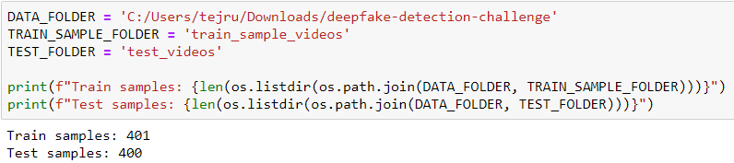
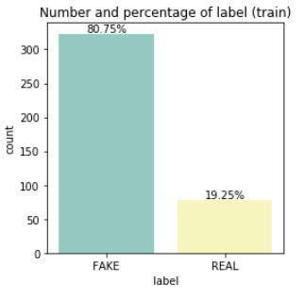
Exploration of dataset:

Slide 10
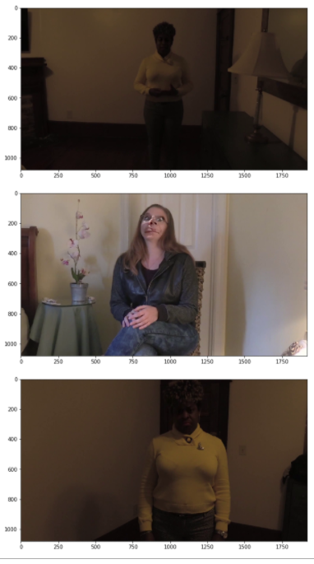
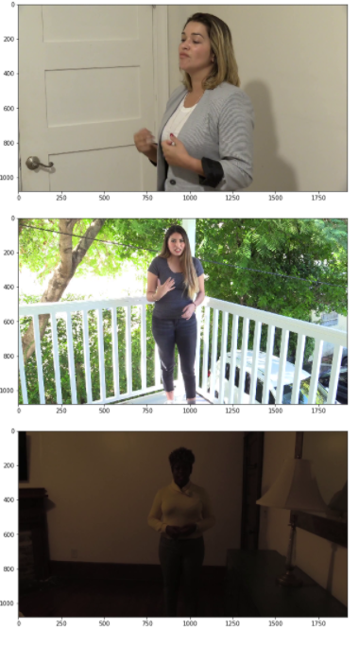
Distinguishing the real and fake frames
Fake frames Real frames

Slide 11
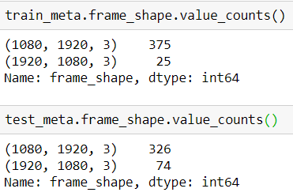
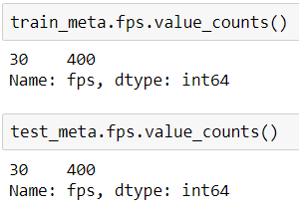
counting the unique values in both train and test datasets
Counting the frames per seconds(fps) in both the training and testing datasets.

Slide 12
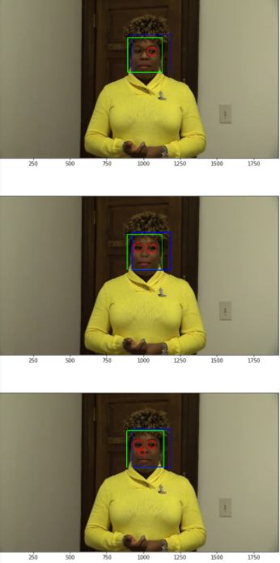
Haarcascade is a cascading tool which helps in identifying the region of interest(ROI) that helps in narrowing down the problem to deal with.

Slide 13
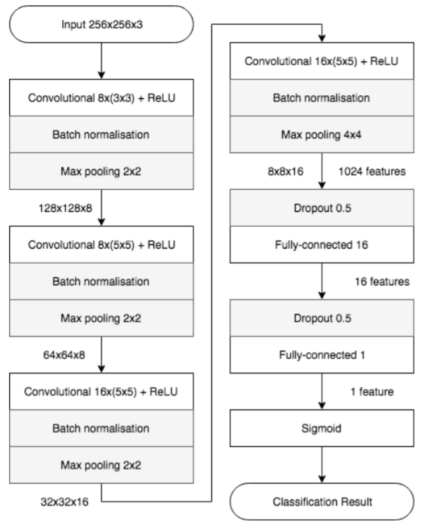
CNN model architecture
CNN is a sequential neural network, for this research batch normalization, Max pooling, Dropout and ReLU activation functions are used for parameter tuning.
ReLU activation used to remove the irregularities from the model.
batch normalization is used to normalize the output frames from neural network.
Dropout 0.5 used for improving model accuracy.
Max pooling is used to remove the overfitting of data.

Slide 14
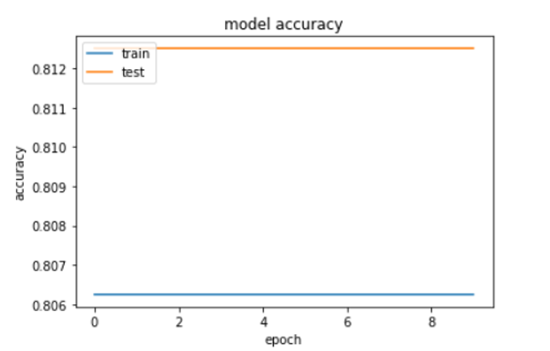
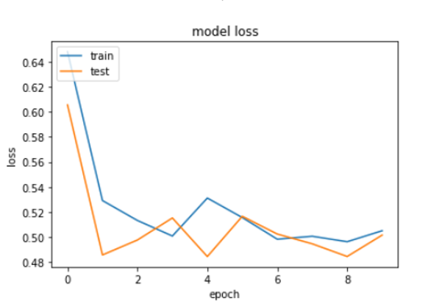
Evaluation results
CNN model has shown a model accuracy about 80 percent for both the training and test dataset.
The log loss values are decreased dramatically which means the modal performance is improved for a greater number of iterations

Slide 15
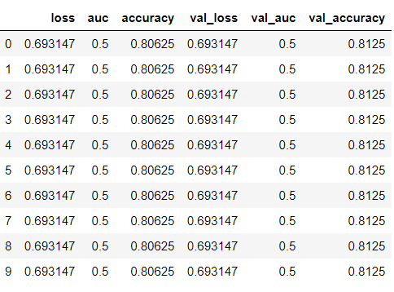
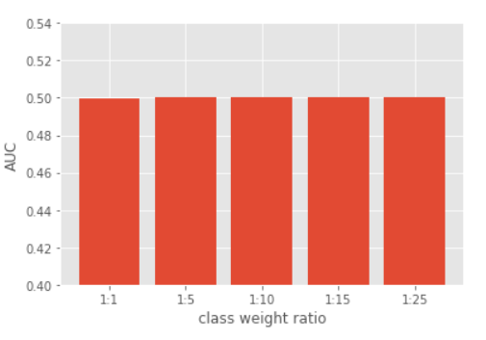
Evaluation results cont.
After hyper parameterizing, the CNN model with lesser number of layer and parameters. The model is evaluated for 5 iterations with different class weight ratios; however the model has shown AUC value of 0.5 for all the five iterations.

Slide 16
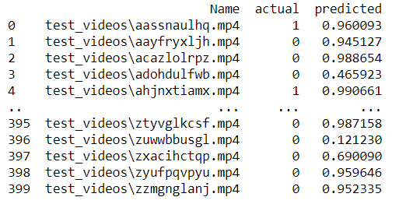
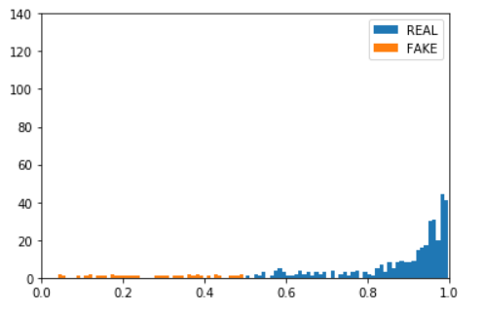
Prediction results
CNN model has predicted for the total 400 videos in the test dataset and the real and fake videos in the test dataset are also distinguished by taking 0.5 as cutoff point for the real and fake videos.

Slide 17
Conclusion
Overall, the CNN model has performed well with an accuracy of 80 percent in predicting the deepfake content.

