Slide 1

Title: Hotel Room Booking Application Project
Student Name: P. Tejaswini
Student ID: 2520030011
Cluster: 02
Section: 06
Under the Guidance
of
Supervisor Name: Dr.Y. Ashok, N.M. Deepika
Assistant Professor
Department of CSE

Slide 2
Abstract
• Web-based Hotel Room Booking System
• Allows users to register and login to the system
• Users can view available rooms and book rooms online
• Developed using HTML, CSS, and JavaScript for front-end
• Java with DSA concepts used for implementing data structures
•Demonstrates concepts like form validation, DOM manipulation, and booking management
• Provides an efficient and simple solution for hotel reservation

Slide 3
Existing System
Manual hotel room booking process
Customers must visit hotel or call for reservations
High chances of human errors in booking records
No centralized digital system to store booking details
Difficult to manage large number of customers

Slide 4
Proposed System
Web based hotel room booking system
Users can signup and login securely
Customers can view available rooms
Easy online room booking system
Admin can view all booking details
Data handled efficiently using DSA concepts

Slide 5
System Architecture
User interacts with Web Interface(HTML, CSS)
JavaScript handles validation and booking logic
Data stored using Browser Local Storage
Booking data processed using Java(DSA structures)
Admin can view booking details

Slide 6
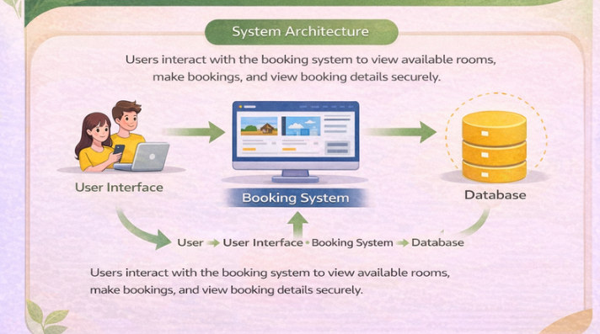

Slide 7
Project Modules
User Authentication Module: User signup and login functionality
Room Display Module: Shows available hotel rooms
Room Booking Module: Allows customers to book rooms
Booking Management Module: Stores Booking details
Admin Module: Displays booking records to admin

Slide 8
Objectives
Develop an online hotel room booking system
Provide simple user interface for booking rooms
Implement front-end web development concepts
Demonstrate JavaScript interaction and validation
Apply Data Structures and Algorithms concepts

Slide 9
Co’s Attainments - FWD
CO 1
HTML page structure
Headings. Paragraphs, links
Basic CSS styling
Colors and spacing
CO 2
HTML forms and input fields
Semantic HTML tags
CSS layout using Flexbox
Responsive design

Slide 10
CO 3
JavaScript conditions and loops
Functions
Arrays and objects
CO 4
Event handling
DOM Manipulation
Dynamic content updates
CO 5
JavaScript form validation
Handling user input
Interactive web pages

Slide 11
Co’s Attainments - DSA
CO 1
Linear Search algorithm
Binary Search algorithm
Searching elements in arrays
CO 2
Bubble Sort
Selection Sort
Insertion Sort
CO 3
List ADT concept
Linked list implementation
Singly linked list

Slide 12
CO 4
Stack Operations like push and pop
Queue operations like enqueue and dequeue
Circular queue implementation
CO 5
Array implementation
Array List for booking storage
Managing booking records using data structures

Slide 13
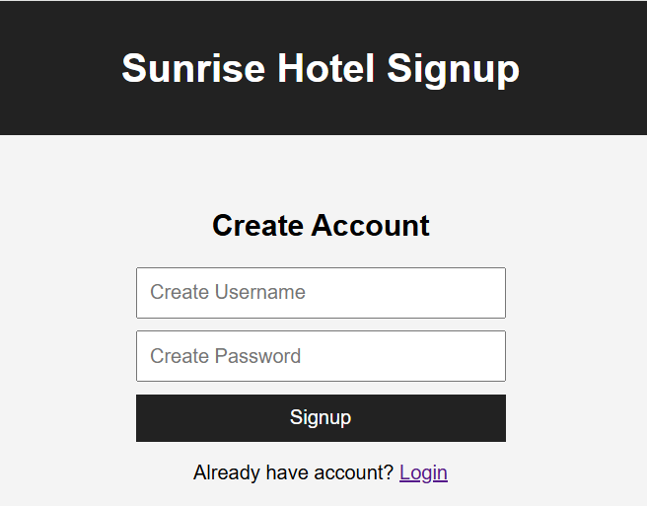
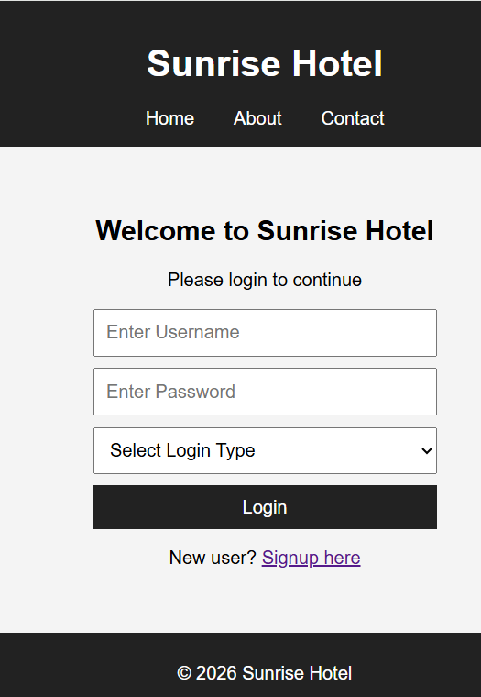
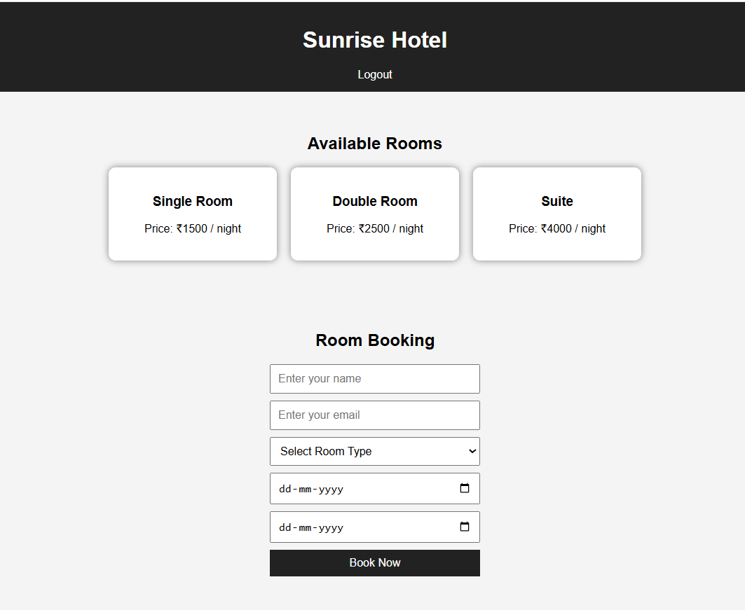
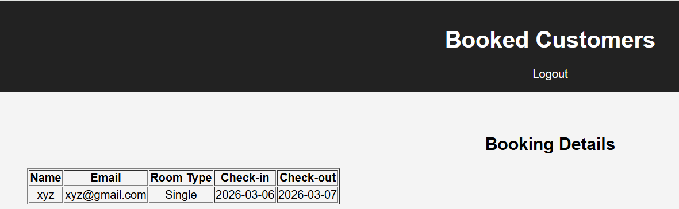
Screenshots for FWD & DSA

Slide 14
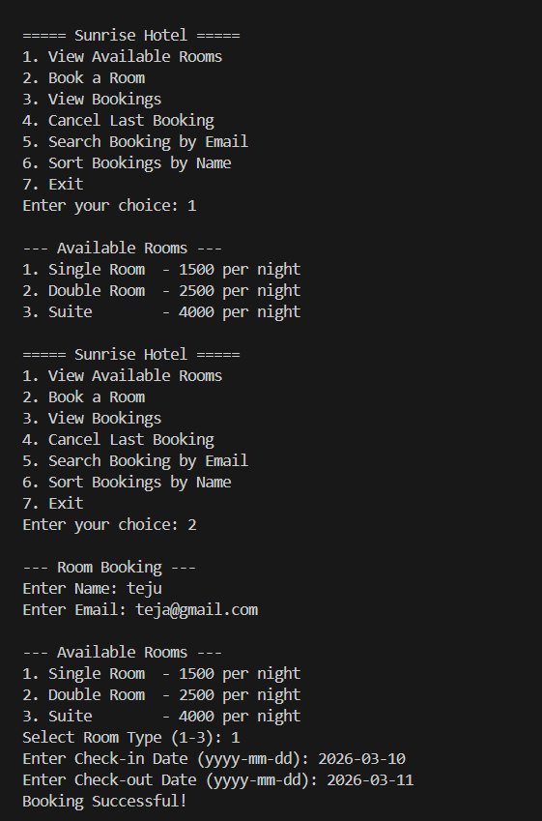
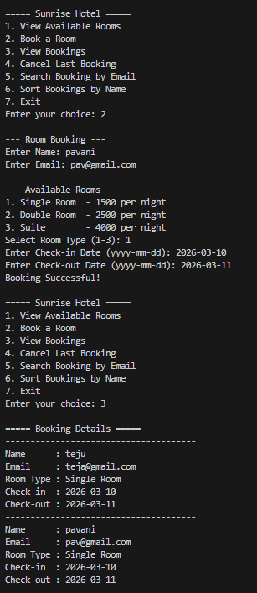
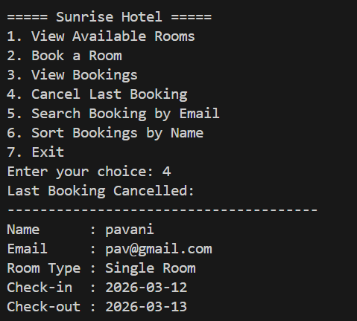
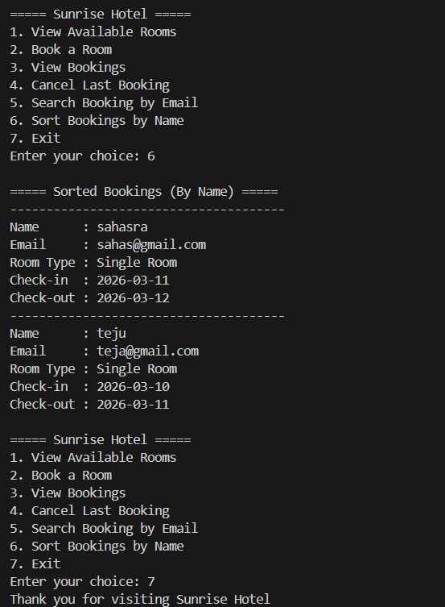
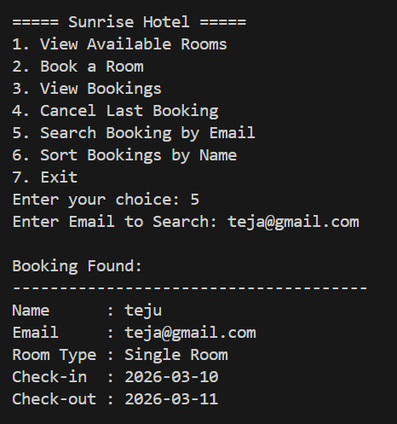

Slide 15
Conclusion
Developed a functional hotel room booking system
Implemented front-end using HTML, CSS and JavaScript
Applied Data Structures and Algorithms concepts
Improved efficiency of booking management
Provided a simple and user friendly booking platform

Slide 16
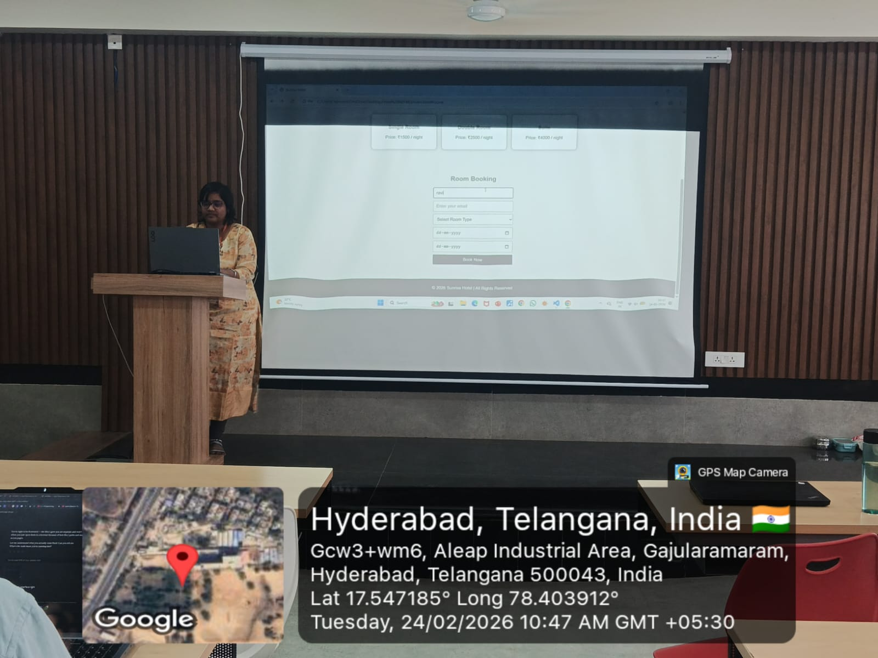
Geo- Tag Photos

Slide 17
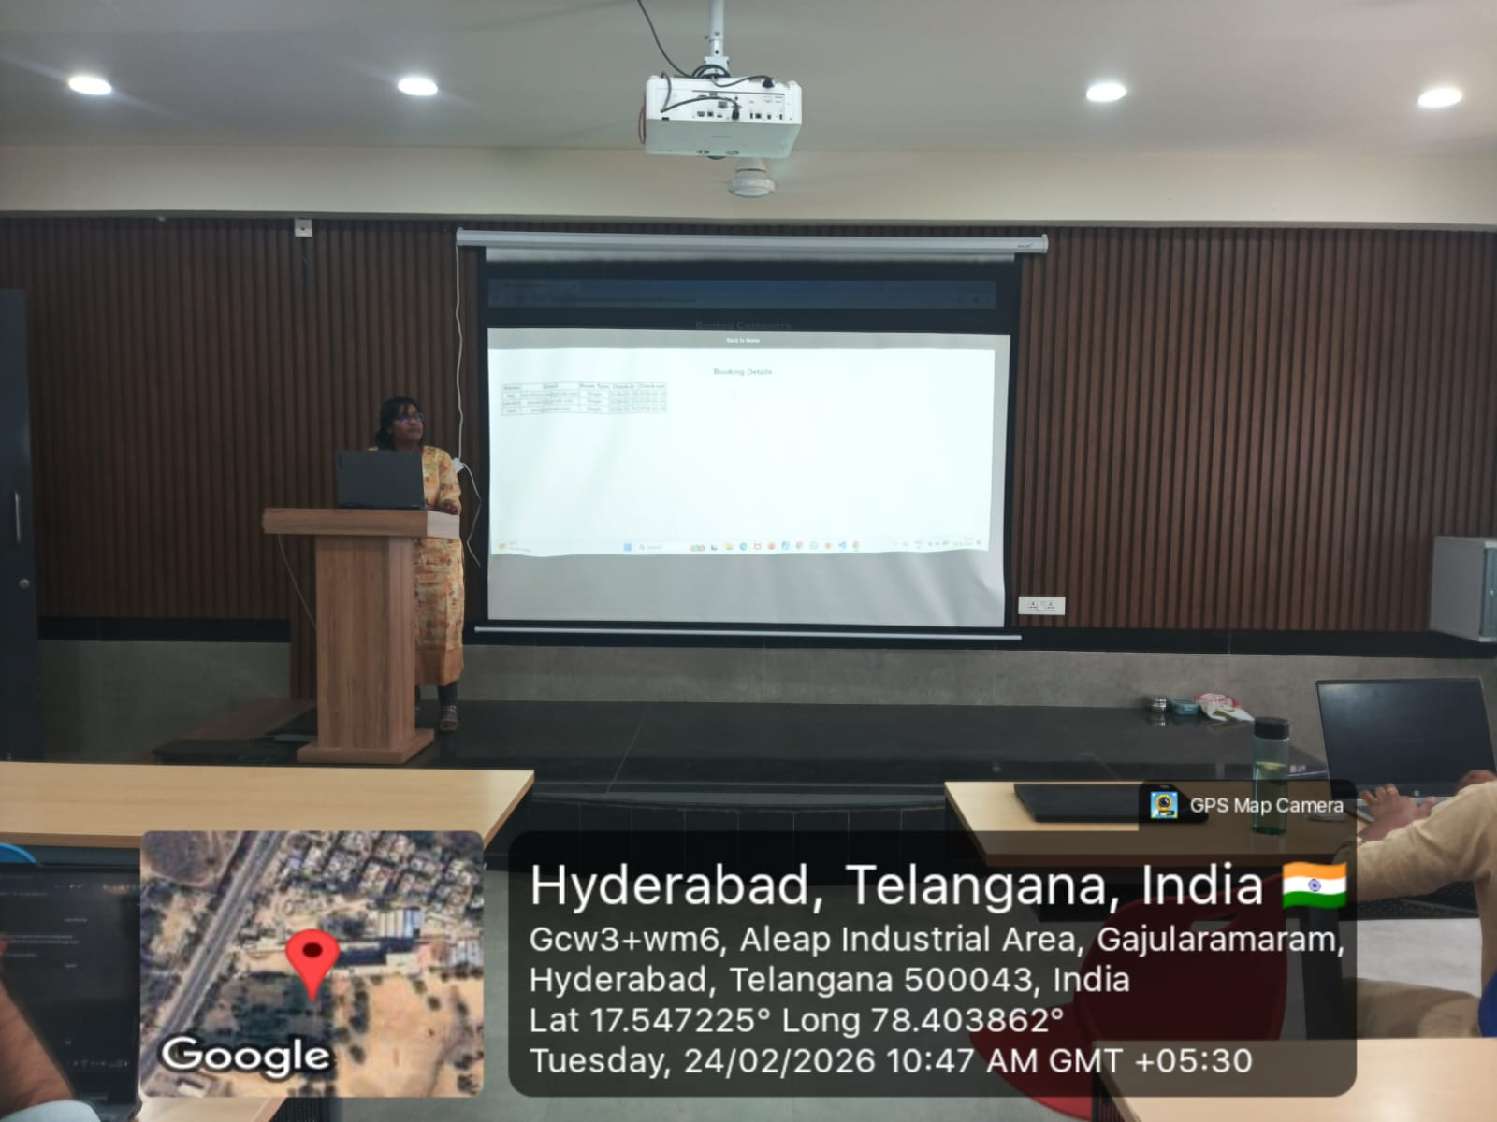

Slide 18
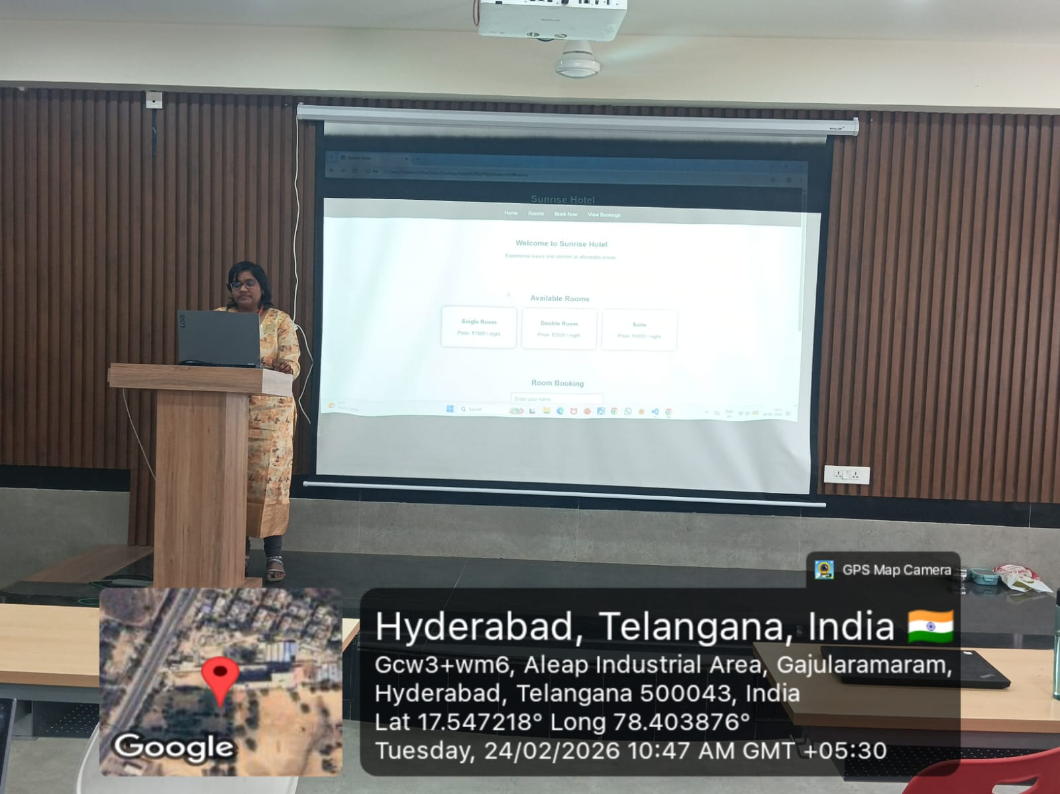

Slide 19
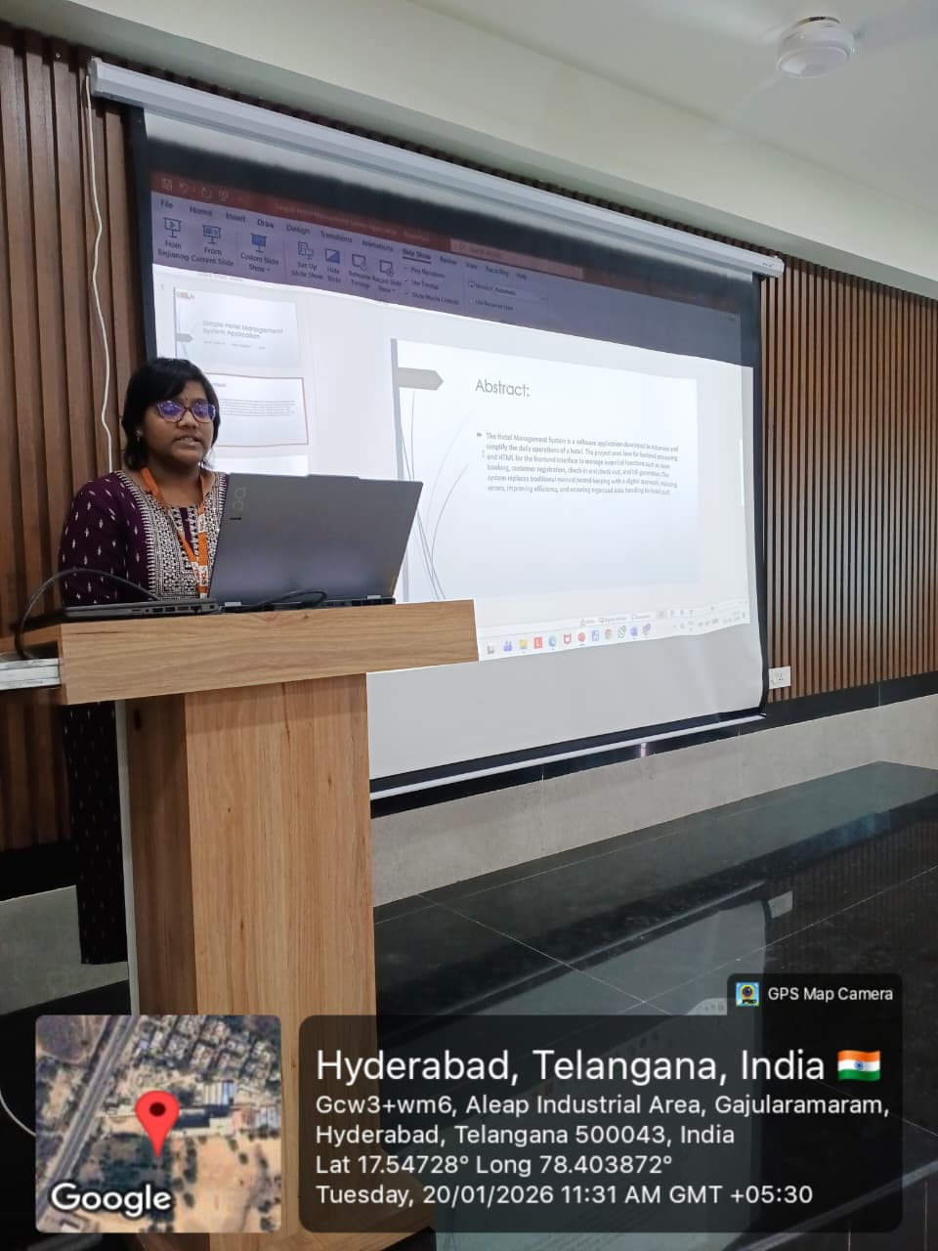

Slide 20
THANK YOU

