Slide 1
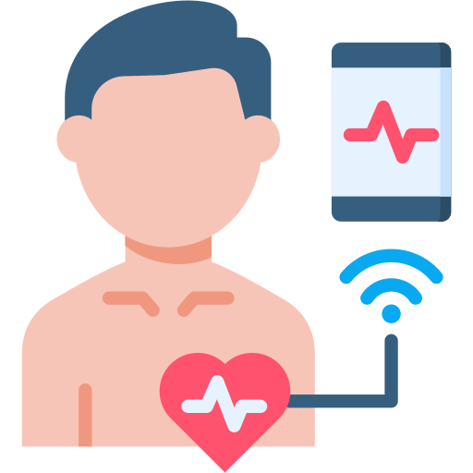
NeuroVitals AI
“Empowering Early Detection with AI, Voice, and Vision.”
Topic :- “Smart Heart Disease Detection System”
Hackathon: Google Hackathon 2025
Built By: Tejaswini Gaikwad
Tagline: Empowering Early Detection with AI, Voice, and Vision.

Slide 2
How NeuroVitals AI Works
🔍 Problem Addressed:
Heart disease is a leading cause of death. Early detection is crucial but often inaccessible. Detection using voice, stress, eye image, and real-time data .
💡 Our Solution:
An offline, AI-powered GUI app that detects heart disease using:
- Machine Learning (99% accurate model)
- Real-time Voice Pitch Analysis
- Eye Image Detection via Webcam
- User-Friendly GUI with Speech Feedback
⚙️ Tech Stack:
Python, Tkinter, scikit-learn, OpenCV, PyAudio, Librosa, pyttsx3, PyInstaller
🚀 Why Judges Will Love It:
- Creative fusion of AI, voice, and vision
- 100% offline accessibility
- Built solo end-to-end
- Real-world medical impact
Call to Action:
“Let’s revolutionize health-tech—one heartbeat at a time.”

