Slide 1


Chronic Kidney Disease Prediction and Prevention
Project team members:
Saloni Gupta - 1PE15IS090
Shweta B N - 1PE15IS100
Tejaswini M - 1PE15IS112
Rohit Ram - 1PE15IS128
Guide: Prof. Kakoli Bora
May 08, 2019
1
Notes:
1

Slide 2
Chronic Kidney Disease Prediction and Prevention
Problem definition
Our project aims at prediction and prevention of Chronic Kidney Disease (CKD) using various attributes from the data obtained from hospitals.
The main objective of this project is to predict the possibility of CKD existing in a patient and further providing details of the stage it manifests in. In addition, the patient is provided with various methods that will prevent the disease from getting worse. Predicting the disease at the earlier stages and providing the right guidance can aid in saving the life of the patient.
Based on the stage the disease persists in, we will provide steps in which the growth of the disease can be reduced. Our work concentrates on identifying the disease utilizing classification calculations like K- Nearest Neighbour algorithm to predict whether the disease exists and Decision Tree to determine the stage it is present in.
May 08, 2019
Guide: Prof. Kakoli Bora
2
Notes:
2

Slide 3
Chronic Kidney Disease Prediction and Prevention
Requirements
Functional Requirements:
The application requires a User Interface model accessible by doctors and admins.
The application requires a Dimensionality reduction model in order to avoid overfitting problem.
The application requires a Classification model to classify whether the patient is suffering from CKD or not.
The application requires a Prevention model to provides measures for prevention of the disease.
May 08, 2019
Guide: Prof. Kakoli Bora
3
Notes:
3

Slide 4
Chronic Kidney Disease Prediction and Prevention
Requirements
Non-Functional Requirements:
The system is fairly easy to use ie. any person with a basic knowledge of computers will find it easy to use.
The system is secure. The administrator’s login is secured using a password known solely to him, ensuring no one else can manipulate this data.
The system performs optimally with an average execution time of 3 seconds and has an accuracy of 95% for the Disease Presence Prediction and 93.75% for the Stage Prediction .
May 08, 2019
Guide: Prof. Kakoli Bora
4
Notes:
4

Slide 5
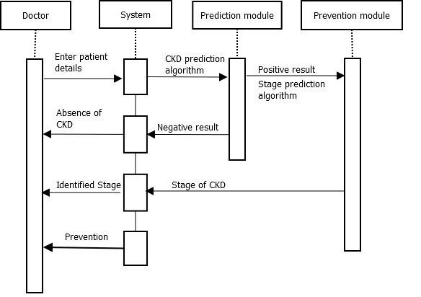
Chronic Kidney Disease Prediction and Prevention
Sequence Diagram
May 08, 2019
Guide: Prof. Kakoli Bora
5
Notes:
5

Slide 6
Chronic Kidney Disease Prediction and Prevention
System Architecture
The Presentation Tier is the top-most level of the application, i.e. User interface. The main function of the interface is to translate tasks and results to something the user can understand.
The Service Tier exists between the UI and the backend systems that store data, and is in charge of managing the business rules of transforming and translating data between those two layers.
The Storage Tier includes the data persistence mechanisms (database servers, file shares, etc.) and the data access layer that encapsulates the persistence mechanisms and exposes the data.
May 08, 2019
Guide: Prof. Kakoli Bora
6
Notes:
6

Slide 7
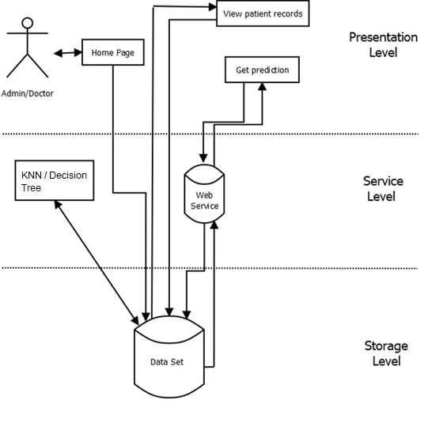
Chronic Kidney Disease Prediction and Prevention
System Architecture
May 08, 2019
Guide: Prof. Kakoli Bora
7
Notes:
7

Slide 8
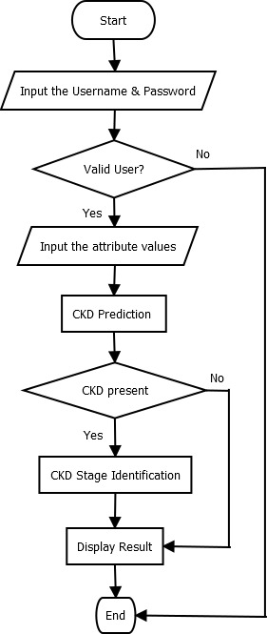
Chronic Kidney Disease Prediction and Prevention
Detailed design
To implement our project, we use the
Non Object- Oriented approach.
Flowchart:
May 08, 2019
Guide: Prof. Kakoli Bora
8
Notes:
8

Slide 9
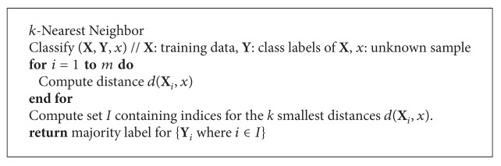
Chronic Kidney Disease Prediction and Prevention
Algorithm
KNN
May 08, 2019
Guide: Prof. Kakoli Bora
9
Notes:
9

Slide 10
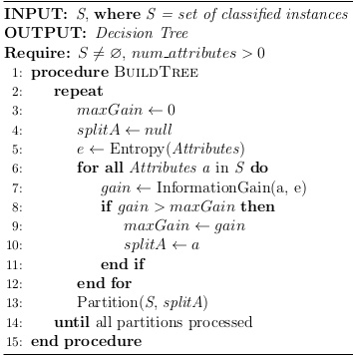
Chronic Kidney Disease Prediction and Prevention
Algorithm
Decision Tree
May 08, 2019
Guide: Prof. Kakoli Bora
10
Notes:
10

Slide 11
Chronic Kidney Disease Prediction and Prevention
The Development Environment
Programming Languages:
Python 3.6 (with external libraries)
Libraries: sklearn, pandas, numpy
Development Tools:
IDLE (IDE)
Algorithm:
KNN
Decision Tree
Web App:
Bootstrap
PHP
May 08, 2019
Guide: Prof. Kakoli Bora
11
Notes:
11

Slide 12
Chronic Kidney Disease Prediction and Prevention
Implementation
We develop a model using Naïve Bayes to predict the possibility of Chronic Kidney Disease being present or absent. Since the accuracy of this model is 55% which is not as high as necessary, we also develop a model using KNN, which has a higher accuracy of 95%.
We develop a model using Decision Tree to predict the stage when the disease is detected. This enables the user to gain in-depth knowledge about his/her disease. In addition, the user is provided with preventive measures based on the stage in which the disease exists in.
We also develop a Web App to serve as a User Interface. This eases the user’s experience (doctors) and makes it easier for him/her to identify whether the disease exists or not. If it exists, the user is provided with the stage it exists in along with preventive measures.
May 08, 2019
Guide: Prof. Kakoli Bora
12
Notes:
12

Slide 13
Chronic Kidney Disease Prediction and Prevention
Implementation
We obtained the 14 attributes from the 24 original attributes by obtaining a correlation matrix between all the attributes and then selecting the ones that had the highest value, thus making it more time efficient.
We ran the code with various split ratios ranging from 60:40 through 95:5. It was found that the 90:10 split yielded the best result.
In addition, we used various values of k and ran the code to find the most optimal value. This ranged from k=3 through k=13. We found that k=3 yielded the highest accuracy of 95%.
We tried various split ratios for the code that predicted the stage as well and found out that the 80:20 split yielded the highest accuracy of 93.75%.
May 08, 2019
Guide: Prof. Kakoli Bora
13
Notes:
13

Slide 14
Chronic Kidney Disease Prediction and Prevention
Testing and Validation Procedure
KNN
The dataset has been split in a 90:10 ratio to obtain the training and the testing datasets.
The expected values are then obtained from the testing dataset which are then compared with the predicted values, yielding an accuracy of 95%.
Decision Tree
The dataset has been split in a 80:20 ratio to obtain the training and testing datasets.
The expected values are then obtained from the testing dataset which are then compared with the predicted values, yielding an accuracy of 93.75%.
May 08, 2019
Guide: Prof. Kakoli Bora
14
Notes:
14

Slide 15
Chronic Kidney Disease Prediction and Prevention
Testing and Validation Procedure
The username and password entered are validated right after the user enters them. Incase they are not correct, an error is thrown up, requiring the user to enter the correct username and password.
In addition, if incorrect values are entered for the attributes, more specifically, if they are out of the bounds previously mentioned, an error is thrown up asking the user to enter correct values for the attributes.
May 08, 2019
Guide: Prof. Kakoli Bora
15
Notes:
15

Slide 16
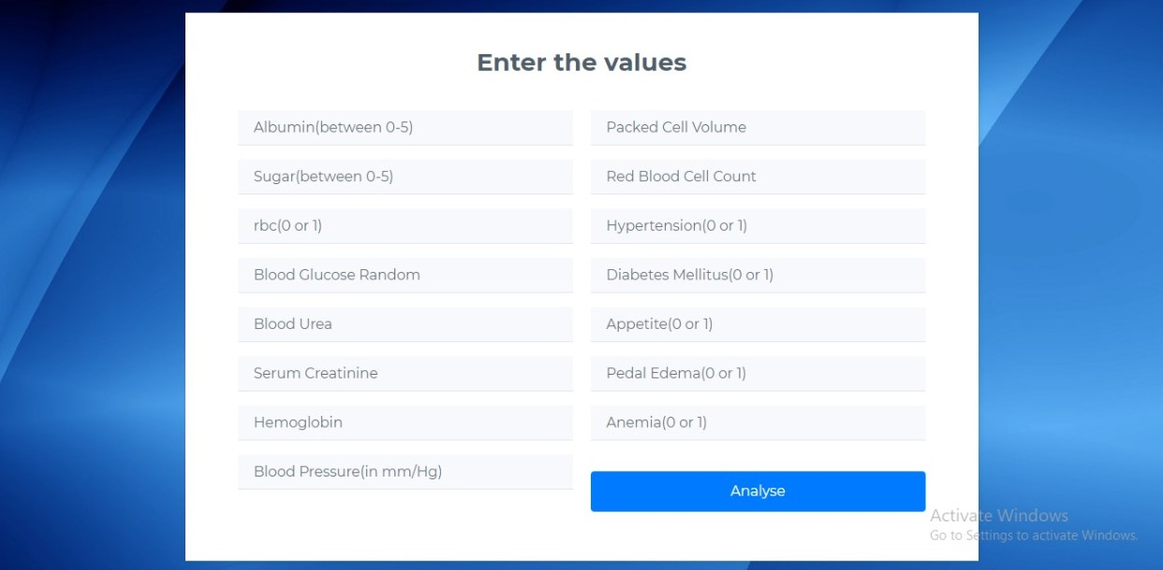
Chronic Kidney Disease Prediction and Prevention
Results
Fig.1 Page for user to enter values
May 08, 2019
Guide: Prof. Kakoli Bora
16
Notes:
16

Slide 17
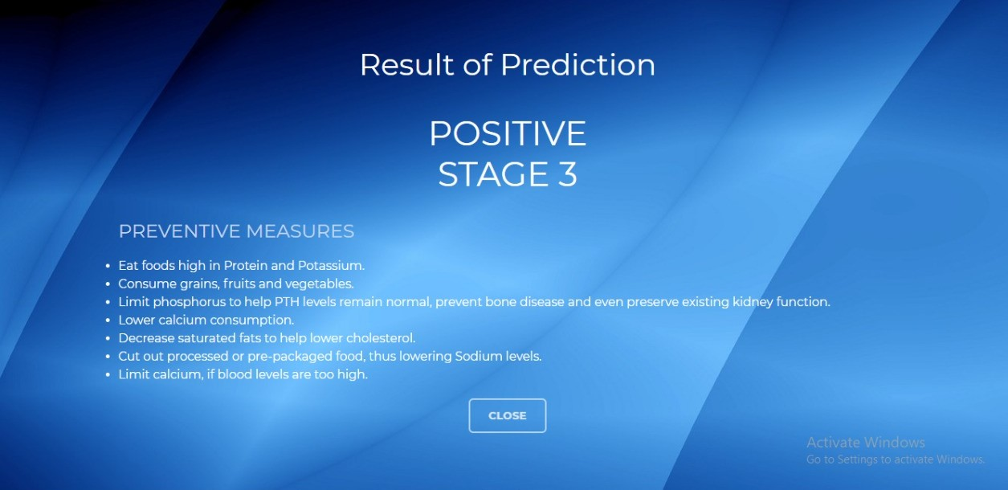
Chronic Kidney Disease Prediction and Prevention
Results
Fig.2 Page showing prediction of presence of CKD and its stage
May 08, 2019
Guide: Prof. Kakoli Bora
17
Notes:
17

Slide 18

Chronic Kidney Disease Prediction and Prevention
Results
Fig.3 Page showing prediction of absence of CKD
May 08, 2019
Guide: Prof. Kakoli Bora
18
Notes:
18

Slide 19
Chronic Kidney Disease Prediction and Prevention
Thank You
Notes:
19

