Slide 1
GENERATOR
DYNAMO
My presentation
amitabh

Slide 2
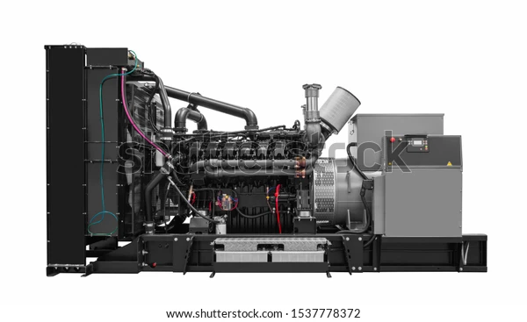
GENERATOR
Generator is a machine that converts mechanical energy into electrical energy . It works based one principle of faraday’s law of electromagnetic induction.

Slide 3
PARTS OF A GENERATOR
Frame :- shields electrical and moving parts. Keeps dirt and moisture out.
Rotating shaft :-connects to the engine motor or propellers in wind /water generators and spins the armature inside the stator.
Stator:- A stationary magnetic field with large copper windings .
Armature :- creates electromagnetic induction by spinning inside the stator of opposing magnetism.
Bearings :- Reduce friction caused by the rotation.
Field windings :-A coil that creates a magnetic field through which current flows.
Commutator:-A conductor through which electricity collects.
Brush Assembly:-Rubs against the commutator that sends electrical current out.

Slide 4
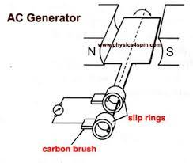
AC GENERATOR
An electrical generator is a device that converts mechanical energy to electrical energy .
Whenever the magnetic flux changes, an emf is induced in the coil.

Slide 5
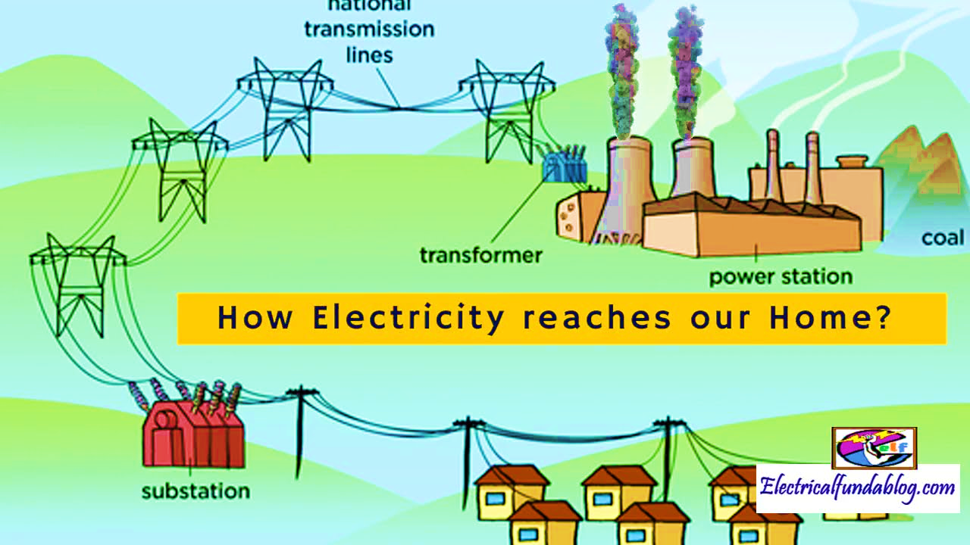
USE OF AC GENERATOR

Slide 6
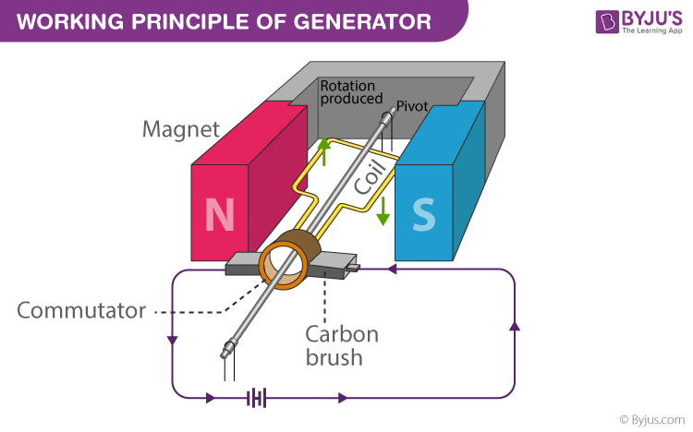
PRINCIPLE
It is based on the principle of electromagnetic induction.
EMF is induced in the coil due to rotation of the coil in the uniform magnetic field.
It concerts mechanical energy of the coil into electrical energy.

Slide 7
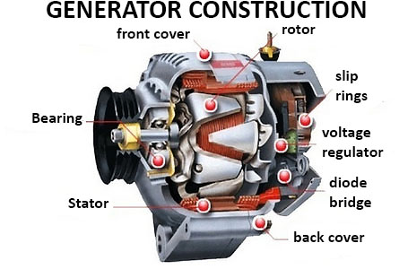
CONSTRUCTION OF GENERATOR
The field system may be composed of either permanent magnets (small generators) or electromagnets (in large generators ). Generally, the field system of a practical electric generator consists to poles on which the field coils are mounted,

Slide 8
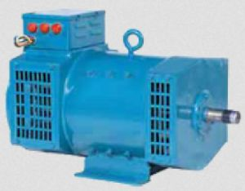
ADVANTAGE OF AC GENERATOR
These generator are generally maintance free because of absence of brushes .
Easily step – up and step down through transfers.
Transmission link size might be thinner because of step up feature .
Size of the generator relatively smaller than DC machine .
Losses are relatively less than DC machine .
These generator breakers are relatively smaller than DC breakers.

Slide 9
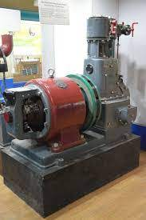
DC GENERATOR
A direct current (DC) generator is a rotating machine that supplies an electrical output with unidirectional voltage and current. The basic principles of operation are the same as those foe synchronous generators.

Slide 10
CLASSIFICATION OF DC GENERATORS
Dc generator are classified according to the their magnetic field as developed in the stator of the machine.
Permanent magnet DC generators.
Separately - excite DC generators and
Self – excite Dc generators.

Slide 11
ADVANTAGE OF DC GENERATOR
The output voltage can be smoothed by regularly organging the coils around the armature. This loads to less fluctuations which is desirable for some steady state applications.
No shielding need for radiation so cable cost will be less as compared to AC.
Mainly DC machine have the wide variety of operating characteristic which can be obtained by selection of the method of excitation of the field windings.

Slide 12
Thankyou
AMITABH

