Slide 1
Welcome to my presentation battery

Slide 2
TOPIC:-
WHAT IS BATTERY?
TYPES OF BATTERIES?
PARIMARY BATTERIES?
SECONDARY BATTERIES?

Slide 3
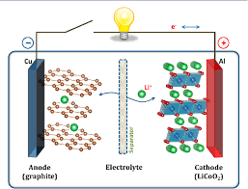
WHAT IS BATTERY?
A battery is collection of one or more cells that go under chemical reactions to crate the flow of electrons within a circuit.
Battery cells are usually made up of three main components;
1.The Anode (Negative Electrode)
2.The Cathode (Positive Electrode)
3.The electrolytes

Slide 4
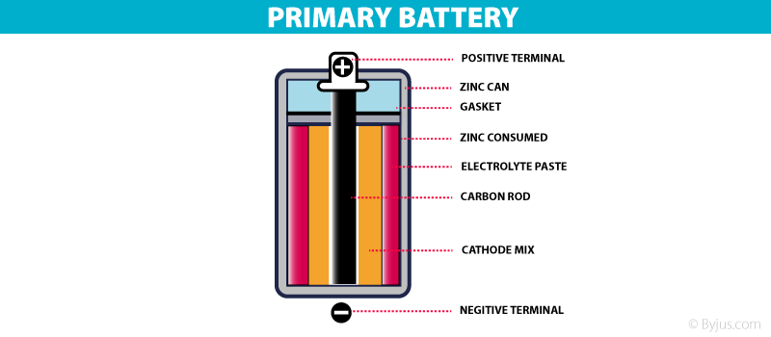
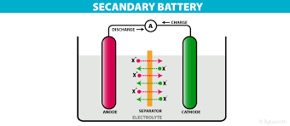
TYPES OF BATTERIES?
1. Primary Batteries 2.Secondary Batteries

Slide 5
PRIMARY BATTERIES?
Primary batteries are batteries that cannot be recharged once depleted.
Primary batteries are made of electrochemical cells whose electrochemical reaction cannot be reversed.
Primary batteries exist in different form ranging from coin cells to AA battery.
Primary batteries always have high specific energy and the system in which they are used are always designed to consume low amount of power to enable the battery last as long as possible.

Slide 6
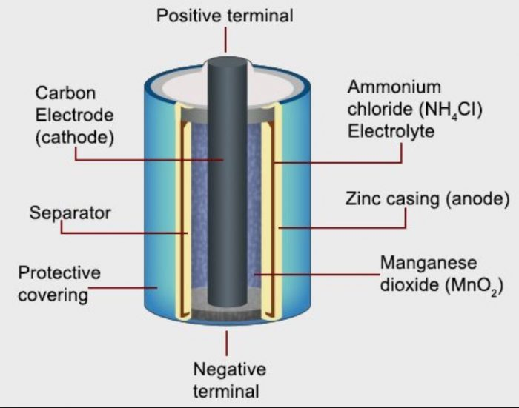
PRIMARY BATTERIES (DRY CELL):-

Slide 7
SECONDARY BATTERIES?
Secondary batteries are batteries with electrochemical cells whose chemical reactions can be reversed by applying a certain voltage to the battery in the reversed direction.
Also referred to as rechargeable batteries, secondary cells unlike primary cells can be recharged after the energy on the battery has been used up.
Small capacity secondary batteries are used to power portable electronic devices like mobile phones .

Slide 8
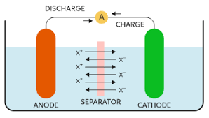
SECONDARY BATTERIES (RECHARGEABLE):-

Slide 9
Secondary batteries of type:-
Lithium-Ion Battery
Lithium Polymer Battery
Lead Acid Gel Battery
NiCd Battery
Nickel Metal Hydride Battery

Slide 10
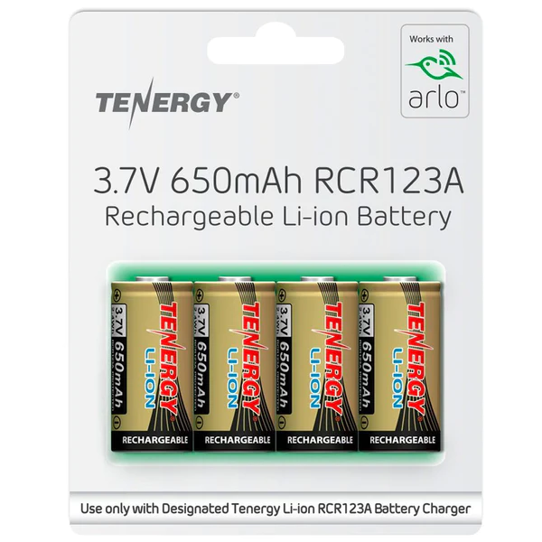
Lithium-Ion Battery
Lithium-ion batteries are the go-to power source for your portable devices. From cell phones and laptops, they charge quickly so you'll never have a dead battery when it's time to use them.

Slide 11
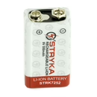
Lithium Polymer Battery
Lithium polymer batteries are less bulky than their lithium-ion counterparts because they use flexible packaging technology. This means that the battery can be thinner and lighter, which is especially helpful for portable electronics like smartphones.

Slide 12
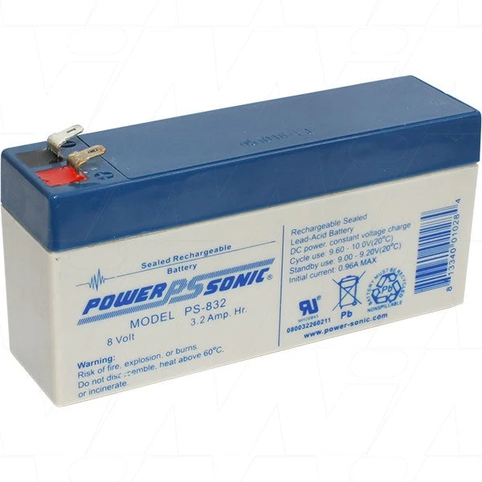
Lead Acid Gel Battery
Lead-acid gels are a type of VRLA ( valve-regulated lead acid) battery with an electrolyte made from sulfuric acid and fumed silica. These substances come together to form the gel that provides power in your vehicle.

Slide 13
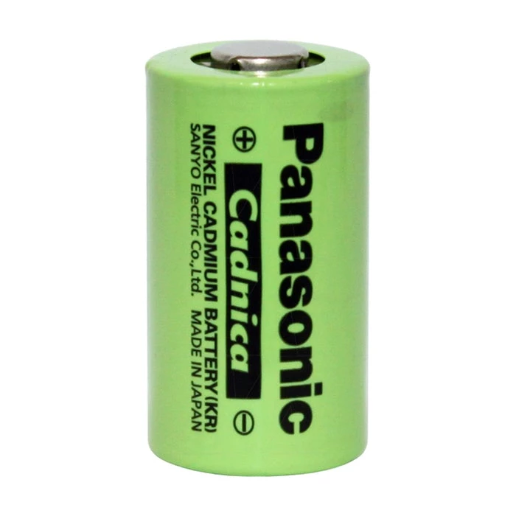
Nickel-Cadmium (NiCd) battery
Nickel-cadmium batteries offer a lot of advantages, including their durability. If you're looking for long-lasting power for your equipment then this is a type of battery that will work well with what you need.

Slide 14
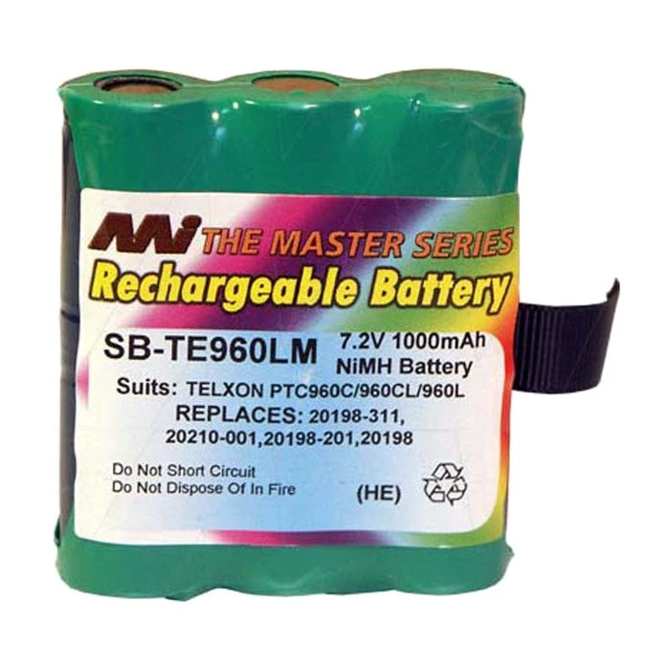
Nickel Metal Hydride Battery
Nickel metal hydride batteries are a fast-working and long-lasting power source. These types of rechargeable batteries can work tirelessly without breaking down or losing their charge quickly

