Slide 1
Content
introduction
Working
Primary battery
Secondary battery
Types of primary battery
Types of secondary battery
advantages
Some equipment use of battery
Use of hydrometer

Slide 2

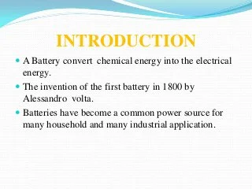

Slide 3
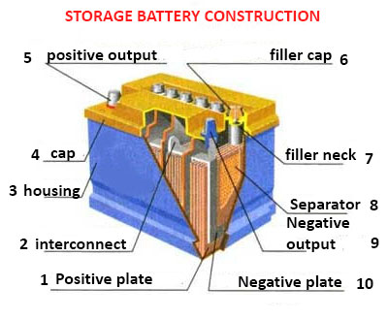

Slide 4
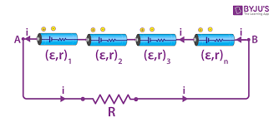
Combination of cells is called battery .

Slide 5
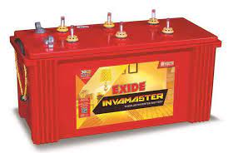
BATTERY
A battery is a device that converts chemical energy contained within its active materials directly into electric energy by means of an electrochemical ...

Slide 6
Working
. A battery is a device that stores chemical energy and converts it to electrical energy. The chemical reactions in a battery involve the flow of electrons from one material (electrode) to another, through an external circuit. The flow of electrons provides an electric current that can be used to do work.

Slide 7
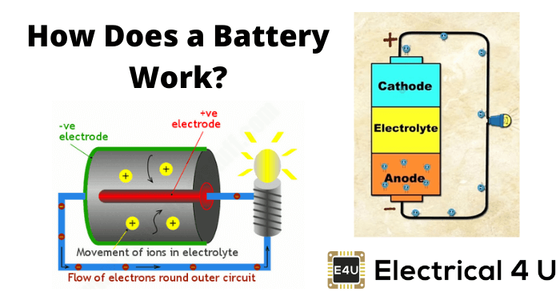

Slide 8
PRIMARY BATTERY
Primary batteries are single-use galvanic cells that store electricity for convenient usage, usually showing a good shelf life. Examples are zinc–carbon ( ...

Slide 9
SECONDARY battery
The storage battery, secondary battery, or charge accumulator is a cell or combination of cells in which the cell reactions are reversible. This means that the ...

Slide 10
Types of secondary batteries
Lead – Acid Batteries.
Nickel – Cadmium Batteries.
Nickel – Metal Hydride Batteries.
Lithium – Ion Batteries.

Slide 11
Types of primary batteries
Alkaline Batteries.
Lead-acid Batteries.
Ni-Cd Battery.
Ni-MH Battery.
Li-Po battery.

Slide 12
ADVANTAGES
Used as both battery and capacitor
It is flexible .
It is ultra thin energy storage device
Long lasting.
Not toxic
Steady power production.

Slide 13

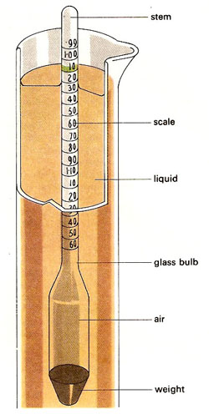
HAYDROMETER
The specific gravity, SG, of the electrolyte in each cell of a battery shows the battery's state of charge: Fully charged, SG = 1.280.
Half charged, SG = 1.200,
Discharged, SG = 1.120.

Slide 14

equipment

Slide 15
Thankyou

