Slide 1
Movie Recommendation System
Tejul
Shivangi
Shraddha
Geethanjali

Slide 2
Table of Contents
01
02
Introduction
Objective
03
04
Datasets
Implementation
05
06
Results
Conclusion

Slide 3
Introduction
Recommender Systems are ubiquitous in the digital world. with a myriad of recommended suggestions, from “items you may also like to purchase”, “movies you may want to watch”, etc.
Reinforcement learning (RL) is a form of machine learning whereby an agent takes actions in an environment to maximize a given objective (a reward) over this sequence of steps.
The purpose of this project is to experiment with the application of deep reinforcement learning to recommendation systems.

Slide 4
02
Objective

Slide 5
Problem Statement
The goal of the agent is to predict what rating a user will give to a given movie.
In this project, we develop a software that keeps record of the movies and helps the user to choose according to their requirements.

Slide 6
Understanding the Problem
Environment
Agent
Rewards
OpenAI Gym compatible environment
Proximal Policy Optimization [PPO2 algorithm]
when the predicted user rating is the same as the actual user rating.
Movie rating by users
The problem is defined as a Partially observable Markov decision process (POMDP).

Slide 7
Understanding the Problem
Action
Policy
State
Response of an agent given a policy output.
Movies available for recommendation
Maps from an observation to an action
Characterization of the environment state.
User vectors

Slide 8
03
Dataset

Slide 9
MovieLens dataset has
100,000 ratings from 943 users on 1,682 movies.
Each of them is related to ratings given by users to a collection of movies.
Constraint - Each of these users has rated at least 20 movies.
It also contains movie metadata and user profiles.

Slide 10
04
Implementation

Slide 11
Environment
The simulator is set up as a Partially observable Markov decision process (POMDP) problem, using OpenAI's Gym framework as the base class.
The reward scheme is based on prediction accuracy:
Reward = 1; y_hat = y
ln(1 - |y_hat-y|/5); y_hat != y
The observation is based on derived features from the MovieLens data set:
user_mean: Average rating given by a specific user_id
movie_mean: Average rating for a specific movie_id
movie_genre_bucket: One-hot of the movie type
age_bucket: One-hot of user's age range
occupation_bucket: One-hot of the user's job
gender_bucket: One-hot of the user's gender (only M or F)

Slide 12
Agent
Proximal Policy Optimization (PPO) is a policy gradient method for reinforcement learning. The motivation was to have an algorithm with the data efficiency and reliable performance of TRPO, while using only first-order optimization.
OpenAI released a GPU-enabled implementation of PPO, called PPO2. This runs approximately 3X faster than the current PPO baseline on Atari.

Slide 13
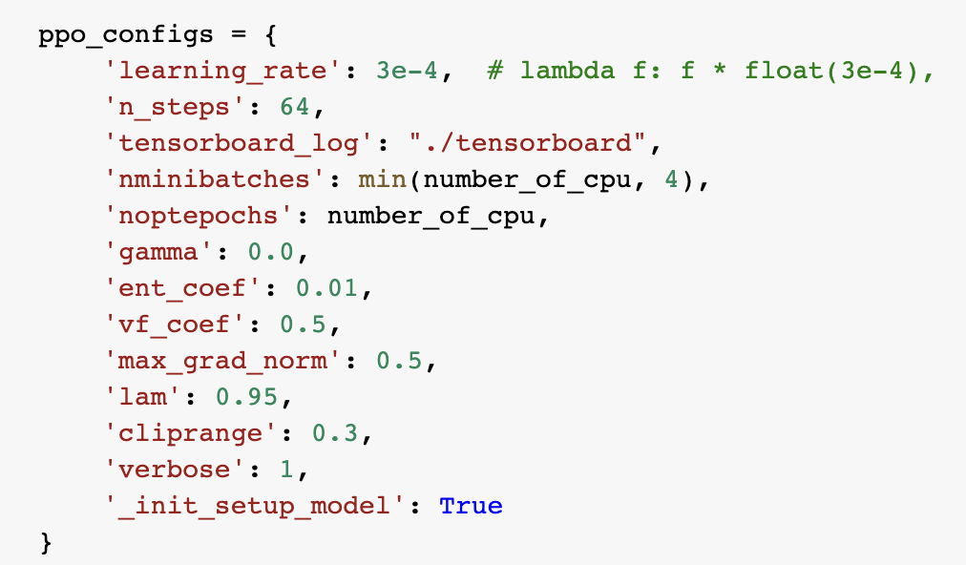
Model Config
The PPO2 algorithm is provided a default Multi-Layered Perceptron algorithm along with the environment defined by OpenAI and the model configurations defined in the ppo_configs dictionary.

Slide 14
Results

Slide 15
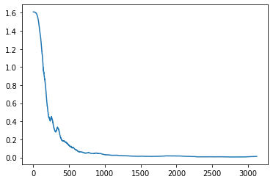
Results
Original Model:
total_correct_predictions | total_rewards
6115 | -75716.29

Slide 16
Results
Decreasing Learning Rate (1e-5):
total_correct_predictions | total_rewards
6113 | -75717.64
Increasing Learning Rate (1e-1):
total_correct_predictions | total_rewards
6117 | -75711.36

Slide 17
Conclusion

Slide 18
We are able to train a new class of reinforcement learning algorithms, Proximal Policy Optimization (PPO2).
Movie Recommendation System is a classic ML problem which we have achieved to solve using Reinforcement Learning, attempting to assess if an agent is able to learn human perception and choice.
Lastly, we see that fine-tuning of learning rate does not provide drastic change in the final results obtained, thus indicating that an RL algorithm is not solely driven by a learning rate.

Slide 19
Thank You!

