Slide 1

-- Gaurav Sonkar, Bharath Kumar, Devi Surya Kumari

Slide 2
What is Software Defined Storage (SDS) ?
Fancy name for Storage Virtualization
All the intelligence is built into software
Commodity Hardware

Slide 3
What are different storage options ?
BLOCK STORAGE
FILE STORAGE
OBJECT STORAGE
Physical storage media appears to computers as a series of sequential blocks of a uniform size.
File systems allow users to organize data stored in blocks using hierarchical folders and files.
Object stores distribute data algorithmically throughout a cluster of media, without a rigid structure.

Slide 4
Ceph
Introduction & Architecture

Slide 5
What is Ceph?
Open Source Software Defined Storage
Unified Storage Platform ( Block , Object and File Storage )
Runs on Commodity Hardware
Self Managing, Self Healing
Massively Scalable
No Single Point of failure
Designed for cloud infrastructure and emerging workloads

Slide 6
Ceph Storage Cluster
Clients
Unified Storage Solution
Object Storage
Block Storage
File Storage
Distributed Storage
Ceph Storage Cluster
Ceph SDS
Ceph
Ceph
Ceph
...
Ceph
Linux OS
Linux OS
Linux OS
Linux OS
...
Linux OS
CPU
Memory
HDDs
SSD
Network
CPU
Memory
HDD
SSD
Network
CPU
Memory
HDD
SSD
Network
...
CPU
Memory
HDD
SSD
Network
Commodity Hardware
SERVER 1
SERVER 2
SERVER 3
SERVER N

Slide 7

Ceph Architecture
APP
HOST/VM
RGW
A web services gateway for object storage, compatible with S3 and Swift
RBD
A reliable, fully distributed block device with cloud platform integration
CephFS
A distributed file system with POSIX
semantics & scale-out metadata
LIBRADOS
A library allowing apps to directly access RADOS (C, C++, Java, Python, Ruby
RADOS
A software-based reliable, autonomous, distributed object store comprised of self-healing, self-managing, intelligent storage nodes and lightweight monitors

Slide 8
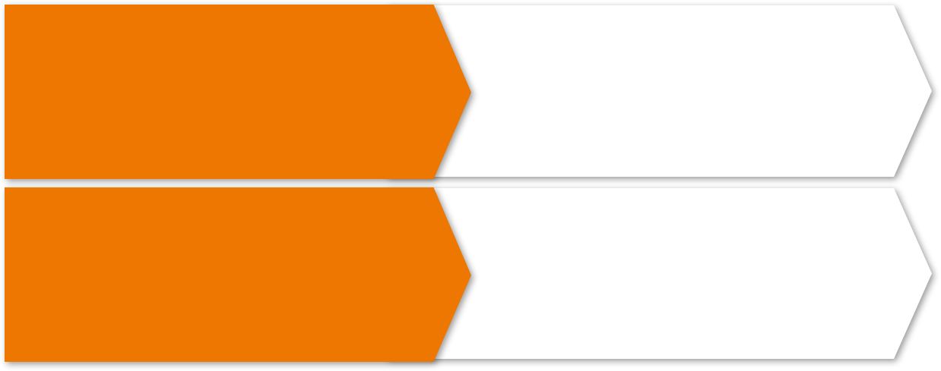
Ceph Components
OSDs (Object Storage Daemon)
10s to 10000s in a cluster
Typically one daemon per physical HDD
Serve stored data to clients
Intelligently peer for replication & recovery
Monitors
Maintain cluster membership and state
Provide consensus for distributed decision-making
Small, odd number
Do not store data

Slide 9
RADOS Cluster a.k.a Ceph Cluster
APPLICATION
RADOS CLUSTER

Slide 10
How data is stored in Ceph
APPLICATION
OBJECTS
LIBRADOS
CRUSH ALGORITHM

Slide 11
Ceph Access Methods

Slide 12
Librados : Native Cluster Access
APP
APP
HOST/VM
RGW
A web services gateway for object storage, compatible with S3 and Swift
RBD
A reliable, fully distributed block device with cloud platform integration
CephFS
A distributed file system with POSIX
semantics & scale-out metadata
LIBRADOS
A library allowing apps to directly access RADOS (C, C++, Java, Python, Ruby)
RADOS
A software-based reliable, autonomous, distributed object store comprised of self-healing, self-managing, intelligent storage nodes and lightweight monitors

Slide 13
Librados : Base Access Layer
APP
HOST/VM
RGW
A web services gateway for object storage, compatible with S3 and Swift
RBD
A reliable, fully distributed block device with cloud platform integration
CephFS
A distributed file system with POSIX
semantics & scale-out metadata
LIBRADOS
A library allowing apps to directly access RADOS (C, C++, Java, Python, Ruby)
RADOS
A software-based reliable, autonomous, distributed object store comprised of self-healing, self-managing, intelligent storage nodes and lightweight monitors

Slide 14
RBD : Block Storage Access
APP
HOST/VM
RGW
A web services gateway for object storage, compatible with S3 and Swift
RBD
A reliable, fully distributed block device with cloud platform integration
CephFS
A distributed file system with POSIX
semantics & scale-out metadata
LIBRADOS
A library allowing apps to directly access RADOS (C, C++, Java, Python, Ruby)
RADOS
A software-based reliable, autonomous, distributed object store comprised of self-healing, self-managing, intelligent storage nodes and lightweight monitors

Slide 15
RBD : Separating Compute from Storage
HYPERVISOR
VM
HYPERVISOR
LIBRBD
LIBRBD
RADOS CLUSTER

Slide 16
Ceph Rados Gateway : Object Storage Access
APP
HOST/VM
RGW
A web services gateway for object storage, compatible with S3 and Swift
RBD
A reliable, fully distributed block device with cloud platform integration
CephFS
A distributed file system with POSIX
semantics & scale-out metadata
LIBRADOS
A library allowing apps to directly access RADOS (C, C++, Java, Python, Ruby)
RADOS
A software-based reliable, autonomous, distributed object store comprised of self-healing, self-managing, intelligent storage nodes and lightweight monitors

Slide 17
Ceph Rados Gateway : Object Storage Access
REST
RADOSGW
RADOSGW
LIBRADOS
LIBRADOS
Socket
CEPH CLUSTER

Slide 18
CephFS : File Storage
APP
HOST/VM
RGW
A web services gateway for object storage, compatible with S3 and Swift
RBD
A reliable, fully distributed block device with cloud platform integration
CephFS
A distributed file system with POSIX
semantics & scale-out metadata
LIBRADOS
A library allowing apps to directly access RADOS (C, C++, Java, Python, Ruby)
RADOS
A software-based reliable, autonomous, distributed object store comprised of self-healing, self-managing, intelligent storage nodes and lightweight monitors

Slide 19

CephFS : File Storage
Linux Host
LIBCEPHFS
CEPH CLUSTER

Slide 20
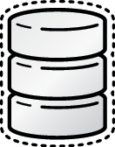






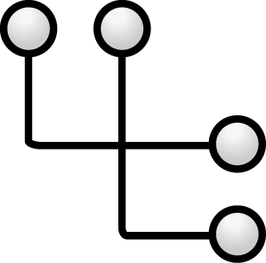
Ceph-The complete storage solution for OpenStack
GLANCE
SWIFT
NOVA
CINDER
MANILA
STORE
GET
PUT
...
BOOT
BLOCK DEVICE
MOUNT
INSTANCE IMAGE
SWIFT OBJECT
BOOT IMAGE
BLOCK STORAGE
FILE SHARE
LIBRBD
RADOSGW
LIBRBD
LIBRBD
CEPHFS

