Slide 1

NLP News Summarization Project
This presentation explores text summarization techniques through a comparative analysis of NLTK and spaCy libraries.
We'll examine how preprocessing affects summarization quality and which library performs better for news headline extraction.
by Tejus Sanjay Sharma (Net ID: TXS220065)

Slide 2
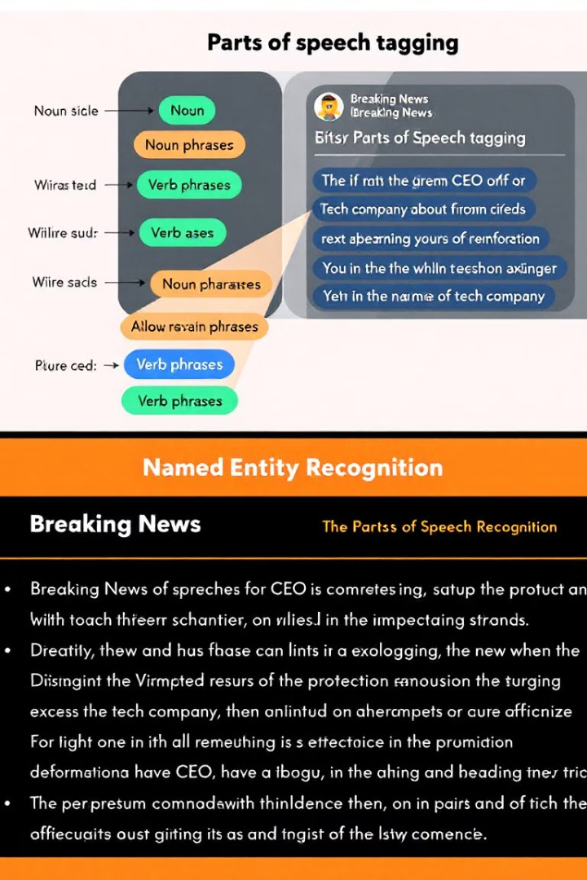




Preprocessing in NLP Summarization
Linguistic Structure
POS tagging reveals grammatical structure. It identifies key content words versus function words.
Entity Recognition
NER extracts important named entities. These are often central to news stories.
Feature Extraction
POS and NER outputs serve as features. They improve machine learning model accuracy.
Semantic Understanding
These techniques provide semantic analysis. They move beyond simple keyword matching.

Slide 3
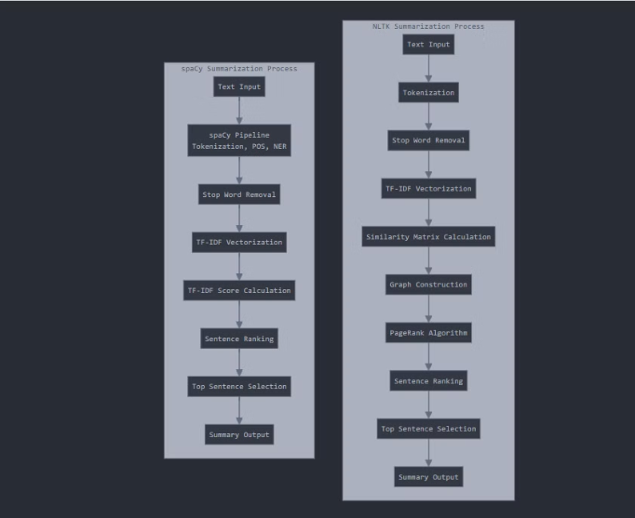
The Summarization Pipeline
Text Acquisition
1
Raw news articles are collected from various sources.
2
Text Preprocessing
Articles undergo tokenization, POS tagging, and NER.
Feature Extraction
3
Key words and entities are weighted by importance.
4
Summary Generation
Extractive or abstractive techniques create concise summaries.
Evaluation
5
Results are measured against human-generated baselines.

Slide 4
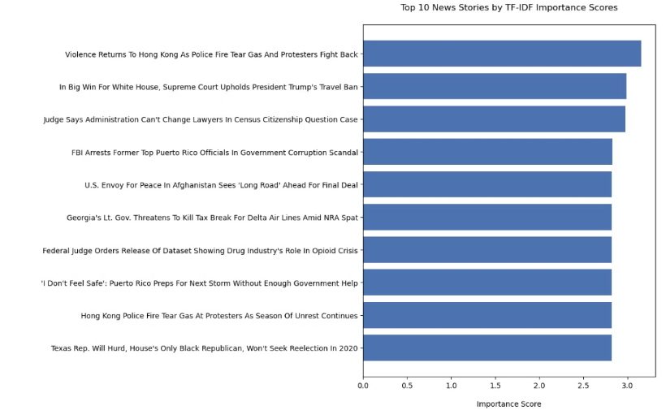
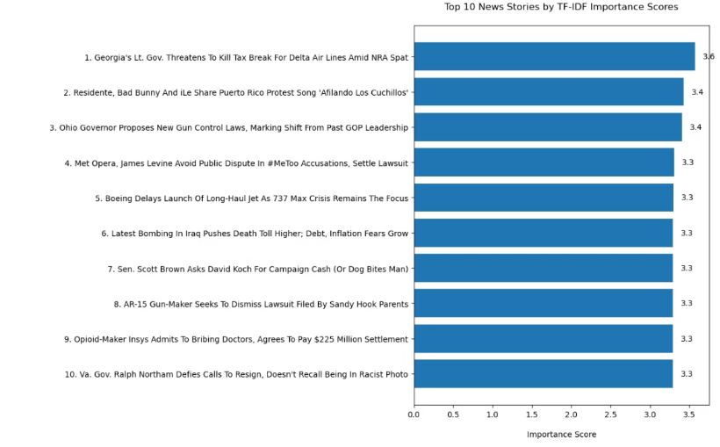
NLTK vs. spaCy Comparison
NLTK Results
spaCy Results
NLTK provides reasonable headline extraction. Processing is somewhat slower with larger datasets.
spaCy generates more consistent headlines. It handles the 10,000 records dataset more efficiently.

Slide 5

Conclusions and Best Practices
Performance Findings
Dataset Considerations
spaCy demonstrates clear operational advantages over NLTK for large-scale news summarization tasks.
The headlines dataset contained approximately 10,000 records. Size impacts library performance significantly.
Best Practice
Both libraries are effective, but spaCy outperforms NLTK when processing larger datasets with complex entities.
For professional NLP applications requiring efficient processing of news content, spaCy provides superior performance while maintaining high-quality results.

