Slide 1


BEFORE CORRECTION

Slide 2

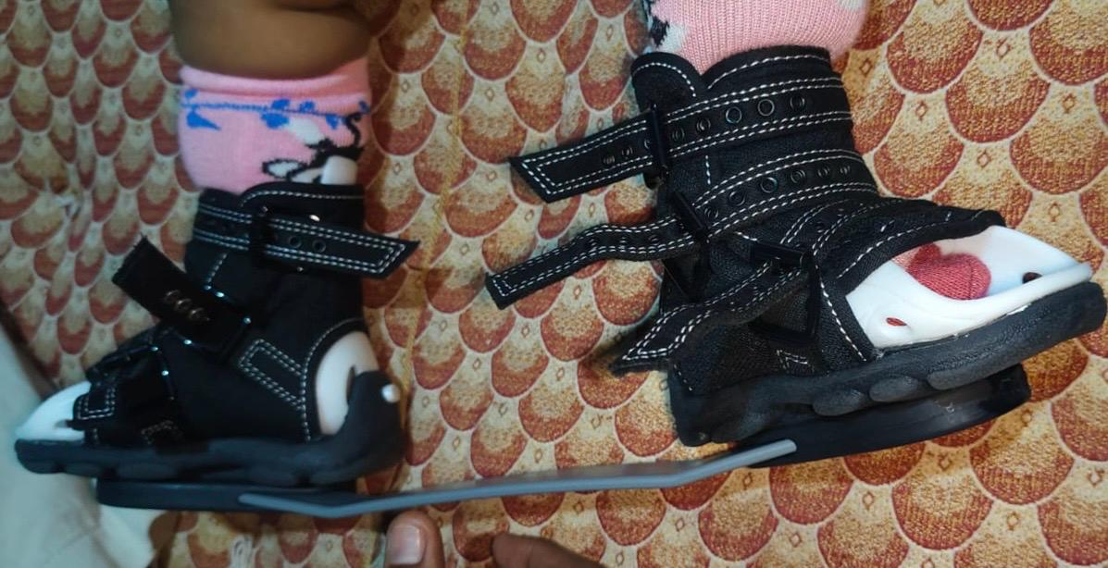
SERIAL CASTING AND DB SPLINT

Slide 3

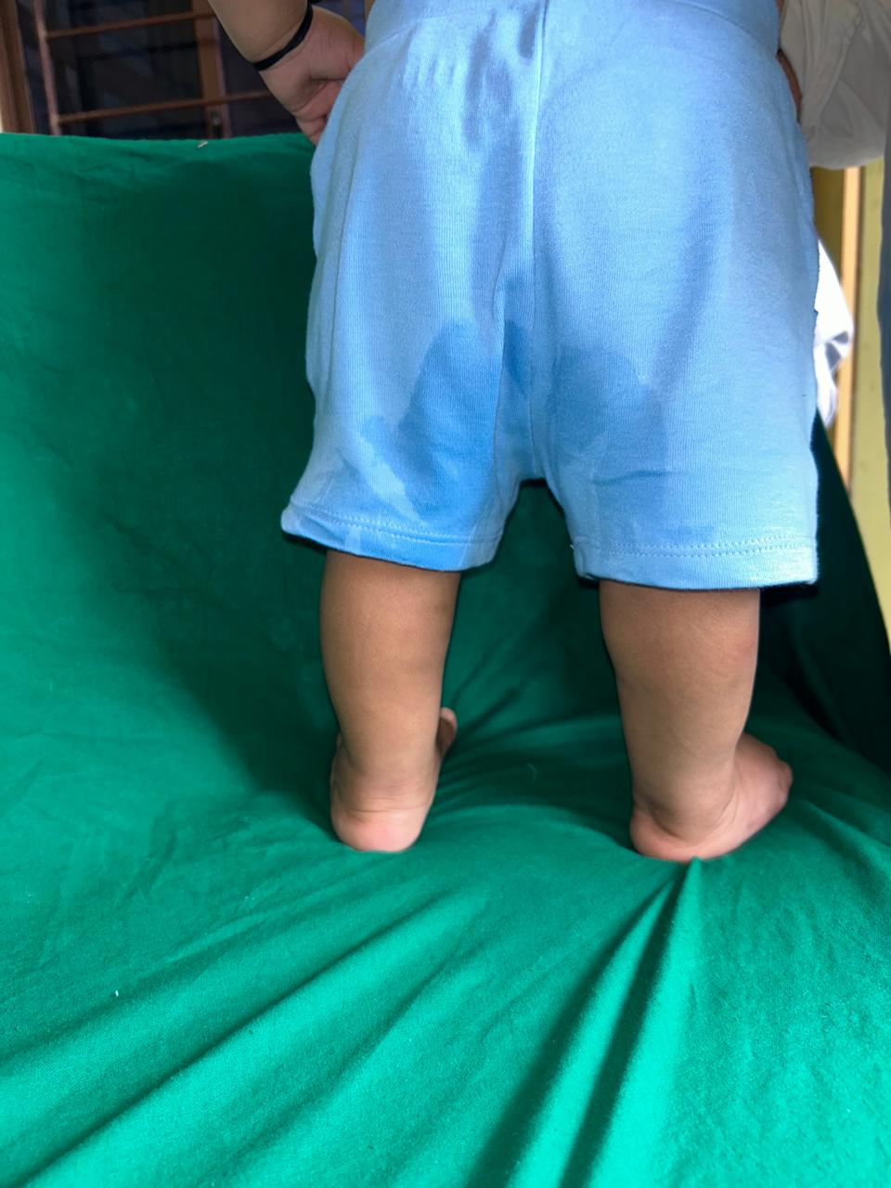
AFTER CORRECTION

