Slide 1

OPTIMIZING SALESMAN ROUTES FOR NATIONWIDE DISTRIBUTION USING TSP
COURSE CODE:
CSA0697-DESIGN ANALYSIS AND ALGORITHM
COURSE INCHARGE:
DR.Gnana Soundari
Dept of Machine Learning
Presented By:
G.Tejaswi
Reg.No:192211748
Dept of Computer Science Engineering

Slide 2
ABSTRACT
Traveling Salesman Problem (TSP):
Finding the shortest route to visit all cities once and return to the start.
Relevance for Nationwide Distribution:
Optimizes delivery routes to improve efficiency.
Benefits:
Enhanced Efficiency: Streamlined operations and better scheduling.
Competitive Advantage: Faster, more reliable deliveries.
Cost Reduction: Lower transportation and operational costs.
Improved Planning: Better data for future growth.
Customer Loyalty: Increased satisfaction and repeat business.
Outcome:
Achieves cost savings, operational effectiveness, and improved customer
service.

Slide 3
INTRODUCTION
Problem Overview:
The Traveling Salesman Problem (TSP) involves finding the shortest route to visit several cities and return to the starting point.
In nationwide distribution, TSP helps optimize delivery routes, reducing the total distance traveled.
Why Route Optimization Matters:
Efficient routes lower costs, shorten delivery times, and improve overall operational efficiency.
Importance for the Company:
Cost Savings: Less fuel and maintenance costs.
Faster Deliveries: Improved customer satisfaction.
Better Fuel Efficiency: Lower environmental impact.
Optimized Resources: Use fewer vehicles and personnel effectively.

Slide 4
REQUIREMENTS
Functional Requirements:
Develop an algorithm for optimizing routes.
Calculate costs for each route segment.
Create a user-friendly interface.
Support data import/export for cities and distances.
Generate reports on routes and costs.
Non-Functional Requirements:
Ensure algorithm efficiency for different data sizes.
Design for scalability.
Ensure usability and intuitive design.
Build a reliable system with error handling.

Slide 5
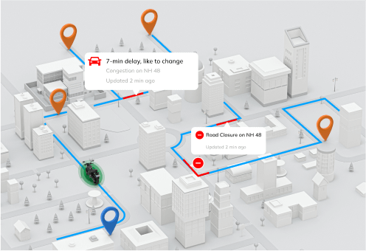
SCOPE
In-Scope:
Implement TSP algorithms.
Integrate the algorithm with a user interface.
Develop data management features.
Include reporting tools.
Out-of-Scope:
Real-time traffic integration.
Advanced customization (e.g., vehicle types).
Mobile application development.
Deliverables:
Functional TSP algorithm.
User interface for route management.
Data management tools.
Reports on optimization results.

Slide 6
PROBLEM OVERVIEW-Traveling Salesman Problem
Content:
One-line definition:
"TSP is about finding the shortest route to visit multiple cities and return to the starting point."
Visual:
A simple map with points representing cities and a path showing the route connecting them.
Importance:
Optimizes delivery routes in logistics and distribution.
Reduces travel time and costs, improving efficiency for companies.

Slide 7
PROBLEM FORMULATION
Graph Representation:
Cities as Nodes:
Each city is a node (point) on the graph.
Routes as Edges:
The paths between cities are represented as edges (lines) connecting the nodes.
Costs on Edges:
Each edge has a cost (distance, time, or fuel) associated with traveling that route.
Objective:
Visit Every City Once:
The goal is to visit each node (city) exactly once.
Minimize Total Travel Cost:
Find the route with the lowest total cost (distance or other metrics).
Return to Start:
After visiting all cities, the salesman must return to the starting city.
Visual Example:
Show a simple diagram of a graph with 5 cities (nodes) and distances (costs) between them (edges).

Slide 8
RELEVANCE TO NATONWIDE DISTRIBUTION
Content:
Minimize Travel Distance and Time.
Reduce Fuel Costs and Vehicle Wear.
Ensure Timely Deliveries for improved customer satisfaction.
Visual:
Show a before-and-after route map:
Before: A long, inefficient route.
After: An optimized, shorter route.

Slide 9
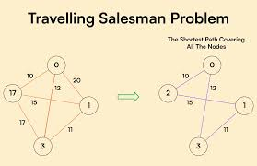
BENEFITS OF ROUTE OPTIMIZATION
Content:
Cost Savings:
Reduce fuel and vehicle maintenance costs.
Faster Deliveries:
Improve customer satisfaction with quicker deliveries.
Fuel Efficiency:
Lower environmental impact by using less fuel.
Resource Management:
Use fewer vehicles and drivers efficiently.
Visual:
Use icons for:
Cost savings (e.g., a money symbol).
Fast delivery (e.g., a delivery truck or clock).
Fuel efficiency (e.g., a fuel pump or leaf).
Resource optimization (e.g., a fleet of trucks).

Slide 10
PERFORMANCE MONITORING
Define Metrics: Identify Key Performance Indicators KPIs (e.g., runtime, accuracy).
Set Baselines: Establish performance benchmarks.
Implement Tools: Use software to track metrics.
Collect Data: Gather performance data regularly.
Analyze: Review data to spot trends and issues.
Optimize: Improve system based on analysis.
Report: Document findings and improvements.
Iterate: Continuously monitor and adjust as needed.
4o mini

Slide 11
TSP MATTERS
Content :
Lower Operational Costs:
Save on fuel, maintenance, and labor.
Better Customer Service:
Faster, more reliable deliveries for happier customers.
Sustainable and Scalable:
More efficient routes mean better resource management and growth potential.
Visual:
Use a pie chart or bar graph to show the breakdown of benefits:
Cost savings
Improved customer service
Sustainability and scalability benefits.

Slide 12
CONCLUSION
Optimize Routes:
TSP helps find the shortest and most efficient delivery routes.
Save Costs:
Reduces fuel and transportation expenses.
Enhance Efficiency:
Streamlines scheduling and resource use.
Boost Customer Satisfaction:
Ensures faster and more reliable deliveries.
Prepare for Growth:
Scalable solutions ready for future expansion.
Using TSP leads to significant savings, better service, and a competitive edge.

Slide 13


