Slide 1

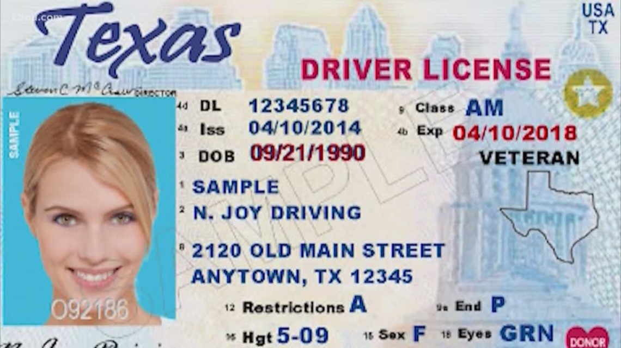
Business Use Case

Slide 2
How do our brains work?
Our brains depend on detecting features and they categorize the objects we see accordingly.
What happens there is that your brain detects the object for the first time, but because the look was brief, your brain does not get to process enough of the object's features so as to categorize it correctly.

Slide 3
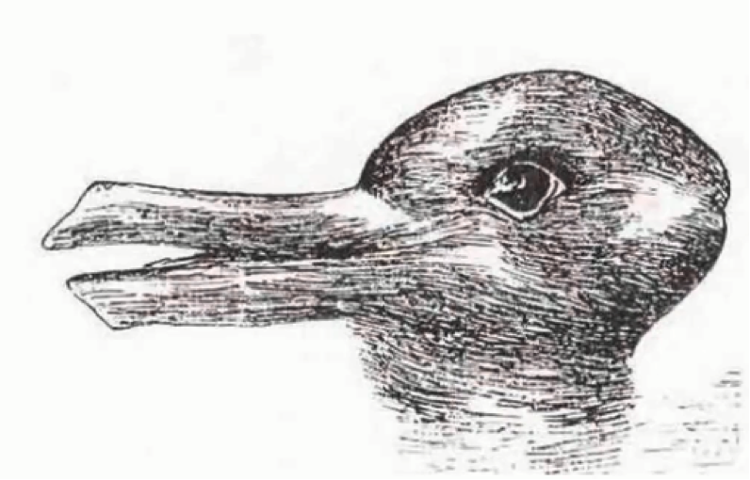
Do you see a rabbit or a duck?
That's enough with the games. The point to be made here is that your brain classifies objects in an image based on the features that it detects first.
As we proceed in our section on convolutional neural networks, you will realize the staggering degree of similarity between how these networks operate and how your brain does. They, too, categorize objects or images based on the set of features that are passed through them and that they manage to detect.

Slide 4
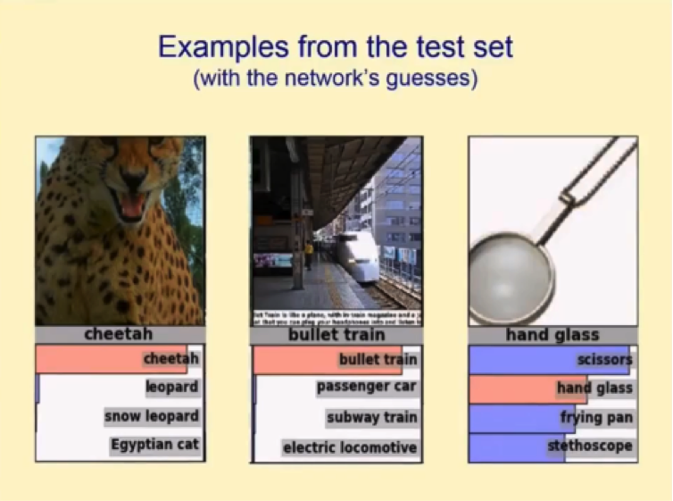
It's worth noting that the four categories that show up on this guess list are far from being the only categories that the network gets to choose from.
It usually has to sift through hundreds, or more likely thousands, of categories until it shortlists the ones you see in the image above, which it then ranks according to their probability of being the right category for the presented image.

Slide 5
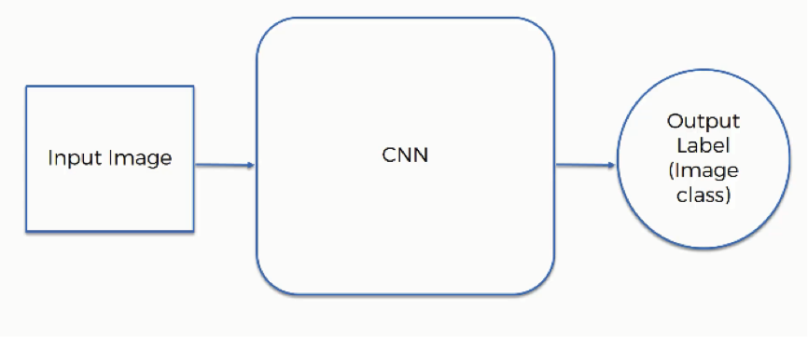
Why Convolutional Neural Networks Are So Important
To understand this, you can ask yourself a couple of simple questions:
How do self-driving cars recognize other cars as well as pedestrians and street objects?
How did Facebook go from making you tag people in images yourself, to being able to identify your friends and automatically tag them as it does now?
And the answer to both questions would be: through the magic of convolutional neural networks.
So, how do convolutional neural networks actually operate?
The first thing you need to know here is the elements that are included in the operation:
Input image
Convolutional Neural Network
Output label (image class)

Slide 6
Types of image
Both types of images are similar in the following respects:
Each pixel contains 8 bits (1 byte) of information.
Colors are represented on a scale from 0 to 255. The reason for this is that bits are binary units, and since we have 8 of these per byte, a byte can have any of 256 (2^8) possible values. Since we count 0 as the first possible value, we can go up to 255.
In this model, 0 is pitch black and 255 is pure white, and in between are the various (definitely more than 50!) shades of gray.
The network does not actually learn colors. Since computers understand nothing but 1's and 0's, the colors' numerical values are represented to the network in binary terms.
Each pixel inside a colored image is represented on three levels. Since any color is a combination of red, green, and blue at different levels of concentration, a single pixel in a colored image is assigned a separate value for each of these layers.
That means that the red layer is represented with a number between 0 and 255, and so are the blue and the green layers. They are then presented in an RGB format. For example, a "hot pink" pixel would be presented to the neural network as (255, 105, 180)

Slide 7
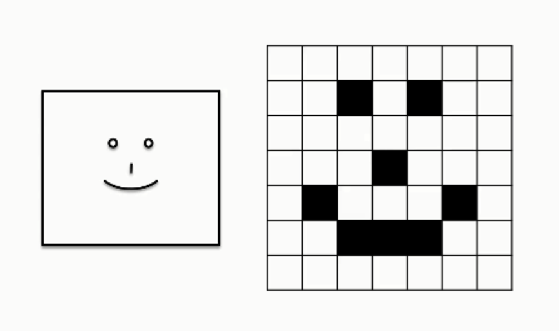
Detecting Facial Expressions
Let's look at a case in which a convolutional neural network is asked to read a human smile. For the purpose of simplification, the following figure shows an extremely basic depiction of a human (loosely speaking, of course) smile.

Slide 8
The steps that go into this process are broken down as follows:
Step 1: Convolution
Step 1: Activation Functions
Step 2: Pooling
Step 3: Flattening
Step 4: Full Connection
CNNs have two components:
The Hidden layers/Feature extraction part
The Classification part

Slide 9
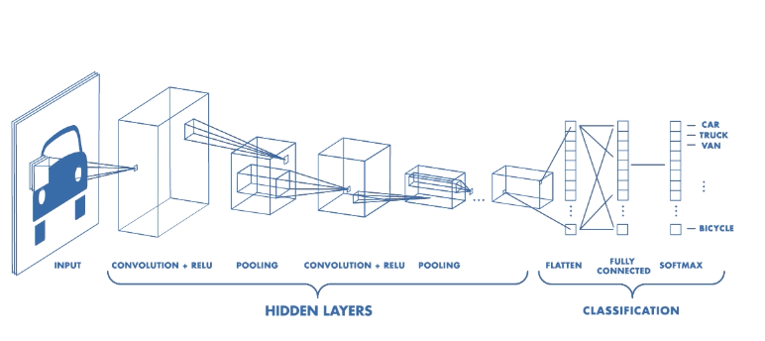
Architecture of a CNN

Slide 10
Feature extraction
Convolution is one of the main building blocks of a CNN. The term convolution refers to the mathematical combination of two functions to produce a third function. It merges two sets of information.
In the case of a CNN, the convolution is performed on the input data with the use of a filter or kernel (these terms are used interchangeably) to then produce a feature map.
We execute a convolution by sliding the filter over the input. At every location, a matrix multiplication is performed and sums the result onto the feature map.
In the animation below, you can see the convolution operation. You can see the filter (the green square) is sliding over our input (the blue square) and the sum of the convolution goes into the feature map (the red square).
The area of our filter is also called the receptive field, named after the neuron cells! The size of this filter is 3x3.

Slide 12
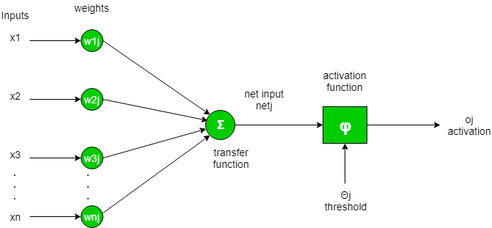
Activation Function
To put in simple terms, an artificial neuron calculates the ‘weighted sum’ of its inputs and adds a bias, as shown in the figure below by the net input.

Slide 13
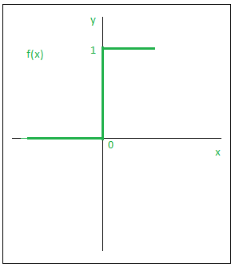
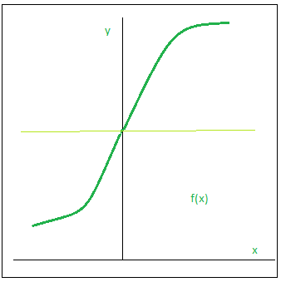
Types of Activation Functions –
Step Function:
Sigmoid Function :

Slide 14
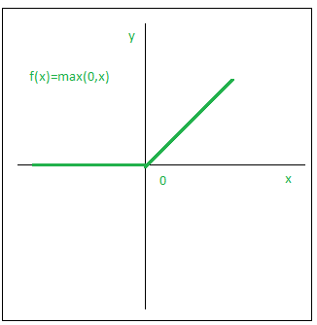
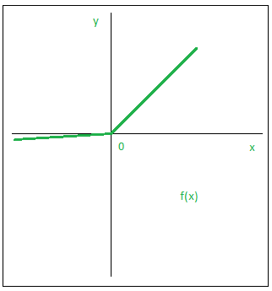
3) Relu:
4) Leaky ReLU:

Slide 15
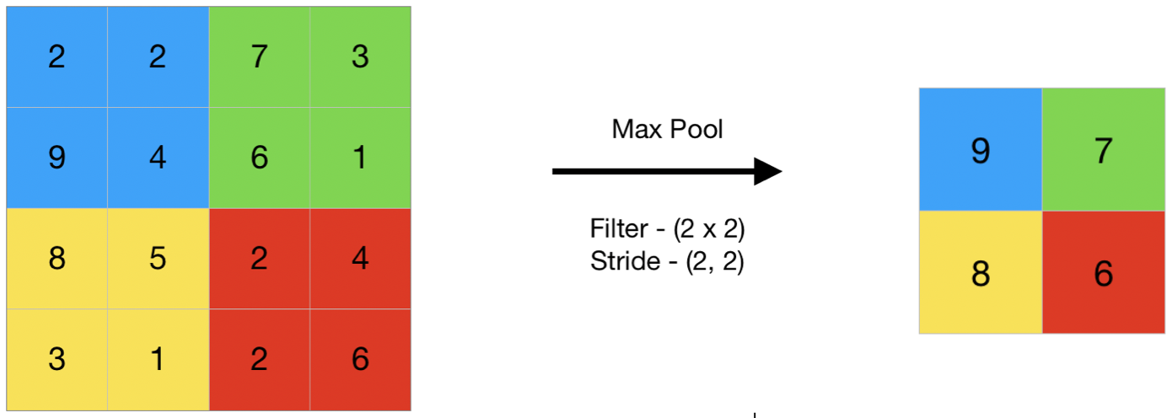
Pooling Layer
The pooling operation involves sliding a two-dimensional filter over each channel of feature map and summarizing the features lying within the region covered by the filter.
1) Max Pooling

Slide 16
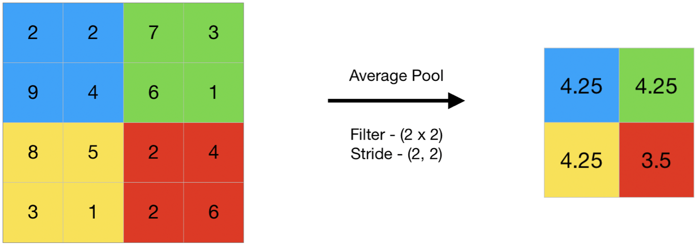
2) Average Pooling

Slide 17
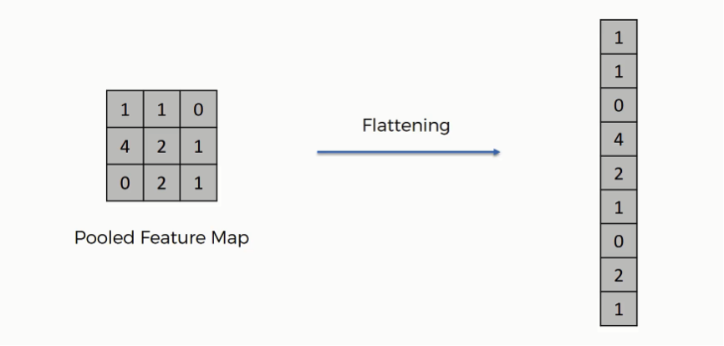
Flatenning

Slide 18
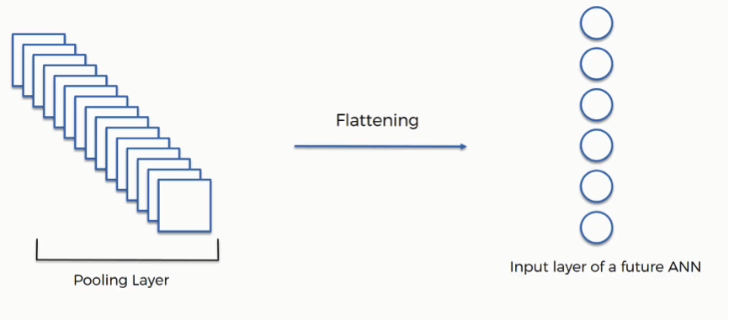

Slide 19
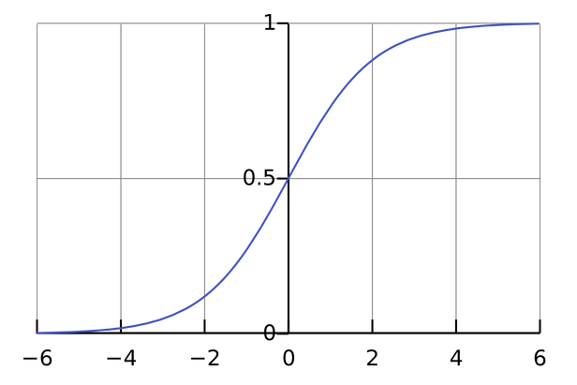
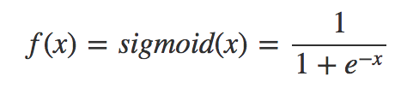
Sigmoid

Slide 20
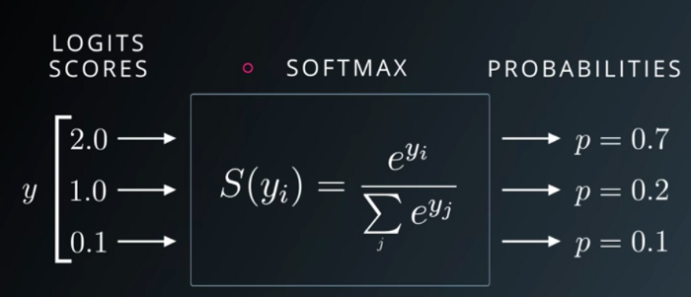
Softmax

Slide 21
Sigmoid vs Softmax
Sigmoid input values: -0.5, 1.2, -0.1, 2.4
Sigmoid output values: 0.37, 0.77, 0.48, 0.91
SoftMax input values: -0.5, 1.2, -0.1, 2.4
SoftMaxoutput values: 0.04, 0.21, 0.05, 0.70

Slide 22
The key takeaway from this example is:
Sigmoid: probabilities produced by a Sigmoid are independent. Furthermore, they are not constrained to sum to one: 0.37 + 0.77 + 0.48 + 0.91 = 2.53. The reason for this is because the Sigmoid looks at each raw output value separately.
Softmax: the outputs are interrelated. The Softmax probabilities will always sum to one by design: 0.04 + 0.21 + 0.05 + 0.70 = 1.00. In this case, if we want to increase the likelihood of one class, the other has to decrease by an equal amount.
Bus|Car|Truck|Train--Sigmoid -> 0.37|0.77|0.48|0.91---> Multilabel classification
Bus|Car|Truck|Train--Softmax-> 0.04|0.21|0.05|0.70 ---> Multi class classification

Slide 23

Error and Loss Function:
In most learning networks, error is calculated as the difference between the actual output and the predicted output.

Slide 24
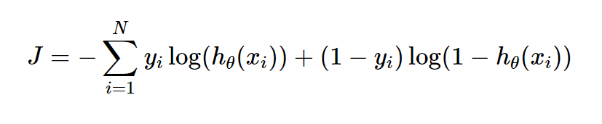
Binary Cross Entropy Loss
Entropy is the measure of randomness in the information being processed, and cross entropy is a measure of the difference of the randomness between two random variables.
If the divergence of the predicted probability from the actual label increases, the cross-entropy loss increases. Going by this, predicting a probability of .011 when the actual observation label is 1 would result in a high loss value. In an ideal situation, a “perfect” model would have a log loss of 0. Looking at the loss function would make things even clearer

Slide 25
Other major Classification losses
Categorical Cross Entropy Loss
Hinge Loss
Kullback Leibler Divergence Loss (KL Loss)

Slide 26
Optimizers
Optimizers are algorithms or methods used to minimize an error function(loss function)or to maximize the efficiency of production. Optimizers are mathematical functions which are dependent on model’s learnable parameters i.e Weights & Biases. Optimizers help to know how to change weights and learning rate of neural network to reduce the losses.

Slide 27
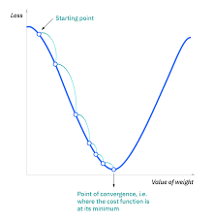
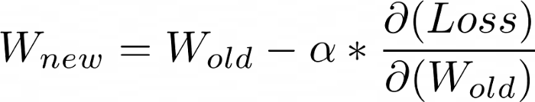
Gradient Descent

Slide 28
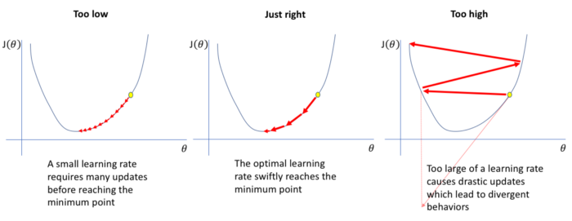
Learning Rate

Slide 29
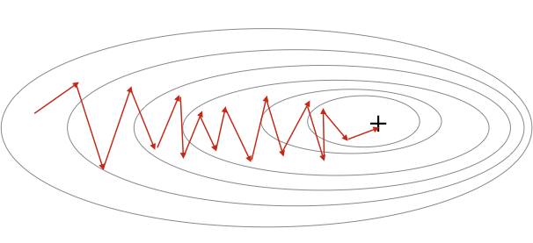
Stochastic Gradient Descent

Slide 30

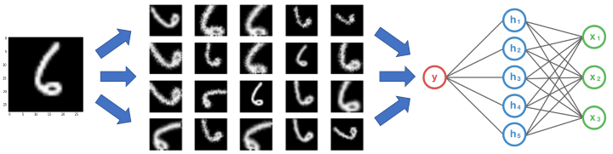
Augmentation

Slide 31
Calculating No of parameters
CONV layer:
(shape of width of the filter * shape of height of the filter * number of filters in the previous layer+1)*number of filters).
POOL layer: 0
Fully Connected Layer (FC): ((current layer neurons c * previous layer neurons p)+1*c).

