Slide 1
Exploratory Spatial Analysis of Urban Agriculture and Air Quality in NYC Omkar Tekawade PLSCI 5200 Project

Slide 2
Project Goal & Hypothesis
Goal: Conduct an initial, exploratory spatial analysis of the relationship between Urban Agriculture (UA) site locations and ambient air quality (AQ) in NYC.
Hypothesis : Urban Agriculture has a good effect on air quality.
Notes:
The goal for this project was to

Slide 3
INTRODUCTION
In recent years, Urban Agriculture (UA) projects have bloomed throughout the world.
Beyond food production, UA has increasing benefits in improving the socio-environmental dimension of cities.
Environmental benefits:- improved carbon and storm water capture, ground water recharge, food and organic waste composting, improved local biodiversity, contamination mitigation, improved air quality, urban cooling, energy savings
Notes:
Economic benefits : Cash sales and jobs;
Social benefits : improving nutritional outcomes, individual and community wellbeing, recreation activities, educational opportunities , improved social integration
Environmental benefits; improved carbon and storm water capture, ground water recharge, food and organic waste composting, wildlife habitat, improved local biodiversity, contamination mitigation, improved air quality, urban cooling, energy savings

Slide 4
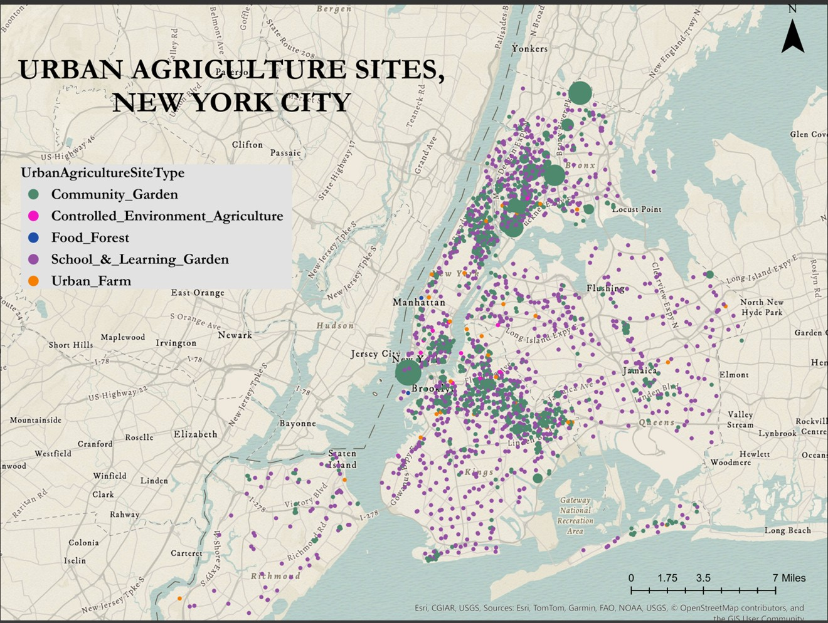
Data Used
NYC Urban Agriculture Sites : - (Point vector layer)
Prepared by :- NYC Mayor’s Office of Urban Agriculture
Hosted on ArcGIS Online and available to public

Slide 5
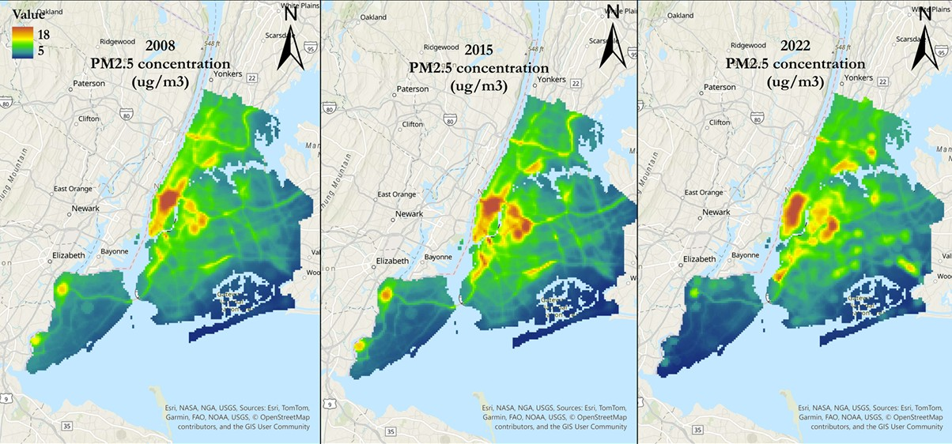
New York City Community Air Survey (NYCCAS) air pollution raster's
Citywide raster files of annual average predicted surface for nitrogen dioxide (NO2), fine particulate matter (PM2.5) and nitric oxide (NO)
Spatial Resolution: 300m
Temporal Resolution: Yearly (2008 - 2022)
Data is available on NYC Open Data Portal

Slide 6
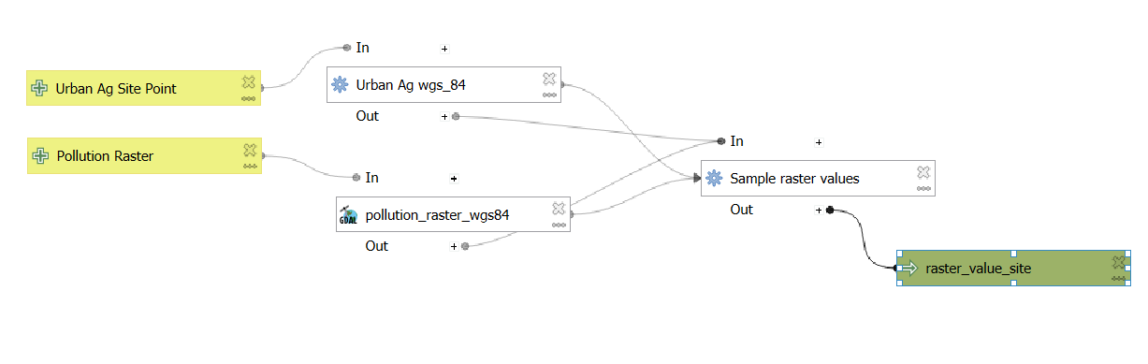
Methods
Method 1: Extract Values to Points
Objective: Determine AQ concentration directly at each UA site.
Process: Sample raster value at each point location.
Output: UA points layer with added PM2.5,NO2 and NO attributes.

Slide 7
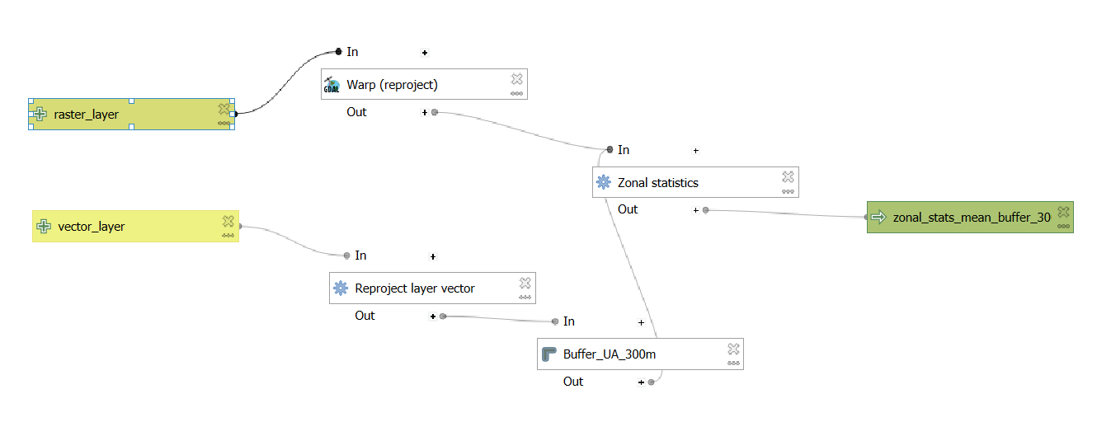
Method 2: Buffer & Zonal Statistics
Objective: Understand average AQ in the vicinity of each UA site.
Process:
Create buffers (300m radius) around UA sites.
Calculate average raster values (Mean PM2.5/NO2/NO) within each buffer.
Output: Buffer polygons with average AQ stats per site.

Slide 8
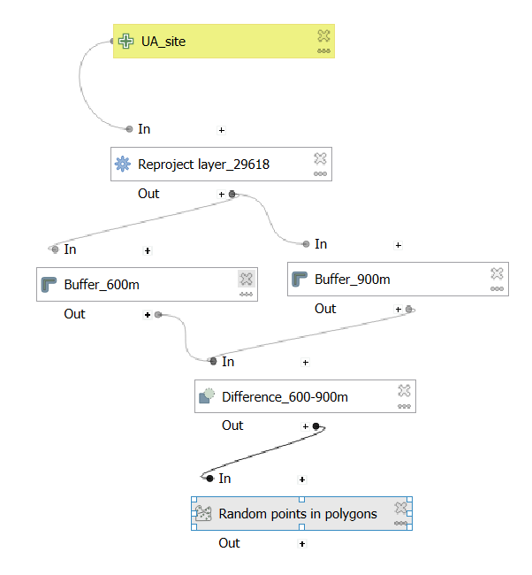
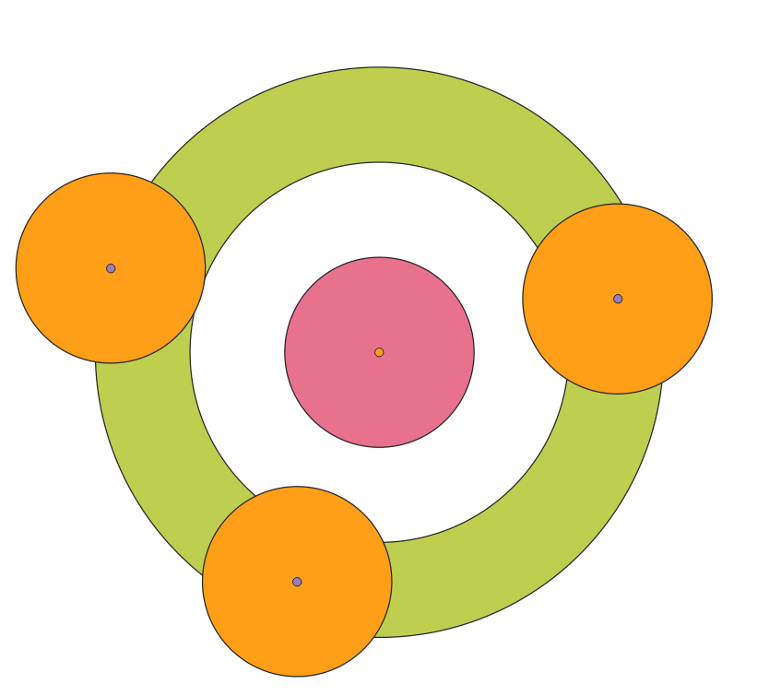
Random Layer Generation
Random Generated
Point
UA

Slide 9
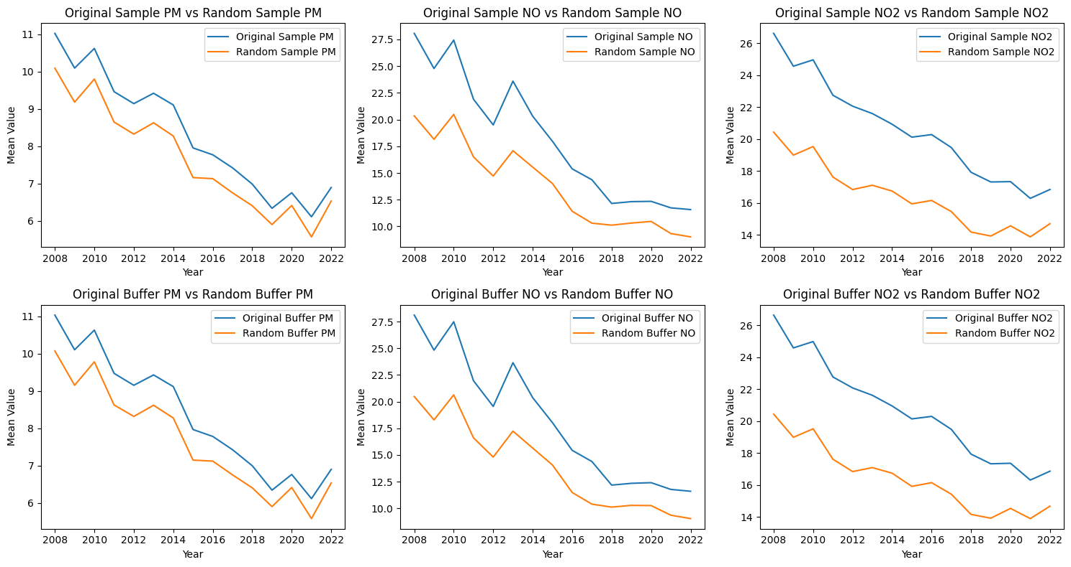
Results

Slide 10
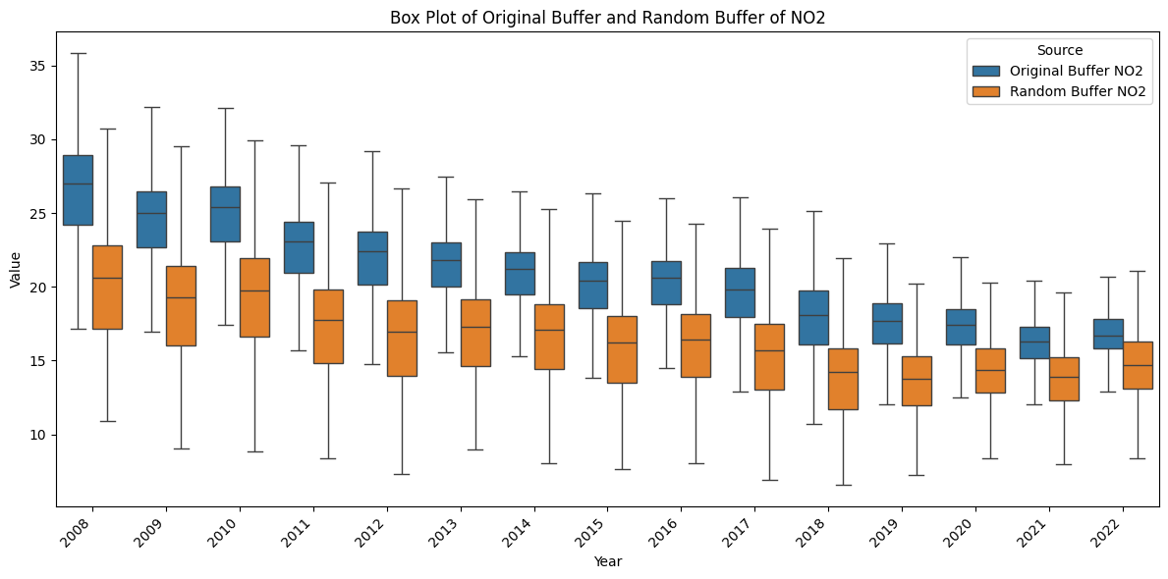
Results

Slide 11
Discussion & Interpretation
Future Improvement
The air quality at the Urban Agriculture sites is lower than the randomly selected sites for the whole period.
Though looking at the graphs, the gap between both values seems to be reducing.
This needs to be further investigated
The study also points out that, there might be initial bias in the UA sites placement as they are mostly located in higher-pollution neighborhoods—perhaps due to land costs, zoning of vacant lots
Add control variables such as:
proximity to emission sources (Traffic, Buildings, Industrial Zones)
Population Density
Land use
Meteorology
Proximity to parks, street trees
Use the different growing methods to differentiate the effects

Slide 12
Limitations
The starting date/year for the urban agricultural sites was not available in the data.
The air pollution rasters are annual average of the pollution and so they cannot represent fully represent air quality.
The spatial resolution of the data is 300m which might not fully represent the effects of UA on air quality.
Due to the quantity of the UA sites, the randomly generated reference data seems to mostly cover the border regions and cannot cover most of the city ground.
The analysis was conducted directly on the UA site location and the air quality, but we need to keep in mind that air pollution is a complex system and has many different factors affecting it.

Slide 13
THANK YOU
Questions?

