Slide 1
🎫
DEVOPS FINAL CAPSTONE / SESSION 21
DeskFlow
A helpdesk ticketing app, delivered through a full DevOps pipeline - containers, CI/CD, image scanning, Terraform on AWS, Kubernetes + Helm, and Prometheus/Grafana monitoring.
Student: ____________________ Roll No: ____________ Date: ____________
Notes:
Introduce the project: a small helpdesk ticketing app whose real purpose is to demonstrate the full DevOps lifecycle. Fill in your name, roll number and date.

Slide 2
THE PROBLEM
Support requests get lost without a system
📋
🕒
📉
Tracked in spreadsheets and chat
No sense of priority
No visibility
Tickets are scattered, duplicated, and easy to miss.
Urgent issues look the same as minor ones.
Nobody can see how much is open, in progress, or resolved.
DeskFlow gives a small team one place to create, prioritise and track tickets - simple on the surface, so the engineering effort can go into the DevOps pipeline around it.
Notes:
The app domain is deliberately simple. The capstone is graded on the DevOps lifecycle, not on app complexity.

Slide 3
OBJECTIVES
What this project sets out to prove
01
Build a real app
02
Automate quality
FastAPI + PostgreSQL + React, with a clean REST API and migrations.
Tests gate every change; CI builds, scans and publishes images.
03
Secure the supply chain
04
Provision with code
Scan container images for vulnerabilities before they ship.
Describe the AWS network and EKS cluster entirely in Terraform.
05
Deploy repeatably
06
Observe in production
Package the app as a Helm chart and run it on Kubernetes.
Expose metrics and watch them live in Grafana.
Notes:
Six objectives, one per DevOps capability the rubric rewards.

Slide 4
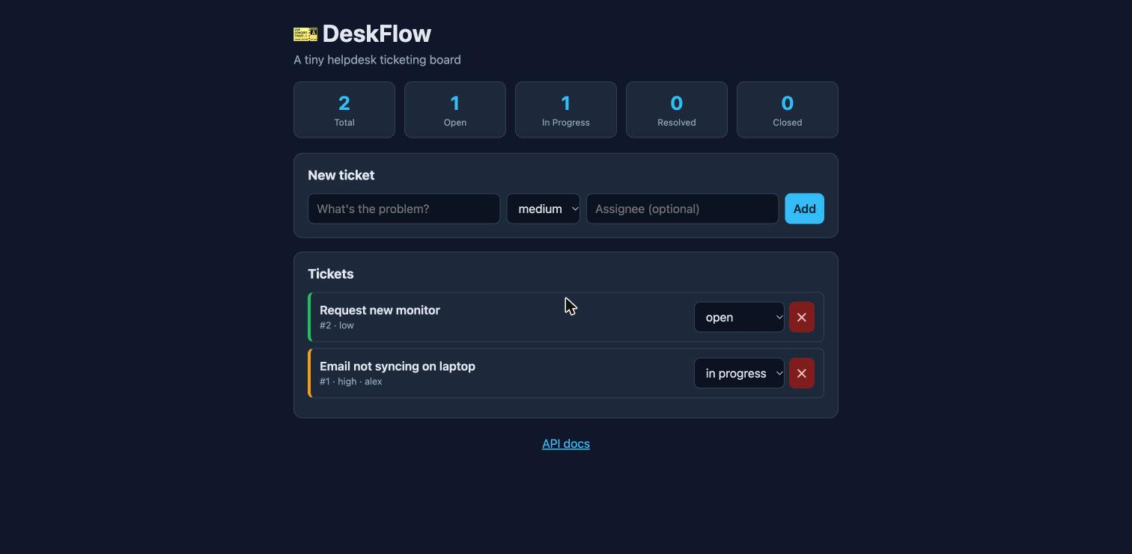
THE SOLUTION
A simple, responsive ticketing board
Create & manage tickets
Full create / list / view / update / delete.
Priorities & status
low to urgent, open to in_progress to resolved to closed.
Live stats
Counts by status and priority at a glance.
Live DeskFlow UI
Ops endpoints
Health, readiness and Prometheus /metrics.
Notes:
Show the running app. Walk through creating a ticket and changing its status.

Slide 5
TECHNOLOGY STACK
Standard, well-supported tools
Application
Testing
FastAPI / PostgreSQL / SQLAlchemy / Alembic / React + Vite
pytest with an in-memory SQLite test database
Containers
CI/CD
Docker / Docker Compose / multi-stage builds / non-root
GitHub Actions / GitHub Container Registry (GHCR)
Security
Infrastructure
Trivy image vulnerability scanning in the pipeline
Terraform / AWS VPC / Amazon EKS
Orchestration
Monitoring
Kubernetes / Helm / Ingress / Horizontal Pod Autoscaler
Prometheus / Grafana / ServiceMonitor
Notes:
Each row maps to one rubric module. Nothing exotic - these are the tools used in real teams.

Slide 6
ARCHITECTURE
How a request flows through the cluster
Kubernetes cluster (minikube / Amazon EKS)
Frontend ×2
Prometheus
Grafana
Nginx SPA
scrapes /metrics
dashboards
Browser
Ingress
deskflow.local
/ and /api
Backend ×2
PostgreSQL
FastAPI
+ PVC
HPA scales the backend 2 to 5 pods on CPU / images pulled from GHCR, tagged by commit SHA
Notes:
Ingress routes / to the frontend and /api to the backend. Backend talks to Postgres. Prometheus scrapes the backend and Grafana visualises it.

Slide 7
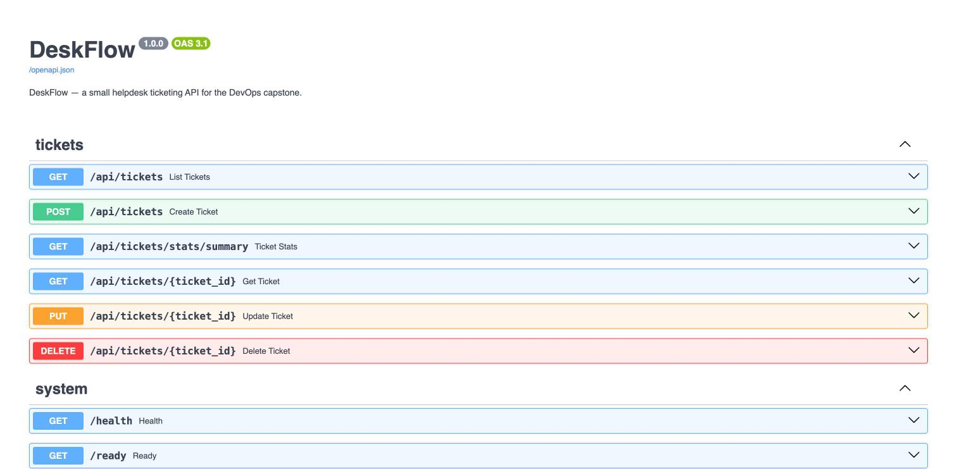
APPLICATION & API
A documented REST API
Endpoints
GET /api/tickets
POST /api/tickets
GET /api/tickets/{id}
PUT /api/tickets/{id}
DELETE /api/tickets/{id}
Auto-generated Swagger UI at /docs
GET /api/tickets/stats/summary
Covers GET / POST / PUT / DELETE + a stats route
Notes:
All four REST verbs plus a stats endpoint. The schema is auto-documented by FastAPI.

Slide 8
PROJECT STRUCTURE
A clean, conventional layout
deskflow-devops-capstone/
├── backend/ FastAPI app, Alembic, tests, Dockerfile
├── frontend/ React + Vite SPA, multi-stage Dockerfile
├── .github/workflows/ ci-cd.yml
├── terraform/ VPC + EKS (AWS modules)
├── k8s/ namespace.yaml
├── helm/deskflow/ Chart.yaml, values.yaml, templates/
├── monitoring/ Grafana dashboard JSON
├── scripts/ deploy-minikube.sh, load-test.sh
├── troubleshooting/ broken manifests + guide
├── docker-compose.yml
└── presentation.pptx
Separation of concerns
App code, infra and CI each live in their own area.
Everything in one repo
Infra-as-code sits next to the app it deploys.
Readable by a grader
Folder names map directly to rubric modules.
Notes:
Conventional structure. Each top-level folder corresponds to a rubric module.

Slide 9
CONTAINERIZATION
Both services containerised, running as non-root
Backend image
Frontend image (multi-stage)
• python:3.12-slim
• Runs migrations, then Uvicorn
• Non-root user (uid 10001)
• Stage 1: Node 20 builds the SPA
• Stage 2: nginx-unprivileged serves it
• Non-root user (uid 101)
docker compose up --build
Starts postgres + backend + frontend together. Verified working: the full stack came up, migrations ran, and all endpoints responded.
✓ all 3 services up
✓ non-root
Notes:
Multi-stage keeps the frontend image tiny. Both run as non-root for security.

Slide 10
CI/CD PIPELINE
Every push to main runs the pipeline
pytest
build frontend
build images
Trivy scan
push to GHCR
quality gate
Vite build
backend + frontend
fail on HIGH/CRIT
tag = commit SHA
If tests fail, nothing is built. If the scan finds a HIGH/CRITICAL vulnerability, nothing is pushed.
Images are tagged with the Git commit SHA - never 'latest' - so every deployed image traces back to one exact commit.
Defined in .github/workflows/ci-cd.yml / runs automatically once the repo is pushed to GitHub.
Notes:
Explain the gate order: test first, then build, then scan, then push.

Slide 11
DEVSECOPS
The scanner caught a real vulnerability
Found
Fixed
HIGH severity CVEs in starlette (a FastAPI dependency) - including CVE-2025-62727, a denial-of-service via Range-header handling. The old Nginx/Alpine base added more.
• fastapi to 0.143.3
• starlette to 1.8.0
• instrumentator to 8.1.0
• nginx base to 1.31.7-alpine3.24-slim
After the upgrade: both images scan clean (0 fixable HIGH/CRITICAL) and all 12 tests still pass.
The scan gate (exit on HIGH/CRITICAL) would block the build here - exactly as intended.
✓ both images clean
Notes:
This is the highlight of the security story: the gate did its job, found a real CVE, and we remediated it rather than suppressing it.

Slide 12
INFRASTRUCTURE AS CODE
The AWS environment, described in Terraform
What Terraform creates
Lifecycle
• VPC (10.0.0.0/16)
• 2 public + 2 private subnets, 2 AZs
• NAT gateway
• Amazon EKS control plane (v1.30)
• Managed node group (t3.small ×2)
init to plan to apply to destroy
💲 Cost control
~$0.30-0.40/hour (control plane + nodes + NAT). Apply, screenshot, then destroy the same day - a demo costs a few dollars.
No credentials live in any file - auth comes from the AWS CLI profile.
Uses the official terraform-aws-modules. init & validate verified clean.
Notes:
Emphasise cost discipline: EKS is billable, so apply then destroy. Credentials never go in code.

Slide 13
KUBERNETES + HELM
Deployed and running on a live cluster
kubectl -n deskflow get pods
Helm chart
deskflow-backend-...-2dtm9 1/1 Running
deskflow-backend-...-zfgxh 1/1 Running
deskflow-frontend-...-cnpfm 1/1 Running
deskflow-frontend-...-fhfmf 1/1 Running
deskflow-postgres-...-xp7cz 1/1 Running
helm upgrade --install deploys everything.
2 replicas each
Backend and frontend both run 2 pods.
Ingress
Routes / to frontend, /api to backend (verified).
HPA
Scales backend 2 to 5 on 60% CPU (cpu: 5%/60%).
Verified live on minikube with the nginx Ingress and metrics-server addons.
Notes:
All five pods Running. Point out the two-replica deployments, the ingress routing, and the HPA reading real CPU.

Slide 14
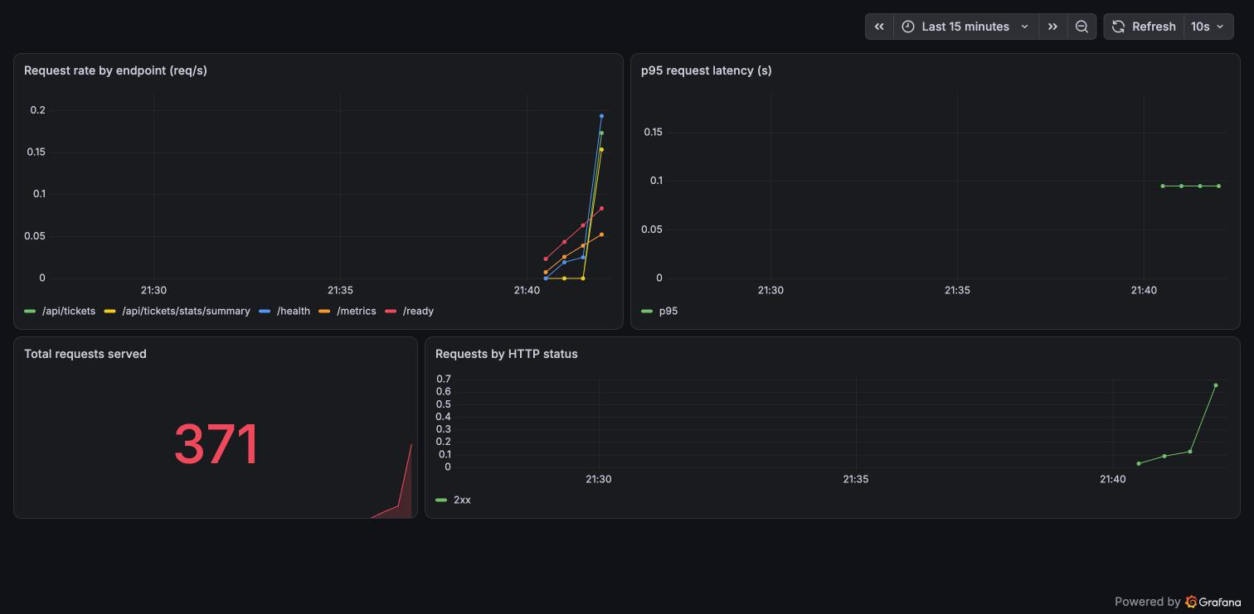
OBSERVABILITY
Live metrics in Grafana
/metrics
Prometheus-format output from the backend.
ServiceMonitor
Tells Prometheus to scrape both pods.
2 targets UP
Both backend pods confirmed as scrape targets.
Live panels
Request rate, p95 latency, status codes.
DeskFlow dashboard - live, under load
Notes:
Generate load with scripts/load-test.sh and watch the panels move. This is M9.

Slide 15
VERIFICATION
Everything below was actually run
12
5
0
2
pytest tests pass
pods Running
fixable HIGH/CRIT CVEs
Prometheus targets UP
Verified: Compose stack live / images scanned clean / Helm release deployed / Ingress routing / Grafana dashboard under load / Terraform init/validate clean.
Notes:
These numbers are real results from this build, not aspirations.

Slide 16
CHALLENGES
Problems hit, and how they were solved
Trivy failed the build
starlette + Alpine CVEs.
Upgraded dependencies and the base image until the scan was clean.
Prometheus didn't scrape
ServiceMonitor not picked up at first.
Reloaded Prometheus config; both pods then appeared as UP targets.
Backend restarted on boot
It started before Postgres was ready.
Readiness/liveness probes let Kubernetes retry until the DB was up.
Port 5432 clash locally
A local Postgres already held the port.
Mapped Compose Postgres to 5433 on the host.
Notes:
Honest troubleshooting story - graders value this. Each row is a real issue fixed during the build.

Slide 17
RUBRIC COVERAGE
All ten modules addressed
M1 Application
M6 Trivy scan
10 pt
5 pt
M2 Testing
M7 Terraform / EKS
10 pt
15 pt
M3 Git & GitHub
M8 Kubernetes + Helm
5 pt
15 pt
M4 Docker
M9 Observability
10 pt
10 pt
M5 CI/CD
M10 Docs & demo
15 pt
5 pt
Total: 100 points / six modules verified live, the rest complete on push to GitHub and a Terraform apply.
Notes:
Walk the grader through the mapping. Reassure them each module is actually covered.

Slide 18
🎫
CONCLUSION
One commit, all the way to production
DeskFlow shows the full DevOps lifecycle: code to test to container to scan to registry to infrastructure to Kubernetes to monitoring, with security and cost handled along the way.
Live demo sequence
1. Show the app to 2. Edit code & push to 3. Watch CI test, scan, push to 4. helm upgrade to 5. Pods roll to 6. Grafana updates to 7. Break a manifest & fix it live.
Thank you - questions welcome.
Notes:
Close with the end-to-end demo. The 'break and fix a manifest' step is the live-failure part of M10.

