Slide 1
Algorithms for Read Mapping
Gary Benson
Computer Science, Biology, Bioinformatics
Boston University
gbenson@bu.edu
http://tandem.bu.edu/

Slide 2
Algorithms for Read Mapping
Different algorithms:
Indexing of Genome
short words (seeds) – bounded expectation for failed mapping
longer words (seeds) – guaranteed mapping with bounded number of errors
Suffix Array/Burrows-Wheeler-Transform of Genome
exact matching and alternate read generation

Slide 3
Similarity Models
Match/mismatch model – Sequences differ only by mismatches:
AAAGCTTCGGAGTGCCCGA
AATGCATCGGGGTGCCTGA
Sequence 1:
Sequence 2:

Slide 4
Similarity Models
Match/mismatch model – Sequences differ only by mismatches:
AAAGCTTCGGAGTGCCCGA
AATGCATCGGGGTGCCTGA
1101101111011111011
Alignments of similar sequences can be represented by
bit strings (zeros and ones).
Sequence 1:
Sequence 2:

Slide 5
Similarity Models
Match/mismatch model – Sequences differ only by mismatches:
One model parameter required:
p = probability of matching letters in a column
= probability of a 1 in the bit string
Sometimes known as a Bernoulli (coin toss) model.

Slide 6
Detecting Similar Sequences
Methods for similarity detection involve some form of scanning the input sequences, usually, with a window of fixed size (also called a seed). Information about the contents of the window is stored. This is called indexing.
0 1 2 3 4 5 6 7 8 9 0 1 2 3 4 5 6 7 8
A C G T T G C A G T T G A C T G A C G

Slide 7
Indexing
The index is a list of all possible window contents together with a list, for each content, of where it occurs. For example, the following is a partial list of the contents possible in a window of length 3:
AAA, AAC,….,ACG,…,CAG,…,CGT,…GAC,…,GTT,…,TGC,…,TTG,…TTT

Slide 8
Building an Index
Genome:
0 1 2 3 4 5 6 7 8 9 0 1 2 3 4 5 6 7 8
A C G T T G C A G T T G A C T G A C G
AAA, AAC,….,ACG,…,CAG,…,CGT,…GAC,…,GTT,…,TGC,…TTG,…TTT

Slide 9
Building an Index
0 1 2 3 4 5 6 7 8 9 0 1 2 3 4 5 6 7 8
A C G T T G C A G T T G A C T G A C G
AAA, AAC,….,ACG,…,CAG,…,CGT,…GAC,…,GTT,…,TGC,…TTG,…TTT
0

Slide 10
Building an Index
0 1 2 3 4 5 6 7 8 9 0 1 2 3 4 5 6 7 8
A C G T T G C A G T T G A C T G A C G
AAA, AAC,….,ACG,…,CAG,…,CGT,…GAC,…,GTT,…,TGC,…TTG,…TTT
0 1

Slide 11
Building an Index
0 1 2 3 4 5 6 7 8 9 0 1 2 3 4 5 6 7 8
A C G T T G C A G T T G A C T G A C G
AAA, AAC,….,ACG,…,CAG,…,CGT,…GAC,…,GTT,…,TGC,…TTG,…TTT
0 1 2

Slide 12
Building an Index
0 1 2 3 4 5 6 7 8 9 0 1 2 3 4 5 6 7 8
A C G T T G C A G T T G A C T G A C G
AAA, AAC,….,ACG,…,CAG,…,CGT,…GAC,…,GTT,…,TGC,…TTG,…TTT
0 1 2 3

Slide 13
Building an Index
0 1 2 3 4 5 6 7 8 9 0 1 2 3 4 5 6 7 8
A C G T T G C A G T T G A C T G A C G
AAA, AAC,….,ACG,…,CAG,…,CGT,…GAC,…,GTT,…,TGC,…TTG,…TTT
0 1 2 4 3

Slide 14
Building an Index
0 1 2 3 4 5 6 7 8 9 0 1 2 3 4 5 6 7 8
A C G T T G C A G T T G A C T G A C G
AAA, AAC,….,ACG,…,CAG,…,CGT,…GAC,…,GTT,…,TGC,…TTG,…TTT
0 1 2 4 3
8
(skipping ahead)

Slide 15
Building an Index
0 1 2 3 4 5 6 7 8 9 0 1 2 3 4 5 6 7 8
A C G T T G C A G T T G A C T G A C G
AAA, AAC,….,ACG,…,CAG,…,CGT,…GAC,…,GTT,…,TGC,…TTG,…TTT
0 1 2 4 3
8 9

Slide 16
Scanning a new sequence
AAA, AAC,….,ACG,…,CAG,…,CGT,…GAC,…,GTT,…,TGC,…TTG,…TTT
0 1 2 4 3
8 9
T A C A G T T G . . .
Read:

Slide 17
Scanning a new sequence
AAA, AAC,….,ACG,…,CAG,…,CGT,…GAC,…,GTT,…,TGC,…TTG,…TTT
0 1 2 4 3
8 9
T A C A G T T G . . .
Read:

Slide 18
Scanning a new sequence
AAA, AAC,….,ACG,…,CAG,…,CGT,…GAC,…,GTT,…,TGC,…TTG,…TTT
0 1 2 4 3
8 9
T A C A G T T G . . .
Read:

Slide 19
Scanning a new sequence
AAA, AAC,….,ACG,…,CAG,…,CGT,…GAC,…,GTT,…,TGC,…TTG,…TTT
0 1 2 4 3
8 9
T A C A G T T G . . .
Read:

Slide 20
Scanning a new sequence
AAA, AAC,….,ACG,…,CAG,…,CGT,…GAC,…,GTT,…,TGC,…TTG,…TTT
0 1 2 4 3
8 9
T A C A G T T G . . .
Read:

Slide 21
Test subject sequence at matching locations
Indexed genome: 0 1 2 3 4 5 6 7 8 9 0 1 2 3 4 5 6 7 8
A C G T T G C A G T T G A C T G A C G
Subject read: T A C A G T T G . . .
Indexed genome: 0 1 2 3 4 5 6 7 8 9 0 1 2 3 4 5 6 7 8
A C G T T G C A G T T G A C T G A C G
Subject read T A C A G T T G . . .
1 0 1 1 1 1 1 1 . . .
Good match?

Slide 22
Seed matching can fail
The scanning method is not guaranteed to find a matching seed, even when the read has a good match to the genome, because there may be no window that matches exactly. Therefore, the main question is:
What is the probability of finding a match
between similar sequences
using the window size chosen?

Slide 23
Q1: Is it possible to find a match?
This is known as the waiting time problem.
Waiting Time: How many consecutive positions must be examined until a run of k ones occurs.

Slide 24
Waiting Time Problem
This is known as the waiting time problem.
Waiting Time: How many consecutive positions must be examined until a run of k ones occurs.
Specific sequence example:
AAAGCTTCGGAGTGCCCGA
AATGCATCGGGGTGCCTGA
1101101111011111011
Sequence 1:
Sequence 2:

Slide 25
Waiting Time – Specific Example
AAAGCTTCGGAGTGCCCGA
AATGCATCGGGGTGCCTGA
1101101111011111011
Sequence 1:
Sequence 2:
1 2 3 4 5
k | waiting time
1 | 1
2 | 2
3 | 9
4 | 10
5 | 16
6 | -

Slide 26
Q: What is the probability of finding a match?
Waiting Time: Given a Bernoulli sequence with generating probability p and length n, what is the probability that a run of k ones occurs?
Randomly generated Bernoulli sequence using p:
k
1110101111011011010
n

Slide 27
Waiting Time Formula
Formula can be used to calculate the probability of a first occurrence of a run of k ones at every sequence length from 1 to n.
Formula for n ≥ 3 and k = 3:
F(111:n) =
P(1)³ – F(111: n – 1) · P(1) – F(111: n – 2) · P(1)²
– ∑ _{k = 3 to n – 3} F(111: k) · P(1)³
where:
F(111:n) is the probability of a first occurrence of 3 ones in a row at position n,
P(1) is the model probability of a match.

Slide 28
Using the Waiting Time Formula
Hypothetical situation:
Read length = 12
Window length = 3
Reads are expected to match in 50% of positions (highly diverged sequences!)
So, n= 12, k = 3, p = .5

Slide 29
Predictions (prior to experiment)
Given n= 12, k = 3, p = .5,
Which position [1..12] is most likely to get a *first* occurrence of 3 ones in a row?
Where will the cumulative probability be 50%?
What is the cumulative probability up to position 12?

Slide 30
Coin Flip Experiment
Goal: To estimate the probability of finding three heads in a row at least once when tossing a coin 12 times.
The Experiment: Each student tosses a coin until the first occurrence of 3 heads in a row. This is one trial. Record the flip where the 3rd head is found. If 12 tosses do not produce 3 heads in a row, stop and begin a new trial. Repeat.
EXAMPLE: Note that the first occurrence of three heads in a row is recorded as the last position of three heads.
1 2 3 4 5 6 7 8 9 10 11 12 Record
Trial 1: H T H H T H H H 8
Trial 2: T T H H H 5
Trial 3: H T T H H T H H H 9
Trial 3: H T T H H T H T H H T T None

Slide 31
Do Experiment

Slide 32
Waiting Time Formulas
Calculated probabilities:
Probabilities of first occurrence of patterns in coin toss sequences
 | P(1) | P(0) |  | P(1) | P(1)^2 | P(1)^3
 | 0.5 | 0.5 |  | 0.5 | 0.25 | 0.125
HHH
P(111) | Position | 1 | 2 | 3 | 4 | 5 | 6 | 7 | 8 | 9 | 10 | 11 | 12
 | Probability | 0.000000 | 0.000000 | 0.125000 | 0.062500 | 0.062500 | 0.062500 | 0.054688 | 0.050781 | 0.046875 | 0.042969 | 0.039551 | 0.036377
 | Cumulative | 0.000000 | 0.000000 | 0.125000 | 0.187500 | 0.250000 | 0.312500 | 0.367188 | 0.417969 | 0.464844 | 0.507813 | 0.547363 | 0.583740

Slide 33
Advantages/Disadvantages of Seed Matching
1. More types and number of differences allowed between reads and genome
2. Very fast
3. Many seeds per read tested
4. Uses lots of memory to store index (>10GB)
5. New index required if different seed structure is used or read length changes.

Slide 34
Alternate Seed Approach – ZOOM
Uses fewer seeds but guarantees not missing any mapping with ≤ k differences.
Note:
Fewer seeds are better
Longer seeds are better
ZOOM! Zillions of oligos mapped, Hao Lin, Zefeng Zhang, Michael Q. Zhang, Bin Ma, Ming Li, Bioinformatics, 24(21), 2431–2437, 2008.
doi:10.1093/bioinformatics/btn416

Slide 35
Example
Suppose a read is 35 bases long and we want to allow at most 2 mismatches between the read and the reference and we want to use seeds that are 14 characters long.
This can be accomplished with 4 seeds.

Slide 36
3 Seeds
Read:
1
35
First seed
1
14
Second seed
22
35
Third seed
8
21
First three seeds shown. Each looks for an exact match. Two mismatches allowed.

Slide 37
3 Seeds
Read:
X
X
1
35
First seed
1
14
Second seed
22
35
Third seed
8
21
X marks a mismatch between the read and its genomic location.

Slide 38
3 Seeds
Read:
X
X
1
35
First seed
1
14
Second seed
22
35
Third seed
8
21
X marks a mismatch between the read and its genomic location.

Slide 39
3 Seeds
Read:
X
X
1
35
First seed
1
14
Second seed
22
35
Third seed
8
21
X marks a mismatch between the read and its genomic location.

Slide 40
3 Seeds
Read:
X
X
1
35
First seed
1
14
Second seed
22
35
Third seed
8
21
X marks a mismatch between the read and its genomic location.

Slide 41
3 Seeds Fail
Read:
X
X
1
35
First seed
1
14
Second seed
22
35
Third seed
8
21

Slide 42
4 Seeds
Solution is possible with 4 seeds, but the 4th seed is a split seed (that is, half is in one location, half is in another)
Can you come up with a solution?
Possible answers follow

Slide 43
4th Seed – Choice 1
Read:
1
35
First seed
1
14
Second seed
22
35
Third seed
8
21
Fourth seed
1
7
15
21

Slide 44
4th Seed – Choice 2
Read:
1
35
First seed
1
14
Second seed
22
35
Third seed
8
21
Fourth seed
1
7
22
28

Slide 45
Which Choice Doesn’t Work?
Answer Follows

Slide 46
4th Seed – Choice 2
Read:
X
X
1
35
First seed
1
14
Second seed
22
35
Third seed
8
21
Fourth seed
1
7
22
28

Slide 47
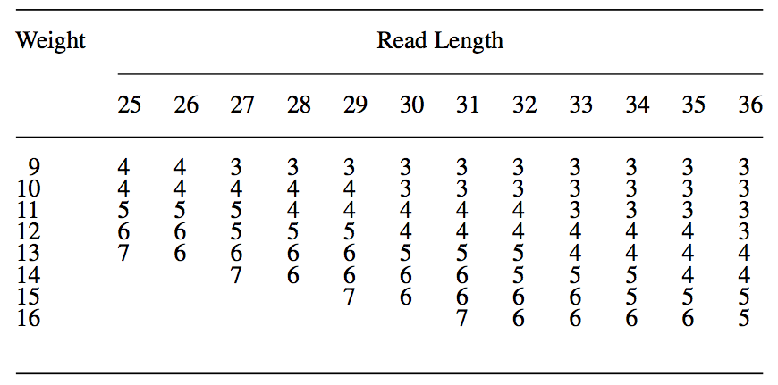
Number of seeds required
ZOOM! Zillions of oligos mapped, Hao Lin, Zefeng Zhang, Michael Q. Zhang, Bin Ma, Ming Li, Bioinformatics, 24(21), 2431–2437, 2008.
doi:10.1093/bioinformatics/btn416

Slide 48
Weaknesses
For longer size reads:
more differences should be allowed
indels should be allowed
many more seeds are required
long seeds are slower to look up

Slide 49
Suffix Arrays and the Burrows Wheeler Transform

Slide 50
Suffix Array
An alphabetically ordered list of the suffixes of a string.
T = MISSISSIPPI
0 10 I
1 7 IPPI
2 5 ISSIPPI
3 1 ISSISSIPPI
4 0 MISSISSIPPI
5 9 PI
6 8 PPI
7 6 SIPPI
8 3 SISSIPPI
9 5 SSIPPI
10 2 SSISSIPPI

Slide 51
Suffix Array
An alphabetically ordered list of the suffixes of a string.
T = MISSISSIPPI
0 10 I
1 7 IPPI
2 5 ISSIPPI
3 1 ISSISSIPPI
4 0 MISSISSIPPI
5 9 PI
6 8 PPI
7 6 SIPPI
8 3 SISSIPPI
9 5 SSIPPI
10 2 SSISSIPPI
First column is position in array.
Second column is position in sequence.
Third column is suffix.

Slide 52
Suffix Array
An alphabetically ordered list of the suffixes of a string.
T = MISSISSIPPI
0 10 I
1 7 IPPI
2 5 ISSIPPI
3 1 ISSISSIPPI
4 0 MISSISSIPPI
5 9 PI
6 8 PPI
7 6 SIPPI
8 3 SISSIPPI
9 5 SSIPPI
10 2 SSISSIPPI
Property: All occurrences of a substring are grouped together

Slide 53
Suffix Array
An alphabetically ordered list of the suffixes of a string.
T = MISSISSIPPI
0 10 I
1 7 IPPI
2 5 ISSIPPI
3 1 ISSISSIPPI
4 0 MISSISSIPPI
5 9 PI
6 8 PPI
7 6 SIPPI
8 3 SISSIPPI
9 5 SSIPPI
10 2 SSISSIPPI
Example: I

Slide 54
Suffix Array
An alphabetically ordered list of the suffixes of a string.
T = MISSISSIPPI
0 10 I
1 7 IPPI
2 5 ISSIPPI
3 1 ISSISSIPPI
4 0 MISSISSIPPI
5 9 PI
6 8 PPI
7 6 SIPPI
8 3 SISSIPPI
9 5 SSIPPI
10 2 SSISSIPPI
Example: SSI

Slide 55
Suffix Array
An alphabetically ordered list of the suffixes of a string.
T = MISSISSIPPI
0 10 I
1 7 IPPI
2 5 ISSIPPI
3 1 ISSISSIPPI
4 0 MISSISSIPPI
5 9 PI
6 8 PPI
7 6 SIPPI
8 3 SISSIPPI
9 5 SSIPPI
10 2 SSISSIPPI
Example: SSI
To find occurrences of the string SSI requires finding the interval in the suffix array containing the strings that start with SSI

Slide 56
Burrows-Wheeler Transform
Sequence = TACAGTACGATCACGAC@
@TACAGTACGATCACGAC
AC@TACAGTACGATCACG
ACAGTACGATCACGAC@T
ACGAC@TACAGTACGATC
ACGATCACGAC@TACAGT
AGTACGATCACGAC@TAC
ATCACGAC@TACAGTACG
C@TACAGTACGATCACGA
CACGAC@TACAGTACGAT
CAGTACGATCACGAC@TA
CGAC@TACAGTACGATCA
CGATCACGAC@TACAGTA
GAC@TACAGTACGATCAC
GATCACGAC@TACAGTAC
GTACGATCACGAC@TACA
TACAGTACGATCACGAC@
TACGATCACGAC@TACAG
TCACGAC@TACAGTACGA
Start with an extended suffix array.
@ is a special character smaller than all the alphabet characters
after the suffix, add @ and then the prefix of the sequence

Slide 57
Burrows-Wheeler Transform
Sequence = TACAGTACGATCACGAC@
@TACAGTACGATCACGAC
AC@TACAGTACGATCACG
ACAGTACGATCACGAC@T
ACGAC@TACAGTACGATC
ACGATCACGAC@TACAGT
AGTACGATCACGAC@TAC
ATCACGAC@TACAGTACG
C@TACAGTACGATCACGA
CACGAC@TACAGTACGAT
CAGTACGATCACGAC@TA
CGAC@TACAGTACGATCA
CGATCACGAC@TACAGTA
GAC@TACAGTACGATCAC
GATCACGAC@TACAGTAC
GTACGATCACGAC@TACA
TACAGTACGATCACGAC@
TACGATCACGAC@TACAG
TCACGAC@TACAGTACGA
Start with an extended suffix array.
@ is a special character smaller than all the alphabet characters
after the suffix, add @ and then the prefix of the sequence

Slide 58
Burrows-Wheeler Transform
Sequence = TACAGTACGATCACGAC@
@TACAGTACGATCACGAC
AC@TACAGTACGATCACG
ACAGTACGATCACGAC@T
ACGAC@TACAGTACGATC
ACGATCACGAC@TACAGT
AGTACGATCACGAC@TAC
ATCACGAC@TACAGTACG
C@TACAGTACGATCACGA
CACGAC@TACAGTACGAT
CAGTACGATCACGAC@TA
CGAC@TACAGTACGATCA
CGATCACGAC@TACAGTA
GAC@TACAGTACGATCAC
GATCACGAC@TACAGTAC
GTACGATCACGAC@TACA
TACAGTACGATCACGAC@
TACGATCACGAC@TACAG
TCACGAC@TACAGTACGA
Start with an extended suffix array.
BWT is the last column.

Slide 59
Burrows-Wheeler Transform
Sequence = TACAGTACGATCACGAC@
@TACAGTACGATCACGAC
AC@TACAGTACGATCACG
ACAGTACGATCACGAC@T
ACGAC@TACAGTACGATC
ACGATCACGAC@TACAGT
AGTACGATCACGAC@TAC
ATCACGAC@TACAGTACG
C@TACAGTACGATCACGA
CACGAC@TACAGTACGAT
CAGTACGATCACGAC@TA
CGAC@TACAGTACGATCA
CGATCACGAC@TACAGTA
GAC@TACAGTACGATCAC
GATCACGAC@TACAGTAC
GTACGATCACGAC@TACA
TACAGTACGATCACGAC@
TACGATCACGAC@TACAG
TCACGAC@TACAGTACGA
Start with an extended suffix array.
BWT is the last column.
Note that in a single row, last letter precedes first letter in the original string.

Slide 60
Burrows-Wheeler Transform
Sequence = TACAGTACGATCACGAC@
@TACAGTACGATCACGAC
AC@TACAGTACGATCACG
ACAGTACGATCACGAC@T
ACGAC@TACAGTACGATC
ACGATCACGAC@TACAGT
AGTACGATCACGAC@TAC
ATCACGAC@TACAGTACG
C@TACAGTACGATCACGA
CACGAC@TACAGTACGAT
CAGTACGATCACGAC@TA
CGAC@TACAGTACGATCA
CGATCACGAC@TACAGTA
GAC@TACAGTACGATCAC
GATCACGAC@TACAGTAC
GTACGATCACGAC@TACA
TACAGTACGATCACGAC@
TACGATCACGAC@TACAG
TCACGAC@TACAGTACGA
Property: k^{th} character σ
in the first and last columns is the same character.

Slide 61
Burrows-Wheeler Transform
Sequence = TACAGTACGATCACGAC@
@TACAGTACGATCACGAC
AC@TACAGTACGATCACG
ACAGTACGATCACGAC@T
ACGAC@TACAGTACGATC
ACGATCACGAC@TACAGT
AGTACGATCACGAC@TAC
ATCACGAC@TACAGTACG
C@TACAGTACGATCACGA
CACGAC@TACAGTACGAT
CAGTACGATCACGAC@TA
CGAC@TACAGTACGATCA
CGATCACGAC@TACAGTA
GAC@TACAGTACGATCAC
GATCACGAC@TACAGTAC
GTACGATCACGAC@TACA
TACAGTACGATCACGAC@
TACGATCACGAC@TACAG
TCACGAC@TACAGTACGA
Property: k^{th} character σ
in the first and last columns is the same character.
2nd C in both columns is twelfth character in original string.

Slide 62
Burrows-Wheeler Transform
Sequence = TACAGTACGATCACGAC@
@TACAGTACGATCACGAC
AC@TACAGTACGATCACG
ACAGTACGATCACGAC@T
ACGAC@TACAGTACGATC
ACGATCACGAC@TACAGT
AGTACGATCACGAC@TAC
ATCACGAC@TACAGTACG
C@TACAGTACGATCACGA
CACGAC@TACAGTACGAT
CAGTACGATCACGAC@TA
CGAC@TACAGTACGATCA
CGATCACGAC@TACAGTA
GAC@TACAGTACGATCAC
GATCACGAC@TACAGTAC
GTACGATCACGAC@TACA
TACAGTACGATCACGAC@
TACGATCACGAC@TACAG
TCACGAC@TACAGTACGA
This makes it easy to find next character in string going backwards.

Slide 63
Burrows-Wheeler Transform
Sequence = TACAGTACGATCACGAC@
@TACAGTACGATCACGAC
AC@TACAGTACGATCACG
ACAGTACGATCACGAC@T
ACGAC@TACAGTACGATC
ACGATCACGAC@TACAGT
AGTACGATCACGAC@TAC
ATCACGAC@TACAGTACG
C@TACAGTACGATCACGA
CACGAC@TACAGTACGAT
CAGTACGATCACGAC@TA
CGAC@TACAGTACGATCA
CGATCACGAC@TACAGTA
GAC@TACAGTACGATCAC
GATCACGAC@TACAGTAC
GTACGATCACGAC@TACA
TACAGTACGATCACGAC@
TACGATCACGAC@TACAG
TCACGAC@TACAGTACGA
This makes it easy to find next character in string going backwards. Steps:
1. Pick letter in last column

Slide 64
Burrows-Wheeler Transform
Sequence = TACAGTACGATCACGAC@
@TACAGTACGATCACGAC
AC@TACAGTACGATCACG
ACAGTACGATCACGAC@T
ACGAC@TACAGTACGATC
ACGATCACGAC@TACAGT
AGTACGATCACGAC@TAC
ATCACGAC@TACAGTACG
C@TACAGTACGATCACGA
CACGAC@TACAGTACGAT
CAGTACGATCACGAC@TA
CGAC@TACAGTACGATCA
CGATCACGAC@TACAGTA
GAC@TACAGTACGATCAC
GATCACGAC@TACAGTAC
GTACGATCACGAC@TACA
TACAGTACGATCACGAC@
TACGATCACGAC@TACAG
TCACGAC@TACAGTACGA
This makes it easy to find next character in string going backwards. Steps:
1. Pick letter in last column
2. How many of that type from top?
2nd C

Slide 65
Burrows-Wheeler Transform
Sequence = TACAGTACGATCACGAC@
@TACAGTACGATCACGAC
AC@TACAGTACGATCACG
ACAGTACGATCACGAC@T
ACGAC@TACAGTACGATC
ACGATCACGAC@TACAGT
AGTACGATCACGAC@TAC
ATCACGAC@TACAGTACG
C@TACAGTACGATCACGA
CACGAC@TACAGTACGAT
CAGTACGATCACGAC@TA
CGAC@TACAGTACGATCA
CGATCACGAC@TACAGTA
GAC@TACAGTACGATCAC
GATCACGAC@TACAGTAC
GTACGATCACGAC@TACA
TACAGTACGATCACGAC@
TACGATCACGAC@TACAG
TCACGAC@TACAGTACGA
This makes it easy to find next character in string going backwards. Steps:
1. Pick letter in last column
2. How many of that type from top?
3. Find row with that many in first column.
2nd C

Slide 66
Burrows-Wheeler Transform
Sequence = TACAGTACGATCACGAC@
@TACAGTACGATCACGAC
AC@TACAGTACGATCACG
ACAGTACGATCACGAC@T
ACGAC@TACAGTACGATC
ACGATCACGAC@TACAGT
AGTACGATCACGAC@TAC
ATCACGAC@TACAGTACG
C@TACAGTACGATCACGA
CACGAC@TACAGTACGAT
CAGTACGATCACGAC@TA
CGAC@TACAGTACGATCA
CGATCACGAC@TACAGTA
GAC@TACAGTACGATCAC
GATCACGAC@TACAGTAC
GTACGATCACGAC@TACA
TACAGTACGATCACGAC@
TACGATCACGAC@TACAG
TCACGAC@TACAGTACGA
This makes it easy to find next character in string going backwards. Steps:
1. Pick letter in last column
2. How many of that type from top?
3. Find row with that many in first column.
4. Look at last letter in that row
2nd C

Slide 67
Burrows-Wheeler Transform
Sequence = TACAGTACGATCACGAC@
@TACAGTACGATCACGAC
AC@TACAGTACGATCACG
ACAGTACGATCACGAC@T
ACGAC@TACAGTACGATC
ACGATCACGAC@TACAGT
AGTACGATCACGAC@TAC
ATCACGAC@TACAGTACG
C@TACAGTACGATCACGA
CACGAC@TACAGTACGAT
CAGTACGATCACGAC@TA
CGAC@TACAGTACGATCA
CGATCACGAC@TACAGTA
GAC@TACAGTACGATCAC
GATCACGAC@TACAGTAC
GTACGATCACGAC@TACA
TACAGTACGATCACGAC@
TACGATCACGAC@TACAG
TCACGAC@TACAGTACGA
This makes it easy to find next character in string going backwards. Steps:
1. Pick letter in last column
2. How many of that type from top?
3. Find row with that many in first column.
4. Look at last letter in that row
Need to know:
1. How many of each letter at each position in BWT
2. How many total for each letter
2nd C

Slide 68
Matching a Read Exactly (Backwards)
Search for: TAC
A...........................
M A
A...........................
C...........................
C..........................A
C...........................
C..........................A
C..........................A
G...........................
M

Slide 69
Matching a Read Exactly (Backwards)
Search for: TAC
A...........................
M A
A...........................
C...........................
C..........................A
C...........................
C..........................A
C..........................A
G...........................
M
All strings starting with C here.

Slide 70
Matching a Read Exactly (Backwards)
Search for: TAC
A...........................
M A
A...........................
C...........................
C..........................A
C...........................
C..........................A
C..........................A
G...........................
M
k As to here.
All strings starting with C here.
k+3 As to here.

Slide 71
Matching a Read Exactly (Backwards)
Search for: TAC
A...........................
M A
A...........................
C...........................
C..........................A
C...........................
C..........................A
C..........................A
G...........................
M
k As to here.
Only As followed by C.
k+3 As to here.

Slide 72
Matching a Read Exactly (Backwards)
Search for: TAC
A..........................T
A...........................
AC........................T
AC.........................
AC........................T
A...........................
M
A...........................
C...........................
M
k+1 A
k+2 A
k+3 A

Slide 73
Matching a Read Exactly (Backwards)
Search for: TAC
A..........................T
A...........................
AC........................T
AC.........................
AC........................T
A...........................
M
A...........................
C...........................
M
All strings starting with AC here.

Slide 74
Matching a Read Exactly (Backwards)
Search for: TAC
A..........................T
A...........................
AC........................T
AC.........................
AC........................T
A...........................
M
A...........................
C...........................
M
h Ts to here.
All strings starting with AC here.
h+2 Ts to here.

Slide 75
Matching a Read Exactly (Backwards)
Search for: TAC
A..........................T
A...........................
AC........................T
AC.........................
AC........................T
A...........................
M
A...........................
C...........................
M
h Ts to here.
Only Ts followed by AC
h+2 Ts to here.

Slide 76
Matching a Read Exactly (Backwards)
Search for: TAC
G...........................
M
T...........................
M
TAC.......................
TAC.......................
T...........................
M
T...........................
h+1 T
h+2 T

Slide 77
Matching a Read Exactly (Backwards)
Search for: TAC
G………………………..
M
T...........................
M
TAC.......................
TAC.......................
T...........................
M
T...........................
All strings starting with TAC here.

Slide 78
Searching with Differences
BWT only finds exact matches, to map reads with differences, we must generate many alternate reads with different characters or indels at each position or use partial reads as seeds.

Slide 79
Advantages/Disadvantages
Very small memory requirement (1 to 3 GB).
Same BWT can be used if read size changes
Fewer differences allowed

Slide 80
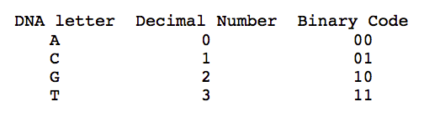

Radix Sort for BWT Construction
Write down three ACGT letters in any order
Represent A C G T as 0 1 2 3
Encode in binary

Slide 81
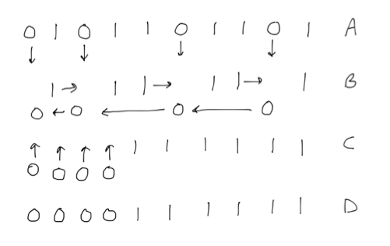
Radix Sort for BWT Construction
Sort

Slide 82
Some popular NGS mappers
Software
indexing
Codebase
Indel support
Multithreading
Comments
Bowtie
Burrows-Wheeler genome index
Open-source
No
Yes
Very fast
BWA
Burrows-Wheeler genome index
Open-source
Recently added
Yes
Very fast
Soap2
Burrows-Wheeler genome index
Closed-source
Limited (1-3)
Yes
Very fast
SSAHA2
Genome hash table
Open-source
Yes
No
Fast, no SOLiD support
Mosaik
Genome hash table
Open-source
Yes
Yes
Fast
BFAST
Genome hash table
Commercial
Yes
Yes
Zoom
Read hash table
Commercial
Yes
GUI-only
SliderII
Merge sorting
Open-source
Written in Java; can use second-best basecall for precise SNP finding Illumina-specific

Slide 83
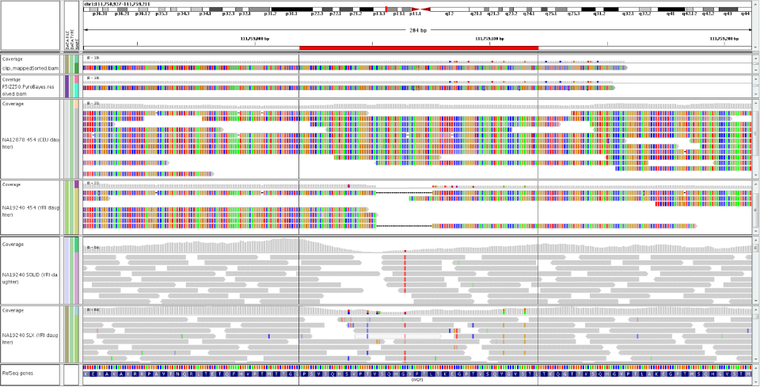
IGV: Integrative Genomics Viewer

