Slide 1
Sequence Comparisons:
Search For Similarity
Fredj Tekaia
tekaia@pasteur.fr
Bioinformatics and Genome Analyses
Institut Pasteur Tunis, Tunisia. September 18 – December 15, 2017

Slide 2
Plan
• Definitions: Homology, Similarity, Identity
• Substitution matrices
• BLAST programmes (note: will be more extensively developed in a next lecture)
• Practical sessions
• References

Slide 3
Search for similarity between sequences
One of the most frequent activity in Bioinformatics
Common ancestor
Two genes are homologs if and only if they derive from the same ancestor
Gene1
Gene2
Homology is inferred by sequence similarity

Slide 4
Example:
CLUSTAL W multiple sequence alignment
ACLA049550_1_76 MQIFVKTLTGKTITLEVESSDTIDNVKSKIQDKEGIPPDQQRLIFAGKQLEDGRTLSDYNIQKESTLHLVLRLRGG
ACL062C_1_76 MQIFVKTLTGKTITLEVESSDTIDNVKSKIQDKEGIPPDQQRLIFAGKQLEDGRTLSDYNIQKESTLHLVLRLRGG
AFUA4G10350_1_76 MQIFVKTLTGKTITLEVESSDTIDNVKSKIQDKEGIPPDQQRLIFAGKQLEDGRTLSDYNIQKESTLHLVLRLRGG
AO090003001182_1_76 MQIFVKTLTGKTITLEVESSDTIDNVKSKIQDKEGIPPDQQRLIFAGKQLEDGRTLSDYNIQKESTLHLVLRLRGG
CAAL6771_1_76 MQIFVKTLTGKTITLEVESSDTIDNVKSKIQDKEGIPPDQQRLIFAGKQLEDGRTLSDYNIQKESTLHLVLRLRGG
CADU0C87180_1_76 MQIFVKTLTGKTITLEVESSDTIDNVKSKIQDKEGIPPDQQRLIFAGKQLEDGRTLSDYNIQKESTLHLVLRLRGG
CAGL0D05082g_1_76 MQIFVKTLTGKTITLEVESSDTIDNVKSKIQDKEGIPPDQQRLIFAGKQLEDGRTLSDYNIQKESTLHLVLRLRGG
DEHA2F02816g_1_76 MQIFVKTLTGKTITLEVESSDTIDNVKSKIQDKEGIPPDQQRLIFAGKQLEDGRTLSDYNIQKESTLHLVLRLRGG
KLLA0E00749g_1_76 MQIFVKTLTGKTITLEVESSDTIDNVKSKIQDKEGIPPDQQRLIFAGKQLEDGRTLSDYNIQKESTLHLVLRLRGG
KLTH0E05852g_105_180 MQIFVKTLTGKTITLEVESSDTIDNVKSKIQDKEGIPPDQQRLIFAGKQLEDGRTLSDYNIQKESTLHLVLRLRGG
PIPA0D0762_1_76 MQIFVKTLTGKTITLEVESSDTIDNVKSKIQDKEGIPPDQQRLIFAGKQLEDGRTLSDYNIQKESTLHLVLRLRGG
PISO0F02161g_1_76 MQIFVKTLTGKTITLEVESSDTIDNVKSKIQDKEGIPPDQQRLIFAGKQLEDGRTLSDYNIQKESTLHLVLRLRGG
PISO0J02121g_1_76 MQIFVKTLTGKTITLEVESSDTIDNVKSKIQDKEGIPPDQQRLIFAGKQLEDGRTLSDYNIQKESTLHLVLRLRGG
PIST73878_1_76 MQIFVKTLTGKTITLEVESSDTIDNVKSKIQDKEGIPPDQQRLIFAGKQLEDGRTLSDYNIQKESTLHLVLRLRGG
SAKL0H25784g_1_76 MQIFVKTLTGKTITLEVESSDTIDNVKSKIQDKEGIPPDQQRLIFAGKQLEDGRTLSDYNIQKESTLHLVLRLRGG
SPBC337.08c_1_76 MQIFVKTLTGKTITLEVESSDTIDNVKSKIQDKEGIPPDQQRLIFAGKQLEDGRTLSDYNIQKESTLHLVLRLRGG
YALI0E18986g_1_76 MQIFVKTLTGKTITLEVESSDTIDNVKSKIQDKEGIPPDQQRLIFAGKQLEDGRTLSDYNIQKESTLHLVLRLRGG
YLL039c_1_76 MQIFVKTLTGKTITLEVESSDTIDNVKSKIQDKEGIPPDQQRLIFAGKQLEDGRTLSDYNIQKESTLHLVLRLRGG
ZYRO0G07854g_1_76 MQIFVKTLTGKTITLEVESSDTIDNVKSKIQDKEGIPPDQQRLIFAGKQLEDGRTLSDYNIQKESTLHLVLRLRGG
UM02073_1_76 MQIFVKTLTGKTITLEVESSDTIDNVKAKIQDKEGIPPDQQRLIFAGKQLEDGRTLSDYNIQKESTLHLVLRLRGG
PODANSg3082_1_76 MQIFVKTLTGKTITLEVESSDTIDNVKAKIQDKEGIPPDQQRLIFAGKQLEDGRTLSDYNIQKESTLHLVLRLRGG
AN2000_1_76 MQIFVKTLTGKTITLEVESSDTIDNVKTKIQDKEGIPPDQQRLIFAGKQLEDGRTLSDYNIQKESTLHLVLRLRGG
***************************:************************************************
Ubiquitin!

Slide 5
Search for similarity
Characterization of any new DNA or protein sequence starts with a database search aiming at finding out whether homologs for this new sequence are already available, and if any, what is known about them.

Slide 6
Example:
>AQF_AAT00004164001 assembled CDS
MDKFEPLLIKSKAPRVLNISSGLGSSTEALVNKWGNNEKFLFSYNASKAALNILSINIRN
LWNSKNYGIKVVAVDPGYCATNLNGNSGPKEASKGAQAAFVAITTDNFEIPFIRSETNEL
VLEAAPF
>ref|YP_004184197.1| short-chain dehydrogenase/reductase SDR [Terriglobus saanensis SP1PR4]
gb|ADV84203.1| short-chain dehydrogenase/reductase SDR [Terriglobus saanensis SP1PR4]
Length=245
Score = 73.2 bits (178), Expect = 9e-14, Method: Compositional matrix adjust.
Identities = 41/93 (44%), Positives = 58/93 (62%), Gaps = 2/93 (2%)
Query 4 FEPLLIKSKAPRVLNISSGLGSSTEALVNKWGNNEKFLFSYNASKAALNILSINIRNLWN 63
F PL+ +SK+ R++N+SSGLGS T+ W YN SKA LN+++I + +
Sbjct 128 FLPLVRESKSGRIVNVSSGLGSLTQNADPNWPFAAYKPIGYNGSKAILNMMTIQLA--YE 185
Query 64 SKNYGIKVVAVDPGYCATNLNGNSGPKEASKGA 96
K+ IKV VDPGY AT++NGNSG + +GA
Sbjct 186 LKDTSIKVNTVDPGYTATDINGNSGHQTVEEGA 218

Slide 7
Methods
• It is important to know how algorithms work in sequence comparisons,
• There are many comparison methods,
• Among most used:
• Smith-Waterman algorithm
dynamic programming method
• FASTA
• BLAST
• HMM (Hidden Markov Model)

Slide 8
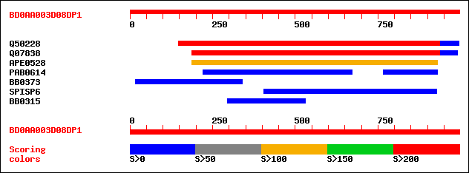
Sequence similarity search
V I T K L G T C V G S V I T K L G T C V G S
V I S . . . T Q V G S V . S K . G T Q V . S
• Smith-Waterman algorithm
• FASTA
• HMM (Hidden Markov Model)
• BLAST
• Identity
• Similarity
• Homology

Slide 9
Comparing 2 sequences
Aims at finding the optimal alignment: the one that shows most similar regions and regions that are less similar.
• In sequence comparisons, three different terms are commonly used :
Identity, Similarity and Homology.
Need for a score that evaluates:
- matches
- mismatches
- gaps
and a method that evaluates the numerous possible alignments.

Slide 10
Identity
• Refers to the occurence of identical nucleotides or amino acids in the same position in aligned sequences ;
• Identity is objective and well defined;
• Identity can be quantified: Percent i.e the number of identical matches divided by the length of the aligned region.
Score = 73.2 bits (178), Expect = 9e-14, Method: Compositional matrix adjust.
Identities = 41/93 (44%), Positives = 58/93 (62%), Gaps = 2/93 (2%)
Query 4 FEPLLIKSKAPRVLNISSGLGSSTEALVNKWGNNEKFLFSYNASKAALNILSINIRNLWN 63
F PL+ +SK+ R++N+SSGLGS T+ W YN SKA LN+++I + +
Sbjct 128 FLPLVRESKSGRIVNVSSGLGSLTQNADPNWPFAAYKPIGYNGSKAILNMMTIQLA--YE 185
Query 64 SKNYGIKVVAVDPGYCATNLNGNSGPKEASKGA 96
K+ IKV VDPGY AT++NGNSG + +GA
Sbjct 186 LKDTSIKVNTVDPGYTATDINGNSGHQTVEEGA 218

Slide 11
Similarity
• Sequence similarity takes approximate matches into account, and is meaningful only when such substitutions are scored according to some measure of «difference» with conservative substitutions assigned more favourable scores than non-conservative ones
(substitution matrices).
• Given a number of parameters (alphabet, scoring matrix, filtering procedure, etc...), the similarity of an aligned region is defined by a score calculated on that region;
• The score depends on the chosen parameters;
• Note: expression like significant or weak similarity are often used.

Slide 12
Example:
Score = 73.2 bits (178), Expect = 9e-14, Method: Compositional matrix adjust.
Identities = 41/93 (44%), Positives = 58/93 (62%), Gaps = 2/93 (2%)
Query 4 FEPLLIKSKAPRVLNISSGLGSSTEALVNKWGNNEKFLFSYNASKAALNILSINIRNLWN 63
F PL+ +SK+ R++N+SSGLGS T+ W YN SKA LN+++I + +
Sbjct 128 FLPLVRESKSGRIVNVSSGLGSLTQNADPNWPFAAYKPIGYNGSKAILNMMTIQLA--YE 185
Query 64 SKNYGIKVVAVDPGYCATNLNGNSGPKEASKGA 96
K+ IKV VDPGY AT++NGNSG + +GA
Sbjct 186 LKDTSIKVNTVDPGYTATDINGNSGHQTVEEGA 218

Slide 13
Homology
• Sequence homology underlies common ancestry and sequence conservation;
=> 2 gene (protein) sequences are homologs if they derive from a common ancestor;
• Homology can be inferred, under suitable conditions from sequence similarity ;

Slide 14
Homology
• The main objective of sequence similarity searching studies is inferring homology between sequences;
• Homology is not a measure.
It is an all or none relashionship (i.e. homology exits or does not exist).
Beware : significant or weak homology are meaningless!
Sequence similarity is a measure of the matching characters in an alignment, whereas homology is a statement of common evolutionary origin.

Slide 15
Alignments
Local Alignment
Global Alignment

Slide 16
Compare one query sequence to a BLAST formatted database

Slide 17
Amino acid scoring schemes

Slide 18
Standard genetic code
Start codon:
ATG
But in a minority of genes:
GTG, TTG or CTG
Stop codons:
TAA, TGA or TAG
Ala: Alanine; Cys: Cysteine; Asp: Aspartic acid; Glu: Glutamic acid
Phe: Phenylalanine; Gly: Glycine; His: Histidine; Ile: Isoleucine; Lys: Lysine; Leu: Leucine; Met: Methionine; Asn: Asparagine; Pro: Proline; Gln: Glutamine; Arg: Arginine; Ser: Serine; Thr: Threonine; Val: Valine; Trp: Tryptophane; Tyr: Tyrosine

Slide 19
Standard genetic code
Charged(basic; acidic); Hydrophiles; Hydrophobes
• Because there are only 20 amino acids, but 64 possible codons, the same amino acid is often encoded by a number of different codons, which usually differ in the third base of the triplet.

Slide 20
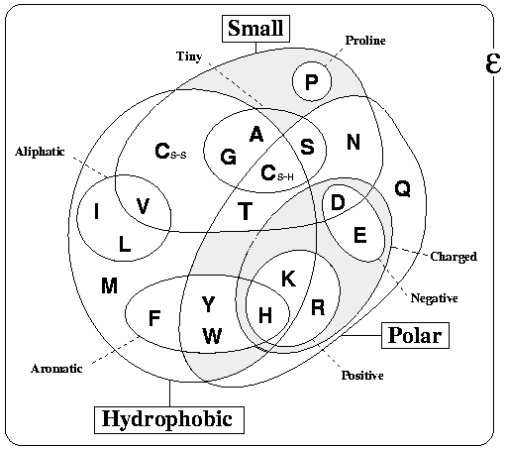
Amino-acids properties
http://www.russelllab.org/aas/

Slide 21
In addition to the specific amino acid codes, placeholders are used in cases where chemical or crystallographic analysis of a peptide or protein cannot conclusively determine the identity of a residue.
21st and 22nd amino acids 3-Letter 1-Letter
Selenocysteine Sec U
Pyrrolysine Pyl O
Ambiguous Amino Acids 3-Letter 1-Letter
Asparagine or aspartic acid Asx B
Glutamine or glutamic acid Glx Z
Leucine or Isoleucine Xle J
Unspecified or unknown amino acid Xaa X

Slide 22
Codons vs Amino Acids
Charged(basic; acidic); Hydrophiles; Hydrophobes

Slide 23
Amino acid scoring schemes
(substitution matrices)
• All algorithms comparing protein sequences rely on some schemes to score the equivalence of each of the 210 possible pairs of amino acids.
V I T K L G T C V G S V I T K L G T C V G S
V I S . . . T Q V G S V . S K . G T Q V . S
Notes:
Progression arithmetique de raison 1: n(n+1)/2 avec n=20 ce qui donne: 20(20 + 1)/2 = 210.

Slide 24
Amino acid scoring schemes
(substitution matrices)
As a result : what a local alignment program produces depends strongly upon the scores it uses. No single scoring scheme is best for all purposes.
• implicitly a scheme may represent a particular theory of evolution,
• choice of a matrix can strongly influence the outcome of an analysis.
•The scores in the matrix are integer values which assign a positive score to identical or similar amino-acids pairs, and a negative value to dissimilar amino-acids pairs.
S_{ij} = (ln(q_{ij}/p_{i}p_{j}))/λ_{u}; q_{ij} are target frequencies for aligned pairs of amino acids, the p_{i} and p_{j} are background frequencies, and λ_{u} is a statistical parameter.
Notes:
24
Progression arithmetique de raison 1: n(n+1)/2 avec n=20 ce qui donne: 20(20 + 1)/2 = 210.

Slide 25
Example: PAM250 substitution matrix
scale = ln(2)/3 = 0.231049 # Expected score = -0.844, Entropy = 0.354 bits
# Lowest score = -8, Highest score = 17
A R N D C Q E G H I L K M F P S T W Y V
A 2 -2 0 0 -2 0 0 1 -1 -1 -2 -1 -1 -3 1 1 1 -6 -3 0
R -2 6 0 -1 -4 1 -1 -3 2 -2 -3 3 0 -4 0 0 -1 2 -4 -2
N 0 0 2 2 -4 1 1 0 2 -2 -3 1 -2 -3 0 1 0 -4 -2 -2
D 0 -1 2 4 -5 2 3 1 1 -2 -4 0 -3 -6 -1 0 0 -7 -4 -2
C -2 -4 -4 -5 12 -5 -5 -3 -3 -2 -6 -5 -5 -4 -3 0 -2 -8 0 -2
Q 0 1 1 2 -5 4 2 -1 3 -2 -2 1 -1 -5 0 -1 -1 -5 -4 -2
E 0 -1 1 3 -5 2 4 0 1 -2 -3 0 -2 -5 -1 0 0 -7 -4 -2
G 1 -3 0 1 -3 -1 0 5 -2 -3 -4 -2 -3 -5 0 1 0 -7 -5 -1
H -1 2 2 1 -3 3 1 -2 6 -2 -2 0 -2 -2 0 -1 -1 -3 0 -2
I -1 -2 -2 -2 -2 -2 -2 -3 -2 5 2 -2 2 1 -2 -1 0 -5 -1 4
L -2 -3 -3 -4 -6 -2 -3 -4 -2 2 6 -3 4 2 -3 -3 -2 -2 -1 2
K -1 3 1 0 -5 1 0 -2 0 -2 -3 5 0 -5 -1 0 0 -3 -4 -2
M -1 0 -2 -3 -5 -1 -2 -3 -2 2 4 0 6 0 -2 -2 -1 -4 -2 2
F -3 -4 -3 -6 -4 -5 -5 -5 -2 1 2 -5 0 9 -5 -3 -3 0 7 -1
P 1 0 0 -1 -3 0 -1 0 0 -2 -3 -1 -2 -5 6 1 0 -6 -5 -1
S 1 0 1 0 0 -1 0 1 -1 -1 -3 0 -2 -3 1 2 1 -2 -3 -1
T 1 -1 0 0 -2 -1 0 0 -1 0 -2 0 -1 -3 0 1 3 -5 -3 0
W -6 2 -4 -7 -8 -5 -7 -7 -3 -5 -2 -3 -4 0 -6 -2 -5 17 0 -6
Y -3 -4 -2 -4 0 -4 -4 -5 0 -1 -1 -4 -2 7 -5 -3 -3 0 10 -2
V 0 -2 -2 -2 -2 -2 -2 -1 -2 4 2 -2 2 -1 -1 -1 0 -6 -2 4

Slide 26
BLOSUM62 Clustered Scoring Matrix in 1/2 Bit Units
# Cluster Percentage: >= 62
# Lowest score = -4, Highest score = 11
A R N D C Q E G H I L K M F P S T W Y V
A 4 -1 -2 -2 0 -1 -1 0 -2 -1 -1 -1 -1 -2 -1 1 0 -3 -2 0
R -1 5 0 -2 -3 1 0 -2 0 -3 -2 2 -1 -3 -2 -1 -1 -3 -2 -3
N -2 0 6 1 -3 0 0 0 1 -3 -3 0 -2 -3 -2 1 0 -4 -2 -3
D -2 -2 1 6 -3 0 2 -1 -1 -3 -4 -1 -3 -3 -1 0 -1 -4 -3 -3
C 0 -3 -3 -3 9 -3 -4 -3 -3 -1 -1 -3 -1 -2 -3 -1 -1 -2 -2 -1
Q -1 1 0 0 -3 5 2 -2 0 -3 -2 1 0 -3 -1 0 -1 -2 -1 -2
E -1 0 0 2 -4 2 5 -2 0 -3 -3 1 -2 -3 -1 0 -1 -3 -2 -2
G 0 -2 0 -1 -3 -2 -2 6 -2 -4 -4 -2 -3 -3 -2 0 -2 -2 -3 -3
H -2 0 1 -1 -3 0 0 -2 8 -3 -3 -1 -2 -1 -2 -1 -2 -2 2 -3
I -1 -3 -3 -3 -1 -3 -3 -4 -3 4 2 -3 1 0 -3 -2 -1 -3 -1 3
L -1 -2 -3 -4 -1 -2 -3 -4 -3 2 4 -2 2 0 -3 -2 -1 -2 -1 1
K -1 2 0 -1 -3 1 1 -2 -1 -3 -2 5 -1 -3 -1 0 -1 -3 -2 -2
M -1 -1 -2 -3 -1 0 -2 -3 -2 1 2 -1 5 0 -2 -1 -1 -1 -1 1
F -2 -3 -3 -3 -2 -3 -3 -3 -1 0 0 -3 0 6 -4 -2 -2 1 3 -1
P -1 -2 -2 -1 -3 -1 -1 -2 -2 -3 -3 -1 -2 -4 7 -1 -1 -4 -3 -2
S 1 -1 1 0 -1 0 0 0 -1 -2 -2 0 -1 -2 -1 4 1 -3 -2 -2
T 0 -1 0 -1 -1 -1 -1 -2 -2 -1 -1 -1 -1 -2 -1 1 5 -2 -2 0
W -3 -3 -4 -4 -2 -2 -3 -2 -2 -3 -2 -3 -1 1 -4 -3 -2 11 2 -3
Y -2 -2 -2 -3 -2 -1 -2 -3 2 -1 -1 -2 -1 3 -3 -2 -2 2 7 -1
V 0 -3 -3 -3 -1 -2 -2 -3 -3 3 1 -2 1 -1 -2 -2 0 -3 -1 4
Notes:
Note the 2 schemas to not give identical weights to identity and substitution…

Slide 27
• PAM matrices (Dayhoff et al. (1978))
PAM stands for “point accepted mutation”.
• 1 PAM corresponds to 1 amino acid change per 100 residues,
• 1 PAM ~1% divergence,
• PAMn: iterate PAM1 n times to obtain substitution rate between more divergent sequences.
Assumptions :
• replacements are independent of surrounding residues,
• sequences being compared are of average composition,
• all sites are equally mutable,
Source of error :
• small, globular proteins were used to derive PAM matrices
(departure from average composition)
• errors in PAM1 are magnified up to PAM250,....
• does not account for conserved blocks or motifs.
Strategy :
• PAM40 short alignments, highly similar
• PAM120 average similarity
• PAM250 longer, weaker local alignments.

Slide 28
• BLOSUM matrices (Henikoff, S., and Henikoff, J., G. (1992))
BlosumX denotes a matrix obtained from alignments of clustered sequence segments with more than X% identity.
Examples :
- Blosum62 is obtained from clustered sequences with identity greater than 62%.
- Blosum80 is obtained from clustered sequences with identity greater than 80%.
Which substitution matrix to choose?

Slide 29
Tips for using substitution matrices
• Generally, BLOSUM matrices perform better than PAM for local similarity searches.
• For database searches, the most commonly used matrix is BLOSUM62.
• When comparing closely related proteins, one should use lower PAM or higher BLOSUM, for distantly related proteins higher PAM or lower BLOSUM matrices
Blosum80 Blosum62 Blosum45
PAM10 PAM120 PAM250
Less divergent <------ searching ------> More divergent

Slide 30
Sequence similarity search
http://blast.ncbi.nlm.nih.gov/Blast.cgi

Slide 31
• Position Specific Scoring Matrix (PSSM)
Conserved motifs are identified and amino acid profile matrix for each motif is calculated.
This matrix (n x 20 aa ) is representative of the relative amino acid probabilities at specific positions and is characteristic of a protein family.
-Such matrices are used by the profile database searching programs (including PSI-BLAST and HMM based programs).

Slide 32
Example of a PSSM matrices (determined by PSI-BLAST program):
A R N D C Q E G H I L K M F P S T W Y V
1 M -1 -1 -2 -3 -1 0 -2 -3 -2 1 2 -1 5 0 -2 -1 -1 -1 -1 1
2 S 1 -1 1 0 -1 0 0 0 -1 -2 -2 0 -1 -2 -1 4 1 -3 -2 -2
3 S 1 -1 1 0 -1 0 0 0 -1 -2 -2 0 -1 -2 -1 4 1 -3 -2 -2
4 S 1 -1 1 0 -1 0 0 0 -1 -2 -2 0 -1 -2 -1 4 1 -3 -2 -2
5 S 1 -1 1 0 -1 0 0 0 -1 -2 -2 0 -1 -2 -1 4 1 -3 -2 -2
6 G 0 -2 0 -1 -3 -2 -2 6 -2 -4 -4 -2 -3 -3 -2 0 -2 -2 -3 -3
7 L -1 -2 -3 -4 -1 -2 -3 -4 -3 2 4 -2 2 0 -3 -2 -1 -2 -1 1
8 K -1 2 0 -1 -3 1 1 -2 -1 -3 -2 5 -1 -3 -1 0 -1 -3 -2 -2
9 Q -1 1 0 0 -3 5 2 -2 0 -3 -2 1 0 -3 -1 0 -1 -2 -1 -2
10 Q -1 1 0 0 -3 5 2 -2 0 -3 -2 1 0 -3 -1 0 -1 -2 -1 -2
11 G 0 -2 0 -1 -2 -2 -2 6 -2 -4 -4 -2 -3 -3 -2 0 -2 -2 -3 -3
12 L -1 -2 -3 -4 -1 -2 -3 -4 -3 2 4 -2 2 0 -3 -2 -1 -2 -1 1
13 A 4 -1 -2 -2 0 -1 -1 0 -2 -1 -1 -1 -1 -2 -1 1 0 -3 -2 0
14 Q -1 1 0 0 -3 5 2 -2 0 -3 -2 1 0 -3 -1 0 -1 -2 -1 -2
15 K -1 2 0 -1 -3 1 1 -2 -1 -3 -2 5 -1 -3 -1 0 -1 -3 -2 -2
16 K -1 2 0 -1 -3 1 1 -2 -1 -3 -2 5 -1 -3 -1 0 -1 -3 -2 -2
17 K -1 2 0 -1 -3 1 1 -2 -1 -3 -2 5 -1 -3 -1 0 -1 -3 -2 -2
18 F -2 -3 -3 -3 -2 -3 -3 -3 -1 0 0 -3 0 6 -4 -2 -2 1 3 -1
19 Q -1 1 0 0 -3 5 3 -2 0 -3 -2 1 0 -3 -1 0 -1 -2 -1 -2
20 L -1 -2 -3 -4 -1 -2 -3 -4 -3 2 4 -2 2 0 -3 -2 -1 -2 -1 1
21 E -1 0 0 2 -4 2 5 -2 0 -3 -3 1 -2 -3 -1 0 -1 -3 -2 -2
22 F -2 -3 -3 -3 -2 -3 -3 -3 -1 0 0 -3 0 6 -4 -2 -2 1 3 -1
23 D -2 -2 1 6 -3 0 2 -1 -1 -3 -4 -1 -3 -3 -1 0 -1 -4 -3 -3
.....................................................................
573 I -1 -3 -3 -3 -1 -3 -3 -4 -3 4 2 -3 1 0 -3 -2 -1 -3 -1 3
574 P -1 -2 -2 -1 -3 -1 -1 -2 -2 -3 -3 -1 -2 -4 7 -1 -1 -4 -3 -2
575 L -1 -2 -3 -4 -1 -2 -3 -4 -3 2 4 -2 2 0 -3 -2 -1 -2 -1 1

Slide 33
Example of a PSSM matrices (determined by PSI-BLAST program):
A R N D C Q E G H I L K M F P S T W Y V
1 M -1 -1 -2 -3 -1 0 -2 -3 -2 1 2 -1 5 0 -2 -1 -1 -1 -1 1
2 S 1 -1 1 0 -1 0 0 0 -1 -2 -2 0 -1 -2 -1 4 1 -3 -2 -2
3 S 1 -1 1 0 -1 0 0 0 -1 -2 -2 0 -1 -2 -1 4 1 -3 -2 -2
4 S 1 -1 1 0 -1 0 0 0 -1 -2 -2 0 -1 -2 -1 4 1 -3 -2 -2
5 S 1 -1 1 0 -1 0 0 0 -1 -2 -2 0 -1 -2 -1 4 1 -3 -2 -2
6 G 0 -2 0 -1 -3 -2 -2 6 -2 -4 -4 -2 -3 -3 -2 0 -2 -2 -3 -3
7 L -1 -2 -3 -4 -1 -2 -3 -4 -3 2 4 -2 2 0 -3 -2 -1 -2 -1 1
8 K -1 2 0 -1 -3 1 1 -2 -1 -3 -2 5 -1 -3 -1 0 -1 -3 -2 -2
9 Q -1 1 0 0 -3 5 2 -2 0 -3 -2 1 0 -3 -1 0 -1 -2 -1 -2
10 Q -1 1 0 0 -3 5 2 -2 0 -3 -2 1 0 -3 -1 0 -1 -2 -1 -2
11 G 0 -2 0 -1 -2 -2 -2 6 -2 -4 -4 -2 -3 -3 -2 0 -2 -2 -3 -3
12 L -1 -2 -3 -4 -1 -2 -3 -4 -3 2 4 -2 2 0 -3 -2 -1 -2 -1 1
13 A 4 -1 -2 -2 0 -1 -1 0 -2 -1 -1 -1 -1 -2 -1 1 0 -3 -2 0
14 Q -1 1 0 0 -3 5 2 -2 0 -3 -2 1 0 -3 -1 0 -1 -2 -1 -2
15 K -1 2 0 -1 -3 1 1 -2 -1 -3 -2 5 -1 -3 -1 0 -1 -3 -2 -2
16 K -1 2 0 -1 -3 1 1 -2 -1 -3 -2 5 -1 -3 -1 0 -1 -3 -2 -2
17 K -1 2 0 -1 -3 1 1 -2 -1 -3 -2 5 -1 -3 -1 0 -1 -3 -2 -2
18 F -2 -3 -3 -3 -2 -3 -3 -3 -1 0 0 -3 0 6 -4 -2 -2 1 3 -1
19 Q -1 1 0 0 -3 5 3 -2 0 -3 -2 1 0 -3 -1 0 -1 -2 -1 -2
20 L -1 -2 -3 -4 -1 -2 -3 -4 -3 2 4 -2 2 0 -3 -2 -1 -2 -1 1
21 E -1 0 0 2 -4 2 5 -2 0 -3 -3 1 -2 -3 -1 0 -1 -3 -2 -2
22 F -2 -3 -3 -3 -2 -3 -3 -3 -1 0 0 -3 0 6 -4 -2 -2 1 3 -1
23 D -2 -2 1 6 -3 0 2 -1 -1 -3 -4 -1 -3 -3 -1 0 -1 -4 -3 -3
.....................................................................
573 I -1 -3 -3 -3 -1 -3 -3 -4 -3 4 2 -3 1 0 -3 -2 -1 -3 -1 3
574 P -1 -2 -2 -1 -3 -1 -1 -2 -2 -3 -3 -1 -2 -4 7 -1 -1 -4 -3 -2
575 L -1 -2 -3 -4 -1 -2 -3 -4 -3 2 4 -2 2 0 -3 -2 -1 -2 -1 1

Slide 34
Blast algorithm:
(1) Query sequence: list of high scoring words of length w.
Query Sequence of length L
Maximum of L-w+1 words; w=3,11
List the words that score at least T using a substitution matrix (Bosum62 or PAM250,...)
.....
(2) Compare the word list to the database and identify exact matches.
DB sequences
.....
Extract matches of words from word list.
(3)For each word match, extend alignment in both directions to
find alignments with scores > S
Maximal Segment Pairs (MSPs): HSPs

Slide 35
E-values:
• Statistics of HSP scores are characterized by two parameters, K and λ.
• The expected number of HSPs with score at least S is given by:
E = Kmne^{-λS} (Karlin & Altschul,1990). m and n are sequence lengths.
• E is the E-value for the score S.
Bit scores:
• S’ = (λS – lnK)/ln2
• The E-value corresponding to a given bit score is : E = mn2^{-S’}.
(note mn).
P-values:
The probability of finding exactly a HSPs with score >= S is given by :
P(a) = e^{-E}.Eª/a! (Poisson distribution), where E is the E-value of S given by the above equation. Finding zero HSP with score >=S is
P(0) = e^{-E},
so the probability of finding at least one such HSP is : P = 1 - e^{-E}.

Slide 36
BLASTP 2.2.27+
………………..
Database: All non-redundant GenBank CDS
translations+PDB+SwissProt+PIR+PRF excluding environmental samples
from WGS projects 21,208,471 sequences; 7,265,817,909 total letters
Query= AQF_AAT00004164001 assembled CDS
Length=127
Score E
Sequences producing significant alignments: (Bits) Value
ref|YP_004184197.1| short-chain dehydrogenase/reductase SDR [... 73.2 9e-14
ref|XP_002669416.1| predicted protein [Naegleria gruberi] >gb... 71.6 4e-13
ref|YP_004812747.1| short-chain dehydrogenase/reductase SDR [... 69.7 2e-12
ref|YP_006423079.1| short-chain dehydrogenase [Terriglobus ro... 69.3 2e-12
ref|ZP_04604473.1| short-chain dehydrogenase/reductase SDR [M... 68.6 4e-12
gb|AAD44003.1| AtsC [Agrobacterium fabrum str. C58] 68.2 6e-12
ref|NP_396088.2| short chain dehydrogenase dehydrogenases [Ag... 68.2 7e-12
ref|YP_004015249.1| short-chain dehydrogenase/reductase SDR [... 67.8 7e-12
gb|EHJ96564.1| short chain dehydrogenase [Agrobacterium tumef... 68.2 7e-12
ref|YP_004280461.1| short chain dehydrogenase [Agrobacterium ... 67.8 9e-12
emb|CCH02226.1| short-chain dehydrogenase/reductase SDR [Fibr... 67.4 1e-11
ref|YP_005464711.1| putative short-chain dehydrogenase [Actin... 67.4 1e-11
ref|YP_004361811.1| short chain oxidoreductase [Burkholderia ... 67.4 1e-11
ref|ZP_10456423.1| short chain oxidoreductase [Streptomyces a... 67.0 1e-11
ref|YP_003486342.1| short chain oxidoreductase [Streptomyces ... 67.0 2e-11
ref|ZP_06920745.1| short-chain dehydrogenase/reductase SDR [S... 66.6 2e-11
ref|YP_005264601.1| putative short chain oxidoreductase (frag... 65.9 2e-11
ref|YP_004016889.1| short-chain dehydrogenase/reductase SDR [... 65.5 5e-11
gb|EHA26682.1| dehydrogenase [Aspergillus niger ATCC 1015] 65.5 5e-11
ref|ZP_07299458.1| short chain dehydrogenase/reductase family... 65.1 6e-11
……………………………………………………………………………….
ref|ZP_06730950.1| short chain dehydrogenase [Xanthomonas fus... 57.4 5e-08

Slide 37
ALIGNMENTS
>ref|YP_004184197.1| short-chain dehydrogenase/reductase SDR [Terriglobus saanensis SP1PR4]
gb|ADV84203.1| short-chain dehydrogenase/reductase SDR [Terriglobus saanensis SP1PR4]
Length=245
Score = 73.2 bits (178), Expect = 9e-14, Method: Compositional matrix adjust.
Identities = 41/93 (44%), Positives = 58/93 (62%), Gaps = 2/93 (2%)
Query 4 FEPLLIKSKAPRVLNISSGLGSSTEALVNKWGNNEKFLFSYNASKAALNILSINIRNLWN 63
F PL+ +SK+ R++N+SSGLGS T+ W YN SKA LN+++I + +
Sbjct 128 FLPLVRESKSGRIVNVSSGLGSLTQNADPNWPFAAYKPIGYNGSKAILNMMTIQLA--YE 185
Query 64 SKNYGIKVVAVDPGYCATNLNGNSGPKEASKGA 96
K+ IKV VDPGY AT++NGNSG + +GA
Sbjct 186 LKDTSIKVNTVDPGYTATDINGNSGHQTVEEGA 218
>ref|XP_002669416.1| predicted protein [Naegleria gruberi]
gb|EFC36672.1| predicted protein [Naegleria gruberi]
Length=244
Score = 71.6 bits (174), Expect = 4e-13, Method: Compositional matrix adjust.
Identities = 42/99 (42%), Positives = 62/99 (63%), Gaps = 8/99 (8%)
Query 1 MDKFEPLLIKSKAPRVLNISSGLGSSTEALVNKWGNNEKFLFSYNASKAALNILSINIRN 60
MD+F+ LL +SK PR++N+SS LGS A+ + +K +Y +K+ALN+L+I
Sbjct 120 MDEFKELLEQSKHPRIVNVSSTLGSL--AVAQLPNSPQKLYTTYTITKSALNMLTI---- 173
Query 61 LWNSK--NYGIKVVAVDPGYCATNLNGNSGPKEASKGAQ 97
+++ K + IKV A PGYCAT LNG G K +GA+
Sbjct 174 IYSQKFAEFNIKVNATCPGYCATELNGYQGTKTPQEGAK 212

Slide 38
Sequence format: FASTA format (most used)
First position
Sequence Identification
Sequence Comments - Annotations
>Rv0006 gyrA DNA gyrase subunit A
MTDTTLPPDDSLDRIEPVDIEQEMQRSYIDYAMSVIVGRALPEVRDGLKPVHRRVLYAMFDSGFRPDRSH
AKSARSVAETMGNYHPHGDASIYDSLVRMAQPWSLRYPLVDGQGNFGSPGNDPPAAMRYTEARLTPLAME
MLREIDEETVDFIPNYDGRVQEPTVLPSRFPNLLANGSGGIAVGMATNIPPHNLRELADAVFWALENHDA
DEEETLAAVMGRVKGPDFPTAGLIVGSQGTADAYKTGRGSIRMRGVVEVEEDSRGRTSLVITELPYQVNH
DNFITSIAEQVRDGKLAGISNIEDQSSDRVGLRIVIEIKRDAVAKVVINNLYKHTQLQTSFGANMLAIVD
GVPRTLRLDQLIRYYVDHQLDVIVRRTTYRLRKANERAHILRGLVKALDALDEVIALIRASETVDIARAG
LIELLDIDEIQAQAILDMQLRRLAALERQRIIDDLAKIEAEIADLEDILAKPERQRGIVRDELAEIVDRH
GDDRRTRIIAADGDVSDEDLIAREDVVVTITETGYAKRTKTDLYRSQKRGGKGVQGAGLKQDDIVAHFFV
CSTHDLILFFTTQGRVYRAKAYDLPEASRTARGQHVANLLAFQPEERIAQVIQIRGYTDAPYLVLATRNG
LVKKSKLTDFDSNRSGGIVAVNLRDNDELVGAVLCSAGDDLLLVSANGQSIRFSATDEALRPMGRATSGV
QGMRFNIDDRLLSLNVVREGTYLLVATSGGYAKRTAIEEYPVQGRGGKGVLTVMYDRRRGRLVGALIVDD
DSELYAVTSGGGVIRTAARQVRKAGRQTKGVRLMNLGEGDTLLAIARNAEESGDDNAVDANGADQTGN

Slide 39
Rough Guide for p-values and e-values
p-Value (reported by many programs): 0≤ p-val ≤ 1
p <= 10⁻¹⁰⁰ | Exact match
10⁻¹⁰⁰ < p < 10⁻⁵⁰ | Sequences nearly identical, e.g.: alleles or SNPs
10⁻⁵⁰ < p < 10⁻¹⁰ | Closely related sequences, homology certain
10⁻⁵ < p < 10⁻¹ | Usually distant relatives
p > 10⁻¹ | Match probably insignificant
• E-value (reported by some programs, eg PSI-Blast): 0 ≤ E-val ≤ size of database
e <= 0.02 | Sequences probably homologous
0.02 <= e <=1 | Homology can’t be ruled out
e >1 | This match would be obtained by chance

Slide 40
e-value limit determination by radom sampling

Slide 41
e-value limit for statistical significance?
Can be determined by simulation:
• Sets of random sequences generated with sizes and compositions equal to the average size and amino acid composition of the entire predicted proteome of a given species.
• Each random sequence is compared to the entire database of the cognate species proteome, and the best probability scores are recorded.
Tekaia F, Dujon B. J Mol Evol.; 1999; 49(5):591-600. Pervasiveness of gene conservation and persistence of duplicates in cellular genomes.

Slide 42
Random proteome
Original proteome
n random sequences
blastp
n original sequences
• Random seq with size and amino-acids composition equal to the average seq size and proteome aa composition.

Slide 43
• Random seq with size and amino-acids composition equal to the average seq size and proteome aa composition.
• Comparison of random sequences vs cognate proteome

Slide 44
ncbi BLAST home page
http://blast.ncbi.nlm.nih.gov/
BLAST Tutorials and Guides: https://blast.ncbi.nlm.nih.gov/Blast.cgi?CMD=Web&PAGE_TYPE=BlastDocs
BLAST Program Selection Guide:
ftp://ftp.ncbi.nlm.nih.gov/pub/factsheets/HowTo_BLASTGuide.pdf

Slide 45
Specialized BLAST
•Find conserved domains in a sequence (cds)
• Find sequences with similar conserved domain architecture (cdart)
• Align two sequences using BLAST (bl2seq)
• Constraint Based Protein Multiple Alignment Tool
• Needleman-Wunsch Global Sequence Alignment Tool

Slide 46
FASTA Sequence Comparisons

Slide 47
FASTA Sequence Comparisons
• Interesting to explore and compare results with those obtained by the BLAST series of programs
• https://fasta.bioch.virginia.edu/fasta_www2/fasta_list2.shtml
Local Alignments
• Local Protein alignments (lalign)
• Plot Protein alignment "dot-plot" (plalign)
• Local DNA alignments (lalign)
• Plot DNA alignment "dot-plot" (plalign)

Slide 48
FASTA Sequence Comparisons
• Compare one sequence (protein/dna) versus a database:
• https://fasta.bioch.virginia.edu/fasta_www2/fasta_list2.shtml
Protein
• Protein-protein FASTA
• Protein-protein Smith-Waterman (ssearch)
• Global Protein-protein (Needleman-Wunsch) (ggsearch)
• Global/Local protein-protein (glsearch)
• Protein-protein with unordered peptides (fasts)
• Protein-protein with mixed peptide sequences (fastf)
Nucleotide
Nucleotide-Nucleotide (DNA/RNA fasta)

Slide 49
FASTA Sequence Comparisons
• https://fasta.bioch.virginia.edu/fasta_www2/fasta_list2.shtml
• Note ssearch and ggsearch programs:
• Protein-protein Smith-Waterman (ssearch)
• Global Protein-protein (Needleman-Wunsch) (ggsearch)

Slide 50
Practical sessions
• We will practice all BLAST programmes
We will use 2 sets of dna and protein sequences:
-SPO11.1
-SPO11.2
and the ncbi BLAST web server.

Slide 51
Practical sessions
Practical session: choose a set of protein sequences
(see Directory ./DATA/SPO11.1; ./DATA/SPO11.2);

Slide 52
BLAST @ ncbi

Slide 53
Algorithm parameters that can be changed

Slide 54
References
•See: http://www.ncbi.nlm.nih.gov/books/NBK20261/
Chapter 4. Principles and Methods of Sequence Analysis
Chapter 6. Comparative Genomics and New Evolutionary Biology
• Park Y, Sheetlin S, Ma N, Madden TL, Spouge JL(2012)
New finite-size correction for local alignment score distributions.
BMC Res Notes.2012 Jun 12;5:286. doi: 10.1186/1756-0500-5-286.

Slide 55
LAST
http://last.cbrc.jp
LAST tutorial: http://last.cbrc.jp/doc/last-tutorial.html
Aligning long DNA and RNA reads to a genome:
https://github.com/mcfrith/last-rna/blob/master/last-long-reads.md
Large-scaleSequenceComparisons:
http://last.cbrc.jp/mcf-kyoto08.pdf
Vmatch large-scale sequence analysis software:
http://www.vmatch.de

Slide 56
FASTA Sequence Comparisons server

Slide 57
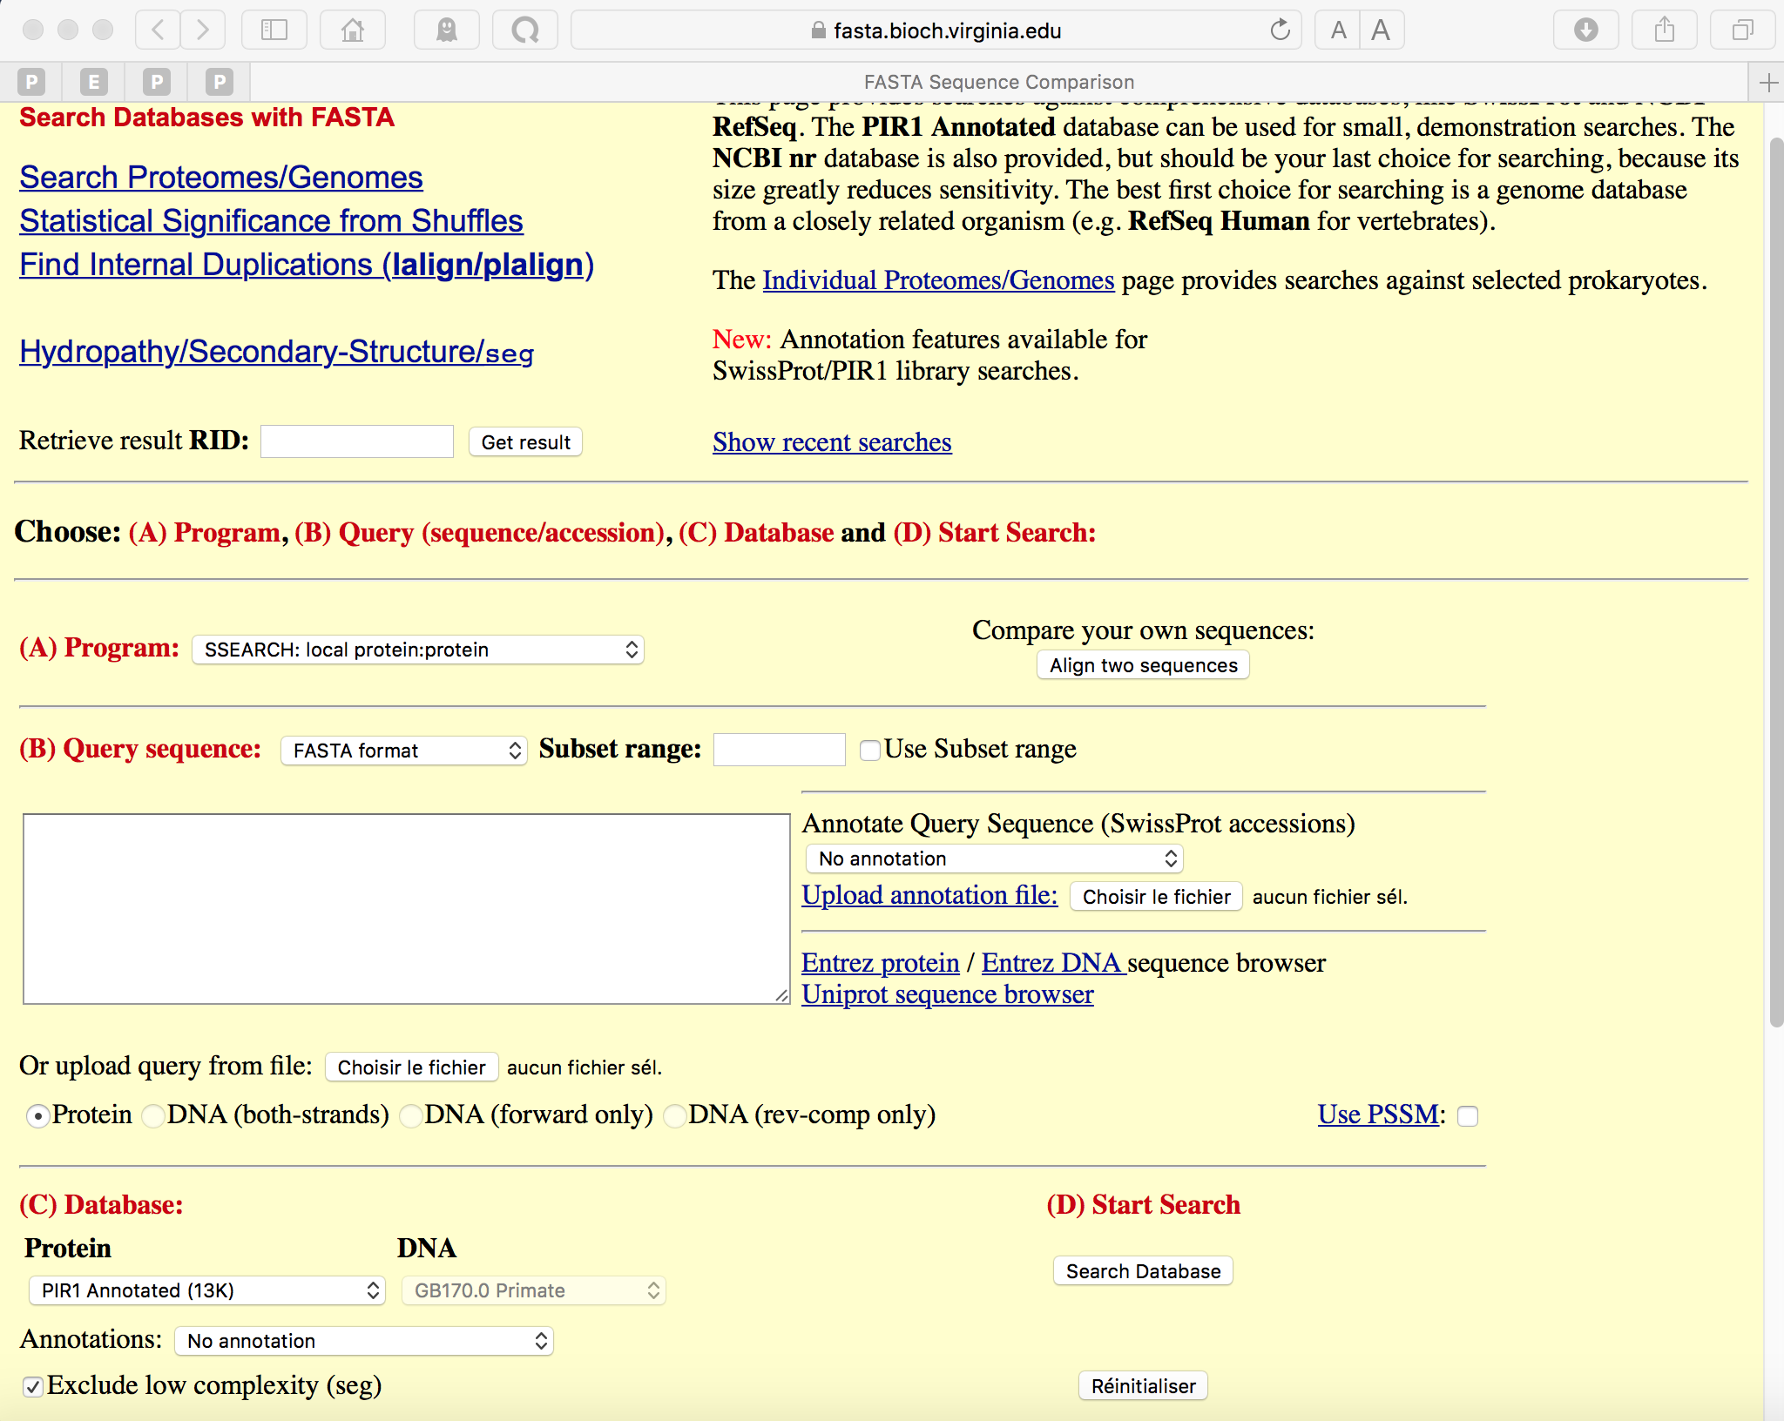
FASTA server: ssearch program

Slide 58
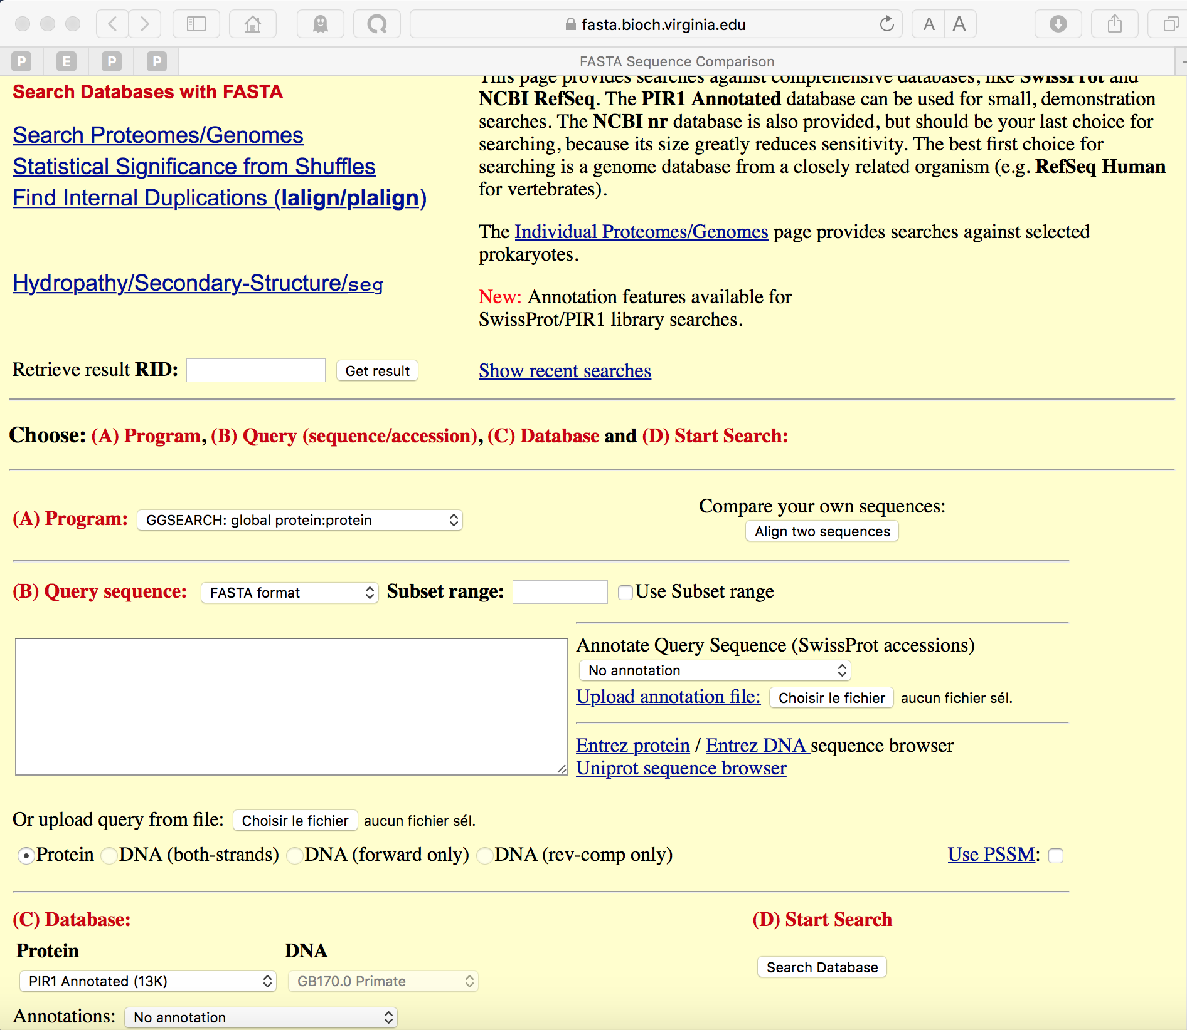
FASTA server: ggsearch program

Slide 59
References
• Tekaia, F. and Dujon, B. (1999).
Pervasiveness of gene conservation and persistence of duplicates in cellular genomes. Journal of Molecular Evolution, 49:591-600.
• Tekaia, F., Lazcano, A. and B. Dujon (1999). Genome tree as revealed from whole proteome comparisons. Genome Res. 12:17-25.
• Tekaia, F., Yeramian, E. and Dujon, B. (2002).
Amino acid composition of genomes, lifestyles of organisms, and evolutionary trends: a global picture with correspondence analysis. Gene 297: 51-60.
• Tekaia, F. and Yeramian, E. (2005).
Genome Trees from Conservation Profiles. PLoS Comput Biol.1(7):e75.
• Tekaia, F. and Yeramian, E. (2006).
Evolution of Proteomes: Fundamental signatures and global trends in amino acid composition. BMC Genomics. 2006 Dec 5;7:307.
• Tekaia, F. and Yeramian, E. (2012).
SuperPartitions: detection and classification of orthologs.
Gene. 2012;492(1):199-211.

Slide 60
F. Tekaia, G. Blandin, A. Malpertuy, et al. (2000):
Methods and strategies used for sequence analysis and annotation.
FEBS 487,1:17-30.
- A. Malpertuy, F. Tekaia, S. Casaregola, et al. (2000):
«Yeast specific» genes. FEBS 487,1:113-121.
G. Blandin, P. Durrens, F. Tekaia, et al. (2000).
The genome of Saccharomyces cerevisiae revisited. FEBS 487,1:31-36.
Tekaia F, Latge JP Aspergillus fumigatus: saprophyte or pathogen? (2005)
Curr Opin in Microb 8 (4): 385-392.
-Dujon et al. (2004) Genome Evolution in Yeasts Nature. 430: p. 35-44.
- Nierman et al. (2005) Genomic sequence of the pathogenic and allergenic filamentous fungus Aspergillus fumigatus.
Nature. 438:1151-6.

Slide 61
Practical Sessions
See BCGAIPT2017_SeqCompPS.pdf

Slide 62
Thank You

