Slide 1
Introduction to UNIX
Fredj Tekaia
tekaia@pasteur.fr
Bioinformatics and Genome Analyses
Institut Pasteur Tunis, Tunisia. September 18 – December 15, 2017

Slide 2
Objective
• In this course we will introduce the basics of UNIX programming.
• The course is not intended for UNIX specialists
• It is intended for genome data analysists

Slide 3
Note:
Consider GSACE.seq, GSACE.pep, GSACE.dna as examples for practical

Slide 4
Course Outline
Introduction
Operating system overview
UNIX utilities
Scripting languages
Programming tools

Slide 5
Course Outline
Introduction
Operating system overview
UNIX utilities
Scripting languages
Programming tools

Slide 6

The UNIX Philosophy
Small is beautiful
Easy to understand
Easy to maintain
More efficient
Better for reuse
Make each program do one thing well
More complex functionality by combining programs
Make every program a filter
Notes:
Core Idea: #1
#2 is an example of #1

Slide 7
The UNIX Philosophy
..continued
Portability over efficiency
Most efficient implementation is rarely portable
Portability better for rapidly changing hardware
Use flat ASCII files
Common, simple file format
Example of portability over efficiency
Reusable code
Good programmers write good code; great programmers borrow good code
Notes:
Example: Failure of ATARI 2600 move to ATARI 800 (hard (8K) so highly non portable)

Slide 8
The UNIX Philosophy
..continued
Beware UNIX is case sensitive
$val is different from $Val
File is different from file
More is different from more
Bin is different from bin
Print is different from print
While is different from while
…..

Slide 9
The UNIX Philosophy
..continued
Scripting increases leverage and portability
print $(who | awk '{print $1}' | sort | uniq) | sed 's/ /,/g'
List the logins of a system’s users on a single line.
who | 755
awk | 3,412
sort | 2,614
uniq | 302
sed | 2,093
9,176 lines
Build prototypes quickly (high level interpreted languages)

Slide 10
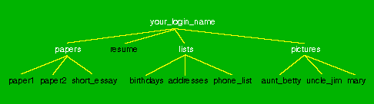
The UNIX Philosophy
..continued
Avoid captive interfaces
The user of a program isn’t always human
Look nice, but code is big and ugly
Problems with scale
Silence is golden
Only report if something is wrong
Think hierarchically

Slide 11
Course Outline
Introduction
Operating system overview
UNIX utilities
Scripting languages
Programming tools

Slide 12
UNIX Highlights / Contributions
Portability (variety of hardware; C implementation)
Hierarchical file system; the file abstraction
Multitasking and multiuser capability
Inter-process communication
Pipes: output of one programmed fed into input of another
Software tools
Development tools
Scripting languages
TCP/IP

Slide 13
The Operating System
The government of your computer
Kernel: Performs critical system functions and interacts with the hardware
Systems utilities: Programs and libraries that provide various functions through systems calls to the kernel

Slide 14
Kernel Basics
The kernel is …
a program loaded into memory during the boot process, and always stays in physical memory.
responsible for managing CPU and memory for processes, managing file systems, and interacting with devices.

Slide 15
UNIX Structural Layout
shell scripts
User Space
utilities
C programs
system calls
compilers
signal handler
Kernel
scheduler
device drivers
swapper
terminal
Devices
printer
disk
RAM

Slide 16
Kernel Subsystems
Process management
Schedule processes to run on CPU
Inter-process communication (IPC)
Memory management
Virtual memory
Paging and swapping
I/O system
File system
Device drivers
Buffer cache

Slide 17
System Calls
Interface to the kernel
Over 1,000 system calls available on Linux
3 main categories
File/device manipulation
e.g. mkdir(), unlink()
Process control
e.g. fork(), execve(), nice()
Information manipulation
e.g. getuid(), time()

Slide 18
Logging In
Need an account and password first
Enter at login: prompt
Password not echoed
After successful login, you will see a shell prompt
Entering commands
At the shell prompt, type in commands
Typical format: command options arguments
Examples: who, date, ls, cat myfile, ls –l
Case sensitive
exit to log out

Slide 19
Remote Login
Use Secure Shell (ssh)
UNIX-like OS
ssh name@access.cims.nyu.edu

Slide 20
Unix System Structure
user
c programs scripts
ls ksh
gcc find
shell and utilities
open() fork() exec()
kernel
hardware

Slide 21
Kernel Subsystems
File system
Deals with all input and output
Includes files and terminals
Integration of storage devices
Process management
Deals with programs and program interaction
How processes share CPU, memory and signals
Scheduling
Interprocess Communication
Memory management
UNIX variants have different implementations of different subsystems.

Slide 22

What is a shell?
The user interface to the operating system
Functionality:
Execute other programs
Manage files
Manage processes
A program like any other
Executed when you log on

Slide 23
Most Commonly Used Shells
/bin/sh The Bourne Shell / POSIX shell
/bin/csh C shell
/bin/tcsh Enhanced C Shell
/bin/ksh Korn shell
/bin/bash Free ksh clone
Basic form of shell:
while (read command) { parse command execute command }

Slide 24
Shell Interactive Use
When you log in, you interactively use the shell:
Command history
Command line editing
File expansion (tab completion)
Command expansion
Key bindings
Spelling correction
Job control

Slide 25
Shell Scripting
• A set of shell commands that constitute an executable program
• A shell script is a regular text file that contains shell or UNIX commands
• Very useful for automating repetitive task and administrative tools and for storing commands for later execution

Slide 26
Simple Commands
simple command: sequence of non blanks arguments separated by blanks or tabs.
1st argument (numbered zero) usually specifies the name of the command to be executed.
Any remaining arguments:
Are passed as arguments to that command.
Arguments may be filenames, pathnames, directories or special options (up to command)
Special characters are interpreted by shell

Slide 27
A simple example
$ ls –l /bin -rwxr-xr-x 1 root sys 43234 Sep 26 2001 date $
prompt
command
arguments
Execute a basic command

Slide 28
Getting Help on UNIX
man: display entries from UNIX online documentation
whatis, apropos
Manual entries organization:
1. Commands
2. System calls
3. Subroutines
4. Special files
5. File format and conventions
6. Games
http://en.wikipedia.org/wiki/Unix_manual

Slide 29
Example Man Page
ls ( 1 )
USER COMMANDS
ls ( 1 )
NAME
ls - list files and/or directories
SYNOPSIS
ls [ options ] [ file ... ]
DESCRIPTION
For each directory argument ls lists the contents; for each file argument the name and requested information are listed. The current directory is listed if no file arguments appear. The listing is sorted by file name by default, except that file arguments are listed before directories.
.
OPTIONS
-a, --all
List entries starting with .; turns off --almost-all.
-F, --classify
Append a character for typing each entry.
-l, --long|verbose
Use a long listing format.
-r, --reverse
Reverse order while sorting.
-R, --recursive
List subdirectories recursively.
SEE ALSO
chmod(1), find(1), getconf(1), tw(1)

Slide 30

Fundamentals of Security
UNIX systems have one or more users, identified with a number and a name.
A set of users can form a group. A user can be a member of multiple groups.
A special user (id 0, name root) has complete control.
Each user has a primary (default) group.

Slide 31
How are Users & Groups used?
Used to determine if file or process operations can be performed:
Can a given file be read? written to?
Can this program be run?
Can I use this piece of hardware?
Can I stop a particular process that’s running?

Slide 32
A simple example
$ ls –l /bin -rwxr-xr-x 1 root sys 43234 Sep 26 2001 date $
read
write
execute

Slide 33
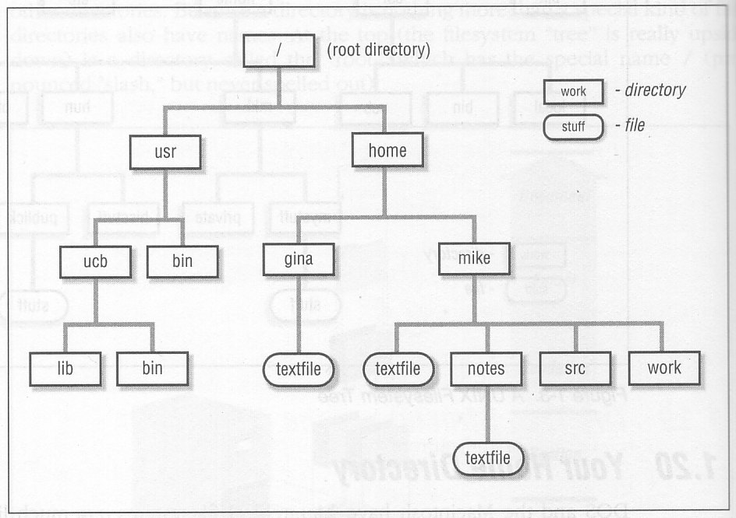
The UNIX File Hierarchy

Slide 34
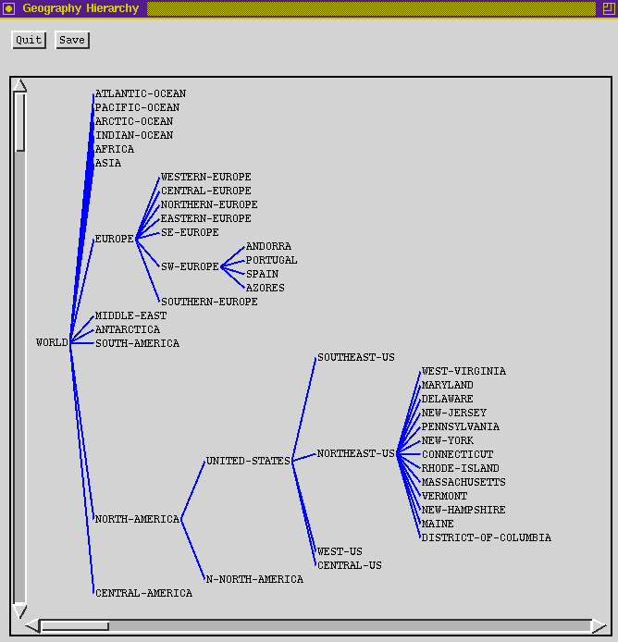
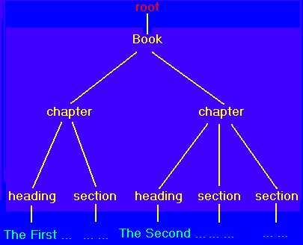
Hierarchies are Ubiquitous

Slide 35
Definition: Filename
A sequence of characters other than slash. Case sensitive.
/
usr
tmp
etc
bin
foo
who
date
dmr
wm4
foo
who date .profile
.profile

Slide 36
Definition: Directory
Holds a set of files or other directories. Case sensitive.
/
usr
tmp
etc
bin
foo
who
date
dmr
wm4
etc
usr dmr bin
.profile

Slide 37
Definition: Pathname
A sequence of directory names followed by a simple filename, each separated from the previous one by a /
/
usr
tmp
etc
bin
foo
who
date
dmr
wm4
/usr/wm4/.profile
.profile

Slide 38
Definition: Working Directory
A directory that file names refer to by default.
One per process.
/
usr
tmp
etc
bin
foo
who
date
dmr
wm4
.profile

Slide 39
Definition: Relative Pathname
A pathname relative to the working directory (as opposed to absolute pathname)
/
usr
tmp
etc
bin
foo
who
date
dmr
wm4
.. refers to parent directory . refers to current directory
.profile
.profile ./.profile ../wm4/.profile

Slide 40
Files and Directories
Files are just a sequence of bytes
No file types (data vs. executable)
No sections
Example of UNIX philosophy
Directories are a list of files and status of the files:
Creation date
Attributes
etc.

Slide 41
Tilde (~) Expansion
Each user has a home directory
Most shells (ksh, csh) support ~ operator:
~ expands to my home directory
~/myfile → /home/kornj/myfile
~user expands to user’s home directory
~unixtool/file2 → /home/unixtool/file2
Useful because home directory locations vary by machine

Slide 42
Printing File Contents
The cat command can be used to copy the contents of a file to the terminal. When invoked with a list of file names, it concatenates them.
Some options:
-n number output lines (starting from 1)
-v display control-characters in visible form (e.g. ^C)
Interactive commands more and less show a page at a time

Slide 43
Common Utilities for Managing files and directories
pwd print process working directory
ed, vi, emacs… create/edit files
ls list contents of directory
rm remove file
mv rename file
cp copy a file
finger displays information about a user
mkdir create a directory
rmdir remove a directory
wc counts the words in a file
file determine file type (text, exec…)
du directory usage

Slide 44
File Permissions
UNIX provides a way to protect files based on users and groups.
Three types of permissions:
read, process may read contents of file
write, process may write contents of file
execute, process may execute file
Three sets of permissions:
permissions for owner
permissions for group (1 group per file)
permissions for other

Slide 45
Directory permissions
Same types and sets of permissions as for files:
read: process may read the directory contents (i.e., list files)
write: process may add/remove files in the directory
execute: process may open files in directory or subdirectories

Slide 46
Utilities for Manipulating file attributes
chmod change file permissions
chown change file owner
chgrp change file group
umask user file creation mode mask
only owner or super-user can change file attributes
upon creation, default permissions given to file modified by process umask value

Slide 47
chmod command
Symbolic access modes {u,g,o} / {r,w,x}
example: chmod +r file
Octal access modes
octal read write execute
0 no no no
1 no no yes
2 no yes no
3 no yes yes
4 yes no no
5 yes no yes
6 yes yes no
7 yes yes yes

Slide 48

Redirection
Before a command is executed, the input and output can be changed from the default (terminal) to a file
Shell modifies file descriptors in child process
The child program knows nothing about this
ls
ls

Slide 49
Redirection of input/ouput
Redirection of output: >
example:$ ls > my_files
Redirection of input: <
example: $ mail kornj <input.data
Append output: >>
example: $ date >> logfile
Bourne Shell derivatives: fd>
example: $ ls 2> error_log

Slide 50
Using Devices
Redirection works with devices (just like files)
Special files in /dev directory
Example: /dev/tty
Example: /dev/lp
Example: /dev/null
cat big_file > /dev/lp
cat big_file > /dev/null

Slide 51
Symbolic links
Symbolic links are created with ln -s
Can be thought of as a directory entry that points to the name of another file.
Does not change link count for file
When original deleted, symbolic link remains

Slide 52
Tree Walking
How can we find a set of files in the hierarchy?
One possibility:
ls –l –R /
What about:
All files below a given directory in the hierarchy?
All files since Jan 1, 2001?
All files larger than 10K?

Slide 53
find utility
find pathlist expression
find recursively descends through pathlist and applies expression to every file.
expression can be:
-name pattern
true if file name matches pattern. Pattern may include shell patterns such as *, must be in quotes to suppress shell interpretation.
Ex: find / -name '*.c'

Slide 54
find: actions
-print prints out the name of the current file (default)
-exec cmd
Executes cmd, where cmd must be terminated by an escaped semicolon (\; or ';').
If you specify {} as a command line argument, it is replaced by the name of the current file just found.
exec executes cmd once per file.
Example:
find -name "*.o" -exec rm "{}" ";"

Slide 55
find Examples
Find all files beneath home directory beginning with f
find ~ -name 'f*' -print
Find all files beneath home directory modified in last day
find ~ -mtime 1 -print
Find all files beneath home directory larger than 10K
find ~ -size 10k -print
Count words in files under home directory
find ~ -exec wc -w {} \; -print
Remove core files
find / -name core –exec rm {} \;

Slide 56
type utility
• The command type will tell you where a particular command resides.
Example:
bash$ type rm
rm is /usr/bin/rm

Slide 57
diff: comparing two files
diff: compares two files and outputs a description of their differences
Usage: diff [options] file1 file2
-i: ignore case
apples oranges walnuts
apples oranges grapes
$ diff test1 test2 3c3 < walnuts --- > grapes

Slide 58
Course Outline
Introduction
Operating system overview
UNIX utilities
Scripting languages
Programming tools

Slide 59
Background Jobs
By default, executing a command in the shell will wait for it to exit before printing out the next prompt
Trailing a command with & allows the shell and command to run simultaneously
$ /bin/sleep 10 & [1] 3424 $

Slide 60
Program Arguments
When a process is started, it is sent a list of strings
argv, argc

Slide 61
Ending a process
When a process ends, there is a return code associated with the process
This is a positive integer
0 means success
>0 represent various kinds of failure, up to process

Slide 62
Process Information Maintained
Working directory
Process id
number used to identify process
Process group id
number used to identify set of processes
Parent process id
process id of the process that created the process

Slide 63
Environment of a Process
Common examples:
PATH: Where to search for programs
TERM: Terminal type

Slide 64
The PATH environment variable
Colon-separated list of directories.
Non-absolute pathnames of executables are only executed if found in the list.
Searched left to right
Examples: $ myprogram sh: myprogram not found $ PATH=/bin:/usr/bin:/home/kornj/bin $ myprogram hello!
Example: type
echo $PATH

Slide 65
Having “.” In Your Path
$ ls foo $ foo sh: foo: not found
$ ./foo Hello, foo.
To add “.” to your PATH type:
PATH=$PATH:.
To add globally insert this line in your .bashrc file

Slide 66
Shell Variables
Shells have several mechanisms for creating variables. A variable is a name representing a string value. Example: PATH
Shell variables can save time and reduce typing errors
Allow you to store and manipulate information
Ex: ls $DIR > $FILE
Two types: local and environmental
local are set by the user or by the shell itself
environmental come from the operating system and are passed to children

Slide 67
Variables (con’t)
Syntax varies by shell
varname=value # sh, ksh
set varname = value # csh
To access the value: $varname
Turn local variable into environment:
export varname # sh, ksh
setenv varname value # csh

Slide 68
Environmental Variables
NAME MEANING
$HOME Absolute pathname of your home directory
$PATH A list of directories to search for
$MAIL Absolute pathname to mailbox
$USER Your user id
$SHELL Absolute pathname of login shell
$TERM Type of your terminal
$PS1 Prompt

Slide 69
Inter-process Communication
Ways in which processes communicate:
Passing arguments, environment
Read/write regular files
Exit values
Signals
Pipes

Slide 70
Process Subsystem utilities
ps monitors status of processes
kill send a signal to a pid
wait parent process wait for one of its children to terminate
nohup makes a command immune to the hangup and terminate signal
sleep sleep in seconds
nice run processes at low priority

Slide 71
Pipes
One of the cornerstones of UNIX

Slide 72
Pipes
General idea: The input of one program is the output of the other, and vice versa
Both programs run at the same time
A
B

Slide 73
Pipes (2)
Often, only one end of the pipe is used
Could this be done with files?
standard out
standard in
A
B

Slide 74
File Approach
Run first program, save output into file
Run second program, using file as input
Unnecessary use of the disk
Slower
Can take up a lot of space
Makes no use of multi-tasking
process 1
process 2

Slide 75
More about Pipes
Pipes are often chained together
Called filters
standard out
standard in
A
B
C

Slide 76
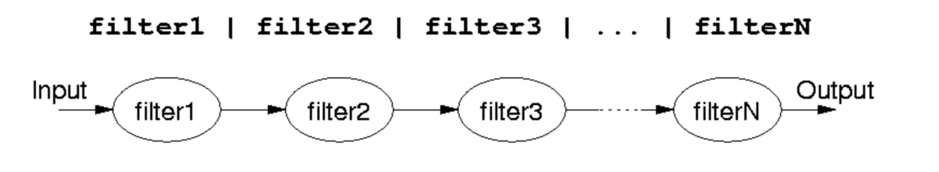
Pipelines
Output of one program becomes input to another
Uses concept of UNIX pipes
Example: $ who | wc -l
counts the number of users logged in
Pipelines can be long

Slide 77
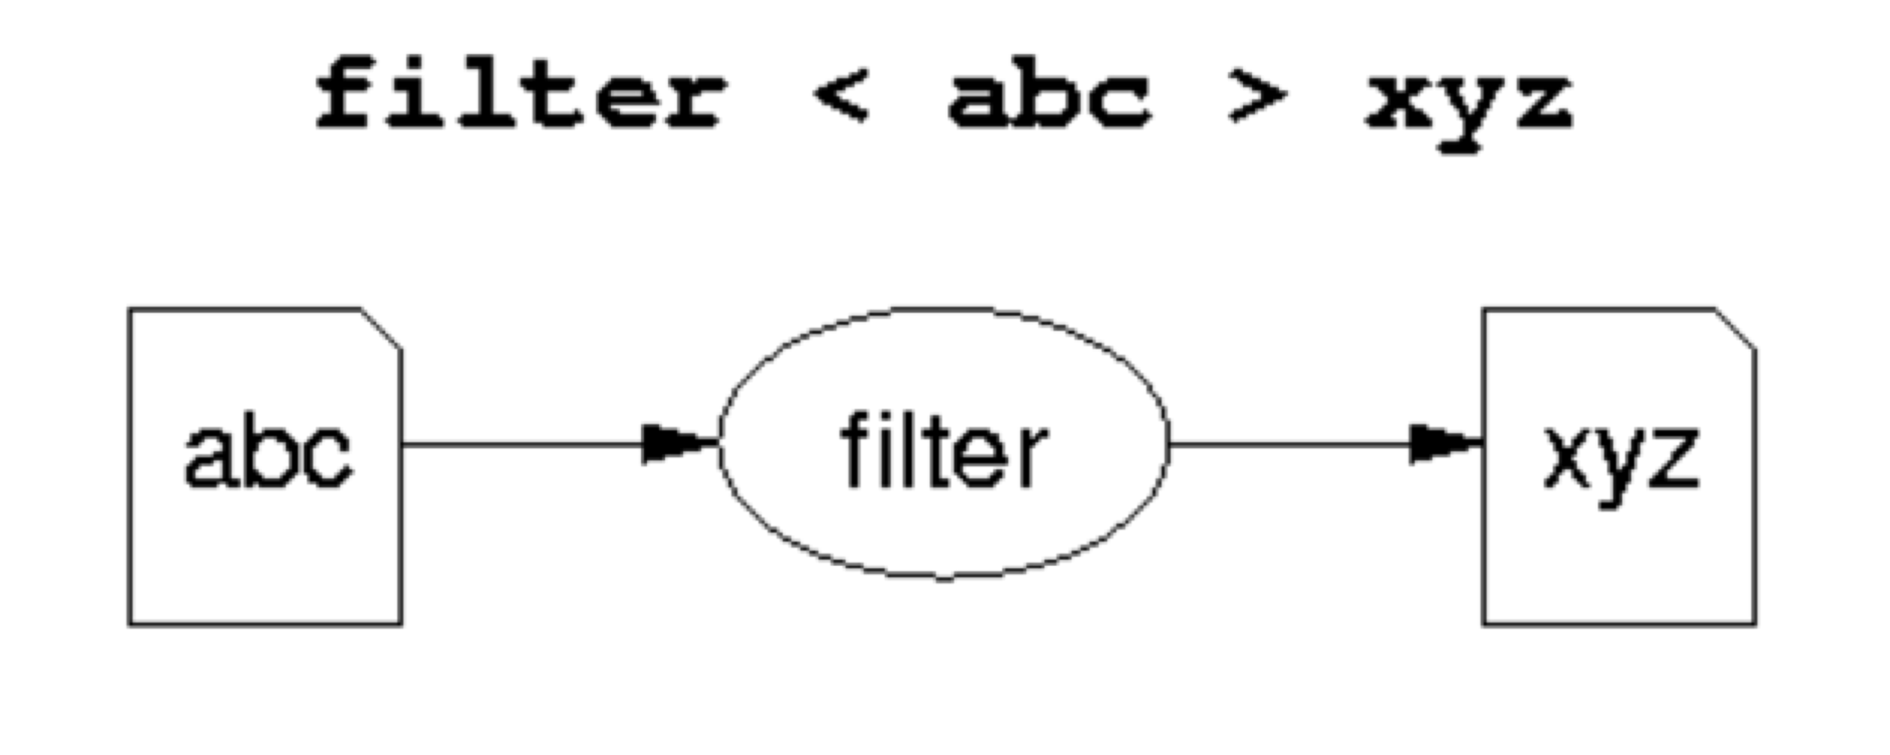
Introduction to Filters
A class of Unix tools called filters.
Utilities that read from standard input, transform the file, and write to standard output
Using filters can be thought of as data oriented programming.
Each step of the computation transforms data stream.

Slide 78
Examples of Filters
sort
Input: lines from a file
Output: lines from the file sorted
grep
Input: lines from a file
Output: lines that match the argument

Slide 79
cat: The simplest filter
The cat command copies its input to output unchanged (identity filter). When supplied a list of file names, it concatenates them onto stdout.
Some options:
-n number output lines (starting from 1)
-v display control-characters in visible form (e.g. ^C)
cat file*
ls | cat -n

Slide 80
head
Display the first few lines of a specified file
Syntax: head [-n] [filename...]
-n - number of lines to display, default is 10
filename... - list of filenames to display
When more than one filename is specified, the start of each files listing displays
==>filename<==

Slide 81
tail
Displays the last part of a file
Syntax: tail +|-number [lbc] [f] [filename]
or: tail +|-number [l] [rf] [filename]
+number - begins copying at distance number from beginning of file, if number isn’t given, defaults to 10
-number - begins from end of file
l,b,c - number is in units of lines/block/characters
r - print in reverse order (lines only)
f - if input is not a pipe, do not terminate after end of file has been copied but loop. This is useful to monitor a file being written by another process

Slide 82
head and tail examples
head /etc/passwd
head *.c
tail +20 /etc/passwd
ls -lt | tail -3
head –100 /etc/passwd | tail -5
tail –f /usr/local/httpd/access_log

Slide 83
Unix Text Files: Delimited Data
Tab Separated
Pipe-separated
John 99 Anne 75 Andrew 50 Tim 95 Arun 33 Sowmya 76
COMP1011|2252424|Abbot, Andrew John |3727|1|M COMP2011|2211222|Abdurjh, Saeed |3640|2|M COMP1011|2250631|Accent, Aac-Ek-Murhg |3640|1|M COMP1021|2250127|Addison, Blair |3971|1|F COMP4012|2190705|Allen, David Peter |3645|4|M COMP4910|2190705|Allen, David Pater |3645|4|M
Colon-separated
root:ZHolHAHZw8As2:0:0:root:/root:/bin/ksh jas:nJz3ru5a/44Ko:100:100:John Shepherd:/home/jas:/bin/ksh cs1021:iZ3sO90O5eZY6:101:101:COMP1021:/home/cs1021:/bin/bash cs2041:rX9KwSSPqkLyA:102:102:COMP2041:/home/cs2041:/bin/csh cs3311:mLRiCIvmtI9O2:103:103:COMP3311:/home/cs3311:/bin/sh

Slide 84
cut: select columns
The cut command prints selected parts of input lines.
can select columns (assumes tab-separated input)
can select a range of character positions
Some options:
-f listOfCols: print only the specified columns (tab-separated) on output
-c listOfPos: print only chars in the specified positions
-d c: use character c as the column separator
Lists are specified as ranges (e.g. 1-5) or comma-separated (e.g. 2,4,5).

Slide 85
cut examples
cut -f 1 < data
cut -f 1-3 < data
cut -f 1,4 < data
cut -f 4- < data
cut -d'|' -f 1-3 < data
cut -c 1-4 < data
Unfortunately, there's no way to refer to "last column" without counting the columns.

Slide 86
paste: join columns
The paste command displays several text files "in parallel" on output.
If the inputs are files a, b, c
the first line of output is composed of the first lines of a, b, c
the second line of output is composed of the second lines of a, b, c
Lines from each file are separated by a tab character.
If files are different lengths, output has all lines from longest file, with empty strings for missing lines.
1 2
3 4
5 6
1 3 5 2 4 6

Slide 87
paste example
cut -f 1 < data > data1
cut -f 2 < data > data2
cut -f 3 < data > data3
paste data1 data3 data2 > newdata

Slide 88
sort: Sort lines of a file
The sort command copies input to output but ensures that the output is arranged in ascending order of lines.
By default, sorting is based on ASCII comparisons of the whole line.
Other features of sort:
understands text data that occurs in columns. (can also sort on a column other than the first)
can distinguish numbers and sort appropriately
can sort files "in place" as well as behaving like a filter
capable of sorting very large files

Slide 89
sort: Options
Syntax: sort [-dftnr] [-o filename] [filename(s)]
-d Dictionary order, only letters, digits, and whitespace are significant in determining sort order
-f Ignore case (fold into lower case)
-t Specify delimiter
-n Numeric order, sort by arithmetic value instead of first digit
-r Sort in reverse order
-o filename - write output to filename, filename can be the same as one of the input files
Lots of more options…

Slide 90
sort Examples
sort +2nr < data sort –k2nr data
sort -t: +4 /etc/passwd
sort -o mydata mydata

Slide 91
uniq: list UNIQue items
Remove or report adjacent duplicate lines
Syntax: uniq [ -cdu] [input-file] [ output-file]
-c Supersede the -u and -d options and generate an output report with each line preceded by an occurrence count
-d Write only the duplicated lines
-u Write only those lines which are not duplicated
The default output is the union (combination) of -d and -u

Slide 92
wc: Counting results
The word count utility, wc, counts the number of lines, characters or words
Options:
-l Count lines
-w Count words
-c Count characters
Default: count lines, words and chars

Slide 93
wc and uniq Examples
who | sort | uniq –d
wc my_essay
who | wc
sort file | uniq | wc –l
sort file | uniq –d | wc –l
sort file | uniq –u | wc -l

Slide 94
tr: TRanslate Characters
Copies standard input to standard output with substitution or deletion of selected characters
Syntax: tr [ -cds ] [ string1 ] [ string2 ]
-d delete all input characters contained in string1
-c complements the characters in string1 with respect to the entire ASCII character set
-s squeeze all strings of repeated output characters in the last operand to single characters

Slide 95
tr (continued)
tr reads from standard input.
Any character that does not match a character in string1 is passed to standard output unchanged
Any character that does match a character in string1 is translated into the corresponding character in string2 and then passed to standard output
Examples
tr s z replaces all instances of s with z
tr so zx replaces all instances of s with z and o with x
tr a-z A-Z replaces all lower case characters with upper case characters
tr –d a-c deletes all a-c characters

Slide 96
tr uses
Change delimiter
tr ‘|’ ‘:’
Rewrite numbers
tr ,. .,
Import DOS files
tr –d ’\r’ < dos_file
Find printable ASCII in a binary file
tr –cd ’\na-zA-Z0-9 ’ < binary_file

Slide 97
Basic UNIX Commands
Files: rm, cp, mv, ls, ln
Processes: ps, kill
Unix Filters
cat, head, tail, tee, wc
cut, paste
find
sort, uniq
comm, diff, cmp
tr

Slide 98
Regular Expressions
Allow you to search for text in files
grep command
Stream manipulation:
sed

Slide 99
Regular Expressions

Slide 100
What Is a Regular Expression?
A regular expression (regex) describes a set of possible input strings.
Regular expressions descend from a fundamental concept in Computer Science called finite automata theory
Regular expressions are endemic to Unix
vi, ed, sed, and emacs
awk, tcl, perl and Python
grep, egrep, fgrep
compilers

Slide 101
Regular Expressions
The simplest regular expressions are a string of literal characters to match.
The string matches the regular expression if it contains the substring.

Slide 102
regular expression
c k s
UNIX Tools rocks.
match
UNIX Tools sucks.
match
UNIX Tools is okay.
no match

Slide 103
Regular Expressions
A regular expression can match a string in more than one place.
regular expression
a p p l e
Scrapple from the apple.
match 1
match 2

Slide 104
Regular Expressions
The “.” regular expression can be used to match any character.
regular expression
o .
For me to poop on.
match 1
match 2

Slide 105
Character Classes
Character classes [] can be used to match any specific set of characters.
regular expression
b [eor] a t
beat a brat on a boat
match 1
match 2
match 3

Slide 106
Negated Character Classes
Character classes can be negated with the [^] syntax.
regular expression
b [^eo] a t
beat a brat on a boat
match

Slide 107
More About Character Classes
[aeiou] will match any of the characters a, e, i, o, or u
[kK]orn will match korn or Korn
Ranges can also be specified in character classes
[1-9] is the same as [123456789]
[abcde] is equivalent to [a-e]
You can also combine multiple ranges
[abcde123456789] is equivalent to [a-e1-9]
Note that the - character has a special meaning in a character class but only if it is used within a range, [-123] would match the characters -, 1, 2, or 3

Slide 108
Named Character Classes
Commonly used character classes can be referred to by name (alpha, lower, upper, alnum, digit, punct, cntrl)
Syntax [:name:]
[a-zA-Z] [[:alpha:]]
[a-zA-Z0-9] [[:alnum:]]
[45a-z] [45[:lower:]]

Slide 109
Anchors
Anchors are used to match at the beginning or end of a line (or both).
^ means beginning of the line
$ means end of the line

Slide 110
regular expression
^ b [eor] a t
beat a brat on a boat
match
regular expression
b [eor] a t $
beat a brat on a boat
match
^word$
^$

Slide 111
Repetition
The * is used to define zero or more occurrences of the single regular expression preceding it.

Slide 112
regular expression
y a * y
I got mail, yaaaaaaaaaay!
match
regular expression
o a * o
For me to poop on.
match
.*

Slide 113
Match length
A match will be the longest string that satisfies the regular expression.
regular expression
a . * e
Scrapple from the apple.
no
no
yes

Slide 114
Repetition Ranges
Ranges can also be specified
{ } notation can specify a range of repetitions for the immediately preceding regex
{n} means exactly n occurrences
{n,} means at least n occurrences
{n,m} means at least n occurrences but no more than m occurrences
Example:
.{0,} same as .*
a{2,} same as aaa*

Slide 115
Subexpressions
If you want to group part of an expression so that * or { } applies to more than just the previous character, use ( ) notation
Subexpresssions are treated like a single character
a* matches 0 or more occurrences of a
abc* matches ab, abc, abcc, abccc, …
(abc)* matches abc, abcabc, abcabcabc, …
(abc){2,3} matches abcabc or abcabcabc

Slide 116
grep
grep comes from the ed (Unix text editor) search command “global regular expression print” or g/re/p
This was such a useful command that it was written as a standalone utility
There are two other variants, egrep and fgrep that comprise the grep family
grep is the answer to the moments where you know you want the file that contains a specific phrase but you can’t remember its name

Slide 117
grep - uses regular expressions for pattern matching

Slide 118
Protecting Regex Metacharacters
Since many of the special characters used in regexps also have special meaning to the shell, it’s a good idea to get in the habit of single quoting your regexps
This will protect any special characters from being operated on by the shell
If you habitually do it, you won’t have to worry about when it is necessary

Slide 119
Escaping Special Characters
Even though we are single quoting our regexps so the shell won’t interpret the special characters, some characters are special to grep (eg * and .)
To get literal characters, we escape the character with a \ (backslash)
Suppose we want to search for the character sequence a*b*
Unless we do something special, this will match zero or more ‘a’s followed by zero or more ‘b’s, not what we want
a\*b\* will fix this - now the asterisks are treated as regular characters

Slide 120
grep: Backreferences
Sometimes it is handy to be able to refer to a match that was made earlier in a regex
This is done using backreferences
\n is the backreference specifier, where n is a number
Looks for nth subexpression
For example, to find if the first word of a line is the same as the last:
^\([[:alpha:]]\{1,\}\) .* \1$
The \([[:alpha:]]\{1,\}\) matches 1 or more letters

Slide 121
grep Family
Syntax
grep [-hilnv] [-e expression] [filename]
-h Do not display filenames
-i Ignore case
-l List only filenames containing matching lines
-n Precede each matching line with its line number
-v Negate matches
-x Match whole line only (fgrep only)
-e expression Specify expression as option

Slide 122
grep Examples
grep 'men' GrepMe
grep 'fo*' GrepMe

Slide 123
This is one line of text
input line
o.*o
regular expression
fgrep, grep, egrep
grep, egrep
grep
Quick Reference
egrep

Slide 124
sed: Stream-oriented, Non-Interactive, Text Editor
Look for patterns one line at a time, like grep
Change lines of the file
Non-interactive text editor
Editing commands come in as script
There is an interactive editor ed which accepts the same commands
A Unix filter
Superset of previously mentioned tools

Slide 125

sed Architecture
Input
scriptfile
Input line
(Pattern Space)
Commands in a sed script are applied in order to each line.
If a command changes the input, subsequent command will be applied to the modified line in the pattern space, not the original input line.
The input file is unchanged (sed is a filter).
Results are sent to standard output unless redirected.
Output

Slide 126
Scripts
A script is nothing more than a file of commands
Each command consists of up to two addresses and an action, where the address can be a regular expression or line number.
address
action
command
address
action
address
action
address
action
address
action
script

Slide 127
sed Flow of Control
sed then reads the next line in the input file and restarts from the beginning of the script file
All commands in the script file are compared to, and potentially act on, all lines in the input file
script
cmd 1
cmd 2
. . .
cmd n
Executed if line matches address
print command
output
output
input
only without -n

Slide 128
sed Syntax
Syntax: sed [-n] [-e] [‘command’] [file…]
sed [-n] [-f scriptfile] [file…]
-n - only print lines specified with the print command (or the ‘p’ flag of the substitute (‘s’) command)
-f scriptfile - next argument is a filename containing editing commands
-e command - the next argument is an editing command rather than a filename, useful if multiple commands are specified
If the first line of a scriptfile is “#n”, sed acts as though -n had been specified

Slide 129
sed Commands
sed commands have the general form
[address[, address]][!]command [arguments]
sed copies each input line into a pattern space
If the address of the command matches the line in the pattern space, the command is applied to that line
If the command has no address, it is applied to each line as it enters pattern space
If a command changes the line in pattern space, subsequent commands operate on the modified line
When all commands have been read, the line in pattern space is written to standard output and a new line is read into pattern space

Slide 130
Commands
command is a single letter
Example: Deletion: d
[address1][,address2]d
Delete the addressed line(s) from the pattern space; line(s) not passed to standard output.
A new line of input is read and editing resumes with the first command of the script.

Slide 131
Address and Command Examples
d deletes all lines
6d deletes line 6
/^$/d deletes all blank lines
1,10d deletes lines 1 through 10
1,/^$/d deletes from line 1 through the first blank line
/^$/,$d deletes from the first blank line through the last line of the file
/^$/,10d deletes from the first blank line through line 10
/^ya*y/,/[0-9]$/d deletes from the first line that begins with yay, yaay, yaaay, etc. through the first line that ends with a digit

Slide 132

sed Commands
• Although sed contains many editing commands, we are only going to cover the following subset:
s - substitute
a - append
i - insert
c - change
d - delete
p - print
y - transform
q - quit

Slide 133
Substitute
Syntax: [address(es)]s/pattern/replacement/[flags]
pattern - search pattern
replacement - replacement string for pattern
flags - optionally any of the following
n a number from 1 to 512 indicating which occurrence of pattern should be replaced
g global, replace all occurrences of pattern in pattern space
p print contents of pattern space

Slide 134
Substitute Examples
s/Puff Daddy/P. Diddy/
Substitute P. Diddy for the first occurrence of Puff Daddy in pattern space
s/Tom/Dick/2
Substitutes Dick for the second occurrence of Tom in the pattern space
s/wood/plastic/p
Substitutes plastic for the first occurrence of wood and outputs (prints) pattern space

Slide 135
Replacement Patterns
Substitute can use several special characters in the replacement string
& - replaced by the entire string matched in the regular expression for pattern
\n - replaced by the nth substring (or subexpression) previously specified using “\(“ and “\)”
\ - used to escape the ampersand (&) and the backslash (\)

Slide 136
Replacement Pattern Examples
"the UNIX operating system …"
s/.NI./wonderful &/
"the wonderful UNIX operating system …"
cat test1
first:second
one:two
sed 's/\(.*\):\(.*\)/\2:\1/' test1
second:first
two:one
sed 's/\([[:alpha:]]\)\([^ \n]*\)/\2\1ay/g'
Pig Latin ("unix is fun" -> "nixuay siay unfay")

Slide 137
sed Advantages
Regular expressions
Fast
Concise

Slide 138
sed Drawbacks
Hard to remember text from one line to another
Not possible to go backward in the file
No way to do forward references like /..../+1
No facilities to manipulate numbers
Cumbersome syntax

Slide 139
sed example
Consider the 2 files: GSACE.pep and GCAGL.pep
• list the comment lines and remove “>” as well as the species identification.
more GSACE.pep | grep ">" | sed -e "s/>//g" -e "s/ \[.*//g" | more
List of sequence identities:
grep “>” GSACE.pep | sed –e “s/>//g” –e ”s/ .*//g” > SACE.ident

Slide 140
Course Outline
Introduction
Operating system overview
UNIX utilities
Scripting languages
Programming tools

Slide 141
What is a shell?
The user interface to the operating system
Functionality:
Execute other programs
Manage files
Manage processes
Full programming language
A program like any other
This is why there are so many shells

Slide 142
Most Commonly Used Shells
/bin/csh C shell
/bin/tcsh Enhanced C Shell
/bin/sh The Bourne Shell / POSIX shell
/bin/ksh Korn shell
/bin/bash Korn shell clone, from GNU

Slide 143
Ways to use the shell
Interactively
When you log in, you interactively use the shell
Scripting
A set of shell commands that constitute an executable program

Slide 144
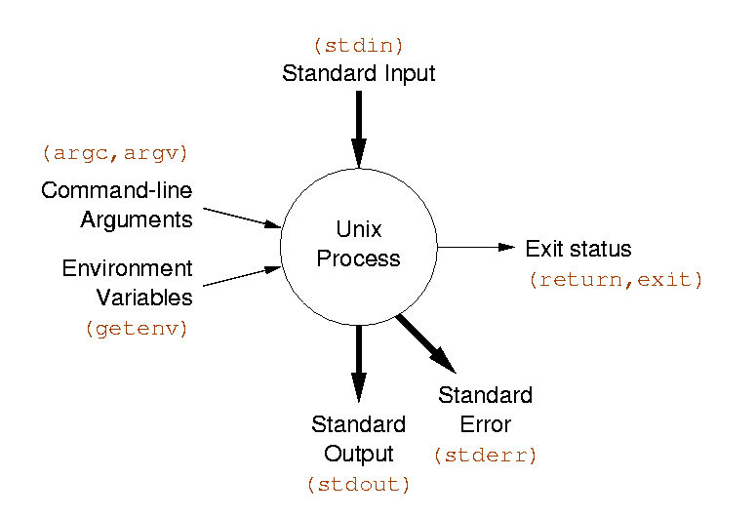
Review: UNIX Programs
Means of input:
Program arguments [control information]
Environment variables [state information]
Standard input [data]
Means of output:
Return status code [control information]
Standard out [data]
Standard error [error messages]

Slide 145
Shell Scripts
A shell script is a regular text file that contains shell or UNIX commands
Before running it, it must have execute permission:
chmod +x filename
A script can be invoked as:
sh name [ arg … ]
sh < name [ args … ]
name [ arg …]

Slide 146
Shell Scripts
When a script is run, the kernel determines which shell it is written for by examining the first line of the script
If 1st line starts with #!pathname-of-shell, then it invokes pathname and sends the script as an argument to be interpreted
If #! is not specified, the current shell assumes it is a script in its own language
leads to problems

Slide 147
Simple Example
#!/bin/sh echo Hello World

Slide 148
Basic emacs commands
• emacs file &
Search/Replace C-s Search forward C-r search backward
Basic movement C-f forward char C-b backward char C-p previous line C-n next line C-a beginning of line C-e end of line C-v one page up M-v scroll down one page M-< beginning of text M-> end of text
Basics C-x C-s save the file C-x C-w write the text to an alternate name C-x i insert file at cursor position
Editing C-d delete a char C-k kill line

Slide 149
Simple Commands
simple command: sequence of non blanks arguments separated by blanks or tabs.
1st argument (numbered zero) usually specifies the name of the command to be executed.
Any remaining arguments:
Are passed as arguments to that command.
Arguments may be filenames, pathnames, directories or special options
/bin/ls -l /
ls –l /

Slide 150
Background Commands
Any command ending with "&" is run in the background.
wait will block until the command finishes
firefox &

Slide 151
Redirection of input/ouput
Redirection of output: >
example:$ ls -l > my_files
Redirection of input: <
example: $ cat <input.data
Append output: >>
example: $ date >> logfile
Arbitrary file descriptor redirection: fd>
example: $ ls –l 2> error_log

Slide 152
Multiple Redirection
cmd 2>file
send standard error to file
standard output remains the same
cmd > file 2>&1
send both standard error and standard output to file
cmd > file1 2>file2
send standard output to file1
send standard error to file2

Slide 153
Shell Variables
To set:
name=value
Read: $var
Variables can be local or environment. Environment variables are part of UNIX and can be accessed by child processes.
Turn local variable into environment:
export variable

Slide 154
Variable Example
#!/bin/sh MESSAGE="Hello World" echo $MESSAGE

Slide 155
Example with Parameters
#!/bin/sh # Parameter 1: word # Parameter 2: file grep $1 $2 | wc –l
$ countlines ing /usr/dict/words 3277

Slide 156
Special Parameters
$# Number of positional parameters
$- Options currently in effect
$? Exit value of last executed command
$$ Process number of current process
$! Process number of background process
$* All arguments on command line
"$@" All arguments on command line individually quoted "$1" "$2" ...

Slide 157
Command Substitution
Used to turn the output of a command into a string
Used to create arguments or variables
Command is placed with grave accents ` ` to capture the output of command
$ date Wed Sep 25 14:40:56 EDT 2001 $ NOW=`date` $ grep `generate_regexp` myfile.c
$ sed "s/oldtext/`ls | head -1`/g" $ PATH=`myscript`:$PATH

Slide 158
File name expansion
Used to generate a set of arguments from files
Wildcards (patterns)
* matches any string of characters
? matches any single character
[list] matches any character in list
[lower-upper] matches any character in range lower-upper inclusive
[!list] matches any character not in list
This is the same syntax that find uses

Slide 159
Boolean Operators
Exit value of a program (exit system call) is a number
0 means success
anything else is a failure code
cmd1 && cmd2
executes cmd2 if cmd1 is successful
cmd1 || cmd2
executes cmd2 if cmd1 is not successful
$ ls bad_file > /dev/null && date $ ls bad_file > /dev/null || date Wed Sep 26 07:43:23 2006

Slide 160
Control Structures
if expression then command1 else command2 fi

Slide 161
What is an expression?
Any UNIX command. Evaluates to true if the exit code is 0, false if the exit code > 0
Special command /bin/test exists that does most common expressions
String compare
Numeric comparison
Check file properties
[ often a builtin version of /bin/test for syntactic sugar
Good example UNIX tools working together

Slide 162
Examples
if test "$USER" = "kornj" then echo "I know you" else echo "I dont know you" fi
if [ -f /tmp/stuff ] && [ `wc –l < /tmp/stuff` -gt 10 ] then echo "The file has more than 10 lines in it" else echo "The file is nonexistent or small" fi

Slide 163
test Summary
String based tests
-z string Length of string is 0
-n string Length of string is not 0
string1 = string2 Strings are identical
string1 != string2 Strings differ
string String is not NULL
Numeric tests
int1 –eq int2 First int equal to second
int1 –ne int2 First int not equal to second
-gt, -ge, -lt, -le greater, greater/equal, less, less/equal
File tests
-r file File exists and is readable
-w file File exists and is writable
-f file File is regular file
-d file File is directory
-s file file exists and is not empty
Logic
! Negate result of expression
-a, -o and operator, or operator
( expr ) groups an expression

Slide 164
Arithmetic
No arithmetic built in to /bin/sh
Use external command /bin/expr
expr expression
Evaluates expression and sends the result to standard output.
Yields a numeric or string result
expr 4 "*" 12
expr "(" 4 + 3 ")" "*" 2
Particularly useful with command substitution X=`expr $X + 2`

Slide 165
Control Structures Summary
if … then … fi
while … done
until … do … done
for … do … done
case … in … esac

Slide 166
for loops
Different than C:
for var in list do command done
Typically used with positional parameters or a list of files:
sum=0 for var in "$@" do sum=`expr $sum + $var` done
echo The sum is $sum
for file in *.c ; do echo "We have $file" done

Slide 167
for loops
Example:
#!/bin/sh
for file in ‘ls *.pep’
do
echo –n $file
grep “>” $file | wc –l
done

Slide 168
Case statement
Like a C switch statement for strings:
case $var in opt1) command1 command2 ;; opt2) command ;; *) command ;; esac
* is a catch all condition

Slide 169
Case Example
#!/bin/sh
for INPUT in "$@"
do case $INPUT in
hello)
echo "Hello there."
;;
bye)
echo "See ya later."
;;
*)
echo "I'm sorry?"
;;
esac
done
echo "Take care."

Slide 170
Case Options
opt can be a shell pattern, or a list of shell patterns delimited by |
Example:
case $name in *[0-9]*) echo "That doesn't seem like a name." ;; J*|K*) echo "Your name starts with J or K, cool." ;; *) echo "You're not special." ;; esac

Slide 171
Types of Commands
All behave the same way
Programs
Most that are part of the OS in /bin
Built-in commands
Functions
Aliases

Slide 172
Course Outline
Introduction
Operating system overview
UNIX utilities
Scripting languages
Programming tools

Slide 173
Parsing and Quoting

Slide 174
Shell Comments
Comments begin with an unquoted #
Comments end at the end of the line
Comments can begin whenever a token begins
Examples
# This is a comment
# and so is this
grep foo bar # this is a comment
grep foo bar# this is not a comment
Note exception:
If the very first two characters of a file are #!, UNIX recognises the first line as an instruction to execute the script using the command interpreter specified by the remainder of that line as in:
/bin/sh
/usr/bin/perl

Slide 175
Special Characters
The shell processes the following characters specially unless quoted:
| & ( ) < > ; " ' $ ` space tab newline
The following are special characters, whenever patterns are processed:
* ? [ ]
The following are special at the beginning of a word:
# ~
The following is special when processing assignments:
=

Slide 176
Token Types
The shell uses spaces and tabs to split the line or lines into the following types of tokens:
Control operators (||)
Redirection operators (<)
Reserved words (if)
Assignment tokens
Word tokens

Slide 177
Operator Tokens
Operator tokens are recognized everywhere unless quoted. Spaces are optional before and after operator tokens.
I/O Redirection Operators:
> >> >| >& < << <<- <&
Each I/O operator can be immediately preceded by a single digit
Control Operators:
| & ; ( ) || && ;;

Slide 178
Shell Quoting
Quoting causes characters to loose special meaning.
\ Unless quoted, \ causes next character to be quoted. In front of new-line causes lines to be joined.
'…' Literal quotes. Cannot contain '
"…" Removes special meaning of all characters except $, ", \ and `. The \ is only special before one of these characters and new-line.

Slide 179
Quoting Examples
$ cat file* a b
$ cat "file*" cat: file* not found
$ cat file1 > /dev/null $ cat file1 ">" /dev/null a cat: >: cannot open FILES="file1 file2" $ cat "$FILES" cat: file1 file2 not found

Slide 180
Simple Commands
A simple command consists of three types of tokens:
Assignments (must come first)
Command word tokens
Redirections: redirection-op + word-op
The first token must not be a reserved word
Command terminated by new-line or ;
Example:
foo=bar z=`date` echo $HOME x=foobar > q$$ $xyz z=3

Slide 181
Word Splitting
After parameter expansion, command substitution, and arithmetic expansion, the characters that are generated as a result of these expansions that are not inside double quotes are checked for split characters
Default split character is space or tab
Split characters are defined by the value of the IFS variable (IFS="" disables)

Slide 182
Word Splitting Examples
FILES="file1 file2" cat $FILES a b
IFS= cat $FILES cat: file1 file2: cannot open
IFS=x v=exit echo exit $v "$v" exit e it exit

Slide 183
Script Examples
Rename files to lower case
Strip CR from files
Emit HTML for directory contents

Slide 184
Rename files
#!/bin/sh
for file in *
do
lfile=`echo $file | tr A-Z a-z`
if [ $file != $lfile ]
then
mv $file $lfile
fi
done

Slide 185
Remove DOS Carriage Returns
#!/bin/sh
TMPFILE=/tmp/file$$
if [ "$1" = "" ]
then
tr -d '\r'
exit 0
fi
trap 'rm -f $TMPFILE' 1 2 3 6 15
for file in "$@"
do
if tr -d '\r' < $file > $TMPFILE
then
mv $TMPFILE $file
fi
done

Slide 186
Acknowledgements
This document is adapted from Mario Dantas presentation : http://webext.pasteur.fr/tekaia/ACBCGA/TALKS/Mario_Dantas_Unix-perl.ppt
during the Advanced course on Bioinformatics and Comparative Genome Analysis (June 30 – July 12, 2008. Florianopolis, Brasil) : https://webext.pasteur.fr/tekaia/ACBCGA.html

Slide 187
Practical sessions
See : BCGAIPT2017_UnixPS.pdf

Slide 188
Thank You

