Slide 1
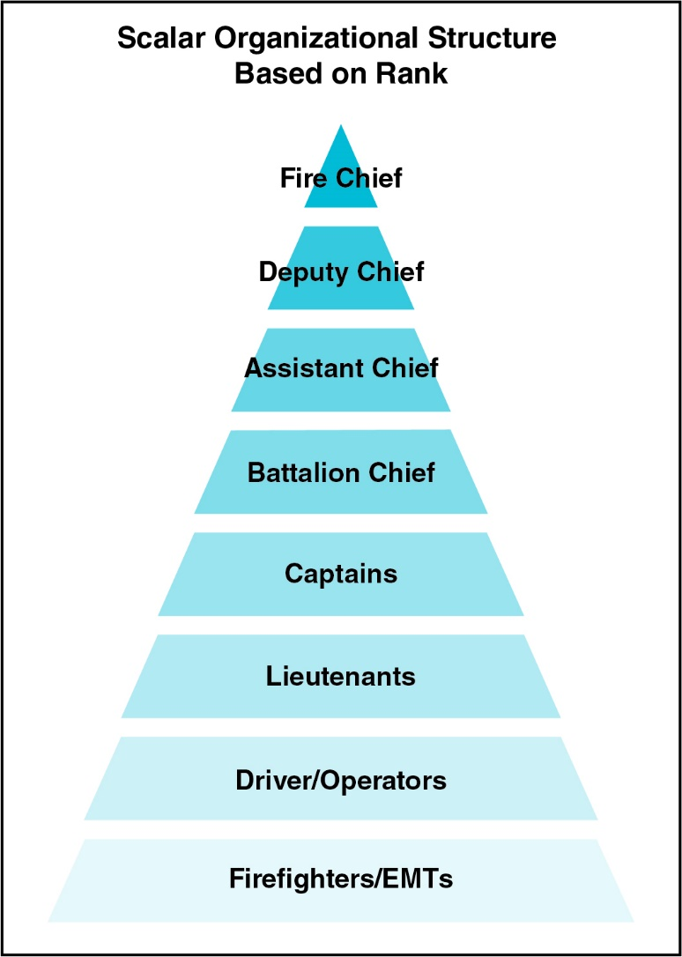

Scalar Organizational Structure
Evaluation only.
Created with Aspose.Slides for Python via .NET 24.4.
Copyright 2004-2024Aspose Pty Ltd.
Feedback and information
Decisions and information
Notes:
[defaultvoice=“echo”]
An organization’s structure and principles establish the foundation for how the organization will function and operate to achieve its mission(s). The most common fire department organizational structure is scalar, defined as having an uninterrupted series of steps. Decisions and information are directed from the top (fire chief) of the organizational structure down through intermediate levels to the base of the structure.
The levels in between are composed of personnel assigned by rank and duty. Feedback and information, in turn, are transmitted up from the bottom through the structure to the top positions. When a person is promoted, their level of authority and responsibility will increase.

Slide 2
Organizational Principles
Chain of command
Unity of command
Span of control
Discipline
Division of labor
Evaluation only.
Created with Aspose.Slides for Python via .NET 24.4.
Copyright 2004-2024Aspose Pty Ltd.
Notes:
All fire and emergency services organizations adhere to the same basic organizational principles. To func-tion effectively as a member of your organization, you must operate according to a set of organizational principles. These principles are Chain of Command, Unity of Command, Span of Control, Discipline and Division of Labour.

Slide 3
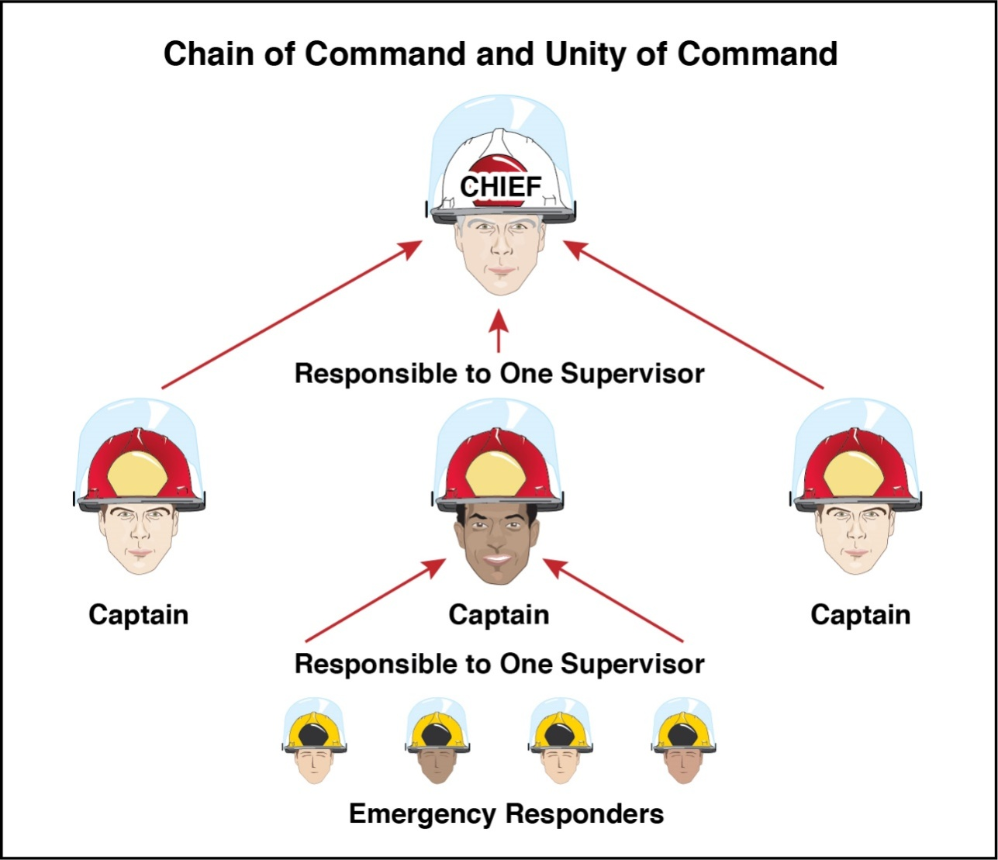
Chain of Command and Unity of Command
Evaluation only.
Created with Aspose.Slides for Python via .NET 24.4.
Copyright 2004-2024Aspose Pty Ltd.
Notes:
[voice=“nova”]
Chain of command is the formal line of authority, responsibility, and communication within an organi-zation. The chain of command can be shown on an organizational chart with the fire chief at the top and the firefighters at the bottom. Adhering to the chain of command helps ensure unity of command within an organization.
Unity of command involves each employee reports directly to just one supervisor. Moving up the chain of com-mand, all personnel ultimately report to the fire chief.

Slide 4
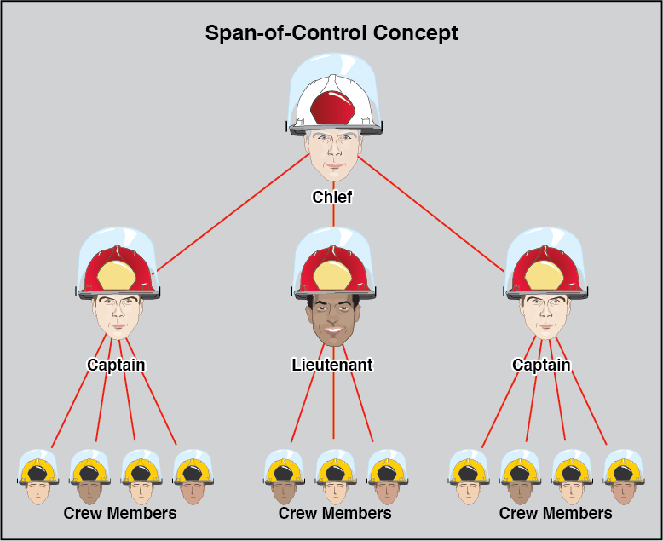
Span Of Control
Evaluation only.
Created with Aspose.Slides for Python via .NET 24.4.
Copyright 2004-2024Aspose Pty Ltd.
Notes:
Span of control is the maximum number of subordinates or functions that any one supervisor can control. This number is typically three to seven, with five considered optimum.

Slide 5
Discipline and Division Of Labor
Discipline
Organization provides leadership
Individual follows orders
Rules, regulations, and policies define acceptable performance and expected outcomes
Division of labor
Dividing large jobs into smaller jobs
Necessary to assign responsibility and prevent duplication of effort
Evaluation only.
Created with Aspose.Slides for Python via .NET 24.4.
Copyright 2004-2024Aspose Pty Ltd.
Notes:
[voice=“shimmer”]
Discipline refers to an organization’s responsibility to provide leadership, and an individual’s responsibil-ity to follow orders. Discipline is administered through rules, regulations, and policies that define acceptable performance and expected outcomes. It can only be properly enforced if rules are clearly written and commu-nicated throughout the organization.
Division of labor is the process of dividing large jobs into smaller jobs to make them more manageable, equalize workloads, and increase efficiency.
Division of labor is necessary in the fire service in order to assign responsibilities in order to assign specific and clear-cut tasks, to prevent duplication of effort.

