Slide 1
Block Pulse Insight – Cryptocurrency Coin Portfolio
Enabling Market Intelligence & Transparency

Slide 2

Project Overview
Goal: Develop structured data platform for daily crypto market intelligence
Data Source: CoinGecko API
Scope: Analyze price trends, trading volume, market cap, and volatility

Slide 3

Objectives
Market Intelligence: Track daily movements and volatility of top cryptocurrencies
Public Transparency: Provide stakeholder access via dashboards and queries

Slide 4

Data Ingestion: CoinGecko API
Endpoint: /coins/markets?vs_currency=usd
Data fields: symbol, name, current_price, market_cap, total_volume, etc.
Frequency: Daily via Databricks notebook integration
Output: JSON to Bronze layer

Slide 5
Medallion Architecture Overview
Layer | Description | Format
Bronze | Raw JSON from CoinGecko API | Raw JSON
Silver | Cleaned data with schema enforcement | Parquet
Gold | Aggregated metrics for dashboards & query tools | Delta
Bronze: Raw JSON from API
Silver: Cleaned and structured data (Parquet format)
Gold: Aggregated insights for dashboards and tools (Delta format)

Slide 6
Data Flow – Pipeline
CoinGecko API → Bronze Layer
Bronze → Silver (schema cleaning, deduplication)
Silver → Gold (aggregations, time-based metrics)
Gold → Dashboards / Query Tools / Public Access

Slide 7
MY ROLE AS DATA ENGINEER
Automation: Build Pipelines that needs to run daily without manual Intervention
Scalable: The model should have Capability to handle large volumes of data and additional crypto coins in the future
Reliability: The model should have fault tolerance, be able to monitor errors and logs
Modularity: I am requested to build clean and reusable components

Slide 8
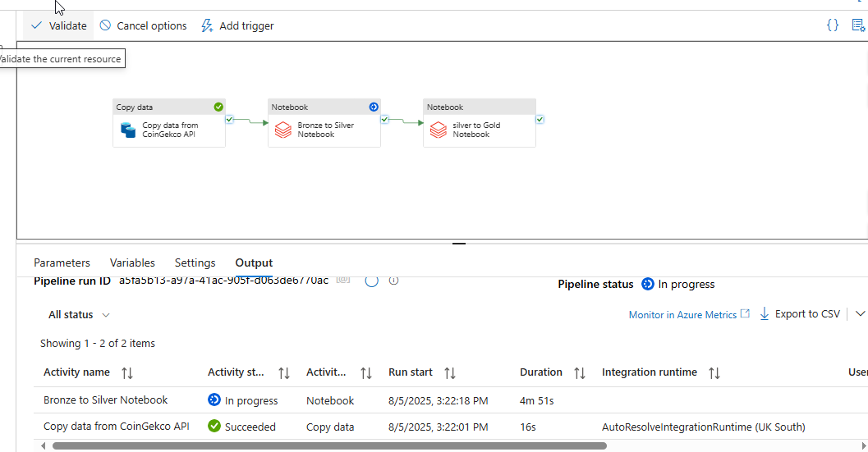
Some screenshot from the Project

Slide 9
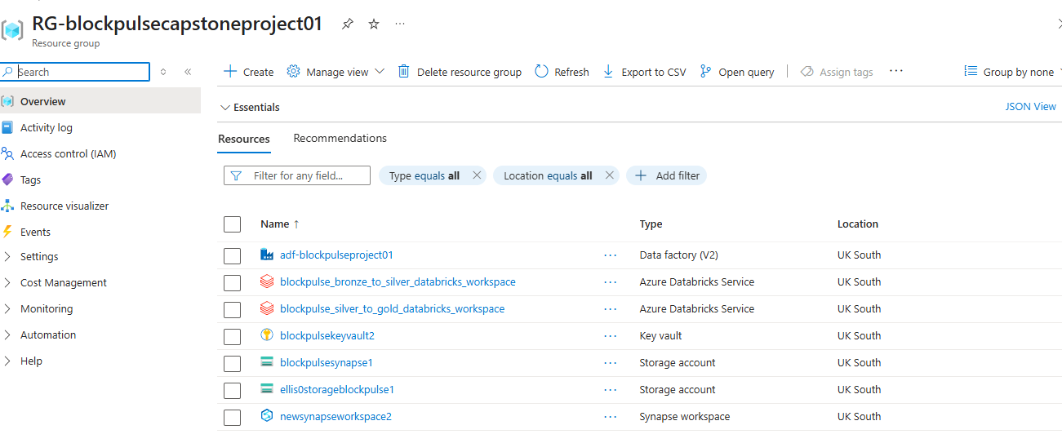
Screenshot of Resources used in Azure

Slide 10
EXPECTATIONS
Fetch daily snapshots of market metrics
Price
Market capitalization
Trending volume
Rankings
Currency metadata(Symbol, Name, Category)

Slide 11
DELIVERABLES
1 Fact Table:cryto_market_snapshot_fact
Price
Market cap\
Volume
Volatility
** 2 DimTables
****Crypto_asset_dim****
Name
Symbol
Lauch date
Category
****Date_dim****
Standard Calendar

Slide 12
TECH STACK
AZURE DATA FACTORY
DATALAKE GEN2
SYNAPSE
DATABRICKS
******TO DEVELOP THE PIPELINES & STORAGE****

Slide 13
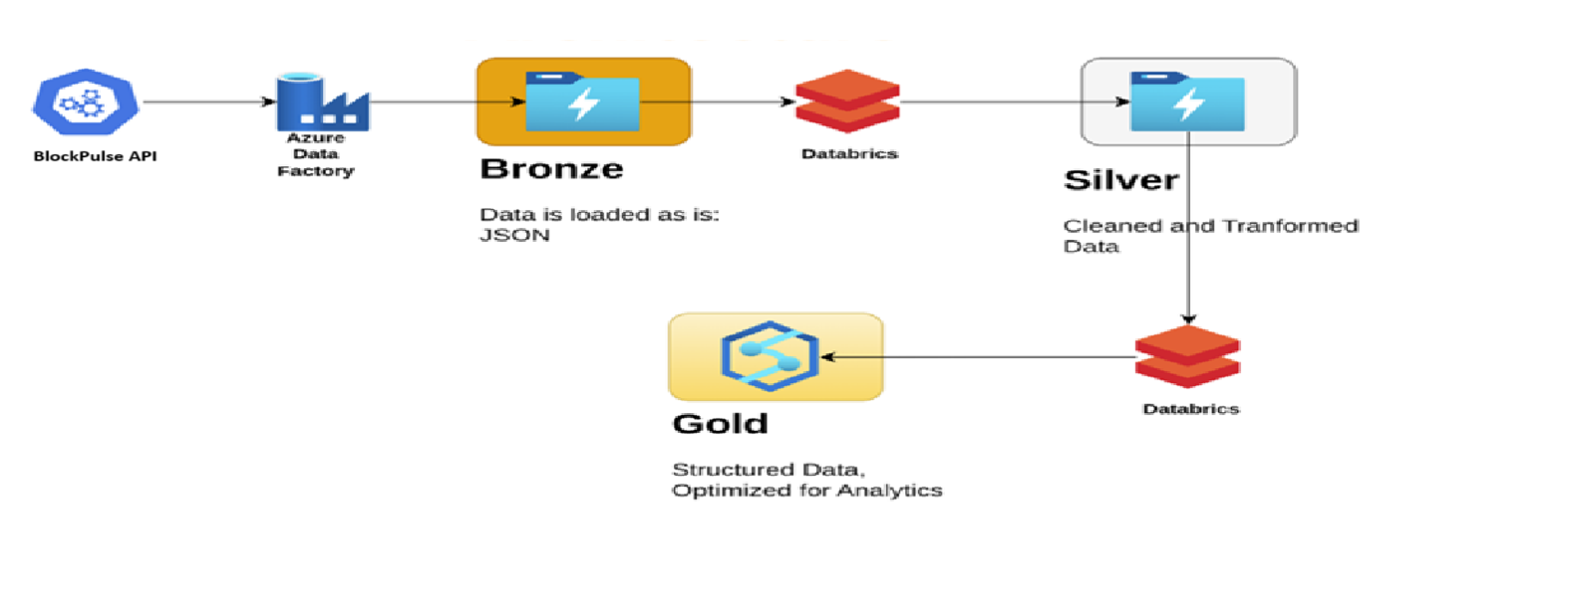
MODEL ARCHITECTURE OF THE BLOCKPULSE PROJECT

Slide 14
Market Metrics Tracked
Price trends (day-over-day, weekly, monthly)
Market cap movements and trading volumes
Volatility index and coin ranking shifts
Correlation analysis among top cryptocurrencies

Slide 15
Access & Transparency Tools
Dashboards via Power BI / Tableau / Databricks SQL
Query Layer for analysts and researchers
Public APIs or downloadable structured datasets

Slide 16
Impact
Empowers stakeholders with reliable market data
Enables long-term crypto trend analysis
Fosters transparency in decentralized finance (DeFi)

Slide 17

Next Steps
Add
Add NFT and DeFi metric support
Expand
Expand to include on-chain data (e.g., Etherscan)
Integrate
Integrate anomaly detection and market alerts

Slide 18
Thank You
Questions & Answers

