Slide 1
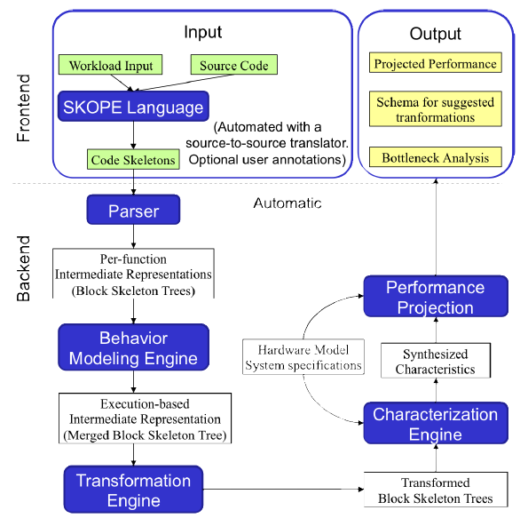
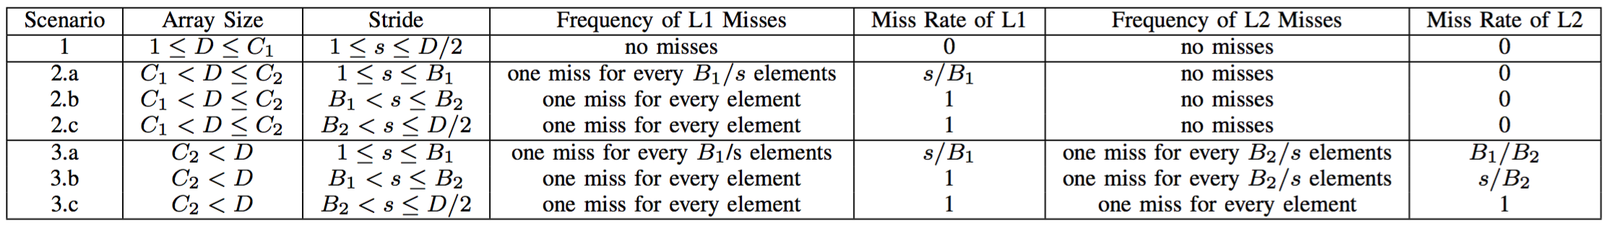
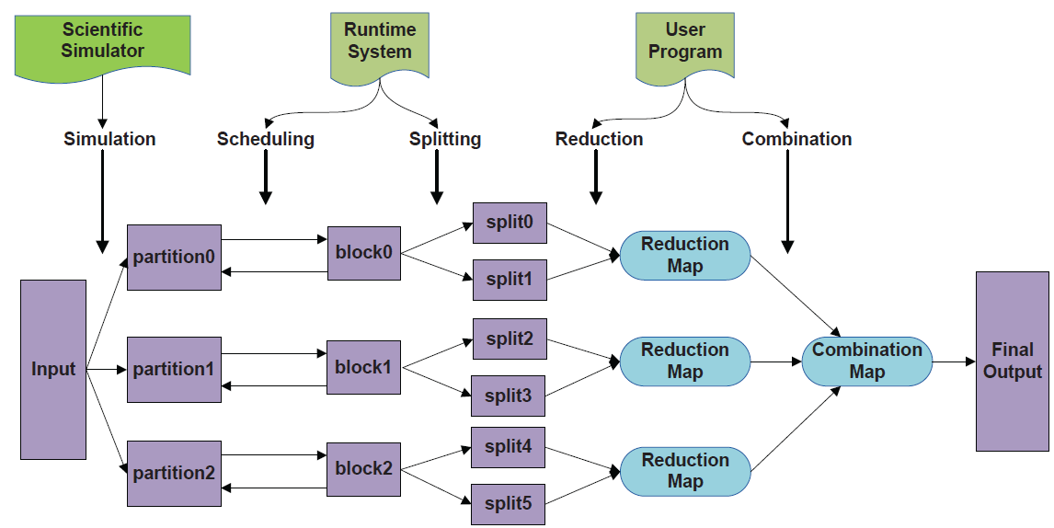
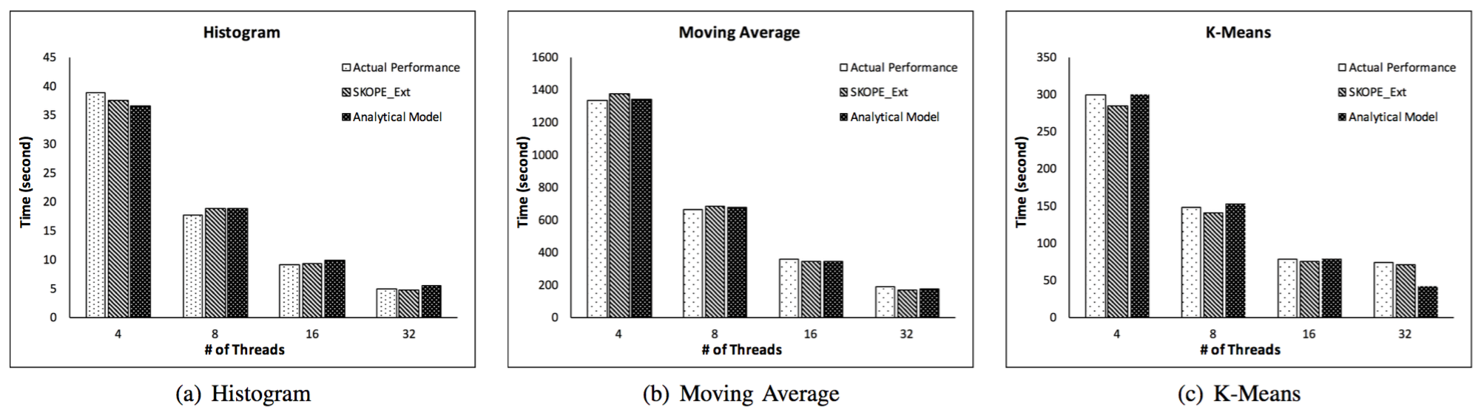
Modeling Analysis Computations and End-to-end Simulation-analysis Workflows
Preeti Malakar¹, Gagan Agrawal², Tekin Bicer¹, Venkatram Vishwanath¹, Todd Munson¹, Rajkumar Kettimuthu¹, Ian Foster¹
¹Argonne National Laboratory, ²Ohio State University
MOTIVATION
CONTRIBUTIONS
Simulations and experiments are costly to perform, in terms of procuring the required resources, and job wait times.
Analysis of petabytes of data from simulations and experiments require strategically utilizing the analysis resources.
Modeling the performance of analysis, simulation-analysis workflows and experiment-analysis workflows helps scientists plan their simulation and experiment campaigns.
Scientific experiments at synchrotron light sources are configuration-sensitive and depend on many parameters such as the number of projections and dose exposure time. Timely analysis of collected data can help deciding on configuration parameters and lead to more accurate data acquisition.
Available compute resources at light sources are typically insufficient for analyzing the generated data, thus we require performance models and software tools to perform efficient analysis on distributed HPC resources.
Developed
Performance models for mapReduce-like in situ data analysis jobs
In situ and co-analysis execution workflow optimization models for scientific applications
Performance models for light source experimental data analysis workflow
MODELING IN SITU MAPREDUCE-LIKE ANALYSIS JOBS
Model for memory access time of 2-level cache hierarchy:
Add new syntax
Add disk model
For applications used in our experiments, the cache miss rate is dependent on dataset size (D), data access stride(s), cache capacity (C1 and C2 for L1 and L2 respectively) and block size (B1 and B2 for L1 and L2 respectively)
Add characterization component for disk reading
SKOPE Extentions: Modeling Disk-Based and In-Situ Analytics
By defining parameters in the hardware model in SKOPE, and collecting memory access information such as read, write, access stride from code skeletons, we can utilize SKOPE to predict cache performance.
Cache Performance Model for a Two-Level Cache Hierarchy
This is the
part we are
interested in!
Smart: A MapReduce-Like Framework for In-Situ Scientific Analytics
Predicting Scalability of Smart (conducted on the TACC Stampede cluster using 4 nodes)
MODELING END-TO-END SIMULATION-ANALYSIS WORKFLOW
Mode 1: In situ analysis
Simulation and analysis alternates at a desired interval
Time
Network bandwidth
Motivation
Memory
I/O bandwidth
Derive maximum scientific insight from the simulations with minimum delay
Simulation
Analysis
Simulation
Analysis
Objective of Linear Program
Amount of output
Analyses features
Maximize number of different important analyses and their frequencies
Mode 2: Local co-analysis
Simulation processes communicate data directly to analysis processes
System parameters
Compute capacity
Constraints
Minimum interval
Throughput, available memory/storage, analysis specifications
Output
Simulation
Data transfer
Analysis
Available memory
Analyses feasibility and their frequencies
Importance
MILP
Experiments
Mode 3: Remote co-analysis
Simulation communicates data to analysis via some form of storage
Applications: LAMMPS, FLASH, miniMD
Systems: 32,768 cores on Mira Blue Gene/Q, 1080 cores on Edison Cray XC30
Results
Simulation
STORAGE
Analysis
Mixed integer linear programming (MILP) based model incorporates various system and application parameters
100x faster than post hoc analysis
More than 85% utilization of allowed time for simulation-time analysis
MODELING LIGHT SOURCE DATA ANALYSIS WORKFLOW
Motivation
Technological advances in x-ray sources and detectors enable increasingly complex experiments and rapid data acquisitions (e.g. 16GiB/s data generation rates)
Timely analysis of this data is important
Experimental facility users have limited time to perform experiments and collect data
Near-real-time data processing is highly desirable to verify accuracy of data and determine proper configuration for experiments
Objectives
Improving the parallelization of tomographic reconstruction jobs to minimize turnaround time
Enabling utilization of geographically distributed resources
Estimating execution times of different stages in workflows
Data transfer, queue/idle time, computation time
Implementation
A MapReduce-like middleware for tomographic reconstruction algorithm
A workflow management system for light source data analysis jobs
Models and methods for estimating execution time of workflow stages
Estimation of data transfer rates between resources
Bandwidth Delay Product + Initialization Cost
Cluster queue time prediction
Simulation of target cluster’s job queue
Modeling the performance of tomographic reconstruction jobs
Experiments
Applications: Iterative tomographic reconstruction algorithms
HPC Resources: Mira Blue Gene/Q (32K cores), Stampede , Gordon
Results
Reconstruction times decreased from days to minutes (24-core workstation vs. 32K cores on Mira BG/Q)
Estimation of end-to-end workflow execution with 2.1-23.3% error rate
Workflow Execution Engine
Data Transfer
Metaschedule
Performance Models
Resource Conf. & Metadata
Reconstruction
CONCLUSIONS
REFERENCES
Modeled performance of map-reduce like in situ data analysis kernels
Extended SKOPE performance modeling framework to model cache
Developed models to propose the optimal set of analysis computations that can be performed within time and space constraints
Proposed mixed-integer linear programs for formulating optimal in situ and co-analysis execution workflows
Shorter turnaround time of experimental data analysis workflow help verification of collected data and steering experiments at light sources
Developed performance models and software tools for execution of light source data analysis tasks on distributed HPC resources
“Smart: a MapReduce-like framework for in-situ scientific analytics”, Y. Wang et al., SC 2015.
“Optimal Scheduling of In-Situ Analysis for Large-Scale Scientific Simulations”, P. Malakar et al., SC 2015.
“Optimal Execution of Co-analysis for Large-scale Molecular Dynamics Simulations”, P. Malakar et al., SC 2016.
“Rapid Tomographic Image Reconstruction via Large-Scale Parallelization”, T. Bicer et al., EuroPar 2015.
“Optimization of Tomographic Reconstruction Workflows on Geographically Distributed Resources”, T. Bicer et al., Journal of Synchrotron Radiation 2016.
Acknowledgements
Funding Source: DOE ASCR RAMSES: Robust Analytical Modeling for Science at Extreme Scales
Compute Resources: Argonne Leadership Computing Facility

