Slide 1
Time & Cost Sensitive Data-Intensive Computing on Hybrid Clouds
†
Tekin Bicer David Chiu Gagan Agrawal
Department of Compute Science and Engineering
The Ohio State University
School of Engineering and Computer Science
Washington State University
†
CCGrid 2012 – Ottowa Canada

Slide 2
Outline
Introduction
Motivation
Challenges
System Overview
Resource Allocation Framework
Experiments
Related Work
Conclusion
CCGrid 2012 – Ottowa Canada

Slide 3
Introduction
Big Data
  Scientific Datasets: Simulation, Climate etc.
Shared resources
  Limitations on usage
  Application deadlines
  Long wait times
Cloud Technologies
  Elasticity
  Pay-as-you-go
CCGrid 2012 – Ottowa Canada

Slide 4
Hybrid Cloud Motivation
Co-locating Resources
  Not always possible
In-house dedicated machines
  Demand for more resources
  Workload might vary in time
Hybrid Cloud
  Local Resources
  Cloud Resources
CCGrid 2012 – Ottowa Canada

Slide 5
Challenges
Meeting User Constraints
  Time: Minimize cost while meeting the time
  Cost: Minimize time while meeting the cost
Resource Allocation
  A Model for Capturing Time & Cost Constraints
Data-Intensive Processing
  Map-Reduce Type of Processing
CCGrid 2012 – Ottowa Canada

Slide 6
Outline
Introduction
Motivation
Challenges
System Overview
Resource Allocation Framework
Experiments
Related Work
Conclusion
CCGrid 2012 – Ottowa Canada

Slide 7
System Overview for Hybrid Cloud
Local cluster and Cloud Environment
Map-Reduce type of processing
All the clusters connect to a centralized node
  Coarse grained job assignment
  Consideration of locality
Each cluster has a Master node
  Fine grained job assignment
Job Stealing
Cluster 2011 - Texas Austin

Slide 8
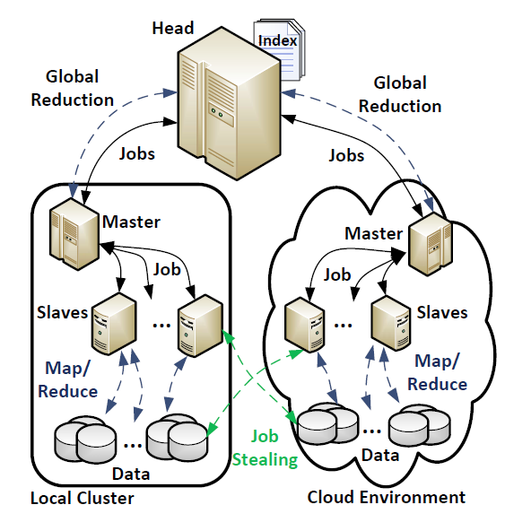
Middleware Design for Hybrid Cloud
Head Node
  Resource Allocation
  Job Assignment (Coarse)
  Global Reduction
Master (In-Cluster)
  Job Assignment (Fine)
  Reduction
Slave
  Local Map-Reduce
  Remote Map-Reduce
CCGrid 2012 – Ottowa Canada

Slide 9
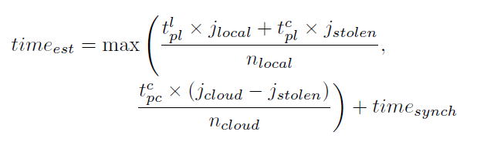
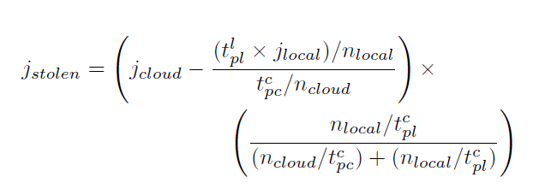
Resource Allocation Framework
Estimate required time
for local cluster processing
Estimate required time
for cloud cluster processing
All variables can be profiled during execution, except estimated # stolen jobs
Estimate required the # jobs
that will be stolen
Estimate processing time of a
cloud job by a local node
CCGrid 2012 – Ottowa Canada

Slide 10
Executing the Model
Head node
  Executes model
  Estimates # cloud inst.
    Before each job assignment
Master
  Initiates nodes
CCGrid 2012 – Ottowa Canada

Slide 11
Outline
Introduction
Motivation
Challenges
System Overview
Resource Allocation Framework
Experiments
Related Work
Conclusion
CCGrid 2012 – Ottowa Canada

Slide 12
Goals of Experiments
Analyzing the behavior of our model
Observing whether user constraints are met
Evaluating system in Cloud Bursting scenario
  Local nodes are dropped during execution
  Observed how system is adopted
CCGrid 2012 – Ottowa Canada

Slide 13
Experimental Setup
Two Applications:
  KMeans (520GB):
    Local: 104GB, Cloud:416GB
    k=5000, 48.2x10^9 points
  PageRank (520GB):
    Local:104GB, Cloud:416GB
    50x10^6 link with 41.7x10^8 edges
Local node – (Ohio State University, Columbus)
  16 nodes, each with 8 cores: 128 cores
Cloud node – (Amazon S3, Virginia)
  Max. 16 nodes, each with 8 cores: 128 cores
CCGrid 2012 – Ottowa Canada

Slide 14
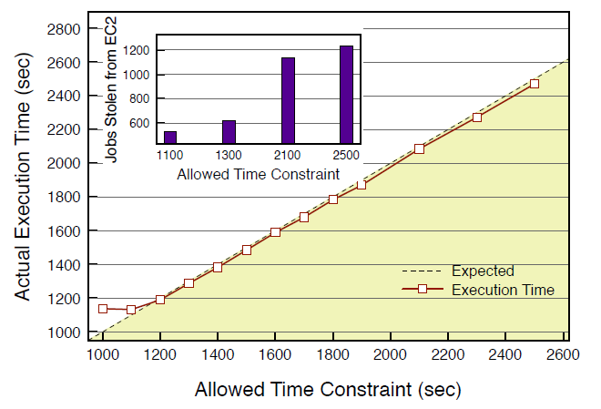
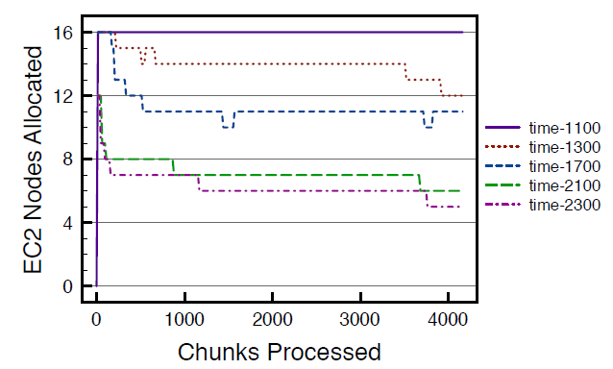
KMeans – Time Constraint
System is not able to meet the time constraint
because max. # of cloud instances is reached
# Local Inst.: 16 (fixed)
# Cloud Inst.: Max 16 (Varies)
    Local: 104GB, Cloud:416GB
All other configurations meet the time constraint with <1.5% error rate
CCGrid 2012 – Ottowa Canada

Slide 15
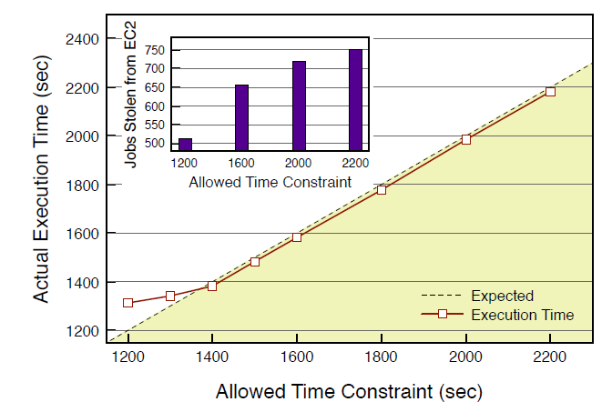
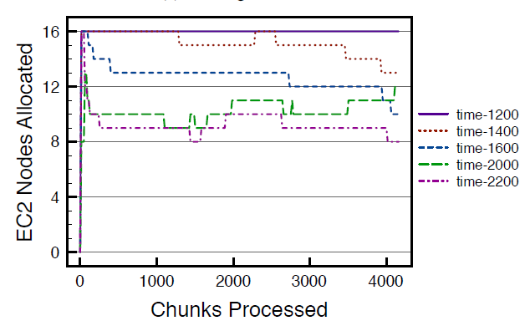
PageRank – Time Constraint
# Local Inst.: 16 (fixed)
# Cloud Inst.: Max 16 (Varies)
    Local: 104GB, Cloud:416GB
Similar results with KMeans
The error rate is <1.3%
CCGrid 2012 – Ottowa Canada

Slide 16
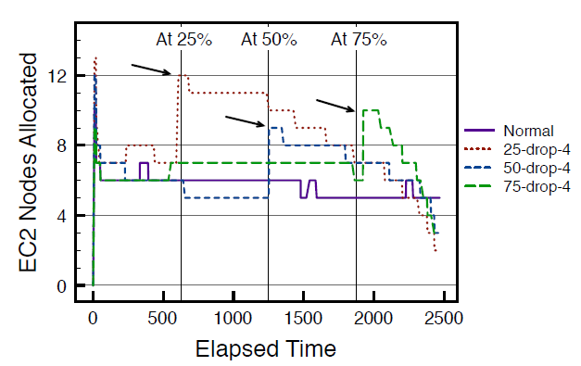
KMeans – Cloud Bursting
# Local Inst.: 16 (fixed)
# Cloud Inst.: Max 16 (Varies)
    Local: 104GB, Cloud:416GB
4 local nodes are dropped …
  After 25% and 50% of time constraints are elapsed, error rate <1.9%
  After 75% of time constraint is elapsed, error rate <3.6%
    Reason of higher error rate: Shorter time to profile new environment
CCGrid 2012 – Ottowa Canada

Slide 17
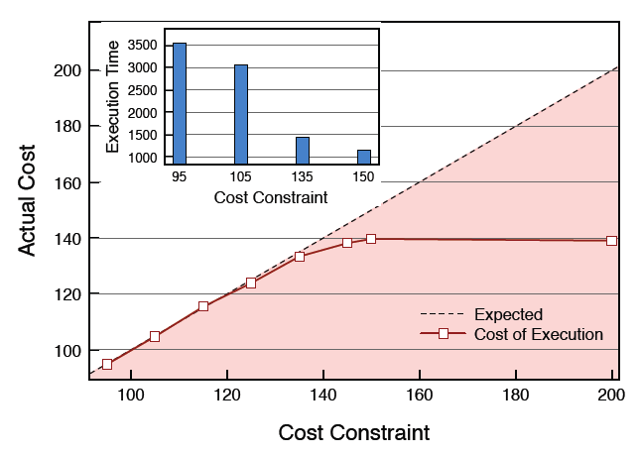
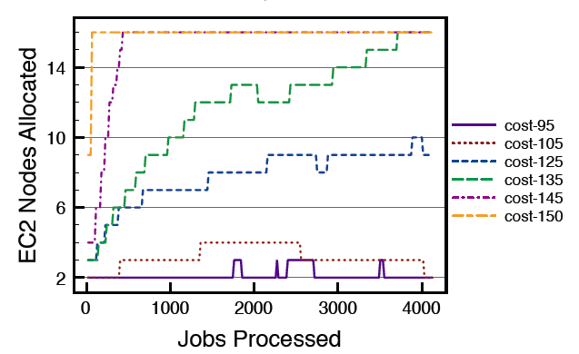
Kmeans – Cost Constraint
System meets the cost constraints with <1.1% error rate
System tries to minimize the execution time
with provided cost constraint
Maximum # cloud instances is allocated
error rate is again <1.1%
CCGrid 2012 – Ottowa Canada

Slide 18
Related Work
Mao et al. (SC’11, GRID’10)
  Dynamically (de)allocate cloud instances to meet user constraint (Single Cluster)
  Considers different types of instances on EC2
De Assuncao et al. (HPDC’09)
  Job scheduling for cloud bursting
Marshall et al., Elastic Site (CCGRID’10)
  Extending computational limit of local resources with cloud
  Considers local cluster’s job queue
Map-Reduce on Cloud
  Kambatla et al. (HotCloud’09);
  Zaharia et al. (OSDI’08);
  Lin et al., MOON (HPDC’10)
CCGrid 2012 – Ottowa Canada

Slide 19
Conclusion
Map-Reduce type of applications
  Hybrid cloud setting
Developed a resource allocation model
  Time and cost constraints
  Based on feedback mechanism
Two data-intensive applications (KMeans, PR)
  Error rate for time < 3.6%
  Error rate for cost < 1.2%
CCGrid 2012 – Ottowa Canada

Slide 20
Thanks
Any Questions?
CCGrid 2012 – Ottowa Canada

