Slide 1
A Framework for Data-Intensive Computing with Cloud Bursting
†
Tekin Bicer David Chiu Gagan Agrawal
Department of Compute Science and Engineering
The Ohio State University
School of Engineering and Computer Science
Washington State University
†
Cluster 2011 - Texas Austin

Slide 2
Outline
Introduction
Motivation
Challenges
MATE-EC2
MATE-EC2 and Cloud Bursting
Experiments
Conclusion
Cluster 2011 - Texas Austin

Slide 3
Data-Intensive and Cloud Comp.
Data-Intensive Computing
  Need for large storage, processing and bandwidth
  Traditionally on supercomputers or local clusters
    Resources can be exhausted
Cloud Environments
  Pay-as-you-go model
  Availability of elastic storage and processing
    e.g. AWS, Microsoft Azure, Google Apps etc.
  Unavailability of high performance inter-connect
    Cluster Compute Instances, Cluster GPU instances
Cluster 2011 - Texas Austin

Slide 4
Cloud Bursting - Motivation
In-house dedicated machines
  Demand for more resources
  Workload might vary in time
Cloud resources
Collaboration between local and remote resources
  Local resources: base workload
  Cloud resources: extra workload from users
Cluster 2011 - Texas Austin

Slide 5
Cloud Bursting - Challenges
Cooperation of the resources
  Minimizing the system overhead
  Distribution of the data
  Job assignments
    Determining workload
Cluster 2011 - Texas Austin

Slide 6
Outline
Introduction
Motivation
Challenges
MATE
MATE-EC2 and Cloud Bursting
Experiments
Conclusion
Cluster 2011 - Texas Austin

Slide 7
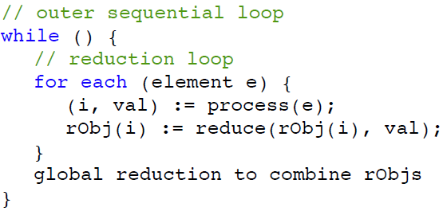
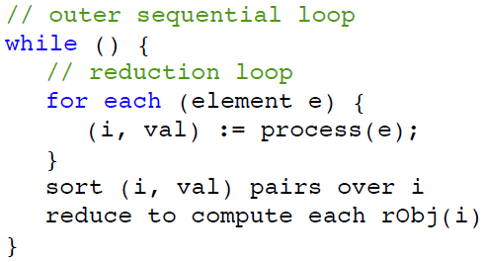
MATE vs. Map-Reduce Processing Structure
Reduction Object represents the intermediate state of the execution
Reduce func. is commutative and associative
Sorting, grouping.. overheads are eliminated with red. func/obj.
Cluster 2011 - Texas Austin

Slide 8
MATE on Amazon EC2
Data organization
  Metadata information
  Three levels: Buckets/Files, Chunks and Units
Chunk Retrieval
  S3: Threaded Data Retrieval
  Local: Cont. read
  Selective Job Assignment
Load Balancing and handling heterogeneity
  Pooling mechanism
Cluster 2011 - Texas Austin
Notes:
Data Organization:
-Buckets: Physical presentation of the data on S3 (data is physically stored in data objects and presented with buckets)
Chunks: Logical data blocks inside buckets (exploits memory utilization)
Data units: Minimum required data units that are processes by the application (exploits cache utilization)
-Metadata information: Index file that consists of fullpath of the data object, offset address of the chunk, size of the chunk, total number of units inside the chunk.
Chunk Retrieval:
-Threaded Data Retrieval: Each chunk is requested with a number of threads. Therefore bandwidth usage of the processing node is maximized.
-Selective Job Assignment: Chunk selection is based on the number of the connections on each bucket. The chunk is selected from the data object that has the minimum number of active -connection. Thus, each bucket’s upload bandwidth is exploited.
Load Balancing and handling heterogeneity:
-Pooling mechanism: Whenever a processing node finishes a job, it requests another from the master node. Master node, then, assigns a job from the job pool. Load balancing mechanism uses the selective job assignment. Thus the job selection is not a sequential or random process.

Slide 9


MATE-EC2 Processing Flow for AWS
T
T
T
C
0
1
2
0
C
5
C
n
S3 Data Object
Computing Layer
Job Scheduler
Job Pool
EC2 Slave Node
EC2 Master Node
Retrieve chunk pieces and
Write them into the buffer
Pass retrieved chunk to
Computing Layer and process
Request another job
Request Job from Master Node
C0 is assigned as job
C5 is assigned as a job
Retrieve the new job

Slide 10
System Overview for Cloud Bursting (1)
Local cluster(s) and Cloud Environment
Map-Reduce type of processing
All the clusters connect to a centralized node
  Coarse grained job assignment
  Consideration of locality
Each clusters has a Master node
  Fine grained job assignment
Work Stealing
Cluster 2011 - Texas Austin

Slide 11

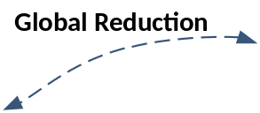
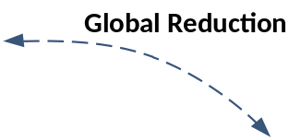
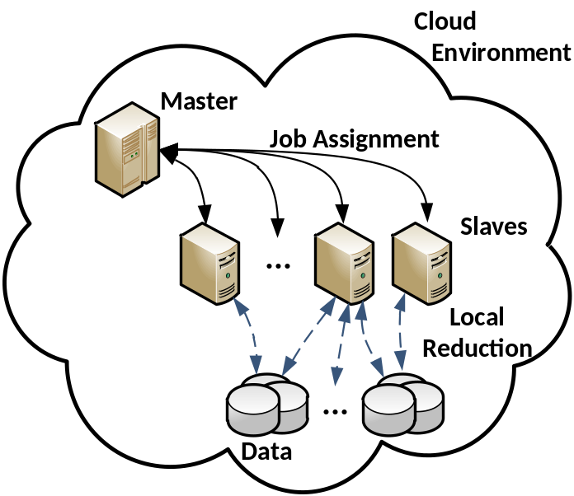
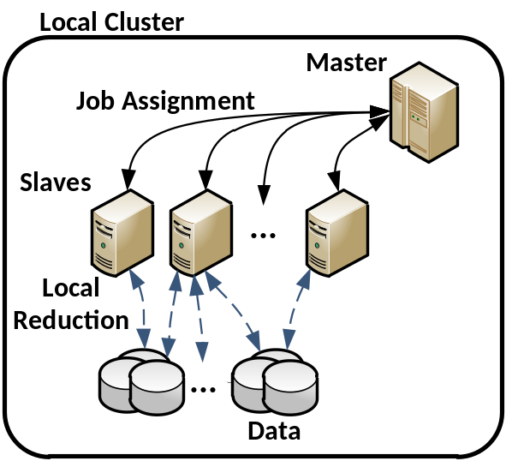


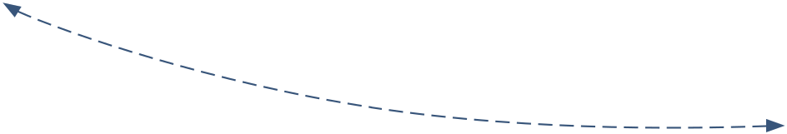
System Overview for Cloud Bursting(2)
Cluster 2011 - Texas Austin

Slide 12
Experiments
2 geographically distributed clusters
  Cloud: EC2 instances running on Virginia
  Local: Campus cluster (Columbus, OH)
3 applications with 120GB of data
  Kmeans: k=1000; Knn: k=1000; PageRank: 50x10 links w/ 9.2x10 edges
Goals:
  Evaluating the system overhead with different job distributions
  Evaluating the scalability of the system
6
8
Cluster 2011 - Texas Austin

Slide 13
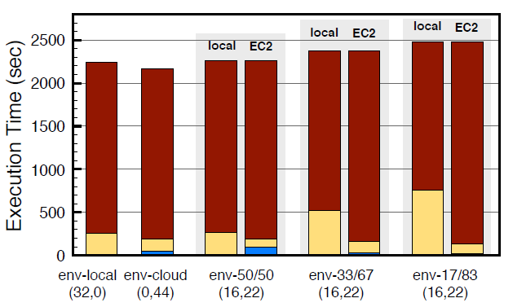
System Overhead: K-Means
Env-* | Global Reduction | Idle Time |  | Total Slowdown | Stolen # Jobs (960)
 |  | local | EC2
50/50 | 0.067 | 0 | 93.871 | 20.430 (0.5%) | 0
33/67 | 0.066 | 0 | 31.232 | 142.403 (5.9%) | 128
17/83 | 0.066 | 0 | 25.101 | 243.312 (10.4%) | 240
Cluster 2011 - Texas Austin

Slide 14
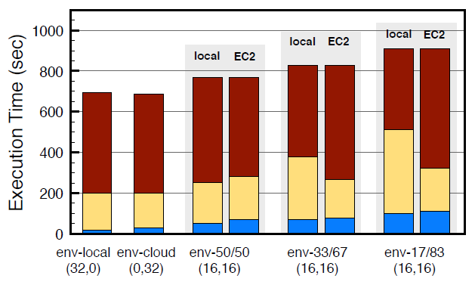
System Overhead: PageRank
Env-* | Global Reduction | Idle Time |  | Total Slowdown | Stolen # Jobs (960)
 |  | local | EC2
50/50 | 36.589 | 0 | 17.727 | 72.919 (10.5%) | 0
33/67 | 41.320 | 0 | 22.005 | 131.321 (18.9%) | 112
17/83 | 42.498 | 0 | 52.056 | 214.549 (30.8%) | 240
Cluster 2011 - Texas Austin

Slide 15
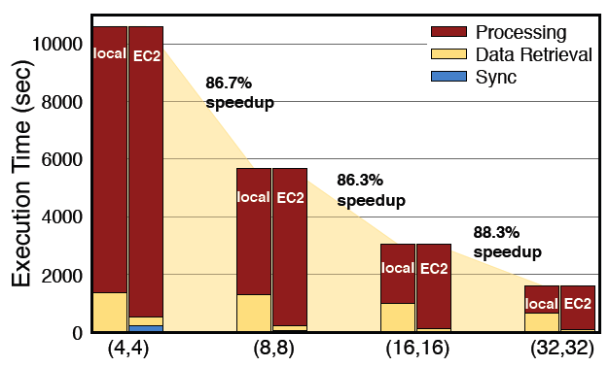
Scalability: K-Means
Cluster 2011 - Texas Austin

Slide 16
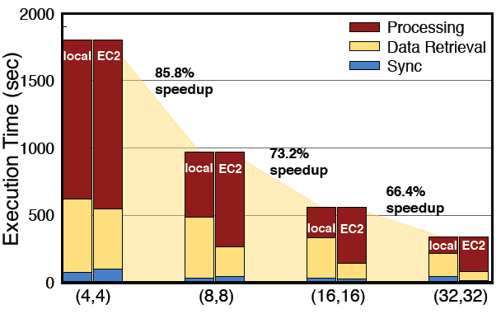
Scalability: PageRank
Cluster 2011 - Texas Austin

Slide 17
Conclusion
MATE-EC2 is a data intensive middleware developed for Cloud Bursting
Hybrid cloud is new
  Most of Map-Reduce implementations consider local cluster(s); no known system for cloud bursting
Our results show that
  Inter-cluster comm. overhead is low in most data-intensive app.
  Job distribution is important
  Overall slowdown is modest even the disproportion in data dist. increases; our system is scalable

Slide 18
Thanks
Any Questions?
Cluster 2011 - Texas Austin

Slide 19
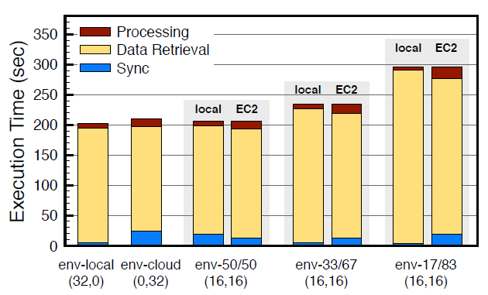
System Overhead: KNN
Env-* | Global Reduction | Idle Time |  | Total Slowdown | Stolen # Jobs (960)
 |  | local | EC2
50/50 | 0.072 | 16.212 | 0 | 6.546 (1.7%) | 0
33/67 | 0.076 | 0 | 10.556 | 34.224 (15.4%) | 64
17/83 | 0.076 | 0 | 15.743 | 96.067 (45.9%) | 128
Cluster 2011 - Texas Austin

Slide 20
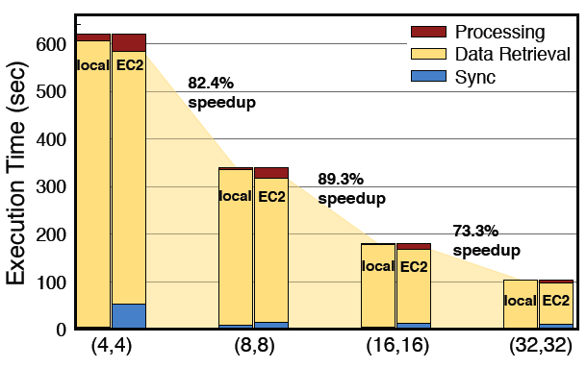
Scalability: KNN
Cluster 2011 - Texas Austin

Slide 21
Future Work
Cloud bursting can answer user requirements
(De)allocate resources on cloud
Time constraint
  Given time, minimize the cost on cloud
Cost constraint
  Given cost, minimize the execution time
Cluster 2011 - Texas Austin

Slide 22
References
The Cost of Doing Science on the Cloud (Deelman et. Al.; SC’08)
Data Sharing Options for Scientific Workflow on Amazon EC2 (Deelman et. Al.; SC’10)
Amazon S3 for Science Grids: A viable solution? (Palankar et. al.; DADC’08)
Evaluating the Cost Benefit of Using Cloud Computing to Extend the Capacity of Clusters. (Assuncao et. al.; HPDC’09)
Elastic Site: Using Clouds to Elastically Extend Site Resources (Marshall et. al.; CCGRID’10)
Towards Optimizing Hadoop Provisioning in the Cloud. (Kambatla et. Al.; HotCloud’09)
Cluster 2011 - Texas Austin

