Slide 1
Rapid Tomographic Image Reconstruction via Large-Scale Parallelization
Argonne National Laboratory
Mathematics and Computer Science
Tekin Bicer, Raj Kettimuthu, Ian T. Foster
Advanced Photon Source
Doga Gursoy, Francesco De Carlo
Ohio State University Computer Science and Engineering Dep.
Gagan Agrawal

Slide 2
Tomographic Image Reconstruction
Analysis of tomographic datasets is challenging
Long image reconstruction/analysis time
E.g. 12GB Data, 12 hours with 24 Cores
Different reconstruction algorithms
Longer computation times
Input dataset < Output dataset
73MB vs. 476MB
High data acquisition rates
E.g. 12 GB < 1sec.
2Kx2K, 16bit/pixel, 1500 projections
Advancement in light sources and detectors
Expected to increase several orders of magnitude

Slide 3
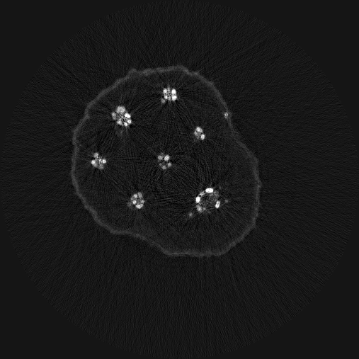
Notes:
Right image requires 2-3 orders of magnitude more computation
Seed dataset reference:
[9] D. Gursoy, T. Bicer, A. Lanzirotti, M. G. Newville, and F. De Carlo. Hyperspectral image reconstruction for x-ray fluorescence tomography. Optics express, 23(7):9014–9023, 2015.

Slide 4
Tomographic Image Reconstruction - Issues
Enabling efficient and parallel reconstruction
Accelerators, e.g. GPUs, MIC
Overhead due to host-device communication
Not suitable for large datasets
Easing the implementation of algorithms
Different types of reconstruction algorithms
Share common functionalities
Hadoop and Spark
Not suitable for HEC and SCs

Slide 5
Outline
Motivation
Parallelization of Reconstruction Algorithms
Per-Slice Reconstruction
In-Slice Reconstruction
A MapReduce-like Middleware for Tomographic Reconstruction
Experimental Results
Conclusion

Slide 6
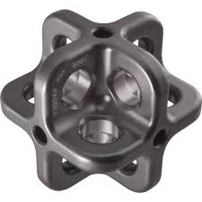
Tomographic Dataset Organization
P
2
…
P
P
1
n
T
P
0
0
P
T
..
n
T
…
n
P
P
1
1
0
T
2
Notes:
Line integrals of a ray, i.e. ray-sum values.

Slide 7
Per-Slice Parallelization
For each slice S_i do:
For each theta T_i do:
For each ray R_i do:
Calculate the indices, indi[]
Calculate the lengths, leng[]
Calculate simdata using recon. object, leng[] and indi[]
Update recon. object using q_i, p_i and leng[]
Parallelization
2D Projections
3D Image
os[n]
Slice (input)
Slice (output)
2D Projections
is[n]
....
R(…)
....
R(is[1], ro[i-1],
os[1])
y
os[1]
x
x
is[1]
P
os[0]
x
is[0]
..
m
z
z
z
P
P
0
1

Slide 8
In-Slice Parallelization
Per-slice parallelization
Limited with # slices
Computational complexity of each slice
In-slice parallelization
Ray-level parallelization
Sufficient rays per slice
Might require communication btw threads
Modifications in algorithms
More computation?

Slide 9
In-Slice Parallelization (How?)
For each ray in slice do:
Calculate indices, indi[]
Calculate length, leng[]
Calculate simdata for the ray
Update ray’s (thread’s) replicated recon. object
Exchange intermediate values (leng[], …) and
Combine all replicas that are in the same recon. slice
Update local recon slice using combined replica, and exchanged values

Slide 10
Porting In-slice Parallelization
Reconstruction
uses both recon.
(iter i-1) and
Projection slice
In-slice communication
Group threads per slice
Update operation needs other vars.

Slide 11
Outline
Motivation
Parallelization of Reconstruction Algorithms
Per-Slice Reconstruction
In-Slice Reconstruction
A MapReduce-like Middleware for Tomographic Reconstruction
Experimental Results
Conclusion

Slide 12
Processing Structure of TRACE
MATE
{* Outer Sequential Loop *}
While() {
{* Reduction Loop *}
ForEach(element e) {
(I, val) = Process(e);
Robj(i) = Reduce(Robj(i), val);
}
Global Reduction to Combine RObj
}
Map-Reduce
{* Outer Sequential Loop *}
While() {
{* Reduction Loop *}
ForEach(element e) {
(I, val) = Process(e);
}
Sort (i, val) pairs using i
Reduce to compute each RObj(i)
}
Reduction Object represents the intermediate state of the execution
Reduce func. is commutative and associative
Sorting, grouping.. overheads are eliminated with red. func/obj.

Slide 13
Processing Structure of TRACE
Inputs IS: Assigned projection slices
Recon: Reconstruction object
dist: Subsetting distance
Output Recon: Final reconstruction object
/* (Partial) iteration i */
For each assigned projection slice, is, in IS {
IR = GetOrderedRaySubset(is, i, dist);
For each ray, ir, in rays IR {
(k, off, val) = LocalRecon(ir, Recon(is));
ReconRep(k) = Reduce (ReconRep(k), off, val);
}
}
/* Combine updated replicas */
Recon = PartialCombination(ReconRep)
/* Exchange and update adjacent slices*/
Recon = GlobalCombination(Recon)
Node 0
Partial Combination()
Thread 0
Recon Rep
Inputs
Local Recon(…)
…
…
…
Projs.
…
…
Recon [i-1]
Thread m
Recon Rep
Recon[i]
…
Local Recon(…)
…
Global Combination Phase
…
Node n
…
…
Thread 0
Inputs
…
…
Thread m
Local Reconstruction Phase
Partial Combination Phase
Iteration i

Slide 14
Experimental Setup
Ported 5 reconstruction algorithms from TomoPy
ART, SIRT, MLEM, PML, APMLR
Two datasets
Seed (a seed of arabidopsis thaliana)
Dimensions: 720x2048x501
Hornby (Shale sample obtained from North Sea)
Dimensions: 360x2048x1024
Mira
2K nodes (i.e. 32K cores)
Notes:
-- For Microtomography:
-- Micro is done at 2-BM beamline . Nano resolution is 30nm aiming to 20 and it is done at 32-ID.
-- Micro speed at 2-GM is 5 full (2k cube) datasets per second. Nano is slower (1 frame/s) but often requires iterative methods for solution.
-- Images are shale samples for characterizing microstructures and porosity at micrometer scale
-- More info at: http://journals.iucr.org/s/issues/2013/01/00/pp5025/pp5025.pdf

Slide 15
Multithreaded Performance
Notes:
We observe the best performance with 32 threads,
achieving a speedup of 18.76 relative to 1 thread.
The performance with 64 threads is slightly slower, presumably because of overheads resulting from insufficient resources.
Each BG/Q node can provide hardware registers for up to four threads; thus, the maximum number of supported threads is 16x4 per node. Since these threads share the same resources (on the same node), we observe a performance degradation after 32 threads.

Slide 16
Scalability Performance - Speedups
MLEM (Seed dataset)
Notes:
Seed dataset. The number of threads per node is 32 (from previous set of experiment). 256 core configuration is the baseline.
Per-slice:
256-1K: almost perfect speedup (3.98x);
2K: 5.18x (less # of threads per node is utilized)
In-slice:
256-8K: almost perfect speedup;
32K:85.6x (b/c of short execution time)
Up to 1K cores, per-slice performs better.

Slide 17
Performance Breakdown (Hornby)
APMLR (Hornby dataset)
Notes:
Perfect speedup up to 8K cores.
32K vs 1K: 24.77x speedup.
The total execution time drops from 1hour (with 1K cores) to ~2mins (with 32K cores).

Slide 18
Summary
Tomographic image reconstruction is challenging
High data acquisition rates
Long computation times
Parallelization techniques
Per-slice and In-slice
A middleware for parallelizing tomography data
Easy implementation of algorithms
Parallel and distributed execution
Experiments
Good scalability performance
Improved reconstruction times: 2hr (256 cores) to 1min (32K cores)
Near real-time image reconstruction
Future work:
Workflow as a service on geographically distributed resources

Slide 19
Thanks

Slide 20
Ordered Subsetting
Notes:
Execution times with 4K cores. 10 iterations.
D: distance from the initial projection.
D=1 vs d=32: 4.8x and 9.7x speedup for APMLR, SIRT.
Hornby dataset.

