Slide 1
Supporting Fault Tolerance in a Data-Intensive Computing Middleware
Tekin Bicer, Wei Jiang and Gagan Agrawal
Department of Computer Science and Engineering
The Ohio State University
IPDPS 2010, Atlanta, Georgia
IPDPS 2010

Slide 2
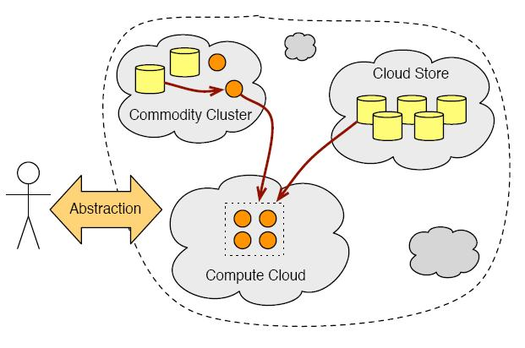
Motivation
Data Intensive computing
  Cloud Environments
Distributed Large Datasets
Distributed Computing Resources
Long execution time
High Probability of Failures

Slide 3
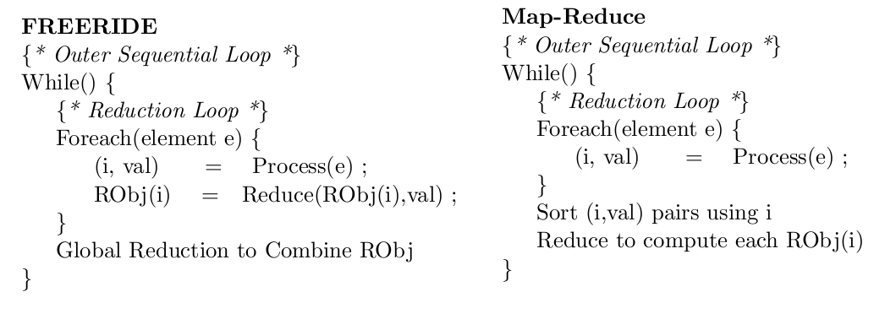
A Data Intensive Computing Middleware - FREERIDE
Reduction Object represents the intermediate state of the execution
Reduce func. is commutative and associative
Sorting, grouping.. overheads are eliminated with red. func/obj.

Slide 4
Simple Example
3 5 8 4 1 3 5 2 6 7 9 4 2 4 8
Our large Dataset ☺
Local
Reduction(+)
Local Reduction (+)
Local Reduction(+)
Robj[1]=
21
8
Robj[1]=
15
23
Robj[1]=
14
27
Our Compute Nodes
Result= 71
Global Reduction(+)

Slide 5
Remote Data Analysis
Co-locating resources gives best performance…
But may not be always possible
  Cost, availability etc.
Data hosts and compute hosts are separated
Fits grid/cloud computing
Our data intensive computing middleware is an implementation of FREERIDE that supports remote data analysis

Slide 6
Fault Tolerance Systems
Checkpoint based
  System or Application level snapshot
  Architecture dependent
  High overhead
Replication based
  Service or Application
  Resource Allocation
  Low overhead

Slide 7
Outline
Motivation and Introduction
Fault Tolerance System Design
Implementation of the System
Experimental Evaluation
Related Work
Conclusion

Slide 8
A Fault Tolerance System based on Reduction Object
Reduction object…
  represents intermediate state of the computation
  is small in size
  is independent from machine architecture
Reduction function is associative and commutative
Suitable for Checkpoint based Fault Tolerance System

Slide 9
An Illustration
3 5
8 4 1
1 3
5 2 6
7 9
4 2
Robj = 8
Robj = 21
Robj = 21
Local Reduction (+)
Local Reduction (+)
Robj=
0
8
21
Robj=
0
21
25

Slide 10
Modified algorithm for FTS
{ * Initialize FTS * }
While {
Foreach ( element e ) {
(i, val) = Process(e);
RObj(i) = Reduce(RObj(i), val);
{ * Store Red. Obj. * }
}
if ( CheckFailure() )
{ * Redistribute Data * }
{ * Global Reduction * }
}

Slide 11
Outline
Motivation and Introduction
Fault Tolerance System Design
Implementation of the System
Experimental Evaluation
Related Work
Conclusion

Slide 12
Simple Implementation of the Alg.
Reduction Object Exchange
Reduction Object Exchange
CN0
CN1
CNn-1
CNn
....
Reduction object is stored another comp. node
  Pair-wise reduction object exchange
Failure detection is done by alive peer

Slide 13
Demonstration
Redistribute Failed Node’s Remaining Data
N0
N1
N2
N3
Local Red.
Local Red.
Local Red.
Local Red.
Robj N0
Robj N1
Robj N2
Robj N3
Robj N1
Robj N0
Robj N3
Robj N2
Global Red.
Failure Detected
Final Result

Slide 14
Outline
Motivation and Introduction
Fault Tolerance System Design
Implementation of the System
Experimental Evaluation
Related Work
Conclusion

Slide 15
Goals for the Experiments
Observing reduction object size
Evaluate the overhead of the FTS
Studying the slowdown in case of one node’s failure
Comparison with Hadoop (Map-Reduce imp.)

Slide 16
Experimental Setup
FREERIDE-G
  Data hosts and compute nodes are separated
Applications
  K-means and PCA
Hadoop (Map-Reduce Imp.)
  Data is replicated among all nodes

Slide 17
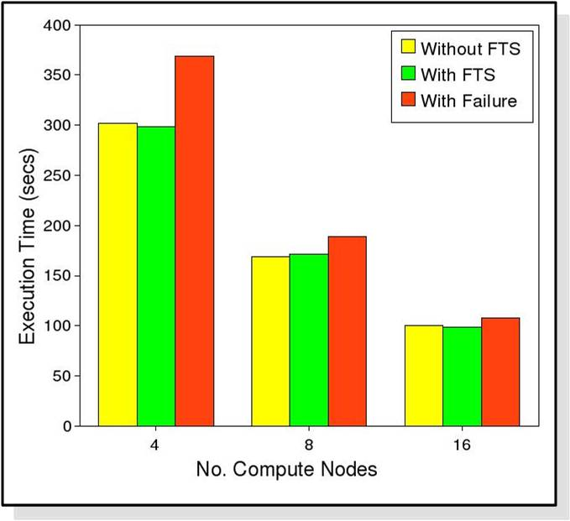
Experiments (K-means)
Without Failure Configurations
  Without FTS
  With FTS
With Failure Configuration
  Failure after processing %50 of data (on one node)
Reduction obj. size: 2KB
With FT overheads: 0 - 1.74%
  Max: 8 Comp. Nodes, 25.6 GB
Relative: 5.38 – 21.98%
  Max: 4 Comp. Nodes, 25.6 GB
Absolute: 0 – 4.78%
  Max: 8 Comp. Nodes, 25.6 GB
Execution Times with K-means 25.6 GB Dataset

Slide 18
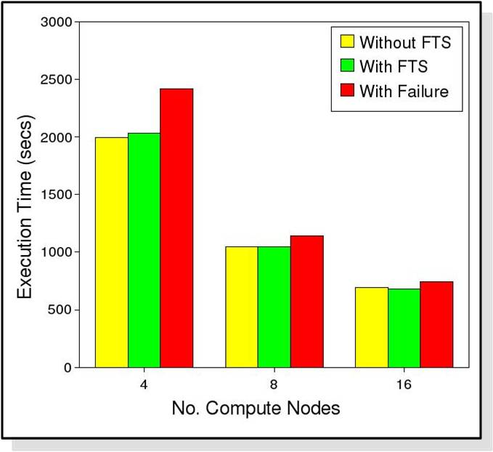
Experiments (PCA)
Reduction obj. size: 128KB
With FT overheads: 0 – 15.36%
  Max: 4 Comp. Nodes, 4 GB
Relative: 7.77 – 32.48%
  Max: 4 Comp. Nodes, 4 GB
Absolute: 0.86 – 14.08%
  Max: 4 Comp. Nodes, 4 GB
Execution Times with PCA, 17 GB Dataset

Slide 19
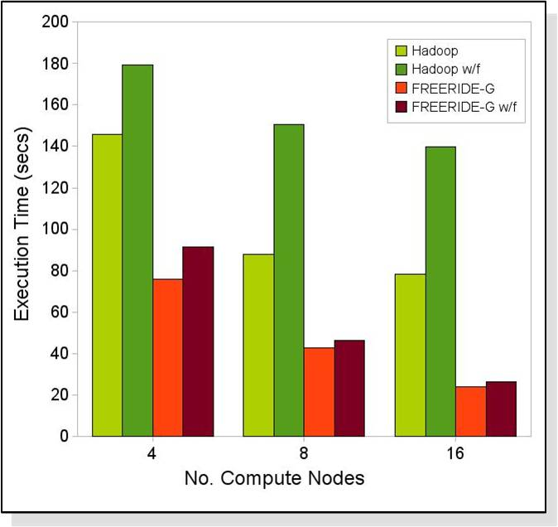
Comparison with Hadoop
w/f = with failure
Failure happens after processing 50% of the data on one node
Overheads
Hadoop
23.06 | 71.78 | 78.11
FREERIDE-G
20.37 | 8.18 | 9.18
K-means Clustering, 6.4GB Dataset

Slide 20
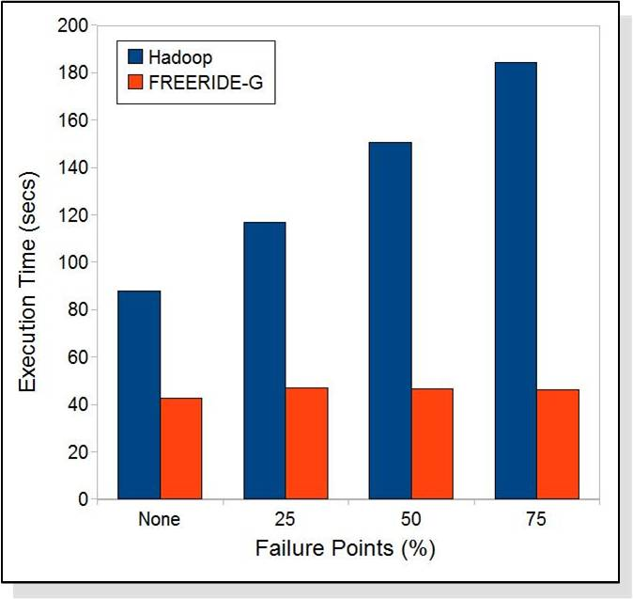
Comparison with Hadoop
One of the comp. nodes failed after processing 25, 50 and 75% of its data
Overheads
Hadoop
32.85 | 71.21 | 109.45
FREERIDE-G
9.52 | 8.18 | 8.14
K-means Clustering, 6.4GB Dataset, 8 Comp. Nodes

Slide 21
Outline
Motivation and Introduction
Fault Tolerance System Design
Implementation of the System
Experimental Evaluation
Related Work
Conclusion

Slide 22
Related Work
Application level checkpointing
  Bronevetsky et. al.: C^3 (SC06, ASPLOS04, PPoPP03)
  Zheng et. al.: Ftc-charm++ (Cluster04)
Message logging
  Agrabia et. al.: Starfish (Cluster03)
  Bouteiller et. al.: Mpich-v (Int. Journal of High Perf. Comp. 06)
Replication-based Fault Tolerance
  Abawajy et. al. (IPDPS04)

Slide 23
Outline
Motivation and Introduction
Fault Tolerance System Design
Implementation of the System
Experimental Evaluation
Related Work
Conclusion

Slide 24
Conclusion
Reduction object represents the snapshot of the system
Our FTS has very low overhead and effectively recovers from failures
Different designs can be implemented using Robj.
Our system outperforms Hadoop both in absence and presence of failures

Slide 25
Thanks

