Slide 1
Exploring the Application-Specific Optimization Opportunities to Accelerate the GPU-based Tomographic Image Reconstruction
Xiaodong Yu
Postdoc Appointee
Data Science and Learning Division
Nov. 25, 2019

Slide 2
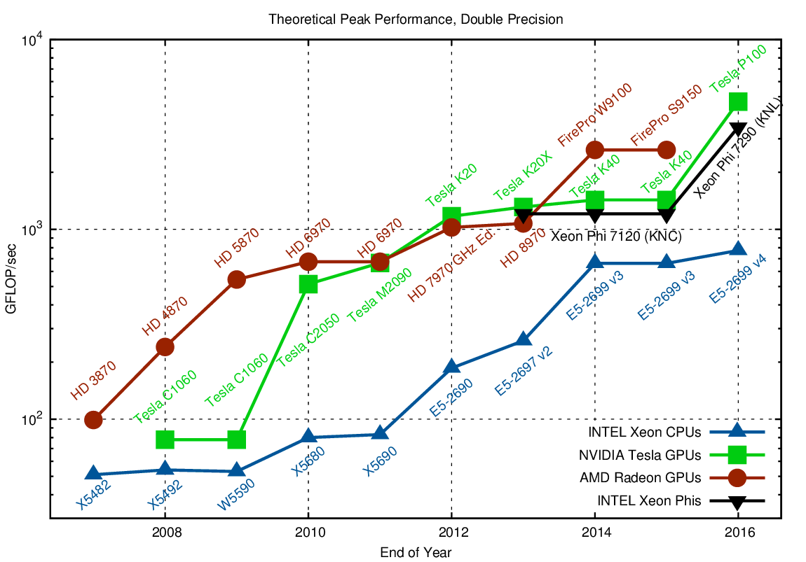
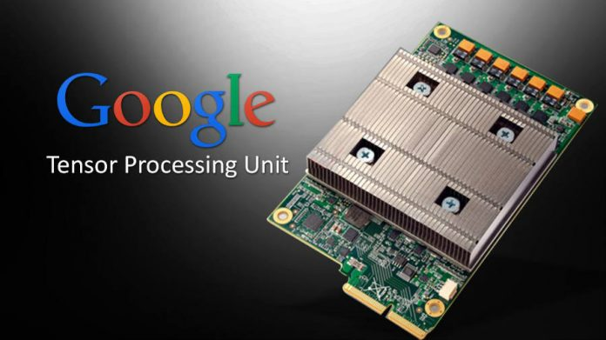
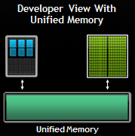
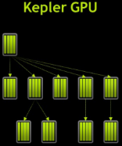
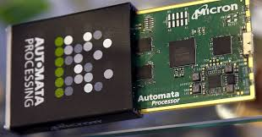
HPC Platforms Become More Powerful
HPC devices’ peak performance keeps increasing in last decade
Emerging Architectures
Novel technologies
2

Slide 3
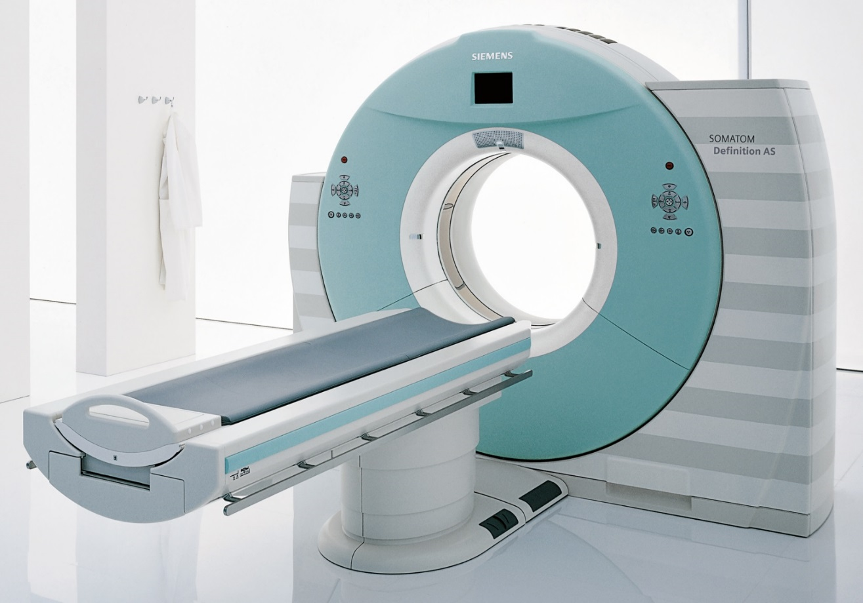
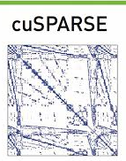



Motivation: HPC Hardware’s Capacity is Underutilized
Generic and coarse-grained parallelization
GPU-based CT image reconstruction
Up to 3X speedup vs. 15x speedup (cuSPARSE peak)
From [Liu, IEEE Access 2014]
Generic, underutilize GPU
Insufficient programming interface support
Automata Processor-based Association rule mining
Manually manipulation of the hardware
Expensive reconfiguration
3
Low-level interface
From [Wang, IPDPS 2015]

Slide 4
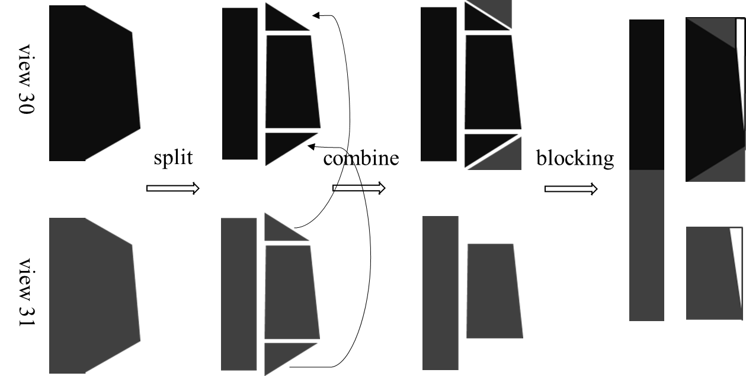
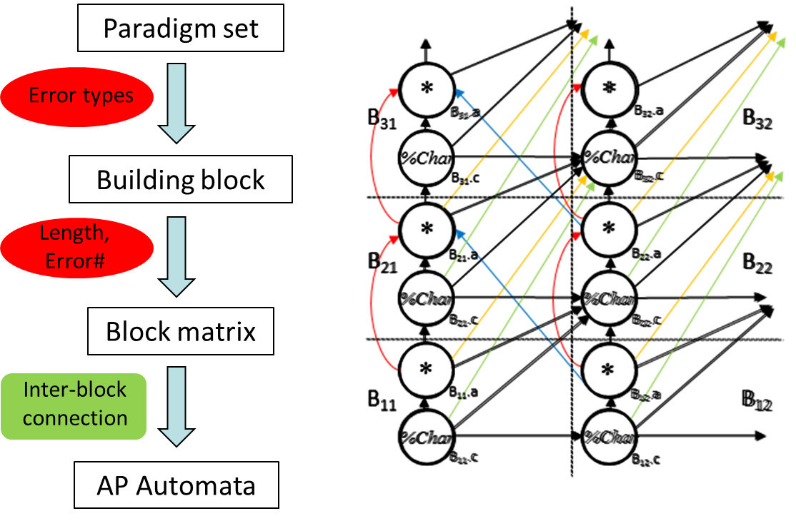
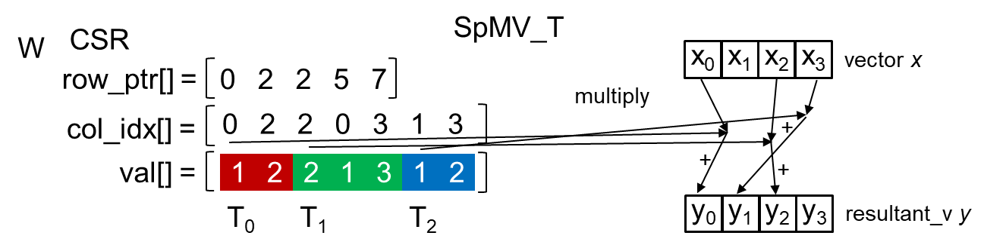
My Research Goal: Boost the Utilization of Hardware’s Capacity
Make specific applications run faster
Make the emerging architectures easier to use
GPU-based CT
Paradigm-based AP programming framework
on top of AP SDK
VS.
VS.
Auto automata construction
Very low-level interface
3X speedup
4
24X speedup
[Yu, IEEE BIGDATA’17]
[Yu, ACM CF’17]
[Yu, CCGrid’16]

Slide 5
cuART: Fine-grained Algebraic Reconstruction Technique for Computed Tomography Images on GPU
X. Yu, H. Wang, W. Feng, H. Gong and G. Cao. 2016. "cuART: Fine-Grained Algebraic Reconstruction Technique for Computed Tomography Images on GPUs," In Proceedings of the IEEE/ACM International Symposium on Cluster, Cloud and Grid Computing (CCGrid)
X. Yu, H. Wang, W. Feng, H. Gong, and G. Cao. 2017. “An Enhanced Image Reconstruction Tool for Computed Tomography on GPUs,” In Proceedings of the ACM Computing Frontiers Conference (CF'17)
5

Slide 6
Computed Tomography is Indispensable
Computed Tomography (CT) is one of the most important medical imaging diagnostic tools
60 million patients undergo a CT scan in 2002 in US
Imaging modality relying on x-ray projections of the subject
Reconstructing images through the projection vector collected from the detector
CT Device
Fan-beam CT model
6

Slide 7
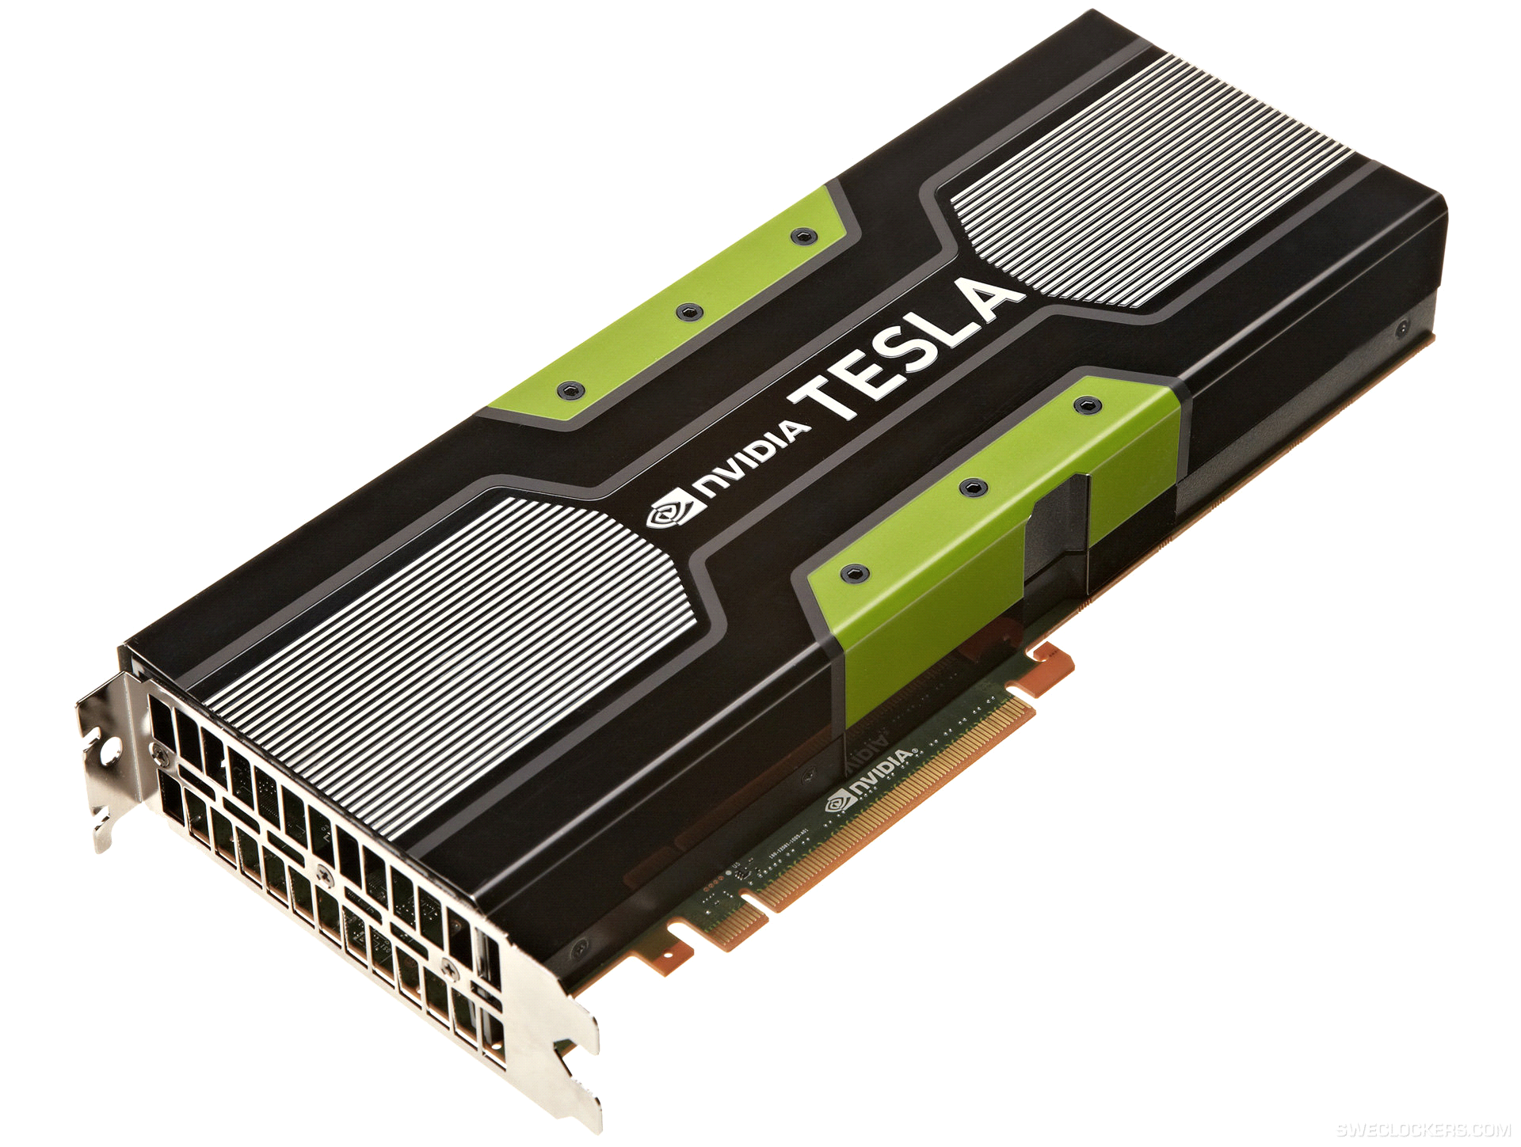
Motivation: CT Image Reconstruction is Computational Expensive
GPU
X-ray is harmful to the patient
map to HPC platform
Keep the dose as low as possible
high computational cost
disadvantage
Algebraic Reconstruction Technique (ART)
produces better images with fewer projection (much less radiation dose on patients)
advantage
7

Slide 8
cuART Design Overview
Traditional implementation: computation-centric
Calculate the weighting factors on the fly
More flexible, suitable for the multi-core devices
Too heavy computational overhead for many-core devices
GPU-based implementation: memory-centric
Pre-calculate all weighting factors and store them as a matrix
The computation pattern is converted to sparse matrix-vector multiplication (SpMV)
8

Slide 9
cuART Design Overview
Application-specific characteristics
Two symmetries
Two level sparsity patterns
Symmetry-based CSR (SCSR)
Unified GPU kernel
generic
Architecture-aware implementation
3X speedup
24X speedup
9
✗
✓

Slide 10
Algebraic Reconstruction Technique (ART)
Where F is N*1 image vector, W is M*N system matrix, W_T is transpose of system matrix, P is M*1 projection vector, C is a M*1 constant vector, .* represent element-wise multiplication
N is image pixel number, M is total ray number
Computational core is sparse matrix-vector multiplication (SpMV)
10

Slide 11
System Matrix in Fan-beam CT model
View 1
source
View 720
System matrix
1024 rays
1024 rays
detector
View 2
P1
P2
P3
P4
source
……
source
detector
P5
P6
P7
P8
detector
column#15
P9
P10
P11
P12
row#(719*1024+1)
w₁₁
w₁₂
w₁₄
0 | 0
 |  | 0 |  |  | 0
…
w
P13
P14
P15
P16
Weighting factor w from ray#(719*1024+1)&pixel#15
……
ray#(719*1024+1)
1024 rays
Only four elements of this row are nonzero, since the corresponding ray only interacts with four pixels
System matrix is a sparse matrix
The value of entries are the weighting factors
Row index represents corresponding ray index
Column index represents corresponding pixel index
11

Slide 12
Compressed Matrix Storage
Compressed Sparse Row (CSR)
One of the most memory efficient format for sparse matrix
Consists of three arrays: val, col_ind, row_ptr
val stores the values of non-zero entries
col_ind stores the column indices of non-zero entries
row_ptr stores the start pointers of the nonzeros of the rows
1
0
2
0
row_ptr[] =
0
2
2
5
7
W =
0
0
0
0
1
0
2
3
col_idx[] =
0
2
0
2
3
1
3
0
1
0
2
val[] =
1
2
1
2
3
1
2
12

Slide 13
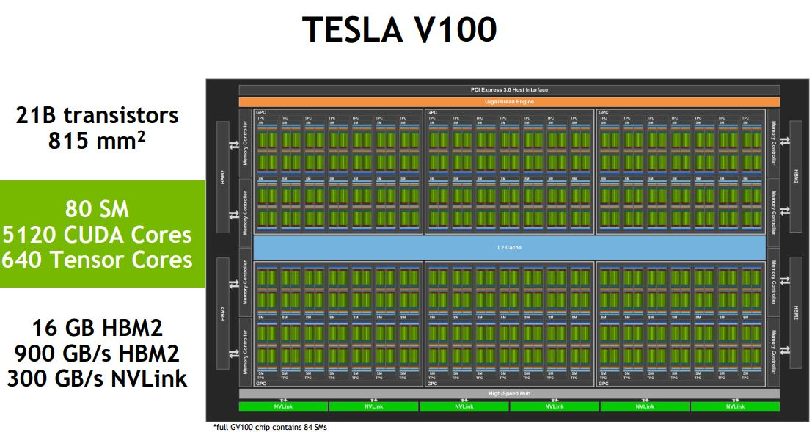
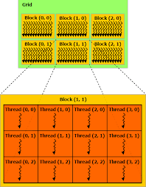
The Background of GPU
CUDA programming model
GPU architecture
13

Slide 14
Memory Space Challenge
Challenge #1: Memory space excess
A Tesla K20 GPU has 6GB global memory
Uncompressed system matrix requires hundreds of GB memory space
Even a CSR-based compressed system matrix may require tens of GB memory space
View number | 180 |  | 360
Image size | Nonzero # | CSR size (GB) | Nonzero # | CSR size (GB)
512² | 157M | 1.17 | 314M | 2.34
1024² | 415M | 3.09 | 830M | 6.19
2048² | 1237M | 9.22 | 2475M | 18.44
Exceed GPU memory capacity
14

Slide 15
Load Balancing Challenge
Challenge #2: Load Imbalance
GPU kernel mapping: each row of system matrix is assigned to one CUDA thread
Different rows have different numbers of non-zero (NNZ) element, and NNZ distribution along rows has a large variance
Hence different threads have different workloads, and differences could be large
Cause a load imbalance problem
Load imbalance can sharply degrade the performance
15

Slide 16
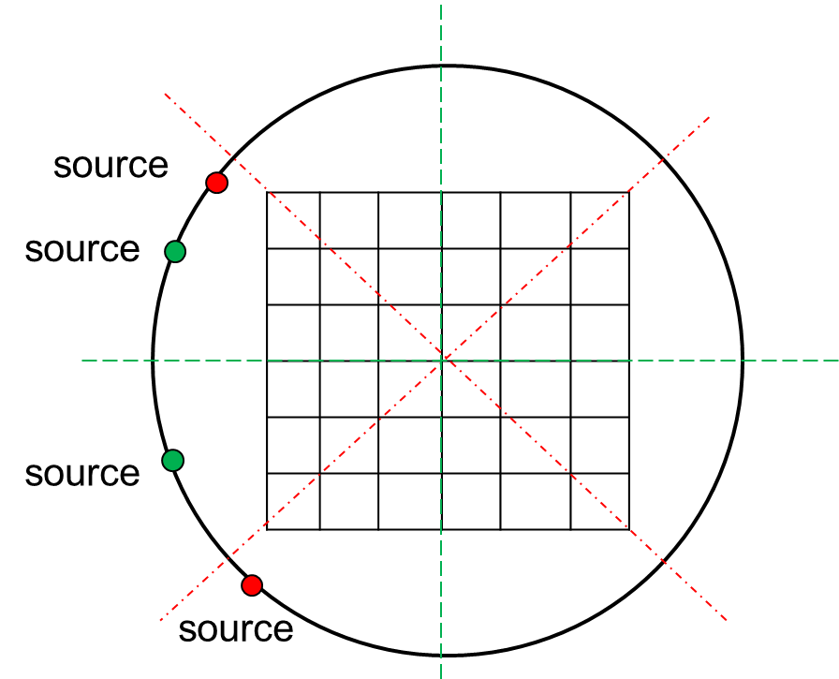
SCSR: Symmetry-Based Compression
There are Two kinds of view symmetries: rotational and reflection
Rotational symmetry
Reflection symmetry
only one eighth of system matrix needed to be stored, all others can be calculated on-the-fly
16

Slide 17
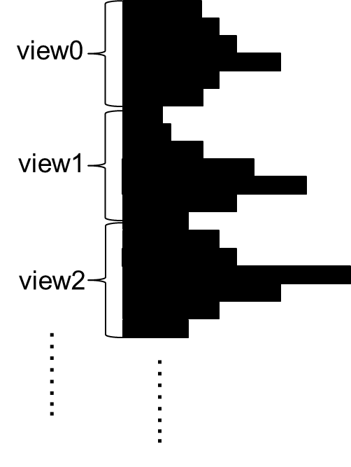
SCSR: Global-Level Blocking
Idea
sparsity
sort
combine
Solution
sort
combine
split
17

Slide 18









SCSR: View-Level Blocking (Sorting Free)
Leverages the view-level sparsities
Adjacent views have nearly the same sparsity
view 30
split
combine
blocking
view 31
18

Slide 19
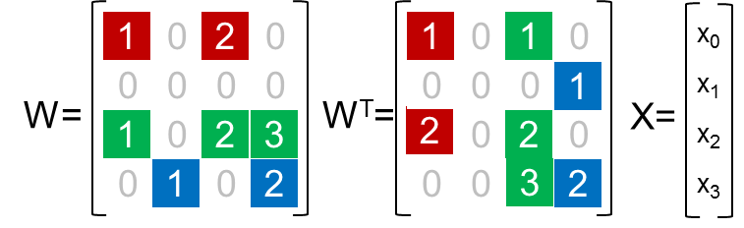

GPU Kernel:
SpMV_T is Expensive
Assigning one row to each CUDA thread
Conducting SpMV on system matrix W in SCSR is straightforward
SCSR
W
x₀
x₁
x₂
x₃
row_ptr[] =
vector x
0
2
2
5
7
multiply
col_idx[] =
0
2
0
2
3
1
3
$$∑$$
val[] =
1
2
1
2
3
1
2
T₀
T₁
T₂
y₀
y₁
y₂
y₃
resultant_v y
Conducting SpMV_T is challenging
Intuitive approach is to explicitly transpose W to W^{T} by using csr2csc (a function in cuSPARSE library)
This approach is expensive
Overhead to transpose the matrix is large
Demand of memory space is doubled (store both CSR&CSC)
T₁ intra thread behavior:
Multiplies each val[] element to corresponding x element serially
Accumulates all intermediate results to register
Adds final result in register to corresponding y element
19

Slide 20
Unified GPU Kernel: Handle Both SpMV and SpMV_T
Unified data structure for SpMV & SpMV_T
Conducting SpMV_T on SCSR instead of CSC
SCSR
SpMV_T
W
x₀
x₁
x₂
x₃
row_ptr[] =
vector x
0
2
2
5
7
col_idx[] =
0
2
0
2
3
1
3
multiply
val[] =
1
2
1
2
3
1
2
+
+
+
T₀
T₁
T₂
y₀
y₁
y₂
y₃
resultant_v y
T₁ intra thread behavior:
Multiplies each val[] element with x₂
Adds each product directly to corresponding y element
20

Slide 21
Unified GPU Kernel: Handle Both SpMV and SpMV_T
Unified data structure for SpMV & SpMV_T
Conducting SpMV_T on SCSR instead of CSC
SCSR
SpMV_T
W
x₀
x₁
x₂
x₃
row_ptr[] =
vector x
0
2
2
5
7
col_idx[] =
0
2
0
2
3
1
3
multiply
val[] =
1
2
1
2
3
1
2
+
+
T₀
T₁
T₂
y₀
y₁
y₂
y₃
resultant_v y
Race condition
Inter thread behavior:
T₀ and T₁ add to the same y element at the same time point when they process their first val[] element
21

Slide 22
Unified GPU Kernel: Handle the Race Condition
Column-indices based permutation
Permute elements within each matrix row
Make elements in each CSR column have different col_idx[] value
CSR
W
x₀
x₁
x₂
x₃
row_ptr[] =
vector x
0
2
2
5
7
col_idx[] =
0
2
0
2
3
1
3
val[] =
1
2
1
2
3
1
2
T₀
T₁
T₂
y₀
y₁
y₂
y₃
resultant_v y
22

Slide 23
Unified GPU Kernel: Handle the Race Condition
Column-indices based permutation
Permute elements within each matrix row
Make elements in each CSR column have different col_idx[] value
CSR
SpMV_T
W
x₀
x₁
x₂
x₃
row_ptr[] =
vector x
0
2
2
5
7
multiply
col_idx[] =
0
2
2
0
3
1
3
+
val[] =
1
2
2
1
3
1
2
+
+
T₀
T₁
T₂
y₀
y₁
y₂
y₃
resultant_v y
23

Slide 24
Experimental Results: Memory Usage
Symmetry-Based Compression
View number | 360 |  | 720
Image size | CSR size (GB) | w/ Sym-based compression(GB) | CSR size (GB) | w/ Sym-based compression(GB)
256² | 1.01 | 0.12 | 2.03 | 0.25
512² | 2.34 | 0.29 | 4.82 | 0.60
1024² | 6.19 | 0.77 | 11.97 | 1.50
2048² | 18.44 | 2.31 | 37.41 | 4.68
Even the system matrix for finest image is within GPU memory capacity
24

Slide 25
Experimental Results
Two Comparisons
overall performance and preprocessing
Comparison of two different blocking techniques (global-level and view-level) coupled with SCSR in our enhanced cuART
Compare our enhanced cuART to three other GPU implementations: CSR (cuSPARSE), BRC, and CSR5
Datasets
Images with three sizes: 2048*2048, 1024*1024, 512*512
Platform
NVIDIA Tesla K80 GPU (4992 CUDA cores, 24GB memory)
Intel Xeon E5-2697 CPU; 256GB system memory
25

Slide 26
Experimental Results: Processing Time
Performance Comparisons: three existing schemes vs. our scheme
Our cuART using view-level blocking coupled with SCSR can achieve up to 24.3-fold speedup against CPU version, and can achieve 6.8-fold, 7.2-fold, and 5.4-fold speedup against CSR, BRC, and CSR5 respectively
26

Slide 27
Experimental Results: Preprocessing Time
Preprocessing Comparisons: three existing schemes vs. our scheme
CSR requires least preprocessing time; BRC and our g-l SCSR require substantial preprocessing time due to sorting overhead; our v-l SCSR requires nearly the same preprocessing time as CSR
27

Slide 28
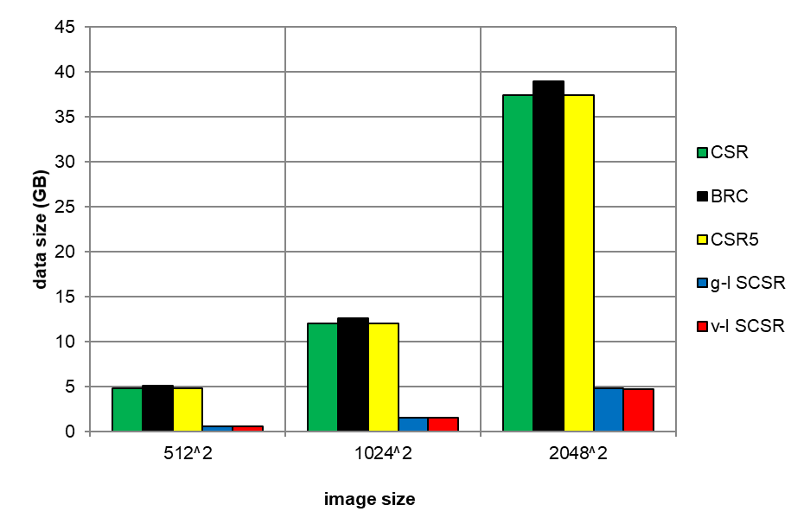
Experimental Results: Data Size
Data size Comparisons
Our enhanced cuART with view-level blocking requires slightly less memory space than with global-level blocking and requires around 8 times less memory space than all other approaches
28

Slide 29
GPU-based CT Image Reconstruction Summary
cuART tool
Symmetry-based CSR (SCSR)
Further compresses CSR data by removing symmetric but redundant non-zero elements
Blocks CSR into multiple dense sub-matrices by leveraging global- and view- level of system matrix sparsities to reduce workload imbalance
Unified GPU kernel
Supports SpMV and SpMV_T at the same time with the same SCSR data
Avoids race condition by permuting elements according to column-indices
cuART can significantly reduce the data size and improve the overall performance
achieves 24.3x speedup vs. CPU, and 6.8x, 7.2x, and 5.4x speedup vs. CSR, BRC, and CSR5 respectively
SCSR with view-level blocking requires nearly the same preprocessing time as CSR
29

Slide 30
Current Project: Multi-GPU Ptychography
Use multiple GPUs to accelerate single angular ptychographic image reconstruction
Sub-images have overlaps to overcome the boundary blurring
30

Slide 31
Asynchronous Processing
Straightforward Implementation
Reconstruct each sub-images asynchronously
Only sync and align once at the end of the reconstruction
Single GPU | 68s
2 GPUs | 36s
4 GPUs | 25s
8 GPUs | 24s
Drawbacks
Lower image quality
Slower convergence speed
31

Slide 32
Synchronous Processing
Advanced Implementation
Sync the sub-images after each iteration
32

Slide 33
Bottlenecks
Data communication pattern
Serial GPU-GPU communication
Each GPU has only one input and one output mem copy engines
Each GPU communicate with eight neighbor GPUs
GPU
Computation cores
Synchronization scheme
Computing should not start until the data copy completed
Requires finer-grained synchronization
Mem copy input
Mem copy output
33

