Slide 1

Text Summarization using Language Models
Shaik Suhana (220001073)
M.Hema Deepika (220001047)

Slide 2
Types of Summarization
Extractive Summarization (ES):
Extract the most relevant information from a document
Context is not taken into consideration and is verbatim text.
Abstractive Summarization (AS):
Generate new text that captures the most relevant information
Context is taken into consideration, compressed paraphrasing of the main contents of the document, potentially using vocabulary unseen in the source document

Slide 3



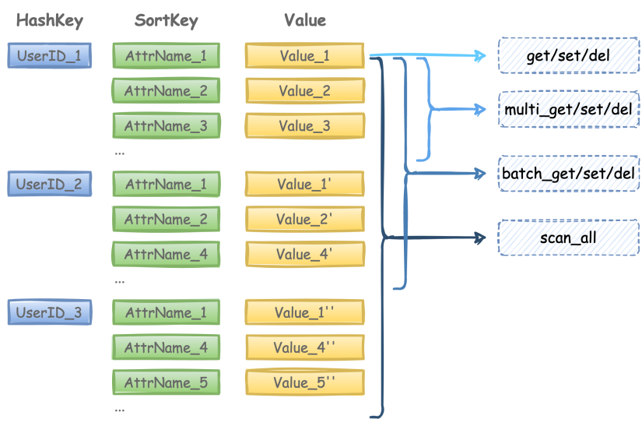
Transformers
BART
T5 (Text-to-Text)
GPT-2
Pegasus

Slide 4
BART (Bidirectional Auto-Regressive Transformers)
Facebook AI research combined Google's BERT and Open Ai's GPT
A denoising autoencoder for pretraining sequence-to-sequence models and uses a standard Transformer-based neural machine translation architecture.
Uses a standard seq2seq/NMT architecture with a bidirectional encoder (like BERT) and a left-to-right decoder (like GPT). This means the encoder's attention mask is fully visible, like BERT, and the decoder's attention mask is causal, like GPT2.
Trained by
corrupting text with an arbitrary noising function
learning a model to reconstruct the original text.

Slide 5
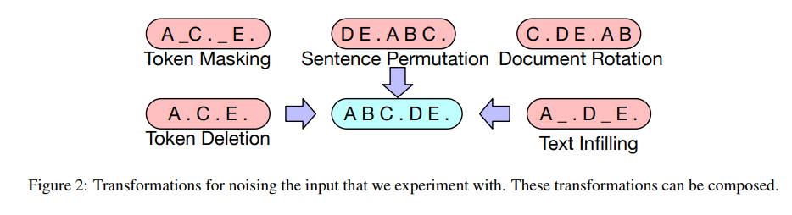
Why not GPT-2?
Decoder-only architecture ,lacks full context like encoder-decoder models
Why Pegasus?
Fine tuned for Abstractive Summarization
Uses Gap Sentence prediction
Why not T5?
T5 is general-purpose; BART is optimized for summarization.
Less targeted pretraining

Slide 6
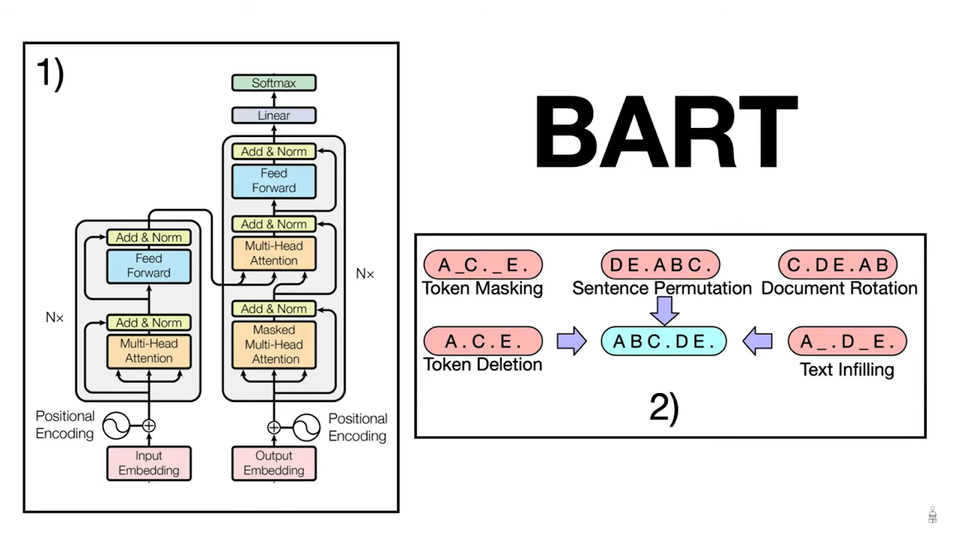

Slide 7
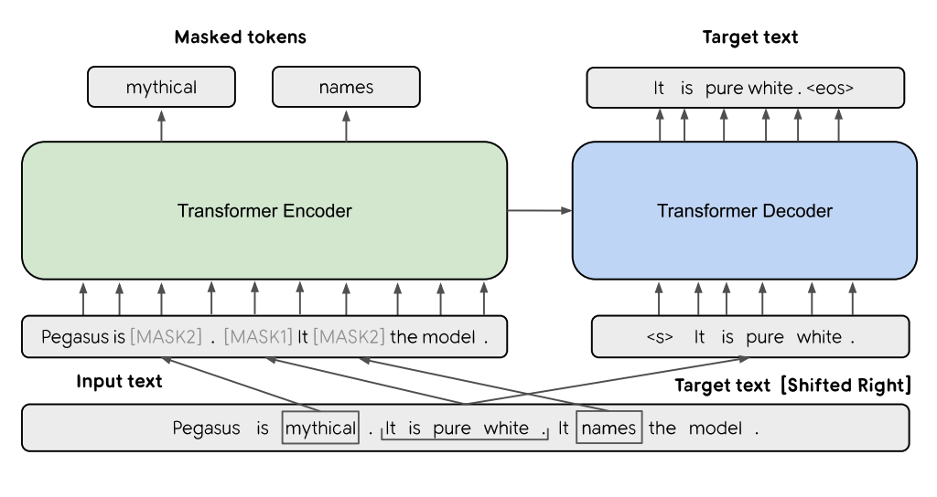
Pegasus

Slide 8
Metrics Used
ROUGE (Recall-Oriented Understudy for Gisting Evaluation):
A metric used for evaluating automatic summarization and machine translation software in natural language processing
Compares an automatically produced summary or translation against a reference or a set of references (human-produced) summary or translation.
Case insensitive, meaning that upper case letters are treated the same way as lower-case letters
ROUGE-1
Selection – how much of the important words are present.
ROUGE-2
Fluency and co-occurrence – Are they correctly paired?
ROUGE-L
Sentence-level structure similarity – respecting word order without requiring strict adjacency.

Slide 9

Data Overview

Slide 10
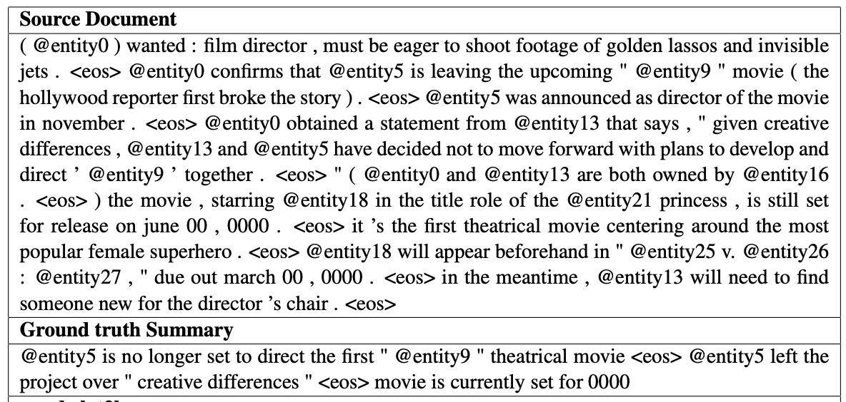
Source: https://www.kaggle.com/datasets/gowrishankarp/newspaper-text-summarization-cnn-dailymail
In all, the corpus has 200K Daily Mail and 100K CNN articles, as defined by their scripts.
The source documents in the training set have 766 words spanning 29.74 sentences on an average while the summaries consist of 53 words and 3.72 sentences.
The dataset is inspired from the one used in the Association for Computational Linguistics (ACL) 2017 paper Get To The Point: Summarization with Pointer-Generator Networks.
Using Daily Mail to train and build a model.
Using CNN as a test corpus to evaluate Daily Mail model

Slide 11



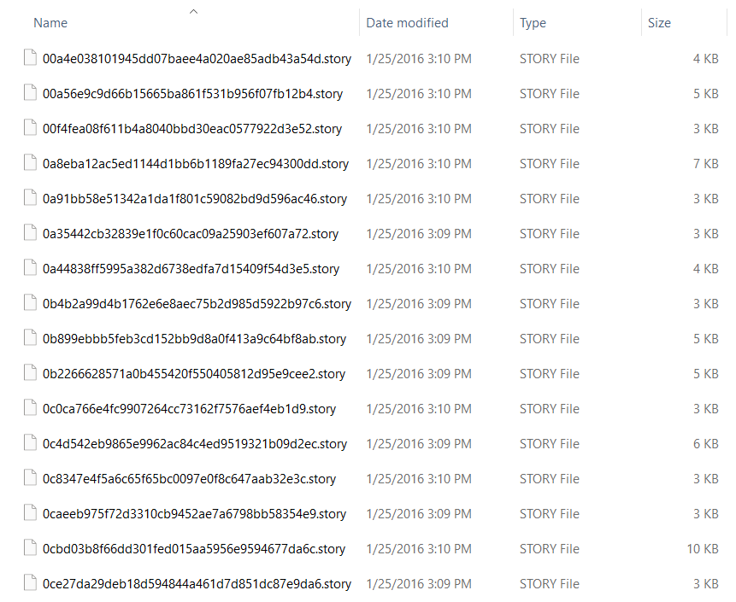
Preprocessing
Remove special characters
Handle contractions
Clean Hashtags
Remove Multiple Spaces
Remove punctuations, links, mentions and \r\n new line characters

Slide 12
Fine-tuning Transformers
LR scheduler: same learning rate throughout training is often suboptimal. Some phases of training benefit from smaller or larger steps.
Warm-up steps: initial training steps during which the learning rate gradually increases from 0 to the initial learning rate , instead of jumping to it instantly.
Prevents the model from blowing up early in training, Helps stabilize training in the beginning.
Especially important for transformer models, which are sensitive to high learning rates initially.
Used AdamW, Adam optimizers.
Frequent Evaluation During Fine-Tuning

Slide 13
Fine-Tuning – Configuration Tracker
Configuration | 1 | 2 | 3 | 4 | 5 (Increased Train Size to 60K)
Optimizer | AdamW | Adam | Adam | Adam | Adam
Epoch | 5 | 5 | 5 | 5 | 5
Learning Rate | 0.00001 | 0.00001 | 0.00001 | 0.00001 | 0.00001
Batch Size | 3 | 3 | 3 | 3 | 3
Max Length Input | 264 | 264 | 264 | 264 | 264
Target Max Length | 64 | 64 | 80 | 90 | 90
ROUGE-1 | 0.3612 | 0.3619 | 0.3618 | 0.3622 | 0.3674
ROUGE-2 | 0.0986 | 0.0980 | 0.0988 | 0.1045 | 0.1640
ROUGE-L | 0.2478 | 0.2499 | 0.2580 | 0.2701 | 0.2755
ROUGE-Lsum | 0.3111 | 0.3114 | 0.3121 | 0.3132 | 0.3180
BART
Configuration | 1 | 2 | 3 | 4 | 5 (increased train size to 60K)
Optimizer | AdamW | Adam | Adam | Adam | Adam
Epoch | 5 | 5 | 5 | 5 | 5
Learning Rate | 0.00001 | 0.00001 | 0.00001 | 0.00001 | 0.00001
Batch Size | 3 | 3 | 3 | 3 | 3
Max Length Input | 264 | 264 | 264 | 264 | 264
Target Max Length | 64 | 64 | 80 | 90 | 90
rouge1 | 0.4135 | 0.4136 | 0.4315 | 0.4328 | 0.4233
rouge2 | 0.1914 | 0.1916 | 0.1923 | 0.1985 | 0.2042
rougeL | 0.2522 | 0.2508 | 0.3025 | 0.3222 | 0.3270
rougeLsum | 0.3680 | 0.3682 | 0.3690 | 0.3703 | 0.3750
Pegasus

Slide 14

Results
ROUGE Scores

Slide 15
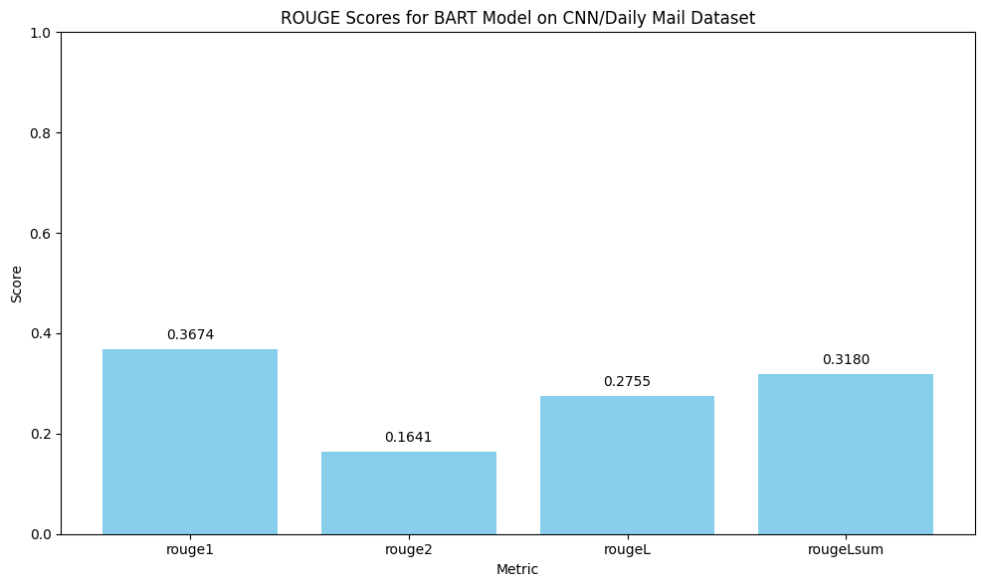
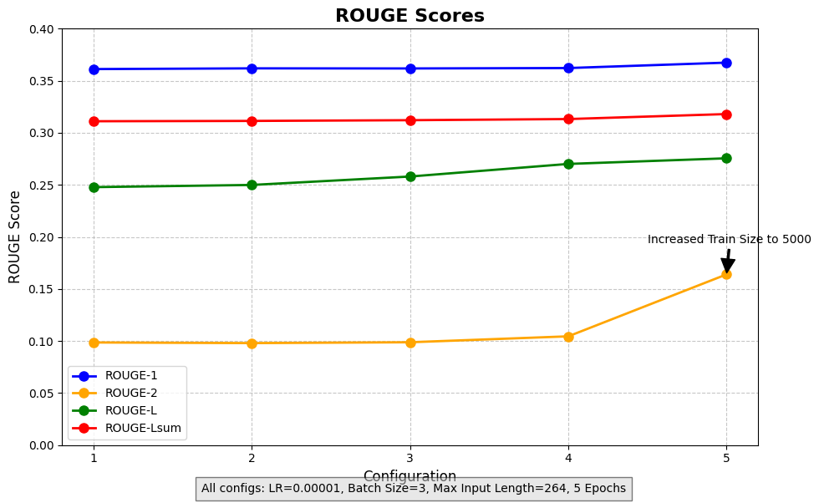
BART
Test ROUGE Score: {rouge1: 0.3681, rouge2: 0.1634, rougeL: 0.2771, rougeLsum: 0.3178}

Slide 16
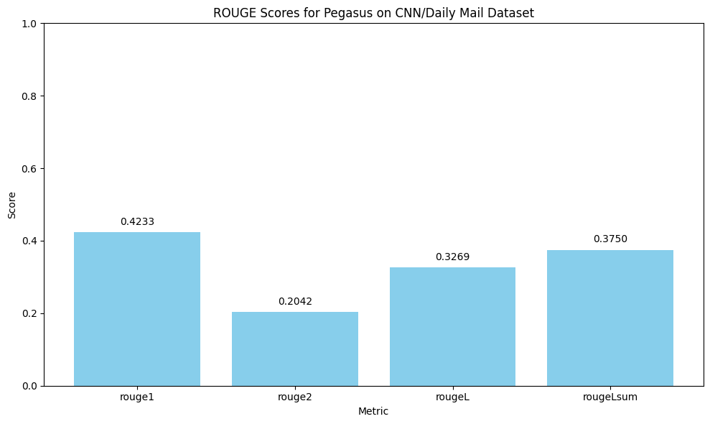
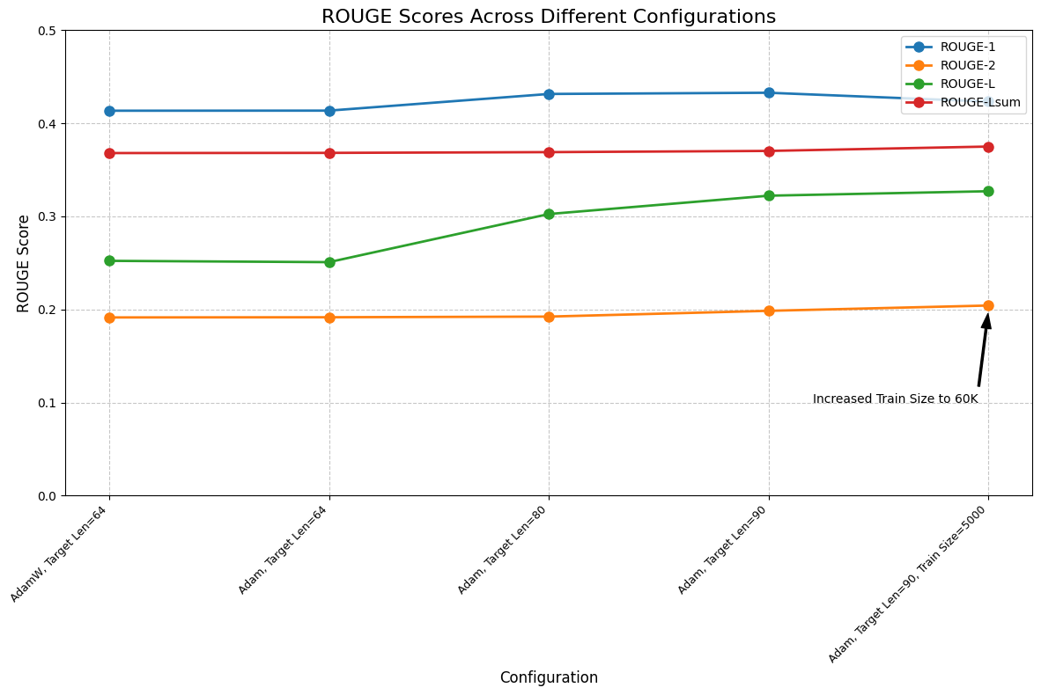
Pegasus
Test ROUGE scores: {rouge1: 0.4233, rouge2: 0.2042, rougeL: 0.3270, rougeLsum: 0.3750}

Slide 17
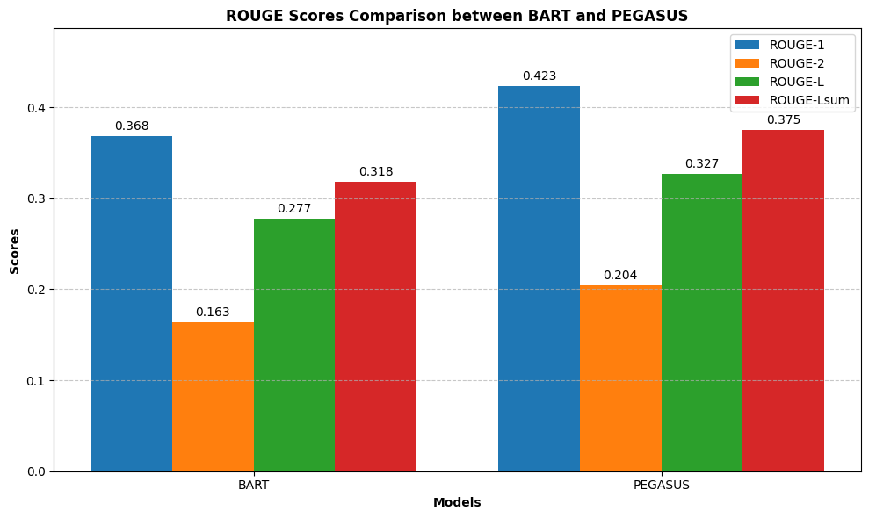
BART vs Pegasus

Slide 18
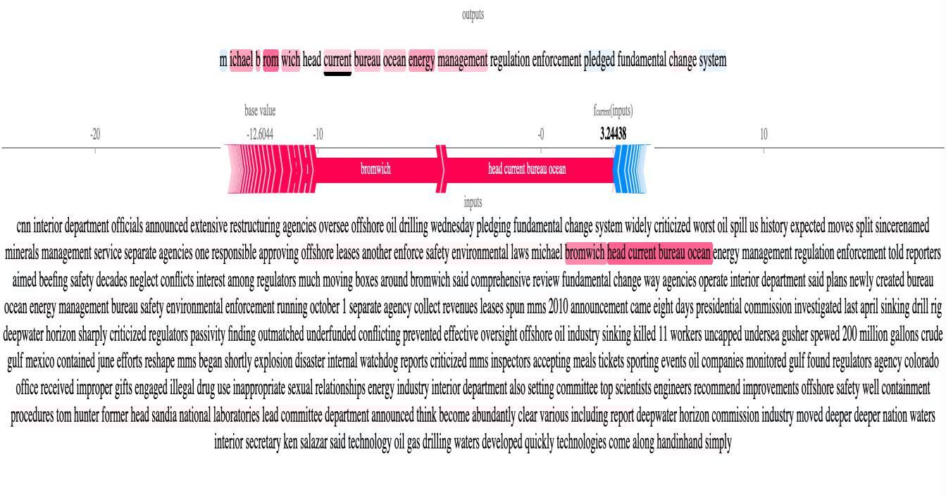
Results – SHAP Explainer

Slide 19
Result - Summarization
Original Text | Predicted Summary
(CNN) -- Interior Department officials announced an extensive restructuring of the agencies that oversee offshore oil drilling Wednesday, pledging "fundamental change" for a system widely criticized after the worst oil spill in U.S. history. The expected moves split the since-renamed Minerals Management Service into separate agencies, with one responsible for approving offshore leases and another to enforce safety and environmental laws. Michael Bromwich, the head of the current Bureau of Ocean Energy Management, Regulation, and Enforcement, told reporters the reorganization is aimed at beefing up safety after "decades of neglect" and conflicts of interest among regulators. "This reorganization is much more than just moving boxes around," Bromwich said. "It is about a comprehensive review and a fundamental change in the way that these agencies operate.“ The Interior Department said it plans to have its newly created Bureau of Ocean Energy Management and Bureau of Safety and Environmental Enforcement up and running by October 1. A separate agency to collect revenues from leases was spun off from MMS in 2010………………….. | BART: 'Former head of Sandia National Laboratories to lead committee on safety, well containment. "This reorganization is much more than just moving boxes around," Michael Bromwich says. Minerals Management Service will be split into separate agencies. The agency is responsible for approving offshore leases and enforcing safety and environmental laws.’ Pegasus: the interior department announces an extensive restructuring of the agencies that oversee offshore oil drilling. the agency is split into separate agencies, with one responsible for approving offshore leases and another to enforce safety and environmental laws. the reorganization is aimed at beefing up safety after "decades of neglect" and conflicts of interest among regulators.

Slide 20
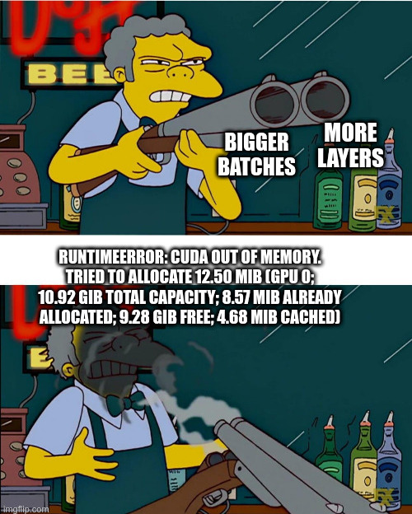
CUDA Error: Out of Memory

