Slide 1

Data Visualization Project
Analysis of Evictions in San Francisco from 1997-2019
Pod: Tekle Gebrezgabhier, Catherine Tan, Lily Tao, Linda Tran
Data Analytics Program, Cohort 65
Fall 2019

Slide 2
AGENDA
Introduction
Data Visualizations: Bar, Times Series, Geographical Charts
Observations: Insights Derived from Data
Conclusion

Slide 3

Introduction
Data Source - https://data.sfgov.org/Housing-and-Buildings/Eviction-Notices/5cei-gny5
Data - 41,043 data points with (alpha)numeric, Boolean true/false, date, geographical, text string values
Visualization Tool
Data Prep Process
Raw Data
Transform Data
Tableau Viz
Load Data
Write Data
Notes:
Raw Data - CSV comma separated values, create data set in Tableau
Transform Data - converting field to date format, figure out how to summarize Boolean values → pivot table with all 19 Boolean fields within Tableau
Create our vizzes by clicking and dragging appropriate fields into the worksheet → Tableau generates

Slide 4
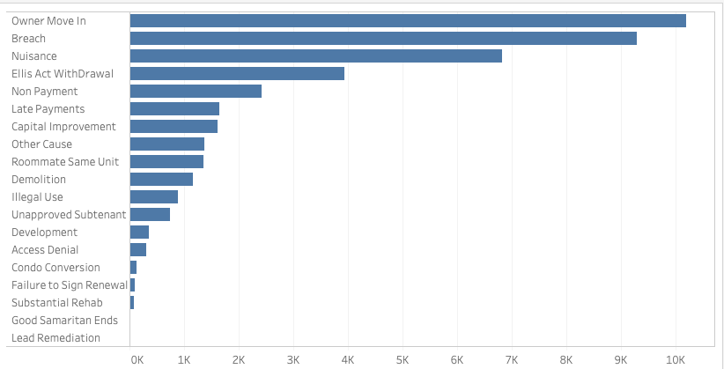
Bar Chart - Reasons for Eviction
This bar chart shows:
19 reasons for eviction
The Owner move in has the maximum of number of records
Lead remediation has the minimum value of records

Slide 5
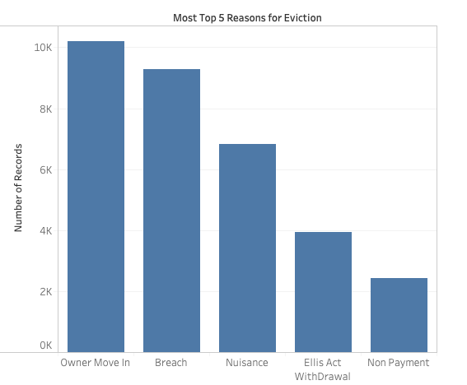
Top 5 Eviction Reasons
Number of records of top 5 reasons for eviction
Owner move in → 10204
Breach → 9289
Nuisance → 6826
Ellis Act Withdrawal → 3940
Non payment → 2427

Slide 6
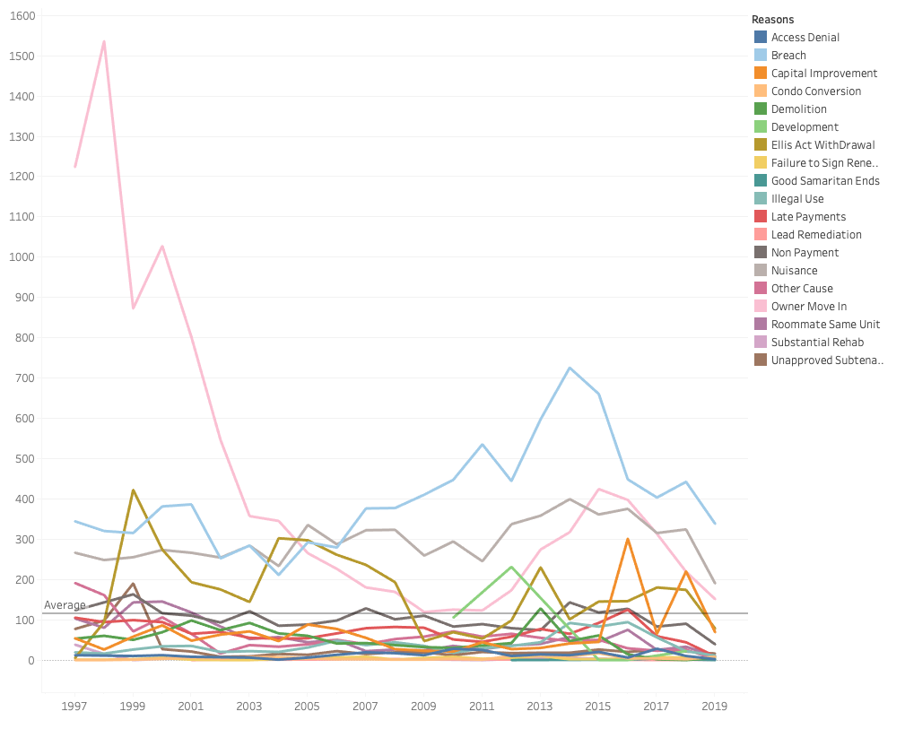
Time Series Chart for Eviction Reasons 1997-2019
Busy chart
Difficult to interpret below average line
We can decipher major trend lines above the average
Average evictions/year ≈ 116
Reinforces Tekle’s findings of top 5 eviction reasons
This chart type would not have been able to pick up “non payment” as top 5 reason
View data from different angle → more granularity

Slide 7
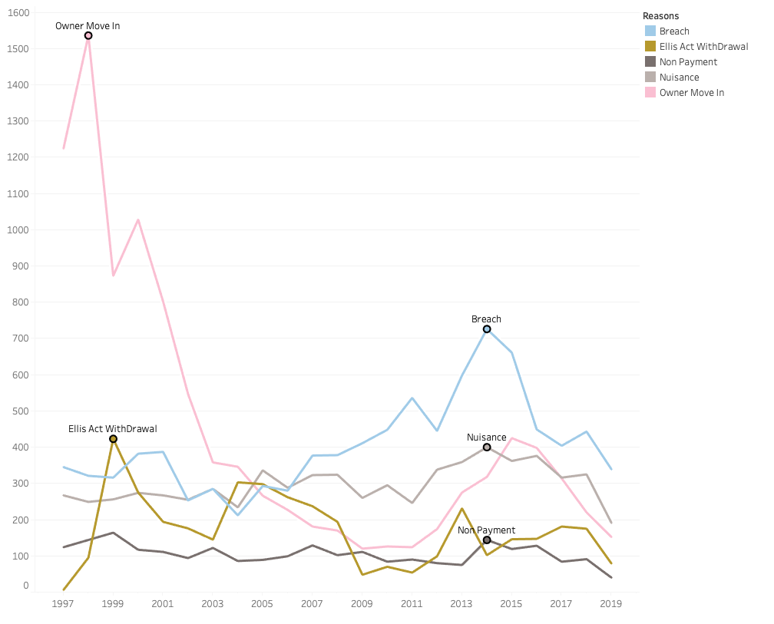
Trend Over Time - Top 5 Eviction Reasons
Owner move in - big spike in 1998 then drops with major fluctuations over time
Breach - spike in 2014 and consistently above overall average with some noticeable fluctuations
Nuisance - peaks in 2014
Ellis Act Withdrawal - peaks in 1999
state law - landlords have the unconditional right to evict tenants to “go out of business”
Non payment - minor fluctuations and skims near the average of 116
Source: https://www.sftu.org/ellis/
Notes:
The “Ellis Act” is a state law which says that landlords have the unconditional right to evict tenants to “go out of business.” For an Ellis eviction, the landlord must remove all of the units in the building from the rental market, i.e., the landlord must evict all the tenants and cannot single out one tenant (for example, with low rent) and/or remove just one unit out of several from the rental market. The Ellis Act is included in the just causes for eviction under the Rent Ordinance as Section 37.9(a)13).
Ellis Act evictions generally are used to change the use of the building. Most Ellis evictions are used to convert rental units to condominiums, using loopholes in the condo law. If your Ellis eviction is intended to convert the apartments to condos see the “Condo & TIC Conversions” section. Also, Ellis evictions are used to convert multi-unit buildings into single family homes that are mansions. For fighting these, see “Mergers & Demolitions.”
Threats
Filing an Ellis Act with the Rent Board means that the re-rental restrictions will be recorded on the deed of the property. The record on the deed is regardless of whether or not the landlord completes the Ellis withdrawal. Thus landlords are motivated to issue Ellis “warnings” and “advisories” to the tenants. These “warnings” are not legal eviction notices but nonetheless are perceived as eviction notices by tenants. They usually warn that an Ellis will be coming in a month or two. (Especially when they want to simply sell a building since realtors report that vacant buildings are worth 20% more). See the strategies for dealing with threats of eviction. Don’t move based on a bluff!
Buyouts
Offers to vacate for money (with implied threats of eviction) are regulated.

Slide 8
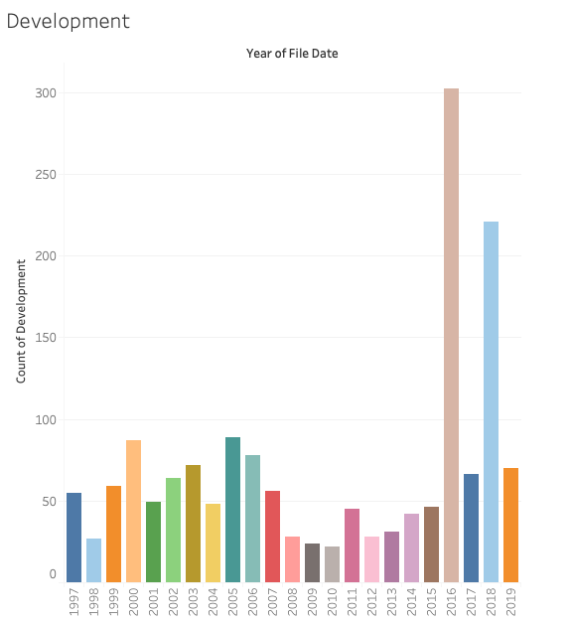
Development in San Francisco
Purpose of development is to improve property by constructing new buildings or land improvements
Development doubles in 2016 and 2018
In recent years, more housing has been constructed
Increased numbers of development may indicate gentrification of neighborhoods (new and improved buildings)
Source: Data SF: Eviction Notices

Slide 9
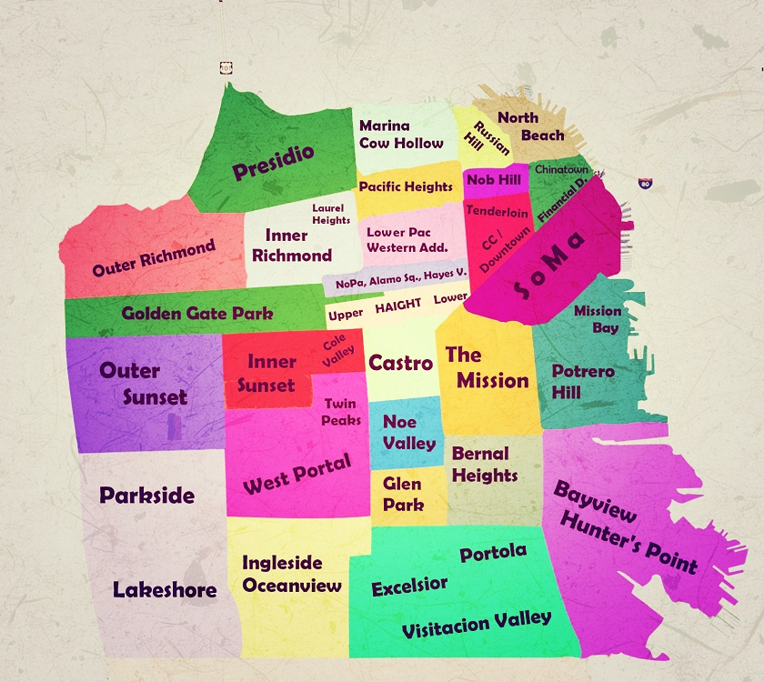
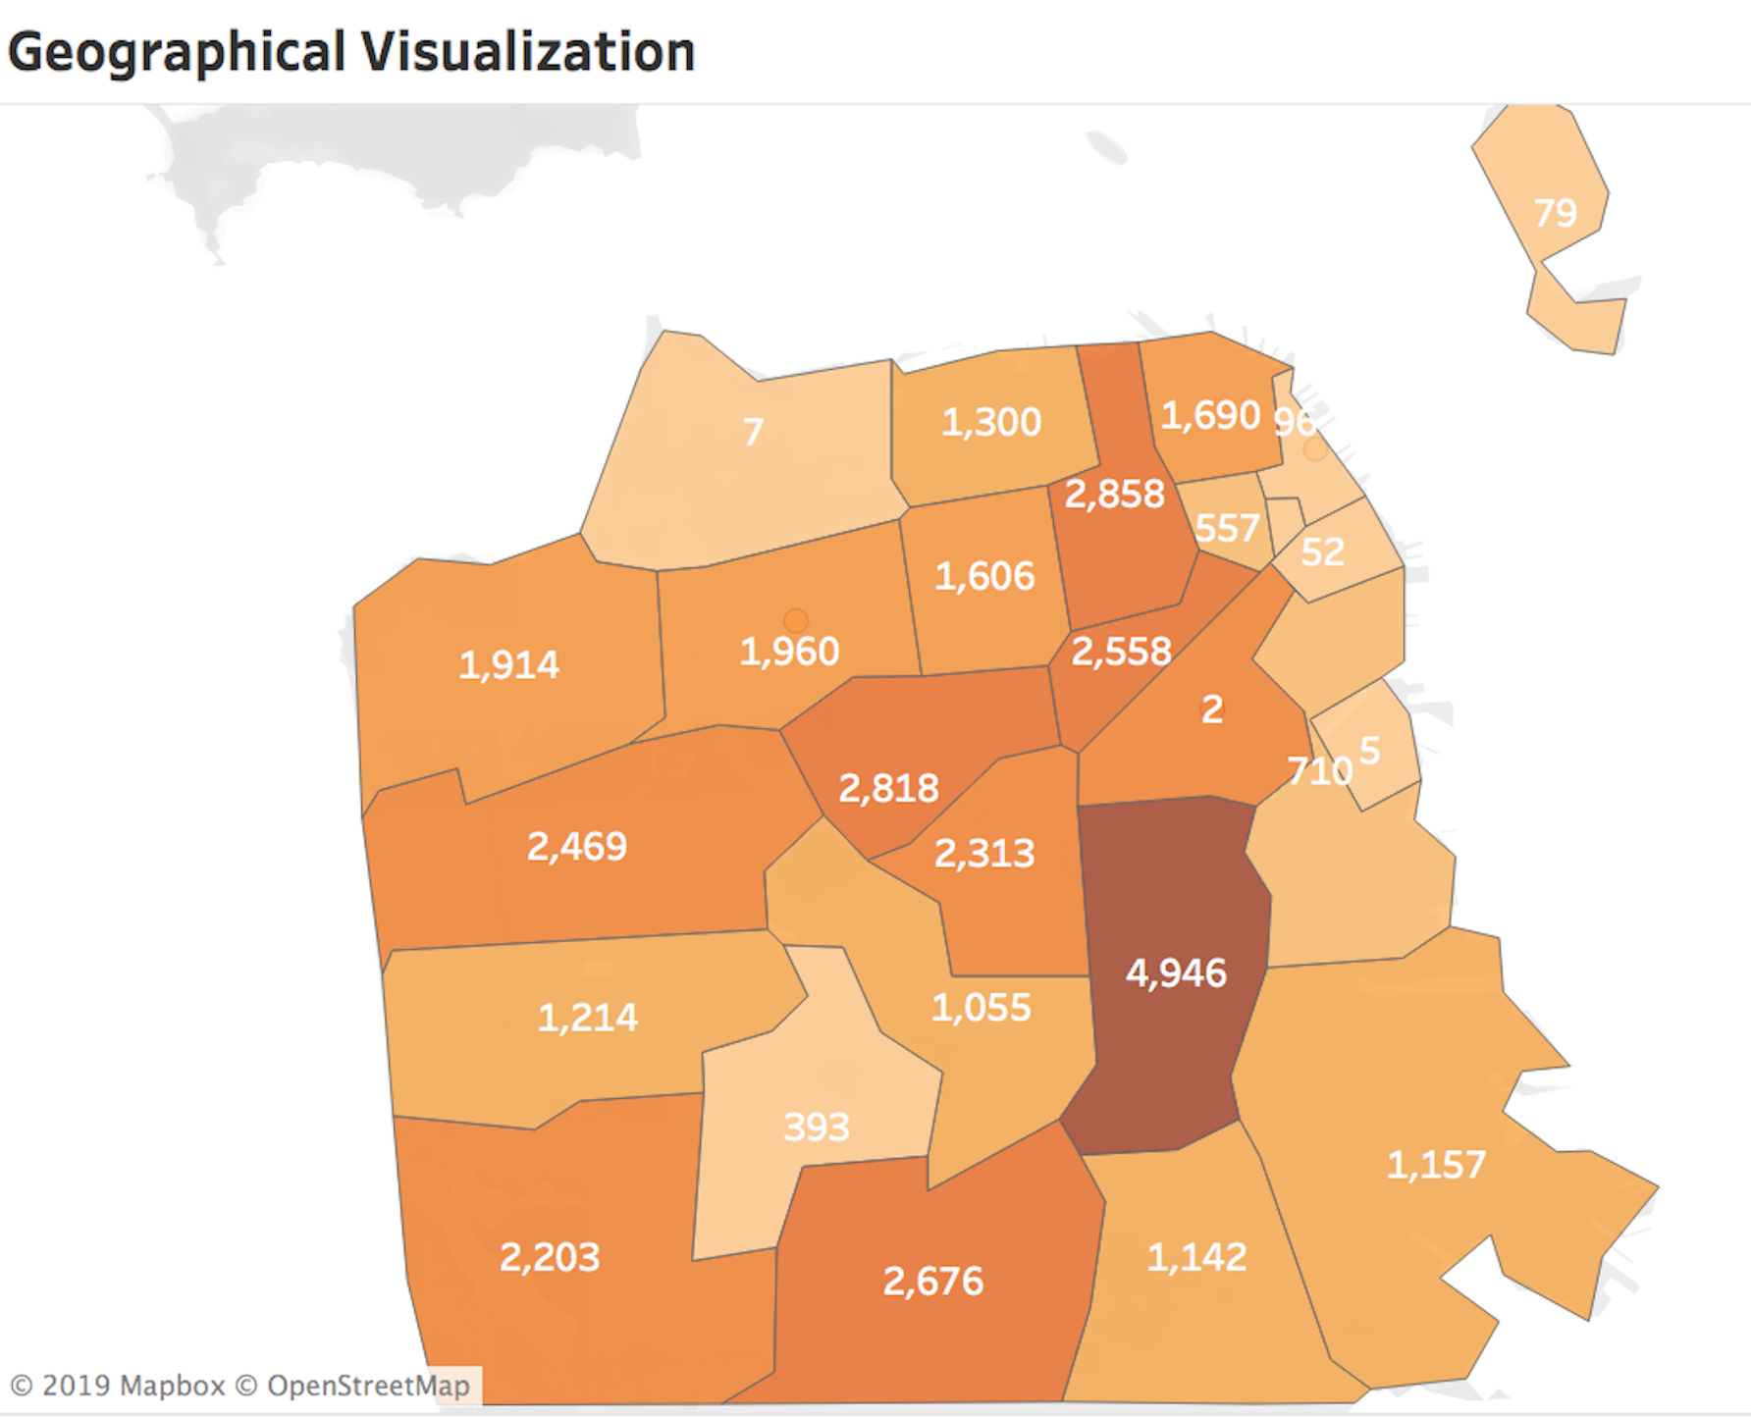
Geographical Impact
Notes:
-Mission: Most effected

Slide 10
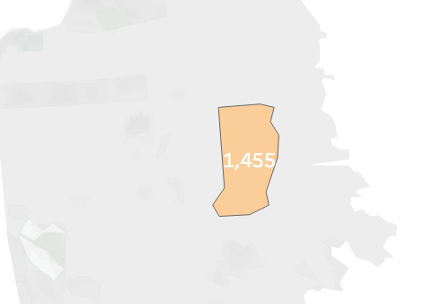
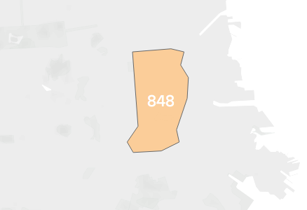
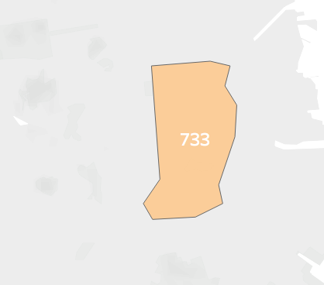
Geographical Impact
Owner Moved In
Breach
Nuisance

Slide 11
Conclusion
Organizing the data
Interpreting the data through different lens
How data analytics help with social justice
Notes:
Organizing the data: - Prep True/False Data prior to visualization tool
Interpreting data: Try out different viz, and rule out outlier data to ensure accuracy,

