Slide 1

Employee Attrition & Salary Prediction
Ndede, George M.
CASE STUDY 2 - DS6306

Slide 2
Employee attrition is a situation that occurs when there is a reduction in the number of staff members over time, owing to certain unavoidable reasons. Employees may resign from work due to retirement or other personal reasons.
Some cases of attrition become unavoidable for an organization. For example, an employee may quit his or her job when he or she attains their retirement or is shifting base to another city.

Slide 3
Introduction:
Introduction:
Goal is to find a way to predict both of the following:
Attrition of employees (Yes or No)
Monthly Income
Using data on 870 Employees
19 numeric variables
7 categorical variables
6 unusable variables

Slide 4
Unusable Variables
Unusable Variables
Constant values:
EmployeeCount
StandardHours
Over18
No Correlation with MonthlyIncome
HourlyRate
DailyRate
MonthlyRate

Slide 5
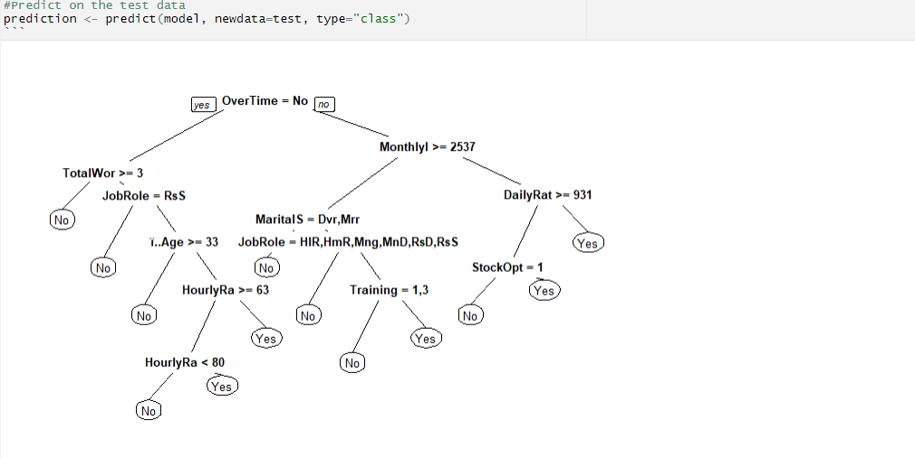
Prediction on Test Data
Prediction on Test Data

Slide 6
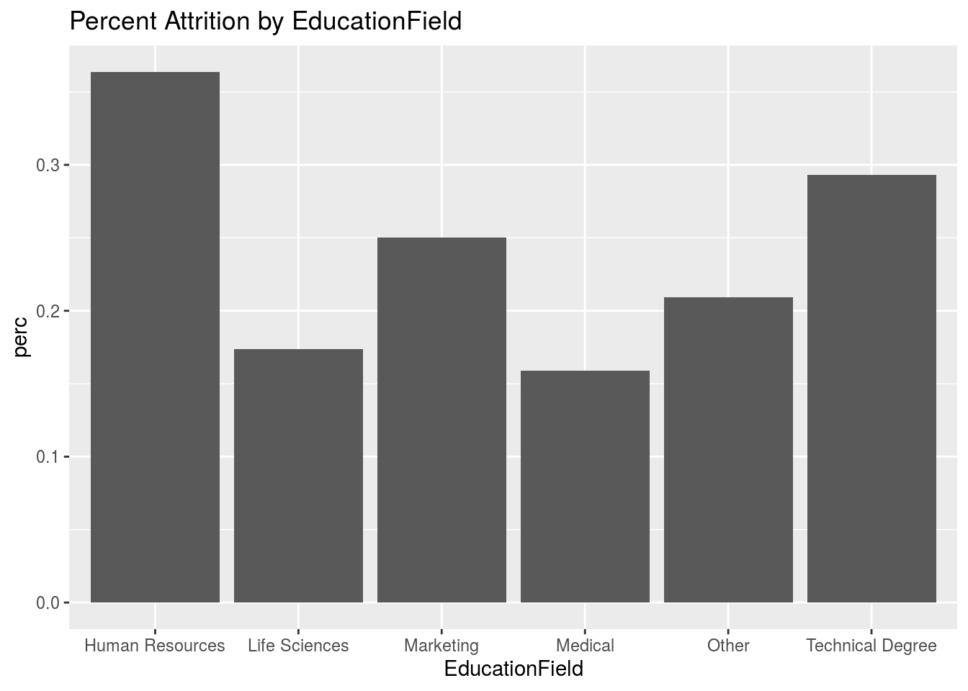
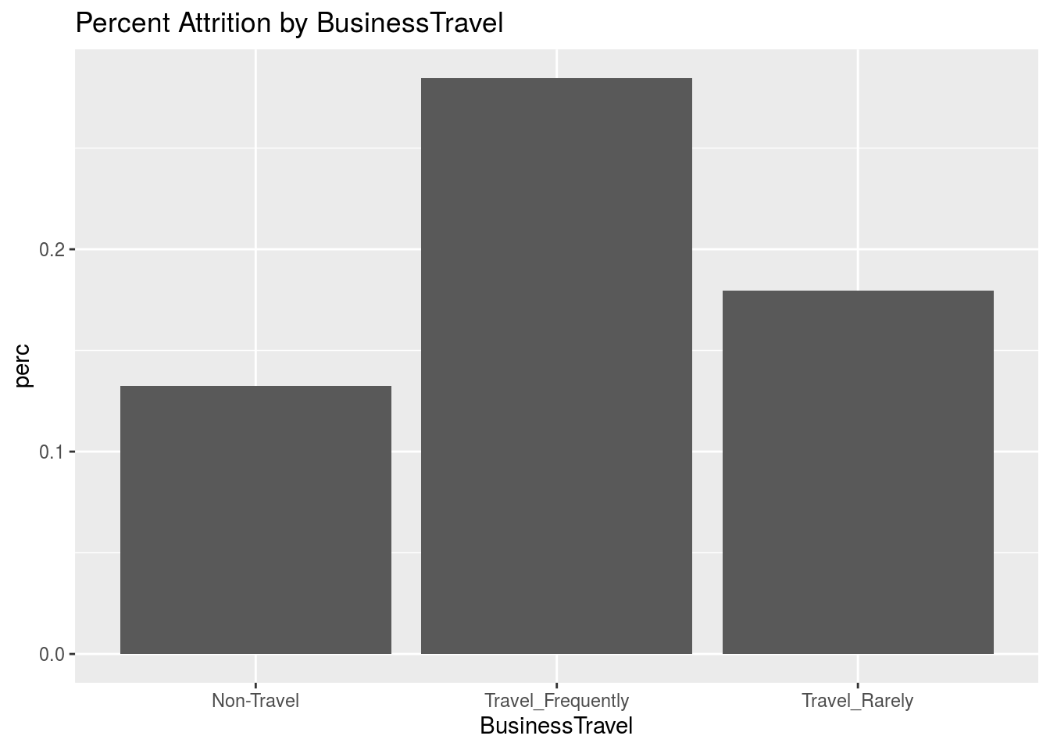
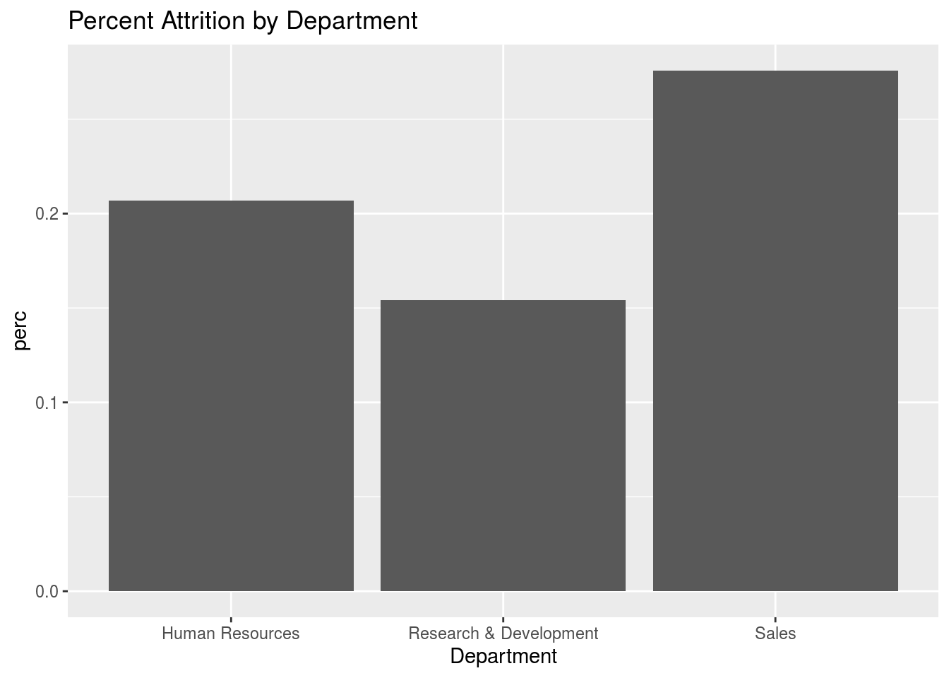
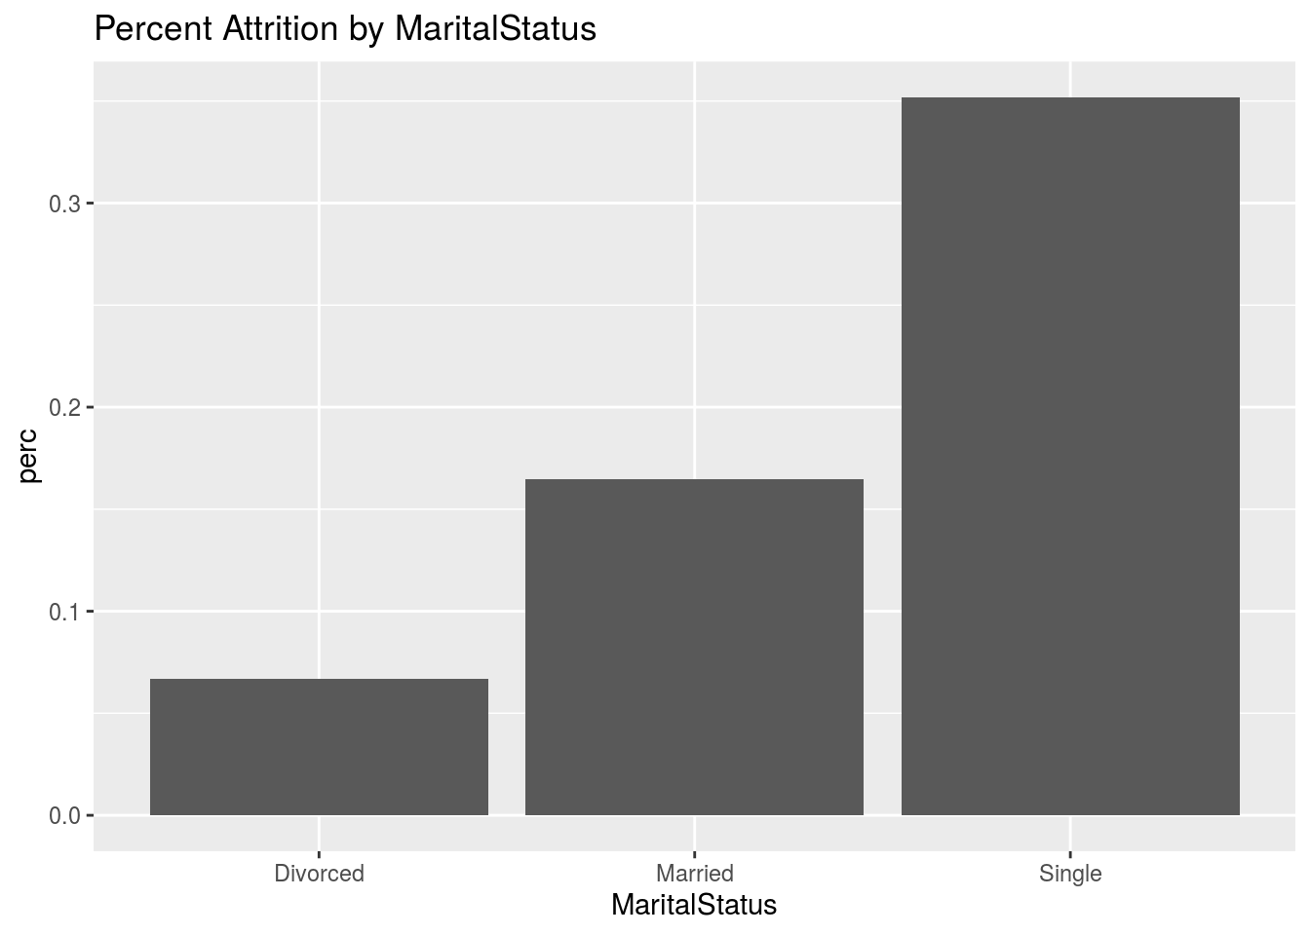
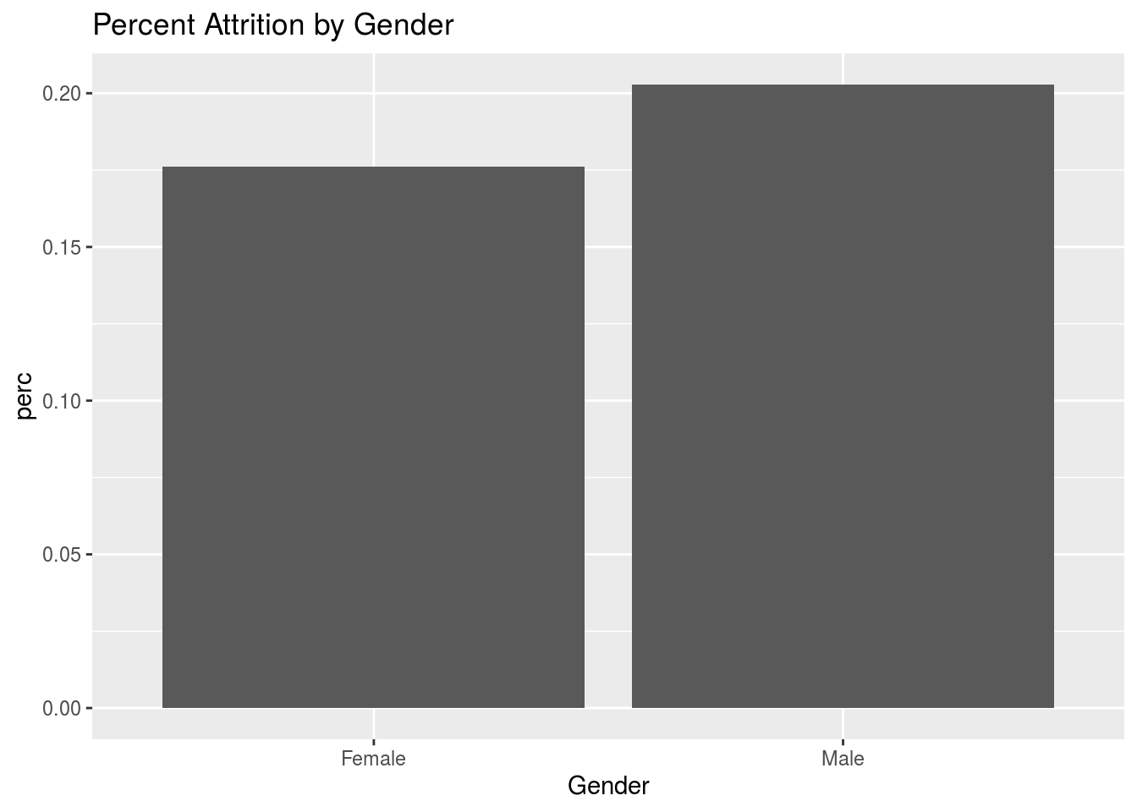
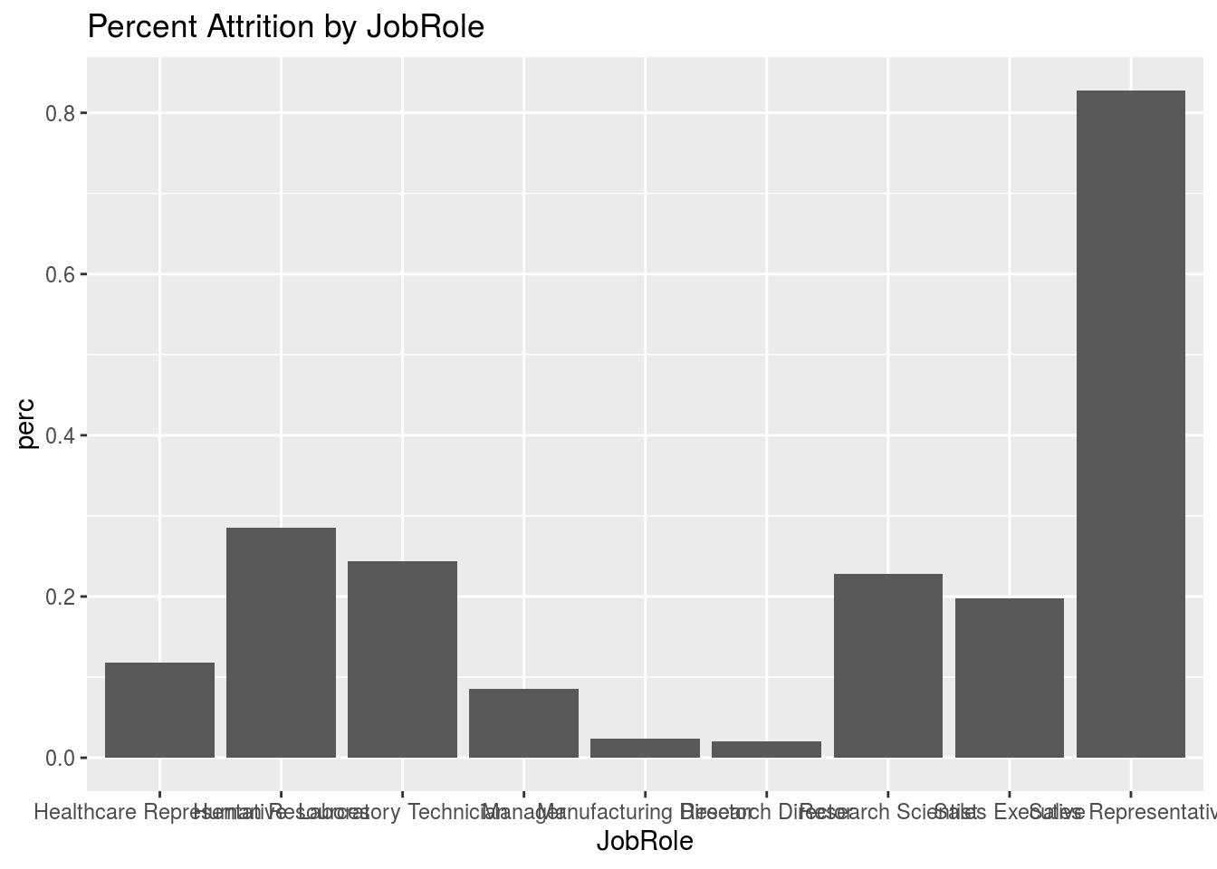
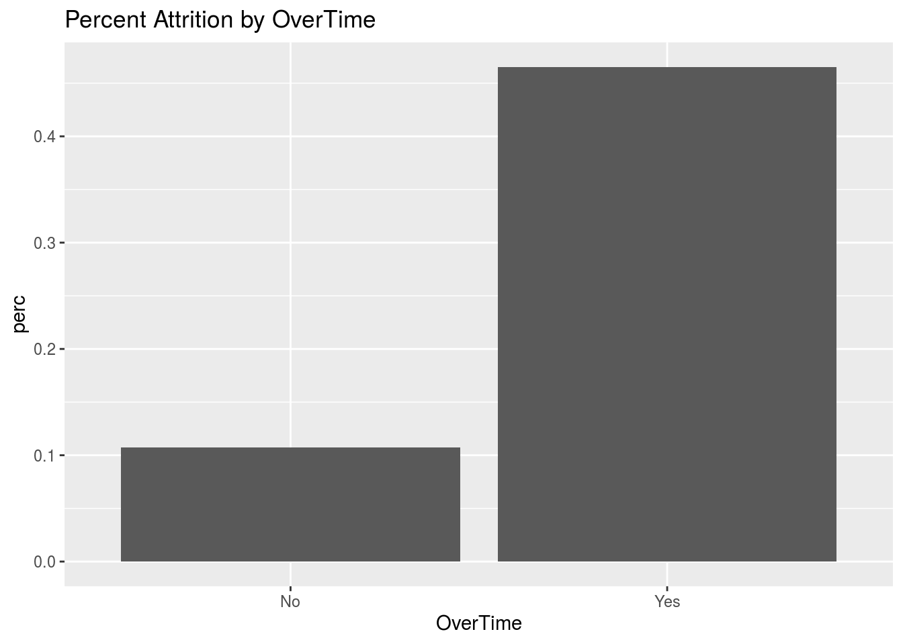
Factors related to Attrition:
Factors related to Attrition

Slide 7
Naïve Bayes Prediction
All Factors Predictors from Stepwise AIC Selection
accuracy of 84 %
sensitivity of 42 %
specificity of 92 %
“yes” predictions:13%
“no” predictions: 87%
accuracy of 86 %
sensitivity of 26 %
specificity of 97 %
“yes” predictions: 6%
“no” predictions: 94%
Distance From Home
EnvironmentSatisfaction
NumCompaniesWorked
OverTime
TotalWorkingYears
TrainingTimesLastYear
WorkLifeBalance
YearsSinceLastPromotion
JobInvolvement
JobSatisfaction
MaritalSTatus
Acceptable Accuracy, but Sensitivity is poor (Not catching all true 'YES')

Slide 8
Naïve Bayes Prediction
All Factors Predictors from Stepwise AIC Selection
accuracy of 84 %
sensitivity of 42 %
specificity of 92 %
“yes” predictions:13%
“no” predictions: 87%
accuracy of 86 %
sensitivity of 26 %
specificity of 97 %
“yes” predictions: 6%
“no” predictions: 94%
Distance From Home
EnvironmentSatisfaction
NumCompaniesWorked
OverTime
TotalWorkingYears
TrainingTimesLastYear
WorkLifeBalance
YearsSinceLastPromotion
JobInvolvement
JobSatisfaction
MaritalSTatus
Acceptable Accuracy, but Sensitivity is poor (Not catching all true 'YES')
Sensitivity: refers to how often does it correctly predict attrition
Specificity: Refers to how often does it correctly predict retention

Slide 9
Unusable Variables:
Unusable Variables
Categorical Data
Department
EducationField
Gender
Job Role
Marital Status
Business Travel
Overtime
Numeric Data
Age
Distance From Home
EnvironmentSatisfaction
JobInvolvement
JobLevel
JobSatisfacton
NumCompaniesWorked
PercentSalaryHike
PerformanceRating
StandardHours
Numeric Data
RelationshipSatisfaction
StockOptionLevel
TotalWorkingYears
TrainingTimesLastYear
WorkLifeBalance
YearsAtCompany
YearsInCurrentRole
YearsSinceLastPromotion
YearsWithCurrManager

Slide 10
Data Summary:
Data Transformation
Categorical Data
Department
EducationField
Gender
Job Role
Business Travel
Overtime
Over18
Numeric Data
Age
EnvironmentSatisfaction
JobInvolvement
JobLevel
JobSatisfacton
NumCompaniesWorked
PercentSalaryHike
PerformanceRating
HourlyRate
DailyRate
MonthlyRate
Numeric Data
RelationshipSatisfaction
StockOptionLevel
TotalWorkingYears
TrainingTimesLastYear
WorkLifeBalance
YearsAtCompany
YearsInCurrentRole
YearsSinceLastPromotion
YearsWithCurrManager
StandardHours
EmployeeCount
Made Numeric Discarded Square Root Log

Slide 11
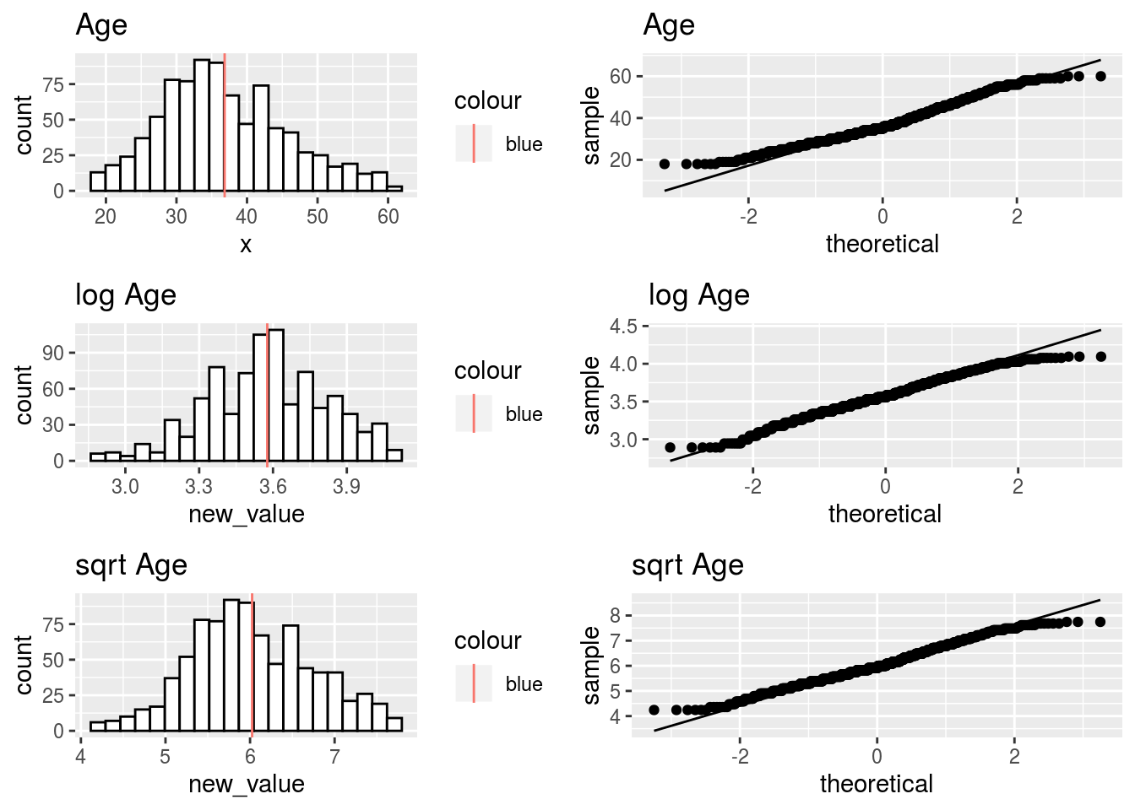
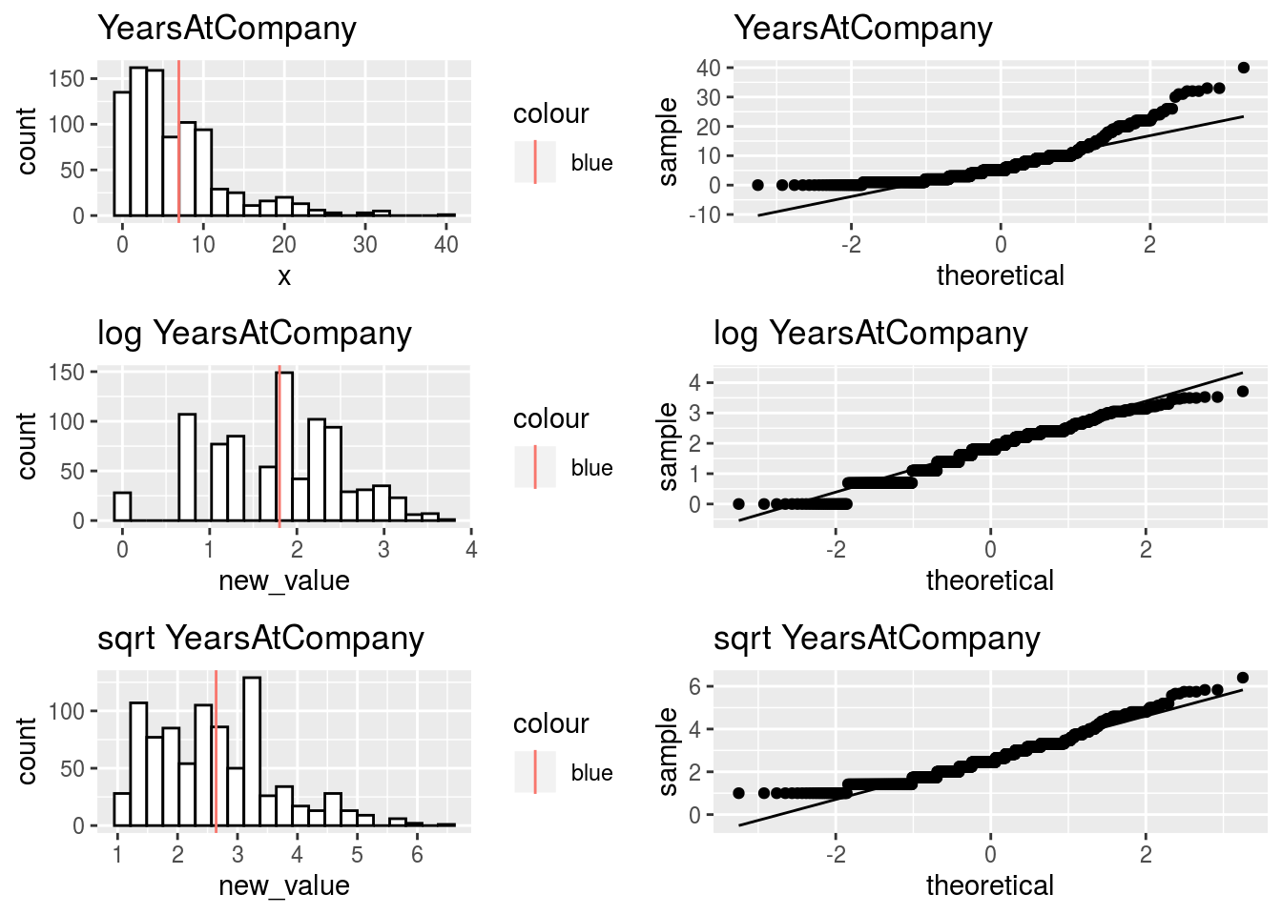
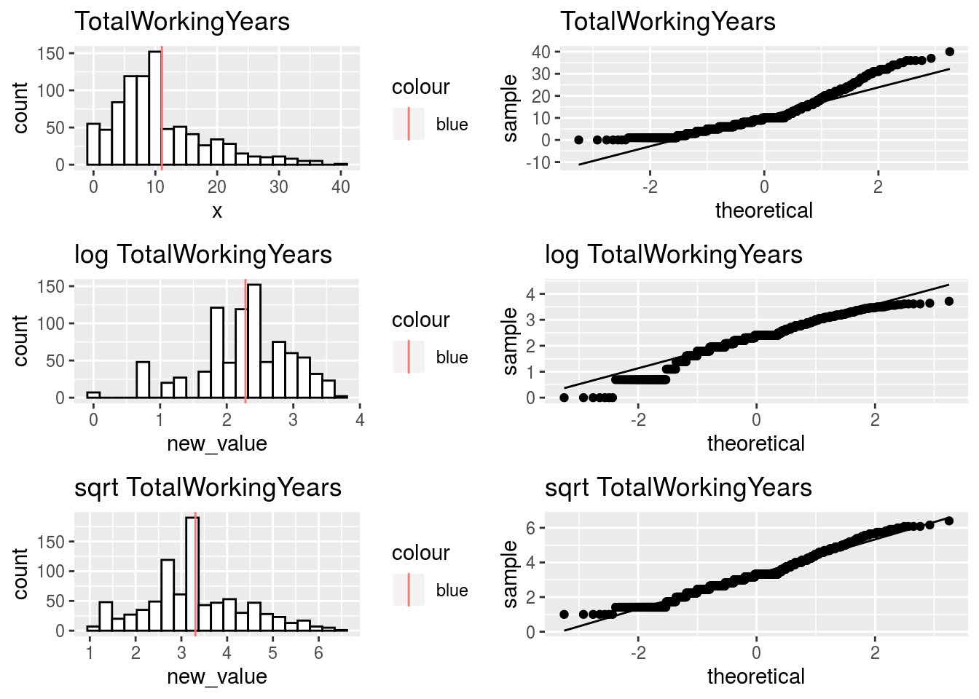
Data Transformation:
Data Transformation
We want numeric predictors to have distributions that are close to normal.
Look at histograms and consider whether log() or sqrt() transforms help.
No transform required Log helps Square root helps
.

Slide 12
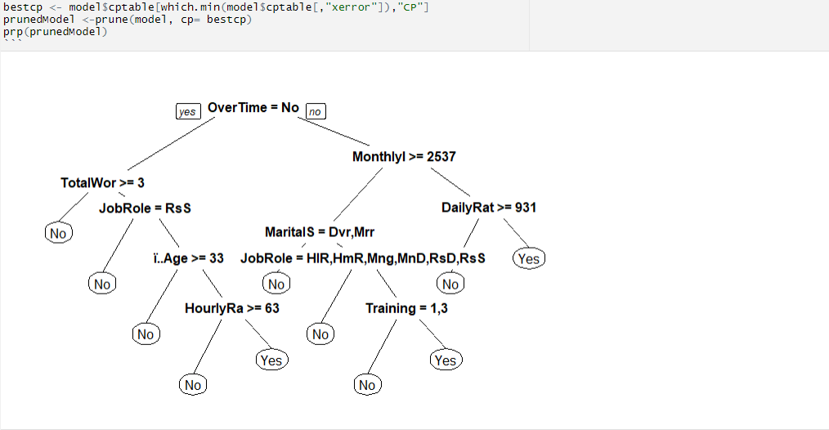
Prune Model
Prune Model:

Slide 13
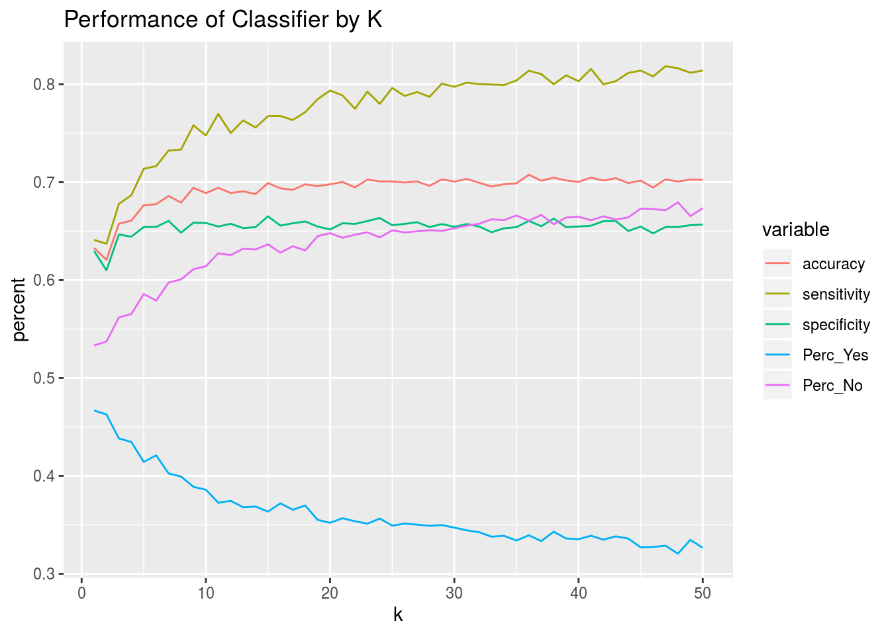
Prediction by K-Nearest-Neighbor (1)
Prediction by K-Nearest-Neighbor (1)
Transform and scale numeric predictors
Use Stepwise AIC method for variable selection
Variable | F Statistic | P value
Age | 25.6 | 5e-7
Distance From Home | 7.65 | .00580
Environment Satisfaction | 6.62 | .0102
Job Involvement | 39.5 | 5e-10
Job Satisfaction | 16.6 | 5e-5
Num Companies Worked | 12.4 | .000448
Relationship Satisfaction | 2.71 | .100
Total Working Years | 36.5 | 2e-9
Training Times Last Year | 5.12 | .0239
Work Life Balance | 7.03 | .00817
Years In Current Role | 3.71 | .00545
Years Since Last Promotion | 20.7 | 6e-6
Years With Current Manager | 1.65 | .200
OverTime | 74.3 | 2e-16
Marital Status | 31.4 | 2e-8
Finding appropriate neighborhood size

Slide 14
Prediction by K-Nearest-Neighbor (2)
Prediction by K-Nearest-Neighbor (2)
Problem of small attrition count relative to total number of employees
For training (finding K), select equal number of 'Yes' and 'No' Observations
For blind dataset, assume same statistics as training data
Algorithm:
Apply KNN, return probabilities
Multiply probabilities by K size to get raw number of votes for Yes and No
Divide raw vote count by expected number of Yes or No votes to get score
Use score to determine new decision Yes or No
Training Data
No | Yes | Accuracy | Sensitivity | Specificity
730 | 140 | 85% | 100% | 84%
Test Data
No | Yes
229 | 71
Since KNN performed better, It is therefore the preferred method to Naïve Bayes method.

Slide 15
Factors related to Salary
Factors related to Salary
Subjective Variable Selection
Variable Selection by Stepwise AIC method
Categorical
Gender
JobRole
EducationField
Numeric
JobLevel
TotalWorkingYears
Education
PerformanceRating
RelationshipSatisfaction
StockOptionLevel
YearsAtCompany
Categorical
BusinessTravel
Gender
JobRole
Numeric
DistanceFromHome
JobLevel
PercentSalaryHike
PerformanceRating
TotalWorkingYears
YearsSinceLastPromotion
YearsWithCurrManager
Minimal Set
Stepwise AIC method: retain statistically significant
Numeric
JobLevel
TotalWorkingYears
YearsWithCurrManager
Numeric
JobLevel
TotalWorkingYears

Slide 16
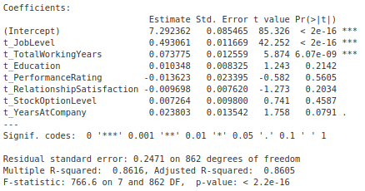
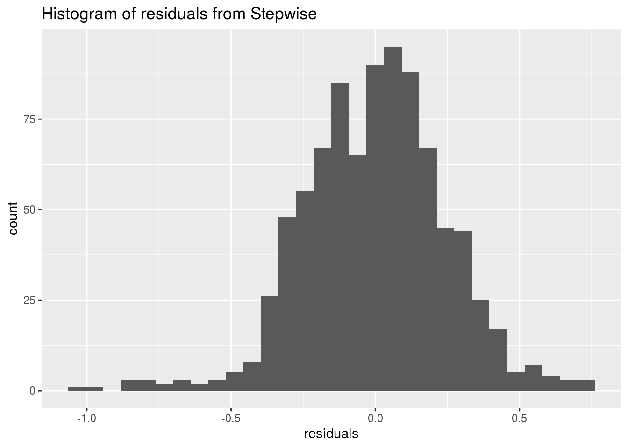
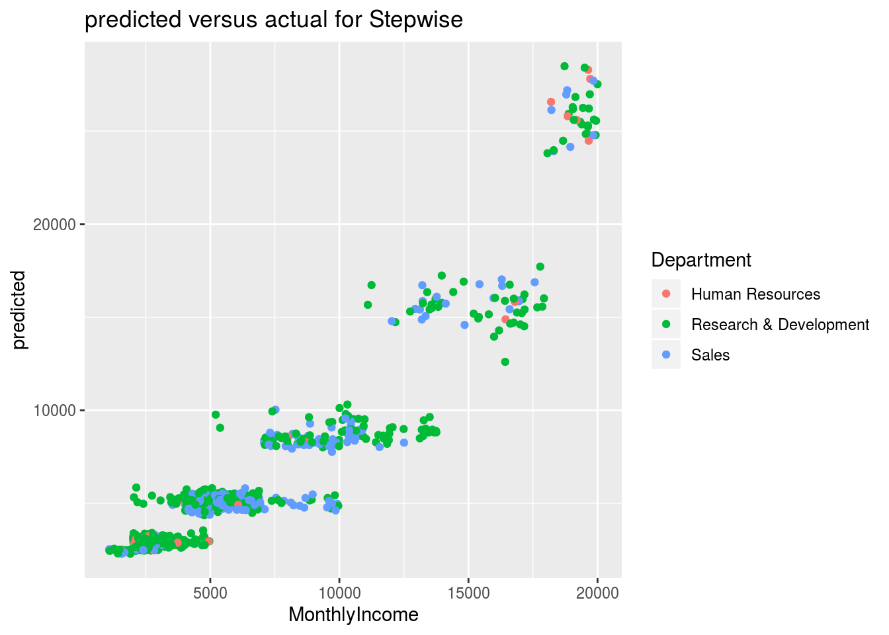
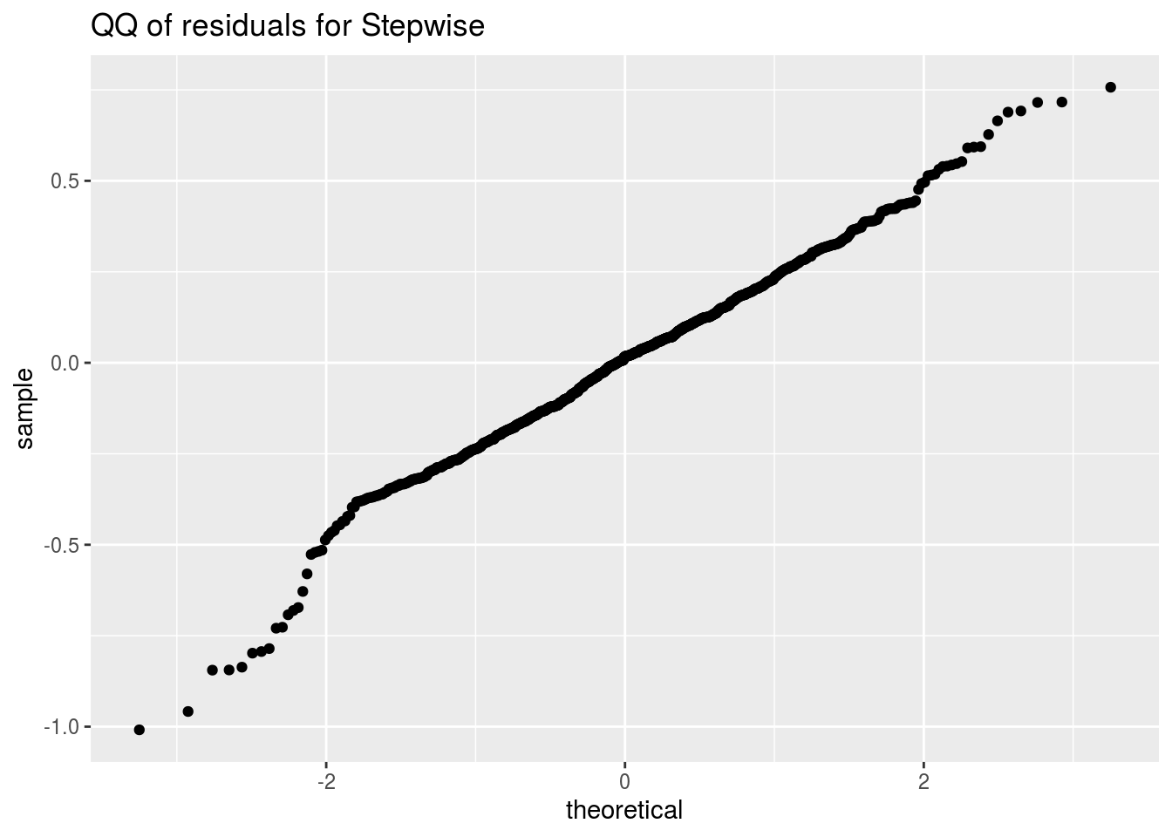
Subjective Model
Subjective Model:

Slide 17
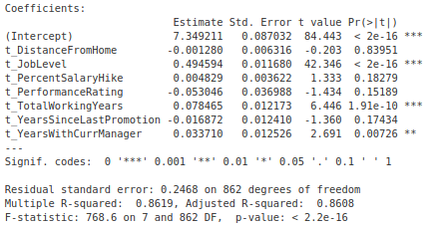
Stepwise Model
Stepwise Model:

Slide 18
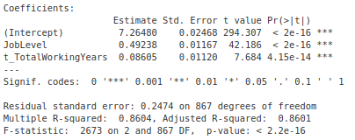
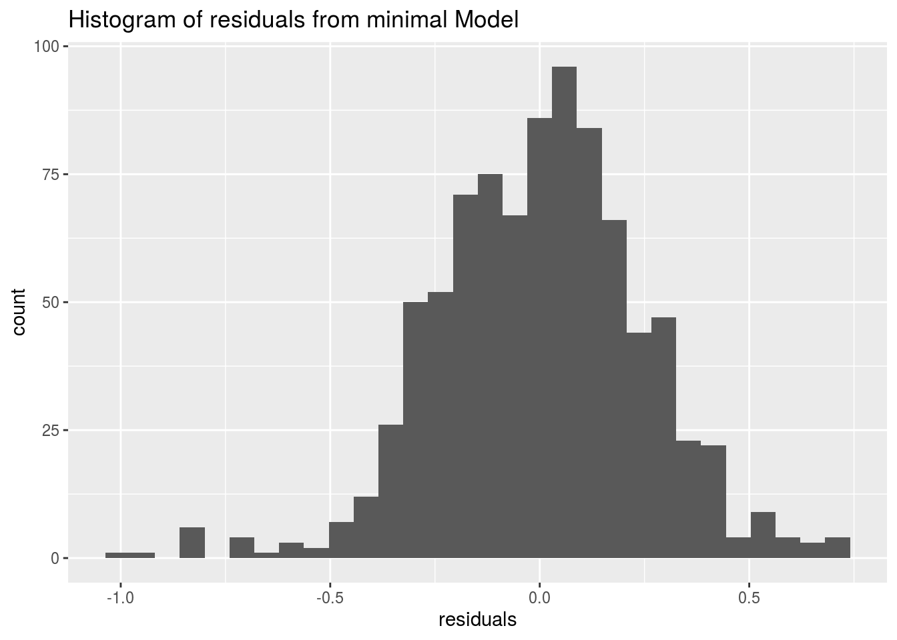
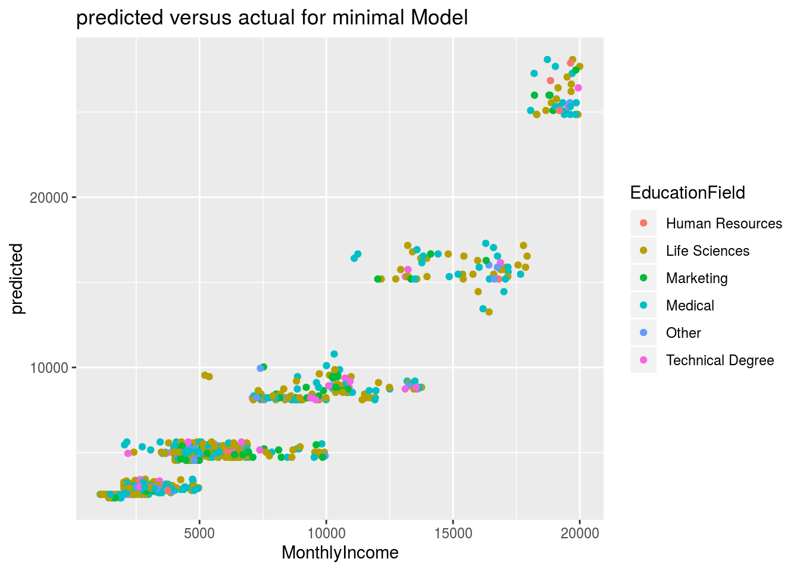
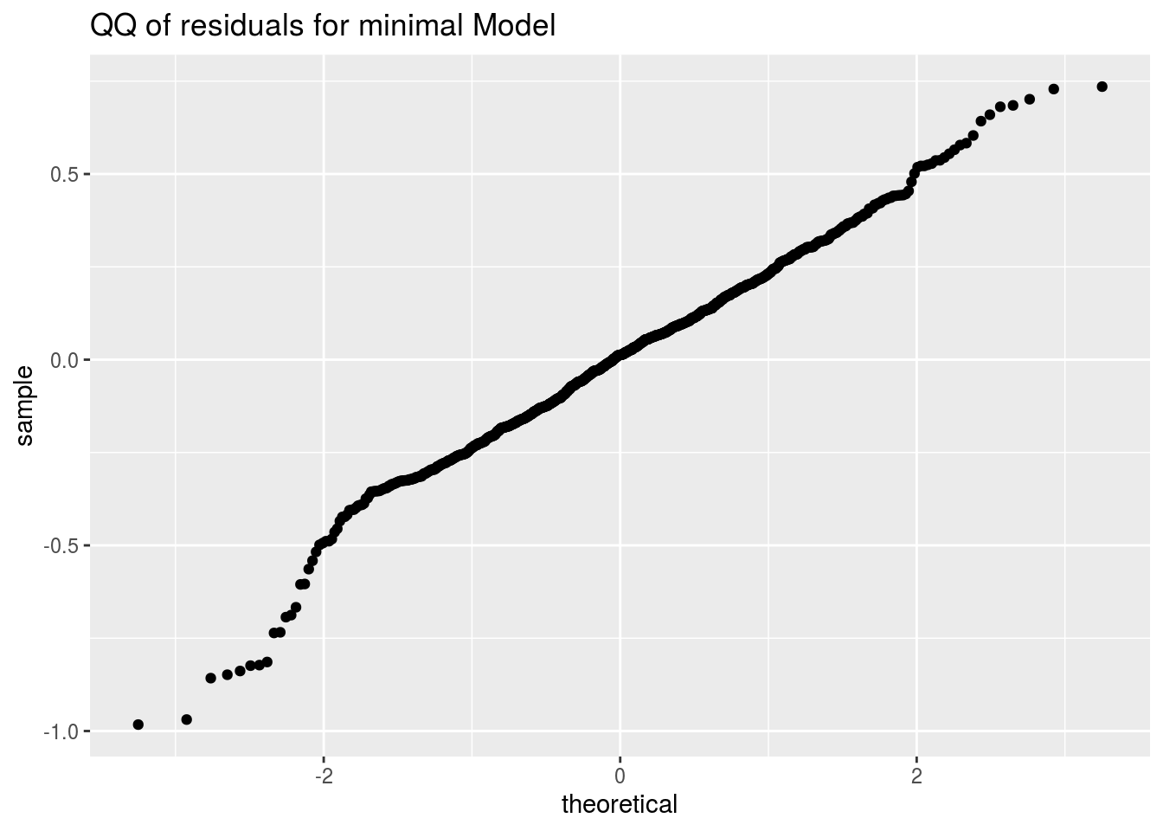
Minimal Model
Minimal Model:

Slide 19
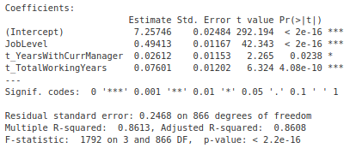
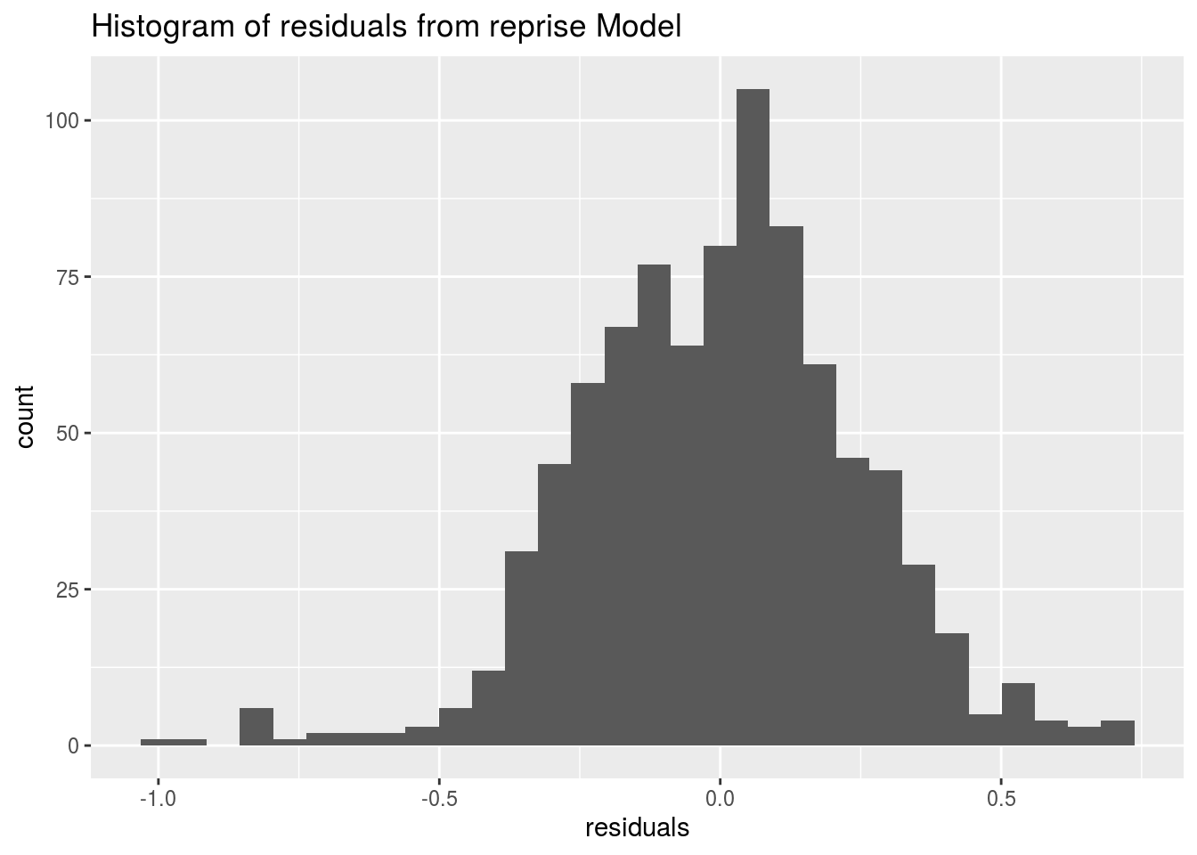
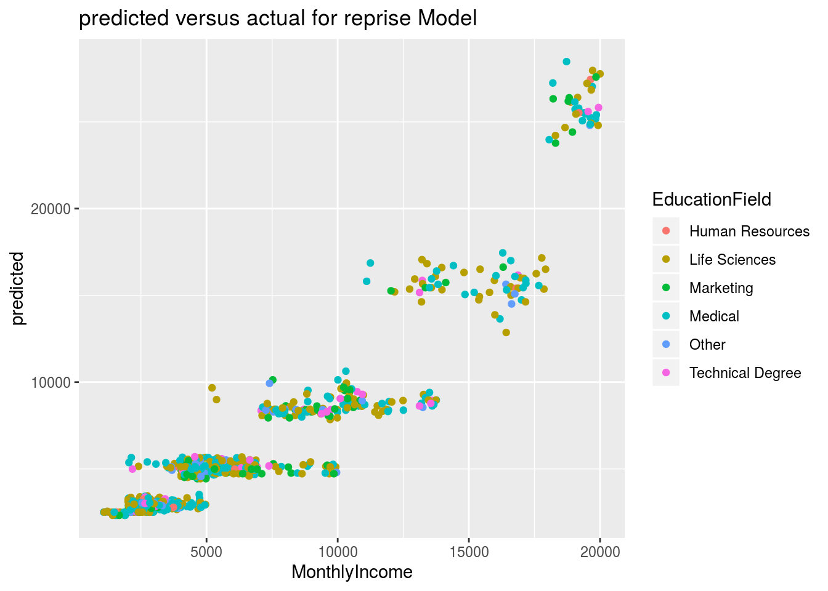
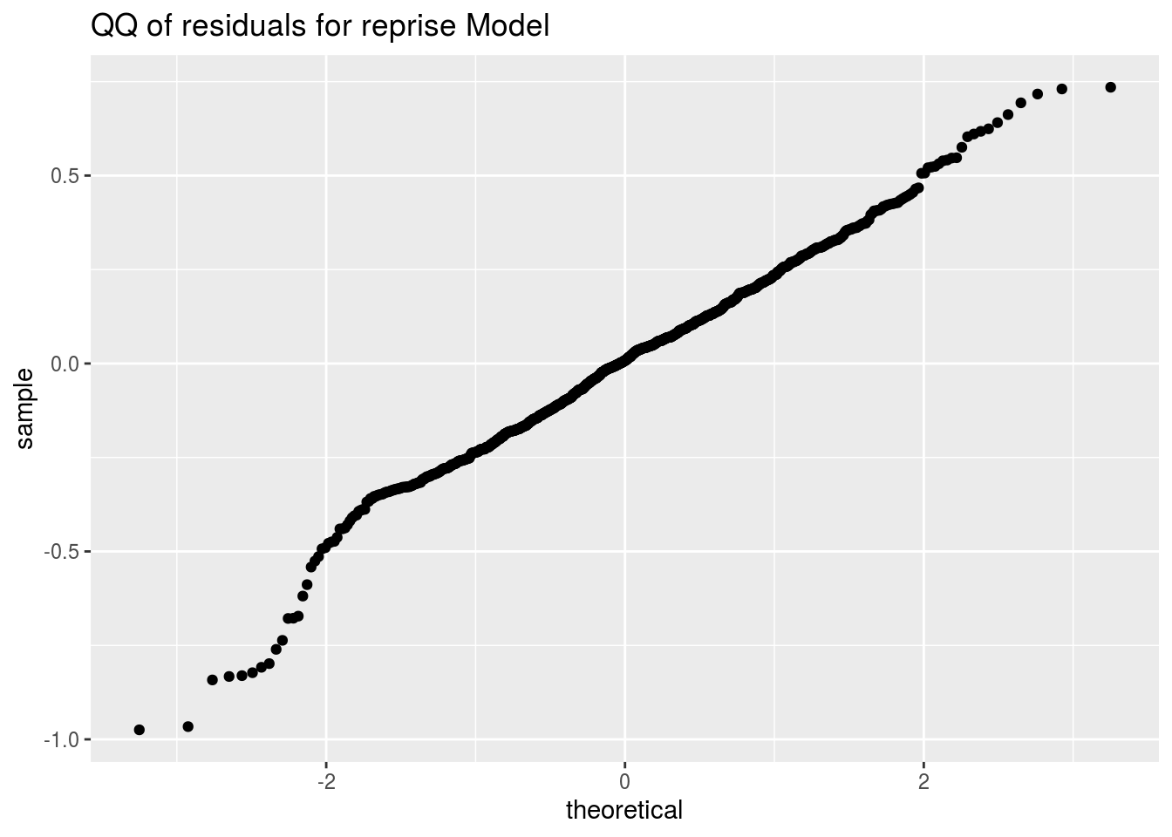
Simplified Model
Simplified Model:

Slide 20
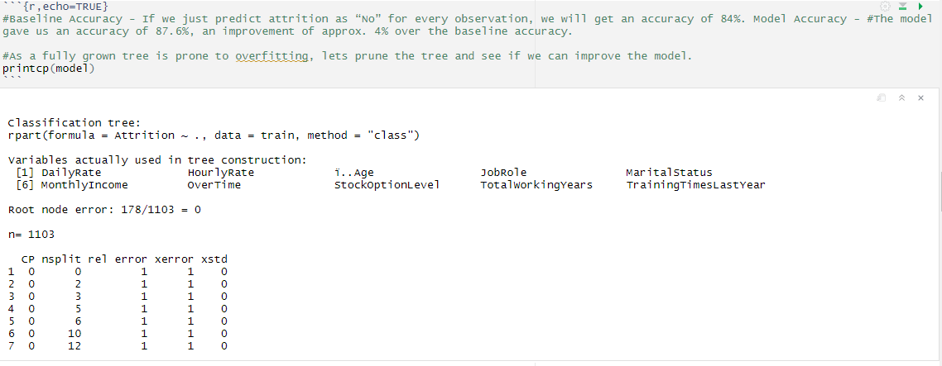
Baseline Accuracy
Baseline Accuracy:

Slide 21
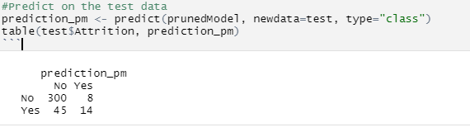
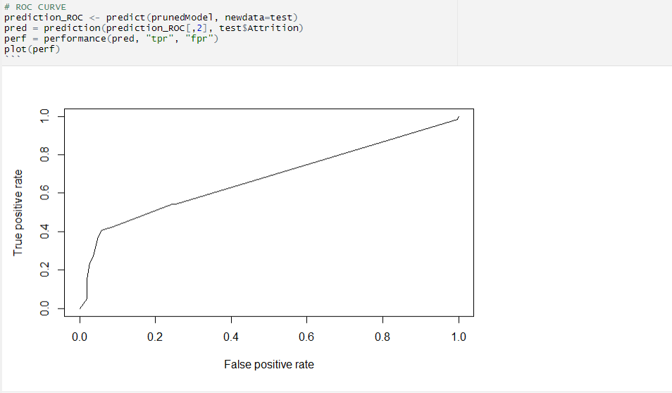
Prediction on the Test Data
Prediction on the test Data:
Prediction on the test Data and ROC Curve

Slide 22
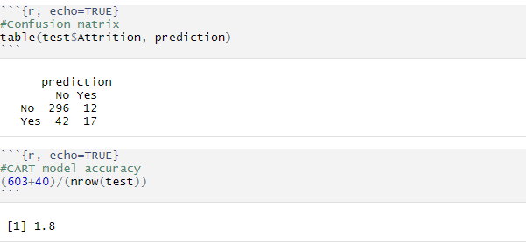
Prediction on the Test Data
CART Model Accuracy and the Confusion Matrix:

Slide 23
Conclusion:
Inference:
Overtime, MonthlyIncome, TotalWorkingYears, HourlyRate, JobRole and Age are the most important factors influencing the attrition rates.
A total of 14 factors influence the attrition rate as is depicted in the decision tree. The complete list includes Age, DailyRate,
DistanceFromHome, EnvironmentSatisfaction, HourlyRate, JobRole, JobSatisfaction, MaritalStatus, MonthlyIncome, NumCompaniesWorked,
OverTime, RelationshipSatisfaction, StockOptionLevel and TotalWorkingYears.
CART does not improve upon the baseline accuracy by too much in case the classes are skewed. In this case, we had a skewed dependent
Variable “Attrition” with 84% as “No”" in the test set.
Other ensemble methods like random forests can be used to improve the accuracy of the prediction.

Slide 24
Conclusion:
Conclusion:
The model produced by stepwise selection appears to have the best R squared, and residuals appear normal
This is what is used for predictions on the blind test data.
There is clustering in the residuals that indicates that some other predictor may help, but it is not easy to point out from the dataset or from my analysis.
Some of the reasons for employee attrition.
Sales Representatives have the highest attrition rate, Directors have the lowers
Job level, total working years, years at the company have the most impact on the monthly income
Overtime, no stock options, and employees in lower level jobs are the biggest drivers of attrition.
Employees making less than $5,000 per month have the highest attrition rates
Employees under 30 are more likely to leave a job than older employees.
Employees with less than 5 years at a company or 5 total working years are more likely to leave.
KNN overrides the best prediction model, and correctly identifies employee attrition, but Naïve Bayes does a better job on this dataset.
Employee attrition can't be completely an avoidable problem in organizations. We can address the issue at the right time. By first, computing the attrition rate so we fully understand the issue and the causes behind the attrition.
We can also then come up with a well-planned, data-driven process to reach out to new job candidates
engage them with different strategies, and retain them for a longer time period.

