Slide 1

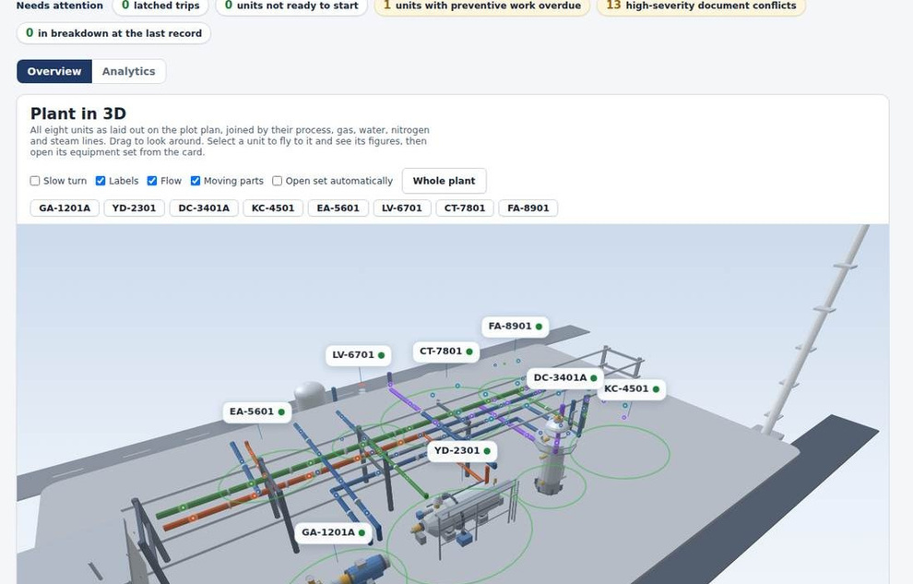
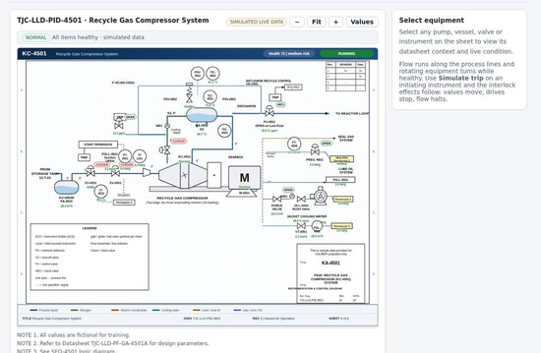
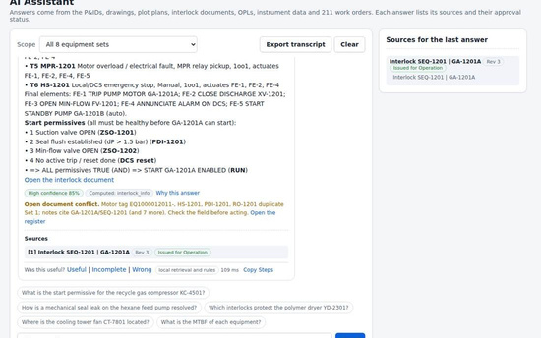
CALIBER 2026 | Business proposal | Final stage
Dashboard: the LLDPE plant in 3D
Protect Production. Optimize Inventory.
An AI-enabled decision-support system that combines historical consumption, maintenance information, equipment criticality, and procurement data to improve spare-parts forecasting and inventory decisions.
Forecast
Prioritize
Optimize
Predict spare-part demand.
Protect critical equipment.
Improve inventory levels.
Live P&ID
AI assistant
7,481
Unique spare parts
17,518
Historical material issue records
11,609
Procurement records
50
Materials selected for initial validation
Case: Spare Part Intelligence & Inventory Optimization
Team: Lagi Pengen University: Universitas Gadjah Mada
Screens of the working prototype, built on the case data.
Notes:
Cover. Chosen use case: Case 1, Manufacturing Knowledge Hub. The windows show the working prototype: the 3D plant dashboard, a live P&ID and the AI assistant.

Slide 2
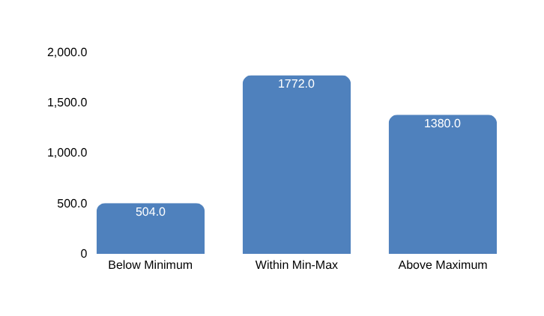
Problem identification
Problem: Critical spare parts are unavailable when needed, while slow-moving inventory ties up working capital
CALIBER 2026
Final Case
Root causes
Core problem
What the baseline reveals
Static inventory settings. Historical consumption and fixed Min–Max parameters do not adapt to changing demand and replenishment conditions.
Inventory decisions are disconnected from future demand and operational risk
Planners lack an integrated, predictive approach to spare-part demand forecasting and inventory level setting, making it difficult to determine what to stock, how much to hold, and when to replenish.
504 parts · 13.8%
Stock items are below their existing minimum levels, indicating replenishment exposure.
Irregular demand. 567 issued parts show intermittent or lumpy demand, while 116 erratic-demand parts account for 62.8% of issued value.
1,380 parts · 37.7%
Stock items exceed their existing maximum levels, indicating potential excess inventory.
Uncertain replenishment. The median PR-to-PO-delivery-date interval is 42 days, rising to 154 days at the 90th percentile.
Limited maintenance traceability. Only 15.9% of material issues link to a maintenance work order, limiting visibility into what drives consumption.
2,174 parts
Stock items have positive inventory but no recorded issues during May 2025–September 2026, warranting review.
Who is affected, and how
What the case data shows
Stock items against existing Min-Max settings
Maintenance & reliability teams
Needs spare parts available for equipment repairs and scheduled maintenance.
7,481
Distinct spare-part materials across 20,653 BoM rows.
1,930
Materials with recorded consumption across 16,655 distinct issue records
51.5% of stock items fall outside their existing Min–Max range
48.5%
Inventory & warehouse teams
Needs to know which parts to stock, how much to keep, and which items are overstocked or unused.
37.7%
Reliability engineers
Needs failure and spare-part data to predict failures and prevent recurring breakdowns
5,795
Maintenance notifications providing equipment and maintenance context.
10,153
Maintenance items across 3,823 maintenance plans
Procurement teams
Needs to know what to order, how much, and when, considering costs and supplier lead times
13.8%
Operations & management
Needs to keep production running while reducing inventory costs and tied-up working capital.
Conclusion
The challenge is to hold the right parts in the right quantities. Connecting consumption, equipment risk, maintenance plans, and procurement data can support earlier replenishment decisions and targeted inventory reduction
Source: CALIBER 2026 synthetic baseline. Consumption period: May 2025–September 2026. Material-level inventory counts; exact duplicate transaction rows excluded
Background
Solution
Impact
Roadmap
Conclusion
2
Notes:
Problem. Four root causes lead to one core problem, improper execution, which appears in the baseline data as repeat failures (8 of 55 corrective jobs), 434 hours of breakdown downtime and only 21 percent of faults found early. Five groups of users are affected. EA-5601 alone lost 124 hours. Chandra Asri already runs an Industry 4.0 programme and a digital twin of the Cilegon complex according to public releases; this proposal adds the knowledge layer around it.

Slide 3
Proposed solution
Solution: one checked knowledge base, linked by equipment tag, feeds an AI assistant that answers, predicts and plans
CALIBER 2026
Final Case
Spare Part Intelligence: predict uncertain demand and turn it into inventory decisions that balance cost and operational risk
Six Baseline Datas
BoM, Movement material, FuncLoc, Notif history, Mitem & Mplan, PR & PO
SQLite Database
clean, linked, data dictionary, quality register
Learned model + engine
demand forecast, dynamic Min/Max, lead-time risk
Planner and Costs
order, release, cost-risk scenarios, one assumption set
Site and AI Assistant
tabs, timeline, answers with sources and buttons
Q1 What will be needed, and when?
Q2 What should we stock, buy, or review?
Considerations
How it is addressed
Results from the data
Historical consumption and usage patterns
Timeline, Stock, Demand pattern, Replenishment simulator, Model flags
1,930 materials issued; 5,551 never issued; 567 intermittent/lumpy; 182 abnormal part-months flagged and capped
Equipment failure history and installed population
Reliability explorer, Notification explorer, Inventory planner, Link map
545 high/emergency notifications; 1.3% issue linkage; 32 repeat-failure locations. Issuance incidence: 96% for 10+ locations vs 15% for one
Planned and preventive maintenance
Maintenance plan, Timeline layer, Work-pack calculator
Consumption correlation: 0.2. 10,153 maintenance items; approximately 15,622 tasks over the next 12 months
Shutdowns, turnarounds, seasonality, and operating conditions
Work-pack calculator, Campaign layer, Maintenance timeline, Scenario toggle
Campaign demand: 2.4–2.8× normal; no future campaign scheduled. Seasonality unproven; production/operating data unavailable
Procurement lead time and supply variability
Suppliers and lead time, Purchase plan
Median replenishment-date proxy: 42 days; 90th percentile: 154 days. 39% of PO delivery dates meet the requested date; 119 suppliers
Background
Solution
Impact
Roadmap
Conclusion
3
Notes:
Solution. Panel A shows how plant inputs enter: documents, drawings, datasheets, interlock matrices, work orders and read-only live data go through ingestion, structuring, a conflict check and approval before they reach the knowledge database. Panel B shows the AI algorithm with four decision points: unsafe requests are refused, weak evidence returns no source found, a local verified draft is shown if the model is unavailable, and an answer whose figures are not found in the cited sources is flagged with a lower score. The confidence score is a weighted sum of five signals. The bottom row lists the six features that use the same database for key question 3.

Slide 4
Proposed solution
Solution: the AI reasons between the case data and every decision
CALIBER 2026
Final Case
Spare Part Intelligence: learned models predict demand, failures and lead time; an AI review checks every part before the engine turns it into orders
Q1 What will be needed, and when? How the AI builds every projection, in five steps
Six case sheets
1 Clean and link / 2 Learn
3 AI projection review (every part, before any number is calculated)
4 Engine
5 Every page
BoM
20,653 rows, where each part is installed
SQLite database
7,481 parts linked by material number and location; data dictionary and quality register
Each part
learned forecast in
Scope check
forecast 823,280 vs 1,226,950 issued (67%); 54% was campaign months, so the campaign input is flagged
Policy per part
reorder point and order size at the service target; today's Min and Max kept where it is cheaper; Monte Carlo of demand and lead time
Optimized Scenario
orders, dates, reasons
Movement Material
17,518 issues, 17 months
Within 2x of its last 12 months?
No
Blend with history
234 parts
Timeline
history and reviewed forecast
FuncLoc List
14,484 locations, criticality
Demand
issue chance x size per part and month; AUC 0.885
Yes
Status and planner
order now, short, overstock
Recent use but no forecast?
Yes
Use the history
7 parts
Notif History
5,795 notifications
Equipment risk
notification in 3 months; AUC 0.936 vs 0.832
Gemini review
proposes factors for flagged parts; kept only inside 0.5 to 2x and with numbers from the evidence
Result, default inputs
1,424 orders, IDR 56.1 bn; cost IDR 250.2 bn to 101.2 bn a year; stockouts 1,415 to 82 a year (Estimate)
No
Model and projection
the review, part by part
Mitem & Mplan
10,153 maintenance items
Lead time
6,260 never-bought parts; 32 days error
Critical S, zero stock, equipment risk 70% or more?
Yes
Keep an insurance spare
6 parts
PR PO
11,609 lines, repeats counted once
Campaign uplift
per part; plant 2.8 times a normal month
AI boxes and assistant
read the same payload
No
Learned forecast, 7,240
Checks that keep every projection honest
Backtest
5 held-out months: 34% error a month; total within 2% after calibration
Size band
81% of held-out issue months fall inside the 80% band
Guardrail
every change 0.5 to 2x, listed with its reason on the Model and projection tab
Never dearer
no policy costs more than today's Min and Max, except the 6 labelled insurance spares
Conclusion
The AI sits between the data and the engine: it checks every part before any number is calculated, so the orders, the timeline, the status and every AI box show one reviewed projection.
Source: running prototype on the six case sheets, default inputs (service S 99%, A 97.5%, B 95%, C 90%; carrying 22%). Money, stockouts and forecasts are Estimates.
Background
Solution
Impact
Roadmap
Conclusion
3
Notes:
How the AI builds every projection. The six case sheets are cleaned and linked in one SQLite database. Four learned models run on it: demand, equipment risk, lead time and campaign uplift. The AI projection review then checks every part before the engine calculates anything: forecasts more than a factor of two away from the last 12 months are blended with the history, parts with recent use but no forecast use the history, and critical parts with zero stock on equipment likely to need work keep an insurance spare. A scope check compares the whole forecast with last year and flags the campaign input. Gemini may propose further factors, which are kept only inside the guardrail and with evidence. The engine then sets the policy per part and runs the Monte Carlo, and every page reads the same result.

Slide 5
Proposed solution
Solution: the AI answers from the evidence first and checks every number
CALIBER 2026
Final Case
Spare Part Intelligence: every question and every feature goes through the same route, tools and checks, so an answer always comes with its source and a next step
Q2 What should we stock, buy, or review? How the AI answers a question
User question
plus what is on screen: tab, part, inputs
Unsafe request?
Understand
part number, tag, equipment set, tab or case point; 30 routes
Run a tool
34 tools read the database, the four models, the AI review and the engine
Evidence found?
No: search everything
parts, tags, notifications, tasks, suppliers, tabs
Still nothing
says it is not in the data, offers where to look
No
No
Yes: refuse
no advice on bypassing a trip
Yes
Answer with sources and buttons
short paragraph, figures in bold, labelled Data, Estimate or Assumption; buttons open the part card, the tab or the timeline
Every number in the evidence?
Gemini 2.5 Flash
reasons over the evidence and writes the wording only
Gemini configured?
No: rules answer
written from the same evidence
Same answer shape
so the page never waits on the model
Yes
Yes
No
No: rejected, the rules answer is shown
On every feature the AI box reasons over the result in seven sections (full paragraphs, every number checked)
Verdict
Why
How the AI checked the projection
Do next (opens the part card)
Risk and confidence
Your inputs against the recommended run
How this was worked out
How it answers the problems of the case (default inputs, Estimates)
Question | Route and evidence | Answer
What will be needed, and when? | demand model, AI review, engine | 1,424 orders over 12 months; 687 this month worth IDR 14.1 bn
What should we stock, buy or release? | policy per part, never dearer than today | yearly cost IDR 250.2 bn to 101.2 bn; 6 insurance spares kept
Which equipment will need parts soon? | equipment risk model | KT-383A: 81% chance of a notification in the next 3 months
Can I trust this forecast? | AI review and backtest | 244 parts flagged, 234 blended; forecast is 67% of last year, 54% of which was campaign work
Conclusion
The tools find the evidence and the engine computes the figures; Gemini only words the answer, and any answer with a number that is not in the evidence is replaced by the rules answer.
Source: running prototype (spi/ai/ask.js, explain.js, review.js). Gemini 2.5 Flash through one Vercel function; without a key the rules answer runs on the same evidence.
Background
Solution
Impact
Roadmap
Conclusion
3
Notes:
How the AI answers a question. The question comes with what is on screen. Unsafe requests are refused. The AI works out what the question is about and runs one of 34 tools on the database, the models, the AI review and the engine. If no evidence is found it searches everything, and otherwise says it is not in the data. Gemini, when configured, writes the wording; every number in its reply must be found in the evidence, or the rules answer is shown instead. Every feature has an AI box with seven sections. The table shows how the four questions of the case are answered.

Slide 6
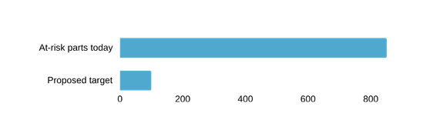

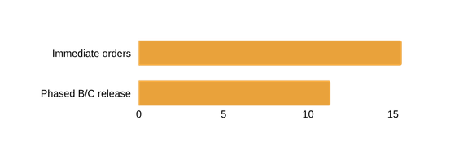
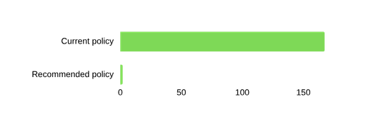

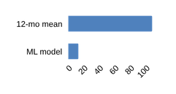
Impact assessment and projection
Business impact: a 10% reduction in average spare-parts inventory could release IDR 8.0 billion in working capital while maintaining critical-part availability.
CALIBER 2026
Final Case
IDR 616.6 bn
Valued Stock
Last PO-Price item
IDR 11.3 bn
Release Plan
Idle B/C stock-phased
IDR 15.5 bn
Estimated payback period
942 parts - initial orders
IDR 2.0 bn
5 year NPV
12% discount - estimated
0.9 years
Payback
Phased B/C business case
A. INVENTORY ECONOMICS / WHAT CHANGES
A. INVENTORY ECONOMICS / WHAT CHANGES
C . SUCCESS METRICS / HOW WE PROVE IT
01. The stock is concentrated above modeled need
05. Critical-part availability is the binding constraint
KPI | Baseline | Target | Measured by
Critical zero-stock items with demand | 53 | 0* | Monthly register
Critical parts at stockout risk | 851 | <100 | Inventory planner
Demand forecast total error | 13% | <15% | Quarterly backtest
Overdue order-by decisions | 1,039 | On time | Purchase plan
Stock above projected need | 558.2 bn | Review | Savings planner
Data quality issues requiring closure | 28 | Close | Quality register
IDR 15.5 bn
of IDR 616.6 bn valued stock
flagged for review (90.5%)
851
<100
Interpretation: a screening flag, NOT saleable cash. Engineering must confirm stock is surplus before disposal or release.
53 critical S/A parts have demand but zero stock. Target zero after funded deliveries; 851→<100 is a pilot goal, not achieved performance.
02. Replenishment must precede stock release
06. Most economic upside depends on downtime assumptions
15.5
167.2 bn
11.3
2.0 bn
942 materials need purchases now; the separate IDR 11.3 bn release is phased. Do not net either amount into annual savings.
Annual modeled shortage + downtime cost. This large difference is assumption-sensitive and must NOT be presented as realized cash savings.
03. Limited movement history
04. Forecast uplift
07. Economic logic: where the projected benefit comes from
1,930 / 7,481
108%
Stock diagnosis
558.2 bn screened
Risk-first action
15.5 bn purchase
Conservative release
11.3 bn phased
BASIS / UNCERTAINTY REGISTER
  VALUATION Last PO price × recorded stock; lot-price anomalies need checking.
  HOLDING 22% per year assumed; 4% cash rate is separate.
  TIMING PR-to-PO delivery is a lead-time proxy; no receipt data.
  DOWNTIME - Event cost, delay and stoppage rates are assumptions.
26% issued in 17 months
13%
Business case uses 30% realization over 3 years and a 5-year 12% discount horizon → estimated NPV IDR 2.0 bn and payback 0.9 years.
Conclusion
Value grows with each unit while the shared platform cost stays fixed, so payback shortens from about 21 months for the pilot unit to about 12 months for three units. All scaling inputs are planning assumptions, and the pilot replaces them with measured Company data.
Background
Solution
Impact
Roadmap
Conclusion
4
Notes:
Business impact at industrial scale. The pilot unit has 45 users and a base-case value of IDR 1.52 B a year: search time 604 M, repair time 857 M and ramp-up 60 M. The scale scenarios assume that each added unit matches the LLDPE unit, with a shared platform cost of IDR 1,050 M, data work of IDR 350 M per unit and extra support of IDR 120 M a year per added unit. Under these assumptions three units return about IDR 4.6 B a year and pay back in about 12 months, and six units return about IDR 9.1 B. Calculations: search time is 45 users x 20 minutes x 230 days at IDR 175,000 an hour; repair time is 20.4 breakdowns x 14.0 hours x 10 percent at IDR 30 M per downtime hour. Only the breakdown rate and MTTR come from the case data. The table on the right lists the KPIs, targets and how each will be measured in the pilot.

Slide 7
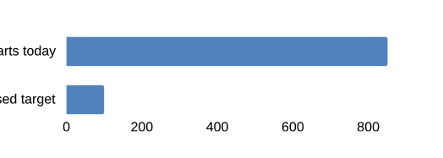

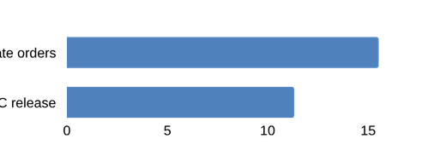
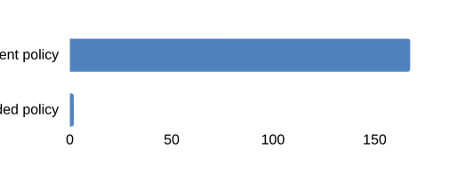
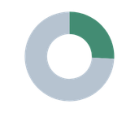
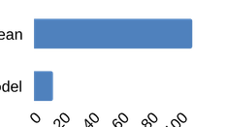
CALIBER 2026 / CASE 03 / BUSINESS IMPACT
SPARE PART INTELLIGENCE
FINAL CASE
Business impact: redirect capital from idle stock to protect critical plant availability
Reported baseline + modeled policy benefits | Capital release is not annual profit | Targets require funded purchasing and pilot verification
IDR 616.6 bn
IDR 11.3 bn
IDR 15.5 bn
IDR 2.0 bn
0.9 years
VALUED STOCK
RELEASE PLAN
BUY PRIORITY
5-YEAR NPV
PAYBACK
Last-PO-price estimate
Idle B/C stock · phased
942 parts · initial orders
12% discount · estimated
Phased B/C business case
A INVENTORY ECONOMICS / WHAT CHANGES
B OPERATING RISK / WHY IT MATTERS
C SUCCESS METRICS / HOW WE PROVE IT
01 The stock is concentrated above modeled need
05 Critical-part availability is the binding constraint
SUCCESS KPI
BASELINE
TARGET
MEASURED BY
IDR 558.2 bn
of IDR 616.6 bn valued stock
flagged for review (90.5%)
851
Critical zero-stock
items with demand
53
0*
Monthly register
<100
Critical parts at
stockout risk
851
<100
Inventory planner
Interpretation: a screening flag, NOT saleable cash. Engineering must confirm stock is surplus before disposal or release.
53 critical S/A parts have demand but zero stock. Target zero after funded deliveries; 851→<100 is a pilot goal, not achieved performance.
Demand forecast
total error
13%
<15%
Quarterly backtest
02 Replenishment must precede stock release
06 Most economic upside depends on downtime assumptions
Overdue order-by
decisions
1,039
On time
Purchase plan
15.5 bn
167.2 bn
11.3 bn
2.0 bn
Stock above
projected need
558.2 bn
Review
Savings planner
942 materials need purchases now; the separate IDR 11.3 bn release is phased. Do not net either amount into annual savings.
Annual modeled shortage + downtime cost. This large difference is assumption-sensitive and must NOT be presented as realized cash savings.
Data quality issues
requiring closure
28
Close
Quality register
03 Limited movement history
04 Forecast uplift
07 Economic logic: where the projected benefit comes from
* After approved orders are funded, received and made available.
1,930 / 7,481
108%
Stock diagnosis
›
Risk-first action
›
Conservative release
BASIS / UNCERTAINTY REGISTER
26% issued in
17 months
558.2 bn screened
15.5 bn purchase
11.3 bn phased
VALUATION Last PO price × recorded stock; lot-price anomalies need checking.
HOLDING 22% per year assumed; 4% cash rate is separate.
TIMING PR-to-PO delivery is a lead-time proxy; no receipt data.
DOWNTIME Event cost, delay and stoppage rates are assumptions.
13%
Business case uses 30% realization over 3 years and a 5-year 12% discount horizon → estimated NPV IDR 2.0 bn and payback 0.9 years.
Why it matters: zero-heavy demand requires specialized forecasting; 13% vs 108% is report total error on a 5-month holdout.
CONCLUSION
Expected business value is a risk-controlled stock reallocation: fund critical replenishment first, then release verified idle B/C inventory.
Approve a measured pilot before treating modeled cost reductions as cash savings.
Source: SPI Deck Report, pp. 2–5 (synthetic CALIBER baseline). All valuation, 5-year NPV, payback and shortage-loss results are scenario estimates; service targets are not achieved outcomes.
BACKGROUND / SOLUTION / IMPACT / ROADMAP / TEAM
04 / 07

Slide 8
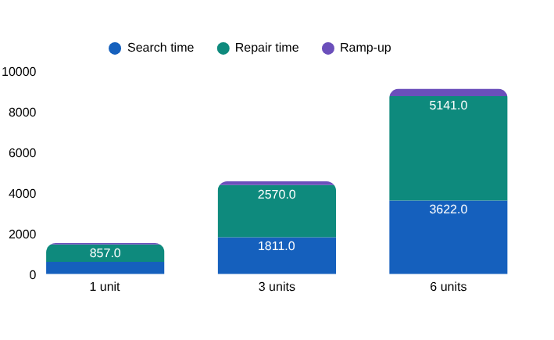
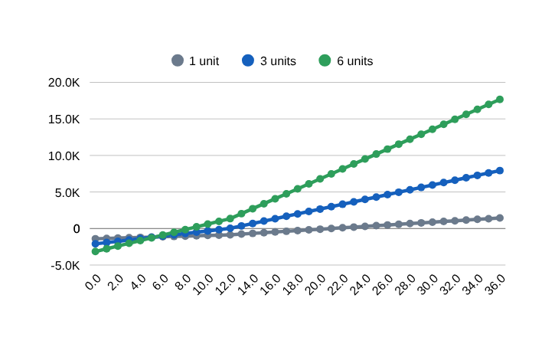
Impact assessment and projection
Business impact: a 10% reduction in average spare-parts inventory could release IDR 8.0 billion in working capital while maintaining critical-part availability.
CALIBER 2026
Final Case
IDR 8.0 B
Potential working capital release
IDR 1.6 B / year
Estimated annual carrying-cost savings
14.4 months
Estimated payback period
Annual value by lever (IDR M)
KPIs and success metrics
KPI | Baseline | Target | Measured by
Time searching and checking sources | 40 min a day (assumed) | 20 min a day | Usage log and user survey
Mean time to repair | 14.0 h | 12.6 h (10% lower) | Work-order closure dates
Repeat failures within 120 days | 8 of 55 jobs | 30% fewer | Failure memory report
Answers with an approved source | Not measured | At least 90% | Answer audit log
Median time to a cited answer | About 15 min (assumed) | 3 min or less | Timed pilot tasks
Users who rate answers useful | Not measured | At least 80% | Feedback buttons in the app
 | Conservative | Base Case | Optimistic
Inventory reduction | 45 | 135 | 270
Capital released (IDR B) | 1,521 | 4,562 | 9,123
Annual carrying-cost savings (IDR B) | 1,400 | 2,100 | 3,150
Annual operating cost (IDR B) | 370 | 610 | 970
Payback | 21 months | 12 months | 8 months
Net over 3 years | 1,443 | 7,930 | 17,661
Cumulative net benefit (IDR M), months 0 to 36
CASE DATA
20.4 breakdowns a year and a 14.0 h MTTR, from the 211 work orders.
20 min saved per user a day, 230 days, IDR 175,000 per hour, IDR 30 M per downtime hour, 10% shorter repairs, IDR 60 M ramp-up.
ASSUMED
ESTIMATE
Pilot cost of IDR 1,400 M one-off and 370 M a year (slide 6).
Each added unit matches the LLDPE unit. Shared cost IDR 1,050 M, data work 350 M per unit, support 120 M a year per added unit.
SCALING
Conclusion
Value grows with each unit while the shared platform cost stays fixed, so payback shortens from about 21 months for the pilot unit to about 12 months for three units. All scaling inputs are planning assumptions, and the pilot replaces them with measured Company data.
Source: Base inputs: 211 work orders (20.4 breakdowns a year, MTTR 14.0 h). All other inputs are assumptions or estimates, listed in the left panel, that the pilot replaces with Company data
Background
Solution
Impact
Roadmap
Conclusion
4
Notes:
Business impact at industrial scale. The pilot unit has 45 users and a base-case value of IDR 1.52 B a year: search time 604 M, repair time 857 M and ramp-up 60 M. The scale scenarios assume that each added unit matches the LLDPE unit, with a shared platform cost of IDR 1,050 M, data work of IDR 350 M per unit and extra support of IDR 120 M a year per added unit. Under these assumptions three units return about IDR 4.6 B a year and pay back in about 12 months, and six units return about IDR 9.1 B. Calculations: search time is 45 users x 20 minutes x 230 days at IDR 175,000 an hour; repair time is 20.4 breakdowns x 14.0 hours x 10 percent at IDR 30 M per downtime hour. Only the breakdown rate and MTTR come from the case data. The table on the right lists the KPIs, targets and how each will be measured in the pilot.

Slide 9






Implementation plan
Roadmap: a 90-day pilot on the critical parts proves the AI-reviewed plan
CALIBER 2026
Final Case
Implementation feasibility: six readiness dimensions
Deployment path and budget (Estimate)
Dimension | Status | In place today | Still needed
Technical | Ready | Vercel, one function, SQLite; four learned models, AI review, engine; tests run on every push | SAP MM and PM extract job; nightly retrain
Data | Owners needed | Six sheets linked; PR PO repeats counted once; quality register | Prices for 6,252 parts; receipt dates; data stewards
Operational | Ready | Advisory: the planner approves every order; works without the AI key | Champion in planning, maintenance and procurement
Legal and AI terms | Decision needed | Gemini free tier, no Company secrets in prompts | Enterprise AI terms with no training on Company data
Cybersecurity | Planned | Read-only database; key only in a Vercel secret; rate limits; safety guard | Single sign-on; hosting review; penetration test
Organisation | Planned | Roles in the app: planner, engineer, viewer | Two-hour training; monthly KPI review; sponsor
Prototype today
Vercel and SQLite on the six case sheets; AI review in every projection; rules fallback
Pilot, 90 days
Critical S and A parts of the 8 equipment sets; weekly SAP extracts and retrain; planner signs off
Production
All 7,481 parts; nightly SAP MM, PM and PR PO feeds; drift check; approval workflow
One-off IDR 1.2 B, running IDR 0.6 B a year (slide 6 business case)
SAP integration 0.50
Data 0.30
Models and AI 0.25
Change 0.15
IDR bn. Integration builds the SAP extracts; data covers prices, receipt dates and stewards; models and AI cover retraining, drift checks and enterprise AI terms; change covers training and champions.
Implementation roadmap
Q4 26
Q1 27
Q2 27
Q3 27
Q4 27
Q1 28
Q2 28
Q3 28
Q4 28
0 Mobilise
Start
data access, owners, AI terms, price master
1 Pilot, critical parts
Pilot
90 days; AI review in the loop; planner sign-off
2 Connect
Integrate
SAP feeds, nightly retrain, drift check, single sign-on
3 Extend
Extend
all parts, budget-capped buying, monthly Gemini review
4 Scale
other units and sites; continuous improvement
Scale
Decision gates
G1 critical zero-stock to 0, no part dearer
G2 integration and security sign-off
G3 measured saving against the estimate
G4 scale decision
Main risks and controls: wrong forecast (AI review, monthly backtest, planner approval); poor data (quality register, named owners); model drift (retrain and drift check on the Model and projection tab); over-buying (budget cap, funding by criticality); AI outage (rules answer on the same evidence).
Conclusion
The pilot runs on the existing stack and weekly SAP extracts. Four decision gates let the Company stop or continue at each step, and every order the AI proposes is approved by a planner before it is placed.
Source: prototype and the business case on slide 6. Dates, budget split and gates are proposals for discussion with the Company (Estimate).
Background
Solution
Impact
Roadmap
Conclusion
5
Notes:
Roadmap. The six readiness dimensions show what is in place and what is still needed; legal needs a decision on enterprise AI terms. The path goes from the prototype to a 90-day pilot on the critical parts of the eight equipment sets, then production on all parts with nightly SAP feeds. The budget uses the one-off and running cost of the business case. Five phases run from Q4 2026 to Q4 2028 with four decision gates.

Slide 10
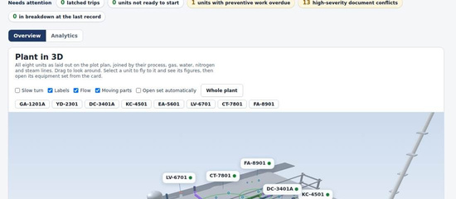
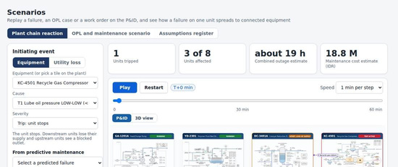
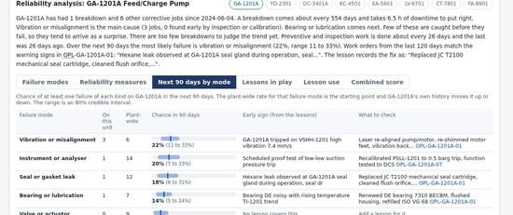
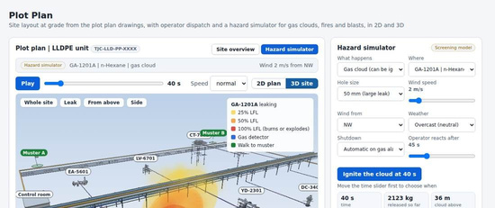
Team profile
CALIBER 2026
Final Case
Team name: Insinyur Jawa University: Universitas Gadjah Mada
No. | Name | Major | Semester | Area of expertise | Contribution to the proposal
1 | Alniko Arya Sudjatmiko | Chemical Engineering | 5 | [AI and software] | [Formulated the idea; built the prototype and the AI assistant]
2 | Anas Fauzan | Chemical Engineering | 5 | [Maintenance and business case] | [Business impact, KPIs and roadmap]
3 | Rainar Athalla Waranggana | Chemical Engineering | 5 | [Process and reliability] | [Problem analysis, process content and hazard models]
Screens of the working prototype
Dashboard
Scenario on the P&ID
Predictive maintenance
Hazard simulator
Background
Solution
Impact
Roadmap
Conclusion
6
Notes:
Team. Complete the table as required by the booklet.

Slide 11
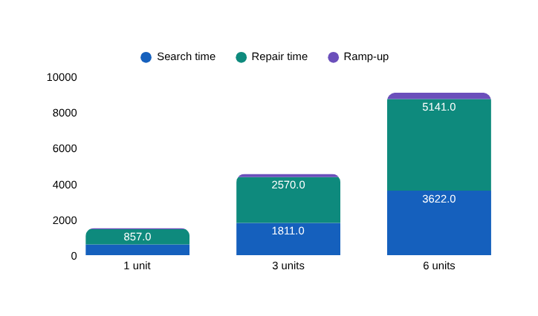
Impact assessment and projection
Business impact: a 10% reduction in average spare-parts inventory could release IDR 8.0 billion in working capital while maintaining critical-part availability.
CALIBER 2026
IDR 8.0 B
Potential working capital release
IDR 1.6 B / year
Estimated annual carrying-cost savings
14.4 months
Estimated payback period
7,481 unique materials, 17,518 material issue records and 11,609 procurement records from the synthetic CALIBER dataset.
KPIs and success metrics
CASE DATA
KPI | Baseline | Target | Measured by
Average inventory investment | 40 min a day (assumed) | 20 min a day | Usage log and user survey
Critical-part cycle service level | 14.0 h | 12.6 h (10% lower) | Work-order closure dates
Forecast error | 8 of 55 jobs | 30% fewer | Failure memory report
Emergency procurement frequency | Not measured | At least 90% | Answer audit log
Slow-moving inventory value | About 15 min (assumed) | 3 min or less | Timed pilot tasks
Recommendation validity | Not measured | At least 80% | Feedback buttons in the app
Average baseline inventory investment: IDR 80 B. Annual inventory carrying-cost rate: 20%.
ASSUMED
 | Conservative | Base Case | Optimistic
Inventory reduction | 5% | 10% | 15%
Capital released (IDR B) | 4.0 | 8.0 | 12.0
Annual carrying-cost savings (IDR B) | 0.8 | 1.6 | 2.4
Annual operating cost (IDR B) | 0.6 | 0.6 | 0.6
Annual net benefit (IDR B) | 0.2 | 1.0 | 1.8
One-off implementation cost (IDR B) | 1.2 | 1.2 | 1.2
Payback | 72 months | 14.4 months
Net benefit over 3 years (IDR B)
ESTIMATE
One-off implementation cost: IDR 1.2 B. Annual system operating ESTIMATED cost: IDR 0.6 B.
SCALING
Potential reductions in average inventory investment of 5%, 10%, and 15%. Service-level compliance must be evaluated separately.
Annual value by lever (IDR M)
Conclusion
Value grows with each unit while the shared platform cost stays fixed, so payback shortens from about 21 months for the pilot unit to about 12 months for three units. All scaling inputs are planning assumptions, and the pilot replaces them with measured Company data.
Source: Base inputs: 211 work orders (20.4 breakdowns a year, MTTR 14.0 h). All other inputs are assumptions or estimates, listed in the left panel, that the pilot replaces with Company data
Background
Solution
Impact
Roadmap
Conclusion
5
Notes:
Business impact at industrial scale. The pilot unit has 45 users and a base-case value of IDR 1.52 B a year: search time 604 M, repair time 857 M and ramp-up 60 M. The scale scenarios assume that each added unit matches the LLDPE unit, with a shared platform cost of IDR 1,050 M, data work of IDR 350 M per unit and extra support of IDR 120 M a year per added unit. Under these assumptions three units return about IDR 4.6 B a year and pay back in about 12 months, and six units return about IDR 9.1 B. Calculations: search time is 45 users x 20 minutes x 230 days at IDR 175,000 an hour; repair time is 20.4 breakdowns x 14.0 hours x 10 percent at IDR 30 M per downtime hour. Only the breakdown rate and MTTR come from the case data. The table on the right lists the KPIs, targets and how each will be measured in the pilot.

Slide 12
Proposed solution (continued)
Solution: every question is routed to a computed function first, and the language model only words the verified result
CALIBER 2026
Case 1
User
AI assistant (in the browser)
Functions: 20 computed tools
Wording and checking
Operator
1 Detect intent
Intent, tags and equipment
Reliability and cost (7)
maintenance_stats, kpi_summary, failure_modes, predictive_maintenance, failure_memory, history_lookup, spares_outlook
Computed result
Figures with their source records
Maintenance engineer
Reliability engineer
2 Safety guard
Unsafe requests are refused
Gemini 2.5 Flash words the answer
Free tier through /api/ai, temperature 0.2, up to 3 tool rounds. If it is unavailable, the local draft is shown.
Assets and limits (6)
equipment_info, spec_lookup, tag_facts, plot_plan_query, compare_equipment, rank_equipment
HSE engineer
Plant manager
3 Retrieve evidence
BM25F ranking and role filter
Operations and safety (6)
interlock_info, procedure_help, consequence_analysis, cascade_analysis, hazard_effects, safety_guard
Figures match the sources?
Example question
What usually causes a mechanical seal leak on the hexane feed pump, and how was it fixed?
No: lower the score
4 Choose function
Computed tool, or open question
Yes
Data quality (1): data_issues
Answer with sources and confidence
Worked example
Q2, from the prototype
Question
Seal leak on pump GA-1201A
Intent
Diagnosis from history
Function
failure_memory
Result
10 similar failures. Most supported fix, in 7 cases: replace the seal cartridge, clean the flush orifice, verify PDI-1201.
Answer
High confidence, 80%. Four sources, including WO-240002.
Conclusion
The assistant decides what to compute and what to retrieve before the language model sees anything. Gemini only words the result, and a figure that cannot be found in a cited source lowers the confidence score.
Source: Prototype assistant (intent router, retrieval index, 20 registered tools) and the Netlify function /api/ai. Tool names are the ones registered in the application
Background
Solution
Impact
Roadmap
Conclusion
4
Notes:
AI assistant. The user asks a question in the browser. The assistant detects the intent, applies a safety guard that refuses requests to bypass a trip, retrieves evidence with the BM25F index and chooses a function. Twenty computed tools in four groups produce figures with their source records. Gemini 2.5 Flash, called through the Netlify function on the free tier, only words the result. A check compares every figure and quote with the cited sources; if one is missing, the confidence score is lowered. If the model is unavailable the local draft is shown. The worked example is a real answer from the prototype: ten similar seal failures on GA-1201A, the most supported fix in 7 cases, high confidence 80 percent.

