Slide 1



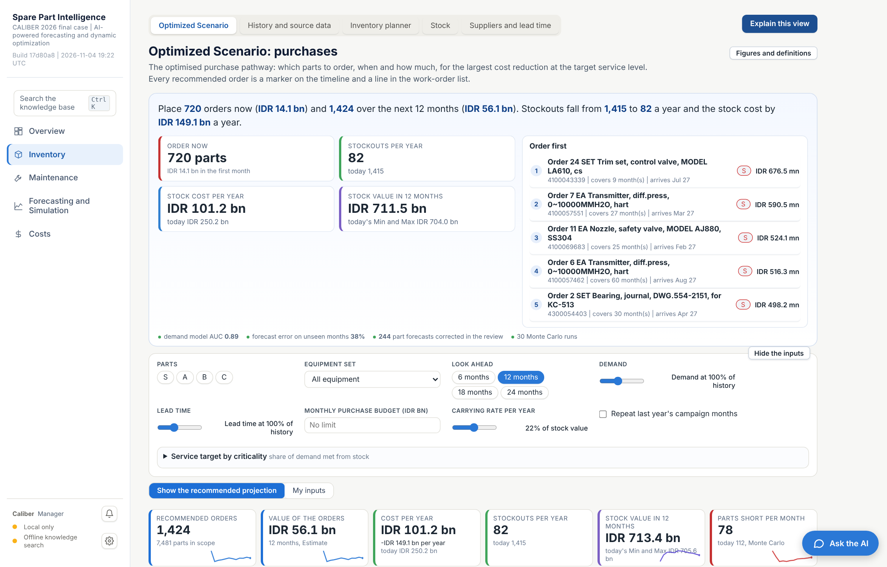



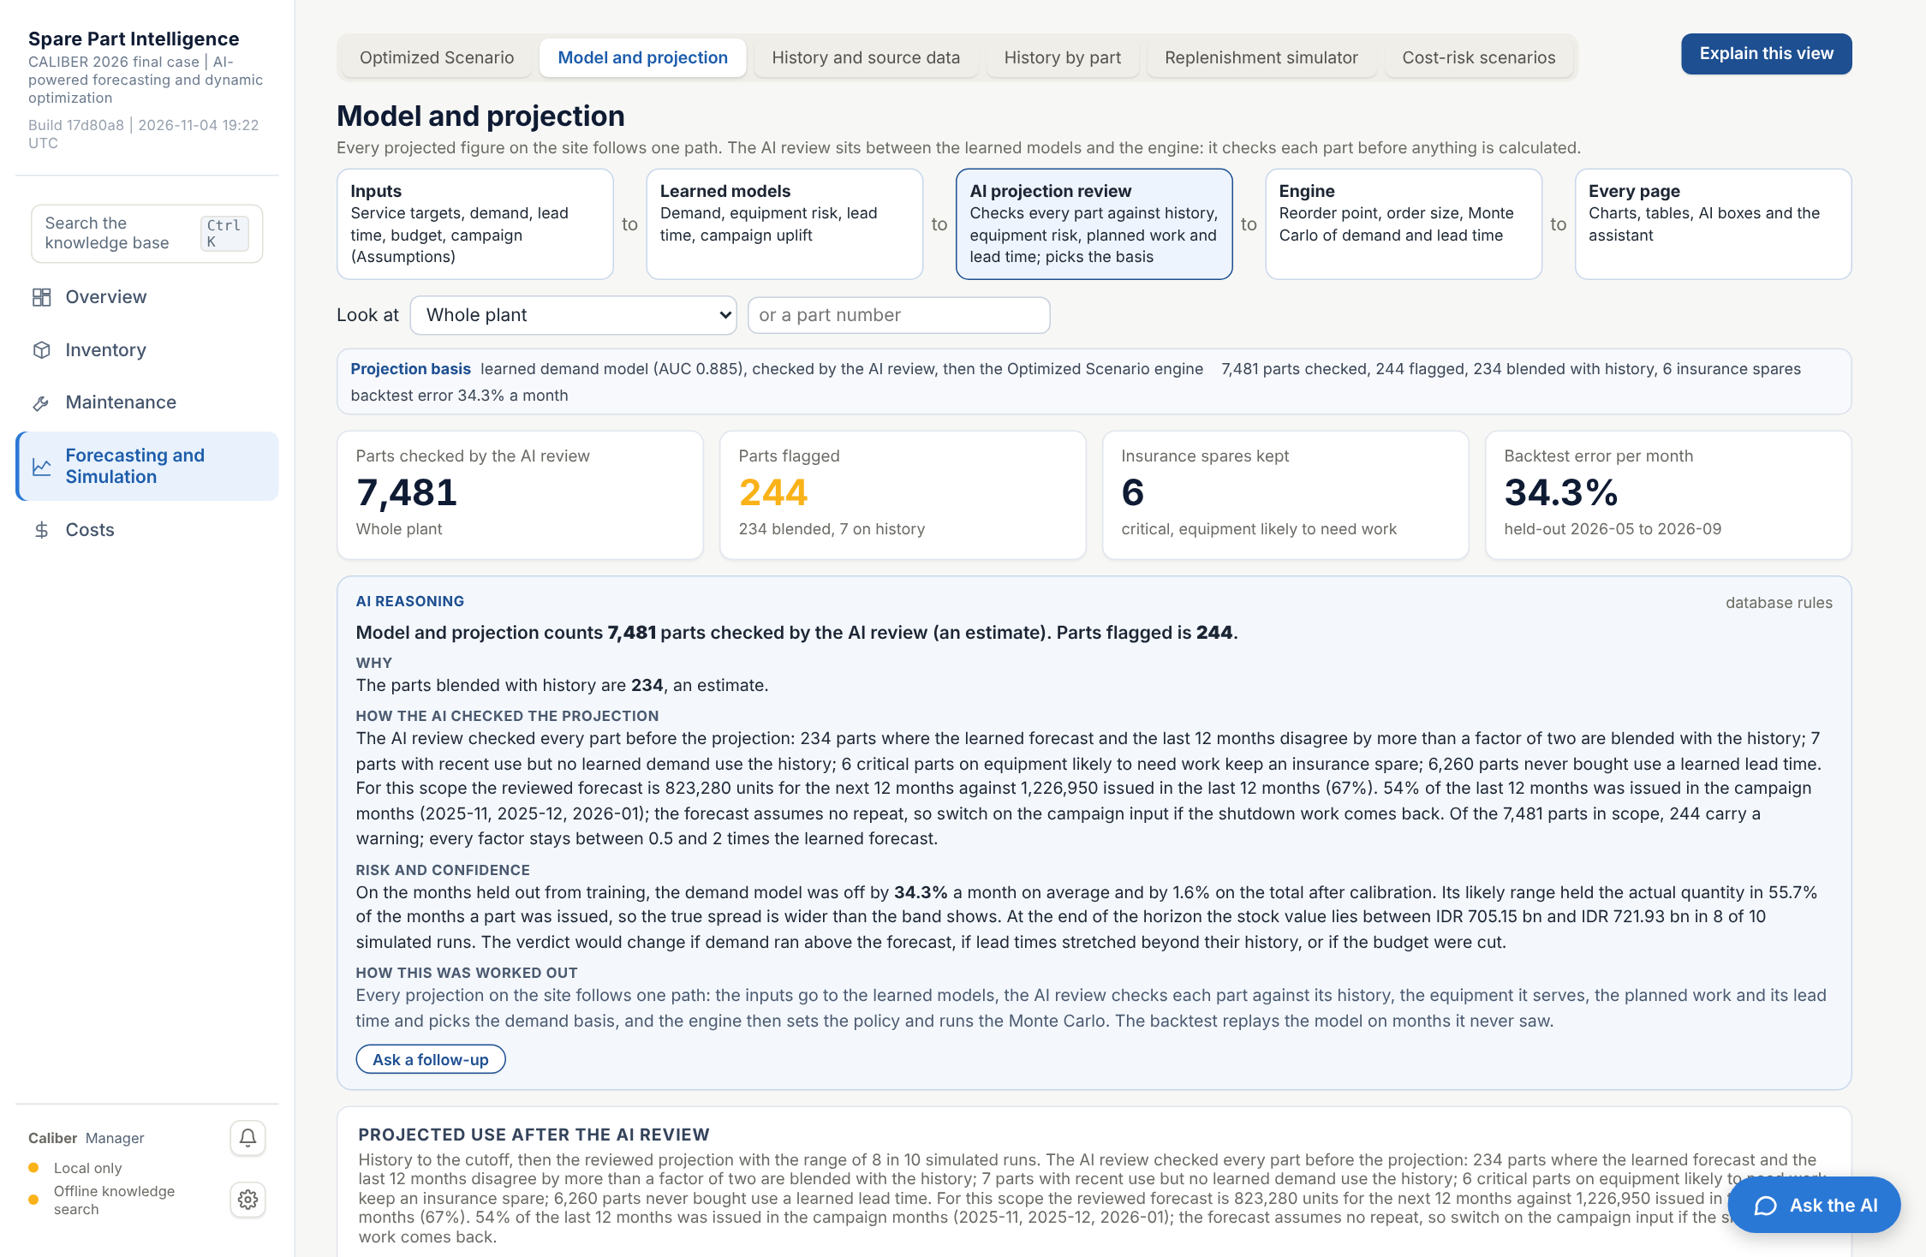
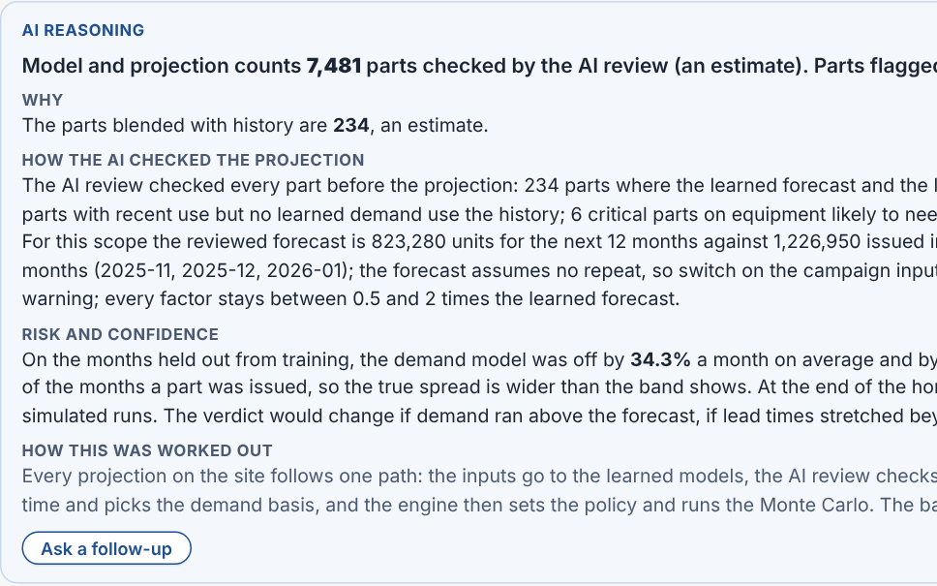
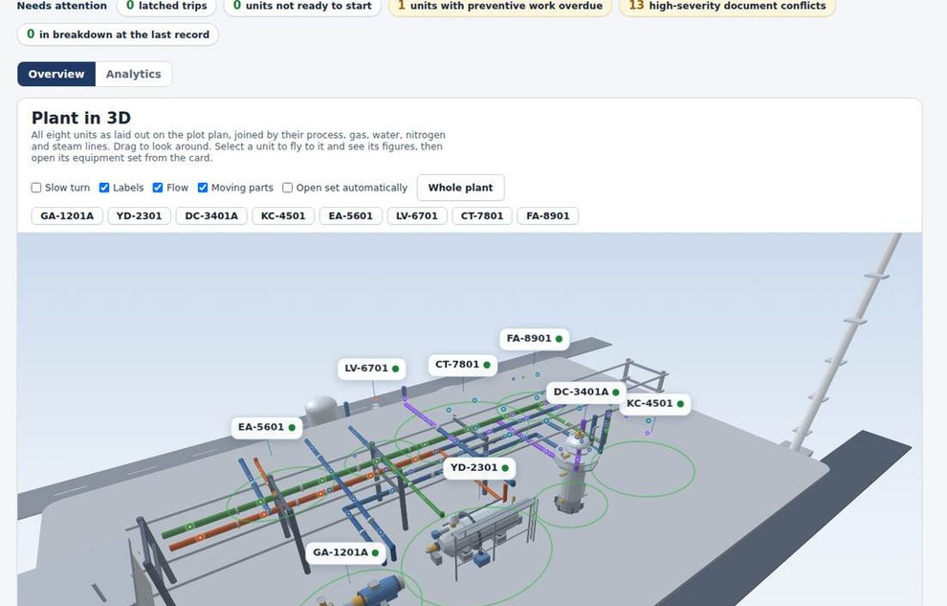
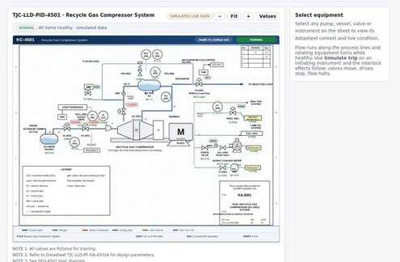
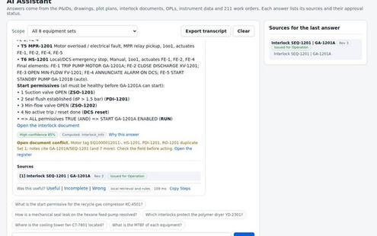
CALIBER 2026 | Business proposal | Final stage
Optimized Scenario: what to buy, when and how much
Protect Production.
Optimize Inventory.
An AI decision layer between the plant data and every spare-part decision: learned models forecast demand, failures and lead time, an AI review checks every part, and the engine turns it into dated orders that a planner approves.
Forecast
Prioritize
Optimize
Predict spare-part demand.
Protect critical equipment.
Improve inventory levels.
Model and projection
AI reasoning on every feature
7,481
Unique spare parts
17,518
Historical material issue records
11,609
Procurement records
5,795
Maintenance notifications
Case: Spare Part Intelligence, Demand Forecast & Inventory Optimization
Team: Lagi Pengen University: Universitas Gadjah Mada
Screens of the working prototype on Vercel, built on the six case sheets.

Slide 2




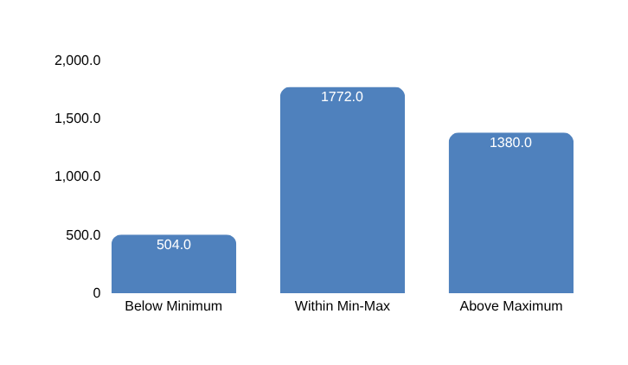





Problem identification
Problem: Critical spare parts are unavailable when needed, while slow-moving inventory ties up working capital
CALIBER 2026
Final Case
Root causes
Core problem
What the baseline reveals
Static inventory settings. Historical consumption and fixed Min–Max parameters do not adapt to changing demand and replenishment conditions.
Inventory decisions are disconnected from future demand and operational risk
Planners lack an integrated, predictive approach to spare-part demand forecasting and inventory level setting, making it difficult to determine what to stock, how much to hold, and when to replenish.
504 parts · 13.8%
Stock items are below their existing minimum levels, indicating replenishment exposure.
Irregular demand. 567 issued parts show intermittent or lumpy demand, while 116 erratic-demand parts account for 62.8% of issued value.
1,380 parts · 37.7%
Stock items exceed their existing maximum levels, indicating potential excess inventory.
Uncertain replenishment. The median PR-to-PO-delivery-date interval is 41 days, rising to 155 days at the 90th percentile.
2,174 parts
Stock items have positive inventory but no recorded issues during May 2025–September 2026, warranting review.
Limited maintenance traceability. Only 15.9% of material issues link to a maintenance work order, limiting visibility into what drives consumption.
Who is affected, and how
What the case data shows
Stock items against existing Min-Max settings
Maintenance & reliability teams
Needs spare parts available for equipment repairs and scheduled maintenance.
7,481
Distinct spare-part materials across 20,653 BoM rows.
1,930
Materials with recorded consumption across 16,655 distinct issue records
51.5% of stock items fall outside their existing Min–Max range
48.5%
Inventory & warehouse teams
Needs to know which parts to stock, how much to keep, and which items are overstocked or unused.
37.7%
Reliability engineers
Needs failure and spare-part data to predict failures and prevent recurring breakdowns
5,795
Maintenance notifications providing equipment and maintenance context.
10,153
Maintenance items across 3,823 maintenance plans
Procurement teams
Needs to know what to order, how much, and when, considering costs and supplier lead times
13.8%
Operations & management
Needs to keep production running while reducing inventory costs and tied-up working capital.
Conclusion
The challenge is to hold the right parts in the right quantities. Connecting consumption, equipment risk, maintenance plans, and procurement data can support earlier replenishment decisions and targeted inventory reduction
Source: CALIBER 2026 synthetic baseline. Consumption period: May 2025–September 2026. Material-level inventory counts; exact duplicate transaction rows excluded
Background
Solution
Impact
Roadmap
Conclusion
2

Slide 3
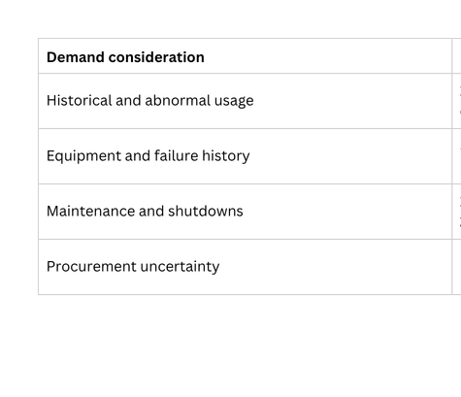
Proposed solution
Solution: AI predicts uncertain demand and turns it into stock decisions
CALIBER 2026
Final Case
AI forecasts which spare parts will be needed, how much and when; an AI review checks every part before the engine turns it into orders
Q1 How can the Company improve demand predictability for irregular and uncertain consumption? How the AI builds every projection
Six case sheets
1 Clean and link / 2 Learn
3 AI projection review (every part, before any number is calculated)
4 Engine
5 Every page
BoM
20,653 rows, where each part is installed
SQLite database
7,481 parts linked by material number and location; data dictionary and quality register
Each part
learned forecast in
Scope check
forecast 823,280 vs 1,226,950 issued (67%); 54% was campaign months, so the campaign input is flagged
Policy per part
reorder point and order size at the service target; today's Min and Max kept where it is cheaper; Monte Carlo of demand and lead time
Optimized Scenario
orders, dates, reasons
Movement Material
17,518 issues, 17 months
Within 2x of its last 12 months?
No
Blend with history
234 parts
Timeline
history and reviewed forecast
FuncLoc List
14,484 locations, criticality
Demand
issue chance x size per part and month; AUC 0.885
Yes
Status and planner
order now, short, overstock
Recent use but no forecast?
Yes
Use the history
7 parts
Notif History
5,795 notifications
Equipment risk
notification in 3 months; AUC 0.936 vs 0.832
Gemini review
proposes factors for flagged parts; kept only inside 0.5 to 2x and with numbers from the evidence
Result, default inputs
1,424 orders, IDR 56.1 bn; cost IDR 250.2 bn to 101.2 bn a year; stockouts 1,415 to 82 a year (Estimate)
No
Model and projection
the review, part by part
Mitem & Mplan
10,153 maintenance items
Lead time
6,260 never-bought parts; 32 days error
Critical S, zero stock, equipment risk 70% or more?
Yes
Keep an insurance spare
6 parts
PR PO
11,609 lines, repeats counted once
Campaign uplift
per part; plant 2.8 times a normal month
AI boxes and assistant
read the same payload
No
Learned forecast, 7,240
Main visual: five-step workflow
Evidence panel: what the platform considers
1 Connect the data
consumption, locations, notifications, maintenance plans, stock and purchases in one SQLite database
4 Add operational context
equipment risk, maintenance plans, campaign months and lead-time spread
5 Present the result
part-level timeline, alerts and an AI explanation with its evidence
Demand consideration | Where the site shows it | Result from the data
Historical and abnormal usage | Timeline, demand pattern, model flags | 1,930 parts issued, 1,220 in one month only; backtest error 34% a month
Equipment and failure history | Reliability explorer, equipment risk model | 5,795 notifications; AUC 0.936; KT-383A 81% in 3 months
Maintenance and shutdowns | Maintenance plan, campaign uplift, scope check | 10,153 items; campaign months 2.8x; 54% of last year was campaign work
Procurement uncertainty | Suppliers and lead time, lead-time model | median 41 days, 9 in 10 within 155; error 32 days
2 Learn demand
chance a part is issued in a month and the quantity if it is
3 Review the forecast
the AI checks each part against its history and flags large differences
Conclusion
The AI sits between the data and the engine: it checks every part before any number is calculated, so the orders, the timeline, the status and every AI box show one reviewed projection.
Source: running prototype on Vercel, database built from the six case sheets; default inputs (service S 99%, A 97.5%, B 95%, C 90%). Money, forecasts and stockouts are Estimates.
Background
Solution
Impact
Roadmap
Conclusion
3

Slide 4
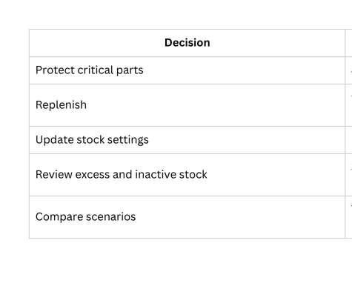
Proposed solution
Solution: AI balances inventory cost, availability and operational risk
CALIBER 2026
Final Case
Forecasts become stock recommendations that balance availability, cost and risk; every answer comes with its source, its check and a next step
Q2 How can the Company dynamically optimize inventory while balancing cost, availability and operational risk? How the AI answers a question
User question
plus what is on screen: tab, part, inputs
Unsafe request?
Understand
part number, tag, equipment set, tab or case point; 30 routes
Run a tool
34 tools read the database, the four models, the AI review and the engine
Evidence found?
No: search everything
parts, tags, notifications, tasks, suppliers, tabs
Still nothing
says it is not in the data, offers where to look
No
No
Yes: refuse
no advice on bypassing a trip
Yes
Answer with sources and buttons
short paragraph, figures in bold, labelled Data, Estimate or Assumption; buttons open the part card, the tab or the timeline
Every number in the evidence?
Gemini 2.5 Flash
reasons over the evidence and writes the wording only
Gemini configured?
No: rules answer
written from the same evidence
Same answer shape
so the page never waits on the model
Yes
Yes
No
No: rejected, the rules answer is shown
Main visual: decision workflow
Evidence panel: what the planner sees
1 Assess exposure
forecast demand against stock on hand, open orders, lead time and criticality
4 Recommend an action
order now, order by a date, monitor, or review excess and dead stock
5 Test and explain
compare scenarios; the AI explains the result and links to the part
Decision | Where the site shows it | Result, default inputs (Estimate)
Protect critical parts | Status, Optimized Scenario | 306 critical parts at zero stock; 6 insurance spares kept
Replenish | order list with order-by dates | 720 orders now (IDR 14.1 bn), 1,424 in 12 months
Update stock settings | Inventory planner | new reorder point and order size for 972 parts
Review excess and dead stock | Status, Savings planner | dead stock IDR 91.4 bn on 2,591 parts; overstock IDR 402.8 bn
Compare scenarios | Optimized Scenario, cost-risk scenarios | cost IDR 250.2 bn to 101.2 bn a year; stockouts 1,415 to 82
2 Calculate stock settings
safety stock, reorder point, order size and the proposed Min and Max
3 Compare cost and risk
holding and ordering cost against stockout, downtime and production loss
Conclusion
The tools find the evidence and the engine computes the figures; Gemini only words the answer, and any answer with a number that is not in the evidence is replaced by the rules answer.
Source: running prototype (spi/ai/ask.js, explain.js, review.js). Gemini 2.5 Flash through one Vercel function; without a key the rules answer runs on the same evidence.
Background
Solution
Impact
Roadmap
Conclusion
4

Slide 5







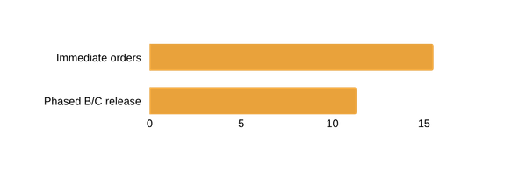



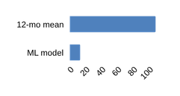



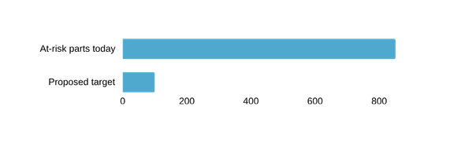
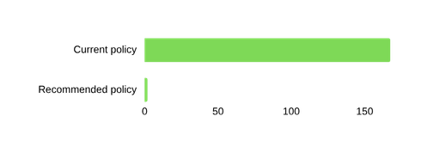



Impact assessment and projection
Business impact: a 5-year NPV of IDR 45.8 bn from avoided losses
CALIBER 2026
Final Case
IDR 45.8 bn
5-year NPV at 12%, base case
2 months
payback of the IDR 1.2 bn one-off
1%
of the modelled loss avoided breaks even
16 x
5-year benefit against total cost
1,415 to 82
stockouts a year, the driver of the loss
Cost of the solution, IDR bn (Estimate)
Item | One-off | A year
SAP integration | 0.50
Data and part prices | 0.30
Models and AI on Vertex AI | 0.25
Change and training | 0.15
Gemini 2.5 Flash usage |  | 0.03
Vercel Pro, 3 seats |  | 0.01
Support and retraining |  | 0.56
Total | 1.20 | 0.60
Return counts only losses that are not capital: downtime avoided at 10% of the modelled IDR 152.1 bn (half in year 1), plus the 4% cash holding cost of 30% of dead stock released, minus the cash cost of the extra stock. Gemini: 414,000 calls a year at USD 0.30 and 2.50 per 1M tokens.
KPIs: how the pilot proves it
KPI | Today | 90-day target
Critical parts at zero stock | 306 | 0
Stockouts a year | 1,415 | under 100
Parts past reorder point | 720 | 0
Forecast error a month | 34% | under 30%
Lead-time forecast error | 32 days | under 25
Dead stock reviewed | IDR 91.4 bn | 100%, 30% out
AI numbers checked | 100% | 100%
Conclusion
The case rests on losses avoided, not on capital: even if only 1% of the modelled downtime loss is avoided the platform pays for itself, and the IDR 27.4 bn of stock released is extra cash on top.
Source: running prototype, default inputs; Estimate. Average lead time 70 to 61 days assumes PR01, PR05 and PR10 lines move to the standard route (Assumption). Released capital is not counted in the return.
Background
Solution
Impact
Roadmap
Conclusion
5

Slide 6
Implementation plan
Roadmap and risk: a 90-day pilot proves the AI decision layer first
CALIBER 2026
Final Case
Q4 26
Q1 27
Q2 27
Q3 27
Q4 27
Q1 28
Q2 28
Q3 28
Q4 28
0 Mobilise
1 Pilot, 90 days
2 Connect
3 Extend
4 Scale
Decision gates
G1 pilot KPIs met
G2 integration and security
G3 measured value
G4 scale decision
Phase | Key activities | Outputs and deliverables | Stakeholders
0 Mobilise, Nov to Dec 2026 | SAP MM, PM and PR PO extracts; named data owners; enterprise AI terms on Vertex AI (data in region, no training on Company data); quotations for the 50 largest unpriced parts | data access signed; AI terms; owners list; price master | Sponsor, IT, Legal, Procurement
1 Pilot, Q1 2027 | critical S and A parts of the 8 equipment sets; weekly extracts and retrain; AI review in the loop; planner approves every order | weekly order list with order-by dates; reviewed forecast; KPI report for G1 | Inventory and maintenance planners, reliability engineers, warehouse
2 Connect, Q2 to Q3 2027 | nightly SAP feeds; single sign-on; drift check; Gemini on Vertex AI under the enterprise terms; security review | live integration; monitoring; security sign-off for G2 | IT, cybersecurity, data stewards
3 Extend, Q4 2027 to Q1 2028 | all 7,481 parts; budget-capped buying; release of reviewed dead stock; monthly Gemini review of flagged parts | plant-wide plan; release register; value review for G3 | Procurement, finance, warehouse
4 Scale, Q2 to Q4 2028 | other units and sites; supplier lead-time agreements; continuous improvement | roll-out plan; G4 decision | Management, other sites
Key risk | Likelihood / impact | How it is mitigated | Owner
Wrong forecast or decision | medium / high | AI review before the engine, guardrail 0.5 to 2x, monthly backtest, planner approves every order | Planning lead
Poor or missing data | high / medium | quality register, shared views, quotations for the top 50 unpriced parts, named data stewards | Data stewards
Model drift after a campaign or new equipment | medium / medium | monthly retrain, drift check on the Model and projection tab, campaign input | Data science
AI outage or a wrong number in the wording | low / low | rules answer on the same evidence; every number checked against the data | IT
Over-buying and cash strain | medium / medium | monthly budget cap, funding by criticality, dead stock released first | Finance
Low adoption | medium / high | advisory start, a champion in each function, two-hour training, monthly KPI review | Sponsor
Conclusion
Each phase ends at a gate the Company controls; the AI stays advisory, and a planner approves every order it proposes.
Source: prototype and the business case on slide 5. Dates, budget and gates are proposals for discussion with the Company (Estimate).
Background
Solution
Impact
Roadmap
Conclusion
6

Slide 7


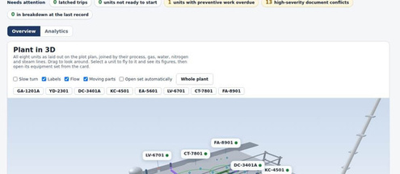

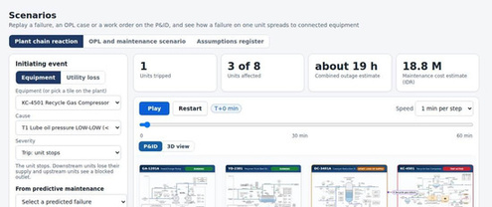
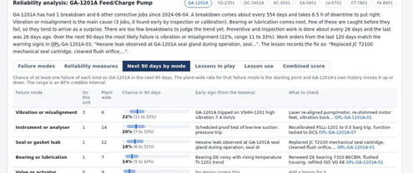
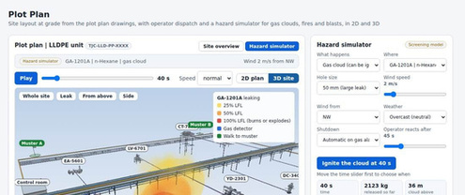
Team profile and key technologies
CALIBER 2026
Final Case
Team name: Insinyur Jawa University: Universitas Gadjah Mada
No. | Name | Major | Semester | Area of expertise | Contribution to the proposal
1 | Alniko Arya Sudjatmiko | Chemical Engineering | 5 | AI and software | Formulated the idea; built the prototype and the AI assistant
2 | Anas Fauzan | Chemical Engineering | 5 | Maintenance and business case | Business impact, KPIs and roadmap
3 | Rainar Athalla Waranggana | Chemical Engineering | 5 | Process and reliability | Problem analysis, process content and hazard models
AI models and tools used to build the solution
Gemini 2.5 Flash (Google)
reasons over the evidence and writes the answers and AI boxes; every number checked; rules answer offline
Learned models (Python, numpy)
demand hurdle model (logistic and ridge), equipment risk (logistic), lead time and price (ridge)
AI projection review and engine
rules that check each part; reorder policy and Monte Carlo in Node.js
Coding assistants
Claude Code (Anthropic) and Codex (OpenAI) built and tested the site with the team
Vercel
hosting and one serverless function for all APIs
SQLite
one database built from the six case sheets (pandas, openpyxl)
Three.js and SVG
3D equipment views, drawings and charts
Playwright and Node tests
over 20 test suites, including 7,289 AI reliability checks
Background
Solution
Impact
Roadmap
Conclusion
7

Slide 8


















Appendix
Appendix: model validation, assumptions and data sources
CALIBER 2026
Final Case
Model validation: every model is scored on data it never saw
Assumptions (one contract for every page)
Model | Tested on | Result against the baseline
Demand (hurdle) | 5 held-out months | AUC 0.885; Brier 0.0206 vs 0.0368; 34% error a month, total within 2% after calibration
Equipment risk | 3-month windows from 2026-05 | AUC 0.936 vs 0.832 for any notification in the last 12 months
Lead time | latest 20% of PO lines | 32 days error vs 36 for the part median, 43 overall
Price | 5-fold on 1,229 priced parts | median error 57% vs 61%; 54% within 2x vs 50%
Campaign uplift | 4 campaign months | plant 2.8 times a normal month, shrunk per part
AI projection review | 7,481 parts | 234 blended, 7 on history, 6 insurance spares; factors 0.5 to 2x
AI answers | 7,289 reliability checks | 0 failures; replies with numbers not in the evidence rejected
Assumption | Value
Carrying rate | 22% of stock value a year
Order cost | IDR 250,000 an order
Service target | S 99%, A 97.5%, B 95%, C 90%
Downtime cost a day | S 100 mn, A 30 mn, B 5 mn, C 1 mn
Hours down per stockout | S 72, A 48, B 24, C 12
Stockouts that stop the equipment | S 50%, A 25%, B 10%, C 2%
Lead time with no history | learned model; 60 days as the contract default
Data sources and what was fixed
Finding | How it is handled
PR PO: 5,420 exact copies | each line counted once (6,189 lines)
PO-Item Amount is a unit price | value = quantity x unit price
Notif History: 1,463 in the first month | flagged as the opening backlog
6,252 parts without a PO price | learned estimate, labelled, opt-in
45% of notifications finish late | late flag on every notification
Reproduce: python3.13 spi/etl/build_db.py, then spi/ml/train.py, train_more.py, train_price.py and spi/etl/enrich_db.py rebuild the database and the models from the six sheets; tests: npm run test:ai, node tests/spi_db_integrity.js.
Conclusion
Every figure in this deck comes from these models and assumptions on the running site, and each one is labelled Data, Estimate or Assumption.
Source: spi/db/spi.sqlite (ml_model, ml_eval, dq_issue) and spi/contracts/econ_assumptions.json on the running prototype.
Background
Solution
Impact
Roadmap
Conclusion
8

