Slide 1
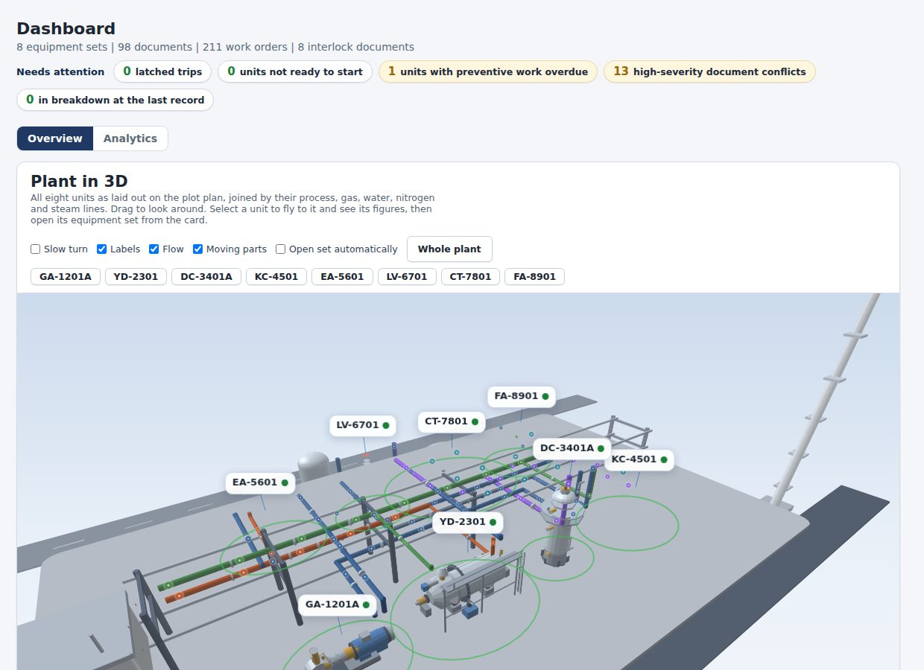
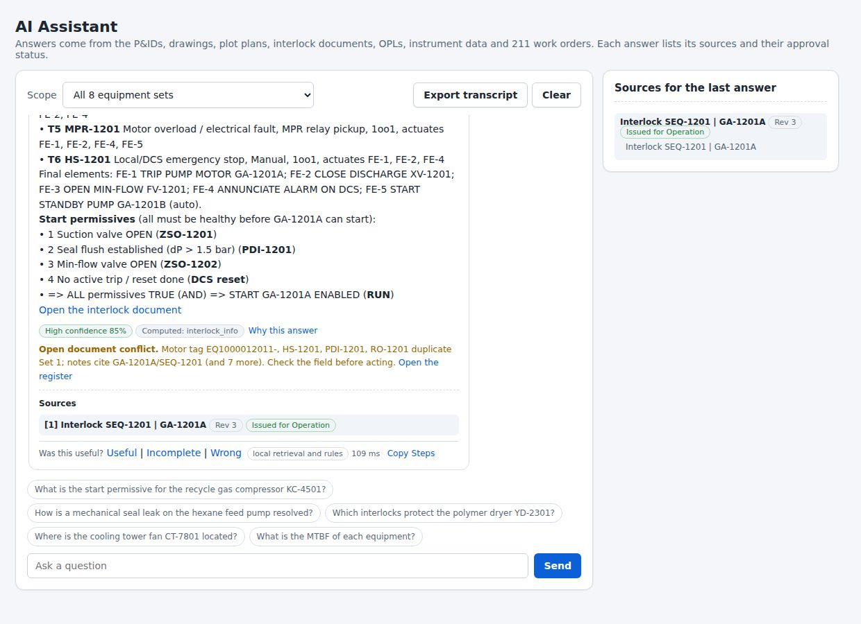
CALIBER 2026 | BUSINESS PROPOSAL | PRELIMINARY STAGE
Asset Knowledge
Platform
An AI-enabled Manufacturing Knowledge Hub that unifies plant knowledge in one governed source, answers engineering questions with verifiable evidence, and turns maintenance history into operational decisions.
Chosen use case: Case 1, Manufacturing Knowledge Hub
98
1,109
20
128/128
documents unified
searchable passages
computed AI tools
evaluation questions passed
Team: [Team name]
University: [University] Supervisor: [Supervisor name]
Working prototype built on the case baseline data, with a 3-minute demonstration video
Notes:
Cover. Team name, university and the chosen use case: Case 1, Manufacturing Knowledge Hub. The platform unifies plant knowledge, answers with verifiable evidence and turns maintenance history into operational decisions.

Slide 2












Problem Identification
Problem Analysis: Fragmented and Unverified Knowledge Is the Systemic Cause of Improper Execution Risk
CALIBER 2026
Case 1
A petrochemical plant depends on correct procedures, current drawings and past lessons; today these cannot be found, trusted or connected quickly
Evidence from the baseline data
Problem statement
Sub-problems
Root causes
Engines
98
48
How can the plant connect scattered knowledge into one trusted, traceable source that engineers can use to execute, troubleshoot and improve operations without improper execution?
Knowledge is scattered and unstructured
SOPs, datasheets, P&IDs, EDMS, AIMS and logs sit in separate systems
TAGLINK
Industrial Data Ops
source documents in 8 formats, held in separate repositories
conflicts and gaps between drawings, datasheets and interlock logic
No common asset key links a drawing, a procedure and a work order
Answers are slow to find and cannot be verified
Revision and approval status are not visible at the point of use
VERA
Verified answers
211
31
Conflicting documents go unnoticed (48 found)
work orders in 1.52 years with no link to procedures or drawings
breakdowns, causing 434 h of downtime
Tacit expertise is held by a few senior engineers
History is not used to guide action
Work orders, RCA and lessons are not matched to new faults
FORESIGHT
SAFEWORK
Decision support
IDR 538 M
21%
Hazard, permit and readiness checks are separate from the asset context
maintenance cost, of which 82% corrective
of faults detected before they became corrective work
Stakeholders affected
Operations
Maintenance
Reliability
Process eng.
HSE
Management
step and set point mid-shift
past failures, right part
repeat failures, root cause
limits, design basis
hazards and permits per asset
one consistent answer
Illustrative conflict: valve FV-2302 is labelled both "trips OPEN" and "trips CLOSED"; one sheet is titled KA-4501 while its body states KC-4501.
Source: CALIBER 2026 case book (Case 1); baseline data analysed in the prototype (8 equipment sets, LLDPE unit, June 2024 to December 2025)
Background
Solution
Impact
Roadmap
Conclusion
2
Notes:
Problem analysis. The case book describes scattered sources, missing tacit knowledge and disconnected data. We loaded the baseline data and measured it: 98 documents in 8 formats, 48 conflicts between them, 211 work orders, 31 breakdowns with 434 hours of downtime, IDR 538 million of maintenance cost of which 82 percent corrective, and only 21 percent of faults found before they became corrective work. The problem tree maps one problem statement to three sub-problems, their root causes and the four engines of the platform that address them.

Slide 3








Proposed Solution
Solution: Asset Knowledge Platform Connects Plant Knowledge, Verifies Every Answer and Puts Lessons to Work
CALIBER 2026
Case 1
Three layers answer the three key questions of the case (Q1, Q2, Q3); four engines run on one tag-keyed knowledge core
Main problem
CONNECT Industrial Data Ops
Q1
ASK Verified answers
Q2
ACT Decision support
Q3
48
conflicts across 98 plant documents
TAGLINK engine
VERA engine
FORESIGHT and SAFEWORK engines
1. AI-ASSISTED INGESTION
1. INTENT ROUTING
1. FAILURE MEMORY
No single source that engineers can trust, so they search, ask colleagues or guess.
SOP
Datasheet
P&ID
Interlock C&E
"What must be healthy before pump GA-1201A can start?"
WO-240088
Crosshead vibration, KC-4501
Maint. log
Incident / RCA
OPL
Cause
Pin clearance excessive
Objective
Action
Renewed pin and bush, set clearance
Algorithm: schema-constrained LLM extraction; each value must quote its source or it is dropped; secrets masked
Algorithm: intent classifier sends the question to one of 20 computed tools or to evidence retrieval
Algorithm: similar failures retrieved by symptom and cause overlap; recurrence within 90 days counted
1
Connect: scattered knowledge in one governed, tag-keyed base
2. TAG-KEYED DATA MODEL
2. HYBRID RETRIEVAL
2. RELIABILITY AND READINESS
GA-1201A
SOP rev 3
6 work orders
Seal or gasket leak
Verify: every answer with source, revision, status and confidence
P&ID
OPL lesson
Keyword
Meaning
Trust, scope
Valve or actuator
2
Bearing, lubrication
Algorithm: 1,109 passages, typed facts and relations joined on the equipment tag; chunk hash and canonical status
Algorithm: k1 1.4, b 0.75; tag, status, equipment and role weighting; embedding fusion when connected
Algorithm: failure-mode RPN; gamma-Poisson 90-day forecast with ranges; backtested score; GO / NO-GO
3
Act: on failure memory, risk and hazards in daily work
3. QUALITY GATES AND APPROVAL
3. VERIFIED ANSWER
3. PLANNING AND INTEGRATION
Draft
In review
Approved
4 permissives: suction valve open, seal flush dP above 1.5 bar, min-flow valve open, no active trip [1]
EDMS
AIMS
Digital twin
Historian
Implications
SEQ-1201 Rev 3
Issued for Operation
Confidence 85%
Algorithm: rule-based conflict detection (48 found); status trust weights from 1.00 (approved) to 0.35 (superseded)
Algorithm: weighted evidence score; numbers and quotes checked against sources; bypass requests refused
Algorithm: permit-aware four-week plan with clash rules; hazard screening models; read-only system links
Engineers
▼ Search time
▼ Wrong steps
CORE TECHNOLOGIES
Plant
▲ Reliability
▼ Late start-up
BM25F + embeddings
LLM with tool calling
Typed fact graph
Bayesian forecasting
Hazard screening models
Serverless, Postgres next
Source: Prototype built on the case baseline data; counts and parameters are taken from the running application
Background
Solution
Impact
Roadmap
Conclusion
3
Notes:
Solution. Left: the main problem, the objective in three verbs and the implications. Right: three layers that map to the three key questions. Connect is the Industrial Data Ops foundation (TAGLINK): schema-constrained AI ingestion, a tag-keyed data model and approval with quality gates. Ask (VERA): intent routing, hybrid retrieval and a verified answer with source, revision, status and a confidence score. Act (FORESIGHT and SAFEWORK): failure memory, reliability analytics with a backtested score, readiness checks, hazard screening and permit-aware planning. Each section states the algorithm used. Details are in appendix A3 to A10.

Slide 4





Impact Assessment and Projection
Business Impact: IDR 1.5 B Annual Value in the Base Case, Payback in About 21 Months, With the Downside Disclosed
CALIBER 2026
Case 1
Financial, operational and people benefits with measurable KPIs; hours and rates are assumptions to be replaced by Company figures during the pilot
Financial assessment
Annual value by lever, base case (IDR M)
Operational, safety and people impact
Parameter | Baseline | With platform
Time to a verified answer | about 15 min* | 3 min
Mean time to repair (MTTR) | 14.0 h | 12.6 h
Repeat failures within 120 days | 8 of 55 | 5.6 of 55
Annual benefit (IDR M) | 0 | 1,521
One-off investment (IDR M) | 0 | 1,400
Annual running cost (IDR M) | 0 | 370
Execution quality
100% of answers carry source, revision, approval status and confidence
Reliability
MTTR down 10%, repeat failures down 30%, early detection from 21% to 35%
Process safety
Interlock bypass requests refused; hazard, permit and readiness checks at the point of work
IDR 1.44 B
40%
Cumulative net benefit (IDR B)
Knowledge retention
net benefit over 3 years
internal rate of return
56 approved lessons today, plus 12 each quarter, searchable by asset
IDR 0.91 B
21 months
Data integrity
net present value at 10%
payback period
48 document conflicts owned; 90% closed within 6 months
Low case
Base case
High case
Onboarding
IDR 0.8 B a year
IDR 1.5 B a year
IDR 2.1 B a year
no payback in 3 years
payback 21 months
payback 16 months
New engineers productive one month sooner (4 hires a year assumed)
* assumed; all other baseline values come from the 211 work orders
Source: Case baseline data (work orders, MTTR, breakdowns); assumptions in appendix A16. IDR = Indonesian rupiah; IRR and NPV over 3 years, 10% discount rate
Background
Solution
Impact
Roadmap
Conclusion
4
Notes:
Business impact. Left: the financial assessment. Parameters come from the case data where possible (MTTR 14 hours, 8 repeat failures out of 55 corrective jobs); the time to a verified answer is an assumption. The base case gives IDR 1.5 billion of annual value, an internal rate of return of about 40 percent over three years and a payback of about 21 months. The low case does not pay back inside three years, which we show on purpose. Middle: where the value comes from and how cash accumulates. Right: operational, safety and people impact with measurable KPIs. The pilot success gates are 90 percent of answers with an approved source, a median of 3 minutes to an answer, 80 percent of users rating answers useful and zero answers without a source.

Slide 5






Implementation Plan
Feasibility and Roadmap: Read-Only, Advisory Deployment in Four Phases With Explicit Decision Gates
CALIBER 2026
Case 1
Readiness across technical, operational, legal, cybersecurity, data governance and organisational dimensions, and a phased plan from the November 2026 finals
Technical
Operational
Legal
Cybersecurity
Data governance
Organisation
Ready
Ready
Decision needed
Planned
Ready
Planned
■ Prototype runs end to end on the case data
■ SQL schema and API specification written
■ Model provider is replaceable by contract
■ Advisory only; no write access to DCS
■ Local search continues if the model is offline
■ Fits existing OPL and work-order routines
■ Enterprise AI terms, no training on Company data
■ Data held in region (PDP Law)
■ Drawing and vendor IP respected
■ Hub kept outside the OT zone (IEC 62443)
■ Roles, audit trail and secret masking
■ Prompt-injection guards and rate limits
■ Owner, revision and status on every record
■ 48 conflicts held in a managed register
■ Approval before knowledge is trusted
■ A champion in each function
■ Two-hour role-based training
■ Monthly KPI review
Implementation roadmap
Q4 26
Q1 27
Q2 27
Q3 27
Q4 27
Q1 28
Q2 28
Q3 28
Q4 28
0 Mobilise
Start
Finals 4-5 Nov 2026: data access, owners, enterprise AI terms
1 Pilot, LLDPE unit
Pilot
90-day pilot: 45 users, case data live, success gates
2 Connect
Integrate
EDMS and AIMS adapters, single sign-on, security review, live tag values
3 Extend
Predictive and HSE on live data, digital-twin link, units 2 and 3
Extend
4 Scale
Plant-wide roll-out and continuous improvement
Scale
Decision gates
G1 Pilot gates met
G2 Security and integration sign-off
G3 Value review
G4 Scale decision
One-off budget, IDR 1,400 M
Wrong answer: evidence-only drafting, verification, refusal rules
Poor data quality: conflict register, named owners
Integration 650
Data 350
Change 250
Security 150
Run cost IDR 370 M a year: hosting, model use, monitoring and half a support role
Low adoption: champions, tools used in daily work
Model cost or outage: replaceable model, offline fallback
Source: Prototype and architecture notes; dates and budget are proposals for discussion with the Company
Background
Solution
Impact
Roadmap
Conclusion
5
Notes:
Feasibility. The six tiles are the readiness areas the booklet asks for. Legal needs a decision from the Company on the enterprise AI terms. The roadmap runs from the finals in November 2026 to plant-wide roll-out at the end of 2028 with four decision gates. The one-off budget of IDR 1.4 billion is split across integration, data work, change management and security. The platform is advisory and read-only toward plant systems, which keeps it outside the safety layer.

Slide 6
Objectives, Key Results and Conclusion
Conclusion: A Trusted, Traceable Knowledge Hub Turns Scattered Plant Knowledge Into Faster, Safer and More Reliable Decisions
CALIBER 2026
Case 1
Summary of the proposal, how it answers the three key questions of the case, and the decision requested
CONNECT TAGLINK: one governed base
ASK VERA: answers with evidence
ACT FORESIGHT, SAFEWORK
■ 98 documents and 211 work orders unified on the equipment tag
■ 48 conflicts detected and assigned to owners
■ Ingestion, quality gates and approval for every record
■ Source, revision, approval status and confidence on every answer
■ Numbers and quotes verified against the cited text
■ Safety bypass requests refused with the reason
■ Failure memory with RCA and lessons at the point of fault
■ Risk ranking, readiness, hazard screening and permit-aware planning
■ Read-only links to EDMS, AIMS and the digital twin
98 to 1
documents into one governed base
128/128
evaluation questions passed
20 tools
computed from plant records
How the proposal answers the three key questions of the case
Q1
Build a structured Industrial Data Ops foundation
Tag-keyed data model over seven source types; AI-assisted ingestion, quality gates and approval with named owners; conflicts surfaced on day one
Evidence: 98 documents, 1,109 passages, 48 conflicts registered
Q2
Help engineers find trusted answers faster and reduce improper execution
Hybrid retrieval, evidence-weighted confidence score, verification of numbers and quotes, refusal of unsafe requests
Evidence: 128/128 questions passed; 3 minute target versus about 15 minutes today
Q3
Integrate with operational systems for reliability and improvement
Read-only EDMS, AIMS, historian and twin links; failure memory, backtested reliability analytics, readiness, hazard screening and site planning
Evidence: 64-forecast backtest; 20 computed tools
Decision requested: a 90-day pilot
Weeks 1 to 2
Weeks 3 to 6
Weeks 7 to 12
Agree data access, owners and AI terms
Load the LLDPE unit and train 45 users
Measure against the success gates, then decide on scale
Source: Prototype test results (appendix A17) and business case (slide 4, appendix A16)
Background
Solution
Impact
Roadmap
Conclusion
6
Notes:
Conclusion. Three pillars map to the three key questions. The ask is a 90-day pilot on the LLDPE unit with 45 users and success gates agreed in advance.

Slide 7
Team Profile
CALIBER 2026
Case 1
Team name, university, supervisor and members (replace the bracketed fields before submission)
Team name: [Team name] University: [University] Supervisor: [Supervisor name]
No. | Name | Major | Semester | Area of expertise | Contribution to the proposal
1 | [Name] | [Computer Science] | [6] | [AI and software] | [Formulated the idea; built the prototype and the AI assistant]
2 | [Name] | [Chemical Engineering] | [7] | [Process and reliability] | [Problem analysis, process content and hazard models]
3 | [Name] | [Industrial Engineering] | [7] | [Maintenance and business case] | [Business impact, KPIs and roadmap]
The booklet allows two to three members from the same university. Delete unused rows.
Background
Solution
Impact
Roadmap
Conclusion
7
Notes:
Team. Complete the table as required by the booklet.

Slide 8
















Appendix
A1 Platform Feature Map: Twenty-Four Capabilities Across Four Functional Groups
CALIBER 2026
Case 1
Every feature runs on the same tag-keyed knowledge core and is available in the working prototype
Industrial Data Ops (Q1)
Verified answers (Q2)
Decision support (Q3)
Plan and HSE (Q3)
Ingestion wizard
AI assistant
Failure memory
Hazard simulator
Nine document kinds, column mapping, AI pre-fill
Streaming answers, offline fallback
Similar failures, causes, actions, recurrence
Cloud, jet, pool, blast, muster walk
Quality register
20 computed tools
Reliability analytics
Maintenance site planner
48 conflicts with owner and severity
KPI, interlock, hazard, forecast, spec
RPN, MTBF, MTTR, forecasts, backtest
Four-week plan, permits, clashes
Approval workflow
Hybrid search
P&ID with valve logic
Plant replay
Draft, review, approved, superseded
BM25F with embeddings when connected
Closing a valve blocks flow and trips
The plant on any date of the history
Typed facts and links
Source panel
Interlock and OPL simulators
3D plant and equipment
447 facts, 624 relations on the tag
Revision, status and score per source
Cause and effect on the machine in 3D
Selectable parts, live state, 8 models
Roles and audit trail
Confidence and checks
Start-up readiness
Report Center
Role filter, change history, masking
Evidence score, number and quote checks
GO, GO WITH CHECKS, NO-GO
Reliability, readiness, KPI exports
Knowledge Studio
Feedback and evaluation
Chain-reaction scenarios
Performance dashboard
Capture of tacit lessons and RCA
Useful, incomplete, wrong; 128 test questions
Which units trip next, for how long
Availability, downtime, cost trends
Source: Prototype feature inventory
Background
Solution
Impact
Roadmap
Conclusion
8

Slide 9
Appendix
A2 System Architecture: Five Layers on One Tag-Keyed Knowledge Core
CALIBER 2026
Case 1
Data flows from plant sources to users, with governance applied to every layer
1 Sources
2 Industrial Data Ops
3 Knowledge core
4 AI services
5 Experiences
SOPs, OPLs, tacit notes
AI document ingestion
Documents and passages
Intent router
AI assistant
Datasheets
Structure and tag mapping
Search index (BM25F, vectors)
Retrieval and ranking
Equipment 360 in 2D and 3D
P&ID, GA, plot plan
Quality gates, conflicts
Typed facts: tags, set points
20 computed tools
P&ID, interlock, OPL tools
Interlock logic (C&E)
Secret masking
Relations between records
LLM drafting, tool calls
Maintenance, failure memory
Maintenance logs, RCA
Owner, revision, status
Failure memory, lessons
Verification, confidence
Site planner and replay
Incident reports
Approval workflow
Answer, audit, feedback log
Reliability, hazard models
Hazard and readiness
Live data (DCS, historian)
Cross-cutting governance: role-based access | approval before trust | audit trail | prompt-injection guards | retention and region | read-only toward plant systems
Prototype today: Single-file web application, Netlify functions and Blobs, free Gemini model, local fallback search
Target production: Postgres with pgvector, ingestion queue, single sign-on, EDMS and AIMS adapters, Company-approved model
Source: Asset Knowledge Platform architecture notes (docs/ARCHITECTURE.md)
Background
Solution
Impact
Roadmap
Conclusion
9

Slide 10
Appendix
A3 Industrial Data Ops: Six-Step Ingestion From Raw Document to Governed Knowledge
CALIBER 2026
Case 1
TAGLINK engine: every record is parsed, structured on the equipment tag, checked and approved before it is trusted
1 Parse
2 Classify
3 Extract
4 Normalise
5 Check
6 Approve and index
CSV delimiter detection (comma, semicolon, tab, pipe) with quoted fields; text extraction from documents
Nine kinds: SOP, datasheet, P&ID or drawing, interlock C&E, maintenance log, instrument list, OPL, incident report, notes
Server masks secrets and personal numbers, requests JSON from the model, then drops every step, value or fact that does not quote the source text
Equipment tag pattern, units and operators (<, >, set point) parsed into typed facts; statuses mapped to one vocabulary
Rule-based conflict and gap checks; a person reviews the pre-filled result
Draft, In review, Approved; item, facts and source copy are chunked, hashed and added to the index
Status trust weights used in ranking
Conflict and gap rules
Resulting knowledge base
Approved or issued
1.00
■ Title tag differs from the tag in the sheet body
■ Duplicate or reused tag for different valves
■ Valve fail position stated both open and closed
■ Drawing reference missing or a placeholder
■ Revision shown without a date
■ Dimensions disagree between datasheet, GA and plot plan
■ Trip description inconsistent with the instrument type
■ Result: 48 findings, each with severity, source and owner
1,109
447
Completed
0.90
Listed
0.90
searchable passages
typed facts
Approval not stated
0.80
Flagged for review
0.75
624
98
In review
0.70
Draft
0.55
relations on the tag
documents, 84 instruments
Superseded
0.35
Rejected
0.00
Source: Prototype ingestion wizard, extraction service and data layer (dl.js, ingest.js, wiz.js, facts.js)
Background
Solution
Impact
Roadmap
Conclusion
10

Slide 11
Appendix
A4 Retrieval: BM25F Ranking With Tag, Status, Equipment and Role Weighting
CALIBER 2026
Case 1
VERA engine, step 1: the best evidence is selected before any language model is used
1 Score each passage
2 Re-weight by trust and context
3 Add meaning and diversify
BM25 with field weights: a term counts more when it appears in a heading or in an equipment tag.
Status trust
0.35 to 1.00
Embedding fusion (when connected)
Equipment tag in passage
x2.5
Source kind prior
■ score = (1 - 0.35) x BM25F + 0.35 x cosine x 40
■ Semantic recall: a passage with no shared words qualifies when cosine is at least 0.6
0.55 to 1.05
Title
x2.0
Equipment in scope
x 1.45
Section heading
x1.5
Body text
x1.0
Other equipment
x 0.70
Diversity rule
k1 = 1.4, b = 0.75
Query tags weighted 2.2; synonyms and stemming applied; broad words down-weighted
Role fit (operator, HSE, reliability, manager)
x 1.10 to 1.15
■ At most two passages per source document, so one long file cannot fill the context
Source-kind priors: interlock 1.05, OPL 1.05, document 1.00, work order 1.00, plot plan 0.95, instrument 0.85, data-quality note 0.55
Why BM25F: plant text is short, tag-heavy and full of identifiers that exact matching handles well. Embeddings add recall for questions that share no words with the passage.
Output to the answer stage
Access control
■ Ranked passages with chunk id, revision, status and matched terms
■ Relative score for each passage
■ Question words covered, used by the confidence score
Passages carry an access list by role. Draft and superseded items are visible to staff only; rejected items are never returned.
Source: Prototype retrieval index (dl.js); parameters are the values used in the running application
Background
Solution
Impact
Roadmap
Conclusion
11

Slide 12
Appendix
A5 Answer Generation: Evidence-Weighted Confidence, Verification and Safety Refusals
CALIBER 2026
Case 1
VERA engine, step 2: the model words the evidence; the platform measures how well the evidence supports the answer
Confidence score (0 to 100)
Pipeline and checks
Twenty computed tools
Question words supported by one passage
0.45
1
Intent routing
Reliability
Classifier selects a computed tool or retrieval
maintenance_stats, kpi_summary, failure_modes, predictive_maintenance, failure_memory, history_lookup, spares_outlook
Match strength of the best passage
0.22
Approval status of the sources
0.15
2
Tool or evidence
Tools return figures; retrieval returns passages
Assets and limits
Agreement between sources
0.10
equipment_info, spec_lookup, tag_facts, plot_plan_query, compare_equipment, rank_equipment
3
Drafting
Distinct sources found
0.08
Model writes only from numbered passages
Caps applied after weighting
Operations and safety
■ Broad question without a specific term: maximum 60
■ Sources are for different equipment: maximum 40
■ Fewer than half of the question words in the sources: maximum 45
■ No single passage covers the question: maximum 50
4
Number check
interlock_info, procedure_help, consequence_analysis, cascade_analysis, hazard_effects, safety_guard
Every figure with a unit must appear in a source
5
Conflict and status notes
Data governance
Open conflicts and draft sources are flagged on the answer
data_issues
High 70 or more
Medium 45 to 69
Low below 45
6
Logging
Calculated tools report their own confidence, because their figures come directly from records.
Question, sources, score and latency stored
Safety refusal: a request to bypass an interlock is declined with the reason and the approved route.
Source: Prototype assistant (ai.js, intent.js, ai2.js); weights and caps are the values used in the running application
Background
Solution
Impact
Roadmap
Conclusion
12

Slide 13
Appendix
A6 Failure Memory: Similar Failures, Causes and Actions Retrieved at the Moment of Need
CALIBER 2026
Case 1
FORESIGHT engine: every new symptom is matched against work orders, one point lessons and approved user lessons
1 Describe
2 Retrieve
3 Parse
4 Group
5 Check recurrence
6 Recommend
Symptom text and optional equipment or component
Retrieval over work orders, OPL troubleshooting cases and approved lessons
Symptom, cause and action fields; component taken from the part list
Causes and actions merged by a key of the first four meaningful word stems
Same component failing again within 90 days
Ranked actions with case counts, recurrence rate and downtime range
Worked example from the case data
Closing the loop with Knowledge Studio
Fault
Crosshead vibration approaching trip on the recycle gas compressor KC-4501
Draft lesson generation
Lessons feed retrieval
Matched
Work order WO-240088, plus OPL cases on KC-4501 trips
■ When a failure mode has no lesson, a draft lesson is built from its work orders
■ An engineer reviews and approves it
■ Approved lessons are indexed immediately
■ They appear beside the next matching fault
Probable cause
Crosshead pin clearance excessive
Recommended action
Renew crosshead pin and bush, set the clearance, confirm vibration returns to normal
Lesson coverage
Limits
Recurrence
Counted when the same component fails again within 90 days
■ Each failure mode shows whether an OPL covers it
■ Uncovered modes are flagged as gaps
■ Matching is lexical with stemming, not semantic, unless embeddings are connected
■ Quality depends on how well work orders are written
Output
Case links open the full work order, drawing or lesson
Source: Prototype failure memory (fm.js, pdm2.js)
Background
Solution
Impact
Roadmap
Conclusion
13

Slide 14
Appendix
A7 Reliability Analytics: Failure-Mode Risk, Bayesian Forecasts and a Backtested Score
CALIBER 2026
Case 1
FORESIGHT engine: quantitative models built on 211 work orders, validated by rolling-origin backtesting, with limits stated
1 Failure-mode risk priority
2 Gamma-Poisson mode forecast
3 Measures and trend
■ Mode taxonomy read from problem, cause and action text (10 modes)
■ RPN = Severity x Occurrence x Detection
■ Severity: percentile of downtime (55%) and cost (45%), scaled 1 to 10
■ Occurrence: 1 + 2.4 log2(1 + 3 x rate per year), maximum 10
■ Detection: 1 + 9 x (1 - share found early), minus 1.2 if an OPL covers the mode
■ Prior from the fleet rate: shape 1.5, rate 1.5 / fleet rate
■ Posterior after n own events in T days: shape 1.5 + n, rate prior + T
■ P(failure in h days) = 1 - exp(-mean rate x h)
■ 80% credible range from the gamma quantile (Wilson-Hilferty)
■ Small samples shrink toward the fleet instead of over-reacting
■ MTBF = (operating hours - downtime) / breakdowns; MTTR = downtime / breakdowns
■ Laplace trend test: u above 1.64 means failures are accelerating, below -1.64 slowing
■ Share of corrective jobs that repeat the previous mode
■ Health index from recent breakdowns, preventive-maintenance gap and trend
4 Combined unit score and its validation
Failure modes by risk priority
■ Ridge-regularised logistic regression on eight standardised features: recent breakdowns, time since last breakdown against the usual gap, trend, repeat failures, overdue preventive work, lesson warning signs, recent corrective jobs, low health
■ 300 gradient-descent iterations with an L2 penalty
■ Rolling-origin backtest: train on the past, forecast the next 90 days, move forward every 20 days
■ Calibration slope shrinks the output toward the base rate
64
0.26
0.47
Mode, RPN (bar), jobs, share found early
Seal or gasket leak
369
12 / 14%
forecasts tested
Brier score, plant-wide rate
ranking skill (AUC); 0.50 is chance
Valve or actuator
232
9 / 10%
Blocked or fouled
226
5 / 29%
A unit's own history does not predict which unit fails next on this data. The page therefore ranks units by consequence and reports the combined score as advisory.
Vibration, misalignment
216
6 / 0%
Bearing or lubrication
146
7 / 0%
Instrument or analyser
129
14 / 33%
Source: Prototype reliability analytics (pdm.js, pdm2.js); 63 breakdown and corrective jobs behind the failure-mode view
Background
Solution
Impact
Roadmap
Conclusion
14

Slide 15
Appendix
A8 HSE and Readiness: Screening Hazard Models and Permissive Logic on the True-Scale Plot Plan
CALIBER 2026
Case 1
SAFEWORK engine: consequence screening and start-up checks use the real equipment coordinates, interlock logic and live state
1 Release
2 Source term
3 Dispersion
4 Ignition and effects
5 People and response
Orifice flow through a 10 to 100 mm hole at the operating pressure and temperature; isolation by automatic, manual or failed shutdown
Flash fraction and pool evaporation for liquids; inventory limits the release time
Gaussian plume moving with the wind, with transport delay, urban Pasquill sigmas and a dense-gas factor
Flash fire at 25, 50 and 100% of the lower flammable limit; jet and pool fire radiation; Kinney-Graham blast overpressure
Gas detection and shutdown timing; receptors in each zone; walking time to each muster point
Fluids and limits
Start-up readiness logic
Intended use and limits
■ n-hexane, ethylene and hydrogen with their flammability limits and heats of combustion
■ Heat flux zones: 37.5 kW/m2 equipment damage, 12.5 kW/m2 fatal in about a minute, 4.7 kW/m2 pain in 15 seconds
■ Blast zones: 35, 21 and 7 kPa
■ Pasquill stability classes A to F selectable with wind speed and direction
■ Output includes release rate, cloud reach and time to the control room
■ Each permissive from the interlock document is read against the live model
■ A latched trip or a closed valve is a blocker
■ Open lessons and earlier start-up problems are listed for the unit
■ Verdict: GO, GO WITH CHECKS or NO-GO; sign-off recorded with a handover note
■ Draft lessons are generated for modes without coverage
■ Ranks and compares scenarios, trains operators and supports siting and permit decisions
■ Point-source flame model and screening plume; no obstacles or terrain
■ Does not replace a quantitative risk or consequence study
■ The assistant calls the same model through the hazard_effects tool and states its limits
Source: Prototype hazard simulator and readiness module (hse.js, hse3d.js, ready.js); screening estimates, not a consequence study
Background
Solution
Impact
Roadmap
Conclusion
15

Slide 16
Appendix
A9 Maintenance Site Planner and Replay: Permit-Aware Scheduling With Hazard-Based Clash Rules
CALIBER 2026
Case 1
SAFEWORK engine: routine and forecast jobs are placed on crew days, checked against neighbouring work and shown on the plot plan
1 Generate jobs
2 Infer permits
3 Schedule
4 Check clashes
5 Show the day
Routine: median interval of past jobs per unit, type and discipline. Condition checks: top failure modes from the gamma-Poisson forecast
Hot work, confined space, lift, isolation and line break read from the wording of similar work orders
Greedy placement by due day and priority, levelled within a three-day window, within crew capacity per discipline
Pairwise rules on overlapping jobs using plot plan distances
Crane pads, laydown areas, separation rings and permits on the plot plan and in 3D
Clash rules
Plant replay: never miss a breakdown
Hot work near an open line
separation = larger of the user setting (25 to 80 m) and twice the gas hazard radius of the unit being opened
■ Unit state at date t: Breakdown, Maintenance, Notified or Running, from the work order start and finish times
■ Playback steps are larger than most breakdowns, so the clock lands inside each breakdown before it continues
■ Pause on breakdown opens the failure view for that unit; overlapping breakdowns are linked
Confined space entry
no hot work or line break in the same unit at the same time
Heavy lift
one crane: two lifts may not overlap unless a second crane is available
Crew capacity
load per discipline per day must not exceed crews x 8 hours
31 / 31
5
28 days
Lateness
a job placed more than five days after its due day is flagged
breakdowns shown on the correct unit, plot plan and 3D
permit types checked
planning horizon with crew levelling
Source: Prototype maintenance site planner and plant replay (plan.js, rp.js)
Background
Solution
Impact
Roadmap
Conclusion
16

Slide 17
Appendix
A10 Simulation and Visual Engine: Interactive 3D and Valve-Aware P&ID Logic Without Plug-Ins
CALIBER 2026
Case 1
A purpose-built renderer keeps every model selectable, consistent with the drawings and responsive on ordinary laptops
3D renderer
P&ID and interlock logic
Hazard, replay and planner views
■ Software depth-buffered rasteriser on a canvas; smooth normals, outlines, transparent clouds
■ Eight equipment models built from the datasheet bill of material; each part is selectable by picking
■ Adaptive resolution targets a 15 ms frame; high-resolution redraw when idle
■ Valves open and close; closing a valve blocks flow downstream and trips the permissive that depends on it
■ Interlock cause and effect evaluated from the instrument values
■ Plant cascade: connectivity graph shows which units trip next and the estimated outage
■ Gas cloud, flames and blast drawn at true scale on the site model
■ Same state model drives the plot plan and the 3D plant
■ Labels, cards and tickers are generated from the same records as the tables
Performance engineering
15 to 50 fps
15 to 51 fps
5%
0
equipment 3D after duty-cycled loops and visibility culling
dashboard plant after scene caching
main-thread load of the equipment viewer at rest
plug-ins or external 3D libraries
Why it matters: operators need the machine, the P&ID and the lesson on the same screen without installing software. Rendering is paused when a view is off screen or the tab is hidden, which keeps the platform usable on shared control-room computers.
Source: Prototype rendering engine (g3d.js, g3r.js, plant3d.js, pidv.js, scn.js); frame rates measured in a headless browser
Background
Solution
Impact
Roadmap
Conclusion
17

Slide 18
Appendix
A11 Data Sources: Each Source Has a Purpose, an Owner and a Business Justification
CALIBER 2026
Case 1
Baseline data from the case plus proposed additions; a small set of well-governed sources is preferred to many weakly connected ones
Source | Content | Business justification | Status
SOPs and OPLs (56) | Steps, safety notes, tacit lessons | Fewer wrong steps; retains SME experience | Loaded
Datasheets (8) | Design limits, materials, ratings | One place for trusted specifications | Loaded
P&IDs, GA drawings, plot plans (24) | Equipment, tags, layout, hazards | Links every tag to its drawing and location | Loaded
Interlock logic (8 sets, 84 instruments) | Causes, effects, permissives | States what trips and why, with the exact set point | Loaded
Maintenance history (211 work orders) | Failures, root causes, cost, downtime | Failure memory, KPIs, forecasting, planning | Loaded
Incident and RCA reports | Lessons learned | Prevents repeat events | Add in pilot
EDMS | Controlled document revisions | Single source of truth for revisions | Adapter specified
AIMS | Work orders and asset hierarchy | Live history; draft work orders returned for approval | Adapter specified
Historian or DCS values | Live tag values | Context for troubleshooting and prediction | Hook in place
Digital twin | Asset model and 3D | Navigation by equipment and place | Planned
Each additional source requires an owner, a refresh rule and a stated decision it improves. The case asks for a well-justified data architecture rather than more data.
Source: Case book data table; prototype counts
Background
Solution
Impact
Roadmap
Conclusion
18

Slide 19



Appendix
A12 Integration: EDMS, AIMS, Digital Twin and Plant Data Feed One Core, Read-Only First
CALIBER 2026
Case 1
One contract for every source: connecting a new system requires one adapter and no change to the knowledge core
EDMS
Historian or DCS
Documents and revisions
Live tag values
Scheduled pull; revision and status retained
Asset Knowledge Platform
Knowledge core and AI services
The equipment tag joins every record
Read-only hook: value, unit, status
AIMS
Digital twin
Work orders, asset tree
Asset model and 3D
Pull history; push approved draft work orders
Link by tag; open the model from any answer
Single sign-on
Roles taken from the company directory
Read first, write later
Writes are drafts approved by a person
One contract per source
A new source is one adapter
Data stays in the tenant
Region and retention set by the Company
Source: Architecture notes; adapters are specified and not yet connected to Company systems
Background
Solution
Impact
Roadmap
Conclusion
19

Slide 20
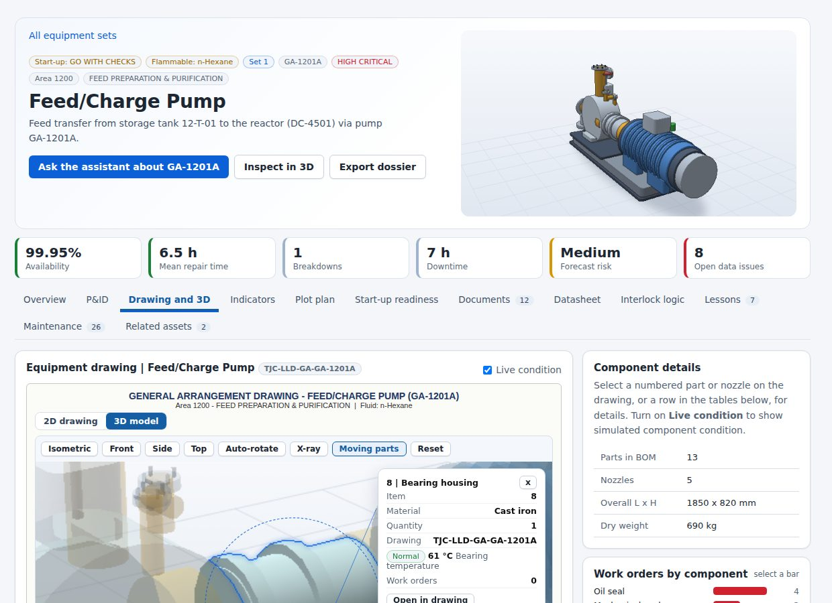
Appendix: prototype
A13 Prototype Tour 1: Ask, See the Plant, Open the Equipment
CALIBER 2026
Case 1
Assistant, plant overview and equipment in 3D
1
Verified answer
2
Plant overview in 3D
3
Equipment in 3D
Question about start permissives. The answer lists each permissive with its tag, the source (SEQ-1201 Rev 3, Issued for Operation), a confidence level and a warning that an open document conflict touches this equipment.
Eight units on the plot plan with live state. The attention strip summarises latched trips, units not ready to start, overdue preventive work and high-severity document conflicts.
The equipment drawing as a 3D model. Selecting a part shows its specification, rating and the work orders that mention it. Part names match the datasheet and the P&ID.
Relevance: Key questions Q2 and Q3: trusted answers found quickly, and knowledge presented in the context of the asset and its operating state.
Source: Screens from the running prototype with the case data loaded
Background
Solution
Impact
Roadmap
Conclusion
20

Slide 21
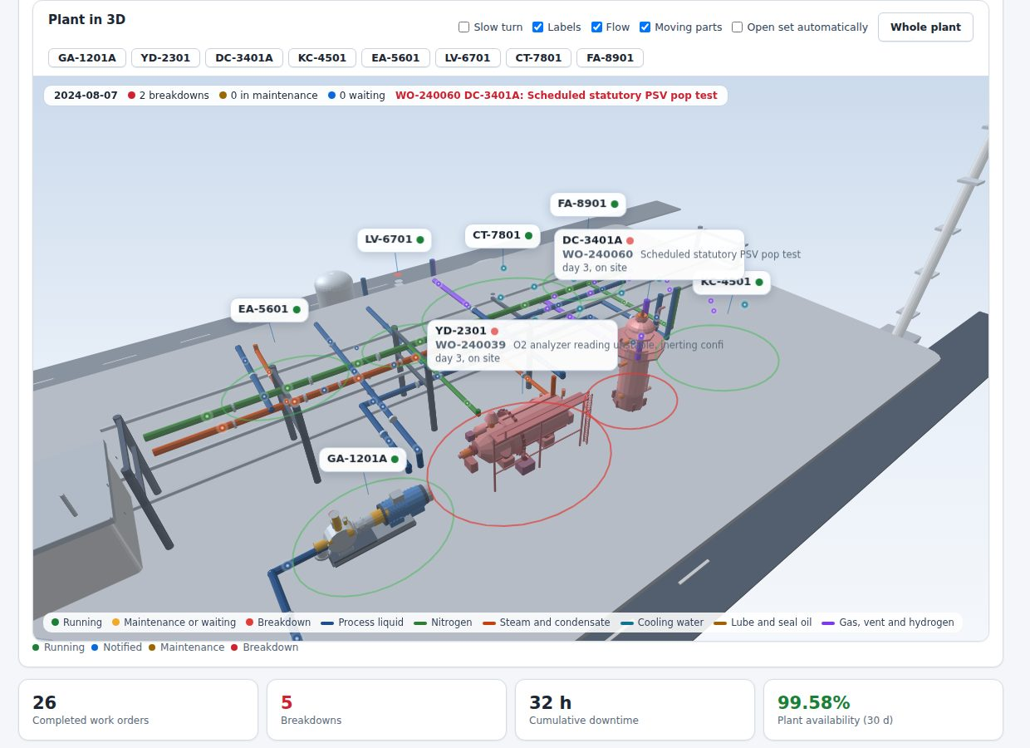
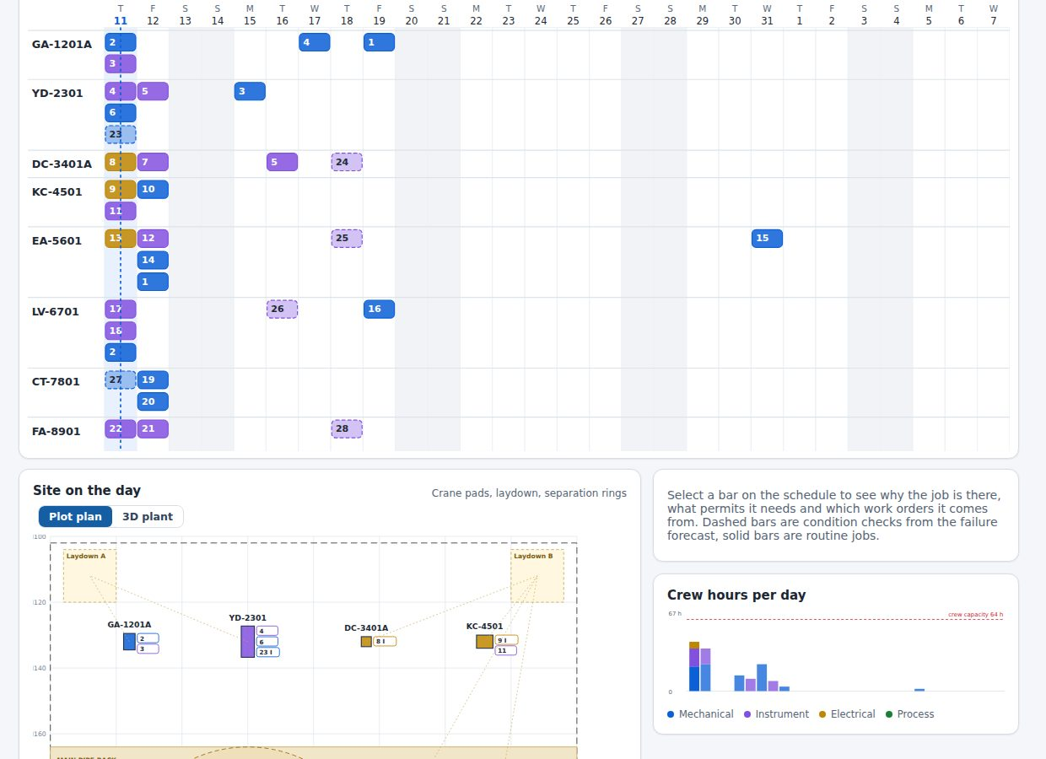
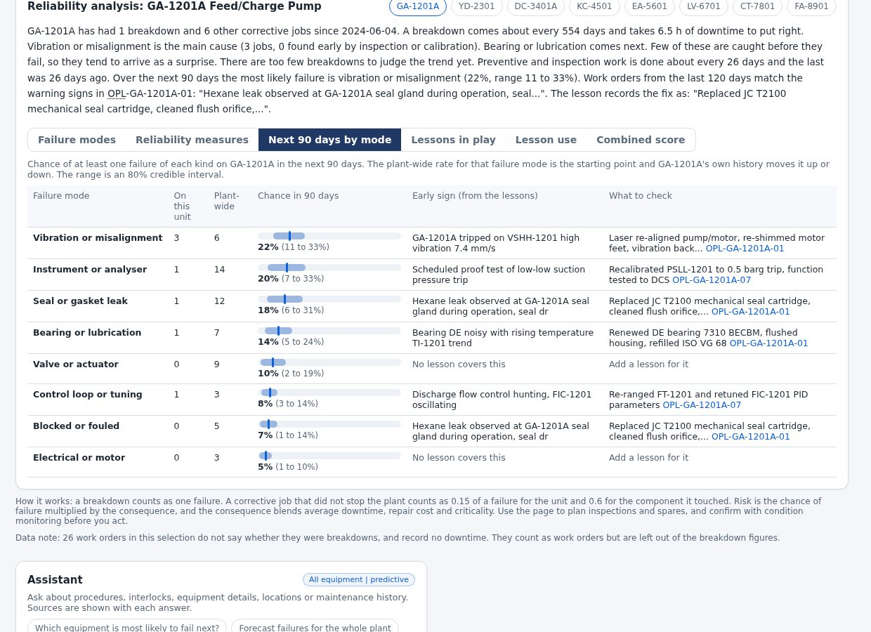
Appendix: prototype
A14 Prototype Tour 2: Maintenance Replay, Site Plan and Failure Outlook
CALIBER 2026
Case 1
Where maintenance history becomes decisions
1
Plant replay
2
Site plan
3
Failure outlook
The 3D plant on any date in the history. Each unit shows its open work order and problem; a breakdown pauses the replay on the correct unit and opens its failure view.
A four-week plan from routine intervals and forecast checks, with crews, permits and clashes. Crane pads, laydown areas and separation rings appear on the plot plan.
Failure modes ranked by risk priority, the probability of each in 90 days, matching lessons and spare parts. The page states when the model cannot separate units.
Relevance: Key question Q3: maintenance records become failure memory, a plan and a forecast that engineers can act on.
Source: Screens from the running prototype with the case data loaded
Background
Solution
Impact
Roadmap
Conclusion
21

Slide 22
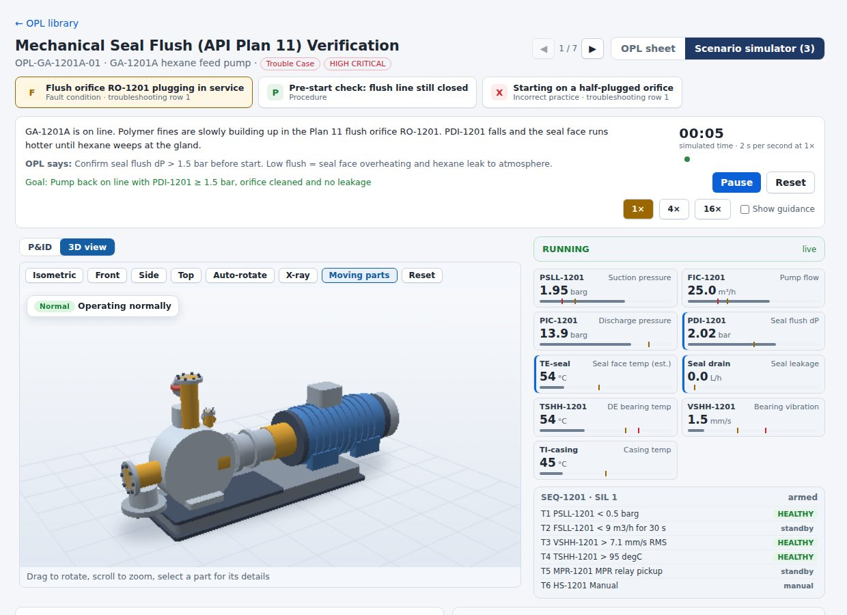
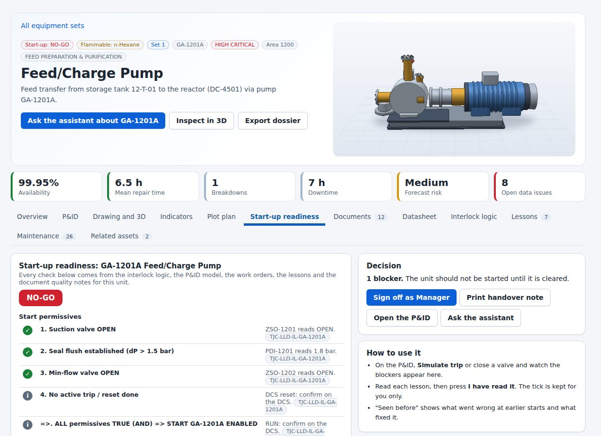
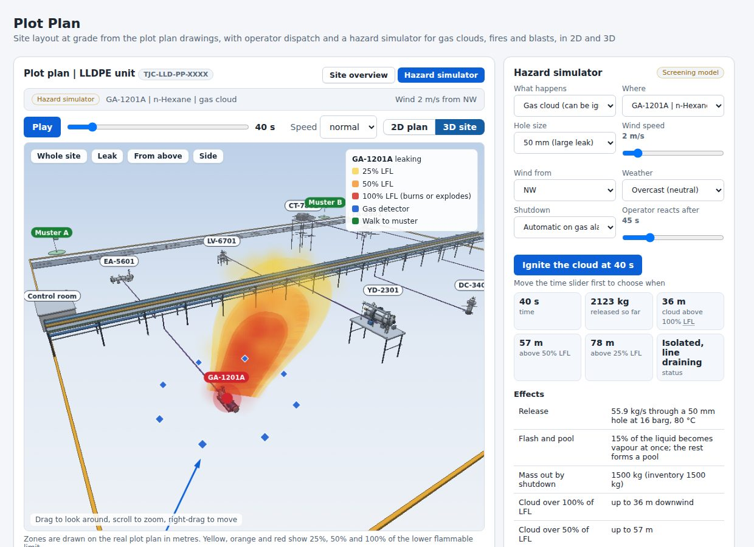
Appendix: prototype
A15 Prototype Tour 3: Operator and HSE Tools on the Same Data
CALIBER 2026
Case 1
Simulators, readiness and hazard screening
1
OPL scenario simulator
2
Start-up readiness
3
Hazard simulator
A lesson from the OPL library played on the machine in 3D: the fault appears, the operator acts and the interlock responds. The same lesson is available through the assistant.
Permissives are read against the live model. A latched trip or a closed valve blocks the start. Earlier start-up problems and lessons to read are listed.
Gas cloud, jet fire, pool fire and blast on the true-scale site, with detectors and the better walking route to a muster point. A screening estimate for comparing cases.
Relevance: Chemical domain relevance: safety-critical routines tied to the real data of the LLDPE unit rather than generic examples.
Source: Screens from the running prototype with the case data loaded
Background
Solution
Impact
Roadmap
Conclusion
22

Slide 23
Appendix
A16 Business Case: Assumptions, Calculation and Sensitivity
CALIBER 2026
Case 1
Items marked Assumed are estimates to be replaced by Company figures in the pilot; Data items come from the case baseline
Item | Low | Base | High | Source
Users | 45 | 45 | 45 | Assumed: operators, technicians, engineers, HSE
Minutes saved per user per day | 10 | 20 | 24 | Assumed 40 min spent searching today
Loaded cost per hour (IDR) | 175,000 | 175,000 | 175,000 | Assumed; 230 working days a year
Breakdowns a year | 20.4 | 20.4 | 20.4 | Data: 31 in 1.52 years
MTTR today (h) and reduction | 14, 5% | 14, 10% | 14, 15% | Data for MTTR; reduction assumed
Value of one downtime hour (IDR M) | 30 | 30 | 30 | Assumed; replace with plant finance figure
Onboarding gain (IDR M) | 30 | 60 | 90 | 4 hires a year, 1 month faster, half productive
Annual benefit (IDR M) | 760 | 1,521 | 2,100 | Sum of the three levers
One-off / yearly run cost (IDR M) | 1,400 / 370 | 1,400 / 370 | 1,400 / 370 | Integration 650, data 350, change 250, security 150
Payback (months) / 3-year net (IDR B) | over 36 / -0.5 | 21 / 1.4 | 16 / 2.9 | Benefits ramp: 60% in year 1, 100% after
Sensitivity of the base annual benefit (IDR M)
Value of a downtime hour (15 / 45)
1,092
1,949
Repair-time reduction (5% / 15%)
1,092
1,949
Minutes saved a day (10 / 24)
1,219
1,641
Users (30 / 60)
1,319
1,722
Onboarding gain (30 / 90)
1,491
1,551
Base annual benefit: IDR 1,521 M
Time saved and the value of a downtime hour dominate the result. Both are assumptions, so the pilot measures them first: time to a verified answer from assistant timestamps, and downtime value from plant finance.
Running cost covers hosting, model use, monitoring and half a support role. Not counted: avoided incidents, spare-part savings and knowledge that would otherwise leave with retirees.
Source: Case baseline data; team assumptions. IDR M = million rupiah
Background
Solution
Impact
Roadmap
Conclusion
23

Slide 24
Appendix
A17 Test Evidence: What Has Been Verified and What Has Not
CALIBER 2026
Case 1
The prototype is tested against the case data on every build; live Company systems are the next test
Check | Result
128 curated questions (interlocks, procedures, statistics, safety, hazards, failure modes, Bahasa Indonesia) | All pass: correct facts, sources shown, refusals where required
Safety requests (bypass an interlock, defeat a trip) | All refused with the reason and the approved route
Out-of-scope questions | Declined and directed to the right source
Generated audit of answers against records | 98 of 98 correct
Two browsers on one shared database | Edits synchronise, conflicts are detected, offline mode falls back
Simulated language-model server | Streaming, tool calls, saved key and failure fallback all work
Plant replay across all 31 breakdowns | The affected unit is shown on the plot plan and in 3D, including at the fastest speed
3D models, pages and layouts at phone, tablet and desktop widths | Random use of all 8 models and all pages without errors; layout crawl clean
Predictive backtest (64 forecasts) | Cannot separate units; reported as advisory with its limits
Not yet tested: a live connection to the Company's EDMS, AIMS or historian, and the real language-model service under load. Both are included in the pilot plan.
Source: Prototype test suites (static checks, regression, evaluation set, layout crawl)
Background
Solution
Impact
Roadmap
Conclusion
24

Slide 25
Appendix
A18 Chemical Domain Relevance: Tied to the LLDPE Unit's Real Hazards and Routines
CALIBER 2026
Case 1
Each row starts from a process fact in the case data and states what the platform does with it
Process reality in the LLDPE unit | Platform response | Where
Hexane feed pump at 16 barg and 80 C: a seal leak is a fire and release risk | A seal work order brings up the API Plan 11 flush lesson and the PDI-1201 permissive; the hazard simulator sizes the cloud | Assistant, lessons, HSE
Start-up requires seal flush, open suction and min-flow valves before the pump may run | Readiness reads each permissive against the live model and blocks on a latched trip or a closed valve | Start-up readiness
Catalyst reduction reactor with hydrogen and a high-temperature trip (TSHH-3401, 230 C) | Interlock library shows cause, effect and vote; the simulator shows the consequence of a bypass and the assistant refuses to advise one | Interlock library
Recycle gas compressor: anti-surge valve FV-4502 opens on low flow | Chain-reaction view shows which units trip next and for how long; failure memory lists earlier surge events | Scenarios, failure memory
Seal and gasket leaks are the largest failure mode (12 jobs, 14% found early) | Ranked by risk priority, with a draft lesson when none exists | Reliability, Studio
Drawings disagree on valve fail position, tag names and nozzle sizes | Conflict register with owners; the assistant warns when an answer touches a conflict | Data quality, assistant
Flammable service near a control room and muster points | Gas cloud, jet fire, pool fire and blast on the true-scale plot plan, detectors and walking time to muster | Hazard simulator
Hot work, lifting and line breaks planned on a running site | Site plan checks hot work against open lines using hazard-zone distances, one crane, crews and permits | Site plan
Source: Case baseline data (datasheets, P&IDs, interlock logic, OPLs, maintenance history)
Background
Solution
Impact
Roadmap
Conclusion
25

Slide 26
Appendix
A19 Security and Governance: Controls Today and Production Steps
CALIBER 2026
Case 1
Roles in the prototype are a demonstration and not a security boundary; production relies on the Company's identity and network controls
Area | Control in the prototype | Production step
Access | Role-based views (operator, engineer, manager, admin) for demonstration | Single sign-on and directory groups
Secrets | Model key held on the server; secrets masked when documents are ingested | Key vault and rotation
Prompt injection | Retrieved text treated as data; fixed tool list; refusal rules | Red-team test before go-live
Traceability | Every answer logs question, sources and confidence; audit trail of changes | Export to the Company's SIEM
Document trust | Approval workflow; status and revision always shown | Link to EDMS revision control
Data location | Held in the Company's own storage | Region fixed, retention set, PDP Law review
Plant safety | Advisory only; no write to control systems; interlock bypass refused | Hub kept outside the OT zone (IEC 62443)
Source: Prototype implementation; production steps are proposals
Background
Solution
Impact
Roadmap
Conclusion
26

Slide 27
Appendix
A20 Document Conflicts Found by the Ingestion Checks: Examples From 48 Findings
CALIBER 2026
Case 1
Each finding is kept in a register with an owner; the assistant warns when an answer touches an open conflict
Finding | Consequence in the field
Title 'KA-4501' versus body tag 'KC-4501' | A tag search misses the sheet
FV-2302 labelled both 'trips OPEN' and 'trips CLOSED' | The failure position of the valve is unclear
TSHH-2301 trip description reads as a low-low flow of 9 m3/h | Wrong trip description for a temperature trip
FV-3403 used for both H2 injection and trim-gas valves | Two valves share one tag
Drawing reference is a placeholder 'XXXX' or missing | The drawing cannot be traced in EDMS
Revision shown as '02' without a full date | Currency of the document cannot be confirmed
Footprint 4.0 x 9.5 m versus 4.0 x 8.5 m versus 9000 mm length | Layout and access decisions use different numbers
GA drawing shows a rotary steam-tube dryer; P&ID shows a fluid bed dryer | Two different machines under one tag
Source: Quality register in the prototype, built from the case documents
Background
Solution
Impact
Roadmap
Conclusion
27

