Slide 1
Containers in an evolving world towards microservices
SCB DevOps Day
3rd of November 2017

Slide 2

Gilles Baillet Head of DevOps and Cloud Engineering
https://www.linkedin.com/in/gillesbaillet/

Slide 3
Monolithic vs SOA vs Microservices

Slide 4
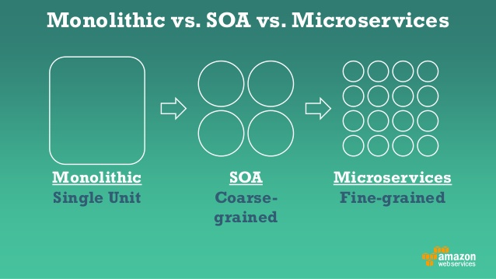

Slide 5
The scaling cube

Slide 6
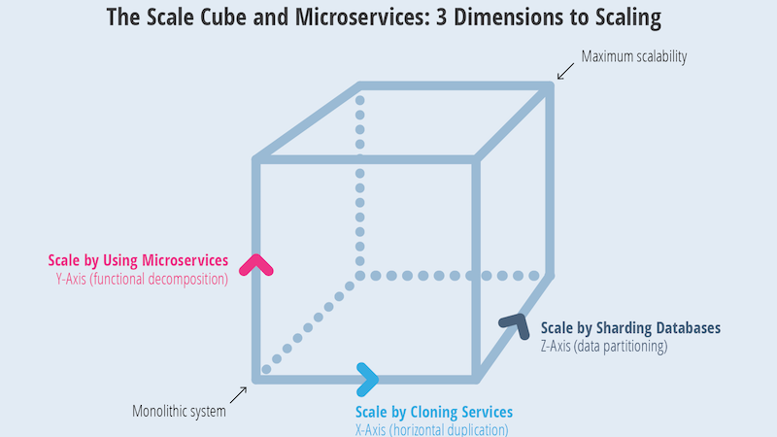
Notes:
Moving a 3-tier architecture to micros need to go through a scaling cube
Y-axis: Breaking apart
X-axis: Scaling horizontally
Z-axis: Shard our data

Slide 7
The power of simplicity: Gall’s Law

Slide 8
A complex system that works is invariably found to have evolved from a simple system that worked.

Slide 9
A complex system designed from scratch never works and cannot be patched up to make it work.

Slide 10
You have to start over with a working simple system.

Slide 11
A container journey start with this:

Slide 12
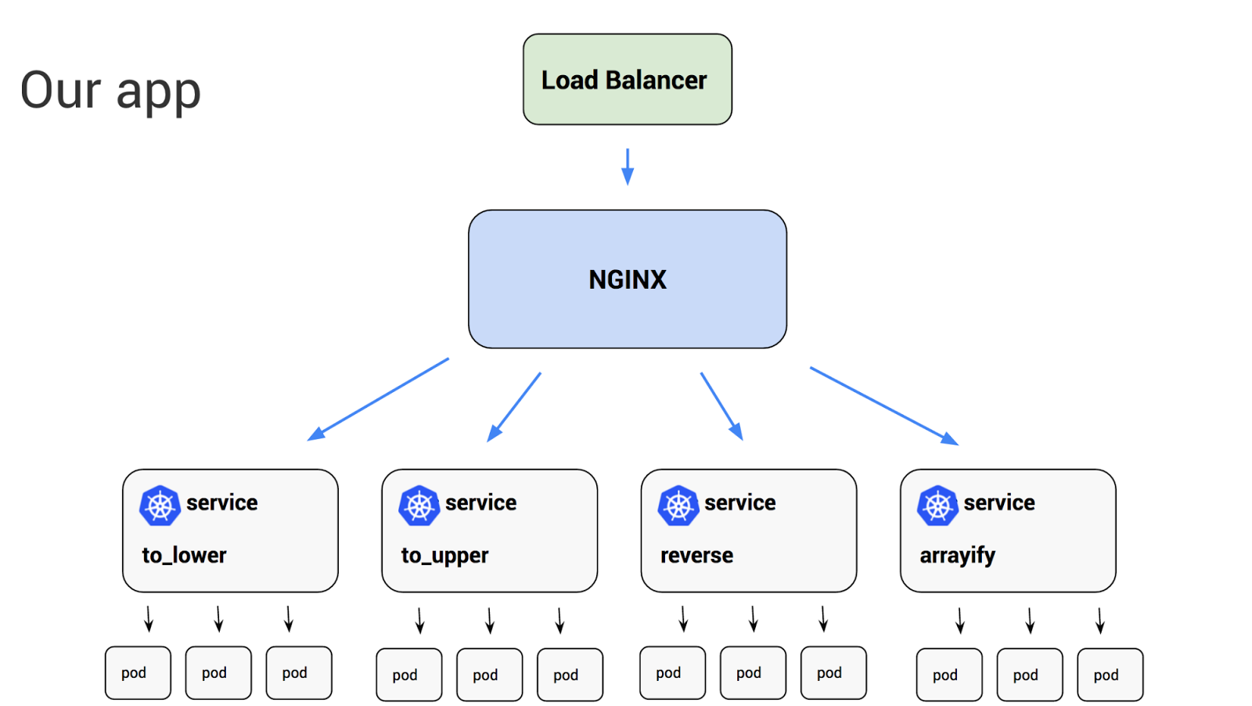

Slide 13
…to achieve this:

Slide 14
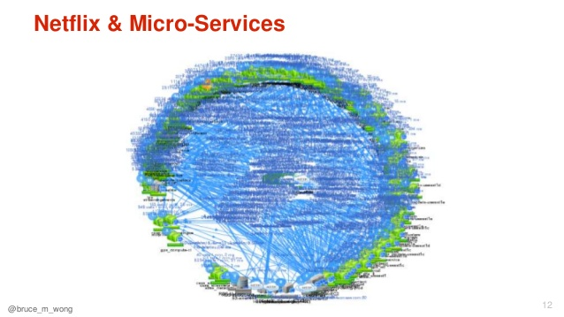

Slide 15
Docker project
DotCloud (~2008) later became Docker
Namespaces providing a layer of isolation
Container Images
lightweight, standalone executable package
Code, runtime, libraries, environment variables, config files
Containers
Runtime instance of a container image
Isolated from the host
Can only access host files and ports

Slide 16
Containers vs Virtual Machines

Slide 17
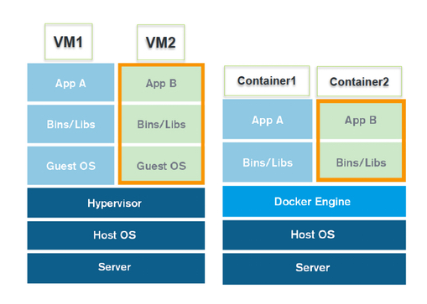

Slide 18
Container Orchestration e.g. Docker Swarm, Kubernetes, Marathon…

Slide 19
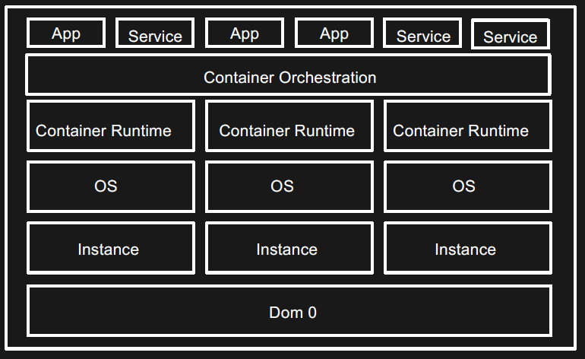
Notes:
3 layers:
Service Management
Scheduling
Resources Management

Slide 20
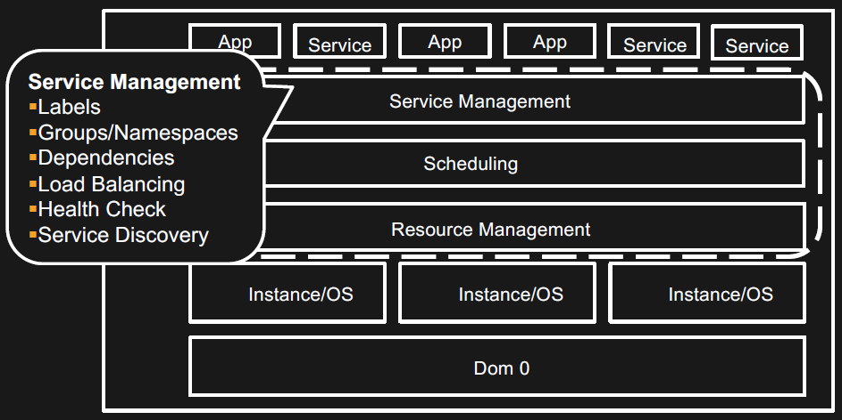

Slide 21
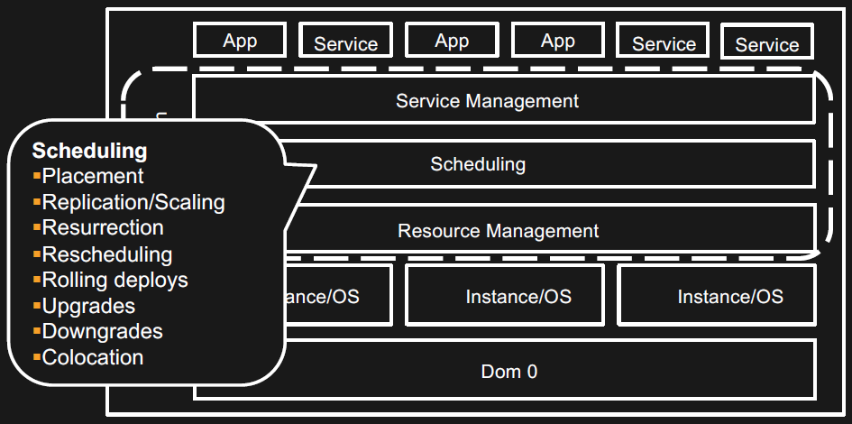

Slide 22
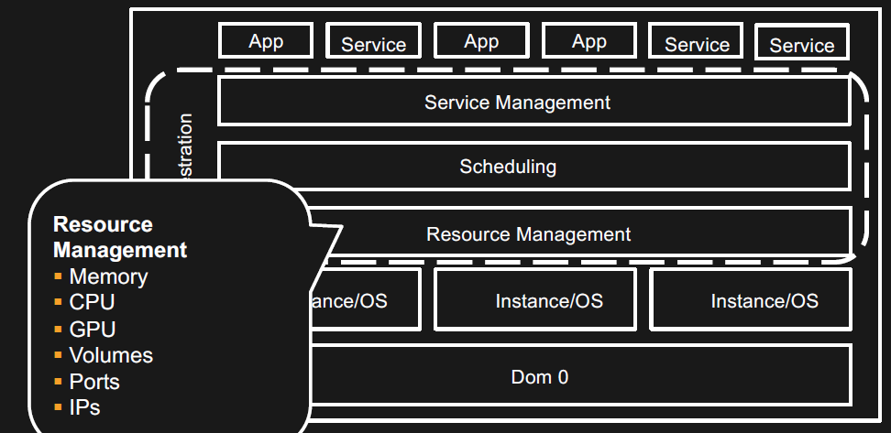

Slide 23
Microservices does not mean containers

Slide 24
But doing containers “right” often lead to running micros

Slide 25
Demo

Slide 26
Search for images docker search nginx docker search postgres
Notes:
At the top the official image In the list, modified images published by others Detailed can be found on Docker Hub : https://hub.docker.com/

Slide 27
Pull images from Docker hub docker pull nginx:latest docker pull nginx:alpine

Slide 28
List local images docker images

Slide 29
Run an image locally docker run --name my-nginx-instance -p 80:80 -d nginx:latest docker run --name my-nginx-instance -p 80:80 -d nginx:alpine
Notes:
I don't need to pull an image first / if I attempt to run a container for which there is no image locally, it will pull the image from Docker Hub
-p80:80?
-d?
http://localhost:80

Slide 30
View running containers docker ps

Slide 31
Stop a container docker stop <container id>

Slide 32
View stopped containers docker ps -a
Notes:
docker ps doesn't display containers that are stopped

Slide 33
Start a stopped containers docker start <container id>

Slide 34
Connect to a running container docker exec -ti <container id> bash
Notes:
Notice that the root of the terminal window changes
Tip: bash needs to be in the PATH of the container - otherwise, needs to call /bin/bash
Some container shell are different from bash
eg. Alpine container is /bin/sh

Slide 35
Modify a running image
Notes:
Modify an image e.g. Modify NGINX default html page
Problem: no vi or vim or nano
Solution: install vim!
Problem: apt-get install vim does not work
Solution: run apt-get update first
Edit the file! Which file? Let's figure out the default HTML file for the official nginx image
vim /etc/nginx/conf.d/default.conf
location / {
root /usr/share/nginx/html;
index index.html index.htm;
}
vim /usr/share/nginx/html/index.html

Slide 36
Start a new instance on another port docker run --name nginx-instance-p81 -p 81:80 –d nginx:latest
Notes:
docker ps
http://localhost:81
Problem: my changes are not reflected in the new instance of the container
Solution: commit changes to a new image!

Slide 37
Commit changes to an image docker commit <container id> <image name>:<tag>
Notes:
docker commit <container id> nginx-demo:v1
Notice the v1 - I am keeping 'latest' intact and creating a new image with tag "v1"
Tag can be anything (foo, bar) eg. nginx:foo, nginx:bar, nginx:v1

Slide 38
Run my new image docker run --name docker-nginx-p82 -p 82:80 -d nginx-demo:v1
Notes:
docker run --name docker-nginx-on-port-82 -p 82:80 -d nginx-demo:v1
http://localhost:82
Changes are now reflected in my new container

Slide 39
Build an image using Dockerfile docker build -t <image name>:<tag> .
Notes:
cd C:\Users\tekni\Documents\GitHub\container-demo\sources\
example of a Dockerfile
explanation
building the container
docker images
docker build -t nginx-demo:v2 . <- now it's v2
docker images
run my new image
docker run --name my-nginx-instance-from-dockerfile -p 83:80 -d nginx-demo:v2

Slide 40
Run a container remotely (in production?!)
Notes:
I've run my container locally and tested that my code works. Now what?
Problem: my new image is only available locally and I don't want to have to re-build all images with my changes everything again remotely
Solution 1: I can commit my Dockerfile or docker-compose.yml to Git (Stash/BitBucket) and build the container on my new host - not ideal
Solution 2: Let's make it available via my private registry and try to run it on a Docker cluster (in AWS for example :-) ) - preferred

Slide 41
Connect to my private container registry aws ecr get-login --no-include-email --region eu-west-1 docker login –U AWS –p <..> https://<registry_url>
Notes:
Demo my private registry 'nginx-demo' using ECR
Demo: Create a new registry for nginx-demo-new
Demo: push container image to new registry
Connect to my registry:
Invoke-Expression -Command (aws ecr get-login --no-include-email --region eu-west-1)
In reality, I am running this command:
docker login -u AWS –p <hashed password> https://996389529590.dkr.ecr.eu-west-1.amazonaws.com

Slide 42
Tag my image docker tag <image name>:<tag> <aws account id>.dkr.ecr.<region>.amazonaws.com/<ecr repository name>:<tag>
Notes:
docker tag nginx-demo:v2 996389529590.dkr.ecr.eu-west-1.amazonaws.com/nginx-demo-new:v2

Slide 43
Push my image docker push <aws account id>.dkr.ecr.<region>.amazonaws.com/<ecr repository name>:<tag>
Notes:
docker push 996389529590.dkr.ecr.eu-west-1.amazonaws.com/nginx-demo-new:v2
Now my image is available from everywhere where I can log in to my private registry

Slide 44
Run my container on an ECS cluster
Notes:
Run container on a cluster with node name as variable displayed on the HTML page
Demo: run containers on ECS
Login:
docker login ...
docker pull 996389529590.dkr.ecr.eu-west-1.amazonaws.com/nginx-demo-new:v2
docker run --name docker-nginx-on-my-ecs-cluster -p 8080:80 -d 996389529590.dkr.ecr.eu-west-1.amazonaws.com/nginx-demo-new:v2
If I run docker run --name docker-nginx-on-my-ecs-cluster -p 8080:80 -d nginx-demo-new:v2
My image gets pulled from Docker Hub and it will fail because nginx-demo-new:v2 doesn't exist in Docker Hub
Verify that I am running different OS version:
on host: cat /etc/*release
on container: docker exec -ti <container id> bash then cat /etc/*release
Extra: Using tag ‘latest’ for different containers instances when changes are being committed to the same version

Slide 45
Bonus Demo

Slide 46
Use docker-compose to build multiple container images
Notes:
why docker-compose? A service is usually made of multiple components (front-end, app, logic, db that are linked to each other)
docker-compose file
docker-compose images
docker-compose build -> from Dockerfile
docker-compose create -> create container from docker-compose.yml
docker-compose up

Slide 47
Build a voting application based on a Python container, a Node.js container, a .Net container, a Redis container and a PostgreSQL container
Notes:
build a voting application based on Python, Redis, Node.js and PostgreSQL using docker-compose
https://github.com/dockersamples/example-voting-app
git clone git@github.com:dockersamples/example-voting-app.git
docker-compose up
Connect to <URL> and vote if you prefer cats or dogs!

Slide 48
Tips

Slide 49
Keep container images light
Notes:
Big containers take time to instantiate

Slide 50
Keep it simple: do one thing and do it well
Notes:
The more it does, the bigger it gets and the more complicated it gets to troubleshoot
It is likely that the more it does, the more people needs to get involved
If the service fails, more than one function fails

Slide 51
Keep it manageable by a single small team: “two-pizza team”
Notes:
The importance of tagging your container with the latest version
when using Kubernetes, Swarm, Mesos, Marathon etc.
if containers dies or autoscale, it will put the version that is configured
if always using latest, risk of having different version running on different containers

Slide 52
Tag your container images with a version
Notes:
when using Kubernetes, Swarm, Mesos, Marathon etc.
if containers dies or autoscale, it will put the version that is configured
if always using latest, risk of having different version running on different containers

Slide 53
Success criteria

Slide 54
Use DevOps

Slide 55
Set standards early

Slide 56
Log everything

Slide 57
Follow ITIL Automated deployments as standard change

Slide 58
Follow ITIL Changes to the pipeline as a normal change

Slide 59
Latest news

Slide 60
Docker is part of a wider community “The Moby Project”

Slide 61
Docker now support Kubernetes

Slide 62
Q&A

Slide 63
THANK YOU!

