Slide 1

R for data science
Tek Raj Chhetri
http://tekrajchhetri.com

Slide 2
Acknowledgements
Beginning R: The Statistical Programming Language by Wrox publisher
Advanced R Statistical Programming and Data Models Analysis, Machine Learning, and Visualization by Matt Wiley and Joshua F. Wiley
Modern R Programming Cookbook by Jaynal Abedin, Packt Publishing
Learning R Programming by Kun Ren, Packt Publishing

Slide 3
Recap
Setting up environment.
How to get help?
Installing packages.
Data structures in R
Matrix
Vectors
Data frame

Slide 4
Outline
Lists
Exercise
Array
Introduction to functions
Basic expressions (assignment, conditional expressions)

Slide 5
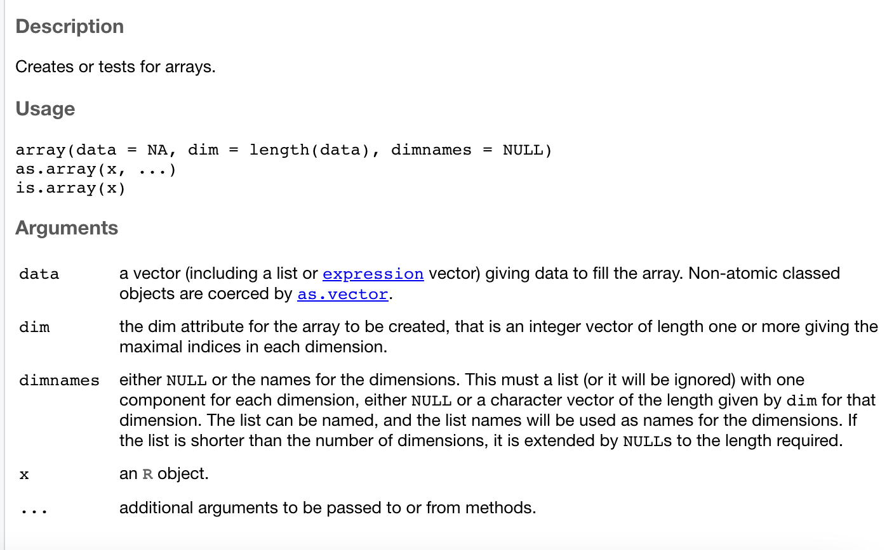
Array
A homogenous data structure.
Array can have more than two dimensional structure unlike matrix.
Array in R

Slide 6
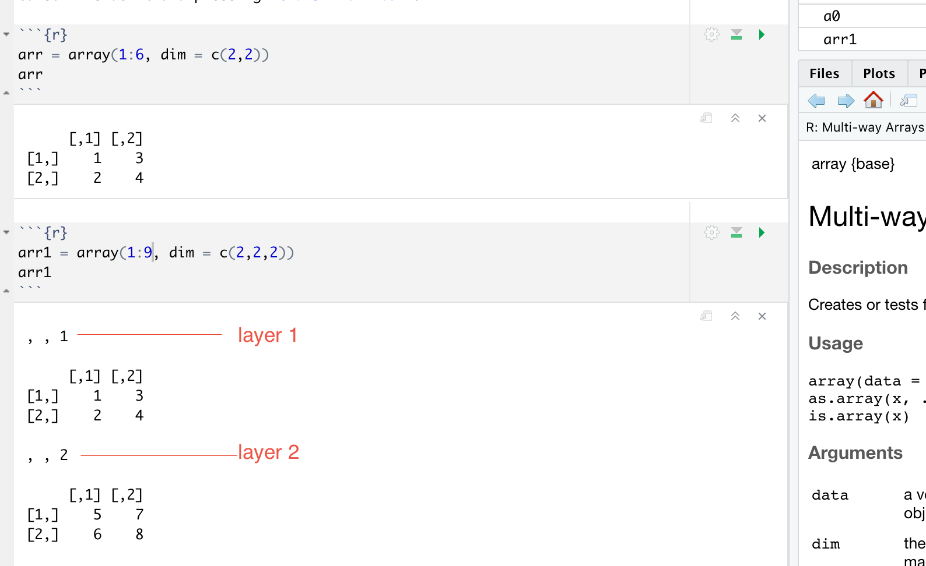
Array
Example array creation

Slide 7
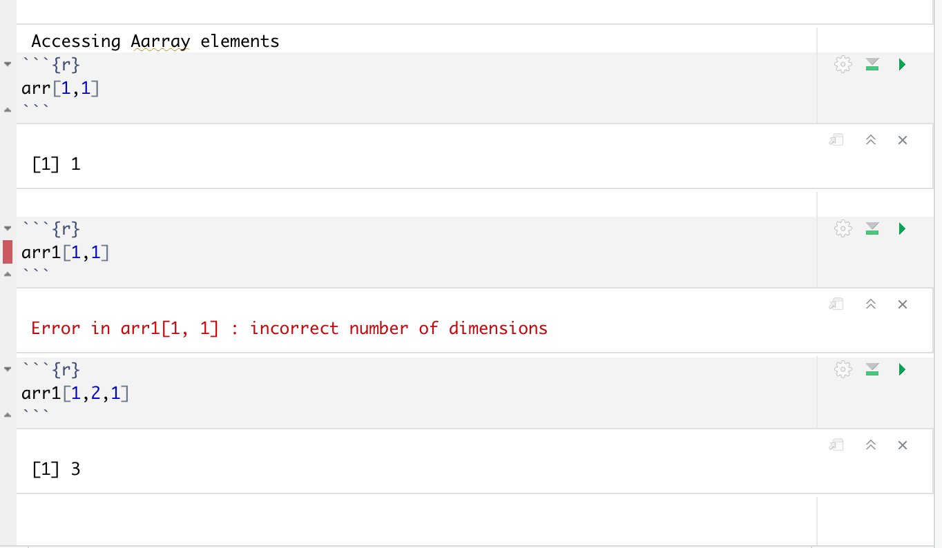
Array
Accessing array elements
array[row, column, dimension]

Slide 8
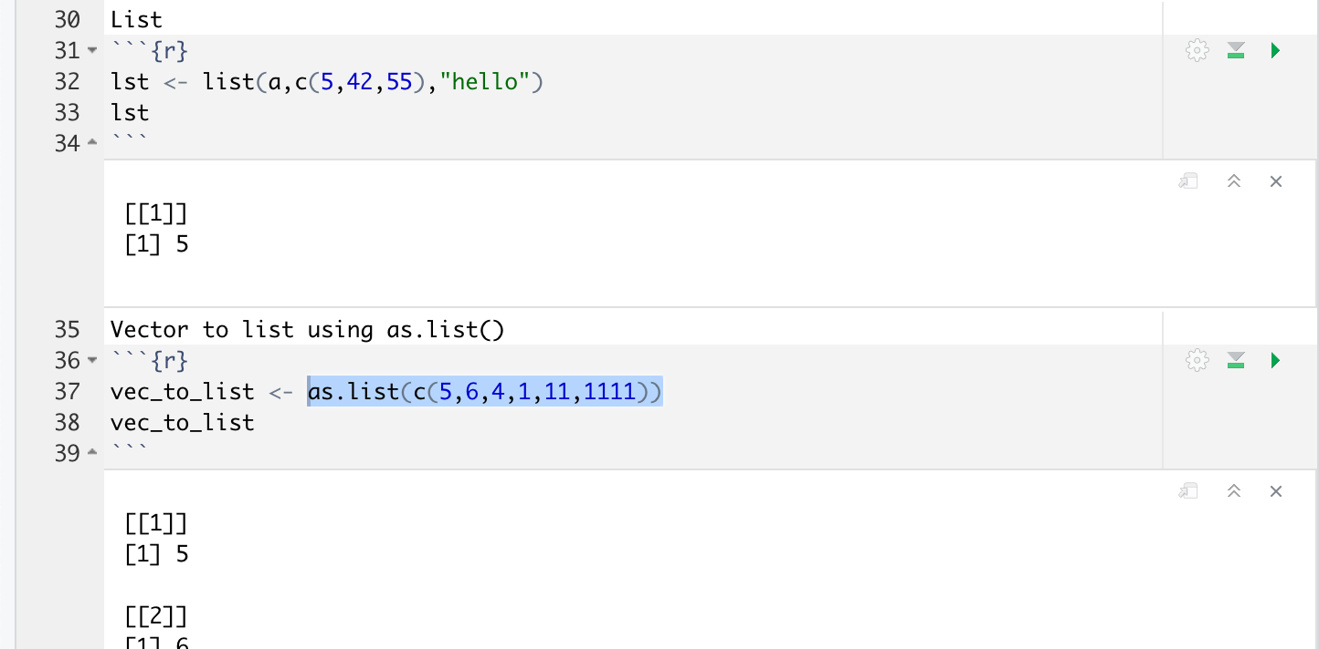
Lists
Heterogenous data structure, can have different types of objects, even other lists
Flexible.
Use list() to create list or as.list() to convert vector
list(a,c(5,42,55),"hello")
as.list(c(5,6,4,1,11,1111))

Slide 9
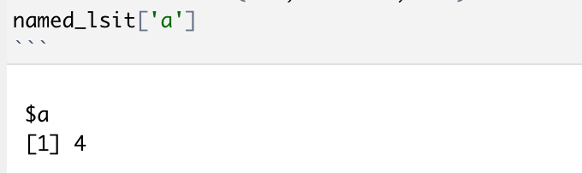
Lists
You can also create a named list, specifying each list elements name.
list(name=value)
Named lists allows easy access of list elements using name.
List indexes are used to access list elements in a non-named list.

Slide 10
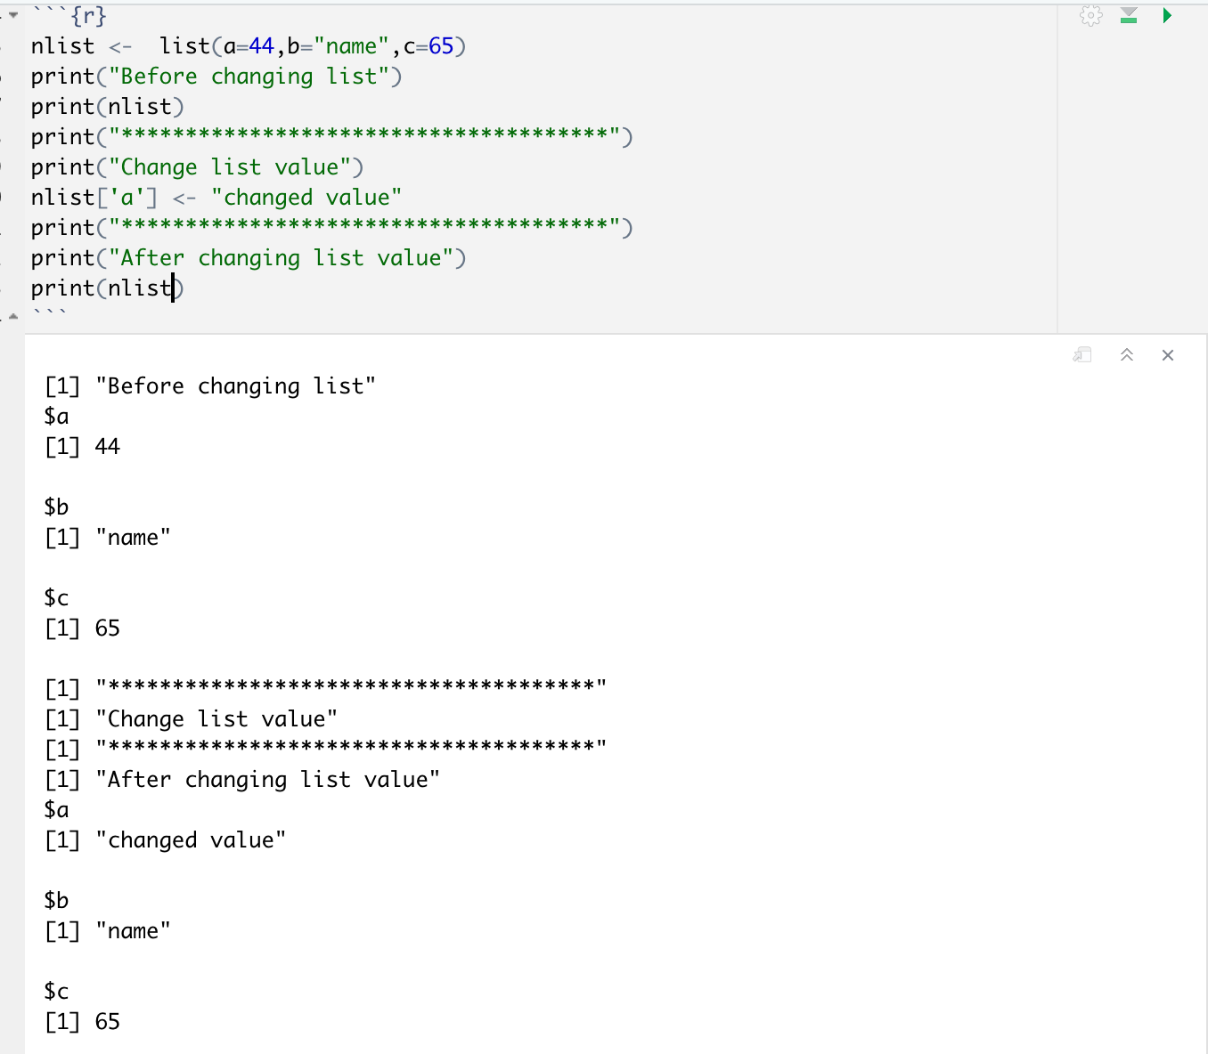
Lists
Manipulating lists elements.
list_element = value

Slide 11
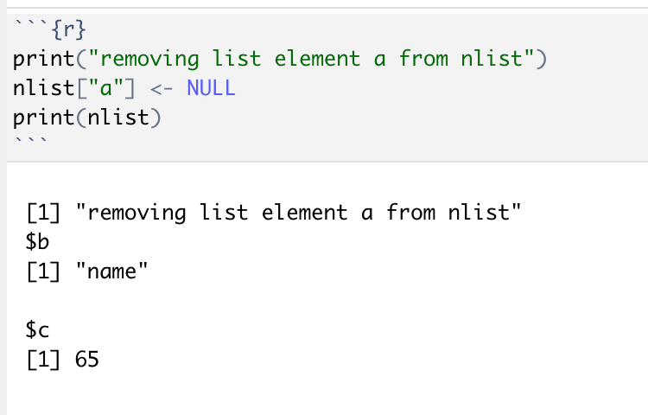
Lists
Manipulating lists elements.
list_element = value
To remove list elements, just assign list elements NULL value.

Slide 12
Lists
To remove multiple list elements at once, assign NULL value to all the elements you want to remove.
toRemoveList[c(”a”,”b”)] <- NULL.
Unlisting list elements
Use to Flatten the list, produces a vector.
For complex list consisting of numbers, text all members will be converted to closest type.

Slide 13
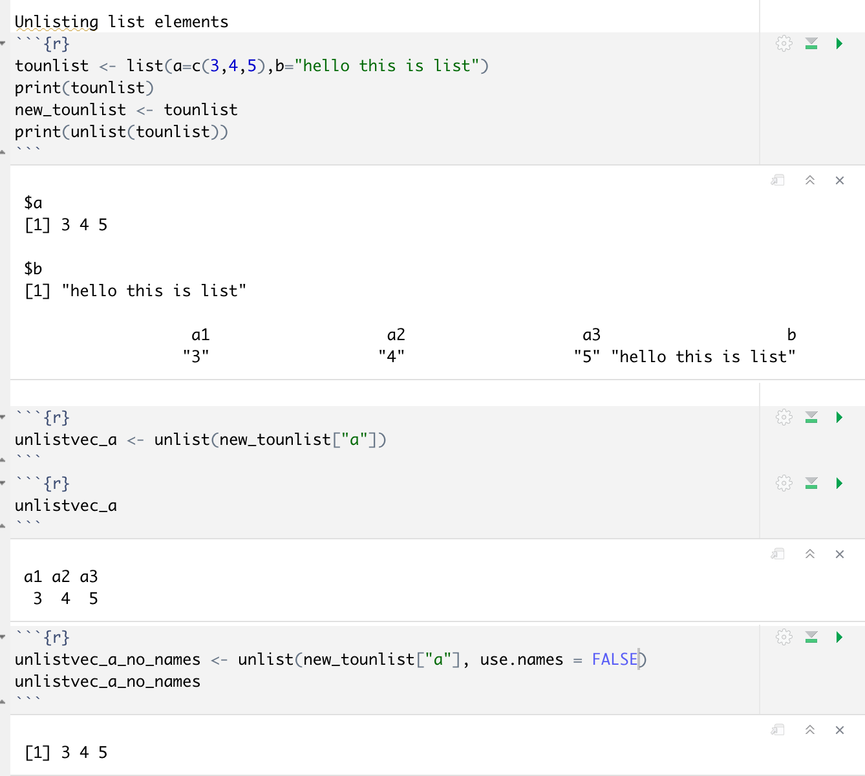
Lists
Set use.names to False to remove indexes and list name.

Slide 14
Introduction to functions
An object you can call (more details and advanced functions as we progress through the course).
Mainly functions are used for code modularity and to increase reusability.
R has many predefined functions, which we are already using such as list(), as.list().
Use is.function(function_name_to_check) to check if R object is function.

Slide 15
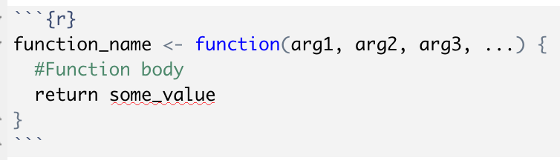
Introduction to functions
Creating user defined function .
Requires function name, the name you will use to call function later.
Requires Function body – where you’ll write code to perform particular task.
Function argument ( or value to take input)
Return value

Slide 16
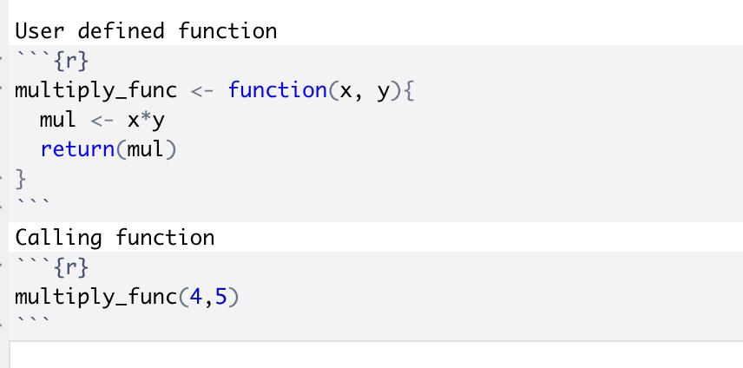
Introduction to functions
User defined function example

Slide 17
Basic expressions (assignment, conditional expressions)
Assignment <- or =. Suggested to use <- as per coding convention.
Conditional expressions are used to test conditions based on the given use case scenario.
Example, If x=4 is even?
Some of the conditional expressions are if statement, if-else statement, switch statement.

Slide 18
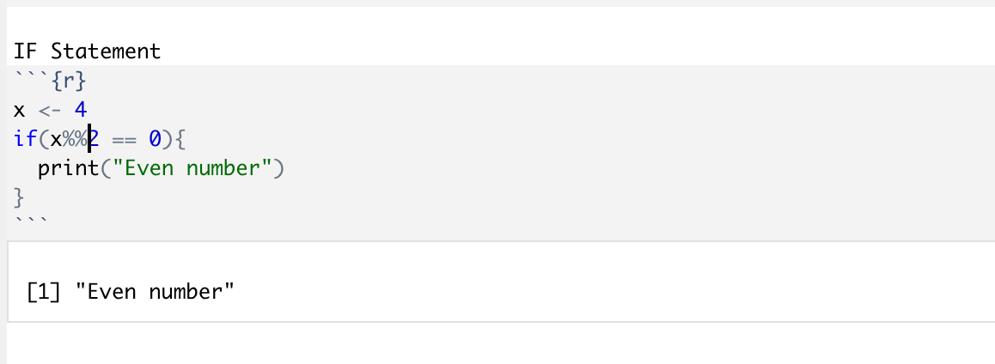
Basic expressions (assignment, conditional expressions)
If Statement.
Syntax:
if (condition){expression}
Execute expression only if the condition evaluates to true.

Slide 19
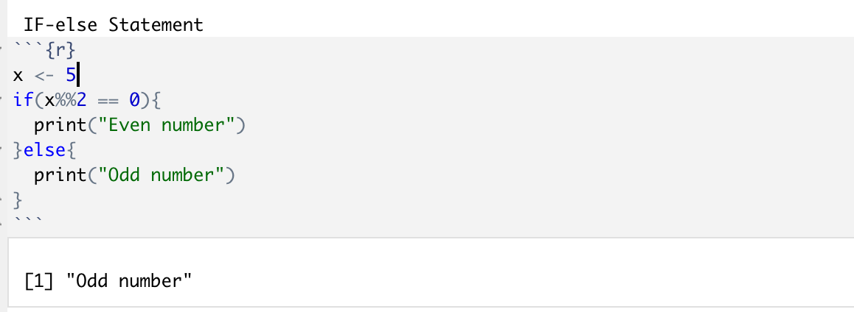
Basic expressions (assignment, conditional expressions)
If-else Statement.
Syntax:
if (condition_true){ expression }else{expression}

Slide 20
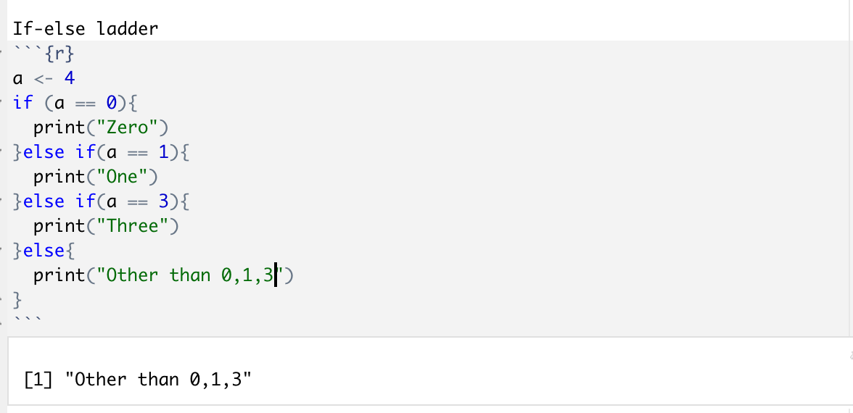
Basic expressions (assignment, conditional expressions)
If-else ladder.
Syntax:
if (condition_1){ expression }else if (condition_2){ expression } . . else{expression}

Slide 21
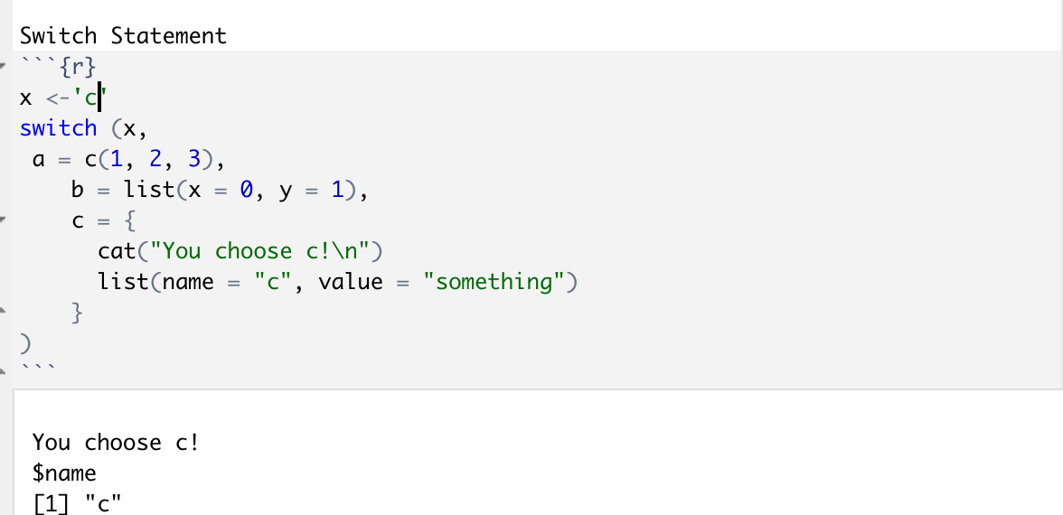
Basic expressions (assignment, conditional expressions)
Switch Statement.
Switch works with a number or a string and chooses a branch to return according to the input, unlike if which works with TRUE or FALSE i.e. boolean.
Syntax:
switch (object, case1 = action1 . . caseN = actionN )

Slide 22
Exercise
Write a simple calculator program that performs the following operation.
Addition
Subtraction
Multiplication
Division
Modular division
Convert the simple calculator program to functions.

Slide 23



Thank you for
your attention!
www.tekrajchhetri.com
@TekRaj_14
@tekrajchhetri

