Slide 1
Assembly Language for Intel-Based Computers
Module 1
Basic Concepts
Slides prepared by Kip Irvine
Modified and supplemented by Clare Nguyen

Slide 2
What's Next
Welcome to Assembly Programming
Data representation in assembly programming
Logic or boolean operations
2

Slide 3
Overview: Basic Concepts
(Read Chapter 1: all sections)
Assembly programming is closer to the hardware than high level language programming.
Therefore, before we actually write programs in assembly, it is necessary that we gain some background knowledge on:
Where assembly language fits in the virtual machine concept
How data are represented and organized in memory
Logic or boolean operations

Slide 4
Welcome to Assembly Language (1 of 2)
Why am I learning Assembly Language?
Closest language to the native machine language, resulting in efficient, compact code.
Provides direct access to the hardware: helps in learning computer architecture.
Helps in understanding how high level languages work.
What background should I have?
Minimum: intermediate level programming experience, preferably in C, C++, Java
Understanding of: if statements, loops, arrays, indirect addressing such as pointers or references, and functions or methods.
What tools do I need to write Assembly Language programs?
Text editor: to write the assembly program
Assembler: translate Assembly Language to machine language
Linker: combine individual object files together into an executable

Slide 5
Welcome to Assembly Language (2 of 2)
What hardware/software do I need?
A computer with x86 based processor and running Windows
The IDE Microsoft Visual Studio 2017 The IDE comes with a text editor, linker, and debugger.
MASM, or Microsoft Assembler, which comes with the Microsoft IDE.
Instructions to download and install the IDE are part of assignment 1.
What types of programs will I create?
- 32-bit protected mode assembly programs

Slide 6
Assembly Language Applications
The majority of modern applications are written in a high level language and not in assembly.
Typically, assembly is used when there are speed and / or memory constraints, or when there is no compiler available for a particular processor.
Some typical applications of assembly language:
Embedded systems: mobile phones, car ignition systems, video cards, printers, etc. Embedded applications need to be compact.
Hardware device drivers for hardware monitoring, precise timing, etc. Device drivers need to communicate directly with the hardware, and most high level languages have restrictions that do not allow direct access to hardware.
Business applications on multiple platforms for bit-wise manipulation, data encryption, etc. Bit-wise applications can be written more efficiently with assembly than with some high level language.
Computer game consoles: taking advantage of hardware features, hand optimizing for speed. Game applications are typically written in a high level, object oriented language, but the code can drop down to assembly for certain modules where speed is important or to take advantage of specific features of the hardware.
6

Slide 7
What is Assembly Language (1 of 2)
When the high level language (HLL) program is compiled, the compiler produces object code, which is in machine language.
Machine language is a series of instructions that are made of 0’s and 1’s. It is difficult for humans to ‘read’ machine language.
- Example of a machine language instruction:
1011 0100 0011 1111
Assembly language is a human readable form of machine language.
Assembly language is made of mnemonics (short meaningful words) that translates directly to machine language.
- In assembly language, the machine language instruction above is: mov ah, 3fh
- The mnemonic mov tells the programmer that the instruction will cause the CPU to move the value 3fh into the register AH.
The use of mnemonics makes assembly language much easier to ‘read’ than the 1’s and 0’s of machine language.
But there is still a one-to-one correspondence between each machine language instruction and the assembly language instruction.

Slide 8
What is Assembly Language (2 of 2)
Since assembly language is a human readable form of machine language, this means that the programs we write in this class are equivalent to the object code that the compiler would produce.
In fact, later in the quarter, we will look at the assembly code that the compiler produces and compare it to the assembly code that we write.

Slide 9
Assembly vs. High Level Language
Each high level language (HLL) statement is translated by the compiler into one or more machine language instructions.
Therefore, a HLL statement is equivalent to one or more assembly language instructions.
Depending on how the compiler is optimized, the same HLL statement can translate to a different number of assembly language instructions.
English: Display the sum of A times B plus C
C++: cout << (A * B + C);
Assembly Language for MASM:
mov eax,A
mul B
add eax,C
call WriteInt
Intel Machine Language (in hexadecimal):
A1 00000000
F7 25 00000004
03 05 00000008
E8 00500000
9

Slide 10
Is Assembly Language Portable ?
Assembly language is not portable.
Each type of processor (CPU) works with a set of instructions that are specifically created for it, and other type of processors will not be able to work with these instructions.
This set of instructions make up the machine language – and therefore the assembly language – of the processor.
For this class, we use the Intel instruction set, so only CPUs that work with the Intel instruction set will be able to run our assembly programs. Fortunately for us, most desktop and laptop systems currently have CPUs that run the Intel instruction sets.
In addition, each assembler has its own set of directives that helps the programmer write shorter assembly language programs. These directives are written for a specific assembler.
Therefore an assembly language program written for the MASM assembler (used in this class) cannot be assembled and run with a different assembler (TASM or NASM, for example).
10

Slide 11
What's Next
Welcome to Assembly Language
Dataa representation in assembly programming
Logic or boolean operations
11

Slide 12
Data Representation Overview
Numbering format
Humans typically work with data in decimal format (base 10).
Data on computers are stored as 1’s and 0’s, also known as binary format (base 2).
Therefore assembly programmers often need to convert from binary to decimal, and vice versa.
However, binary data are cumbersome to work with when the data is large, so a shorter format to represent binary data is hexadecimal (base 16).
For example, the binary value 1010000111001000 has many digits and is cumbersome, but the same data value is A1C8 in hexadecimal, much shorter and easier to work with.
Therefore assembly programmers also often need to convert between decimal and hexadecimal, and binary and hexadecimal.
Basic data types
A basic type of numeric data is an unsigned integer, a positive whole number.
Another basic type of numeric data is the signed integer, a whole number that can be positive or negative
Characters are stored as unsigned integers.
For this class we work with integer data types only. Floating point data are covered in the Advanced Assembly course.

Slide 13
Binary Numbers
Data on computers are in binary or base 2 format.
A binary number is made up of multiple digits.
The binary digits have the value 1 or 0, and are called bits:
1 is interpreted as true or on
0 is interpreted as false or off
Typically a binary number used by the computer is an 8-bit, 16-bit, 32-bit, or 64-bit number.
MSB = most significant bit, the left most bit of a binary number.
LSB = least significant bit, the right most bit of a binary number.
Because a binary number typically have multiple bits, each bit is numbered for ease of identification.
Bits are numbered starting with the LSB = 0, and counting up to the MSB.
Bit numbering for a 16 bit number:
MSB is bit 15, LSB is bit 0, counting up from right to left

Slide 14
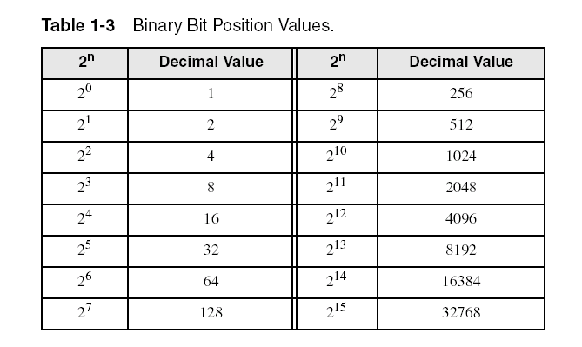
Binary Numbers
Each digit (bit) in a binary number has a specific value.
The value of each bit is a power of 2, and depends on the bit’s location in the number.
Therefore every binary number is a sum of powers of 2.
Here is the value of each bit in an 8-bit number.

Slide 15
Converting Unsigned Binary to Decimal
Recall that an unsigned number is a number that is 0 or positive (no negative)
To convert binary to unsigned decimal
dec = (D_{n-1} × 2^{n-1}) + (D_{n-2} × 2^{n-2}) + ... + (D₁ × 2¹) + (D₀ × 2⁰)
D = binary digit, value 1 or 0
n = the bit number
Example:
- binary 0 0 0 0 1 0 0 1 = decimal 9
(0 x 2⁷) + (0 x 2⁶) + (0 x 2⁵) + (0 x 2⁴) + (1 × 2³) + (0 x 2²) + (0 x 2¹) + (1 × 2⁰) = 9
- binary 1 0 1 1 0 0 1 1 = decimal 179
(1 x 2⁷) + (0 x 2⁶) + (1 x 2⁵) + (1 x 2⁴) + (0 × 2³) + (0 x 2²) + (1 x 2¹) + (1 × 2⁰) = 179

Slide 16
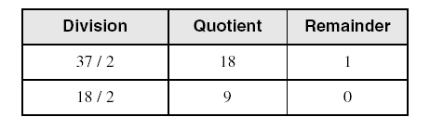
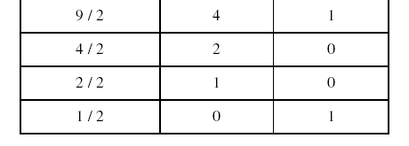
Converting Unsigned Decimal to Binary
Repeatedly divide the decimal integer by 2.
Each remainder is a binary digit in the translated value, in order from LSB to MSB.
For example, to convert decimal 37 to binary:
LSB
MSB
Decimal 37 = binary 100101

Slide 17
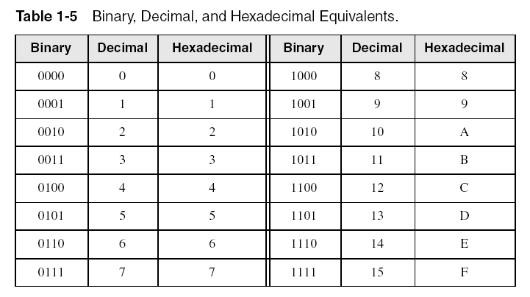
Hexadecimal Numbers
Binary values can be cumbersome: it takes many bits to represent a value.
A shorter representation of binary is hexadecimal, or base 16.
Every 4 digits of a binary number is grouped into 1 hexadecimal digit.
The smallest 4-digit binary value is 0000 = 0 hexadecimal
The largest 4-digit binary value is 1111 = F hexadecimal
The following table shows all the combinations of 4-digit binary values and their decimal and hexadecimal equivalence.

Slide 18

Converting Binary to Hexadecimal
Each hexadecimal digit corresponds to 4 binary bits.
To convert from binary to hexadecimal, group 4 bits together into a hexadecimal equivalence, starting from the LSB and working toward the MSB.
Example: To convert the binary value 000101101010011110010100 to hexadecimal:
Binary 000101101010011110010100 = Hexadecimal 16A794

Slide 19
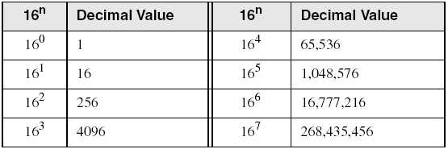
Converting Hexadecimal to Unsigned Decimal
Multiply each hexadecimal digit by its corresponding power of 16:
dec = (D_{n-1} × 16^{n-1}) + (D_{n-2} × 16^{n-2}) + ... + (D₁ × 16¹) + (D₀ × 16⁰)
D = hexadecimal (or hex) digit
n = digit number, numbering starts at 0 for the right most digit
Example:
Hex 1234 = (1 × 16³) + (2 × 16²) + (3 × 16¹) + (4 × 16⁰) = decimal 4660
Hex 3BA4 = (3 × 16³) + (11 × 16²) + (10 × 16¹) + (4 × 16⁰) = decimal 15268
The following table shows the decimal value of the powers of 16:

Slide 20
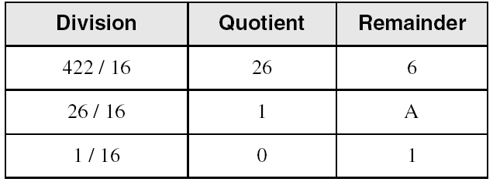
Converting Unsigned Decimal to Hexadecimal
Repeatedly divide the decimal integer by 16.
Each remainder is a hexadecimal digit in the translated value, in order from LSB to MSB.
LSB
MSB
decimal 422 = 1A6 hexadecimal

Slide 21
Basic Operations with Binary and Hexadecimal
Memory addresses and data values that are shown by the debugger are in hexadecimal. So it is important to know how to add and subtract in these bases so we can debug our programs
Adding binary numbers
Adding hexadecimal numbers
Subtracting hexadecimal numbers
Calculating 2’s complement
Subtracting binary numbers

Slide 22
Binary Addition
Basic addition of binary values:
0 + 0 = 0
0 + 1 = 1
1 + 1 = 0 carry 1
Starting with the LSB, add each corresponding pair of digits, include the carry if present.
Another example: binary decimal
0 0 1 0 1 0 0 0 40
+ 0 0 1 1 1 1 0 0 + 60
0 1 1 0 0 1 0 0 100

Slide 23
Hexadecimal Addition
As with any addition, add corresponding digits from right to left.
If the sum of the digits is 15 (F) or less, there is no carry so the sum is the result.
If the sum is greater than 15, divide the sum by 16. The quotient becomes the carry value, and the remainder is the result.
Examples:
1
1
36 28 28 6A
+ 42 + 45 + 58 + 4B
78 6D 80 B5
21 / 16 = 1, rem 5
This is an important skill: Programmers frequently add and subtract the addresses of variables and instructions, and addresses are always shown in hexadecimal

Slide 24
Hexadecimal Subtraction
Just like subtractions in other bases, subtract from right to left.
When a borrow is required from the digit to the left, add 16 (decimal) to the current digit's value.
16 + 5 = 21, 21 – 7 = 14 = E hexadecimal
−1
C6 75
- A2 - 47
24 2E

Slide 25
Signed Numbers
Recall that signed numbers are numbers that can be positive or negative.
In base 10, decimal numbers have:
+ sign or no sign to indicate positive value
– sign to indicate negative value
In base 2 (and its shorter form, base 16), there is no +/- sign to indicate positive or negative.
A binary or hexadecimal number is interpreted as positive or negative based on context only.
If we write a program that deals with positive numbers only, then all binary or hexadecimal values are considered unsigned.
If we write a program that can have negative numbers, we must interpret the data to be signed data.
In other words, it is up to the programmer to decide whether a particular data value is a signed value or an unsigned value.
For this module, you will be told whether a value is signed or unsigned when you need to evaluate it. For the later modules, it will be up to you to interpret a data value as signed or unsigned based on how it is used in the code.

Slide 26
Signed Binary Integers (1 of 2)
Recall that for an unsigned integer, the MSB is a part of the data value.
For signed integer, the MSB is not part of the data value, instead it is
used as a sign. An MSB of:
1 = negative
0 = positive
This means every signed integer has one less bit for data representation
than its counterpart unsigned integer.
An 8-bit unsigned integer has 8 bits for data
An 8-bit signed integer has 7 bits of data and 1 bit for the sign
For signed hexadecimal values, if the MSB > 7, the value is negative
Examples: 8A, C5, A2, 9D are all negative values if they are signed
integers.
26

Slide 27
Signed Binary Integers (2 of 2)
For signed binary integers, half of the possible binary values are designated for positive numbers, and the other half for negative numbers.
Example: for a 3-bit signed binary integer
Binary Signed Decimal Unsigned Decimal
011 3 3
010 2 2
001 1 1
000 0 0
111 -1 7
110 -2 6
101 -3 5
100 -4 4
Other than counting down from 111, how do we easily calculate the binary format of a negative decimal value? We used the 2’s complement method.
Note the MSB = 1

Slide 28
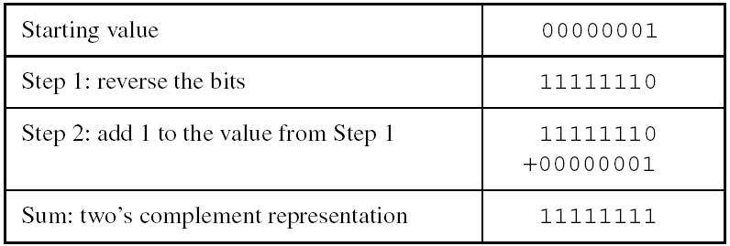
The Two's Complement
Negate a binary number by using two's complement.
Two’s complement gives the additive inverse, or the negation, of a positive number.
The following steps show how to form the 2’s complement of an 8-bit binary number:
Note that the starting value is 0000 0001, or decimal 1.
The resulting 2’s complement is 1111 1111, or decimal -1.
Checking our work: 0000 0001 + 1111 1111 = 0000 0000
or in decimal: 1 + (-1) = 0

Slide 29
Convert Signed Binary Integers to Decimal
Find the absolute value of the signed binary integer. This means that if the signed binary integer is negative, use the 2’s complement to get its absolute value.
With the absolute value, use the same method as the conversion from unsigned binary integer to decimal.
If the original binary integer is negative, add a negative sign to the converted decimal value to get the negative decimal result.
Example 1: binary 1011 0011 = decimal -77
1. Find absolute value: 1 0 1 1 0 0 1 1 → 0 1 0 0 1 1 0 1
Convert: (0 x 2⁷) + (1 x 2⁶) + (0 x 2⁵) + (0 x 2⁴) + (1 × 2³) +
(1 x 2²) + (0 x 2¹) + (1 × 2⁰) = 77
3. Add negative sign: 77 → -77
Example 2: binary 0011 0011 = decimal 51
1. No need to find absolute value since it’s a positive number
Convert: (0 x 2⁷) + (0 x 2⁶) + (1 x 2⁵) + (1 x 2⁴) + (0 × 2³) +
(0 x 2²) + (1 x 2¹) + (1 × 2⁰) = 51
3. No need to add negative sign since it’s a positive number

Slide 30
Convert Decimal to Signed Integers
Find the absolute value of the signed decimal integer.
With the absolute value, use the same method as the conversion from unsigned decimal integer to binary.
If the original decimal integer is negative, use the 2’s complement to get the negative binary result.
Example 1: decimal 19 = 0001 0011 binary
No need to find absolute value since it’s a positive number.
Convert: 19/2 = 9 R 1, 9/2 = 4 R 1, 4/2 = 2 R 0, 2/2 = 1 R 0, 1/2 = 0 R 1
Reading the remainder values in order from LSB to MSB: 0001 0011
No need to use 2’s complement since it’s a positive number.
Example 2: decimal -5 = 1111 1011
Find absolute value: -5 → 5
Convert: 5/2 = 2 R 1, 2/2 = 1 R 0, 1/2 = 0 R 1 → 0000 0101
Use 2’s complement since it’s a negative number: 0000 0101 → 1111 1011

Slide 31
Binary Subtraction
When subtracting A – B, first convert B to its two's complement.
Then add A to (–B)
0 0 0 0 1 1 0 0 0 0 0 0 1 1 0 0
– 0 0 0 0 0 0 1 1 + 1 1 1 1 1 1 0 1
0 0 0 0 1 0 0 1

Slide 32
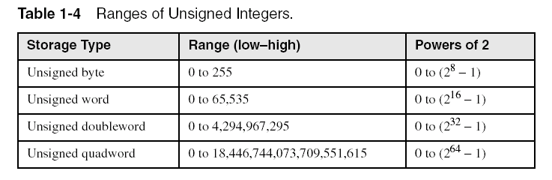
Integer Storage Sizes
Standard sizes (in bits):

Slide 33
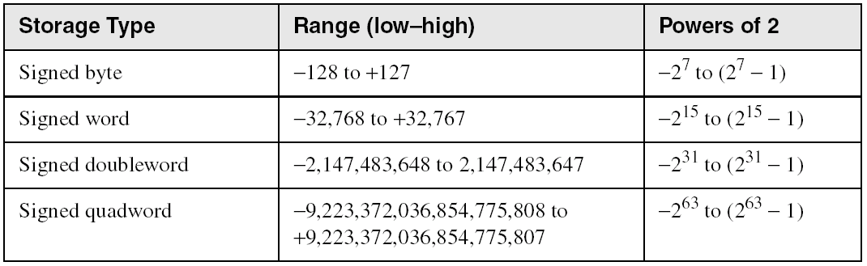
Ranges of Signed Integers
The highest bit is reserved for the sign. This limits the range:

Slide 34
Signed vs. Unsigned Integers
Since data in an assembly program are often shown in binary format (or hexadecimal, if you want a shorter version of the binary number), it is impossible to distinguish between a signed and unsigned integer if you only see the number by itself.
1000 0010 binary = 82 hex = 130 decimal
or
1000 0010 binary = 82 hex = -126 decimal
To determine whether the data value above is 130 decimal or -126 decimal (vastly different values), you need to decide whether it is signed or unsigned. This means you need to know the context in which it is used.

Slide 35
Numeric Data in a Program
Numeric data used by the CPU and stored in memory are always pure binary data (1’s and 0’s).
When entering a numeric data constant in a program, we enter the value as a string of text, which is then converted to pure binary format before it can be stored and used.
For example, the decimal value 65 in the source code is converted into 0100 0001 in memory.
Even if the programmer enters the binary value 101 in the source code, it is still a text string, which is converted to the binary value 101 in memory.
Likewise, when the program runs and the user is asked to enter a data value, the user enters a text string, for example,12 decimal. This text string is then read in and converted into 0000 1100 before any calculation can be performed with it.
35

Slide 36
Character Data in a Program
Recall that characters are stored as unsigned integers.
There are several character sets, listed below are 2 main ones:
- Standard ASCII: values 0 – 127, symbols on a US keyboard.
- Unicode: values 0 – 65535, current standard for modern computer systems, has 3 formats UTF-8, UTF-16, UTF-32 and covers symbols for international languages. (Click on the link for a discussion of how we moved from ASCII to Unicode.)
The character set we use for this class is the standard ASCII set that can be found in an ASCII table.
Using the ASCII table
The integer value of each character can be looked up in the ASCII table.
On the back inside cover of book is the ASCII table.
To look up the integer value of a character symbol:
Locate the symbol in the table.
To get the decimal integer value: Add the outer numbers of the corresponding row and column.
To get the hexadecimal value: Put the inner number of the corresponding column in front of the inner number of the corresponding row.
For example: A is 64 (column) + 1 (row) = 65 decimal
A is 4 (column) and 1 (row) = 41 hexadecimal

Slide 37
What's Next
Welcome to Assembly Programming
Data representation in assembly programming
Logic or boolean operations
37

Slide 38
Boolean Algebra
Based on symbolic logic, designed by George Boole
There are 2 Boolean values
True
False
Boolean expressions are created from the Boolean operators
NOT
AND
OR
XOR (exclusive or)

Slide 39
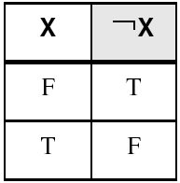
NOT
Accepts 1 input value.
Inverts (reverses) the boolean input value.
Truth table for Boolean NOT operator:
Digital gate diagram for NOT:

Slide 40
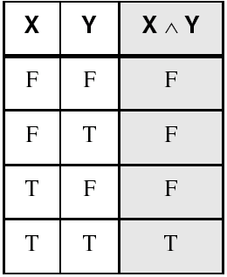
AND
Accepts 2 input values.
Returns True only if both input are True.
Truth table for AND operator:
Digital gate diagram for AND:

Slide 41
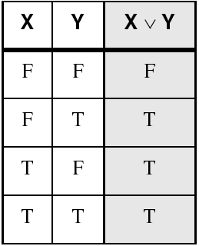
OR
Accepts 2 input values.
Returns False only if both input are False.
Truth table for Boolean OR operator:
Digital gate diagram for OR:

Slide 42
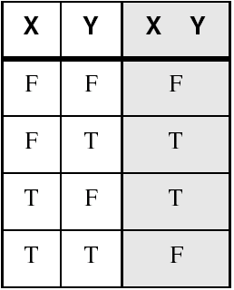


XOR
Accepts 2 input values.
Returns True only if the 2 input are different.
Truth table for Boolean XOR operator:
Digital gate diagram for XOR:
42

Slide 43
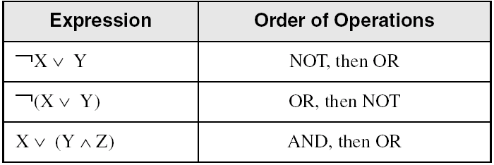
Boolean Operator Precedence
Order of precedence, from highest to lowest:
Parentheses, NOT, AND, XOR, OR
Examples showing the order of operations:

Slide 44
Summary of Key Concepts
Assembly language has a one-to-one instruction correspondence to machine language, and a many-to-one instruction correspondence to high level languages.
Data is always stored as a binary value. In a program, binary values can be written in a more compact form by using hexadecimal, or can be converted to decimal for human ease. Therefore it is important for assembly programmers to know how to convert values among binary, hexadecimal, and decimal formats.
Binary data is accessed in units of specific sizes: byte, word, doubleword, quadword, etc. Given each unit of data, the value can be interpreted as signed or unsigned, depending on how it is used.
For signed data, negating a value means calculating its 2’s complement.
Assembly programmers often need to do adding and subtracting of hexadecimal or binary numbers during debugging.
Boolean expressions are essential to the design of computer hardware and software.

Slide 45
54 68 65 20 45 6E 64
What do these numbers represent?

