Slide 1
Assembly Language for Intel-Based Computers
Module 5
Branching
Slides prepared by Kip Irvine
Modified and supplemented by Clare Nguyen

Slide 2
Overview: Branching
(Read chapter 4: 4.5, chapter 6: 6.1, 6.3 - 6.5)
Instead of running instructions one after another in sequence, branching occurs when execution skips forward or backward to a different part of the code.
HLL if statements and looping statements are built upon the concept of branching.
Concepts covered in this section:
Unconditional Jump
Conditional Processing
Building if and loop constructs
2

Slide 3
What’s next
Unconditional Jump
Conditional Processing
Building if and looping constructs

Slide 4
JMP Instruction
JMP is an unconditional jump to a code label that is usually within the same procedure.
Syntax: JMP target
where target is a code label (address of an instruction).
Logic: EIP ← target
target is loaded into EIP.
since EIP always points to the next instruction, this makes the instruction at the target become the next instruction to be executed.
the jump could be to a target above the current instruction (backward jump), or it could be to a target below the current instruction (forward jump).
Example:
top: dec ebx
.
.
.
jmp top ; go back to “dec ebx” line

Slide 5
LOOP Instruction
The LOOP instruction creates a counter controlled loop.
There is no instruction for event controlled loops (these are implemented with conditional jumps).
Syntax: LOOP target
where target is a code label
LOOP uses ECX as the counter, and the CPU interprets the count as an unsigned integer.
Logic when LOOP is executed:
Step 1: ECX ← ECX – 1
Step 2: if ECX != 0, loop (jump) back to target
LOOP can only jump a distance of 128 bytes. For longer distances than this, use a conditional jump instruction.
Be careful when using LOOP:
Make sure ECX is set to the appropriate count before the loop
Within the loop, don’t change the value of ECX or the loop will not stop at the expected count.

Slide 6
LOOP Example
The following loop calculates the sum of the integers: 5 + 4 + 3 +2 + 1
Offset machine code source code
00000000 66 B8 0000 mov ax,0 ; initialize ax
00000004 B9 00000005 mov ecx,5 ; set counter to 5
00000009 66 03 C1 L1: add ax,cx ; add cx to ax
0000000C E2 FB loop L1 ; loop until cx is 0
0000000E ; ... next instruction
When the instruction LOOP runs, EIP is pointing to 0000000E (address offset of the next instruction). –5 (or FBh) is added to EIP, causing a jump back to location 00000009:
00000009 ← 0000000E + FB

Slide 7
Your turn . . .
If the relative offset is encoded in a single signed byte,
(a) what is the largest possible backward jump?
(b) what is the largest possible forward jump?
−128
+127

Slide 8
Your turn . . .
mov ax,6
mov ecx,4
L1:
inc ax
loop L1
What will be the final value of AX?
10
How many times will the loop execute?
mov ecx,0
X2:
inc ax
loop X2
4,294,967,296 times
(from ffff ffffh back to 0)

Slide 9
Nested Loop
If you need to code a loop within a loop, you must save the outer loop counter's ECX value. In the following example, the outer loop executes 100 times, and the inner loop 20 times.
.data
count DWORD ?
.code
mov ecx,100 ; set outer loop count
L1:
mov count,ecx ; save outer loop count
mov ecx,20 ; set inner loop count
L2:
.
.
loop L2 ; repeat the inner loop
mov ecx,count ; restore outer loop count
loop L1 ; repeat the outer loop

Slide 10
What’s next
Unconditional Jump
Conditional Processing
Building if and looping constructs

Slide 11
Status Flags and Comparison Instructions
Conditional branching means instruction execution will jump from one part of the program to another, depending on certain conditions.
The conditions are typically based on one of the following:
CPU status flags
CMP instruction result

Slide 12
Conditions Based on Status Flags
The Zero Flag
Example: Before a division, check if the divisor is zero. If it is, execution should jump (branch) to code to handle a divide by zero error.
The Sign flag
Example: There are many applications where it is important to verify whether a value is positive or negative and branch to the appropriate section of code.
The Carry flag
Example: After an addition with unsigned integers, check if the carry flag is set, indicating that the sum is invalid.
The Overflow flag
Example: After an addition with signed integers, check if the overflow flag is set, indicating that the sum is invalid.

Slide 13
CMP Instruction
CMP compares the destination operand with the source operand
Certain status flags are set based on the comparison. These flags are used as conditions for branching.
Syntax: CMP destination, source
Internally, CMP:
performs a nondestructive subtraction: destination – source
The difference does not overwrite the destination (destination remains unchanged).
However, certain status flags are set as a result of the subtraction.

Slide 14
CMP Instruction (unsigned integers)
Case 1: destination > source
mov al,6
cmp al,5 ; ZF = 0, CF = 0
; both ZF and CF are clear
Case 2: destination < source
mov al,4
cmp al,5 ; CF set
Case 3: destination == source
mov al,5
cmp al,5 ; ZF set

Slide 15
CMP Instruction (signed integers)
Case 1: destination > source
mov al,5
cmp al,-2 ; SF == OF
Case 2: destination < source
mov al,-1
cmp al,5 ; SF != OF
Case 3: destination == source
mov al,5
cmp al,5 ; ZF = 1

Slide 16
Using CMP
CMP is useful because the flags are set as a result of the compare.
Most of the time, however, the programmer does not need to look at the status of the flag directly. Instead, CMP is used in conjunction with conditional jump instructions.
CMP sets the flags and then the conditional jump instructions use these flag status as the condition for branching.
Since there are many instructions that can affect the flags, when you use conditional jump instructions, it is important that the CMP instruction is immediately followed by the conditional jump instruction. This way the branching is a result of the compare, and not due to some other instructions.

Slide 17
Conditional Jumps: Jcond Instruction
Jcond represents the set of conditional jump instructions. They all start with J followed by a mnemonic for a particular condition.
For example:
JC means jump when the carry flag is set
JE means jump when CMP shows that the 2 operands are equal
There are 4 kinds of conditional jumps. Jump based on:
Specific flags
Equality
Unsigned comparisons
Signed comparisons

Slide 18
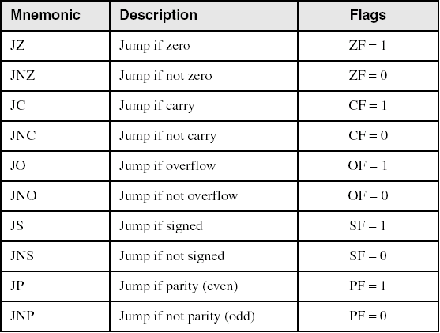
Jumps Based on Specific Flags
The following jump instructions are typically used after an arithmetic instruction or an instruction that sets status flags.
Example: add ax, bx ; add values in ax and bx
jc error ; jump to label “error” if there is a carry, ; indicating invalid result for unsigned int

Slide 19
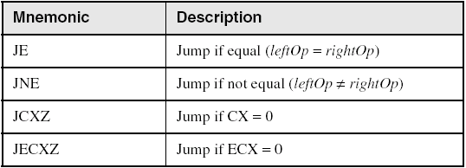
Jumps Based on Equality
The following jump instruction are used after the CMP instruction (testing for equal or not equal), or within a LOOP instruction (where ECX serves as a counter for the loop).

Slide 20
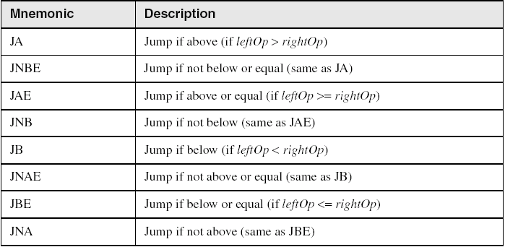
Jumps Based on Unsigned Comparisons
The following jump instructions are used after the CMP instruction when comparing unsigned integers.
For each pair of instructions that are the same, use the one that makes your code more readable. For example, JA is better if branching should take place when a value is above a certain limit, while JNBE is better if branching should take place when a decreasing value has not reached a lower limit.

Slide 21
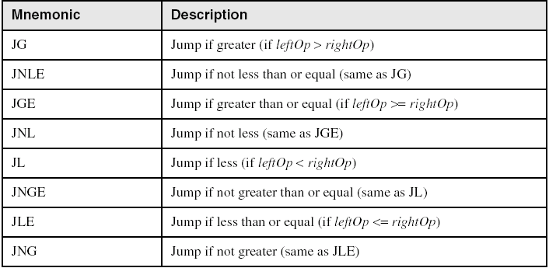
Jumps Based on Signed Comparisons
The following jump instructions are used after a CMP instruction when comparing signed integers.
Again, each pair of instructions have the same effect, use the one that makes the code more readable

Slide 22
Examples (1 of 4)
Task: Jump to a label if unsigned EAX is greater than EBX.
Solution: Use CMP, followed by JA
cmp eax,ebx ; if (eax > ebx)
ja Larger ; jump to Larger
Task: Jump to a label if signed EAX is greater than EBX.
Solution: Use CMP, followed by JG
cmp eax,ebx ; if (eax > Ebx)
jg Greater ; jump to Greater

Slide 23
Examples (2 of 4)
Jump to label L1 if unsigned EAX is less than or equal to Val1.
cmp eax,Val1 ; if (eax <= Val1)
jbe L1 ; jump to L1
Jump to label L1 if signed EAX is less than or equal to Val1.
cmp eax,Val1 ; if (eax <= Val1)
jle L1 ; jump to L1

Slide 24
Examples (3 of 4)
Compare unsigned AX to BX, and copy the larger of the two into a variable named Large.
mov Large,bx ; Large = bx
cmp ax,bx ; if (ax <= bx)
jna Next ; jump to Next
mov Large,ax ; else Large = ax
Next:
; code after setting Large
Compare signed AX to BX, and copy the smaller of the two into a variable named Small.
mov Small,ax ; Small = ax
cmp bx,ax ; if (bx >= ax)
jnl Next ; jump to Next
mov Small,bx ; else Small = bx
Next:
; code after setting Small

Slide 25
Examples (4 of 4)
Jump to label L1 if the Val1 equals Zero.
cmp Val1,0 ; if (Val1 == 0)
je L1 ; jump to L1

Slide 26
Your turn . . .
Write code that jumps to label L3 if EAX is negative.
Write code that jumps to label L4 if the expression (EBX – ECX) is greater than or equal to zero.
cmp eax,0
jl L3
sub ebx,ecx ; ebx is modified
jns L4
OR
cmp ebx,ecx ; ebx is not modified
jge L4

Slide 27
Conditional Loop Instructions
There are 4 conditional looping instructions:
LOOPZ and LOOPE
LOOPNZ and LOOPNE
These conditional loop instructions are similar to LOOP:
ECX is used as the counter.
It always counts down from the original value of ECX and stops when ECX is 0.

Slide 28
LOOPZ and LOOPE
LOOPZ (loop if zero) and LOOPE (loop if equal) are the same, they both translate to the same machine code. Use the one that makes your program easier to read.
LOOPZ and LOOPE behave like LOOP, except that ZF is an additional condition for looping.
Syntax:
LOOPE destination
LOOPZ destination
Logic:
ECX ← ECX – 1
if ECX > 0 and ZF is 1, loop (jump) back to destination.
Equivalent to: loop while ECX is not 0 AND ZF is 1.

Slide 29
LOOPNZ and LOOPNE
LOOPNZ (loop not zero) and LOOPNE (loop not equal) are the same, both are translated to the same machine code.
They work like LOOP, except that ZF is an additional condition for looping.
Syntax:
LOOPNZ destination
LOOPNE destination
Logic:
ECX ← ECX – 1;
if ECX > 0 and ZF is 0, loop back to destination.
Equivalent to: loop while ECX is not 0 AND ZF is 0.

Slide 30
LOOPNE Example
The following code decrements the value in AX by 10 or up until AX is 3, whichever comes first.
mov cx, 10 ; loop counter set to 10
CmpLoop:
dec ax ; decrement ax
cmp ax, 3 ; if (ax != 3 && cx != 0)
loopne CmpLoop ; jump back to CmpLoop
Note that LOOPNZ could be used in the example above, in place of LOOPNE, but in this case LOOPNE “reads” better because we’re looking for the ‘not equal’ condition for AX instead of the ‘not zero’ condition.

Slide 31
What’s next
Unconditional Jump
Conditional Processing
Building if and looping constructs

Slide 32
Conditional Structures
The jump and loop instructions are used to implementing HLL constructs:
IF Statements
Compound Expressions with AND
Compound Expressions with OR
WHILE Loops

Slide 33
IF Statements
Assembly language programmers can easily translate logical statements written in C++/Java into assembly language. For example:
if( op1 == op2 )
{ //true block
X = 1;
}
else
{ //false block
X = 2;
}
mov eax,op1
cmp eax,op2
jne L1 ; jump to else (false block)
mov X,1 ; this is the true block
jmp L2 ; jump over the false block
; when true block ends
L1: mov X,2 ; this is the false block
; end of if statement
L2: ; instruction after if
; statement

Slide 34
Your turn . . .
Implement the following pseudocode in assembly language. All values are unsigned:
if( ebx <= ecx )
{
eax = 5;
edx = 6;
}
cmp ebx,ecx
ja next
mov eax,5
mov edx,6
next:
(There are multiple correct solutions to this problem)

Slide 35
Your turn . . .
Implement the following pseudocode in assembly language. All values are 32-bit signed integers:
if( var1 <= var2 )
var3 = 10;
else
{
var3 = 6;
var4 = 7;
}
mov eax,var1
cmp eax,var2
jle L1
mov var3,6
mov var4,7
jmp L2
L1: mov var3,10
L2:
(There are multiple correct solutions to this problem)

Slide 36
Compound Expression with AND (1 of 3)
When implementing the HLL logical AND, consider that HLLs use short-circuit evaluation: if the left side expression is false, the right side expression is not evaluated.
Here is the HLL statement:
if (al > bl) AND (bl > cl)
X = 1;
With short circuit evaluation, if the expression a1 > b1 is false, then there is no need to evaluate b1 > c1 because the if condition is already false.

Slide 37
Compound Expression with AND (2 of 3)
if (al > bl) AND (bl > cl)
X = 1;
This is one possible implementation, translating step by step from the HLL code:
cmp al,bl ; left expression...
ja L1
jmp next ; quit if false
L1:
cmp bl,cl ; right expression...
ja L2
jmp next
L2: ; both are true
mov X,1 ; set X to 1
next:

Slide 38
Compound Expression with AND (3 of 3)
if (al > bl) AND (bl > cl)
X = 1;
But the following implementation uses less code by reversing the first relational operator. We allow the program to "fall through" to the second expression:
cmp al,bl ; left expression...
jbe next ; quit if false
cmp bl,cl ; right expression...
jbe next ; quit if false
mov X,1 ; both are true
next:

Slide 39
Your turn . . .
Implement the following pseudocode in assembly language. All values are unsigned:
if( ebx <= ecx
AND ecx > edx )
{
eax = 5;
edx = 6;
}
cmp ebx,ecx
ja next
cmp ecx,edx
jbe next
mov eax,5
mov edx,6
next:
(There are multiple correct solutions to this problem)

Slide 40
Compound Expression with OR (1 of 2)
When implementing the HLL logical OR operator, consider that HLLs use short-circuit evaluation: if the left side expression is true, the right side expression is skipped.
Consider the following HLL statement:
if (al > bl) OR (bl > cl)
X = 1;
With short circuit evaluation, if the expression a1 > b1 is true, then there is no need to evaluate b1 > c1 because the if condition is already true.

Slide 41
Compound Expression with OR (2 of 2)
if (al > bl) OR (bl > cl)
X = 1;
We can use "fall-through" logic to keep the code as short as possible:
cmp al,bl ; is AL > BL?
ja L1 ; yes, jump to L1
cmp bl,cl ; no, is BL > CL?
jbe next ; no, jump to next
L1: mov X,1 ; yes, set X to 1
next:

Slide 42
WHILE Loops
A WHILE loop is really an IF statement followed by the body of the loop, followed by an unconditional jump to the top of the loop. Consider the following example:
while( eax < ebx)
eax = eax + 1;
This is a possible implementation:
top: cmp eax,ebx ; check loop condition
jae next ; false? exit loop
inc eax ; body of loop
jmp top ; repeat the loop
next:

Slide 43
Your turn . . .
Implement the following loop, using unsigned 32-bit integers:
while( ebx <= val1)
{
ebx = ebx + 5;
val1 = val1 - 1
}
top: cmp ebx,val1 ; check loop condition
ja next ; false? exit loop
add ebx,5 ; body of loop
dec val1
jmp top ; repeat the loop
next:

Slide 44
Decision Directives
Decision directives are directives that look like HLL keywords .IF, .ELSE, .WHILE, etc.
When you use high level directives, the assembler generates assembly language instructions for you
While the use of high level directives simplifies the task of writing a program in assembly, it is important that you check the generated code to be sure it is what you intended
For this class we will not use these decision directives because we want to learn how branching works in assembly language

Slide 45
Summary of Key Concepts
Branching occurs with the jump and loop instructions.
The unconditional JMP instruction causes execution to jump forward or backward in the code, regardless of any condition.
The conditional jumps can be based on a flag status and / or on a CMP result.
When using CMP result for a jump based on inequality, use the correct jump instructions for signed vs. unsigned integers.
The LOOP instruction causes a counter controlled loop, where the counter is in ECX.
There are specialized loop instructions that depend on the ECX value and on a CMP result.
If and looping constructs in HLL are built from jump and loop instructions.
For this class, we don’t use the decision directives provided by MASM.
45

