Slide 1



Naan Mudhalvan
Industrial IoT and Industry 4.0
Tektork Private Limited, Coimbatore

Slide 2
ESP32 – WiFi
Tektork Private Limited, Coimbatore

Slide 3

Wi-Fi
Tektork Private Limited, Coimbatore

Slide 4
Wi-Fi
Wi-Fi is a wireless networking technology that enables electronic devices such as computers, smartphones, tablets, and other equipment to connect to the internet and communicate with each other without the need for physical cables.
This is achieved by using radio waves to transmit data over a local area network (LAN), which is commonly referred to as a WLAN (Wireless Local Area Network).
Wi-Fi technology facilitates seamless connectivity and mobility, allowing users to access network resources and the internet from virtually anywhere within the coverage area.
The technology is built upon the IEEE 802.11 family of standards, which specify the protocols and techniques used for wireless communication between devices.
Over the years, multiple versions of Wi-Fi standards have been developed, including 802.11b, 802.11g, 802.11n, 802.11ac, and the latest 802.11ax (also known as Wi-Fi 6).
Tektork Private Limited, Coimbatore

Slide 5
Wi-Fi
Each successive standard has introduced improvements in data transmission speeds, frequency band utilization, coverage range, and network efficiency.
For instance, earlier standards like 802.11b operate primarily on the 2.4 GHz frequency band and offer lower speeds, while newer standards such as 802.11ac and 802.11ax utilize the 5 GHz band (and in some cases the 6 GHz band) to provide significantly faster data rates and better performance in crowded environments.
Wi-Fi-enabled devices typically connect to the network through wireless access points or routers, which serve as intermediaries that bridge wired Ethernet networks to wireless clients.
These access points manage the wireless traffic, coordinate communication between devices, and provide security features such as encryption and authentication to protect data transmission.
Tektork Private Limited, Coimbatore

Slide 6
Wi-Fi
This infrastructure allows multiple devices to share a single internet connection and facilitates communication across devices within the network’s coverage area.
Moreover, Wi-Fi technology supports various network configurations and operational modes, including infrastructure mode (where devices connect through an access point) and ad-hoc mode (where devices communicate directly with each other).
The continuous advancement of Wi-Fi standards ensures better handling of multiple simultaneous connections, reduced latency, enhanced power efficiency for battery-operated devices, and improved overall user experience.
Tektork Private Limited, Coimbatore

Slide 7
Core Principles of Wi-Fi Communication
Frequency Bands:
Wi-Fi primarily operates in the 2.4 GHz and 5 GHz bands, with newer standards also utilizing the 6 GHz band for faster speeds and reduced interference.
Standards and Protocols:
Defined by IEEE 802.11 standards (e.g., 802.11n, 802.11ac, 802.11ax), which determine data rates, frequency bands, range, and features.
Data Rates and Throughput:
Vary depending on the standard, ranging from a few Mbps in early Wi-Fi versions to multi-gigabit speeds in Wi-Fi 6 and beyond.
Tektork Private Limited, Coimbatore

Slide 8
Range and Coverage:
Influenced by frequency band, environment, and antenna design. Lower frequencies like 2.4 GHz offer better range, while higher frequencies provide faster speeds but shorter coverage.
Security:
Wi-Fi networks use encryption protocols such as WPA2 and WPA3 to protect data and prevent unauthorized access.
Network Modes:
Infrastructure mode: Devices connect through an access point or router.
Ad-hoc mode: Devices connect directly to each other without an access point.
Tektork Private Limited, Coimbatore

Slide 9
Channels and Interference:
Wi-Fi operates on multiple channels within frequency bands. Overlapping channels or other devices can cause interference, impacting performance.
Multiple Input Multiple Output (MIMO):
Technology that uses multiple antennas to send and receive data simultaneously, improving speed and reliability.
Power Consumption:
Important for battery-powered devices; newer standards optimize power use with features like Target Wake Time (TWT).
Compatibility:
Devices often support multiple Wi-Fi standards to maintain backward compatibility.
Tektork Private Limited, Coimbatore

Slide 10
Common Applications of Wi-Fi
Wireless Internet Access:
Wi-Fi is widely used to provide wireless internet connectivity in homes, offices, cafes, airports, hotels, and public hotspots.
It allows multiple devices such as laptops, smartphones, tablets, and smart TVs to connect seamlessly without the need for cables.
Internet of Things (IoT) Ecosystem:
Many smart home devices, industrial automation equipment, and IoT sensors utilize Wi-Fi to communicate and exchange data, enabling smart environments and automation.
Tektork Private Limited, Coimbatore

Slide 11
Streaming Media:
Wi-Fi facilitates streaming of high-definition video and audio on smart TVs, media players, and mobile devices, providing convenient media consumption without wired connections.
Enterprise Networks:
Offices deploy Wi-Fi to establish flexible and scalable wireless LANs, reducing the need for complex cabling and enabling mobile computing.
Education:
Schools and universities use Wi-Fi networks to support internet access, e-learning platforms, online classes, and digital collaboration.
Tektork Private Limited, Coimbatore

Slide 12
Healthcare:
Medical devices connect wirelessly via Wi-Fi to monitoring systems, improving patient care with real-time data access and remote diagnostics.
Industrial Automation:
Manufacturing plants and industrial facilities leverage Wi-Fi for wireless data exchange, remote monitoring, and control of machinery, enhancing efficiency and safety.
Retail:
Retail stores offer free Wi-Fi to customers for an enhanced shopping experience and use Wi-Fi for marketing and data collection purposes.
Transportation:
Wi-Fi networks are implemented in airports, trains, buses, and other modes of transportation to provide internet access during travel.
Tektork Private Limited, Coimbatore

Slide 13
Emerging and Advanced Applications
Wi-Fi Sensing and Gesture Recognition:
Wi-Fi signals are increasingly used for sensing motion, gestures, and even vital signs by analyzing signal reflections. This enables smart control and security applications without relying on cameras.
AI-Powered Wi-Fi Management:
Artificial intelligence optimizes Wi-Fi performance by dynamically managing transmission power, channel selection, and network resource allocation to reduce interference and improve user experience.
High-Bandwidth Applications:
The latest Wi-Fi standards, such as Wi-Fi 6, support demanding applications including augmented reality (AR), virtual reality (VR), and low-latency communication, which are critical for enterprise and healthcare environments.
Tektork Private Limited, Coimbatore

Slide 14
Wi-Fi Standards Overview
Standard | Frequency Band(s) | Maximum Speed | Key Features | Year Introduced
802.11b | 2.4 GHz | Up to 11 Mbps | Early Wi-Fi standard, longer range, slower speeds | 1999
802.11a | 5 GHz | Up to 54 Mbps | Less interference than 2.4 GHz, shorter range | 1999
802.11g | 2.4 GHz | Up to 54 Mbps | Backwards compatible with 802.11b | 2003
802.11n | 2.4 GHz & 5 GHz | Up to 600 Mbps | MIMO technology, dual-band support | 2009
802.11ac | 5 GHz | Up to 3.46 Gbps | Improved MIMO, wider channels, beamforming | 2013
802.11ax (Wi-Fi 6) | 2.4 GHz & 5 GHz | Up to 9.6 Gbps | OFDMA, improved efficiency, better performance in dense environments | 2019
802.11be (Wi-Fi 7) | 2.4 GHz, 5 GHz & 6 GHz | Up to 30 Gbps (projected) | Enhanced throughput, lower latency, multi-link operation | Upcoming
Tektork Private Limited, Coimbatore

Slide 15
ESP32 WiFi
Frequency Band and Protocols: The ESP32 operates on the 2.4 GHz band and supports the 802.11 b/g/n protocols.
Data Rate: It has a maximum data transfer rate of 150 Mbps.
Adjustable Transmit Power: The transmit power can be set up to 20.5 dBm. Reducing the transmit power can lower current consumption, which is useful for battery-powered projects.
Antenna Diversity: This is an advanced feature that allows the ESP32 to switch between multiple antennas using an external RF switch. This helps the device find the best possible signal, improving reliability and range, especially in environments with signal interference.
Tektork Private Limited, Coimbatore

Slide 16
ESP32 WiFi Modes.
WiFi Mode | Function
WiFi.mode(WIFI_STA) | Station mode: the ESP32 connects to an existing Wi-Fi network (access point)
WiFi.mode(WIFI_AP) | Access Point mode: other devices can connect directly to the ESP32
WiFi.mode(WIFI_AP_STA) | AP + STA mode: ESP32 connects to a Wi-Fi network and acts as an access point
Tektork Private Limited, Coimbatore

Slide 17
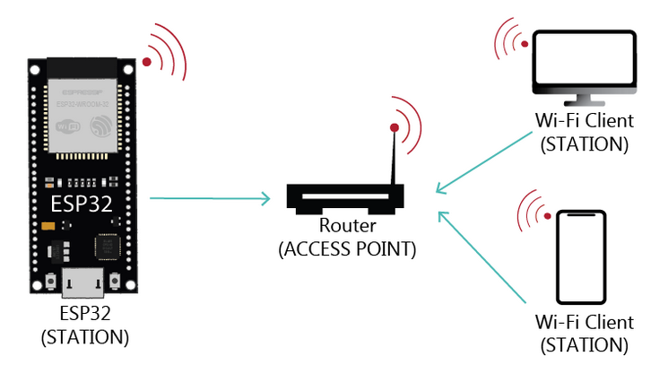
Wi-Fi Modes for ESP32
Station Mode (STA):
Tektork Private Limited, Coimbatore

Slide 18
Station Mode (STA):
When the ESP32 is set as a Wi-Fi station, it can connect to other networks, such as your router. In this mode, the router assigns a unique IP address to the ESP32 board.
You can communicate with the ESP32 using other devices (stations) that are also connected to the same network by referring to its unique IP address.
Since the router is connected to the internet, the ESP32 can request information from online sources (such as weather data from APIs), publish data to online platforms, use images and icons from the internet, or include JavaScript libraries to build web server pages.
Tektork Private Limited, Coimbatore

Slide 19
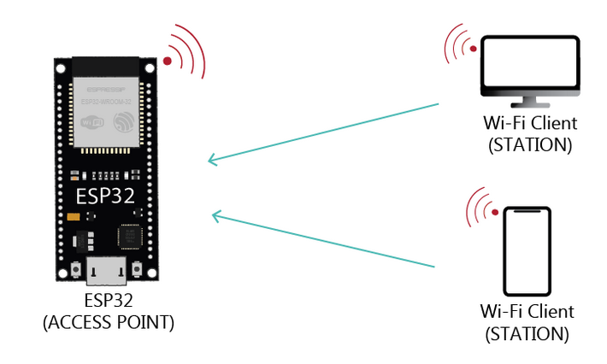
Access Point Mode (AP):
Tektork Private Limited, Coimbatore

Slide 20
Access Point Mode (AP):
When you set your ESP32 board as an access point, it creates its own Wi-Fi network, allowing any nearby device with Wi-Fi capabilities—such as a smartphone or computer—to connect directly to it, without needing to connect through a router.
This is useful when you want to control the ESP32 without internet access, or when you want multiple ESP32 devices to communicate with each other without relying on a router.
Because the ESP32 in this mode doesn’t connect to a wired network like your router, it is called a soft-AP (soft Access Point).
This also means that internet-related functions—such as loading external libraries, accessing firmware updates, making HTTP requests, publishing sensor data to the cloud, or using online services (like sending emails)—will not work in this mode.
Tektork Private Limited, Coimbatore

Slide 21
Combined AP-STA Mode:
Combined AP-STA mode allows the ESP32 to function as both a Wi-Fi client (Station) and a Wi-Fi Access Point (AP) simultaneously.
In this mode, the ESP32 can connect to an existing Wi-Fi network (such as your home router) to access the internet, while also creating its own local Wi-Fi network that other devices can connect to.
This dual-mode capability is particularly useful for device setup and configuration.
For example, a new smart device can start in AP mode, allowing you to connect directly to it using your smartphone.
Once connected, a captive portal or web page hosted on the ESP32 can prompt you to enter your home Wi-Fi credentials.
Tektork Private Limited, Coimbatore

Slide 22
Combined AP-STA Mode: cond..
After receiving this information, the ESP32 can connect to your router in STA mode while optionally maintaining its AP mode for local communication—or it can switch entirely to STA mode.
This hybrid mode provides flexibility for various IoT applications by enabling the device to:
Access the internet for cloud-based services and data
Act as a local hub for direct communication with other devices
Tektork Private Limited, Coimbatore

Slide 23
Wi-Fi Modes and Usecase
Mode | Description | Use Case Example
Station (STA) | ESP32 connects to an external Wi-Fi network (like a router). | IoT device sending sensor data to a cloud server
Access Point (AP) | ESP32 creates its own Wi-Fi network for other devices to connect. | Local control panel or peer-to-peer communication
Station + AP (STA+AP) | ESP32 connects to a network while also allowing other devices to connect to it. | Mesh networks, device provisioning, or bridging
Tektork Private Limited, Coimbatore

Slide 24
Wi-Fi Connection Status
To check the status of the Wi-Fi connection, you can use WiFi.status(). This function returns one of several constant values that indicate the current connection status. These constants are listed in the table below:
Constant | Meaning
WL_IDLE_STATUS | Wi-Fi is in the process of changing state
WL_NO_SSID_AVAIL | No SSID (network) available
WL_SCAN_COMPLETED | Scan networks is completed
WL_CONNECTED | Successfully connected to a Wi-Fi network
WL_CONNECT_FAILED | Failed to connect to the Wi-Fi network
WL_CONNECTION_LOST | Connection was lost
WL_DISCONNECTED | Disconnected from the Wi-Fi network
Tektork Private Limited, Coimbatore

Slide 25
ESP32 Wi-Fi Events
The ESP32 can handle the following Wi-Fi events:
ID | Event Constant | Description
0 | ARDUINO_EVENT_WIFI_READY | ESP32 Wi-Fi is ready
1 | ARDUINO_EVENT_WIFI_SCAN_DONE | Wi-Fi scan is complete
2 | ARDUINO_EVENT_WIFI_STA_START | Wi-Fi station has started
3 | ARDUINO_EVENT_WIFI_STA_STOP | Wi-Fi station has stopped
4 | ARDUINO_EVENT_WIFI_STA_CONNECTED | Station connected to access point
5 | ARDUINO_EVENT_WIFI_STA_DISCONNECTED | Station disconnected from access point
6 | ARDUINO_EVENT_WIFI_STA_AUTHMODE_CHANGE | Authentication mode of the connected AP changed
7 | ARDUINO_EVENT_WIFI_STA_GOT_IP | Station received an IPv4 address from the AP
8 | ARDUINO_EVENT_WIFI_STA_LOST_IP | Station lost IP address (reset to 0)
9 | ARDUINO_EVENT_WPS_ER_SUCCESS | WPS succeeded in enrollee mode
10 | ARDUINO_EVENT_WPS_ER_FAILED | WPS failed in enrollee mode
Tektork Private Limited, Coimbatore

Slide 26
ID | Event Constant | Description
11 | ARDUINO_EVENT_WPS_ER_TIMEOUT | WPS timed out in enrollee mode
12 | ARDUINO_EVENT_WPS_ER_PIN | WPS PIN code received in enrollee mode
13 | ARDUINO_EVENT_WIFI_AP_START | Soft-AP started
14 | ARDUINO_EVENT_WIFI_AP_STOP | Soft-AP stopped
15 | ARDUINO_EVENT_WIFI_AP_STACONNECTED | A station connected to the soft-AP
16 | ARDUINO_EVENT_WIFI_AP_STADISCONNECTED | A station disconnected from the soft-AP
17 | ARDUINO_EVENT_WIFI_AP_STAIPASSIGNED | Soft-AP assigned IP to a connected station
18 | ARDUINO_EVENT_WIFI_AP_PROBEREQRECVED | Probe request received on the soft-AP interface
19 | ARDUINO_EVENT_WIFI_AP_GOT_IP6 | Soft-AP obtained an IPv6 address
19 | ARDUINO_EVENT_WIFI_STA_GOT_IP6 | Station obtained an IPv6 address
Tektork Private Limited, Coimbatore

Slide 27
Wi-Fi Scanning on ESP32
Wi-Fi scanning on an ESP32 involves passively or actively searching for nearby Access Points (APs) by listening for their broadcast beacon frames.
The ESP32's Wi-Fi module detects available networks and records important information such as:
Service Set Identifiers (SSIDs) — the network names,
Received Signal Strength Indicator (RSSI) — signal strength,
Authentication types — the security protocols used.
This scanning process is typically performed in station (client) mode using the WiFi.scanNetworks() function in Arduino, or similar APIs in the ESP-IDF framework.
The collected network details help in tasks like selecting the strongest network or performing network diagnostics.
Tektork Private Limited, Coimbatore

Slide 28
Steps to Scan for Networks (Arduino Example)
Include the library: #include <WiFi.h.
Initialize serial communication: Serial.begin(115200); to display the results.
Set Wi-Fi to station mode: WiFi.mode(WIFI_STA);.
Perform the scan: Call int n = WiFi.scanNetworks(); which returns the number of networks found.
Display results: Loop through the found networks (from i = 0 to n-1) and access their details using functions like WiFi.SSID(i), WiFi.RSSI(i), and WiFi.encryptionType(i).
Tektork Private Limited, Coimbatore

Slide 29
ESP32 WiFi Network Scan Procedure
Step | Function / Code | Purpose
Include library | #include <WiFi.h> | Use ESP32 wifi functions
Initialize Serial | Serial.begin(115200); | Allow console output
Set station mode | WiFi.mode(WIFI_STA); | Prepare for scanning without connecting
Disconnect WiFi | WiFi.disconnect(); | Clear prior connections
Scan networks | int n = WiFi.scanNetworks(); | Find nearby WiFi networks
Display info loop | WiFi.SSID(i), WiFi.RSSI(i), WiFi.encryptionType(i) | Show SSID, signal strength, security
Cleanup | WiFi.scanDelete(); | Free memory after scan
Repeat or delay | delay(5000); | Pause before next scan (optional)
Tektork Private Limited, Coimbatore

Slide 30
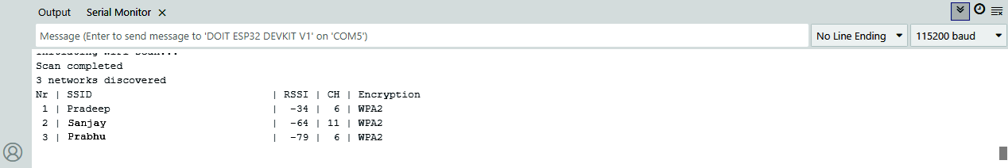
WiFi Scan Output on Serial Monitor
Upload the Wi-Fi scan code to your ESP32 using the Arduino IDE (or other IDE).
Open the Serial Monitor (make sure the correct baud rate is set, usually 115200).
You’ll see a list of available Wi-Fi networks, including their SSID, signal strength (RSSI), and encryption type.
Tektork Private Limited, Coimbatore

Slide 31
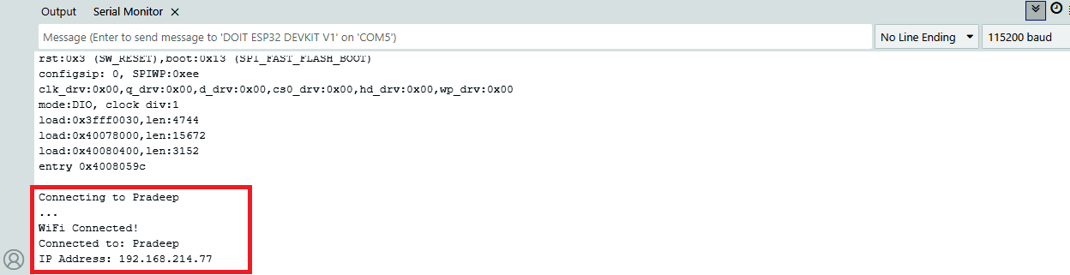
WiFi Connection: Print SSID and IP Address to Serial Monitor
Upload the Wi-Fi connection code to your ESP32 using the Arduino IDE.
Enter your Wi-Fi SSID and password in the code before uploading.
Open the Serial Monitor — the connected SSID name and assigned IP address will be displayed.
Tektork Private Limited, Coimbatore

Slide 32
ESP32 -- WebServer
Tektork Private Limited, Coimbatore

Slide 33
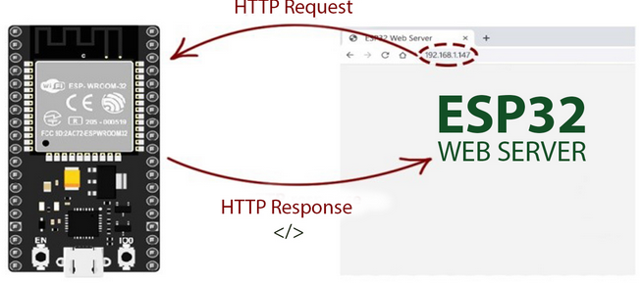
Web Server
Tektork Private Limited, Coimbatore

Slide 34
Web Server
The ESP32 web server works by turning the microcontroller into a server that listens for and responds to requests from web clients, such as a browser on a computer or smartphone. This is made possible by the ESP32's built-in Wi-Fi capabilities.
Working Principle
The process involves several key steps and principles:
Request-Response Model:
The core of a web server is the request-response model.
A client (your web browser) sends an HTTP request to the server (the ESP32) for a specific resource, like a web page.
The server processes this request and sends an HTTP response back to the client, which can contain HTML, CSS, JavaScript, or other data.
Tektork Private Limited, Coimbatore

Slide 35
Wi-Fi Connection:
To act as a server, the ESP32 must be connected to a network.
This is typically done in Station Mode, where the ESP32 connects to an existing Wi-Fi network (like your home router) and is assigned a local IP address.
Alternatively, it can be configured in Access Point (AP) Mode, where it creates its own Wi-Fi network for other devices to connect to.
Listening for Requests:
Once connected to the network and assigned an IP address, the ESP32's web server software starts listening on a specific port, most commonly port 80 for standard HTTP traffic.
It constantly checks for incoming HTTP requests.
Tektork Private Limited, Coimbatore

Slide 36
Handling Requests:
When a request is received, the ESP32's code parses the request to determine what the client is asking for (e.g., the root URL "/", or a specific path like "/LED_ON"). Based on the URL and the type of request (e.g., GET or POST), the server executes a pre-defined function.
This function can do a variety of tasks, such as:
Sending back a static HTML page.
Reading sensor data and displaying it on a web page.
Controlling connected hardware, like turning an LED on or off.
Tektork Private Limited, Coimbatore

Slide 37
Sending a Response:
After processing the request, the ESP32 sends an HTTP response back to the client.
This response includes a status code (like 200 OK for a successful request), content type information (e.g., text/html), and the actual data (e.g., the HTML code for the web page).
State-less Protocol:
HTTP is a "stateless" protocol. Each client request is independent, so the ESP32 server must respond to every request individually without memory of past interactions (unless explicitly coded otherwise).
The entire process is managed by a combination of the ESP32's hardware and specific libraries, such as WiFi.h and WebServer.h or ESPAsyncWebServer.h, which simplify the low-level networking tasks.
Tektork Private Limited, Coimbatore

Slide 38
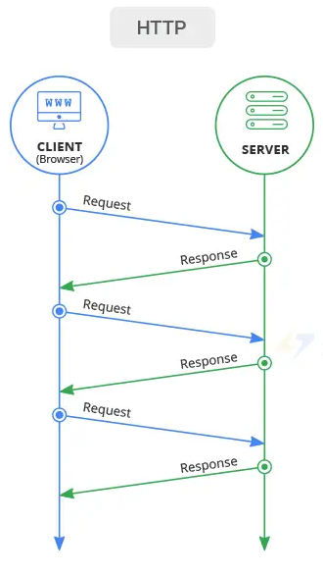
Tektork Private Limited, Coimbatore

Slide 39
ESP32 Web Server Working
An ESP32 web server works similarly to a traditional web server but on a much smaller scale. Instead of hosting entire websites for millions of users, the ESP32 hosts a simple web interface—for example, a page to control LEDs or monitor sensors.
When you connect your device (like a phone or computer) to the same Wi-Fi network as the ESP32 and type in its IP address in the browser, you’re sending a request to the ESP32, just like you would to a normal website.
The ESP32 receives this request and responds by sending back the web page it’s hosting—this could include buttons to toggle LEDs, display sensor data, etc.
Just like every website has a unique IP address, your ESP32 also gets an IP address from your router when it connects to Wi-Fi.
Tektork Private Limited, Coimbatore

Slide 40
This address allows your browser to find and communicate with the ESP32 directly over the local network.
Behind the scenes, your browser and the ESP32 communicate using HTTP (HyperText Transfer Protocol). When you click a button on the web interface,
your browser sends an HTTP request to the ESP32, which then processes the request—for example, turning an LED ON or OFF—and sends back a response or updated page.
Tektork Private Limited, Coimbatore

Slide 41
Finding the ESP32 IP Address
After uploading the code, open the Serial Monitor in the Arduino IDE and set the baud rate to 115200.
The ESP32 will connect to your Wi-Fi network and display its assigned IP address in the Serial Monitor.
Press the ESP32 EN button (reset).
The red box in the image highlights the Serial Monitor interface.
The ESP32 connects to Wi-Fi, and outputs the ESP IP address on the Serial Monitor. Copy that IP address, because you need it to access the ESP32 web server.
Tektork Private Limited, Coimbatore

Slide 42
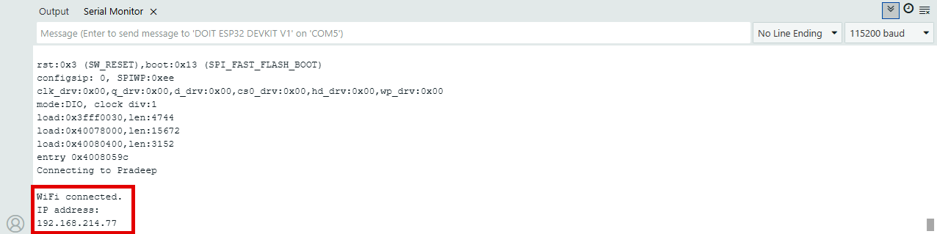
Accessing the Web Server
To access the web server, open your browser and enter the ESP32’s IP address in the address bar.
For example, in our case, the IP address is 192.168.214.77. This will load the web interface hosted by the ESP32.
Tektork Private Limited, Coimbatore

Slide 43
The web server you’ll build controls two LEDs connected to ESP32 GPIO 33 and GPIO 4.
You can access the ESP32 web server by typing its IP address into a browser connected to the same local network.
By clicking the buttons on the web interface, you can instantly change the state of each LED.
Tektork Private Limited, Coimbatore

Slide 44
Controlling the LED
Open the sketch, enter your Wi-Fi SSID and password in the appropriate variables, and then upload the code to your ESP32 board.
After uploading the code, open the Serial Monitor at the correct baud rate (usually 115200). Once the ESP32 connects to your Wi-Fi network, it will print the IP address assigned by your router. You can use this IP address to access the web interface from your browser.
When the web interface is accessed from multiple clients, pressing the ON button for a specific LED (such as GPIO 33 or GPIO 4) from any one client sends a command to the ESP32 web server, which updates the state of only that corresponding LED on the device. This change is not reflected or updated on the other clients’ interfaces.
Tektork Private Limited, Coimbatore

Slide 45
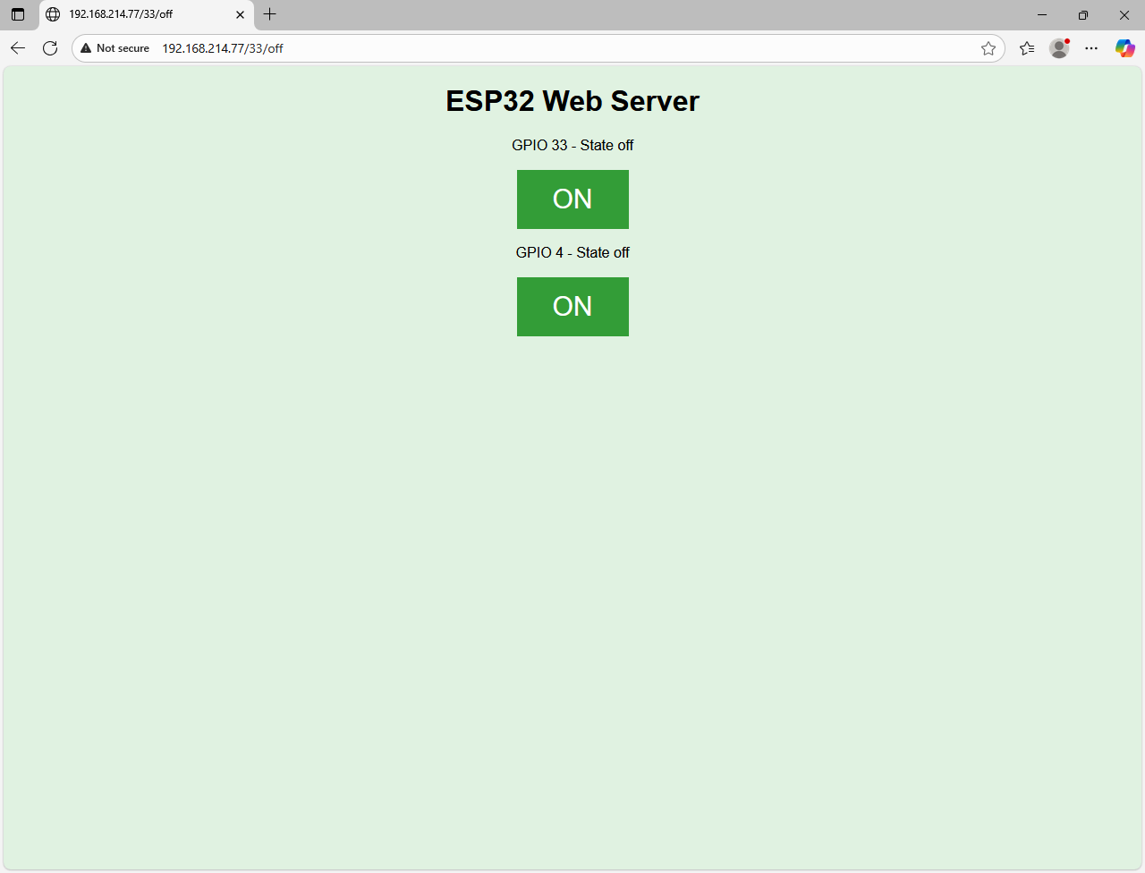
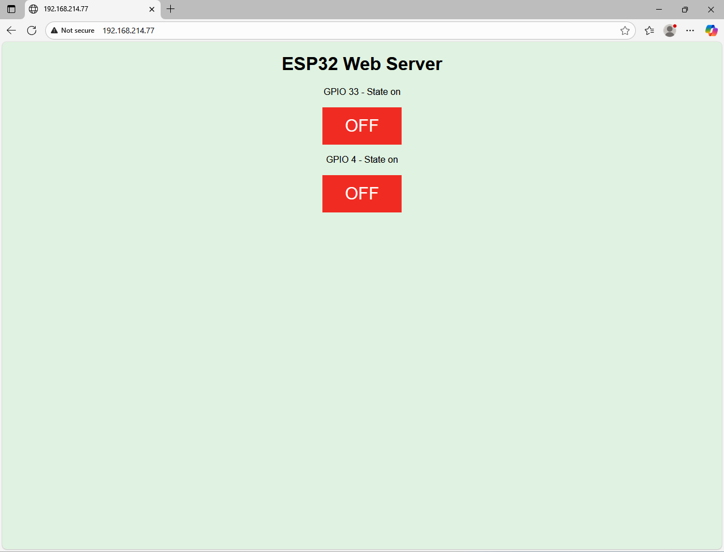
Local ESP32 Web Server interface – Controlling LEDs
Tektork Private Limited, Coimbatore

Slide 46
Reading Potentiometer Value
Open the sketch, enter your Wi-Fi SSID and password in the appropriate variables, and then upload the code to your ESP32 board.
After uploading the code, open the Serial Monitor at the correct baud rate (usually 115200). Once the ESP32 connects to your Wi-Fi network, it will print the IP address assigned by your router. You can use this IP address to access the web interface from your browser.
By manually adjusting the potentiometer connected to the ESP32 development board, the system continuously reads the raw ADC value from the analog input. This raw value is then converted into the corresponding voltage level using a 12-bit resolution formula.
Both the raw ADC value and the calculated voltage (in volts) are displayed in real time on a web-based interface, which is hosted directly by the ESP32. The values are automatically updated every second, allowing users to observe live changes in analog input as they rotate the potentiometer knob.
Tektork Private Limited, Coimbatore

Slide 47
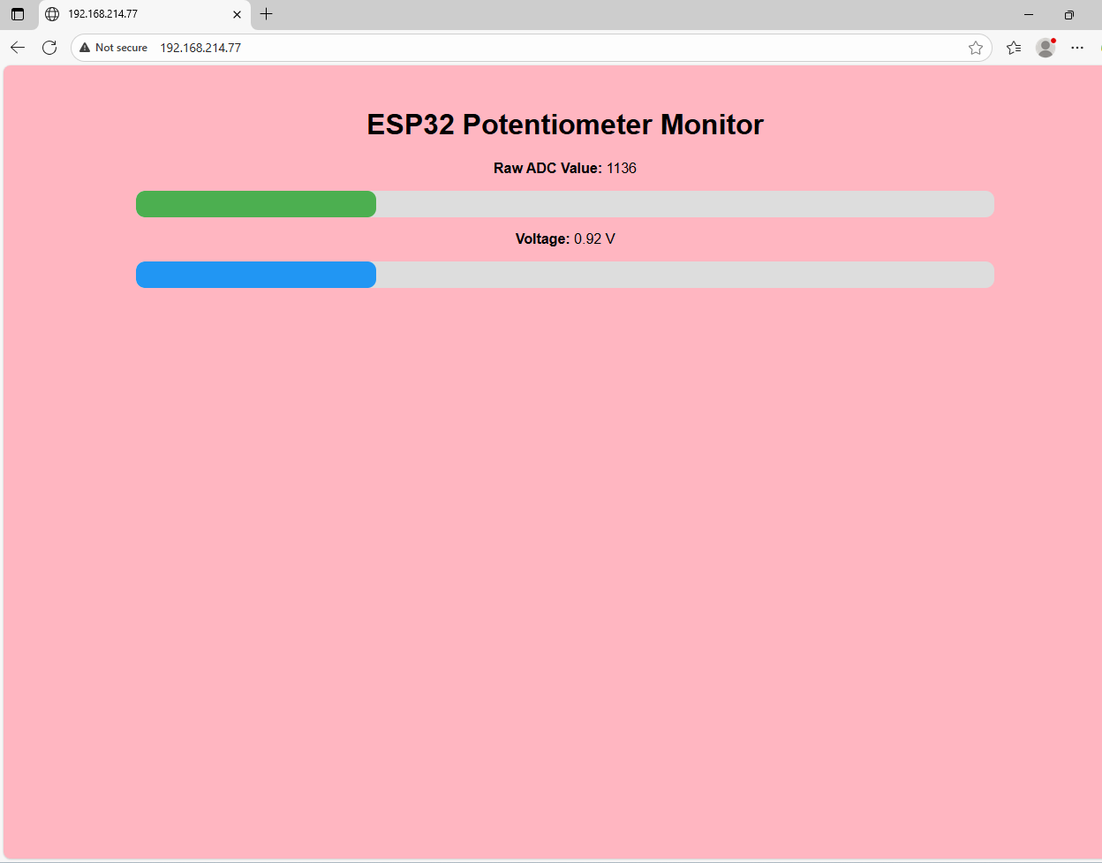
Local ESP32 Web Server interface –Reading Potentiometer Value
Tektork Private Limited, Coimbatore

Slide 48
Thank You
Tektork Private Limited, Coimbatore

