Slide 1
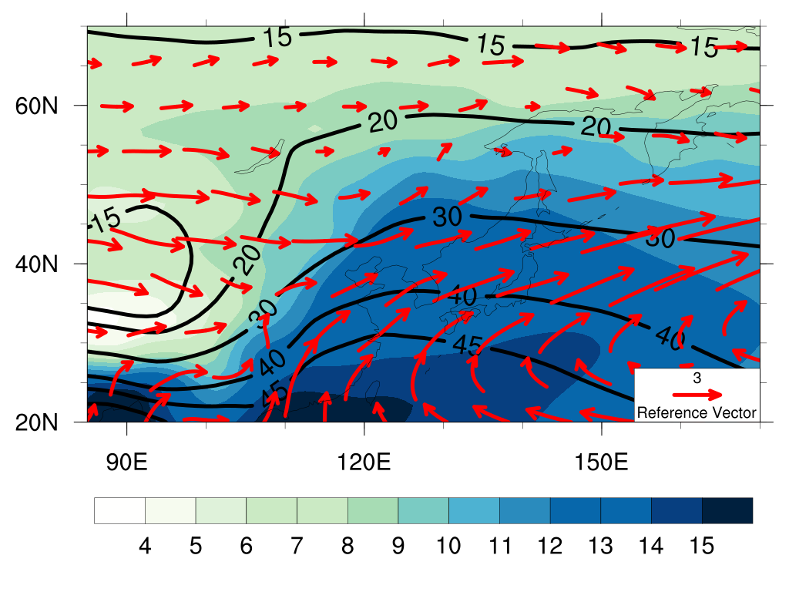
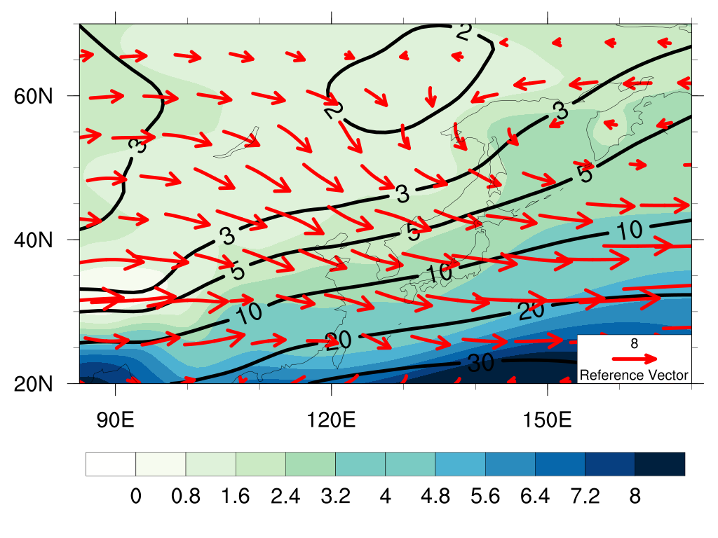
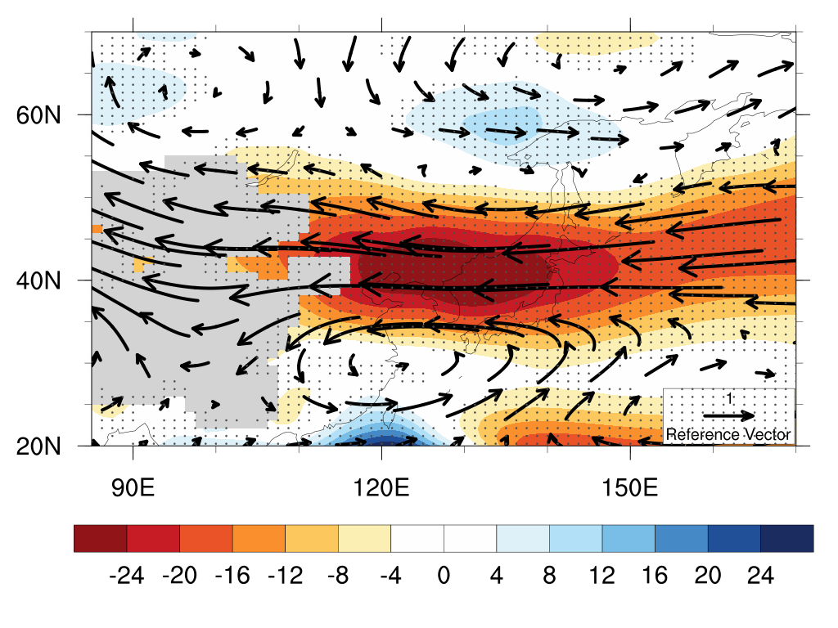
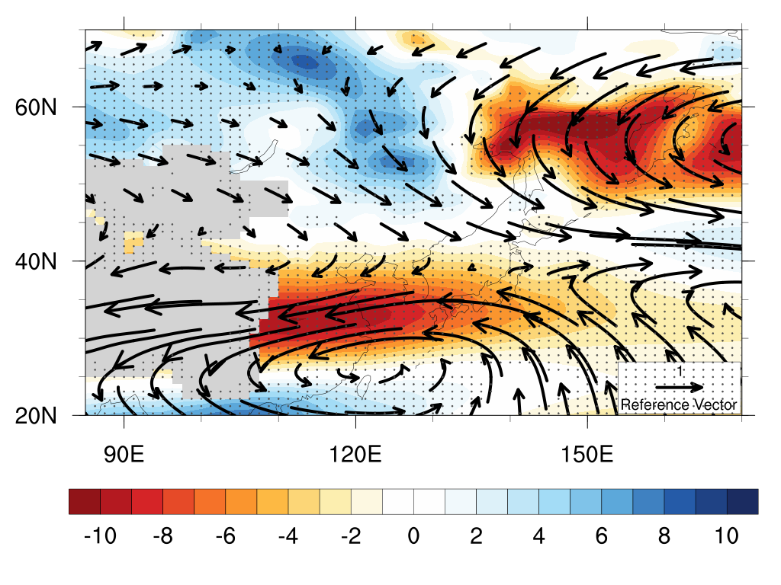
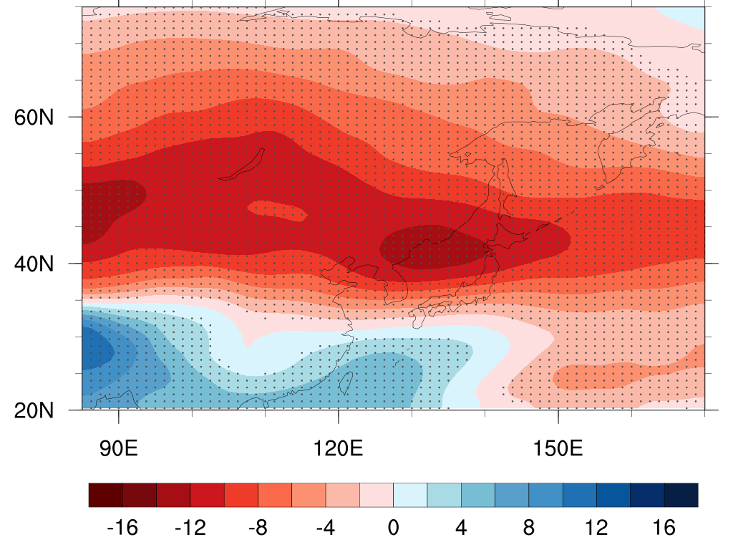
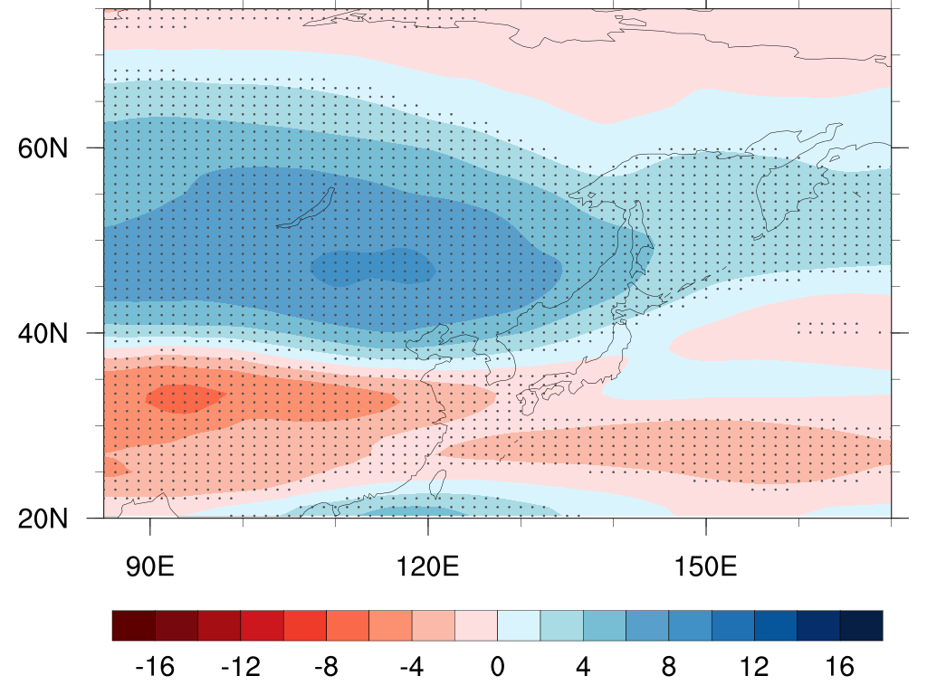
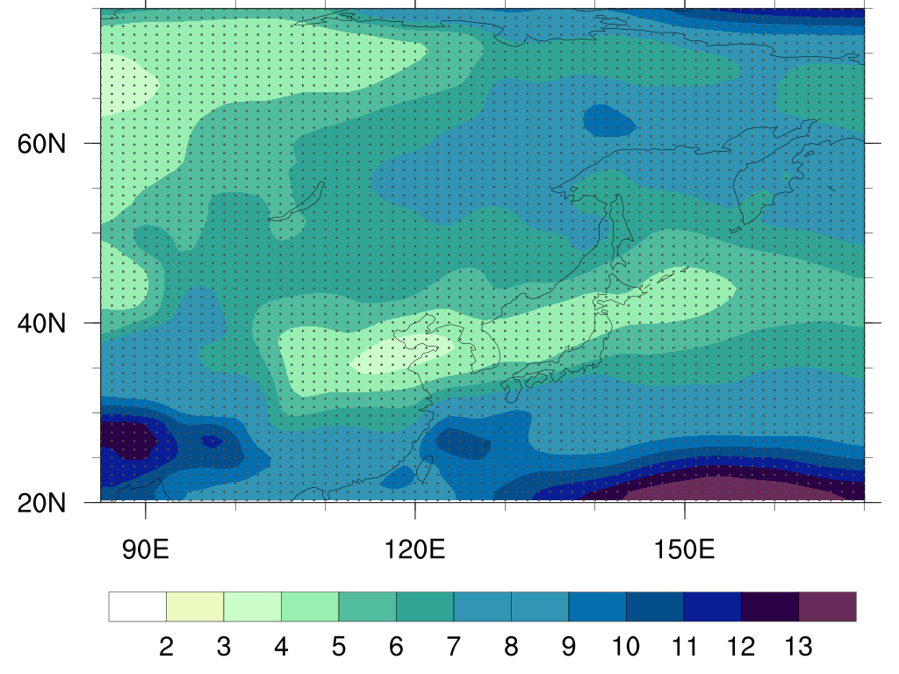
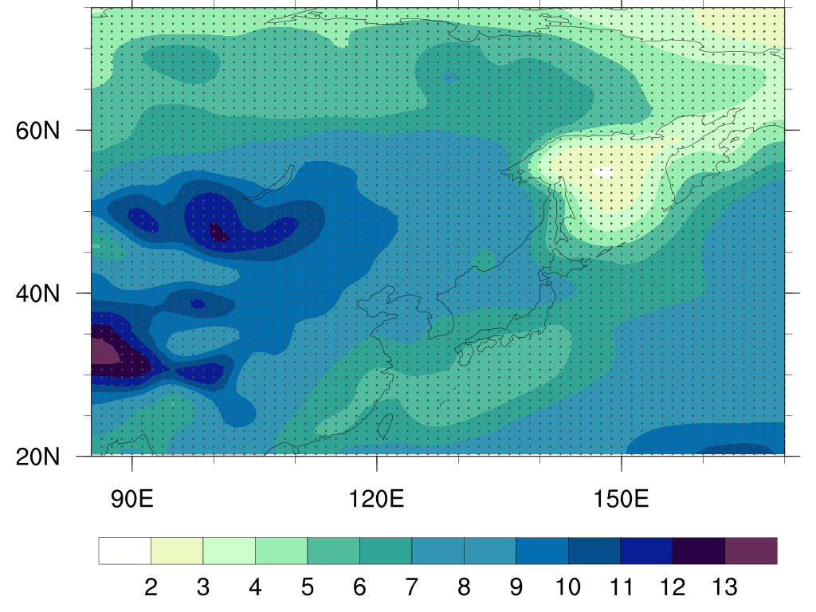
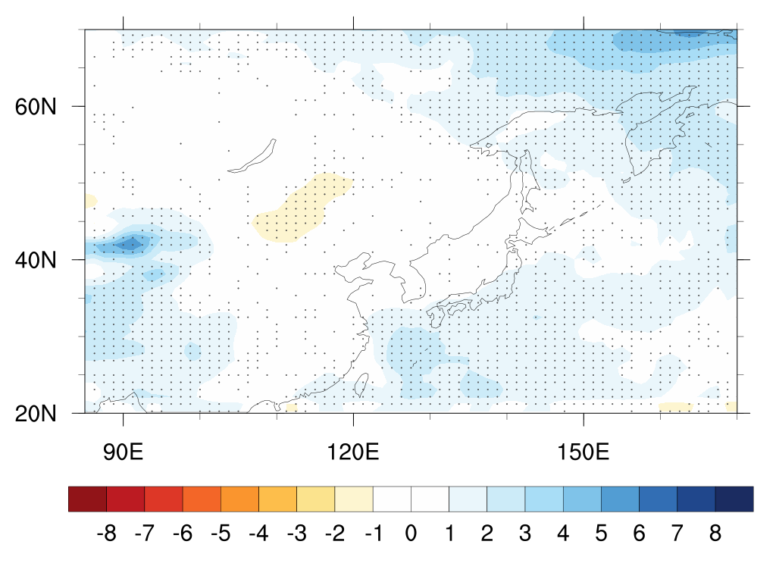
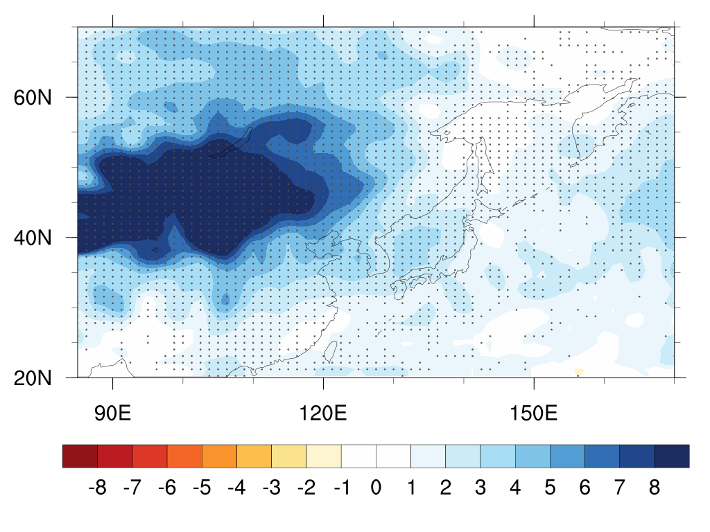
a
b
JJA
Moisture and climatological winds
DJF
Moisture and climatological winds
(Kg/m²)
c
d
JJA
Winds and vertical shear
DJF
Winds and vertical shear
(%)
e
f
JJA
Dynamical amplitude of eddies
DJF
Dynamical amplitude of eddies
g
(%)
h
JJA
Moisture amplitude of eddies
DJF
Moisture amplitude of eddies
(%/K)
i
j
JJA
Moisture discharge
DJF
Moisture discharge
(%/K)

