Slide 1
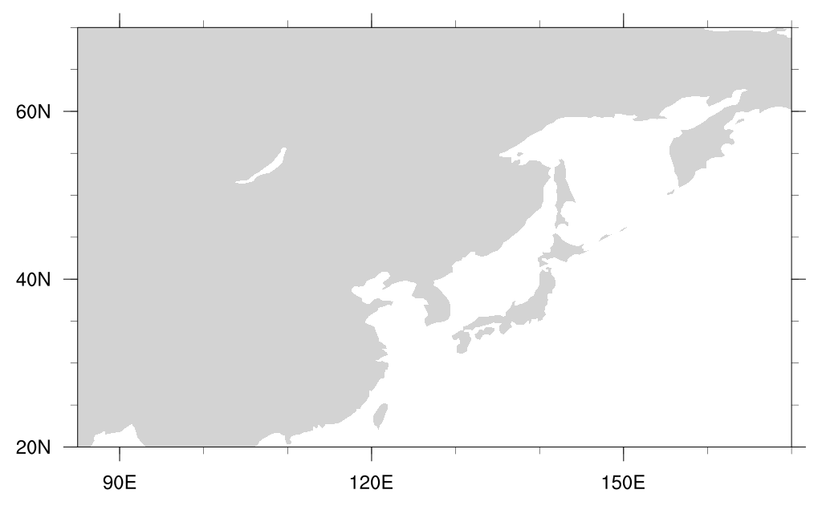






DRY
DRY
DRY
Cold
Smaller q
2
Cool Center
3
$$δq$$
DRY
5
$$δq$$
Smaller q
10
30
Moisture Convergence
$$δq$$
Larger q
Westerlies
Moisture Divergence
35
Climatological Winter Monsoon
$$δq$$
20
40
$$δq$$
Larger q
45
Climatological Summer Monsoon
14
16
18
20
$$δq$$
Warm
Smaller q
Larger q
Moisture Divergence
Warm
WET
WET

Slide 2
Negative Vorticity
Moisture Divergence
Jet Weakening
Negative Vorticity
Moisture Divergence
Positive Vorticity
Moisture Convergence
Jet Weakening

Slide 3




Climatology
Westward Anomaly
Climatology
Discharge
Discharge
$$q′$$
$$v′$$
Jet Weakening
Future
$$q′$$
$$v′$$
Future
Discharge
Jet Weakening
More Discharge

