Slide 2
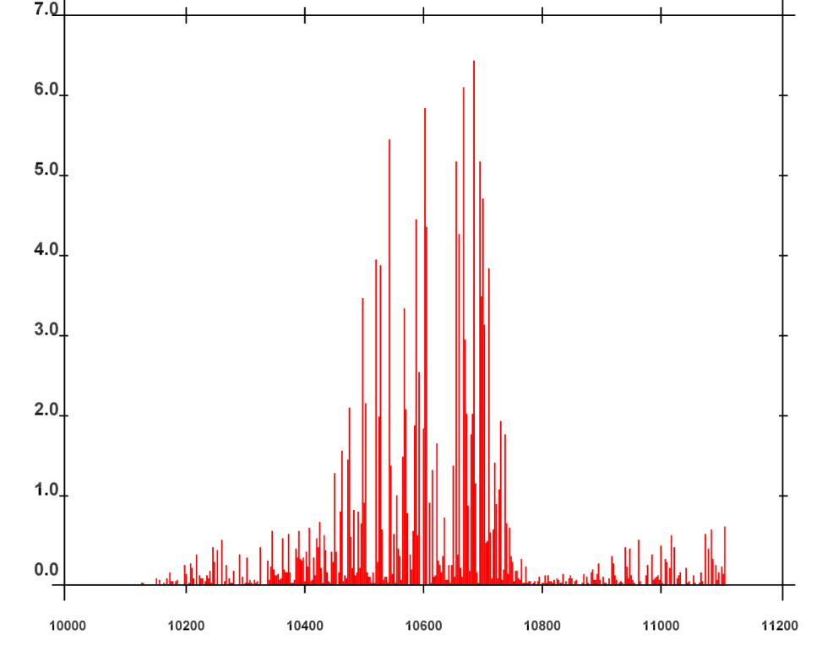
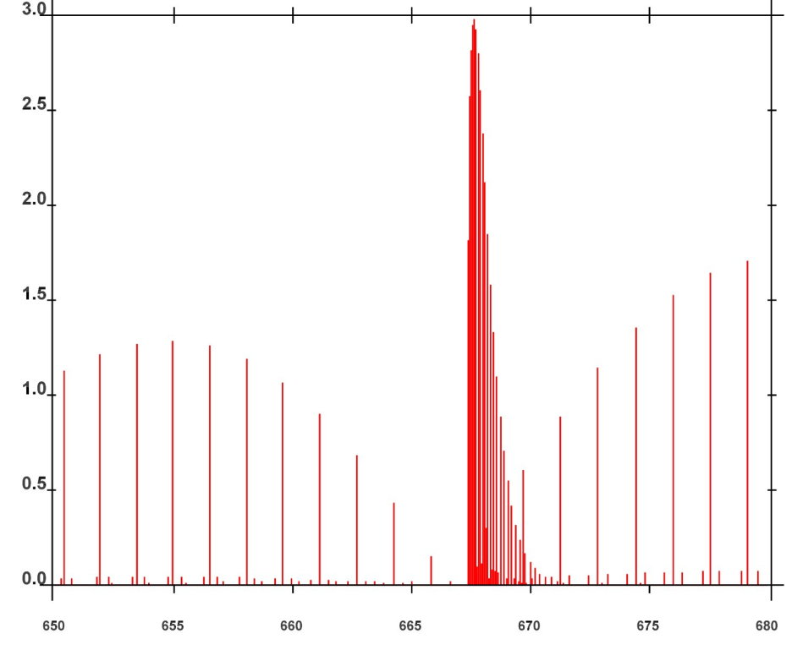
Absorption line intensity in cm⁻¹/(molecule x cm⁻²) at 296 Kelvin Degrees
10⁻²²
10⁻¹⁹
(a) H₂O
(b) CO₂
Wavenumber (cm⁻¹)
Wavenumber (cm⁻¹)

Slide 4
q = condensed water mass
N = drop number concentration
Melting
q, N
q, N
Cloud Droplets
Freezing
Cloud Ice
Deposition Sublimation
(macrophysics)
Evaporation Condensation
(macrophysics)
q
-
Autoconversion
Breakup
Water Vapor
Breakup
Autoconversion
Evaporation Sublimation
Melting
q, N
q, N
Snow
Rain
Freezing

Slide 5
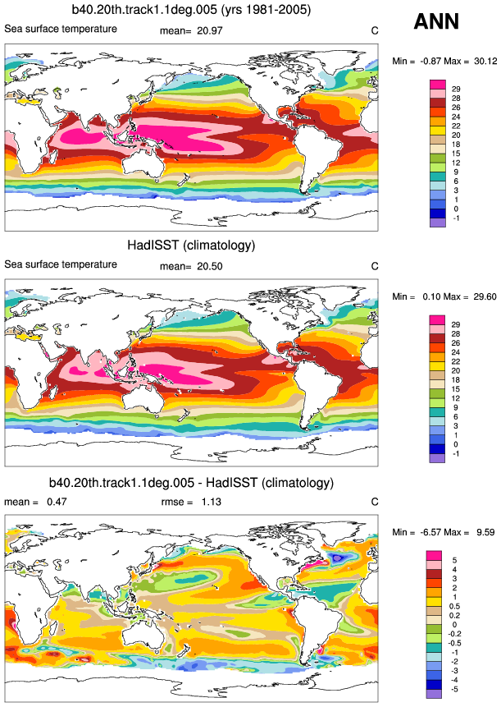

Slide 6
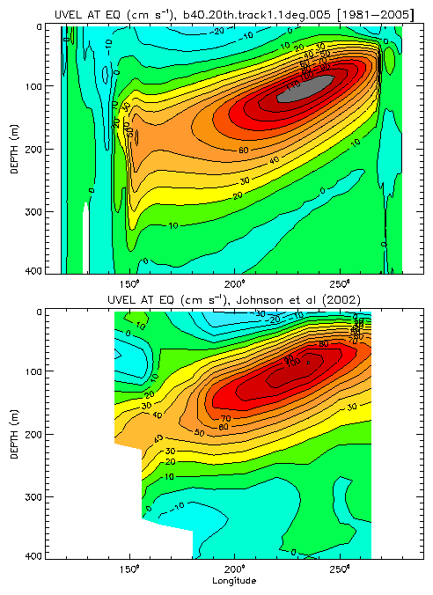

Slide 7
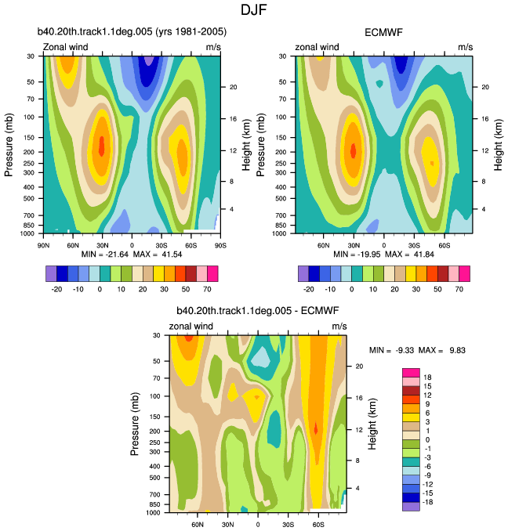

Slide 8
