Slide 1
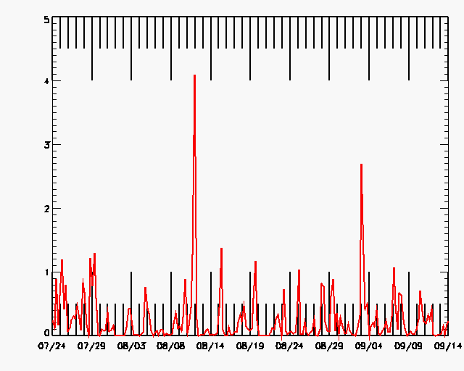
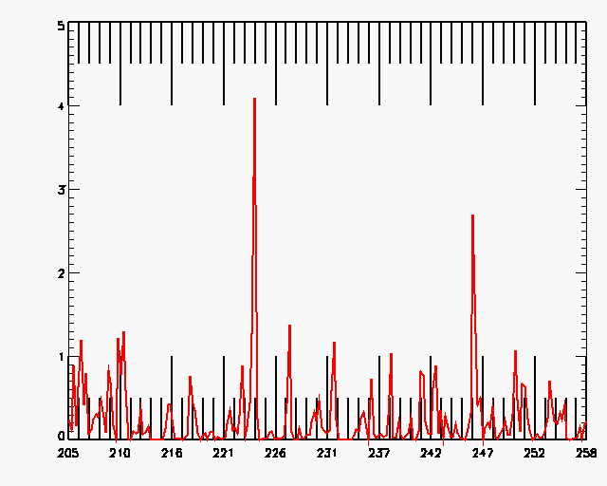

Slide 2
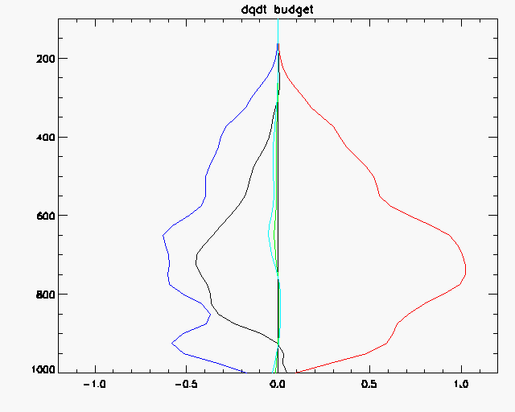

Slide 3
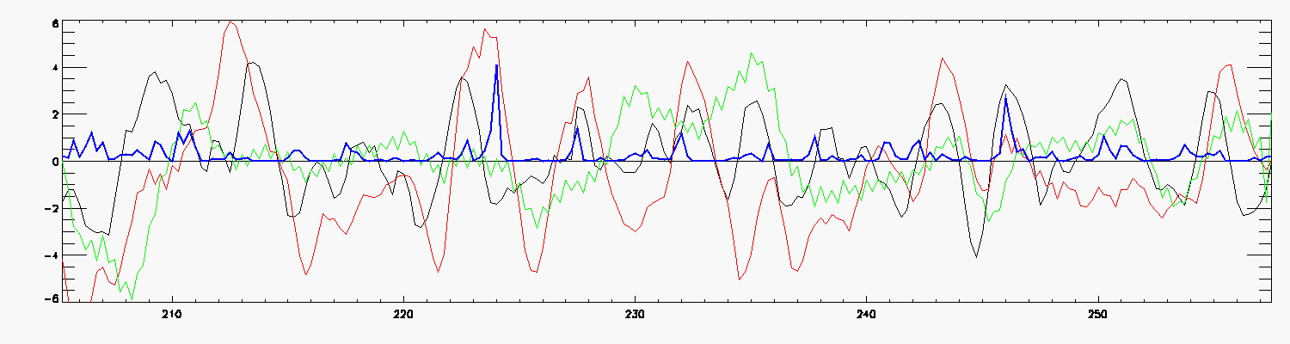
xrange1 = [242.,248.]
period = 'B'
;xrange1 = [220.,226.]
;period='A'
; xrange1 = [225.,229.] ; good structure
; period='C'
; xrange1 = [216.,219.] ; good structure
; period='D'
; xrange1 = [240,244.] ; good structure
; period='E'

