Slide 1
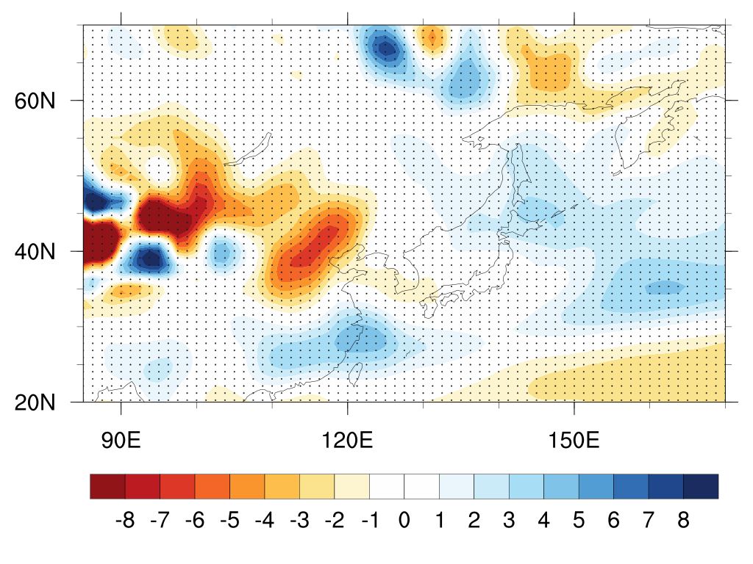
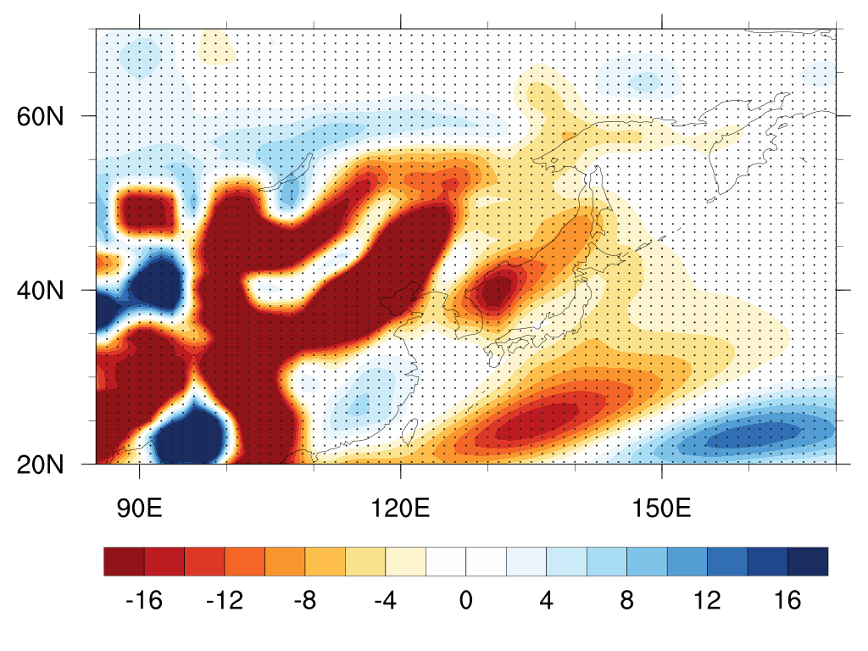
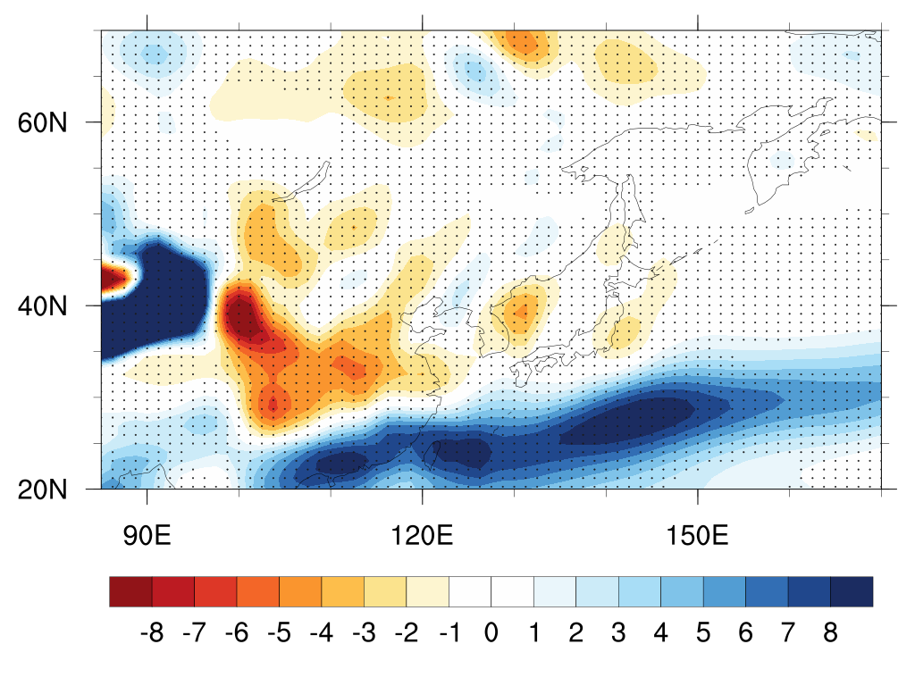
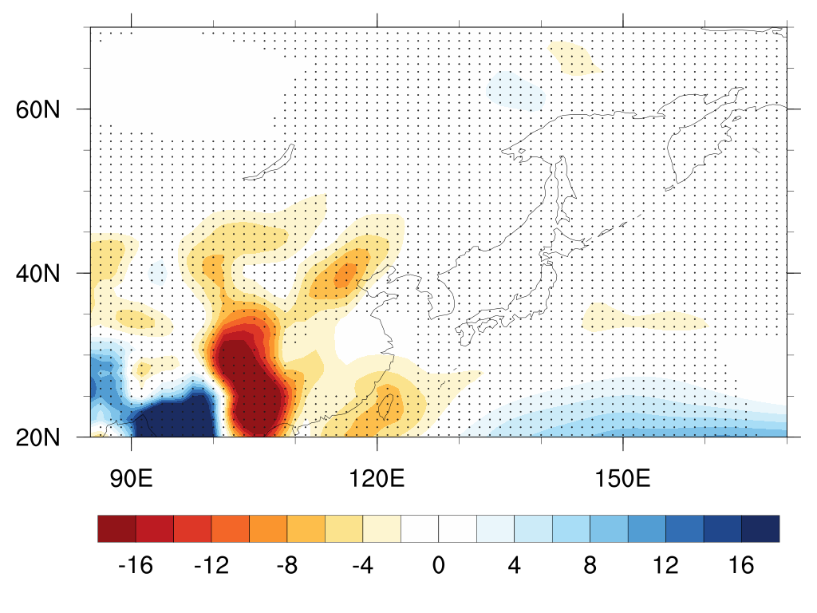
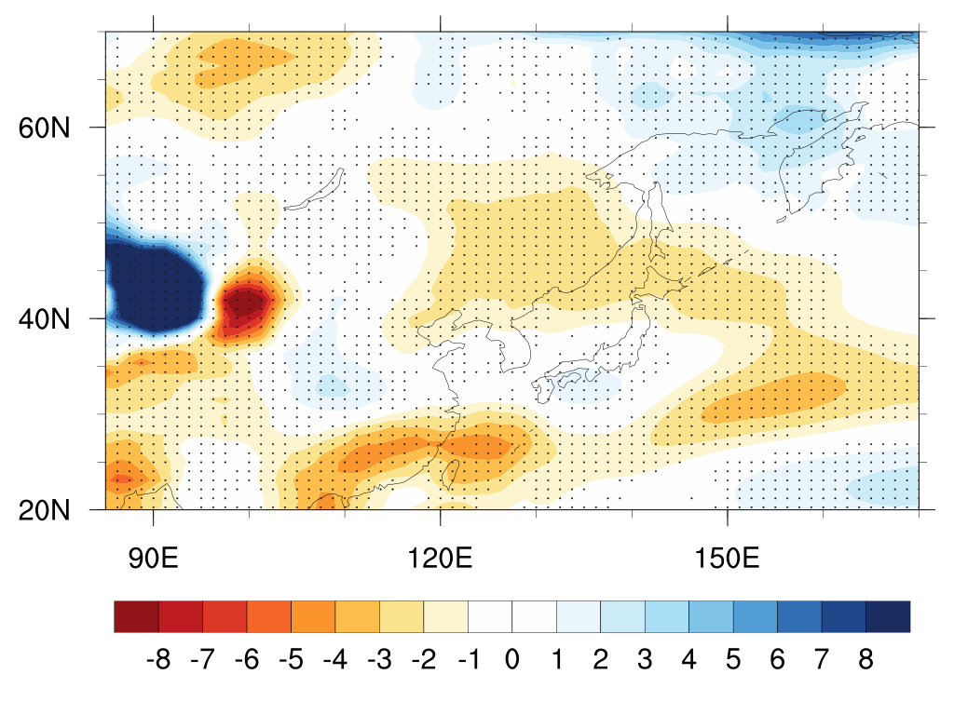
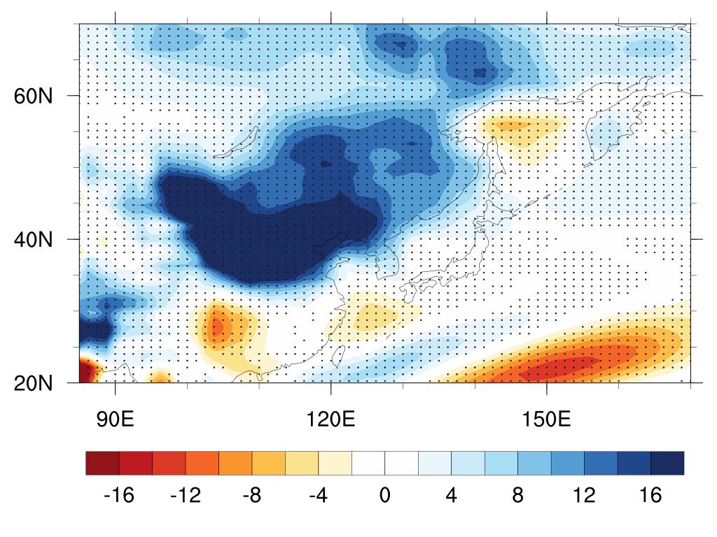
a
JJA
Spatial thermodynamics
b
DJF
Spatial thermodynamics
c
JJA Div Change
c
JJA
Dynamics of mean circulation
d
DJF
Dynamics of mean circulation
e
JJA
Eddy transport
f
DJF
Eddy transport
(%/K)

Slide 2
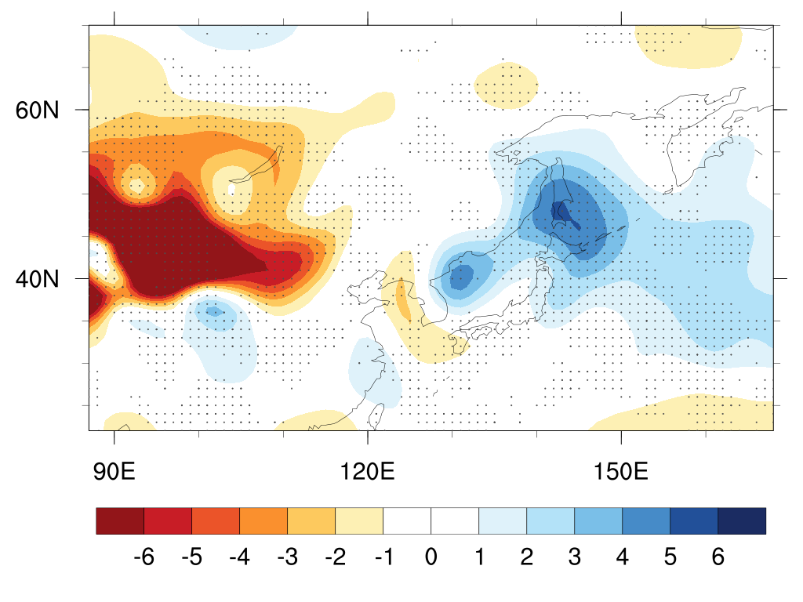
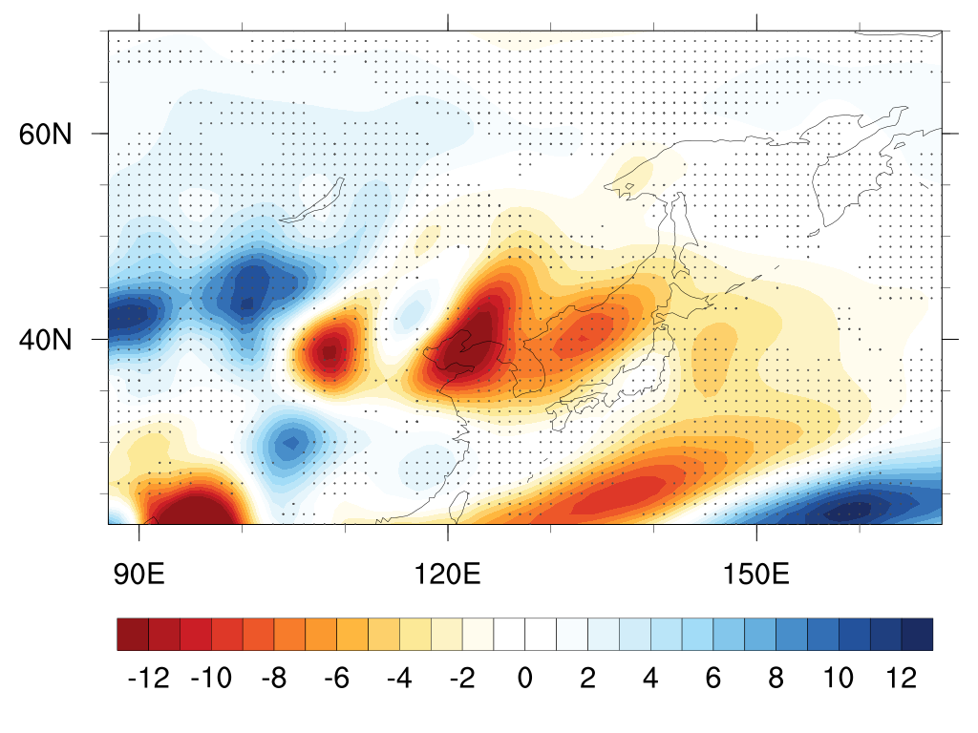
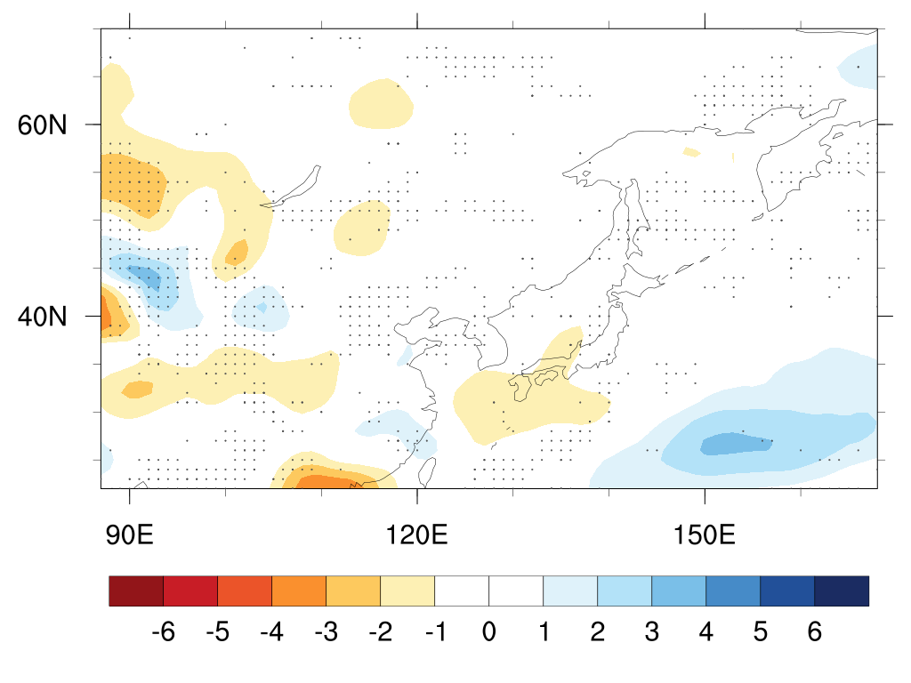
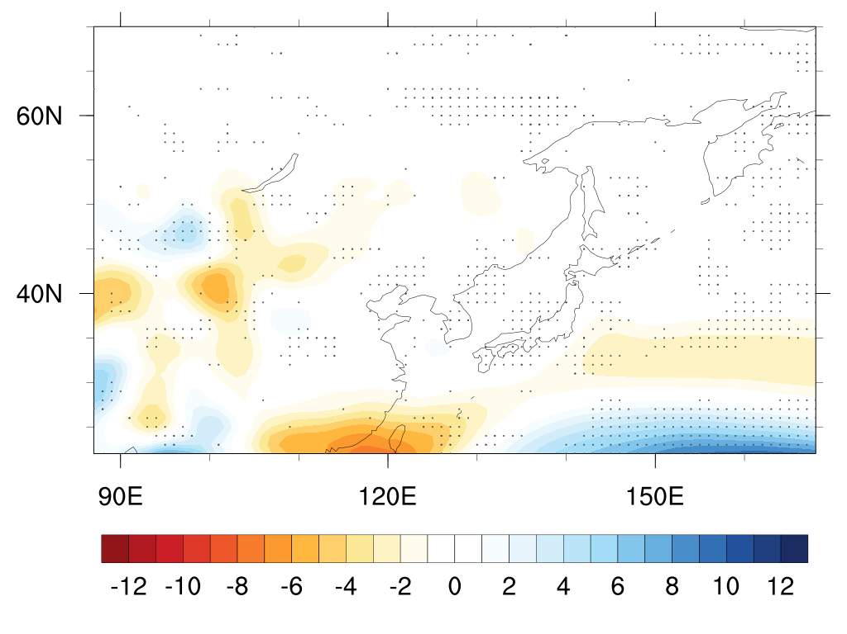
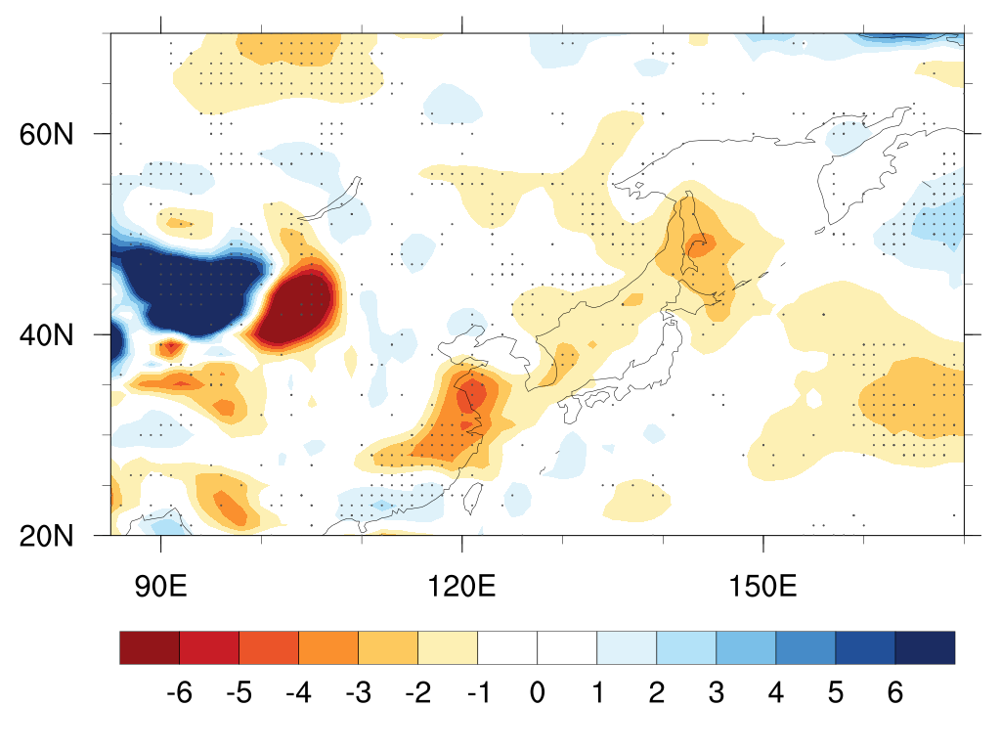
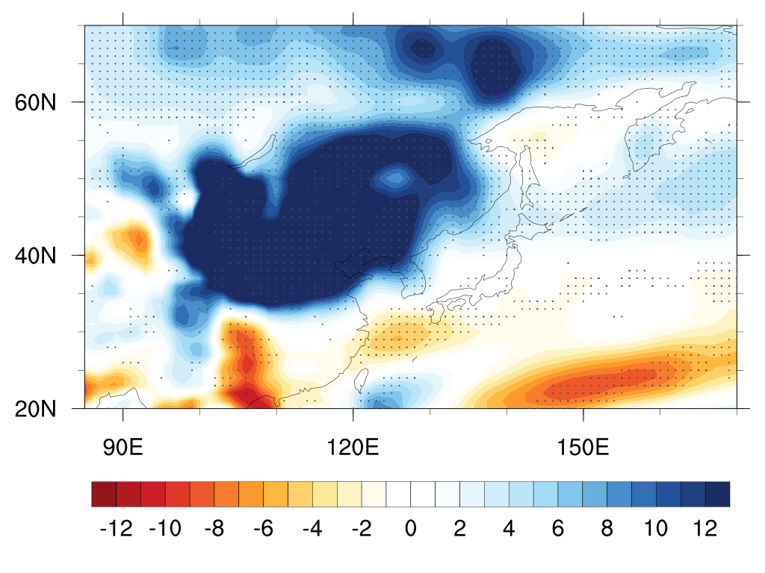
a
JJA
Spatial thermodynamics
b
DJF
Spatial thermodynamics
c
c
JJA
Dynamics of mean circulation
d
DJF
Dynamics of mean circulation
e
JJA
Eddy transport
f
DJF
Eddy transport
(%/K)

